Slide 1
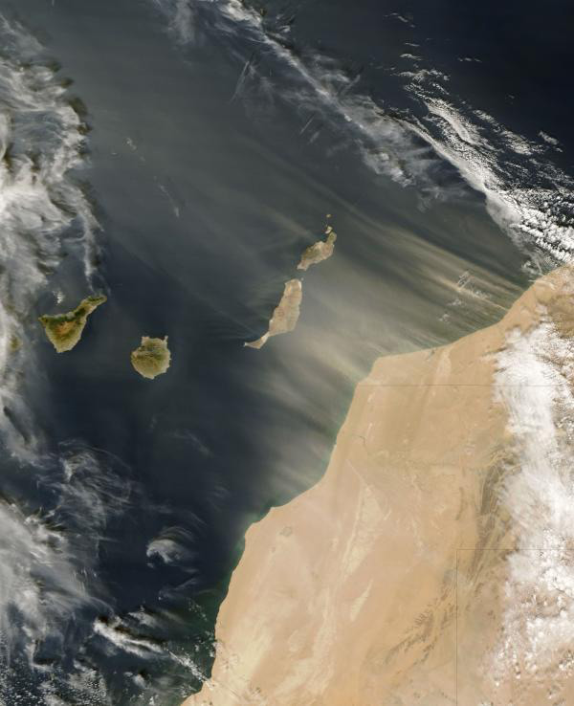
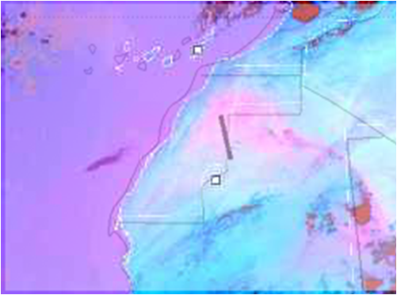
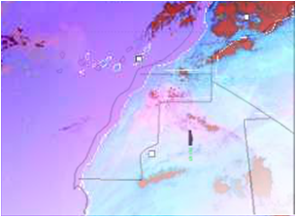
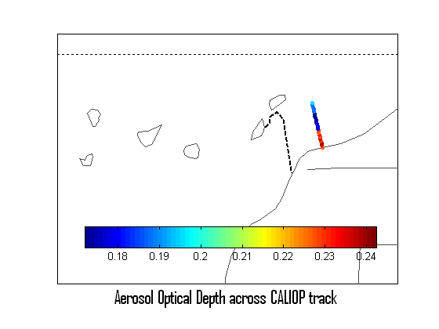
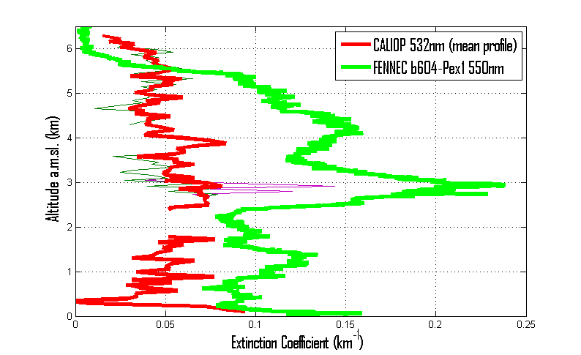
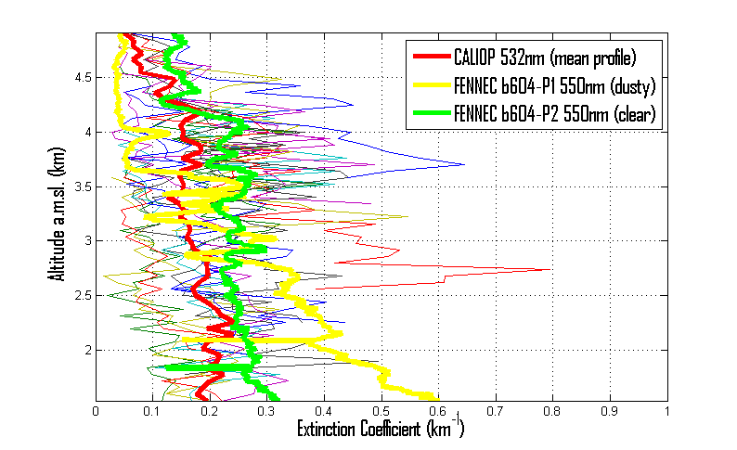
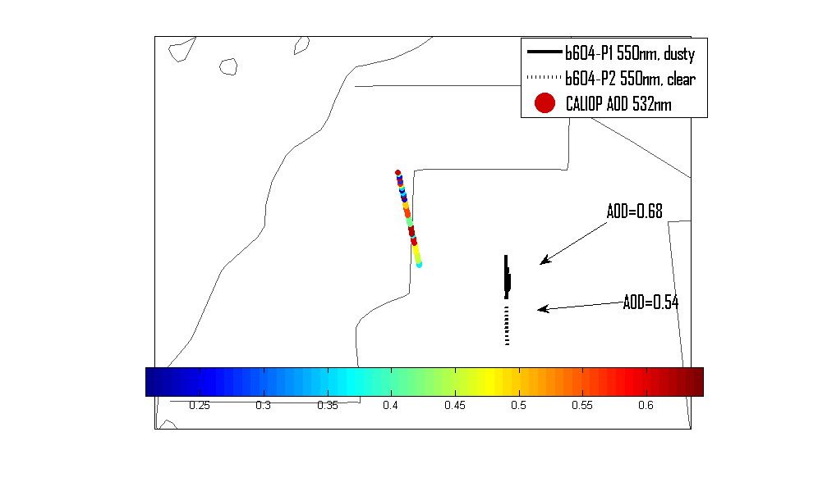
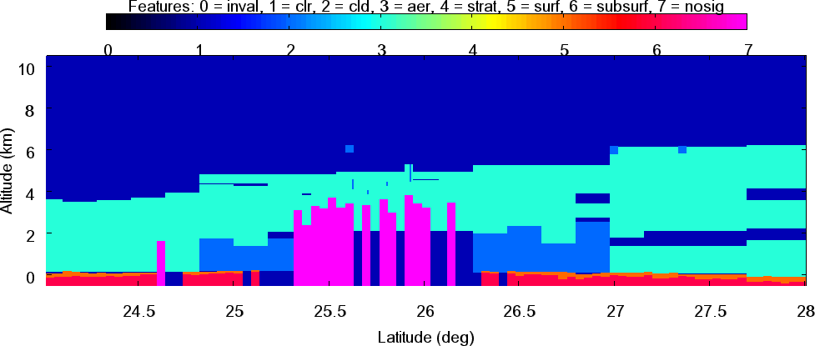
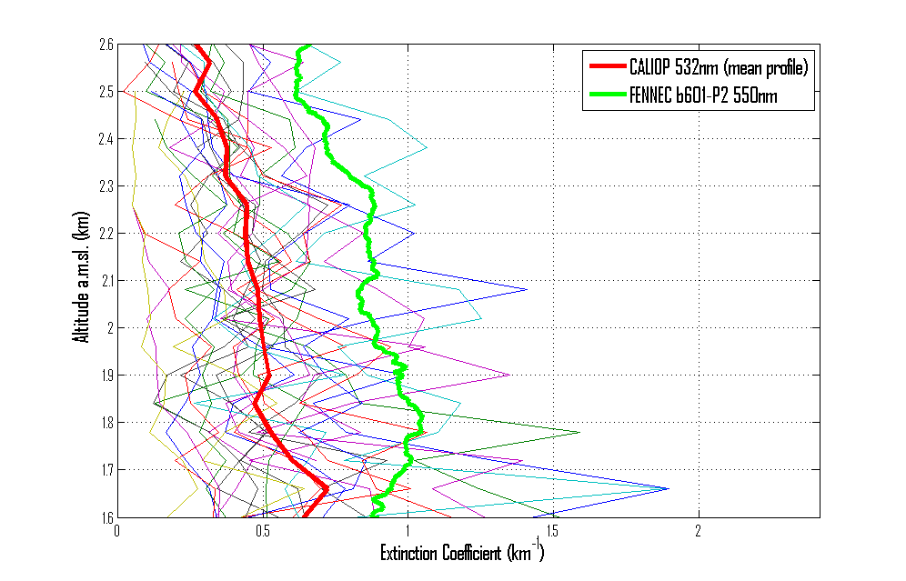
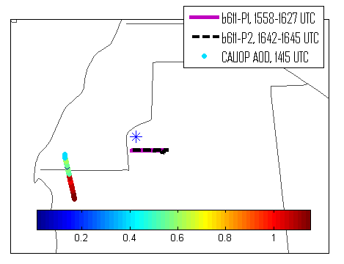
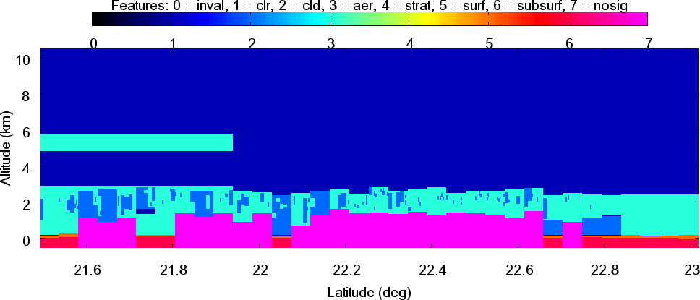
Dust measurements from Fennec aircraft vs. retrievals from spaceborne CALIOP lidar
Introduction
Dust is globally the most abundant aerosol type. While there are several major deserts around the world, from which dust mainly originates, Sahara desert in the northern part of Africa is the main source of it (Jickells et al., 2005). The main effects of dust on the Earth-atmosphere system are the enrichment of Atlantic Ocean and Amazon basin with iron and its impact on atmospheric dynamics.
The objective of this study is to compare dust optical properties, namely extinction coefficient (σ_{ext} ) and aerosol optical depth (AOD) that were: a) retrieved by the space-borne CALIOP lidar and b) measured on the Fennec aircraft in June 2011. While similar studies exist (i.e. Omar et al., 2010, Liu et al., 2011), the originality of this study stems from the variety of vertical profiles considered here- from freshly uplifted dust to aged cases. At the same time, most of these profiles come from areas near dust sources, which has not been the case with previous campaigns/studies.
Vertical distribution
Detailed knowledge of vertical distribution of dust is crucial for two major reasons: a) transportation of it by upper air features, such as trade winds or Saharan Air Layer, depends on the altitude of the dust particles and b) the radiative effect of the dust layer depends on its vertical position, especially relative to clouds.
Instrumentation and Data
Methodology
Initially, data from all the flights during the June 2011 Fennec campaign with satellite overpasses close enough in time (less than 3 hours) and space (less than 250 km) were selected. Then, using MSG SEVIRI (Meteosat Second Generation Spinning Enhanced Visible and InfraRed Imager) RGB satellite images of dust load, along with HYbrid Single Particle Lagrangian Integrated Trajectory model (HYSPLIT, Draxler and Hess, 1998) model backward and forward trajectories, a number of case studies were shortlisted. The selection was made in order to ensure better uniformity between the two platforms and to have a variety of vertical profiles.
Case Studies
Over Land
Fresh Dust Uplift (17/6/2011)
Considering only the altitudes (1.6-2.6 km a.m.s.l.) where at least half of the individual CALIOP profiles are available and have not been attenuated, CALIOP mean σ_{ext} is smaller than the aircraft’s by 46% (Fig. 1).
Aged Haboob
The two platforms do not observe exactly the same air mass, however it is useful to see how CALIOP does in the case of an aged haboob.
The two aircraft profiles (Fig. 2b-d) correspond to a dusty air mass further north (b604-P1), and to a cleaner air mass further south (b604-P2). The CALIOP average profile resembles the aircraft profile in the cleaner air mass better than the dusty one. Again, some of the CALIOP profiles do not reach surface and need to be excluded from the study. The mean σ_{ext} in CALIOP profiles is 28.4% smaller than the aircraft clearer one and 155% larger than the dusty (large values of σext can be found below 1.54 km).
Over Ocean
On this occasion, the two σ_{ext} profiles are similar, with CALIOP having lower values, especially in the altitudes between 3 and 5 km. The dust layer retrieved by CALIOP is very uniform, with the majority of retrievals yielding the same σ_{ext} values. Some individual CALIOP profiles have detected the peak of σ_{ext} values at around 3 km, in agreement with the aircraft. The mean optical depth retrieved by CALIOP (0.204) is smaller than the optical depth measured by the aircraft (0.682) by 70%, but in close agreement with MODIS (Fig. 4c).
Date | Time of profile, UTC | Time of satellite overpass, UTC | Spatial separation (km) | Temporal separation (h)*
20 June 2011 | 1247-1309 | 1417 | 212-236 | +1
Date | Time of aircraft profile, UTC | Time of satellite overpass, UTC | Spatial separation (km) | Temporal separation (h)
17/6/2011 | 1630 to 1656 | 1345 | 213-245 | -3 (satellite before aircraft)
20/6/2011 | 1445 to 1522 | 1415 |  | +1
 | 1540 to 1615 |  | 169-211 | -2
Figure 4. Top row : Left: Track and columnar CALIOP AOD and aircraft track, Right: Vertical profiles of extinction coefficient. Bottom row: MODIS Aerosol Optical Depth.
Conclusions
CALIOP dust retrieval algorithms can greatly benefit from similar studies, testing them in various regions around the world.
Although the temporal and spatial variability between the two platforms has been large, it might be that the current value of lidar ratio in CALIOP dust algorithm (40 sr; Omar et al., 2009) might be low for dust particles close to their sources.
The discrepancy between the two platforms might in reality be even larger, considering the fact that the aircraft extinction excludes a significant fraction of the coarse mode.
Figure 2. Top row : Left: SEVIRI image with CALIOP track overplotted, Right: SEVIRI image with aircraft tracks overplotted (solid line for dusty profile and dashed line for clear). Middle row: Left: Vertical profiles of extinction coefficient. Right: CALIOP and aircraft columnar aerosol optical depths. Bottom row: Vertical Feature Mask (VFM) plot from CALIOP for the area of interest.
Comparison against AERONET 25/06/2011
AOD550 from the aircraft measurements is 1.01 for profile P1 and 0.91 for profile P2, while the mean AOD550 from AERONET station for the same time period with the Fennec flight (1558 UTC- 1645 UTC) was 0.79. Based on this, the AERONET AOD is 13 to 22% smaller, but is within the instrumental uncertainty of the aircraft measurements. Unfortunately, CALIOP is too far from Zouerate to make a reasonable comparison.
Fennec | CALIOP
TSI Integrating Nephelometer 3563: measures total scattering coefficient at 450, 550 and 700 nm | Dual-Wavelength Polarization Lidar measuring: Extinction Coefficient (532nm) Column Optical Depth (532nm)
Particle Soot Absorption Photometer: measures absorption coefficient
Scattering and absorption (their sum is the extinction) from the aircraft are only representative of particles d<2.5 μm. Therefore there will be additional extinction from the larger particles. | Level 2 – Version 3 Aerosol Profile Product
References
Ryder, C. L. et al., ‘Optical properties of Saharan dust aerosol and contribution from the coarse mode as measured during the Fennec 2011 aircraft campaign’, Atmos. Chem. Phys., 13, pp. 303-325, 2013.
Omar, A. et al., ‘The CALIPSO automated aerosol classification and lidar ratio selection algorithm’, J. Atmos. Ocean. Tech., 26(10), pp. 1994–2014, 2009.
Acknowledgements
Thanks to Young Stewart, CSIRO, who has provided me with some of the images appearing here.
Figure 3. Satellite (coloured dots) and aircraft (solid and dashed lines) tracks. The blue star denotes the location of Zouerate AERONET station. The colorbar is for CALIOP columnar aerosol optical depths. Distance between aircraft and Zouerate station is 64-164 km, while between CALIOP and station is 34-0-350 km.
Contact information
Email: v.pappas@reading.ac.uk , vpappas@cc.uoi.gr
Figure 1. Top left: CALIOP (blue dashed line) and aircraft (blue solid line) tracks. Top right: Vertical profile of extinction coefficient . Bottom: Vertical Feature Mask (VFM) plot from CALIOP for the area of interest.

