Slide 1
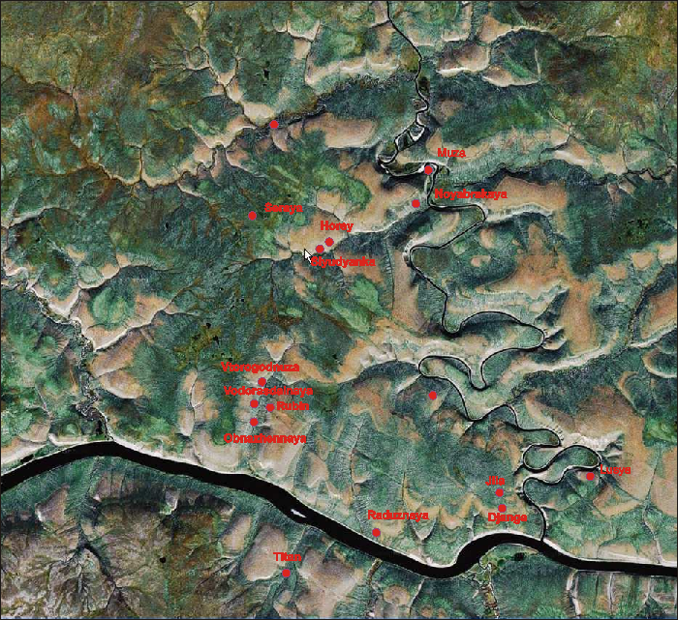
New model of the mantle lithosphere beneath Kuoyka kimberlite field Yakutia.
Ashchepkov I.V. , Kostrovitsky S.I , Ovchinnikov Yu.I. Tychkov N.S, Khmelnikova O.S., Palessky S.V.
¹ Institute of Geology and Mineralogy SD RAS, Koptyug ave 3, Novosibirsk, Russia
² Institute of Geochemistry SB RAS, Favorskogo1a,. Irkutsk, Russia
Cr- Amphiboles
New data for the 11 pipes from Kuoyka field show that high Cr2O3 garnets to 10- 12% as well as high Cr chromites (to 64%Cr2O3) are found in several more pipes Zaozernaya, Seraya, Slyudyanka, Vodorasdelnaya, Titan, Lusya in addition to Djanga pipe. All garnets belong o lherzolite field and not less than 1/3 are TiO rich. The TiO2 rich chromites are dominating in the Cr- rich population. Metasomatic Cr2O3- rich (to 6%) ilmenites pre in the MgO and TiO2– part of the variation diagrams. The Cr- diopside variations show high variations of Fe and Na content to 4 % suggesting the hybridic origin similar to the Cr- pyroxenes from Obnazhennaya pyroxenites (Taylor et al ., 2003). Omphacites (to 7 % Na2O) are rare. Cr-amphiboles (pargasites and hornblendes) are common in the upper part of the SCLM as well as in the Anabar and Kharamai region.
Reconstructions of the mantle sections show the deep lithospheric roots beneath the Zaosernaya pipe (7.5 GPa) traced by the PT conditions for Opx, Cpx, Gar, Cr and Ilm. SCLM is divided in to 4 sections and Ilm trace tow intervals in lower and upper part form 4 GPa. Th HT branch is sporadically found from 7 GPa to the Moho. In other pipes ilmenite and garnet PT estimates are more common in the lower part o mantle section while the Cpx trace mainly middle part of SCLM similar to the Obnazhennaya pip. It seems that kimberlites captured mainly the walls of feeders traced by Cr- low garnets and ilmenites in the lower part of SCLM while peridotitic mantle column was captured starting from the middle part of SCLM. The NS transsect of the Kuoyka field show more fertile mantle sections in the NNW part of the field.
The TRE determined for the minerals from Kuoyka field show rather rounded patterns for REE of garnets with high variations in HREE part and small elevation in LREE . The depleted compositions reval the inflection in Eu TRE spidergrams well as relatively small Sr minima. Many of them show Ta peak, relatively small Pb elevation and Th trough. The asymmetric bell like patterns of the clinopyroxenes with the humps from SM to Pr also show HREE variations due to the difference in Ga/Cpx ration peridotites. The spidergram show Zr –Hf minima deeper for Zr and Pb troughs. The left incompatible parts show flattened but very different levels.
The REE spideregrams of the pyrrotites reveal notable REE content to from 0.1 to 10C1 difference in LREE levels with the division to tetrads which show higher LREE then HREE . The spider grams show Hf minima but small elevation in Nb , Ta and Hf. RBRF grant 11-05- 00060a
Cr- Diopsides
Chromites
Ilmenites
Garnets

