Slide 1


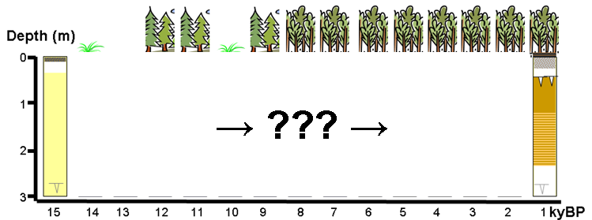
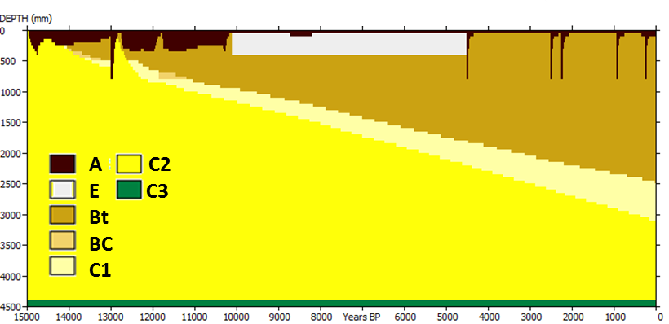
Modeling pedogenesis at multimillennium timescales
Achievements and challenges
Peter A. Finke
Dept. Geology & Soil Science, Ghent University, Belgium
Introduction
SoilGen model
Achievements
  Calibration and quality tests
  Applications
Challenges
  Multimillennium boundary conditions
  Panta rhei and hydrological parameters
  Calibration and performance testing
  Soil redistribution

Slide 2
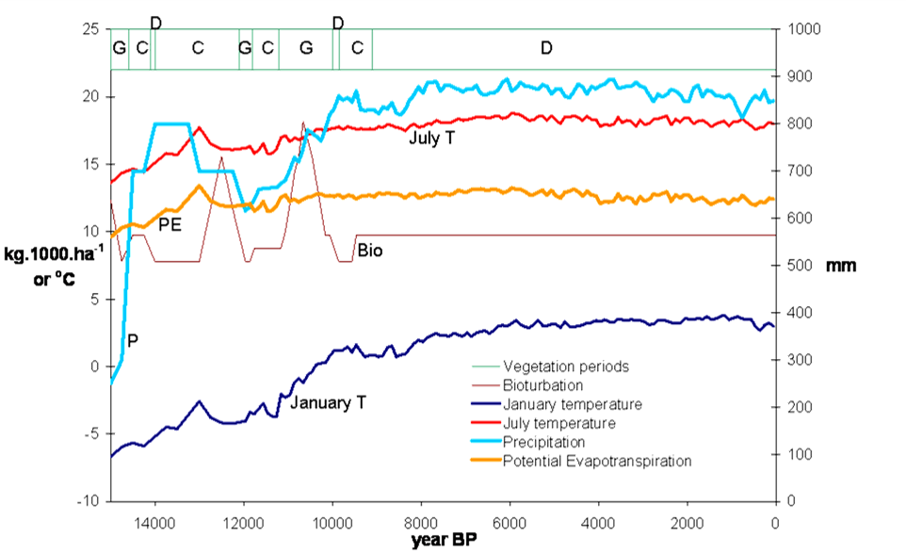
Introduction
Vadose zone modeling | Pedogenesis modeling | “Misery”
Sat/Unsat Water flow |  | BC’s
Solute flow |  | BC’s
Chemistry, exchange reactions |  | complexity
Heat flow | Heat flow | BC’s
Weathering | Weathering (chem, phys) | complexity
C-cycle | C-cycle | BC’s
 | Soil formation processes: Clay migration, bioturbation, podzolisation, … | Process Coverage
(multi-) annual + (sub-)second | (multi-)millennium + sub-second | Runtime
Deciduous forest

Slide 3


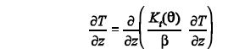

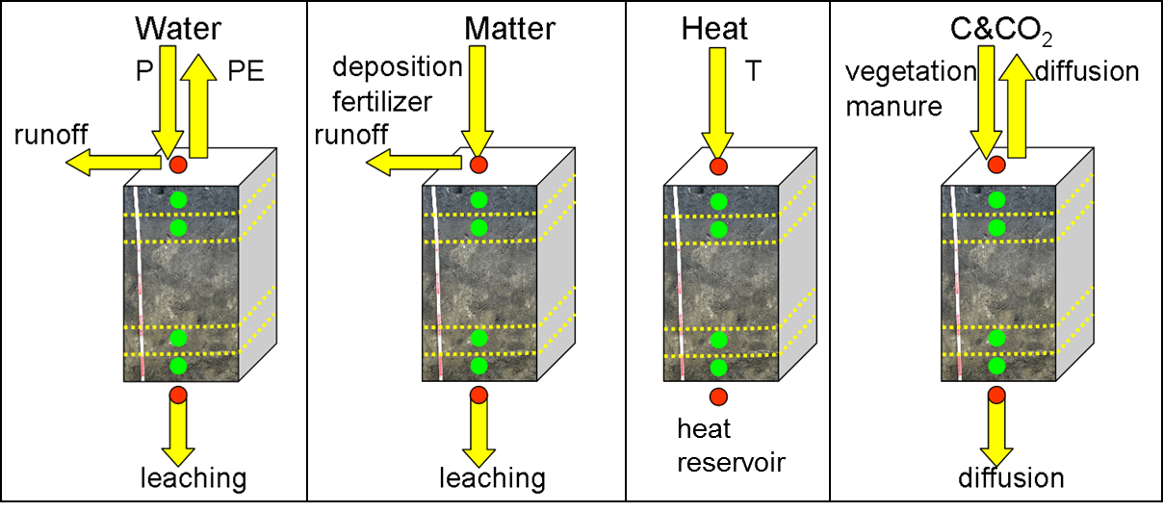
SoilGen2 Flow of water, solutes, heat
Based on LEACHM(2003) model
Water flow: Richards’ equation
Solute flow: CDE
Heat flow eq.
Added
Diffusive gas transport (CO₂)
Examples

Slide 4
SoilGen2 = enhanced transport model
Environmental factor |  | Processes covered | Time scale (year)
CLimate | Temperature | Flow of water solutes heat Temperature effects on chemistry, C-turnover, water flow | 10⁻⁸ – 10⁻⁴ 10⁻⁸ – 10⁻⁴ 10⁻⁴
 | Precipitation: water
 | Precipitation: solutes
 | Evaporation
Organisms | Vegetation | Soil-Plant cycles of C, Ca, Mg, K, Na, Al | 10⁻³
 | Fauna | Bioturbation | 10⁰
 | Human influence | Effects of Fertilization and Plowing | 10⁰/pulse
Relief | Slope | Runoff | 10⁻⁸ – 10⁻⁴
 | Erosion / Sedimentation | Effects of Removal or Addition of top layers | 10⁰/pulse
 | Local variants of T, P, E | Effects of slope exposition of Heat/water/solute flow
Parent material | Texture | Physical weathering, Clay migration | 10³ - 10¹
 | Mineralogy | Cation exchange, Weathering primary minerals, Chemical Dissolution/Precipitation, Chemical equilibriums | 10³ - 10¹
 | Species of Ca, Al, Mg, K, Na, …
Time | Change of boundary conditions | Effects of changing climate, vegetation and soil management

Slide 5
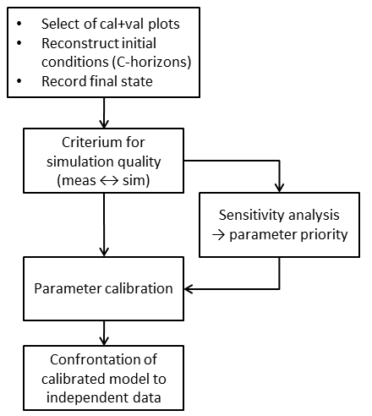
Calibrations and tests
Notes:
Calibration involved only process parameters, not time series or initial conditions
Confrontation to final state after 1000 year (OC%), x000 year (decalcification), 15000 year (clay%)
Long runtime (≈1 CPU-week/run) > minimal number of calibration runs
Calibration methods:
SA followed by iterative dissection-type calibration per sensitive parameter (OC%)
Generic calibration by comparison to data-based metamodel (decalcification)
Fit relation model quality – parameter values and find function minimum (clay%)

Slide 6
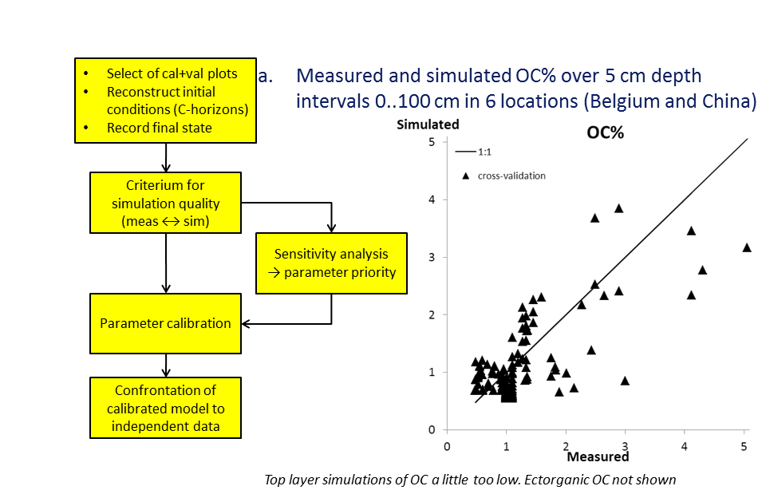
Calibrations and tests: OC%
Calibrations refer to last 1000 years
R²=0.724
RMSE=0.6%
Yu, Finke, Guo, Wu. 2013. Geoscientific Model Development.

Slide 7
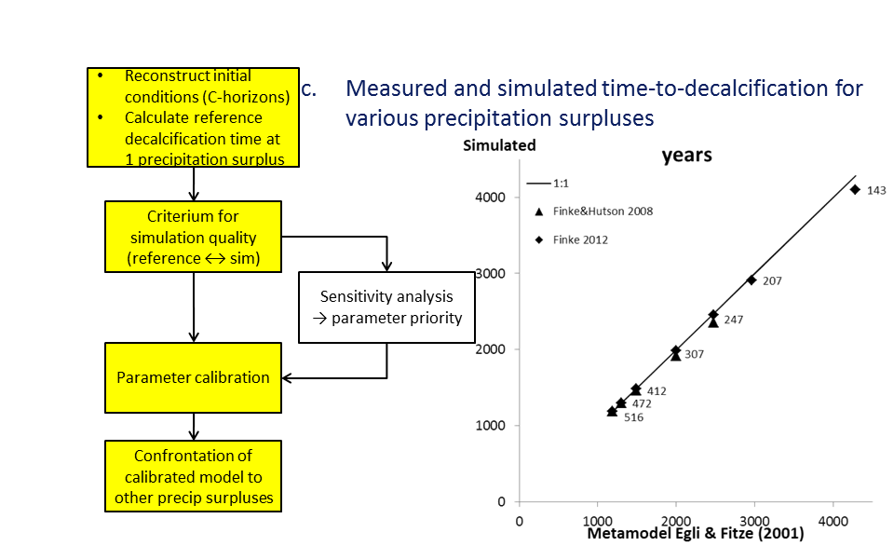
Calibrations and tests: Decalcification
Calibrations refer to x000 years
R²=0.999
RMSE=71 year
OK, but time series of precipitation surplus is highly uncertain!
Finke & Hutson, 2008. Geoderma + Finke, 2012. Quaternary International

Slide 8
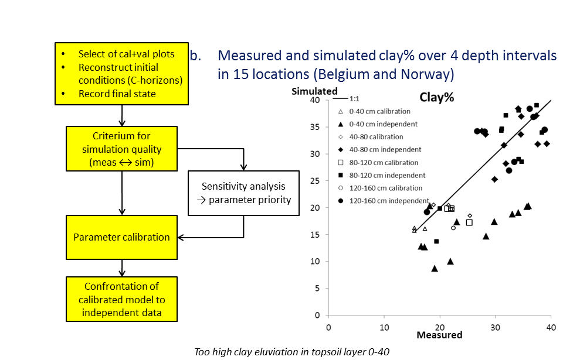
Calibrations and tests: Clay%
Calibrations refer to last 15000 years
R²=0.785
RMSE=6.5%
Finke, 2012. Quaternary International + Sauer et al., 2012. Quaternary International

Slide 9
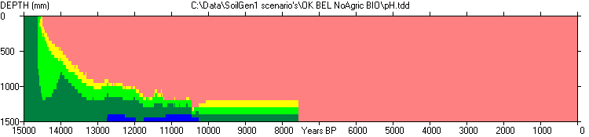
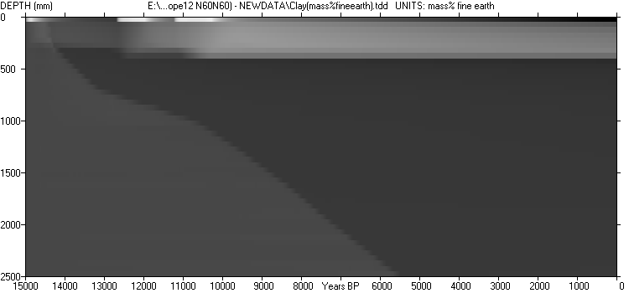
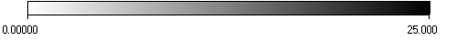
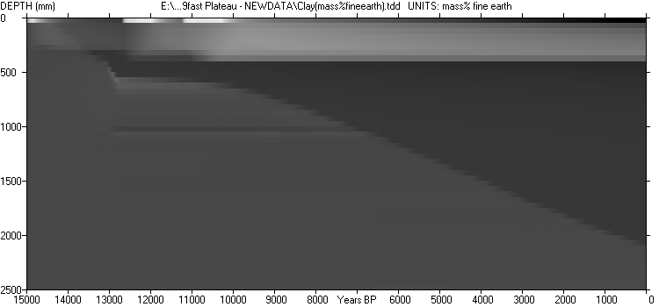
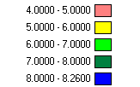
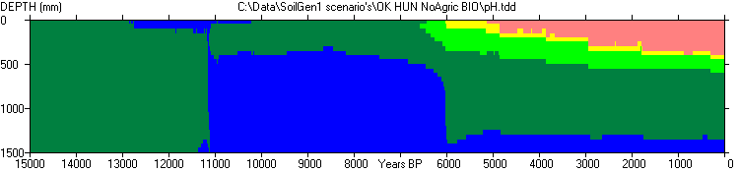
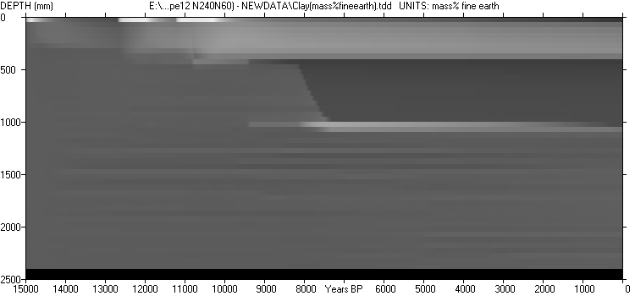
Cases: Climosequence + Toposequence
Model = sensitive to effect topographic position
South
exposed:
more rain
+
higher PE
Plateau
North
exposed:
Less rain
+
lower PE
Effect climate evolution on soil pH
Model = sensitive to effect climate
Belgium
Hungary
Effect slope exposition on clay leaching, Belgium
Finke & Hutson, 2008. Geoderma
Finke, 2012. Quaternary International

Slide 10
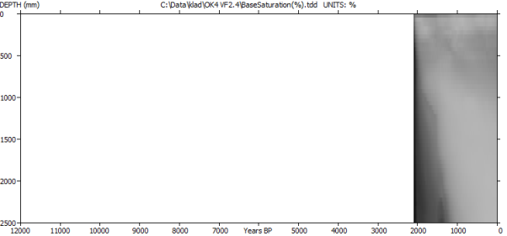
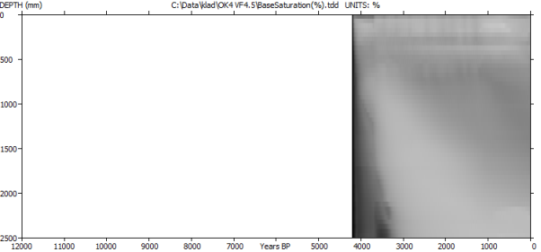
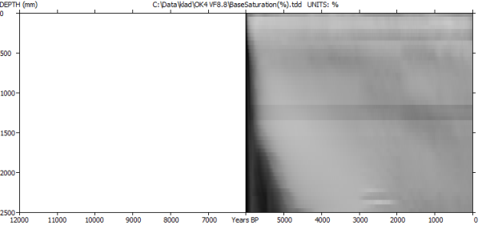
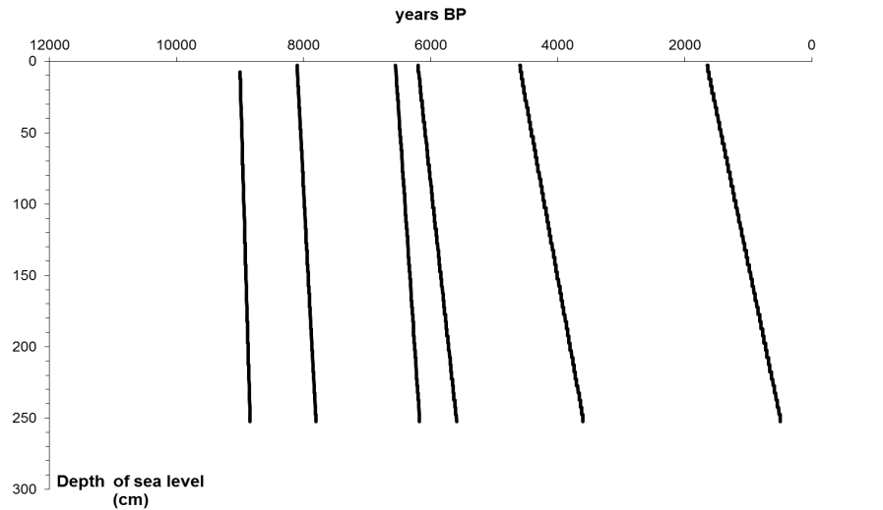
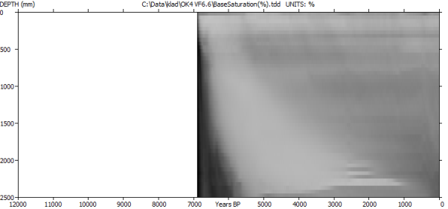
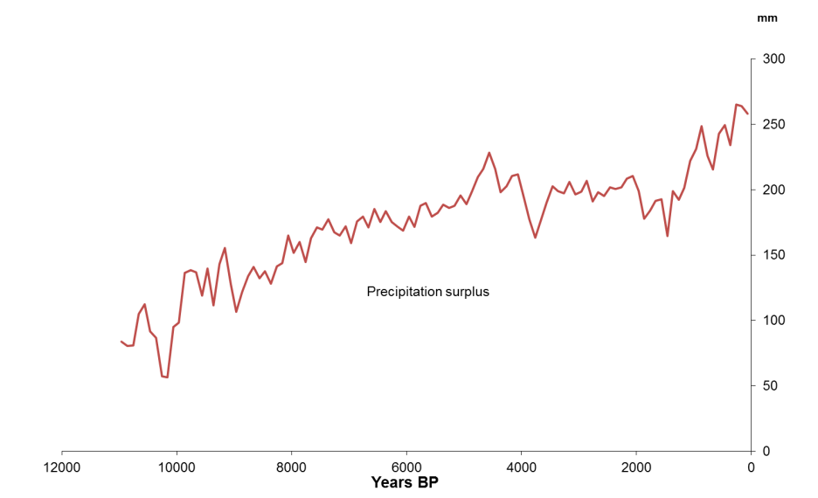
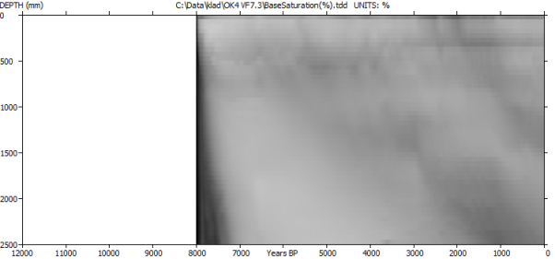
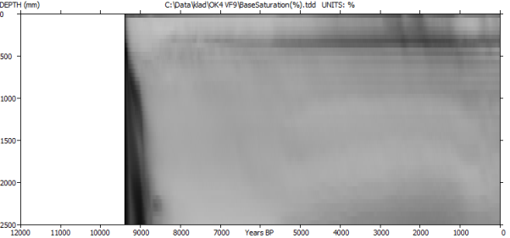
Case: Chronosequence
Vestfold,Norway
Base Saturation
Effect soil age on non-linear development of soil properties in 12 - 1.9 kBP chronosequence
Slower recent uplift rates related to slower leaching of “marine legacy” basic cations”
Countering effect of higher recent precipitation surplus (P-PE)
Model = sensitive to “non-linear” soil development
Isostatic
uplift
Precipitation
surplus
Sauer et al., 2012. Quaternary International

Slide 11
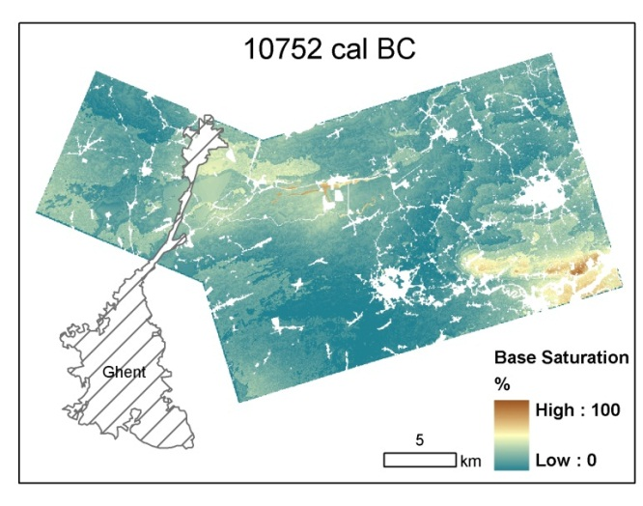

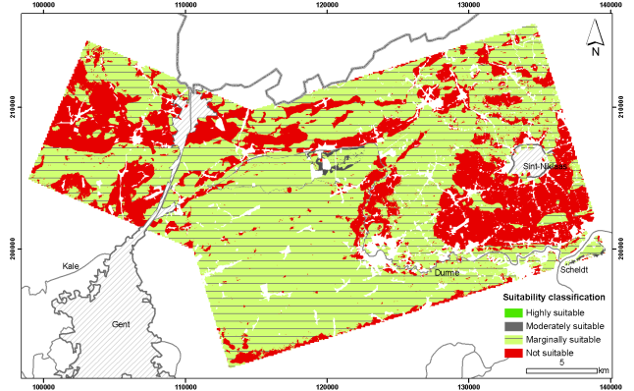
Case: Soilscape reconstruction
Archaeological land evaluation, Belgium
Modeling terrain evolution
Modeling 3D hydrology
  Calibration and quality testing
  Application
Modeling 1D soil evolution
  Multiple locations
  Take erosion and deposition from terrain model
  Take water fluxes (or water tables) from hydrological model
  DSM for interpolation of soil characteristics to full extent
Land evaluation of past land uses in past landscapes
Model = applicable in soilscape reconstruction
Zwertvaegher et al. 2010. Geoarchaeology
Vermeer et al. In review
Zwertvaegher et al. 2013. Geoarchaeology
Zwertvaegher et al. In review
Zwertvaegher, 2012. PhD-thesis

Slide 12
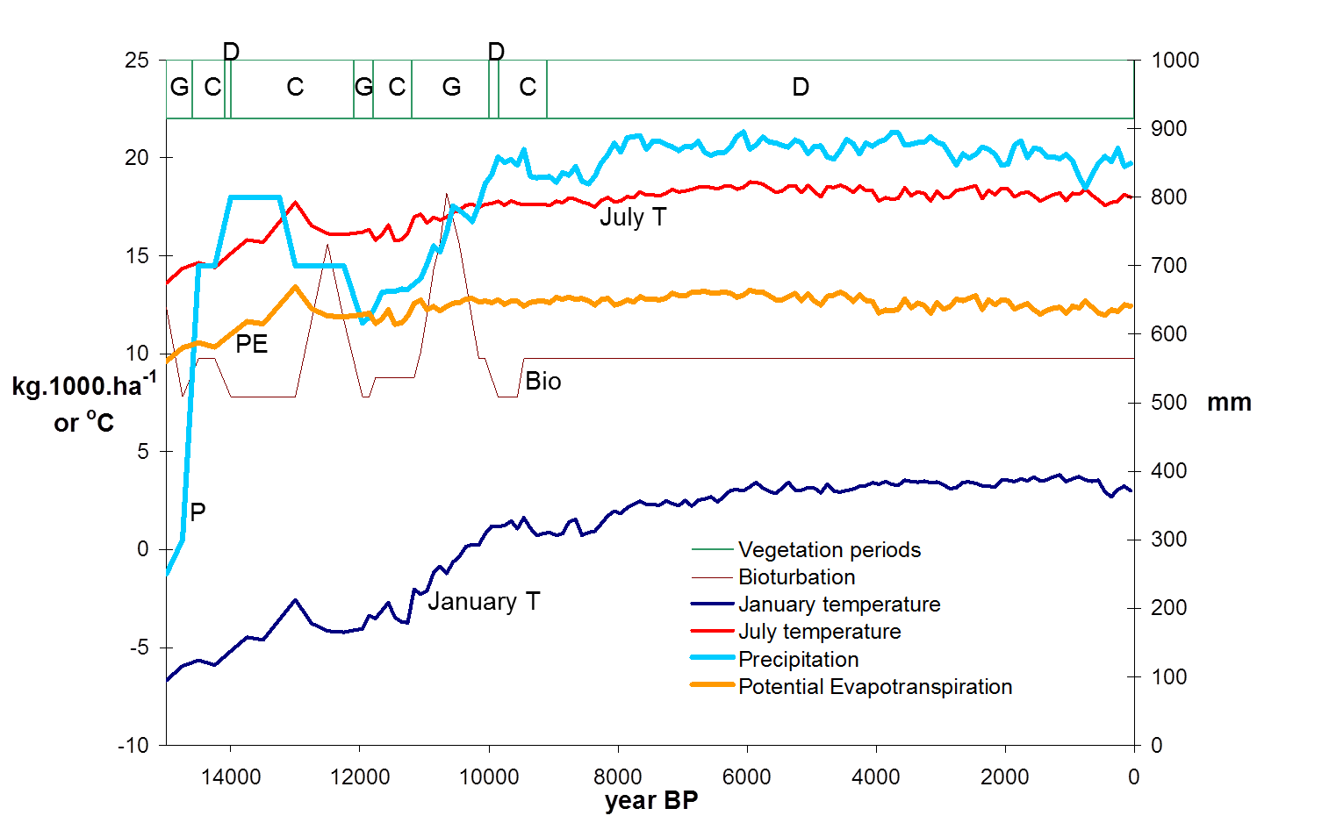
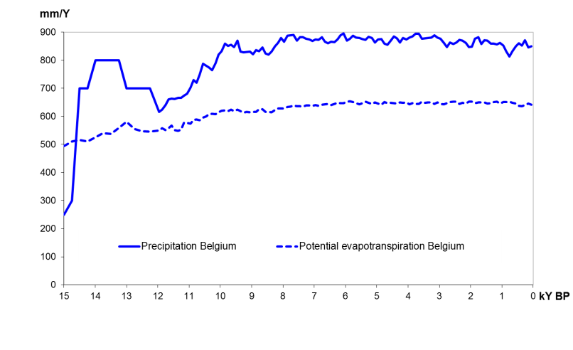
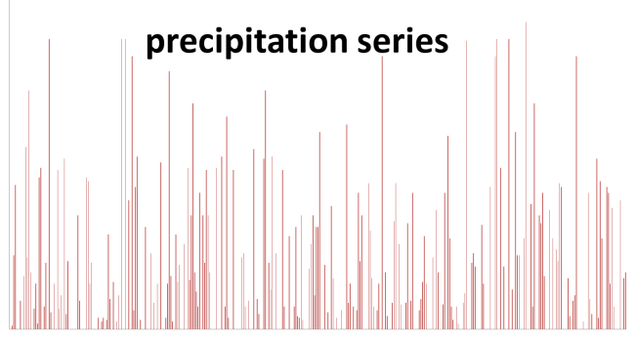

Challenge 1: Multimillennium boundary conditions
Reconstructed boundary conditions are a major source of uncertainty on model results. Consistency?
Vegetation type series
Pollen diagrams
Davis et al., 2003
Plant functional types with “known” P, T
Land-Atmosphere-Ocean climate model
linked to
Dynamic Global Vegetation Model:
Internally consistent data set
Spatiotemporal interpolation of P, T anomalies
Annual Precipitation series
Generation of annual P, T values
Daily Precipitation series
Downscaling to daily P, T values for model input
Pedogenesis model

Slide 13
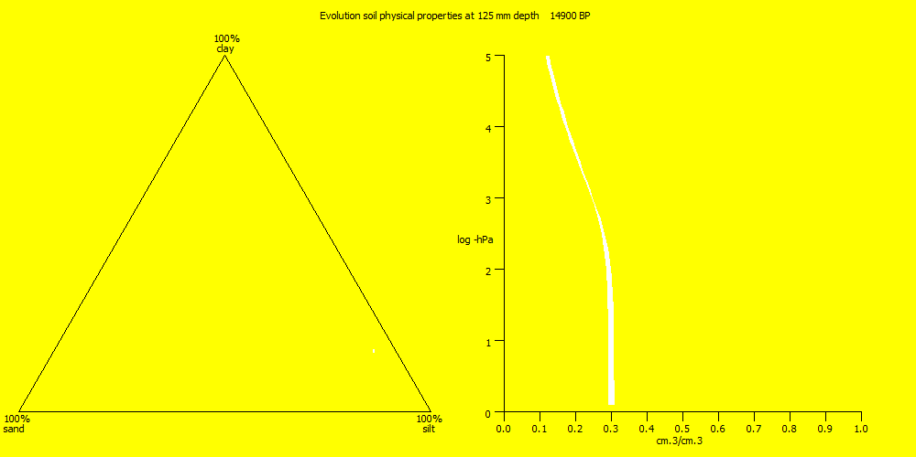
Challenge 2: Panta rhei and hydrological parameters
Pedogenesis= ΔOC, decalcification, weathering, clay migration → Δρ, Δtexture, Δh-θ-K, Δstructure. PTFs?

Slide 14
Challenge 3: Calibration and performance testing
Runtime issues, final state calibration. Efficient calibration methods and smart evaluation proxies?
Issues:
1. Long runtime = no brute force methods. What else?
2. Confronting simulations to data and proxies (not just final state calibration).
Ex: Calibration of MODFLOW phreatic water tables over period 12.7 kBP - present
Calibration using the mapped drainage class (1953), but also by:
Maximizing the number of dated and dry archaeological sites (“dry feet proxy”)
Maximizing the number of sites where the bottom of the Podzol-Bh is above the water table at least 1500 years (“time-integrated proxy”)
ALT: chronosequence calibration.
Zwertvaegher et al. 2013. Geoarchaeology

Slide 15
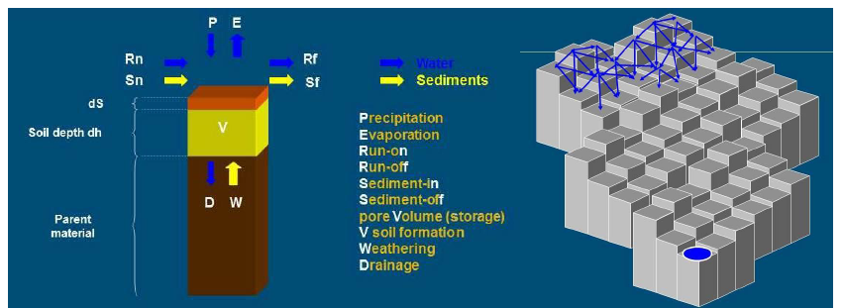
Challenge 4: Soil redistribution
Importance
C-sequestration in erosion/deposition landscapes
Understanding feedback mechanisms between soil development / erosion
Approaches
Linked soil-landscape-vegetation models (e.g. Zwertvaegher et al. in review)
Integrated soil-landscape-vegetation models (e.g. Schoorl et al. 2012)
Challenges
Computational effort
Reconstruction of boundary conditions in human-affected landscapes
Quantification interactions soil-water-vegetation-mass redistribution

Slide 16
Conclusions
Pedogenetic modeling is feasible
Work needed on
Process coverage (e.g. Podzolisation)
Generating “mutually consistent” BC (e.g. by Climate-Vegetation models)
Quantification effect changing soil structure on hydro props (e.g. ripening)
Efficient calibration and smart proxies along the timeline
Soil-landscape interactions

Slide 17
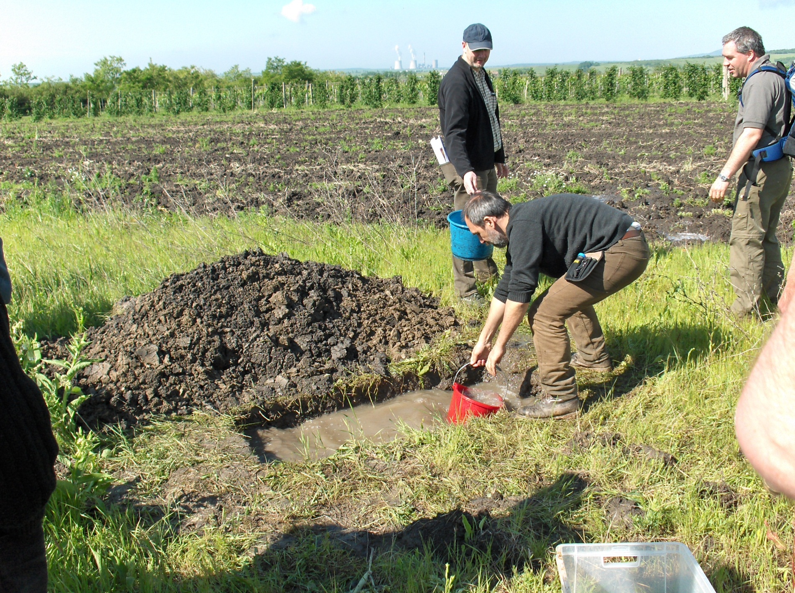
?
Thank you
PS:
Water flow drives pedogenesis

Slide 18
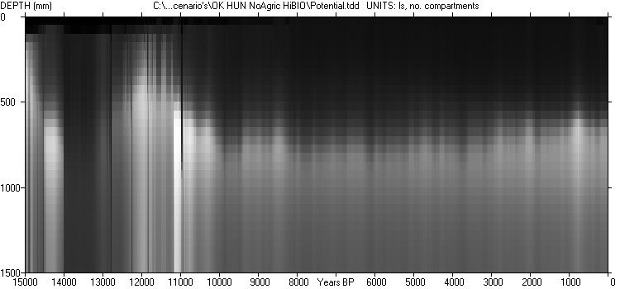
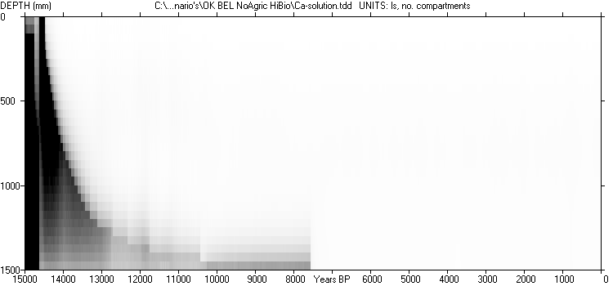


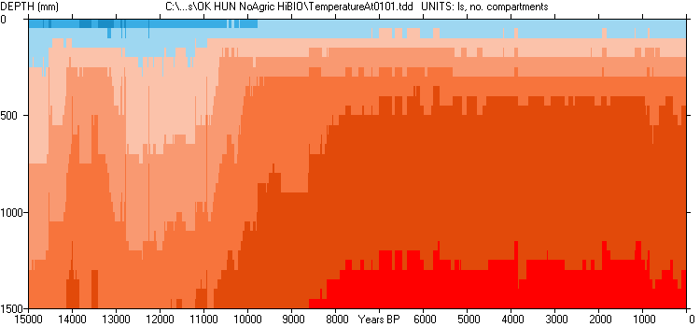
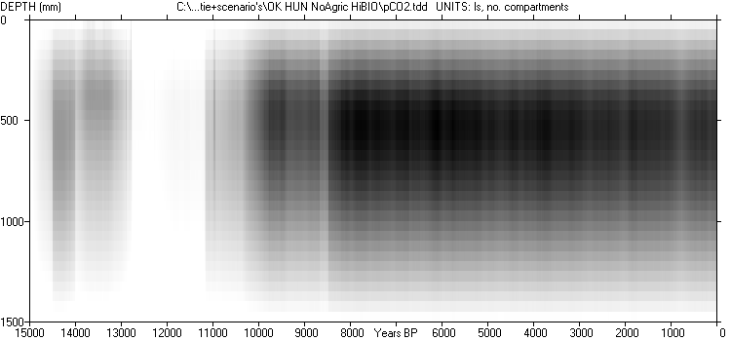
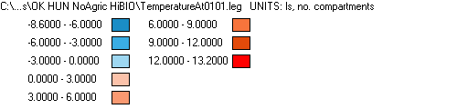

Water flow → pF 31-12-yyyy Solute flow → Ca²⁺ 31-12-yyyy
Heat flow → Temperature 31-12-yyyy Gas flow → pCO₂ 31-12-yyyy
3… pF …0.7
0… mmol Ca²⁺/dm³ …3
-8.6 … ⁰C … 13.2
0.001… hPa …0.014

