Slide 1




Climate change impacts on carbon stocks of Mediterranean soils: a CarboSOIL model application
European Geosciences Union
General Assembly 2013
Vienna | Austria | 7-12 April 2013
M. Muñoz Rojas, A. Jordán, LM Zavala, D de la Rosa, Félix A.
González-Peñaloza, SK Abd-Elmabod, M. Anaya-Romero

Slide 2
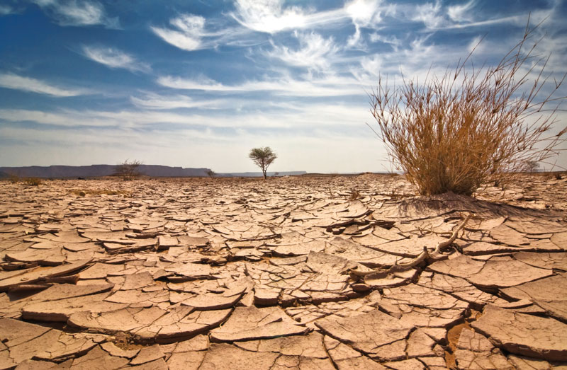
Introduction CarboSOIL in climate change scenarios
Global warming and climate change affect soil C storage and soil capacity for C sequestration
Soil C is the largest pool among terrestrial ecosystems and small changes could have a great impact on atmospheric CO₂
To formulate adaptation policies in response to climate change impacts, it is crucial to assess soil C stocks and dynamics in future climate scenarios
Notes:
Global warming and climate change are major environmental problems nowadays and they will affect soil C storage and soil capacity for C sequestration
Soil C is the largest pool among terrestrial ecosystems and small changes could have a great impact on atmospheric CO₂
To formulate adaptation policies in response to climate change impacts, it is crucial to assess soil C stocks and dynamics in future climate scenarios

Slide 3
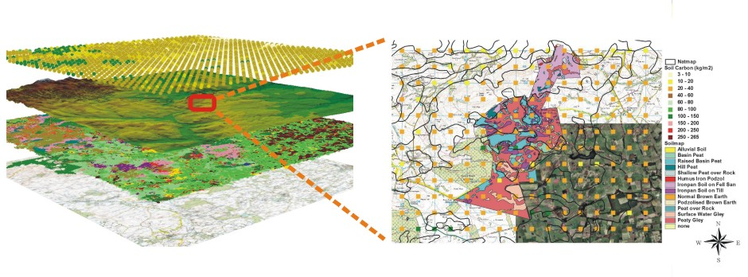
Introduction CarboSOIL in climate change scenarios
Soil carbon models
Efficient tools to understand processes involved in SOC sequestration dynamics and trends
Very useful as Decision Support Systems (DSSs) in scenario analysis (climate, land management)
Notes:
Soil C Models are efficient tools to understand processes involved in SOC sequestration dynamics and trends.
But they are especially useful as Decision Support Systems (DSSs) in scenario analysis (under climate or land management scenarios)

Slide 4
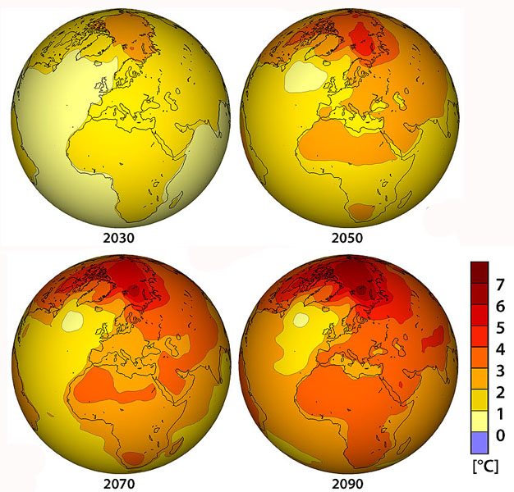
Introduction CarboSOIL in climate change scenarios
Climate change scenarios
Global Climate Models (GCMs)
IPPC Special Report Emissions Scenarios (SRES)
Simulate global climate
Produce climate projections
Divided in groups
Different pathways
Carbon changes in climate change scenarios
Notes:
Specifically , they are commonly used with climate change scenarios based on GHG emissions. These scenarios are divided in different groups or families representing different social, economic or enviornmental pathways.

Slide 5
Objectives CarboSOIL in climate change scenarios
To develop a method to assess SOC stocks and changes in Mediterranean areas in future climate projections
Application of CarboSOIL model in a Mediterranean area (Andalusia, Southern Spain) under climate change scenarios to predict future SOC stocks and changes for different land uses and soil types
Notes:
The main objective of this research were>
- To develop a method to assess SOC stocks and changes in Mediterranean areas in future climate projections
- To apply the CarboSOIL model in a Mediterranean area (Andalusia, Southern Spain) under climate change scenarios to predict future SOC stocks and changes for different land uses and soil types

Slide 6
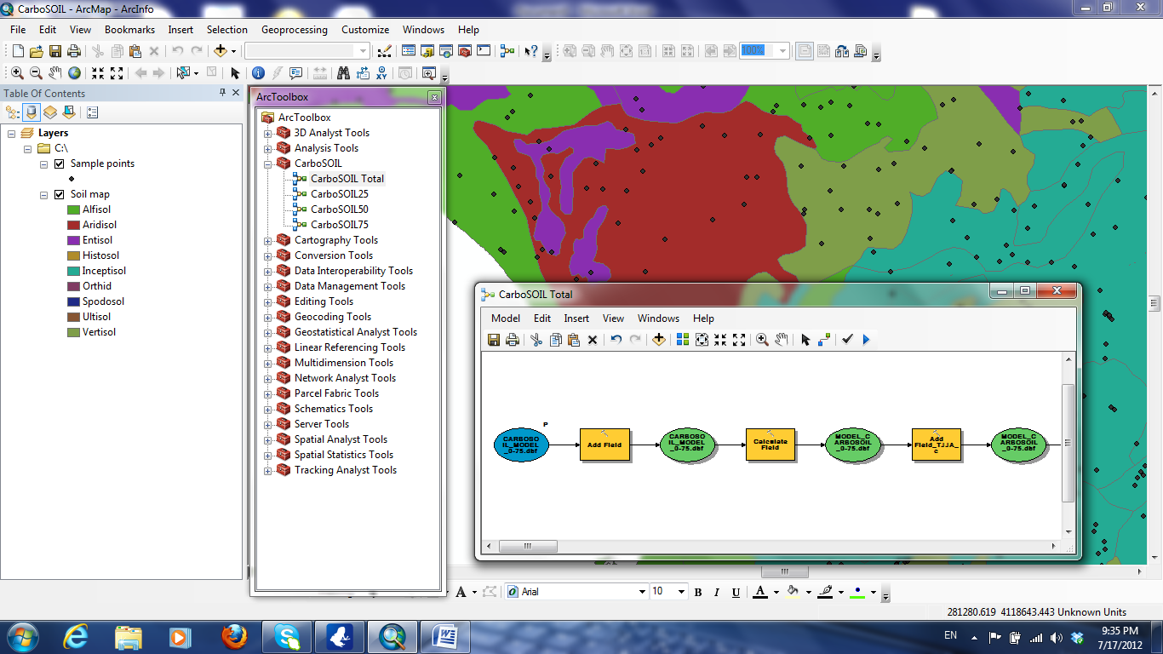
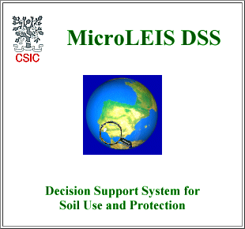
Materials and methods CarboSOIL in climate change scenarios
CarboSOIL model
Land evaluation tool for soil C accounting under global change scenarios at different soil depths
Computer application in a GIS environment to perform spatial analysis and obtain maps.
New component of the MicroLEIS DSS (De la Rosa et al., 2004)
Notes:
CarboSOIL model is a land evaluation tool for soil carbon assessment under global change scenarios at different soil depths.
This model is a new component of the MicroLEIS decission support system, which was designed to assist decision-makers facing specific agro-ecological problems
CarboSOIL has been developed as a computer application in a Geographical Information System environment. This way the users can perform spatial analysis and obtain soil carbon maps under different scenarios.
Cada submodelo CarboSOIL25, CarboSOIL 50, CarboSOIL 75 y CarboSOIL TOTAL (para las distinats secciones del suelo) ha sido desarrollado como una herramienta espacial pudiendo funcionar de manera independiente a través de la ArcTool Box, que es un componente del programa de ordenador ArcGIS 10.
De esta forma los usuarios del modelo pueden realizar análisis espaciales y obtener mapas de contenidos de carbono bajo distintos escenarios.

Slide 7
Materials and methods CarboSOIL in climate change scenarios
CarboSOIL in global change scenarios
CarboSOIL 25 (0-25 cm), CarboSOIL50 (0-50 cm), CarboSOIL75 (50-75 cm) and CarboSOIL TOTAL (0-75 cm)
Model application in 1356 plots along the study area
Climate change scenarios
Notes:
In this research, we applied the different submodels of CarboSOIL (at the different soil depths 0-25, 25-50, 50-75 and 0-75 cm) in 1356 plots along the study area and under different climate change scenarios.

Slide 8
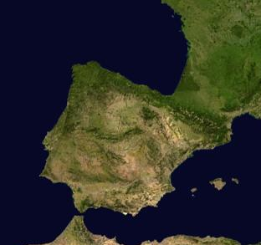
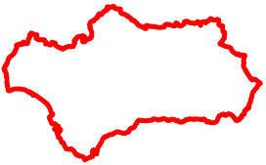
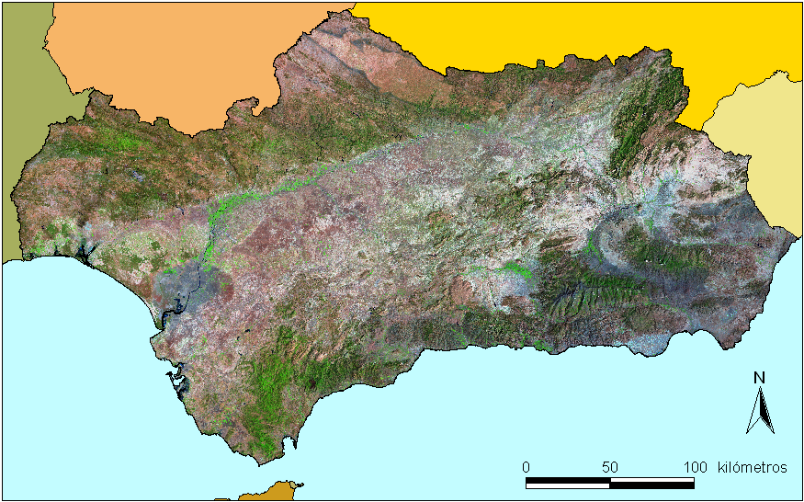
Materials and methods CarboSOIL in climate change scenarios
Study Area: Andalusia, Southern Spain
Area: 87000 km².
Mediterranean climate.
Elevation between 0 and 3479 masl (Mulhacén).
Main soils: Cambisoles (33%), Regosols (20%), Luvisols (13%) and Leptosols (11%) (CSIC-IARA, 1989).
Mediterranean forest and crops
Notes:
The syudy area is Andalusia in Southern Spain wich covers an area of 87000 km2. The climate is typically mediterranean and elevation varies form 0 to almost 3500 masl.

Slide 9
Materials and methods CarboSOIL in climate change scenarios
Input data: variables description
Variable type | Variable name | Code | Unit | Source and reference
Dependent variable | Soil organic C | SOCC | Mg/ha | SEISnet and other SDB
Climate | Total precipitation | PRPT | mm | REDIAM- CLIMA
 | Winter temperature | TDJF | ºC
 | Summer temperature | TJJA | ºC
Site | Elevation | ELEV | m | DEM Andalusia
 | Slope | SLOP | %
 | Drainage | DRAI | - | SEISnet and other SDB 1356 soil profiles
 | Soil erosion | SERO | -
Soil | Nitrogen | NITRO | g/100g
 | pH | PHWA | -
 | Cation exchange capacity | CEXC | meq/100g
 | Sand | SAND | g/100g
 | Clay | CLAY | g/100g
 | Bulk density | BULK | g/cc
 | Field capacity | FCAP | g/100g | Simanctel Project
Land use | Land use/land cover | LULC | CLC LEVEL 3 | LULCMA
Notes:
This table show the input variables which cover climate, soil, site and land use data. En total quedaron 15 variables independientes para la construcción del modelo, que fueron procesadas y homegenizadas para su tratamiento estadístico.

Slide 10
Materials and methods CarboSOIL in climate change scenarios
Input data: climate change scenarios
3 Global Climate Models:
  BCCR-BCM2 (Bjerknes Centre for Climate Research, Norway)
  CNRMCM3 (Centre National de Recherches Meteorologiques, Meteo France, France)
  ECHAM5 (Max Planck Institute for Meteorology, Germany).
4 time periods:
  1961-2000 (baseline climate period)
  2011-2040 (2040, the “near-future” period)
  2041-2070 (2070, the “mid-future” period)
  2071-2100 (2100, the “far-future” period).
3 IPPC SRES scenarios: A1B, A2 and B1
A1B: heterogeneous world, balance across all energy sources
A2: high population growth, slow economic and energetic development
B1: more emphasis on sustainability and efficient technologies
Notes:
For the climate change scenarios, we have used data from 3 global climate models, downscaled for the study area and 3 scenarios of GHG emissions (A1B, A2, B1).
We have considered 4 time periods, the actual period and the 3 future scenarios: from 2011 to 2040, from 2041 to 2070 and from 2071 to 2100.

Slide 11
Results and discussion CarboSOIL in climate change scenarios
Model test and validation
Soil depth (cm) | N | R Spearman | ACTUAL |  | BCCR-BCM2 |  | CNRMCM3 |  | ECHAM5 |  | KS, p
 |  |  | Measured SOC |  | Modelled SOC |  | Modelled SOC |  | Modelled SOC
 |  |  | Mean | SD | Mean | SD | Mean | SD | Mean | SD
0-25 | 1504 | 0.989 | 30.51 | 28.11 | 31.36 | 29.93 | 31.7 | 26.89 | 31.48 | 26.9 | < 0.01
25-50 | 1033 | 0.990 | 19.66 | 19.18 | 19.82 | 18.60 | 19.88 | 18.60 | 19.87 | 18.59 | < 0.01
50-75 | 600 | 0.992 | 15.65 | 14.67 | 15.87 | 14.31 | 15.92 | 14.31 | 15.88 | 14.31 | < 0.01
0-75 | 1504 | 0.884 | 51.25 | 47.55 | 54.78 | 38.82 | 52.51 | 38.66 | 54.47 | 38.88 | < 0.01
Notes:
In this table we see the correlation analysis that we performed between measured soc contents and predicted values in the baseline or actual scenario. We observed very good correlations with R Spearman values between 0.8840 and 0.9912.

Slide 12
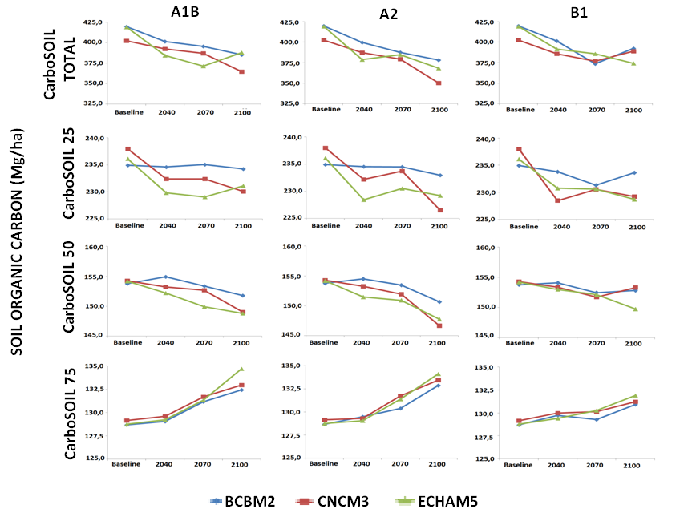
Results and discussion CarboSOIL in climate change scenarios
SOC stocks in climate change scenarios
Notes:
This figure shows the total SOC stocks predicted for 2040, 2070 and 2100 according to each scenario and GCM at the different sublevels.
In general, there is negative effect of climate change on soc stocks, since these contents decrease in all scenarios in the total profile, and the upper soil layers. However, SOC increase in the deepest layer *, from 50/75 cm.

Slide 13
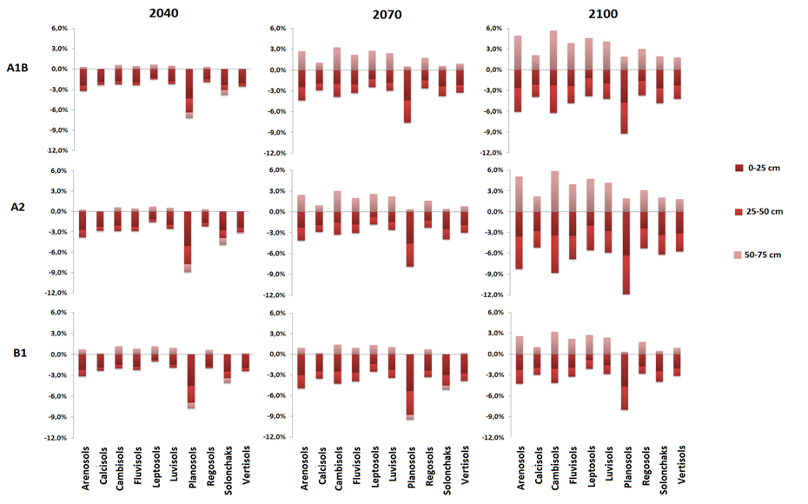
Results and discussion CarboSOIL in climate change scenarios
Changes in SOC stocks in depth for different soil types
Notes:
According to this figure, which shows changes in SOC contents for the main soil types and different scenarios, major decreases in the upper layers of the soil profile were found in Planosols, Arenosols and Cambisols.

Slide 14
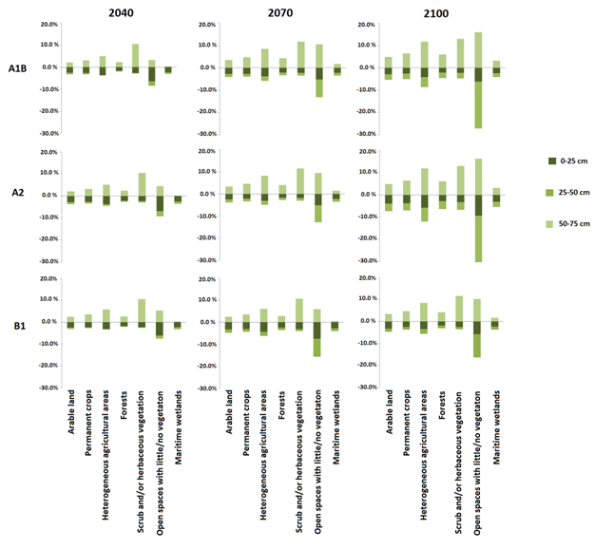
Results and discussion CarboSOIL in climate change scenarios
Notes:
For different land uses, changes in SOC contents are particularly large in open spaces with little or no vegetation, with decreases of more than 30% in the upper layers. On the contrary, in the deepest layer (from 50 to 75 cm), SOC significantly increased in scrubs, which might be explained by the increase in the roots depth in future dryer conditions.

Slide 15
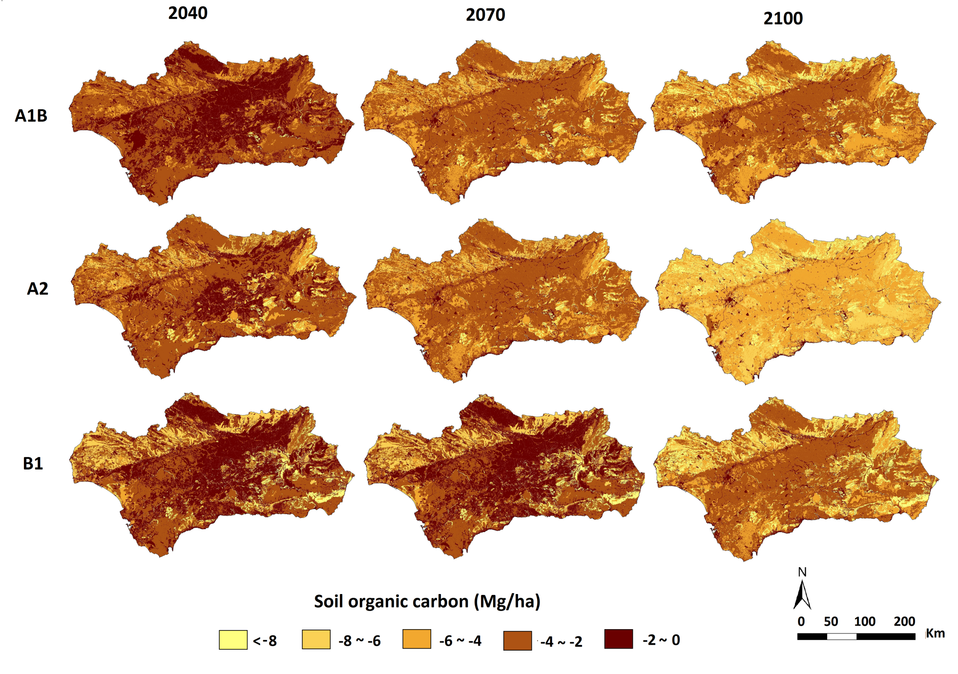
Results and discussion CarboSOIL in climate change scenarios
Changes in SOC stocks in climate change scenarios
Notes:
Finally, this figure shows the spatial distribution of changes in SOC contents for different climate change scenarios and different periods (2040, 2017 and 2100). In general the northwestern and the eastern areas of Andalusia would be the most affected by climate change, with SOC losses above 4 Mg ha⁻¹ in 2040 and up to 8 Mg ha⁻¹ in 2070 and 2100. We can observe that the most important changes occur under the A2 scenario.

Slide 16
Conclusions CarboSOIL in climate change scenarios
The model CarboSOIL has proved its ability to predict SOC stocks at different soil depths under different climate change scenarios.
Climate change will have a negative impact on SOC stocks in the upper layers of the soil section (0-25 and 25-50 cm).
In particular, these stocks are expected to drop severely in the medium-high emission A2 scenario by 2100.
Important decreases of SOC stocks were found in “Planosols”, “Arenosols” and “Cambisols”, and “open spaces with little or no vegetation”
The methodology developed in this research might be easily applied to other Mediterranean areas with available data on climate, site, soil and land use.

Slide 17


Thank you for your attention
V Simposio Nacional
CDUSS
More information:
miriammunozrojas@gmail.com
Murcia, 2011
MED_Soil
Research Group

