Slide 1
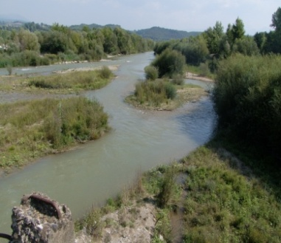
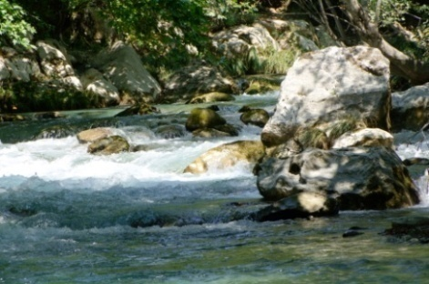
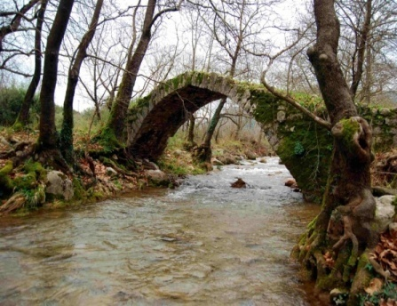
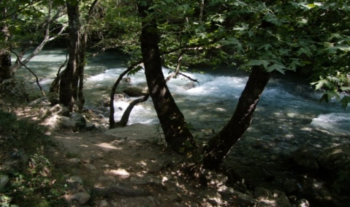
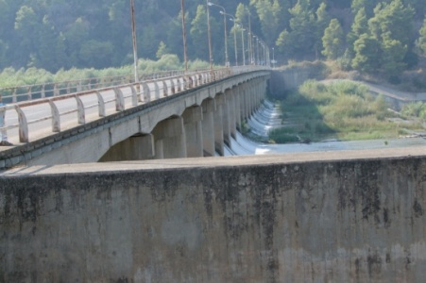




A combined linear optimisation methodology for water resources allocation in an alfeios river subbasin (greece) under uncertain and vague system conditions
Eleni Bekri⁽¹⁾⁽²⁾, Panayotis Yannopoulos⁽¹⁾ & Markus Disse⁽²⁾
(1) Environmental Engineering Laboratory, Department of Civil Engineering, University of Patras, Patras, Greece
(2) Institute of Water Management and Resources Engineering,
Universität der Bundeswehr München, Munich, Germany

Slide 2
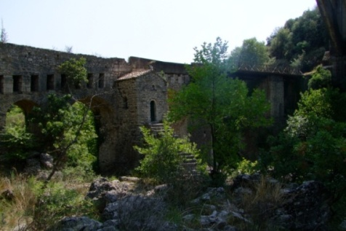
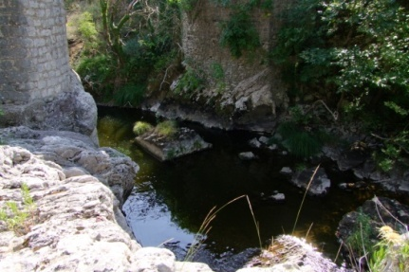
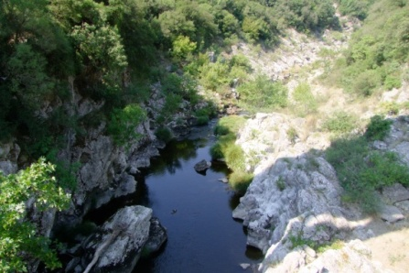
OVERVIEW
Introduction in uncertainties in water resources management
Brief description of applied methodology
(Huang et al., 1992; Li et al., 2010)
Characteristics of the studied Alfeios River Subbasin
Formulation of the optimisation problem
Uncertain variable identification
Results & Conclusions

Slide 3

INTRODUCTION
Uncertainties in water resources management in impact factors & system components :
    Available water resources
    Water Demand / supplies
    Related cost / benefit coefficients
    Sustainability requirements
    Policy regulations
(Α)
Decision variables
In optimization problem:
(Β)
Objective function coefficients
(C)
Constraints coefficients
(Α)
Probability distribution
Types of uncertainty variables:
(B)
Possibility distribution
(C)
Interval (Upper & Lower Value)

Slide 4

DESCRIPTION OF METHODOLOGY
Fuzzy-boundary interval - stochastic programming (Li et al., 2010):
  Linear optimization problem
  Uncertain variables: (a) favourable (X_{ij}⁺) & (b) unfavourable (X_{ij}⁻)
  Aim: Identification of optimal water allocation target with minimised
  risk of economic penalty from water shortage (water demand)
  & opportunity loss from spill water volumes
  Two solution methods:
  1. “Risk-Prone” or “Optimistic” (best -case model)
    2. “Risk-adverse” or “Pessimistic” (worst -case model)
Different solution methods imply
different risk attitudes of decision makers
considering system uncertainties

Slide 5
DESCRIPTION OF METHODOLOGY
  Discretization of membership grade into α-cut levels (0, 1)
  Solving for each solution type and α-cut level:
  2^{n} deterministic submodels corresponding to all combinations of
  lower & upper bound value for n fuzzy / interval variables
  For each solution type: f^{α}_{opt} = {f_{min}^{α}, f_{max}^{α}},
  where f_{min}^{α}=min{f₁,f₂,.., f₂^{n}}
  f_{max}^{α}=max{f₁,f₂,.., f₂^{n}}

Slide 6
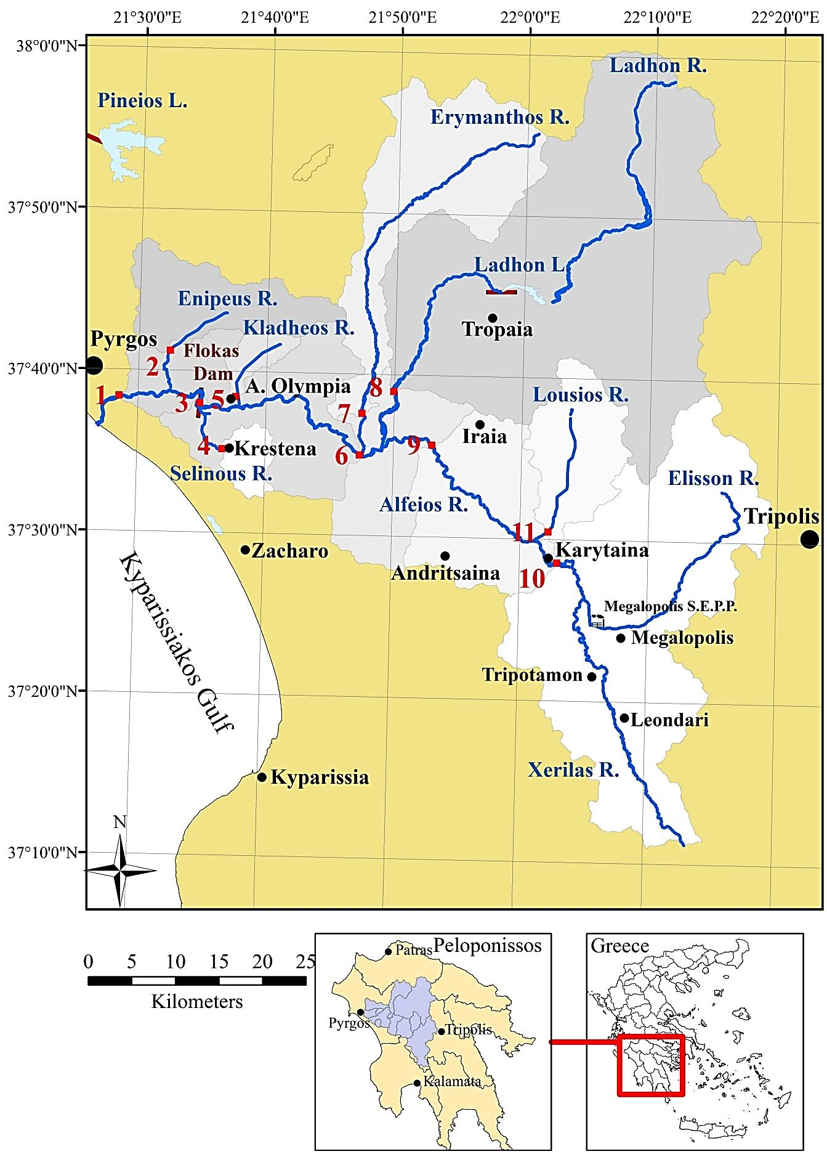
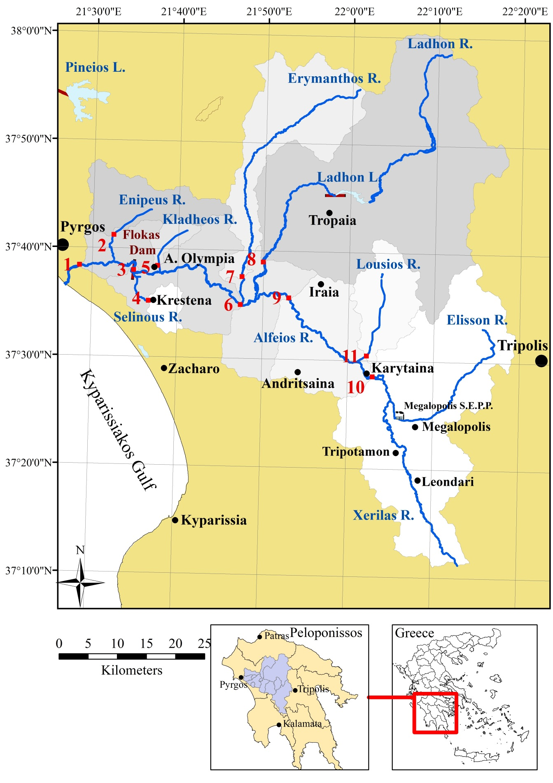
EXAMINED ALFEIOS RIVER SUBBASIN
Ladhon Dam - HPS
2. Flokas Dam – HPS
- Irrigation canal

Slide 7
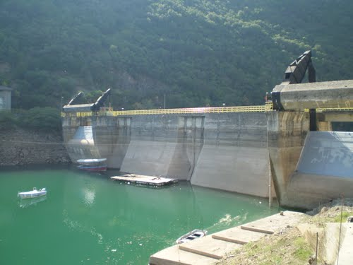
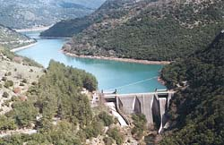
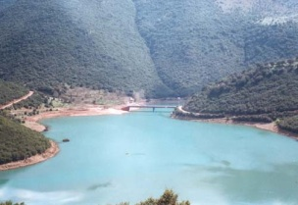
LADHON RESERVOIR & HYDROPOWER STATION
Ladhon Reservoir - Dam:
    Gross - usable storage: 57.6 ×10⁶ - 46.2×10⁶ m³
    Main purposes: Irrigation & Hydropower production
    Monthly operational curve (target reservoir level)
Ladhon Hydropower Station:
    ~8 km downstream from Ladhon Dam
    Purpose: Satisfy peak energy demand
    Total max capacity: 70 MW
    Primary & Total Mean Annual Energy: 173 & 340 GWh

Slide 8
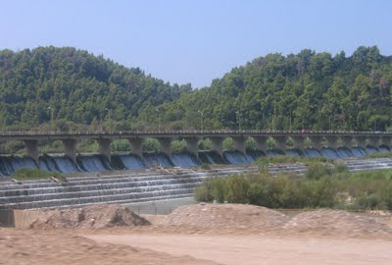
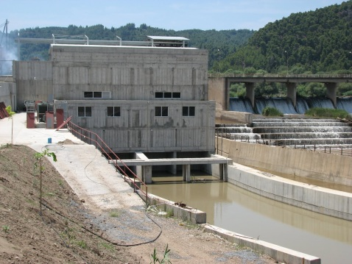
FLOKAS DAM – IRRIGATION
Flokas Dam:
    Diversion dam for irrigation purposes
    16 km from Kyparissiakos Gulf coastline
    97% of Alfeios catchment
    Small Hydroelectric Power Station :
    Max power capacity : 6.6 MW
Flokas Irrigation canal:
  Present irrigated area : 50-60% Total irrigable area (12,250 ha)
  Irrigation period : Mid April to Mid October
  Crop pattern : Cotton, corn, alfalfa, watermelons, citrus
  Surface and drip irrigation

Slide 9


OPTIMISATION PROBLEM
Maximise Total Benefit :
Benefit(HPLadhon) - Penalty(SpillLadhon) +
Benefit(Irrigation+Extra) - Penalty(IrrigationShortage) +
Benefit(HPFlokas) - Penalty(SpillFlokas)
(Α)
Objective function:
(Β)
Constraints: 1. Ladhon:
            Water Volume Mass Balance
            Min & Max pumping capacity
            Min & Max reservoir storage capacity
            Evaporation: linear F(average reservoir storage(t))
2. Flokas: (Degree of Ladhon Contribution to Flokas)
            Water Volume Mass Balance
            Min & Max pumping capacity
            Fish ladder flows & Min environmental flows

Slide 10
UNCERTAIN VARIABLES
VariableName | Uncertainty Type | Variable Effect
Unit Benefit HP Ladhon (€/MWh) | Fuzzy: LB (40, 50, 55), UB (60, 65, 75) | Favourable
Unit Benefit HP Flokas (€/MWh) | Interval: (80, 87.75) | -
Unit Benefit Irrigation Flokas (€/m³) | Interval: LB (0.19, 0.2), UB (0.24, 0.26) | Favourable
Unit Penalty HP Ladhon (€/MWh) | Fuzzy: LB (90, 115), LB (0.19, 0.2) | Unfavourable
Unit Penalty HP Flokas (€/MWh) | Interval: (120, 130) | -
Unit Penalty Irrigation Flokas (€/m³) | Fuzzy: UB (0.29, 0.31), LB (0.36, 0.39) | Unfavourable
Ladhon Contribution To Flokas (%) | Interval: (0.65, 0.71) | -
For Hydropower Production Unit Benefit/ Penalty:
        operators experience Flokas: Price for small HPS
        Max observed energy sale price of Greek Energy Market
For Irrigation Unit Benefit/ Penalty (Flokas):
        Net agricultural income per crop + Irrigation water cost
        Net agricultural income per crop + Groundwater pumping costs

Slide 11

RESULTS
Optimisation using LINGO – M. Excel
        Available data: monthly inflows in Ladhon reservoir
        (2002-2012)
        Time step / period: Monthly / one year
        Selection of a. wet year (2003)
        b. dry year (2007)
        Examined α-cut levels: 0 - 0.5 - 1
        Total number of deterministic submodels: 576
Two alternative scenarios:
1. Present Water allocation: Min monthly reservoir water level (Ladhon)
2 . Free: No operation rule (Ladhon reservoir)

Slide 12
RESULTS
Total Excess Benefit 36%
Variation of Total Benefit value : up to 32%

Slide 13
RESULTS
Total Excess Benefit 9%
Variation of Total Benefit value : up to 29%

Slide 14
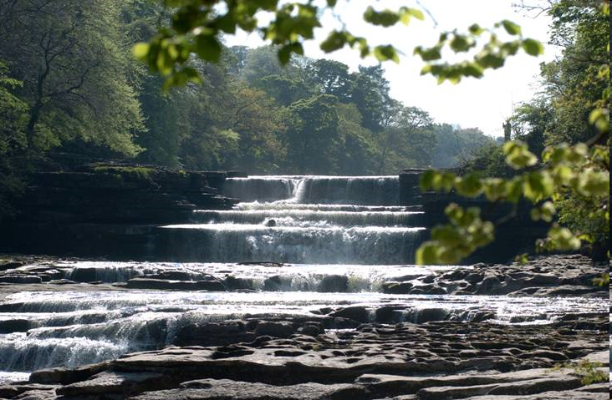
CONCLUSIONS
Flexible & efficient incorporation of uncertainties (intervals and fuzzy) in linear optimisation process through α-cut levels, providing a clear & comprehensive interpretation of uncertain variable values at each stage.
Assessment & comparison of total benefit range of various water allocation pattern for a risk-prone and risk-adverse attitudes of decision makers
OUTLOOK
Further analysis of uncertain variables: (social benefits and non consuming water uses i.e. tourism and recreation)
Further investigation of appropriate adjustments incorporating stochastic water inflows into methodology

Slide 15
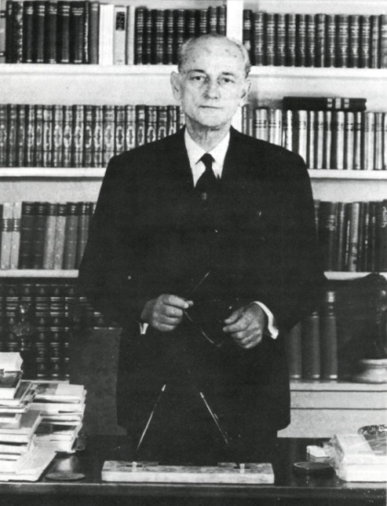
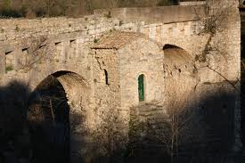
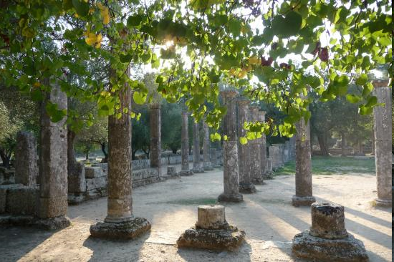
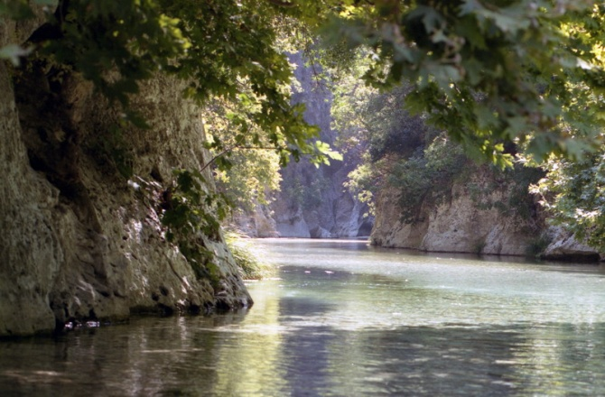
When you bend down and look at the waters of the Alfeios river near Olympia, their clarity is such that your face and soul are mirrored in them... The nature becomes here spirit. The clarity of waters becomes clarity of thought ...
Panayiotis Kanellopoulos (1902-1986)
Professor of Sociology, Prime Minister of Greece
Thank you for your attention!

Slide 16


ACKNOWLEDGEMENTS:
We would like to express our gratitude to:
Dimitrakopoulos D., Argyrakis I., Mavros I., Gatsis K., and Stathas I. from the Hellenic Public Power Corporation,
Panayotopoulos N., Rousakis I.from HPS Flokas,
Tzifas V., Altanis T. and Labadaris A.
Dr.-Ing Karellas S. from Laboratory of Steam Boilers and Thermal Plants School of Mechanical Engineering, National Technical University of Athens and Dipl.-Ing. Varela Gl., University of Stuttgart
for their support and for providing necessary data. This research is also supported by HYDROCRITES University Network.
(http://www.hydrocrites.upatras.gr)
This research has been co-financed by the European Union (European Social Fund – ESF)
and Greek national funds through the Operational Program
"Education and Lifelong Learning" of the National Strategic Reference Framework (NSRF) - Research Funding Program: Heracleitus II.
Investing in knowledge society through the European Social Fund.
European Union
European Social Fund

