Slide 1
Identifying a new African dust phosphorus “hot-spot” that fertilize the Amazon and the Atlantic Ocean
A. Gross¹, T. Goren¹, D. Rosenfeld¹, D. Custódio², C.Pio², M. Todd³, O. Tirosh¹, Y. Erel¹, T. Weiner¹ and A. Angert¹
1. The Institute of Earth Sciences, The Hebrew University of Jerusalem, Israel.
2. CEASM & Department of Environment, University of Aviero, Portugal.
3. School of Global Studies, University of Sussex, Brighton, UK.
Avner.gross@gmail.com

Slide 2
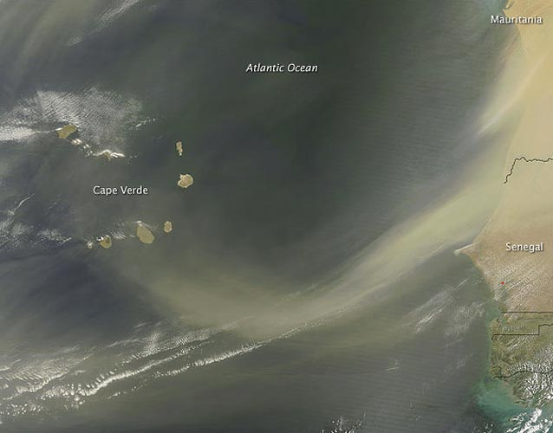
CV-Dust - Atmospheric aerosol in Cape Verde region
Coordiantor: Prof Casimero Pio, CEASM, University of Aviero, Portugal.

Slide 3
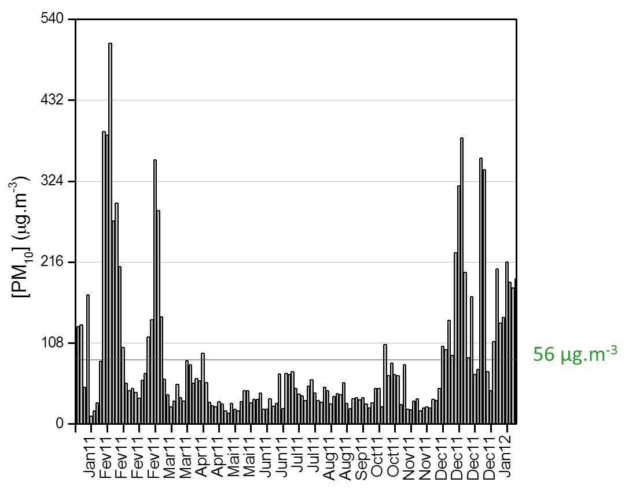
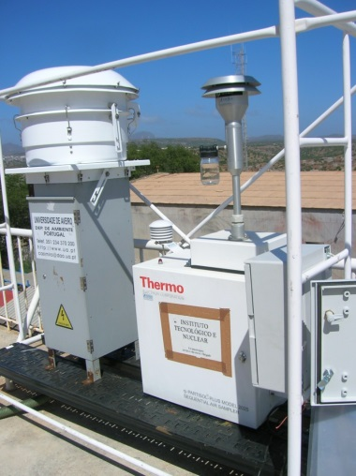
Desert dust collected during Saharan dust storms, 2011.
High volume PM₁₀ sampling

Slide 4
Desert dust collected during Saharan dust storms, 2011.
High volume PM₁₀ sampling

Slide 5
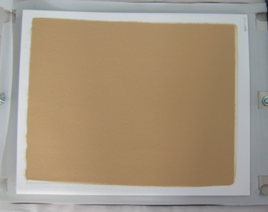
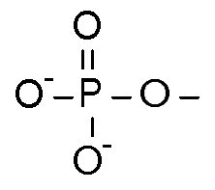
Identifying African dust-P using phosphate stable oxygen isotopes
δ¹⁸O_{P}
(Gross et al, 2013)

Slide 6
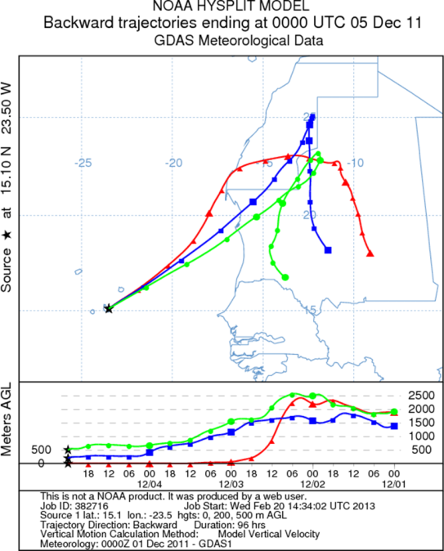
Dust arrives to Cape-Verde from 3 major sectors.
N.W.
Mauritania

Slide 7
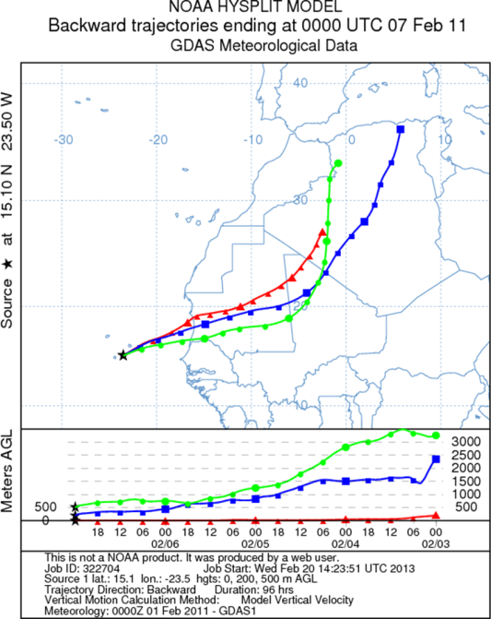
Dust arrives to Cape-Verde from 3 major sectors.
Northern Sahara
(-N.W Mauritania)
N.W.
Mauritania

Slide 8
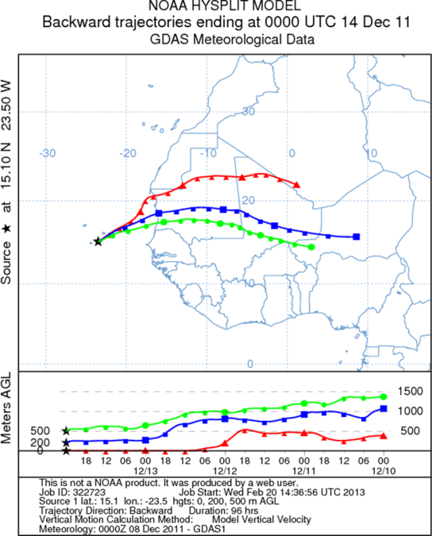
Dust arrives to Cape-Verde from 3 major sectors.
Northern Sahara
(-N.W Mauritania)
N.W.
Mauritania
Southern Sahara (+N.W Mauritania)

Slide 9
Clustering of major elements and REE compositions between sectors
Northern Sahara
(-N.W Mauritania)
N.W.
Mauritania
Southern Sahara (+N.W Mauritania)

Slide 10
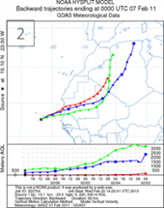
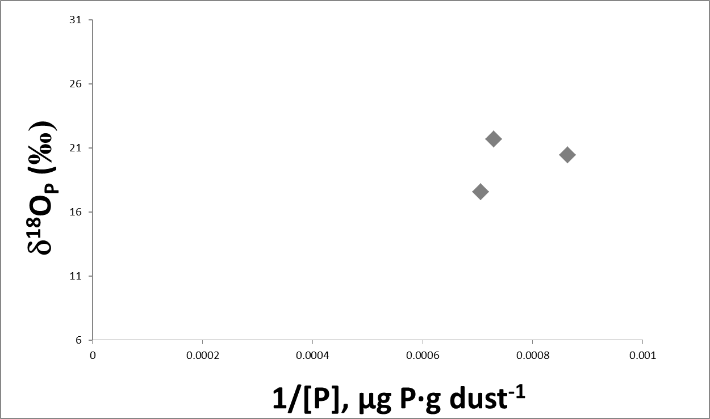
Dust events were characterized by a unique dust-P δ¹⁸O_{P} value

Slide 11
Dust events were characterized by a unique dust-P δ¹⁸O_{P} value
Marine sedimentary phosphorites

Slide 12
Dust events were characterized by a unique dust-P δ¹⁸O_{P} value
Marine sedimentary phosphorites
1200-1500ppm

Slide 13
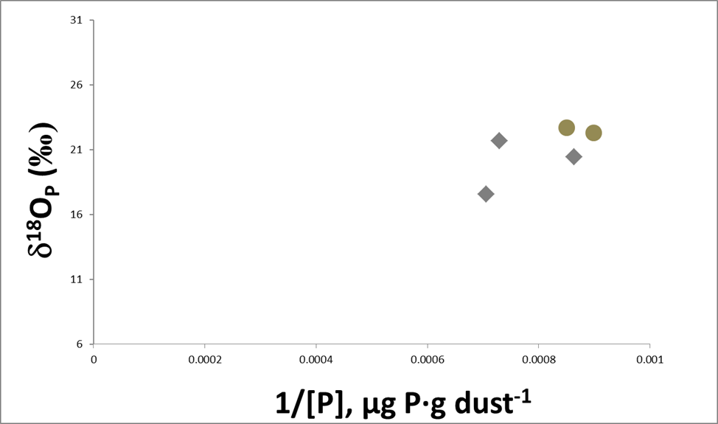
Dust events were characterized by a unique dust-P δ¹⁸O_{P} value
Dust events in Israel
Marine sedimentary phosphorites
1200-1500ppm

Slide 14
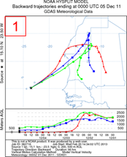
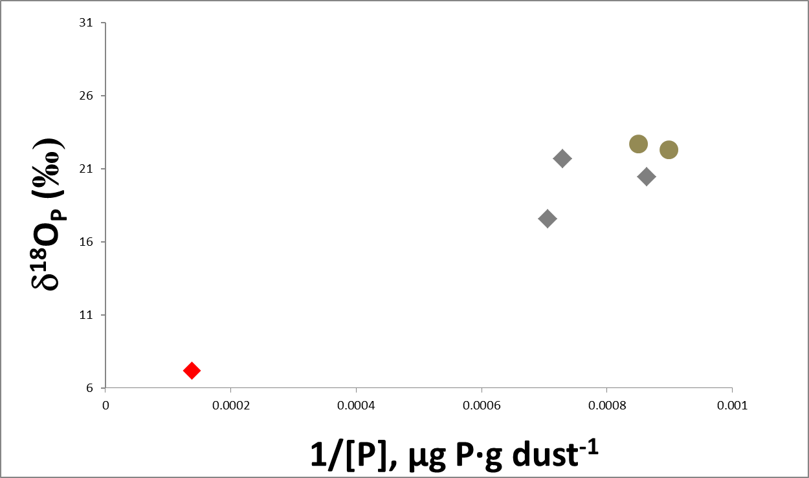
Dust events were characterized by a unique dust-P δ¹⁸O_{P} value
Dust events in Israel
Marine sedimentary phosphorites
1200-1500ppm

Slide 15
Dust events were characterized by a unique dust-P δ¹⁸O_{P} value
Dust events in Israel
Marine sedimentary phosphorites
1200-1500ppm
Magmatic rocks

Slide 16
Dust events were characterized by a unique dust-P δ¹⁸O_{P} value
Dust events in Israel
Marine sedimentary phosphorites
1200-1500ppm
7500ppm
Magmatic rocks

Slide 17
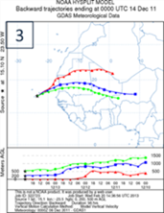
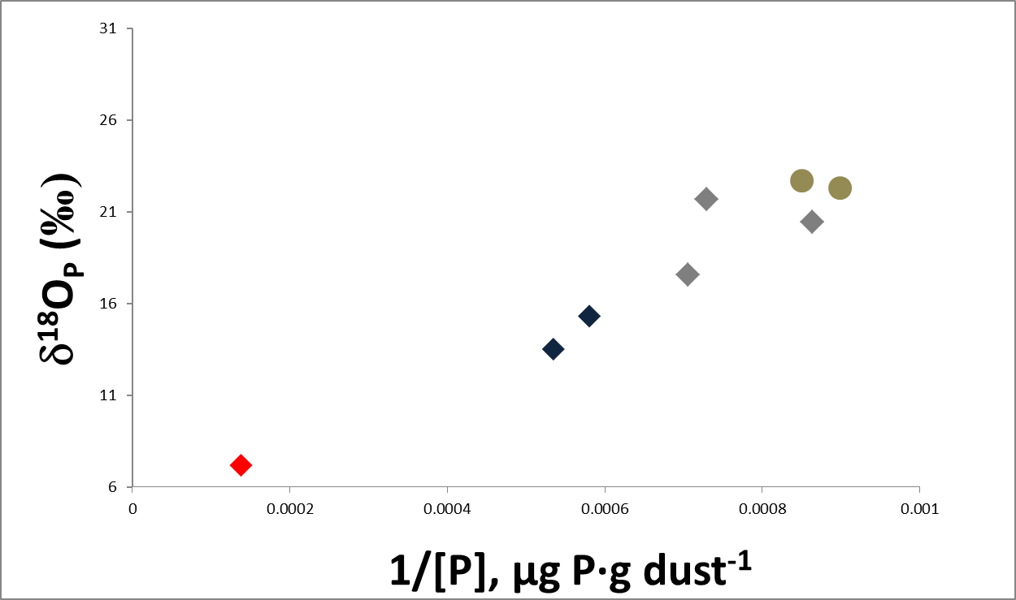
Dust events were characterized by a unique dust-P δ¹⁸O_{P} value
Dust events in Israel
Marine sedimentary phosphorites
1200-1500ppm
7500ppm
Magmatic rocks

Slide 18
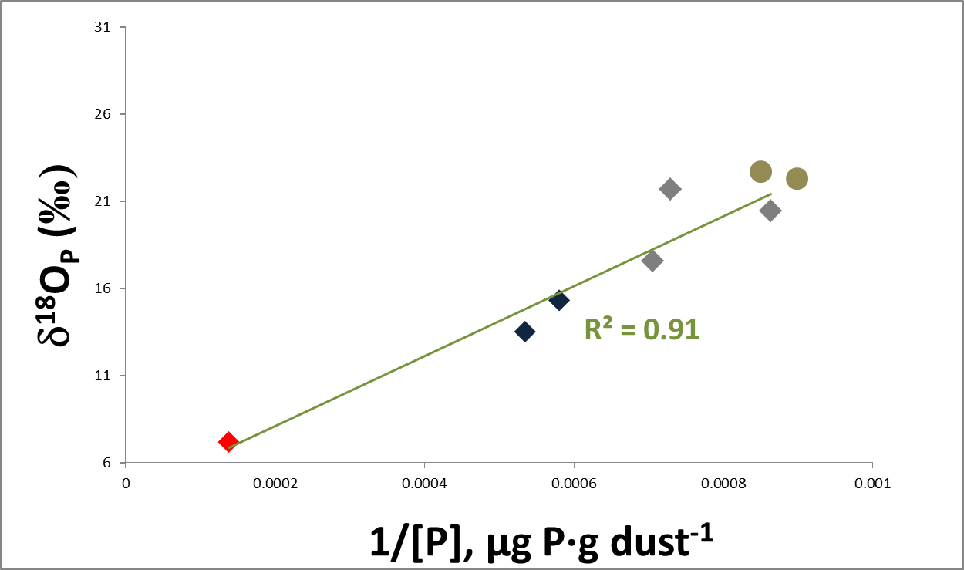
Dust events were characterized by a unique dust-P δ¹⁸O_{P} value
Dust events in Israel
Marine sedimentary phosphorites
1200-1500ppm
7500ppm
Magmatic rocks

Slide 19
Dust events were characterized by a unique dust-P δ¹⁸O_{P} value
Bodélé
Dust events in Israel
Marine sedimentary phosphorites
1200-1500ppm
7500ppm
Magmatic rocks

Slide 20
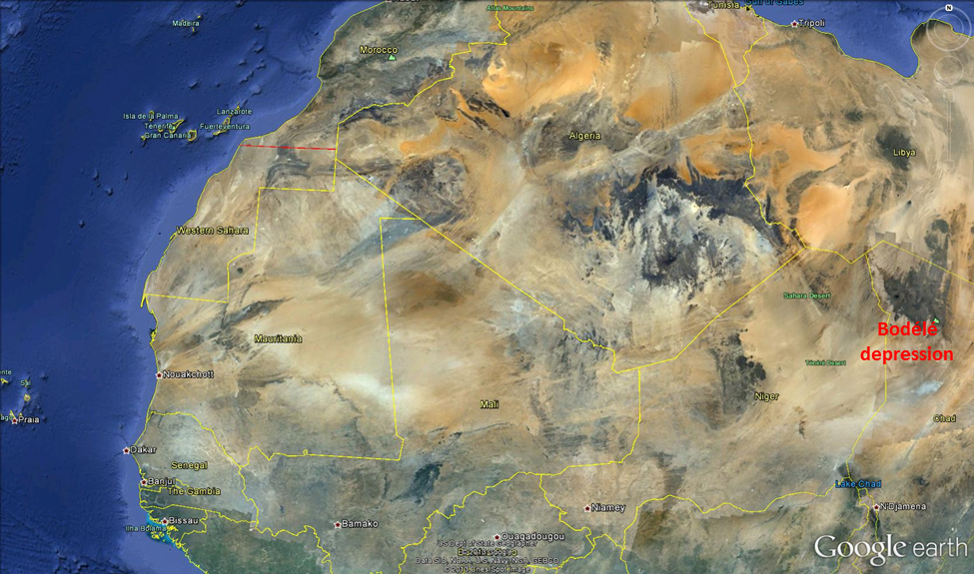
55-60% of the yearly dust-P is derived from a magmatic rock P “HOT-SPOT” in North Western Mauritania
Bodélé
depression

Slide 21
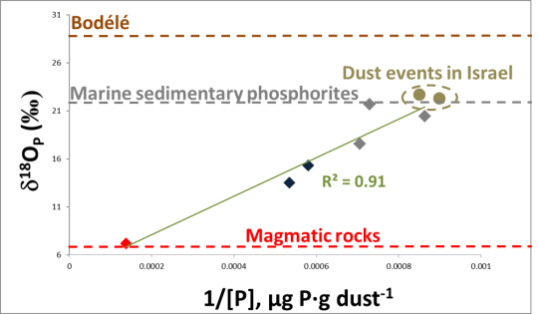
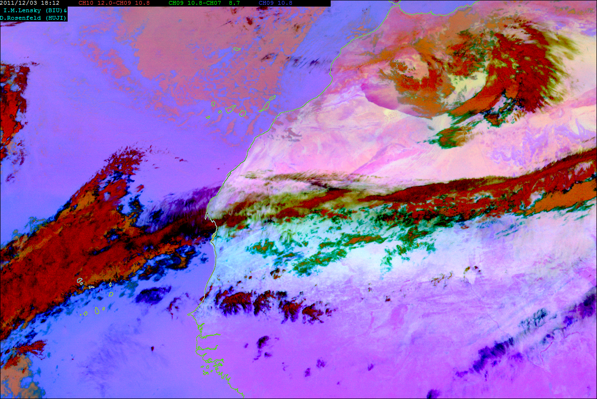
Dust-P with magmatic signature (+North Western Mauritania)
RGB image sequence from the geo stationary MSG satellite
(Lensky and Rosenfeld, 2008)

Slide 22
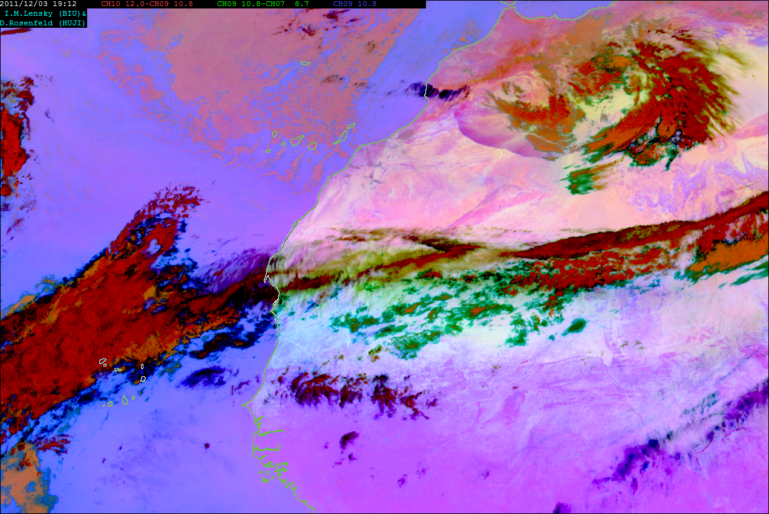
Dust-P with magmatic signature (+North Western Mauritania)
RGB image sequence from the geo stationary MSG satellite
(Lensky and Rosenfeld, 2008)

Slide 23
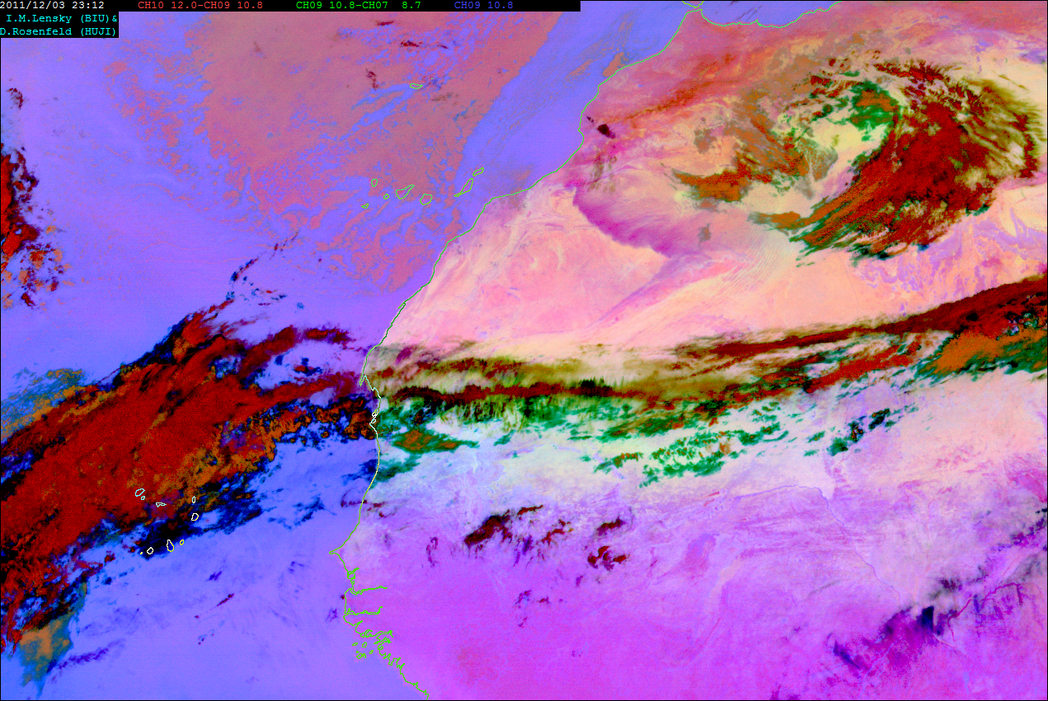
Dust-P with magmatic signature (+North Western Mauritania)
RGB image sequence from the geo stationary MSG satellite
(Lensky and Rosenfeld, 2008)

Slide 24
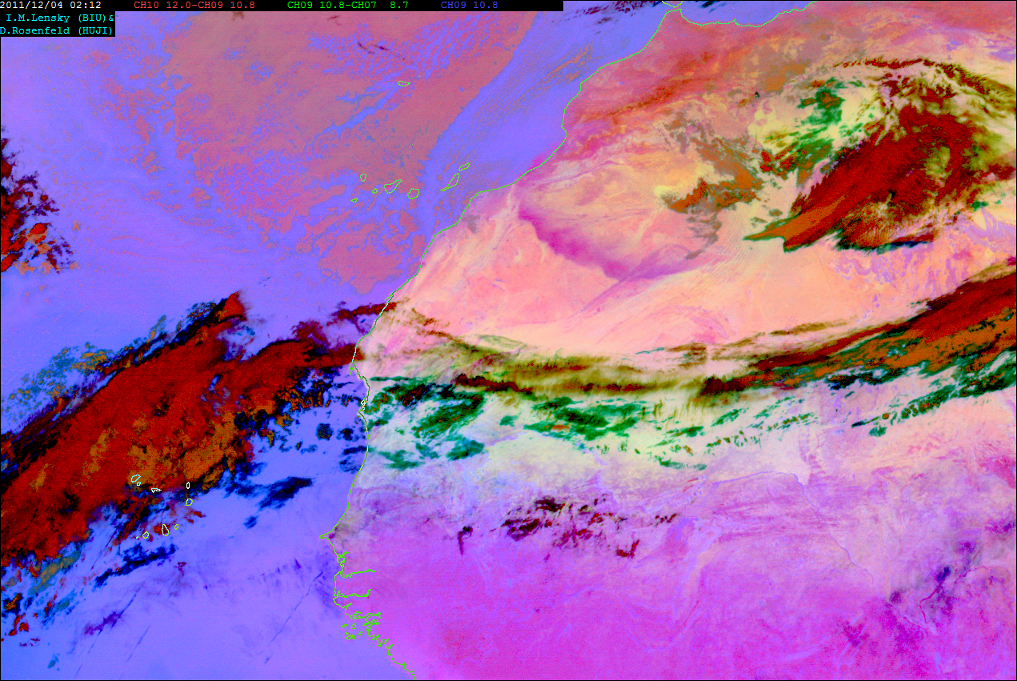
Dust-P with magmatic signature (+North Western Mauritania)
RGB image sequence from the geo stationary MSG satellite
(Lensky and Rosenfeld, 2008)

Slide 25
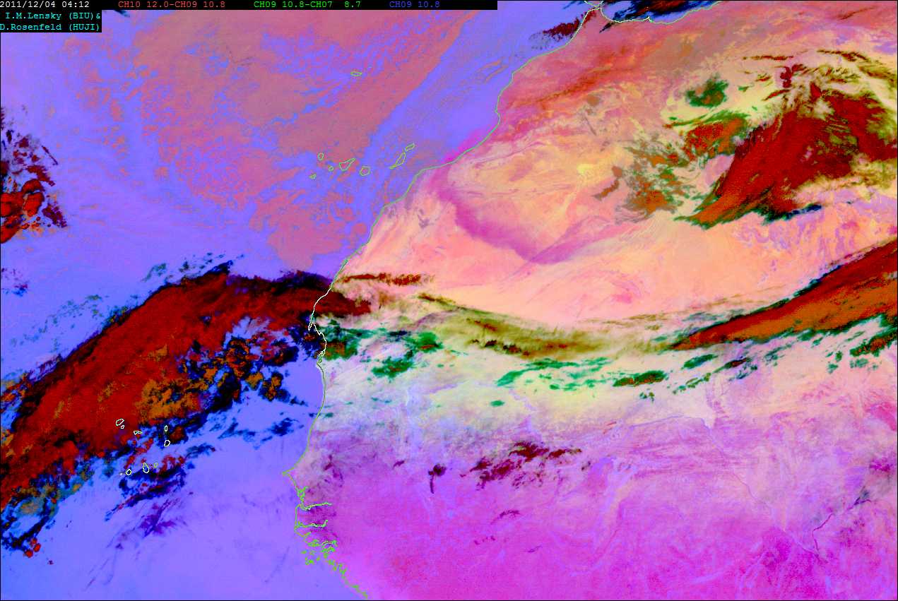
Dust-P with magmatic signature (+North Western Mauritania)
RGB image sequence from the geo stationary MSG satellite
(Lensky and Rosenfeld, 2008)

Slide 26
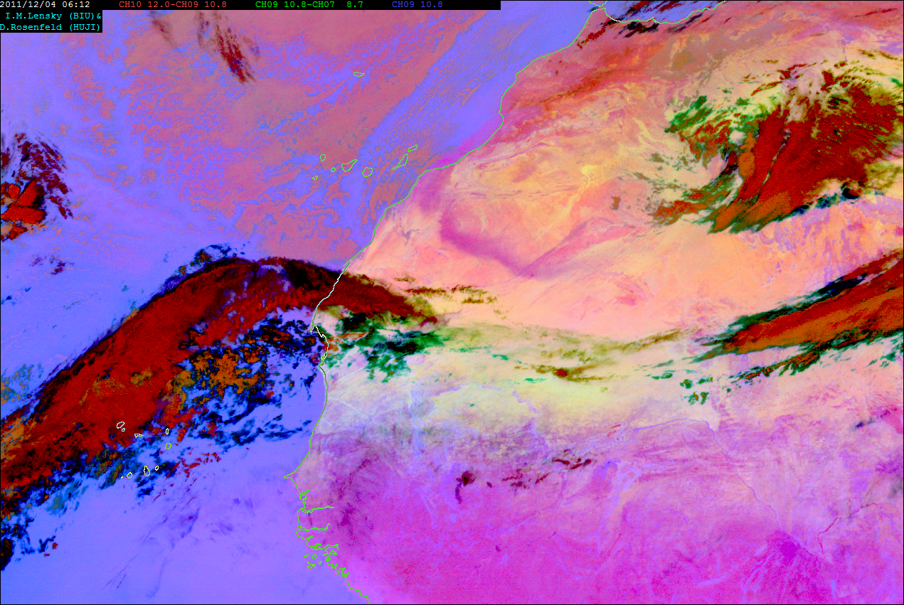
Dust-P with magmatic signature (+North Western Mauritania)
RGB image sequence from the geo stationary MSG satellite
(Lensky and Rosenfeld, 2008)

Slide 27
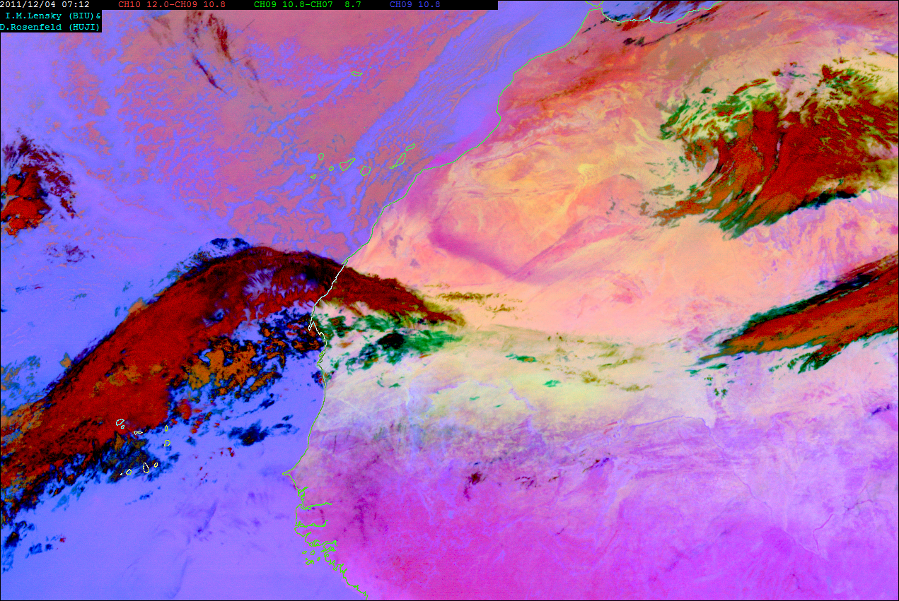
Dust-P with magmatic signature (+North Western Mauritania)
RGB image sequence from the geo stationary MSG satellite
(Lensky and Rosenfeld, 2008)

Slide 28
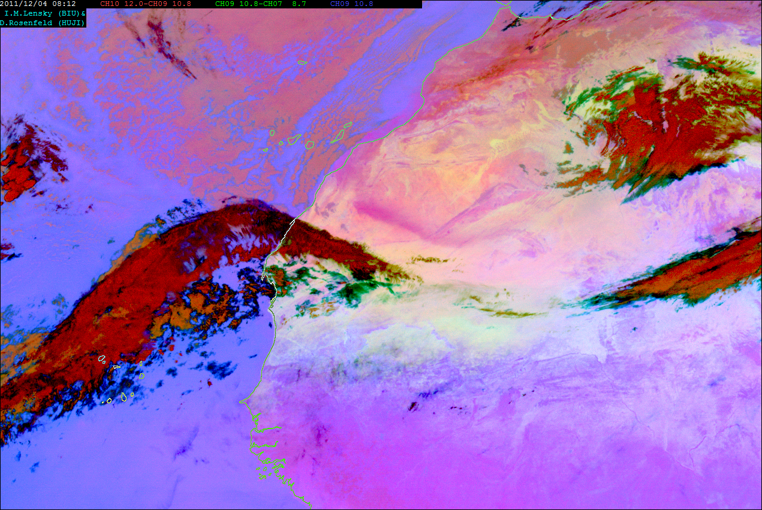
Dust-P with magmatic signature (+North Western Mauritania)
RGB image sequence from the geo stationary MSG satellite
(Lensky and Rosenfeld, 2008)

Slide 29
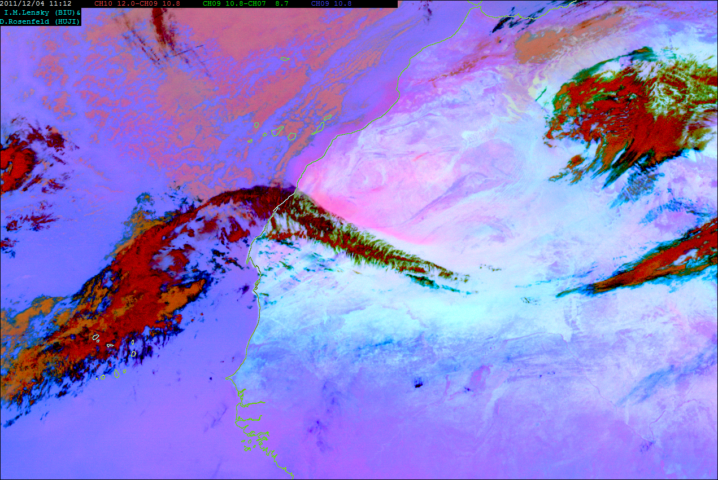
Dust-P with magmatic signature (+North Western Mauritania)
RGB image sequence from the geo stationary MSG satellite
(Lensky and Rosenfeld, 2008)

Slide 30
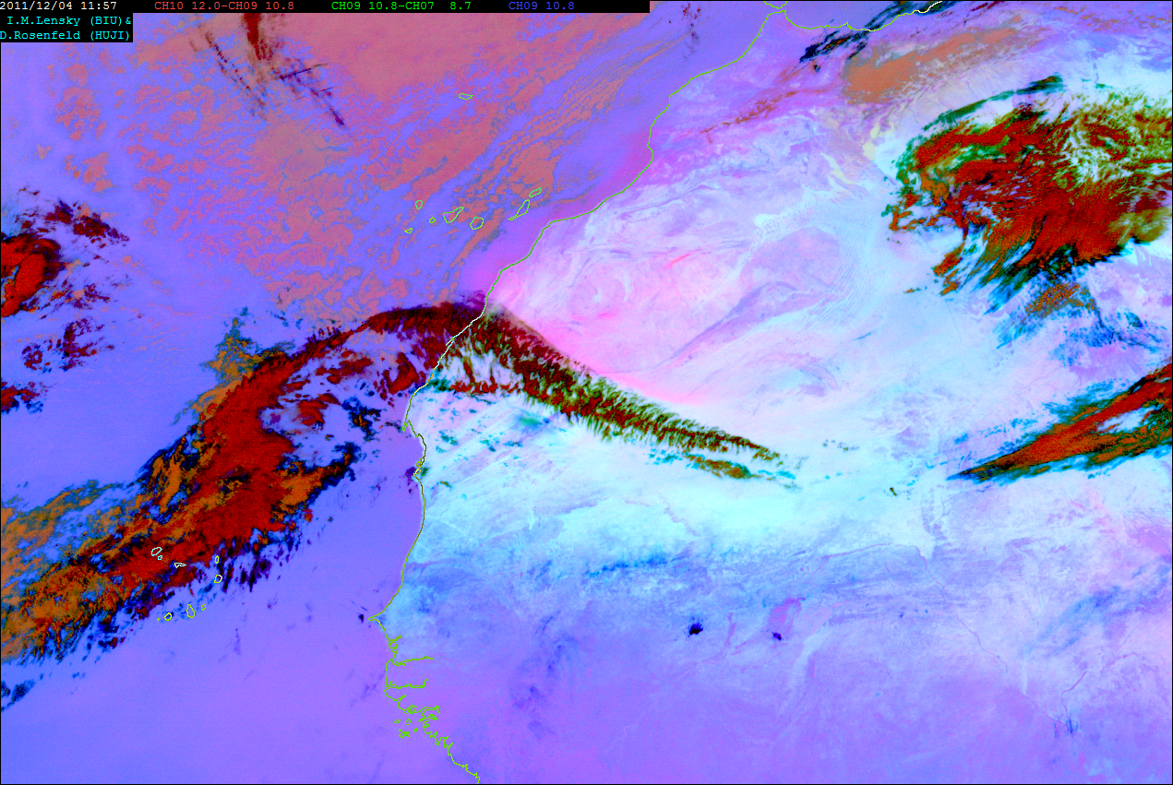
Dust-P with magmatic signature (+North Western Mauritania)
RGB image sequence from the geo stationary MSG satellite
(Lensky and Rosenfeld, 2008)

Slide 31
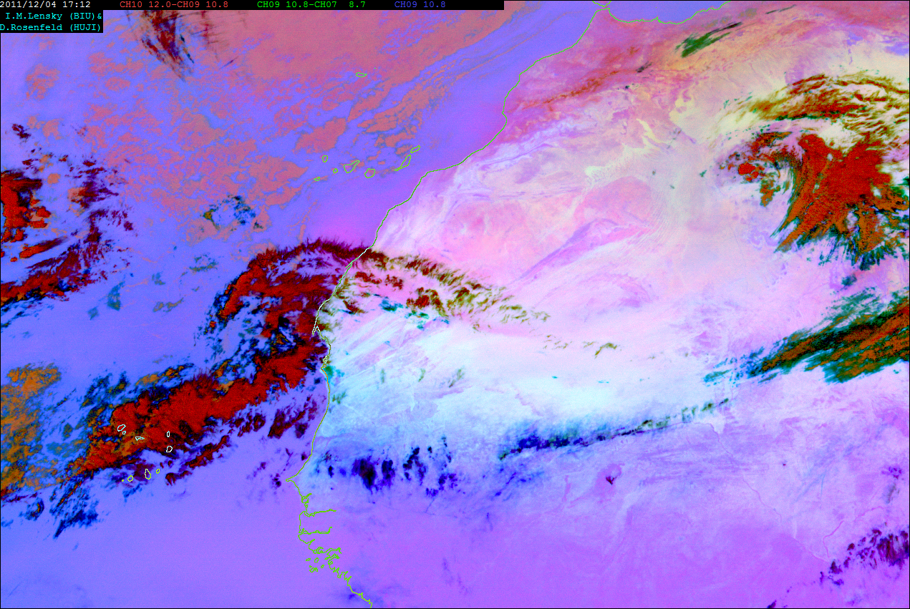
Dust-P with magmatic signature (+North Western Mauritania)
RGB image sequence from the geo stationary MSG satellite
(Lensky and Rosenfeld, 2008)

Slide 32
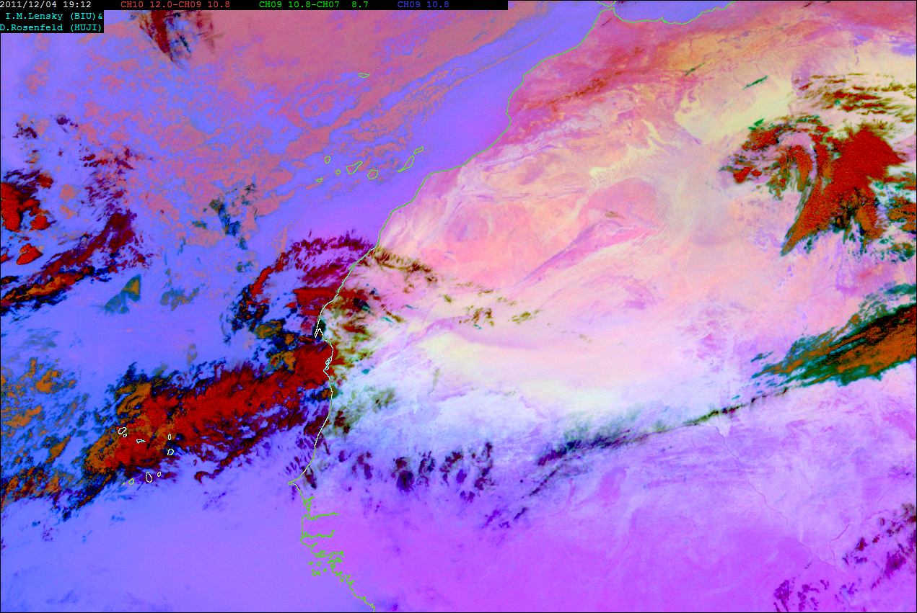
Dust-P with magmatic signature (+North Western Mauritania)
RGB image sequence from the geo stationary MSG satellite
(Lensky and Rosenfeld, 2008)

Slide 33
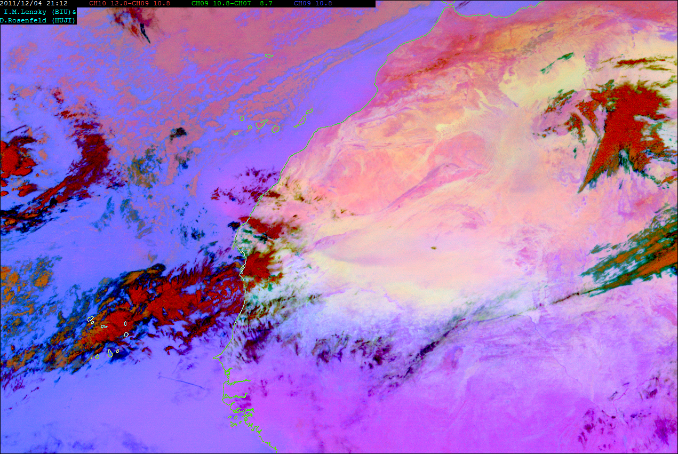
Dust-P with magmatic signature (+North Western Mauritania)
RGB image sequence from the geo stationary MSG satellite
(Lensky and Rosenfeld, 2008)

Slide 34
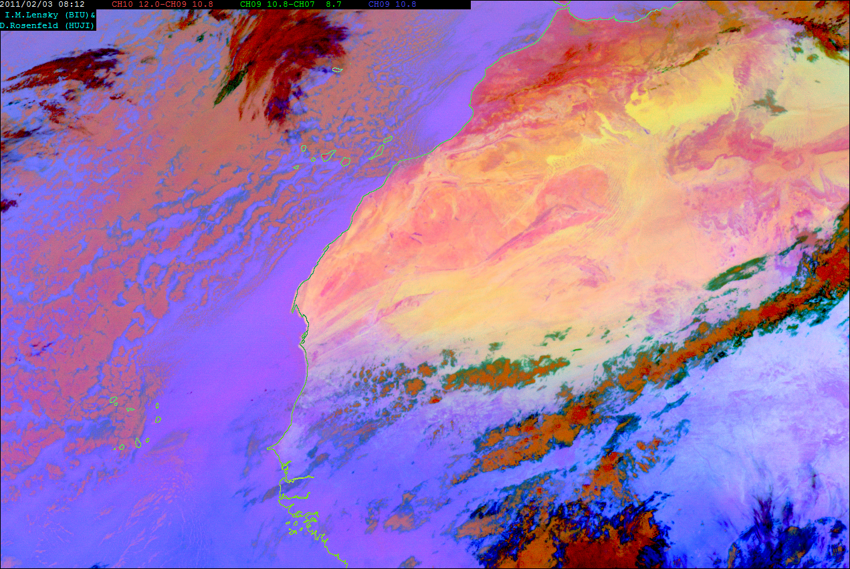
Dust-P with sedimentary signature (-North Western Mauritania)
RGB image sequence from the geo stationary MSG satellite
(Lensky and Rosenfeld, 2008)

Slide 35
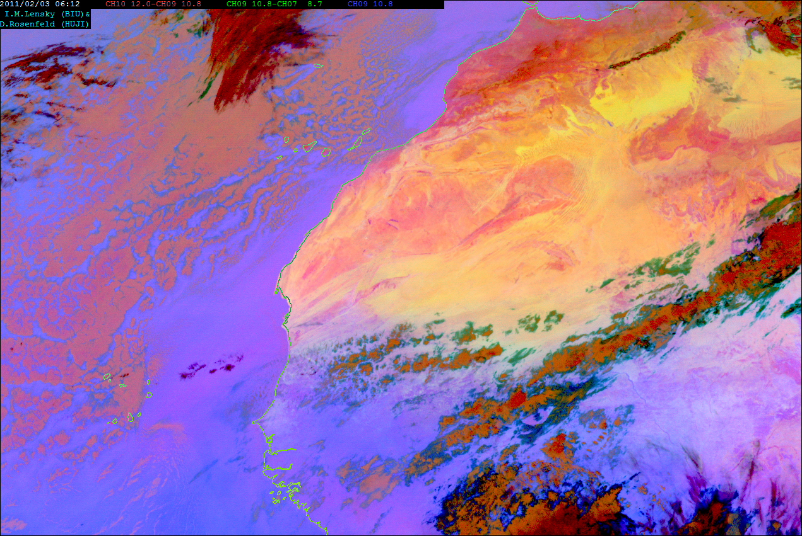
Dust-P with sedimentary signature (-North Western Mauritania)
RGB image sequence from the geo stationary MSG satellite
(Lensky and Rosenfeld, 2008)

Slide 36
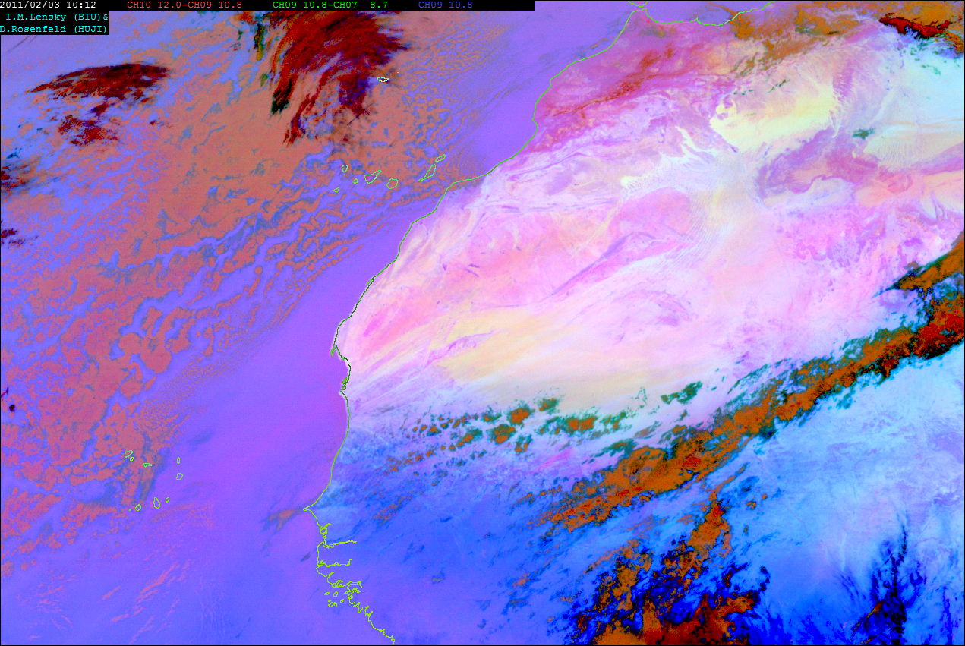
Dust-P with sedimentary signature (-North Western Mauritania)
RGB image sequence from the geo stationary MSG satellite
(Lensky and Rosenfeld, 2008)

Slide 37
Dust-P with sedimentary signature (-North Western Mauritania)
RGB image sequence from the geo stationary MSG satellite
(Lensky and Rosenfeld, 2008)

Slide 38
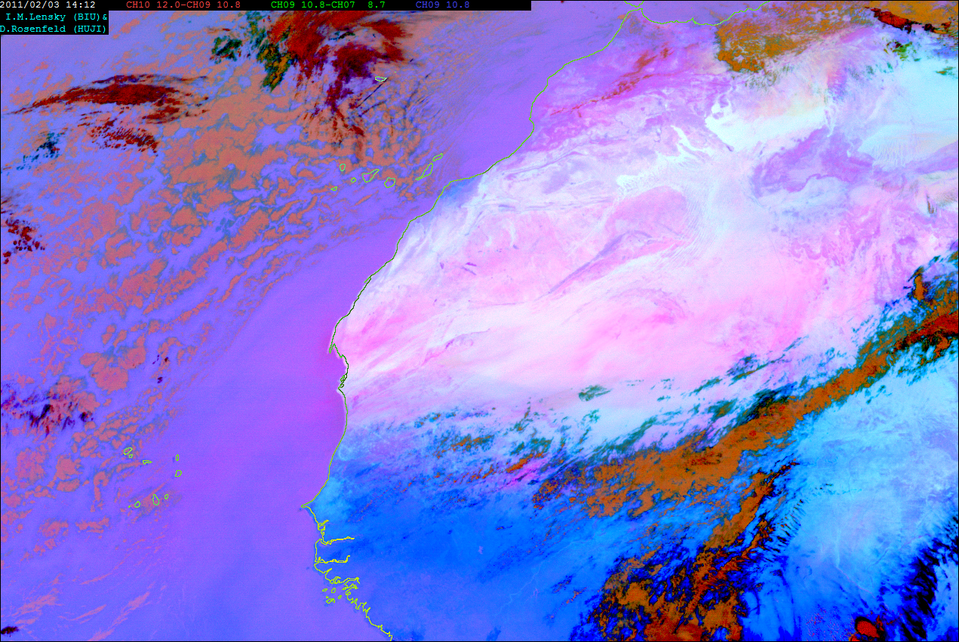
Dust-P with sedimentary signature (-North Western Mauritania)
RGB image sequence from the geo stationary MSG satellite
(Lensky and Rosenfeld, 2008)

Slide 39
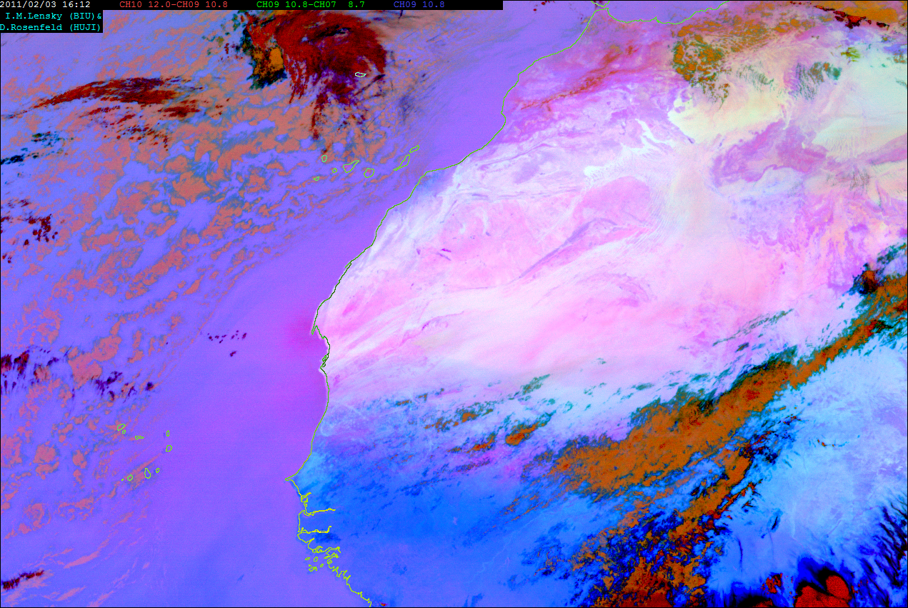
Dust-P with sedimentary signature (-North Western Mauritania)
RGB image sequence from the geo stationary MSG satellite
(Lensky and Rosenfeld, 2008)

Slide 40
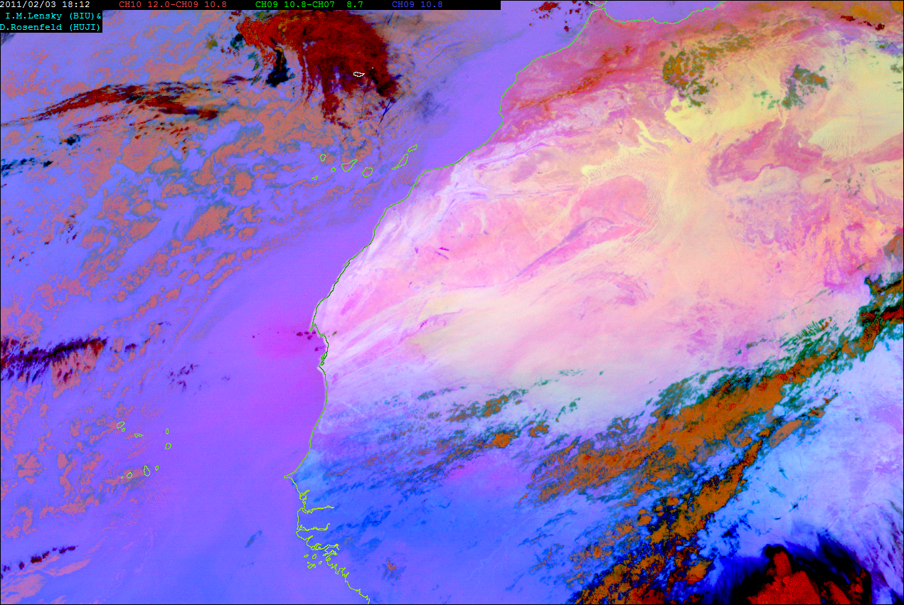
Dust-P with sedimentary signature (-North Western Mauritania)
RGB image sequence from the geo stationary MSG satellite
(Lensky and Rosenfeld, 2008)

Slide 41
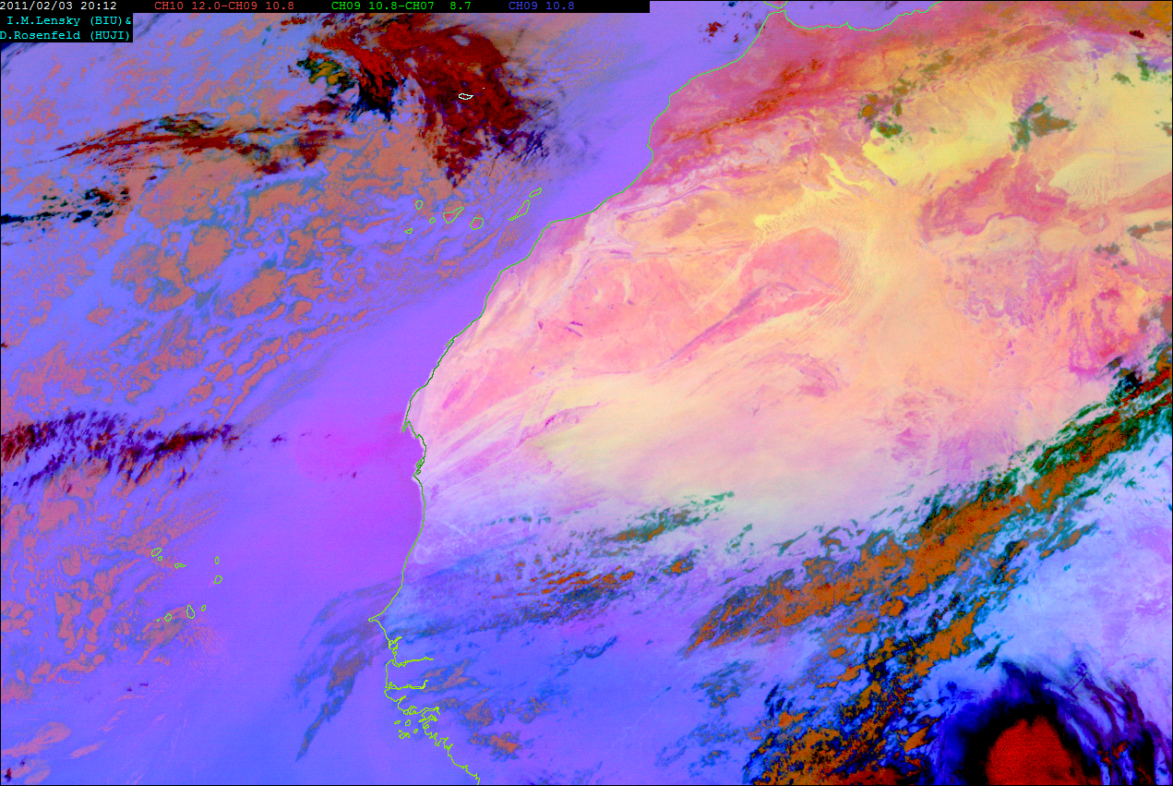
Dust-P with sedimentary signature (-North Western Mauritania)
RGB image sequence from the geo stationary MSG satellite
(Lensky and Rosenfeld, 2008)

Slide 42
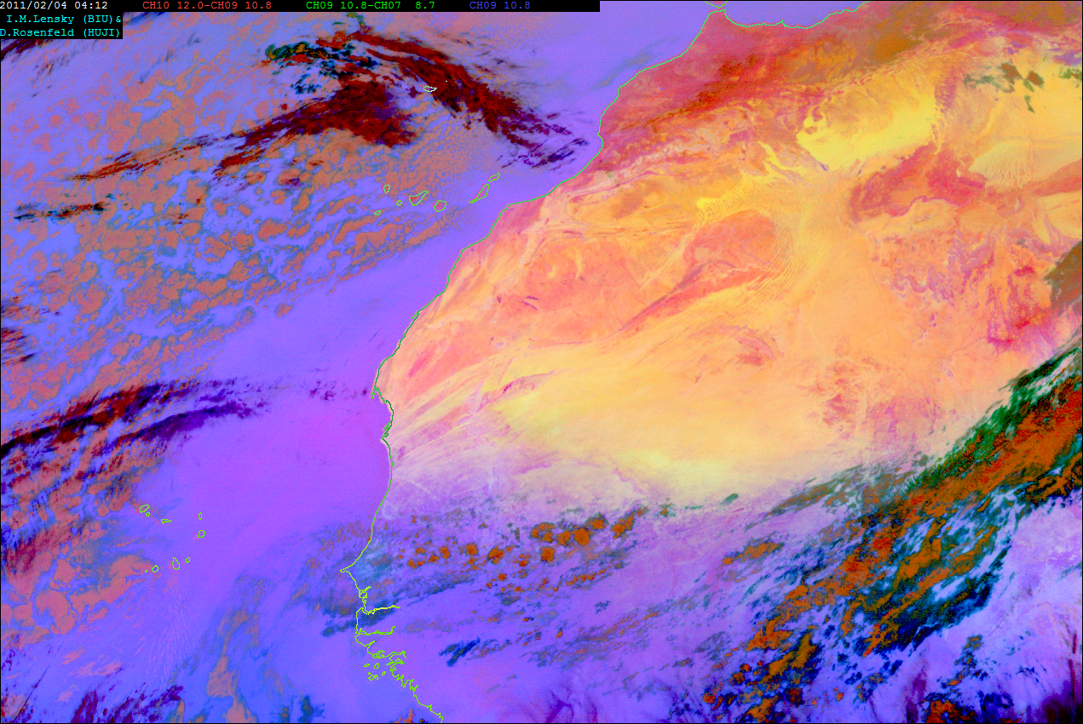
Dust-P with sedimentary signature (-North Western Mauritania)
RGB image sequence from the geo stationary MSG satellite
(Lensky and Rosenfeld, 2008)

Slide 43
Conclusions
The African dust-P deposited in Cape-Verde is derived from 2 major sources:

Slide 44
Conclusions
The African dust-P deposited in Cape-Verde is derived from 2 major sources:
1. ~40% originated from a widespread marine sedimentary phosphorite source.

Slide 45
Conclusions
The African dust-P deposited in Cape-Verde is derived from 2 major sources:
1. ~40% originated from a widespread marine sedimentary phosphorite source.
2. ~60% originated from a magmatic P “HOT-SPOT” in North Western Mauritania.

Slide 46
Conclusions
The African dust-P deposited in Cape-Verde is derived from 2 major sources:
1. ~40% originated from a widespread marine sedimentary phosphorite source.
2. ~60% originated from a magmatic P “HOT-SPOT” in North Western Mauritania.
Insignificant contribution of “Bodélé-P”.

Slide 47
Conclusions
The African dust-P deposited in Cape-Verde is derived from 2 major sources:
1. ~40% originated from a widespread marine sedimentary phosphorite source.
2. ~60% originated from a magmatic P “HOT-SPOT” in North Western Mauritania.
Insignificant contribution of “Bodélé-P”.
Samples of Mauritania’s soil or desert dust are welcome

Slide 48
Thanks...
Tom Goren, Ofir Tirosh, Yigal Harel, Yehoshua Kolodny, Tal Weiner, Uri Dayan and Alon Angert (The Hebrew University of Jerusalem, Israel).
Cape-Verde dust samples- Casimero Pio, Danilo Castudio (CEASM, Aveiro University, Portugal).
Bodélé samples – Martin Todd (University of Sussex, Brighton, UK).
Avner.gross@gmail.com

