Slide 1
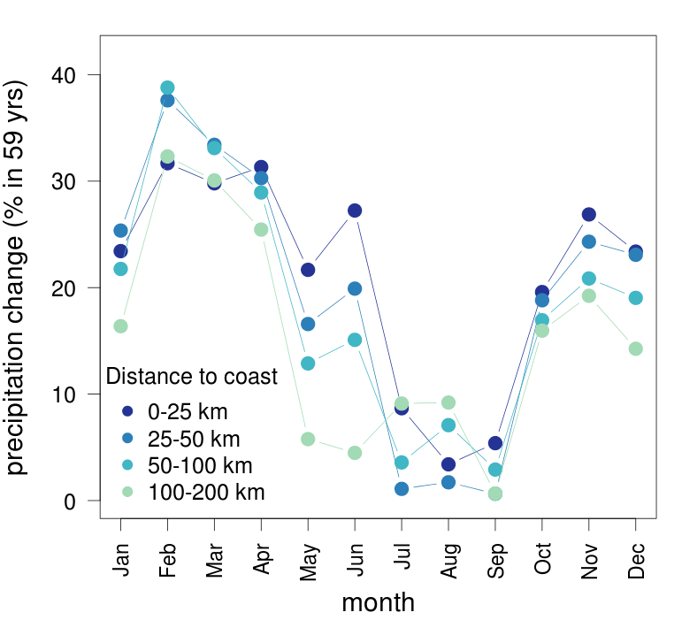
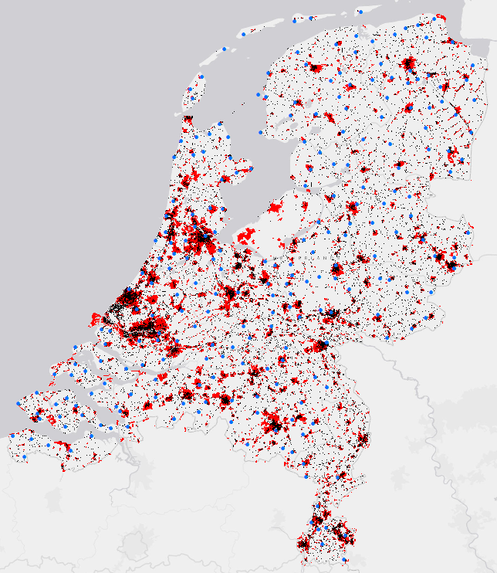
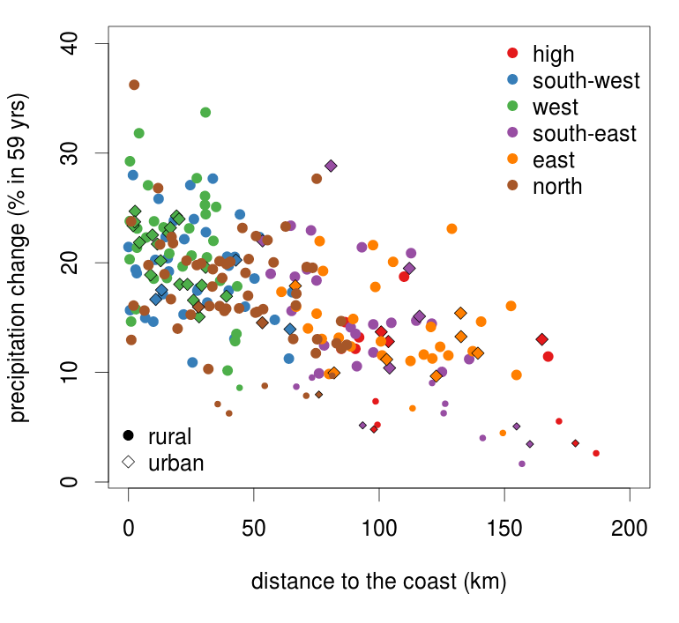
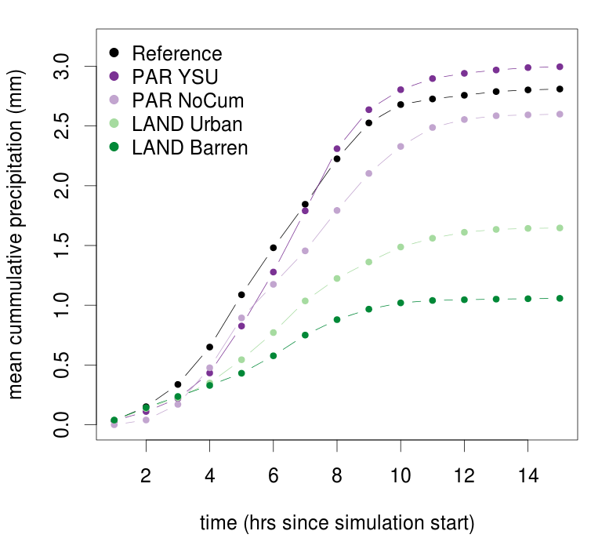
Sensitivity of observed and modelled precipitation to the land surface in the Netherlands
Emma Daniels¹, Geert Lenderink², Ronald Hutjes¹, Bert Holtslag³
Contact: emma.daniels@wur.nl (Jan 2011 – Dec 2015)
1. Earth System Science group, Wageningen University and Research centre (WUR), Wageningen, The Netherlands
2. Royal Netherlands Meteorological Institute (KNMI), De Bilt, The Netherlands
3. Meteorology and Air Quality group, WUR, Wageningen, The Netherlands
1. Introduction
Significant increases in both mean and extreme precipitation in the Netherlands have been observed over the last 60 years. We investigated the influence of soil type, sea surface temperature (SST), topography and urbanization.
3. Sensitivity
The land surface has a large impact on the energy partitioning and therefore has the potential to influence precipitation. Urban areas for example have higher roughness length and heat capacity and lower albedo than natural areas.
5. Future
Preliminary results show clear responses to large alterations in land-use, but will this hold for smaller -realistic- changes and how do these influence spatial variability in precipitation?
Further research plans include:
“Composite” simulations of extreme events with more representative future weather conditions.
Sensitivity analysis of land-use changes , soil moisture and SST in present and future climate
Assessment how large scale adaptation measures could influence precipitation events
Figure 1: Mean daily precipitation change (%) in the Netherlands for coastal distance zones for the period 1951-2009. Months are based on overlapping 3-month periods, e.g., Jul refers to the average of June, July and August.
Figure 3: Schematic representation of the energy partitioning at the land surface and mechanisms through which the formation of clouds and precipitation is affected.
Figure 5: Urbanization in NL in 1960 (black) and 2000 (red). Blue dots indicate KNMI precipitation station positions.
2. Observations
Coastal distance zones were found to describe more of the spatial variability in precipitation trends than regions based on surface characteristics. We therefore consider SST the most influential factor for precipitation changes in the Netherlands.
4. Modelling
We conduct a high-resolution (< 3km) sensitivity analysis with WRF for physics parameterizations and land-use. Initially we investigate convective situations, because there we expect the greatest influence of the land surface.
Figure 2: Scatterplot of the station-wise daily precipitation change (%) in the Netherlands in the period 1951-2009. Stations belonging to the different surface characteristics regions are represented by different colours. Stations with changes that are not significant have smaller symbols.
Figure 4: Mean accumulated precipitation over the Netherlands for a WRF simulation of 07-08-2002. Runs with altered physics parameterizations are purple, runs with altered land-use are green.
This research is supported by the Dutch programme:
Knowledge for Climate (Kennis voor Klimaat).
In press: Daniels, E.E., G. Lenderink, R.W.A. Hutjes, A.A.M. Holtslag, 2013.
Spatial precipitation patterns and trends in the Netherlands during 1951-2009.
International Journal of Climatology.

