Slide 1
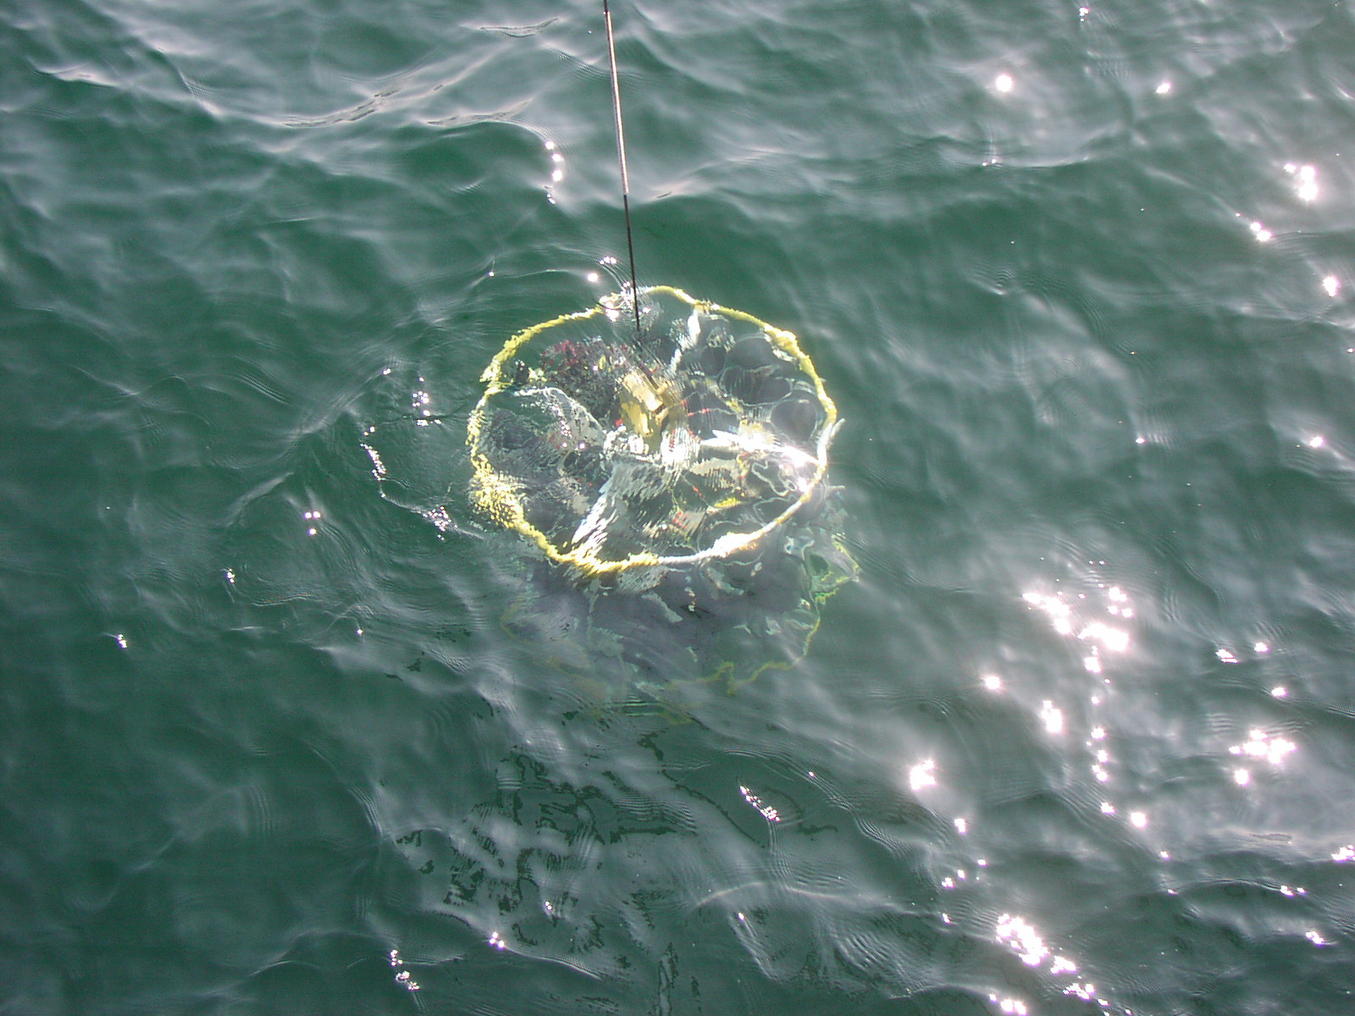


Metrology for ocean salinity and acidity- the European Metrology Research Project ENV05
Petra Spitzer, PTB, Germany
Steffen Seitz, PTB, Germany, Simona Lago, INRiM, Italy, Daniela Stoica and Paola Fisicaro, LNE, France, Michal Mariassy, SMU, Slovakia, Robert Clough, UoP, UK, Filomena Camões, FFCUL, Portugal,
H. Wolf,PTB
Vienna | Austria | 07 – 12 April 2013

Slide 2
Metrology - What do we really measure ?
Oceanography:
- relies on separate international standards since 1902
- relies on salinity measurements not traceable to the SI
- permits high-precision field measurements,
utterly needed to detect tiny but systematic climatic changes
- needs world-wide comparability on climatologically century time scales
(R. Feistel, CCQM, Paris 2012)
Metrology: to ensure world-wide comparability of measurement results and their traceability to stated references (to the International System of Units (SI))
Traceability: to link measurement result to a reference through a unbroken chain of calibrations, each contributing to the measurement uncertainty
Tested once, accepted everywhere
measurement result
0.6 ± 0.1 units on a scale

Slide 3
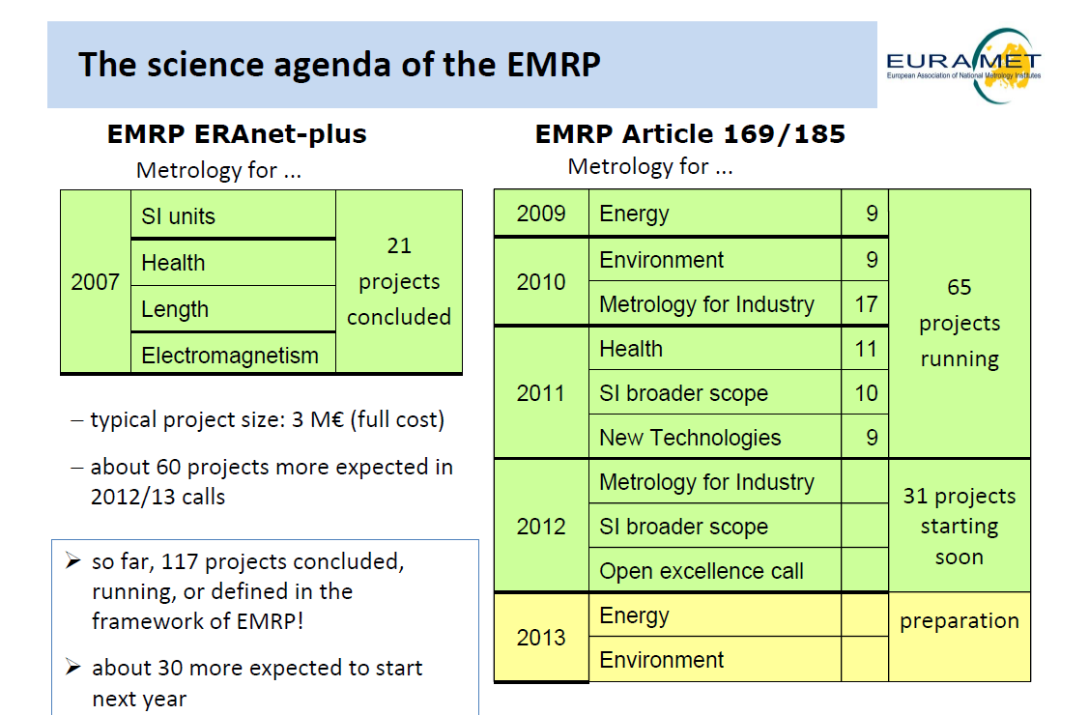

Slide 4











Metrology of Ocean Salinity and Acidity
EMRP-ENV05 OCEAN (2011-2014)
Coordinator: P. Spitzer, PTB, DE
Funded partners: INRiM (IT), IPQ(PT), JRC(IRMM) (EC),LNE(FR), SYKE(FI), MKEH (HU), NPL(UK), SMU(SK), University of Tartu (EE)
Research Excellence Grants: University of Plymouth (R.Clough) and Universidade de Lisboa (F. Camões)
Who is supporting the project
http://projects.ptb.de/emrp/index.php?id=2

Slide 5
Objective and Impact
Objectives:
Salinity, temperature, density, speed of sound,
pH, composition, dissolved oxygen
SI traceability: long time comparability of results
Novel measurement capabilities with reduced uncertainties
Improved standards
Impact:
Europe provides comparability of oceanographic data
on climatic time scale
Metrological concepts are established in oceanography
European NMIs build up knowledge on ocean monitoring
Seawater data are disseminated to oceanographic community

Slide 6
Research Topics
Traceability of Practical Salinity based on density standards (WP1)
Conductivity ratio K₁₅ linked to density to establish SI traceability of Practical Salinity
(Ocean Science (2011) 7:45-62)
Primary procedure for Practical Salinity at high pressures (70 MPa, salinity 4 to 42)
Investigation of effect of composition anomalies on Practical Salinity - density relation
Extension of range for thermophysical parameters to high pressure (WP2)
Traceable speed of sound measurements in seawater as function of temperature
(0 °C up to 40 °C), pressures up to 70 MPa and salinity 4 to 42)
Improved in-situ measurements of temperature (acoustic tomography)
and speed of sound

Slide 7
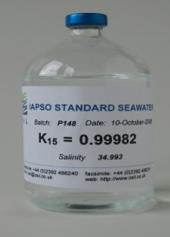
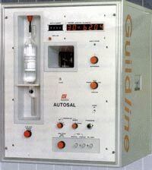
Current Traceability Chain of Practical Salinity
UNESCO Technical papers in
Marine Scienes 37, 1981
Adjustment of conductivity of natural seawater from North Atlantic to that of defined KCl_{aq} solution
Standard Seawater (SSW)
Conductivity ratio K₁₅
assignment of K₁₅
calibration of R₁₅ with K₁₅
Salinometer
Seawater Sample
Practical Salinity
S_{P} = S_{P} (R₁₅) ± u(σ(R₁₅))
assignment of value and uncertainty
Replicability of conductivity of SSW is crucial for comparability !

Slide 8
Dilemma
Current traceability
low uncertainty on short time scale
replicability of conductivity of SSW
can not be verified on long time
scales w/o referring it to the SI
SI traceability
guarantees long term comparability
relatively high uncertainty
if traceable to
SI conductivity standards
Way out
Density can be determined with a relative uncertainty of a few 10⁻⁶
Density results are traceable to the SI
Density depends on salt content

Slide 9
New Route of SI Traceability to Density
Idea
Use conductivity sensor to measure density
SSW can be used as density standard
K₁₅ is verified with conductivity ratio calculated from density
(consistently with PSS-78 definition)
Advantages
Traceability of Practical Salinity to SI
Direct density measurement
Current SSW production and Practical Salinity measurement procedures remain the same
⇒ Metrological task of WP1:
Prepare the ground for such a route of traceability to SI

Slide 10
Research Topics 2
Metrology of dissolved oxygen (WP4)
Improved Gravimetric Winkler titration procedure for calibration of DO sensors
(Analytica Chimica Acta (2012) 741:21– 31)
Coulometric measurement procedure of dissolved oxygen
Good Practice Guide and an ILC (ESTDO 2012: http://www.ut.ee/katsekoda/ILC/)
Primary and reference methods for acidity and composition (WP3)
Iron traces in seawater (REG 1); Seawater pH (REG 2)
Primary method for seawater pH/ artificial seawater standards
(Marine Chemistry (2011) 126:89-96)
Guideline for field pH measurements (potentiometric/ spectrophotometric)
Anion mass fraction data with known uncertainty
Report on uncertainty estimation for trace element determination

Slide 11
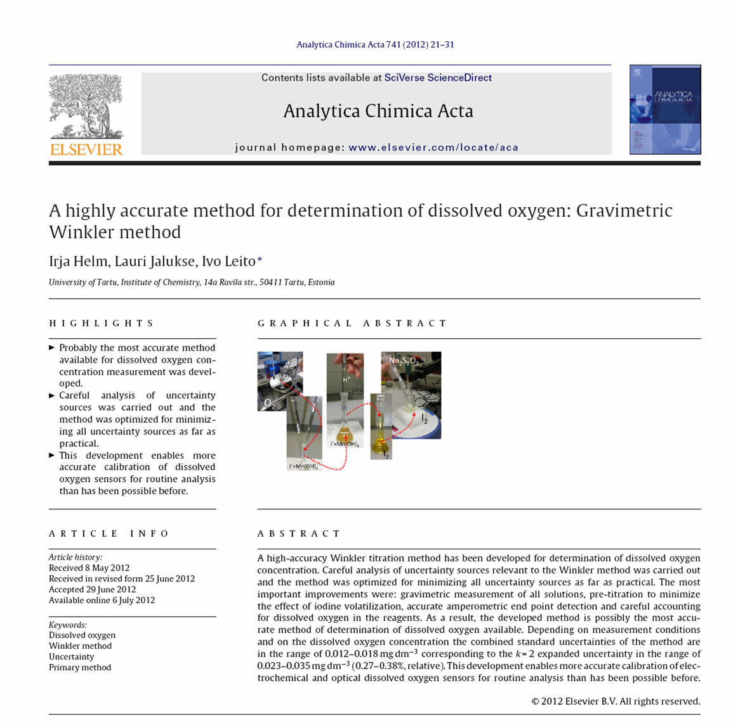
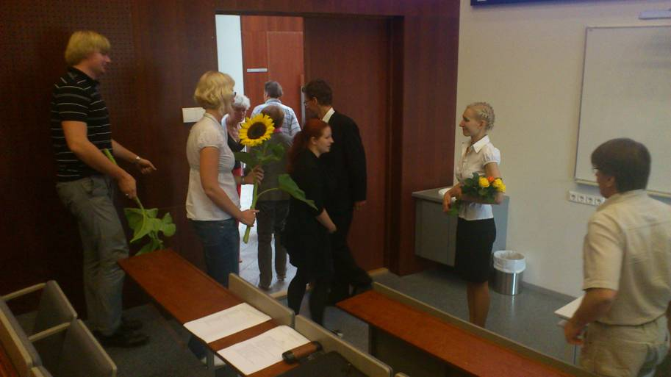

Slide 12
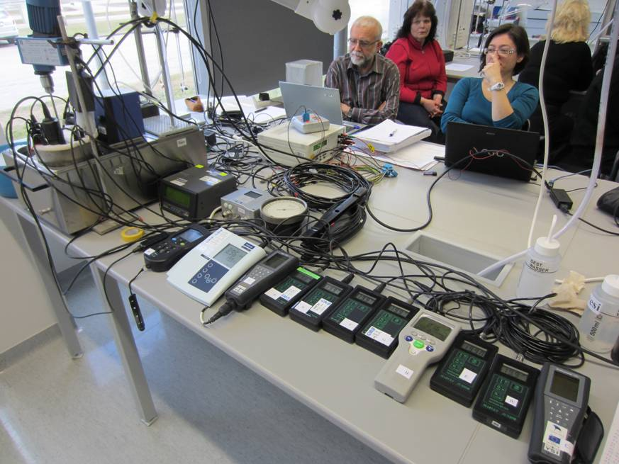
Preliminary Comparison of Dissolved O₂
3
An ILC of O₂ sensors took place at Tartu on 23.03.12
  Amperometric and optical
Estonia, Germany, France, Finland
Report: first draft available
                Interlaboratory Comparison 2014:
7-9 April 2014
© Jere Riikonen

Slide 13
Researcher Excellent Grant
Link to WP 3 : Trace element determination
University of Plymouth, UK (Robert Clough) / IRMM (Christophe Quétel)
Task 1: Uncertainty estimates for iron species in seawater (REG)
Task 2: Mathematical equations for describing contributions
to the overall uncertainty estimate
Task 3: General protocol for trace element uncertainty budget
Task 4: Effect of oceanic parameters on iron dissolution
from atmospheric dust

Slide 14
OCEAN 2: Metrology for key oceanographic observables
OCEAN 1 to fulfil the demand for traceability (includes long-term stability)
Mainly high end facilities to ensure traceability and to give basic relations
Mainly Standard Seawater or natural seawater of standard composition
EMRP Potential research topic (PRT) 2013
Co-authors: as for ENV05 and
F. Salvetat, Ifremer, P. Worsfold, UoP, C. Waldmann, MARUM, Bremen, M.Visbeck, GEOMAR, Kiel, R.Feistel, IOW, R. Pawlowicz, JCS (SCOR/IAPSO/IAPWS)
Dissemination of procedures and guidelines :
Calibration procedures and uncertainty budgets
from national standards down to the sensor in field
Handling and sampling procedures and guidelines
Report on impact of ageing, corrosion, and biofouling caused
by seawater on the measurement capabilities of on-line sensors

Slide 15
OCEAN 2 Potential Research Topics
Potential research topics:
Derivation of relationships for salinity-density-refractive index
Derivation of relationships for speed of sound-pressure
Quantification of equilibrium thermodynamics and dissociation constants
of carbonic acid in seawater
Standards and simplified calibration methods for sum parameters (DOC, DIC, DO)
Traceable calibration methods and uncertainty estimation
(carbonate system,marco nutrients ( N, P), micronutrients (Fe)

Slide 16
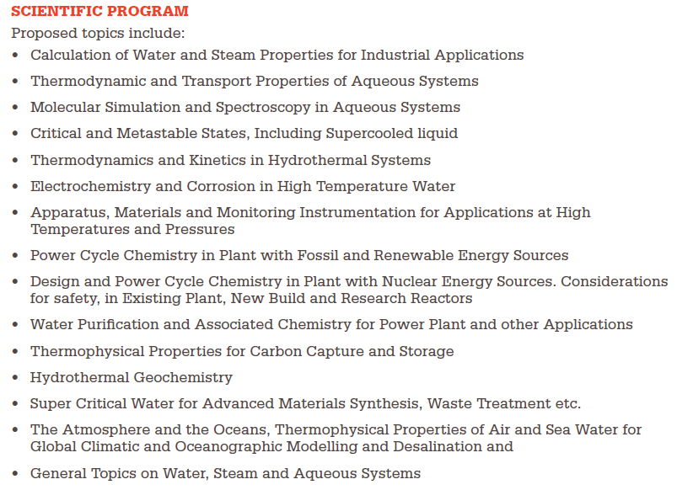
Planned Workshops on Seawater Salinity: R. Pawlowicz/ S. Seitz
Seawater pH: A. Dickson / P.Spitzer
Atmospheric Humidity: O.Hellmuth

Slide 17
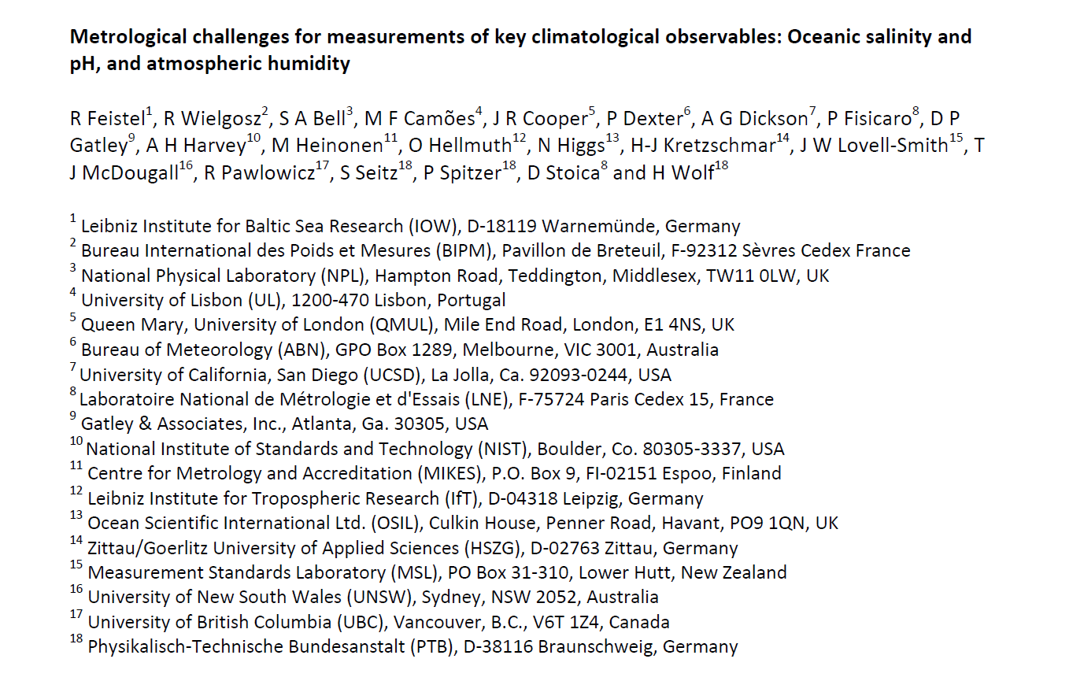
In preparation (Metrologia: 2013..)
Draft 01 March 2013: 78 pages
Work in progress…

Slide 18
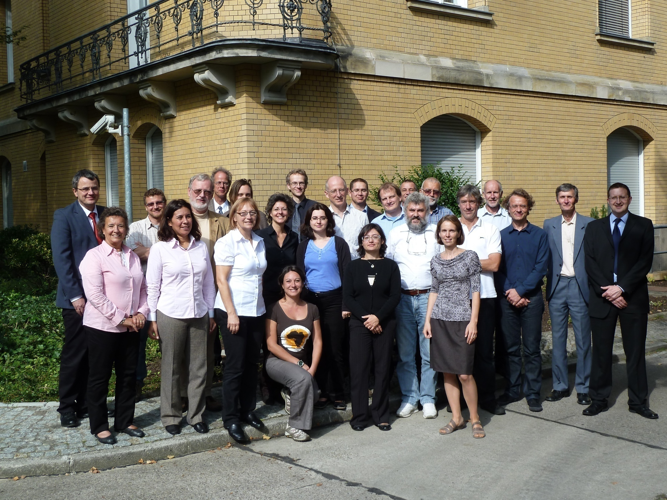
Kick-off Meeting Berlin 20-21. Sept. 2011

Slide 19
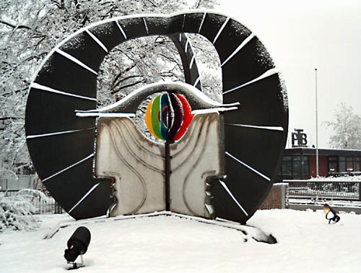

Thank you for your attention !
Physikalisch-Technische Bundesanstalt
Braunschweig and Berlin
petra.spitzer@ptb.de
www.ptb.de
“The EMRP is jointly funded by the EMRP participating countries within EURAMET and the European Union.”

