Slide 1
Estimation of hydraulic conductivity using one dimensional electrical resistivity survey
You-Cheng Chen , Helen Lin, Jui-Pin Tasi, Liang-Cheng Chang,
Chung-Jung Chiang, Chih-Chao Huang, and Jui-Er Chen
National Chiao Tung University, Taiwan
2013.04.08
Notes:
Good afternoon everyone, I am chen you-chang, a phd student in 交通university, Taiwan. Today I want to talk about estimation of hydraulic conductivity using one dimensional electrical resistivity survey

Slide 2
Outline
Introduction
Methodology
Results
Conclusions
Notes:
I will introduce the current problems for estimating hydraulic conductivity, and I will show methodology and results, followed by conclusions

Slide 3
Introduction
Groundwater is an important source of water supply in Taiwan.
Understanding hydrogeological parameters can assist in estimating groundwater resource.
Traditionally, these parameters are obtained using pumping test, but it’s high cost and time consuming.
This study proposes a method, integrating 1D electrical resistivity survey and observation well data, to efficiently estimate hydraulic conductivity.
Notes:
In recent years, groundwater is an important water supply source. But excessive use of groundwater will lead to disaster.
Therefore , Reasonable use of groundwater resources is necessary. And understanding hydrogeological parameters can assist in estimating groundwater resource.
Traditionally, these parameters are obtained using pumping test. but high cost and time consuming, Parameters difficult to be collected.
Hydraulic conductivity is one of these parameters and its value has widest range.
This study proposes a method, integrating 1D electrical resistivity survey and observation well data, to estimate hydraulic conductivity

Slide 4
Methodology – Flowchart
Notes:
First we collect following data 1d electrical resistivity, pore water electrical resistivity and hydraulic conductivity data.
Next, we apply archies law to estimate formation factor, and then we develop the relationship between formation factor and hydraulic conductivity
Finally we use pumping test data to verify our estimation result

Slide 5
Methodology – Formation Factor
Archie’s Law
σ₀ = ασ_{w}ϕ^{-m}
F = σ₀/ σ_{w} = α ϕ^{-m}
σ₀ = Bulk electrical resistivity
σ_{w} = Pore water resistivity
F = formation factor
Notes:
Because formation factor is importment for our study,
So explain more detail for formation factor

Slide 6
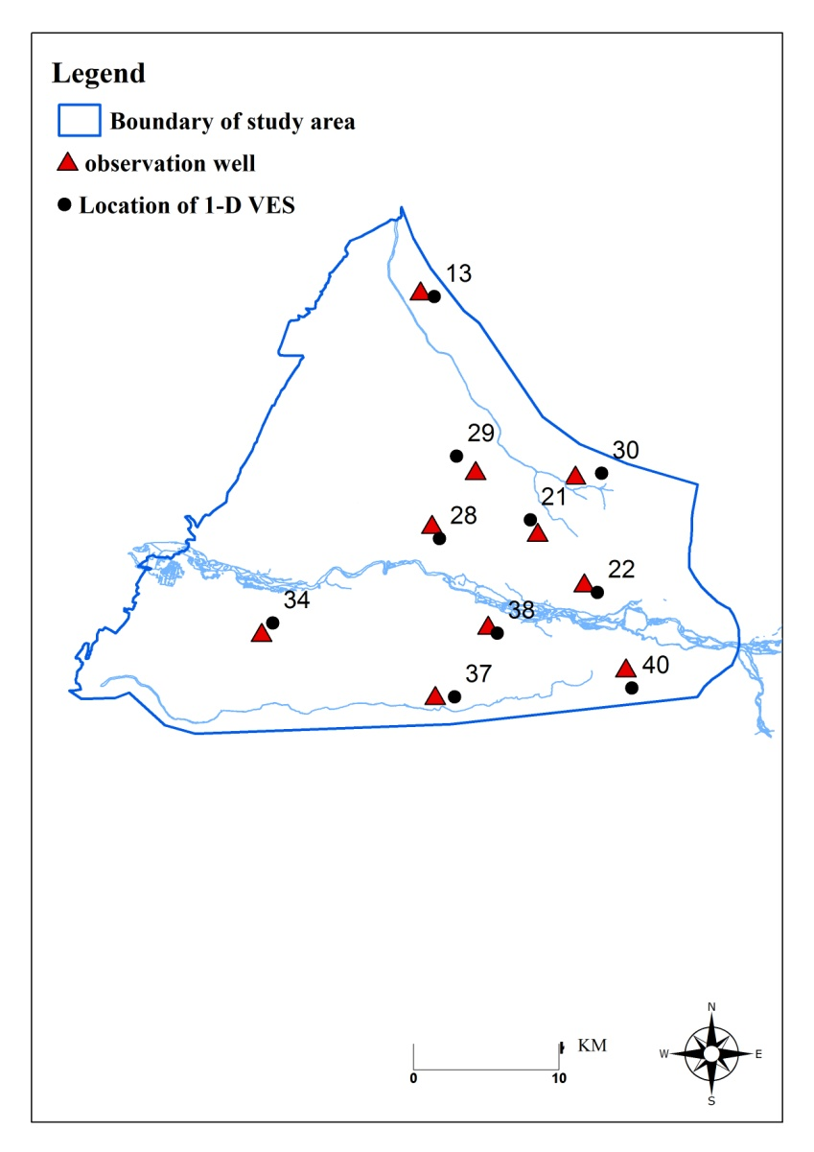
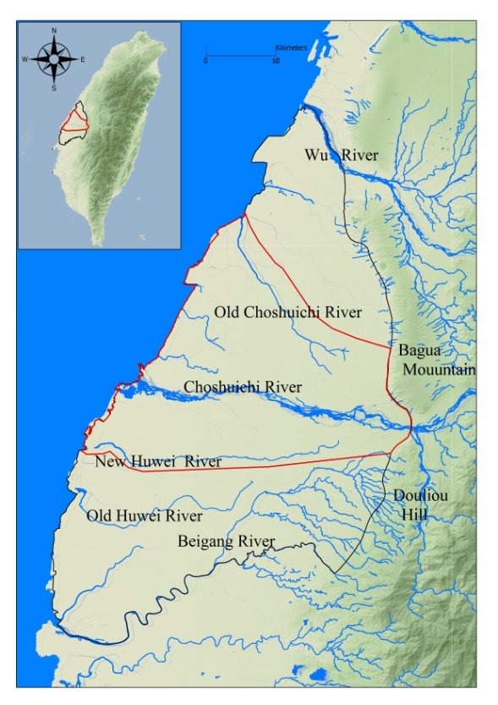
Results - Study Area
Location
In the middle of Taiwan
area：950km²
Notes:
In this study, we choose Chou-Shui River basin for the demonstrative area. It is in central Taiwan and area is 950 kilometers Square.
(右圖) this figure shows the location of electrical resistivity survey

Slide 7
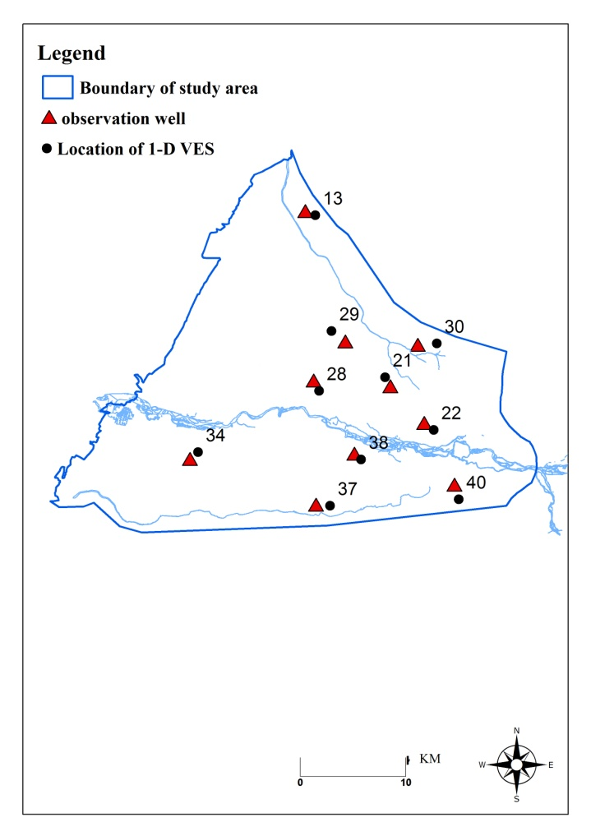
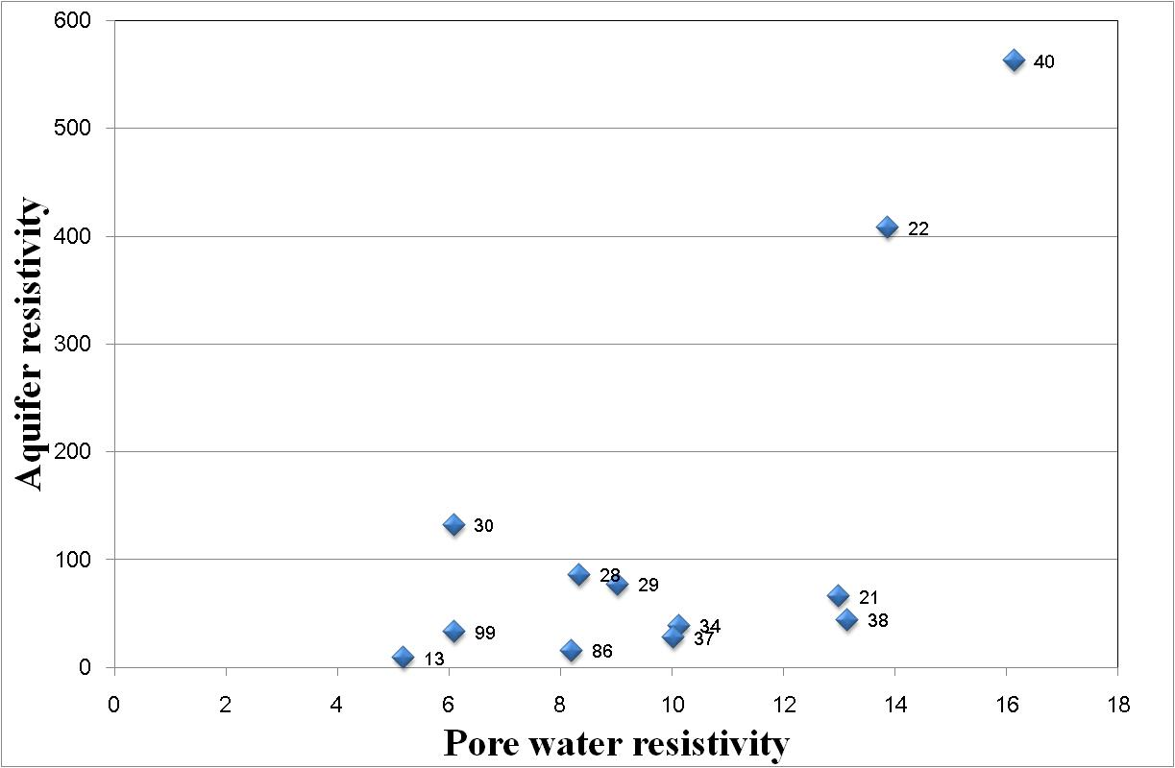
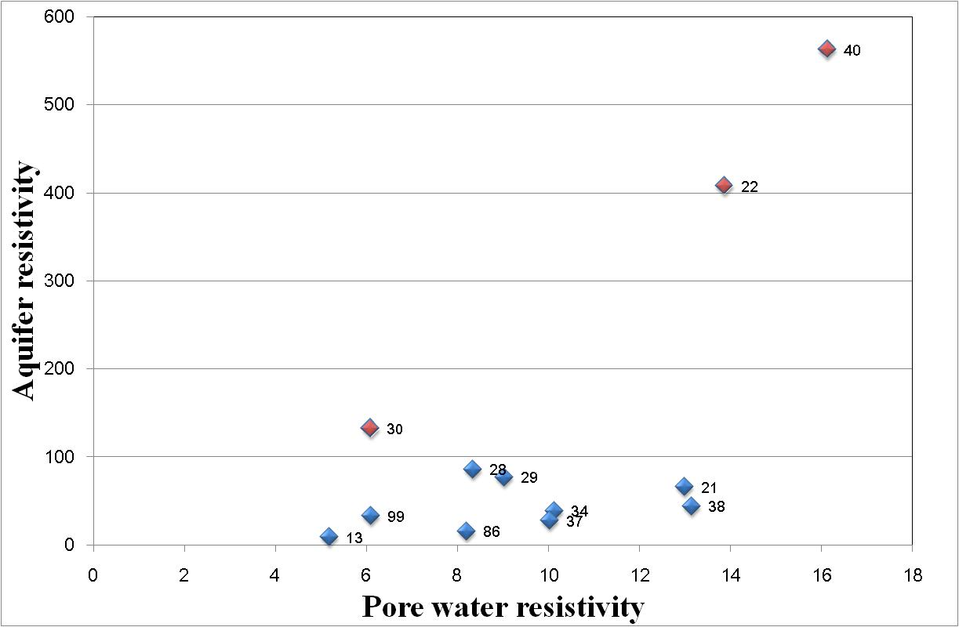
Results – Data analysis
Notes:
The figure is using two resources, one is aquifer resistivity, another is pore water resistivity.
Through initial analysis, we find the data is obviously two trends. We join the geological data to compare.
the points in the red circle locate at gravel layer in the fan top, the upstream area of Chou-Shui River
the points in the blue circle locate at the layer that consists clay and sand outside of fan top.
Following analysis, we separately use two groups data to estimate hydraulic conductivity.

Slide 8
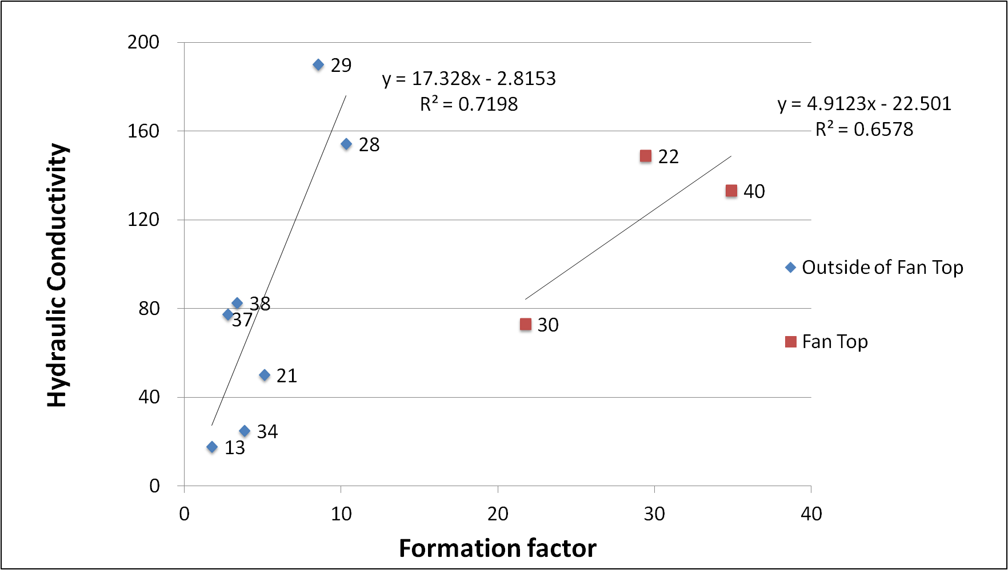
Results – Linear regression equation
Relationship between foramtion factor and hydraulic conductivity
Fan top
K=4.9123F-22.501
Outside of fan top
K=17.328F-2.8153
Notes:
After transform the electrical resistivity to formation factor, we use linear regression to develop the relationship of formation factor nad hydraulic conductivtiy.
And we separately developed the relationship for theses two groups
The results show that fan top equation is K=4.9123F-22.501 , outside of fan top equation is K=17.328F-2.8153

Slide 9
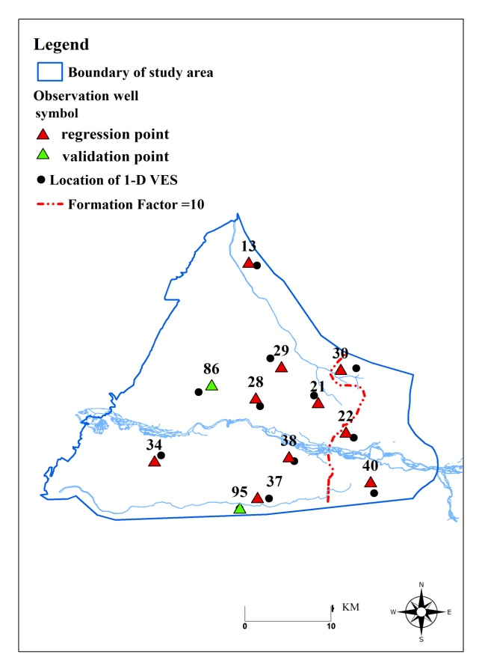
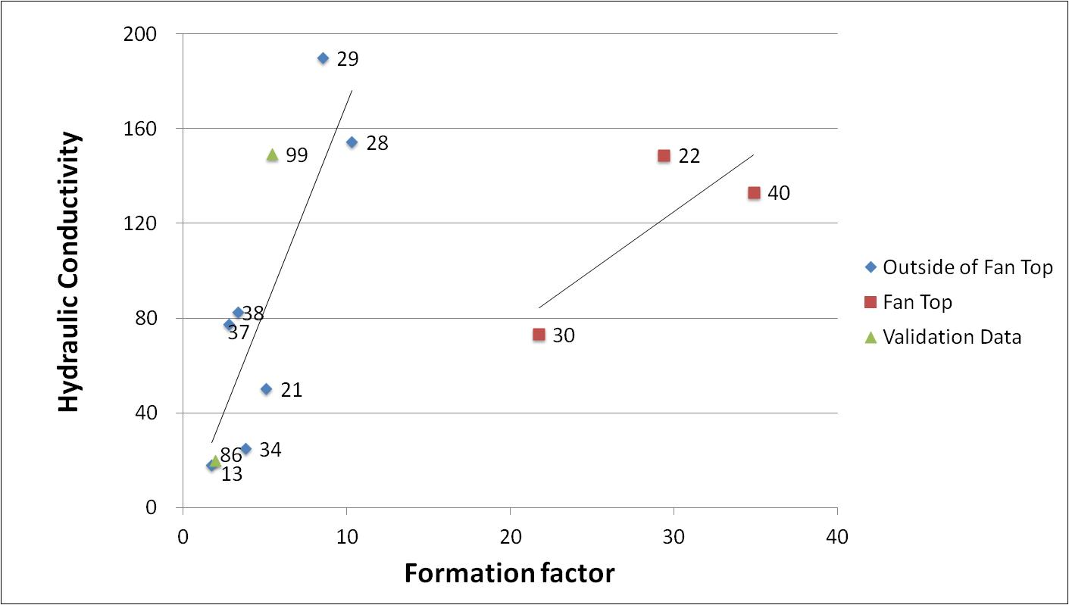
Results – Validation
Two pumping test data set are used to verify the estimation result. The result is close to the regression line.
The validation result is shown that little difference between estimation model and pumping test.
Station | Pumping Test(m/day) | Regression equation(m/day)
86 | 20 | 31
99 | 149 | 91

Slide 10
Conclusion
This study successfully estimates hydraulic conductivity using 1-D electrical survey data along with pumping test data in basin scale.
This study develops two equations to estimate hydraulic conductivity of Chou-Shui River Fan, one is appropriate for fan top (Archie’s condition) and the other is suitable for center fan and fan tail (Extend- Archie’s condition).
The validation results show that the developed method is reliable and feasible.
Notes:
This study successfully using one dimension vertical electrical survey data and pumping test data to estimate hydraulic conductivity.
Two relationship equations in Chou-Shui River Fan. One equation is for fan top, the other is for center fan and fan tail.
The validation results show that the developed method is feasible

Slide 11
Thanks For Your Attention

