Slide 1
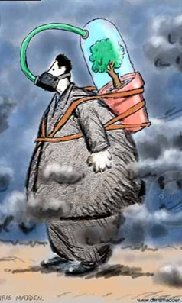
Air-quality in the mid-21st century for the city of Paris. From the regional to the local scale.
7-12 April 2013
Vienna, Austria
EGU General assembly 2013
Session: Climate: Past, Present, Future
8 April
Konstantinos Markakisª
Myrto Valariª
Augustin Colette^{b}
Olivier Sanchez^{c}
Olivier Perrussel^{c}
ªLMD (Laboratoire de Meteorologie Dynamique), IPSL
Ecole Polytechnique, 91128 Palaiseau Cedex
^{b}Institut national de l’environnement industriel et des risques (INERIS), Paris, France.
^{c}AIRPARIF, Surveillance de la qualité de l’air en Île-de-France, Paris, France
Notes:
-Thank hospitality
-introduce yourself
-name of talk, why this title
-word “parametarisation”=boring

Slide 2
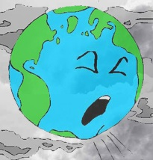
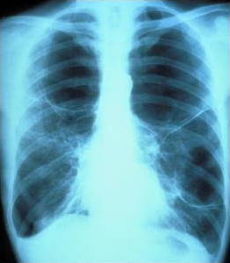
ACHIA
Background in AQ-climate research in Europe
Meleux et al., 2007 AE
Hedegaard et al., 2008 ACP
Katragkou et al., 2011 JGR
Manders et sl., 2012 ACP
Langner et al., 2012a ACP
Climate – GHG’s changes
Ozone increases
LOCAL SCALE
Health impacts are a major concern
The only available information originates from global/regional applications employing global/regional inventories
Climate effects on AQ
Climate + emissions projections (reductions)
RCP’s: Compensation
Langner et al., 2012b ACP
Wild et al., 2012 ACP
Developed for GCMs (range of radiative forcings)
Not developed for AQ studies
Bridging the gap (ACHIA project)
Exploring AQ in the city of Paris performing a 10yr run for the mid-21st century employing a bottom-up inventory and a CTM in 4km resolution
Europe - Ozone decreases
Hotspots – Ozone increases
GEA: Climate + AQ co-benefits
2030
Colette 2012 ACP
2050
Europe - Ozone decreases
Colette 2013 ACPD
Notes:
-Why this dates (to know where we are in time)
-Why start from 1991. nothing before (small pieces that where far from creating a solid parametarisation)
-all these from specific tree species

Slide 3
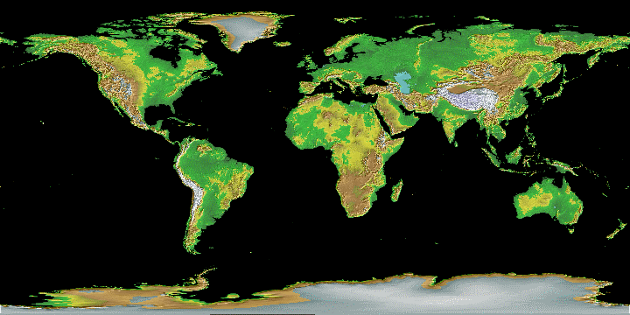
ACHIA
Modelling framework
GCM: IPSL-CM5A-MR (2.5ºx1.25º)
GCTM: LMDz-INCA (3.75ºx2.5º) (Szopa et al., 2012)
Forcing: RCPs: 2.6-MIT and 8.5-REF (Riahi et al., 2011)
Offline coupling
RCM: WRF (0.5º) (Menut et al., 2012; Vautard et al., 2012)
CTM: CHIMERE in 0.5º (~50km) with 8 VL (Colette et al., 2012a)
GEA emissions: MIT, REF (Colette et al., 2012b)
MIT (more optimistic, AQ legislation + climate policy).
REF (less optimistic, AQ legislation, no climate policy).
Offline coupling
RCM: WRF (0.1º)
CTM: CHIMERE in 4km with 12 VL
Continuous 10 year simulation (1995-2004 and 2045-2054)
Airparif inventory: 2 consistent scenarios
1km resolution, explicit quantification of more than 50 anthropogenic activities in the region, 600 point sources
Notes:
-Why this dates (to know where we are in time)
-Why start from 1991. nothing before (small pieces that where far from creating a solid parametarisation)
-all these from specific tree species

Slide 4
ACHIA
Laboratoire de Meteorologie Dynamique
Rationale
1) Using the Regional and the Local scale applications we intent to investigate the differences that arise in mid-21st century AQ projections when implementing bottom-up emissions and a higher resolution.
quality of the emission inventory
limitations of the projection approach
modelling effects (e.g. resolution)
2) How will air-quality look like at 2050 in Paris?
Notes:
-Why this dates (to know where we are in time)
-Why start from 1991. nothing before (small pieces that where far from creating a solid parametarisation)
-all these from specific tree species

Slide 5
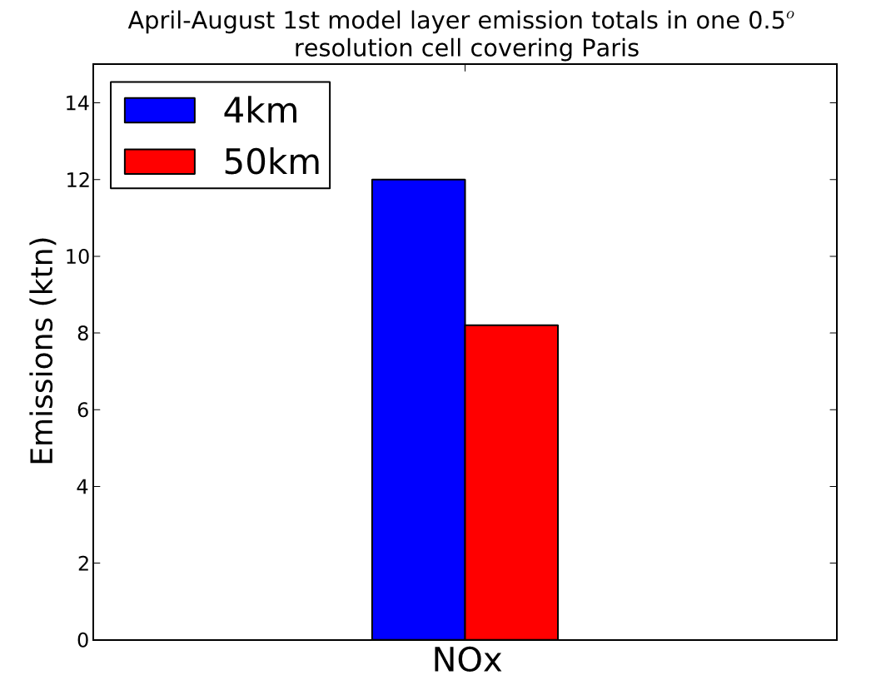
Emission inventory: Regional vs. local
ACHIA
Emissions inventories developed in global/regional scale can be erroneous when describing emission hotspots (Butler et al., 2008 AE and 2012 ACP; Colette et al., 2012a ACP)
Notes:
-Why this dates (to know where we are in time)
-Why start from 1991. nothing before (small pieces that where far from creating a solid parametarisation)
-all these from specific tree species

Slide 6
ACHIA
Laboratoire de Meteorologie Dynamique
Emission inventory: Projections
Emission projections developed for global/regional applications maybe also unrepresentative for a city
We use a hybrid methodology to project the local scale emissions to 2050
1st element Short term: Local experts REF for 2020
2nd element
Long term: coefficients extracted from the MIT / REF GEA national totals for France
Future Emissions for Paris:
2 pathways
Notes:
-Why this dates (to know where we are in time)
-Why start from 1991. nothing before (small pieces that where far from creating a solid parametarisation)
-all these from specific tree species

Slide 7
ACHIA
Laboratoire de Meteorologie Dynamique
Emission inventory – projections
We use the national totals because GEA uses a spatial algorithm to distribute future emissions for which emissions in urban centers are reduced more rapidly than in rural areas.
This produces a very clean Paris
Climate policy benefit
Climate policy benefit
Notes:
-Why this dates (to know where we are in time)
-Why start from 1991. nothing before (small pieces that where far from creating a solid parametarisation)
-all these from specific tree species

Slide 8
ACHIA
Evaluation O3 – daytime (April - August)
-18.2% bias in ozone during episodes
Episodically produced ozone is more sensitive to meteorology
Lower NOx
NOx dilution
Notes:
-Why this dates (to know where we are in time)
-Why start from 1991. nothing before (small pieces that where far from creating a solid parametarisation)
-all these from specific tree species

Slide 9
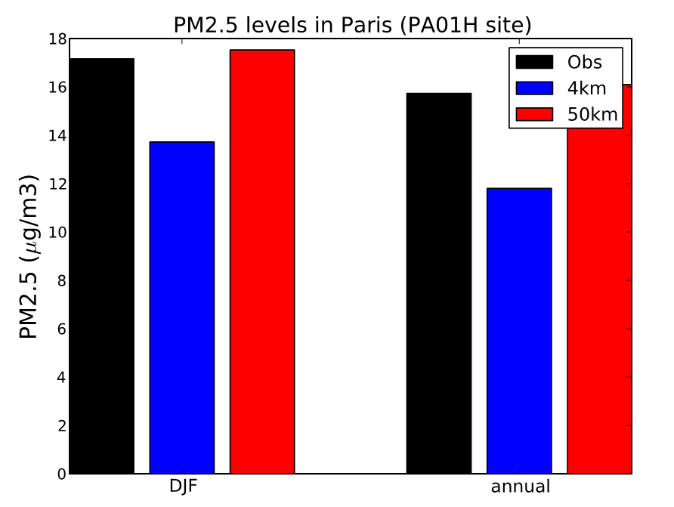
ACHIA
Laboratoire de Meteorologie Dynamique
Evaluation PM_{2.5}
Notes:
-Why this dates (to know where we are in time)
-Why start from 1991. nothing before (small pieces that where far from creating a solid parametarisation)
-all these from specific tree species

Slide 10
ACHIA
Laboratoire de Meteorologie Dynamique
Rationale
How will air-quality look like at 2050 in Paris?
Notes:
-Why this dates (to know where we are in time)
-Why start from 1991. nothing before (small pieces that where far from creating a solid parametarisation)
-all these from specific tree species

Slide 11
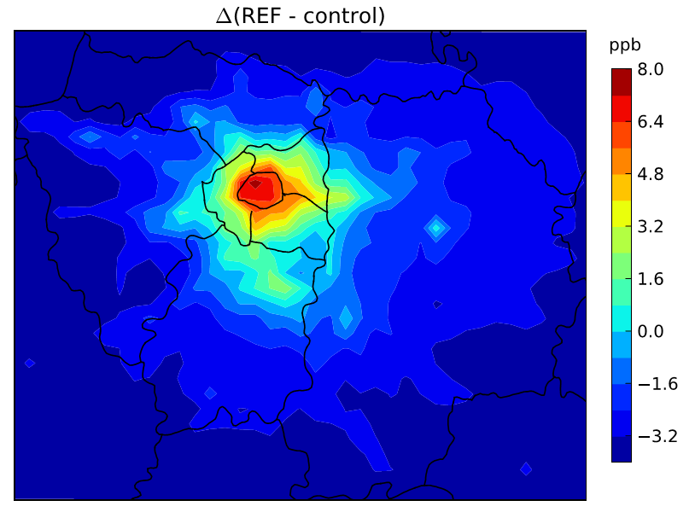
ACHIA
Laboratoire de Meteorologie Dynamique
Mid-21st century in Paris – O3 “reference” scenario
2020: Roustan et al., 2011 AE
2030: Colette et al., 2012 ACP
Ozone increases
4km:+7 ppb
4km:-3 ppb
50km: -5.6 ppb
T2: +0.9 K
50km: -4.5 ppb
isop: +16%
In the 4km simulation Paris stays strongly VOC-limited.
REF scenario of GEA shows very large reductions of NOx but also for VOCs. It uses the spatial algorithm leading to large reductions in the cities
SOMO35 increases by 70% in the city
Notes:
-Why this dates (to know where we are in time)
-Why start from 1991. nothing before (small pieces that where far from creating a solid parametarisation)
-all these from specific tree species

Slide 12
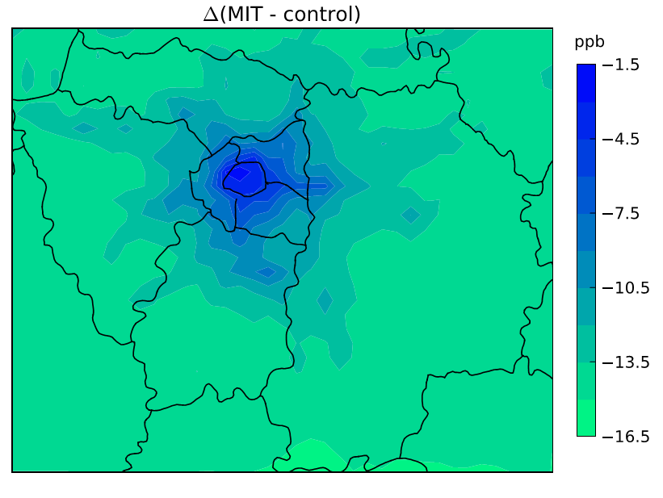
ACHIA
Laboratoire de Meteorologie Dynamique
Mid-21st century in Paris – O3 “mitigation” scenario
Tarasson et al., 2003
Beekmann and Vautard, 2010
4km: -2.9 ppb
4km:-14.3 ppb
More NOx sensitive
50km: -16 ppb
T2: -0.6 K
50km: -10.7 ppb
isop: -24.5%
4km shifts to more NOx limited environment but apparently too late.
MIT scenario of GEA shows very large reductions of NOx but also for VOCs. It uses the spatial algorithm leading to large reductions in the cities
SOMO35 decreases by 83%.
Notes:
-Why this dates (to know where we are in time)
-Why start from 1991. nothing before (small pieces that where far from creating a solid parametarisation)
-all these from specific tree species

Slide 13
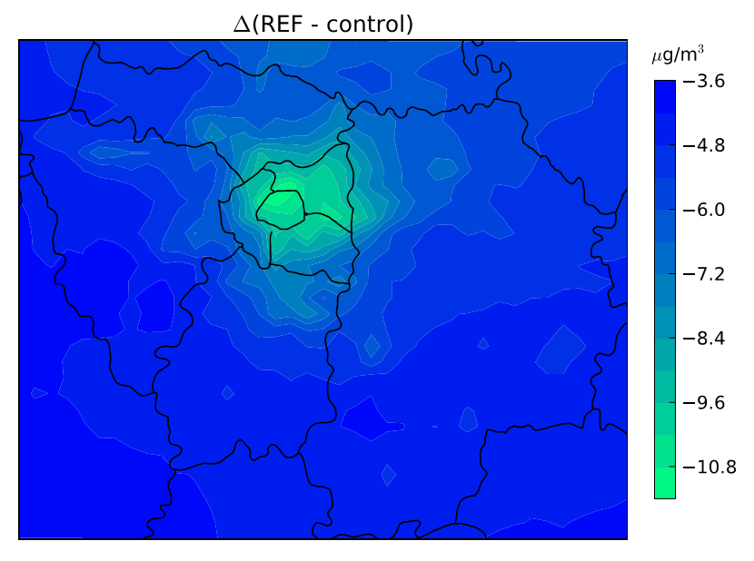
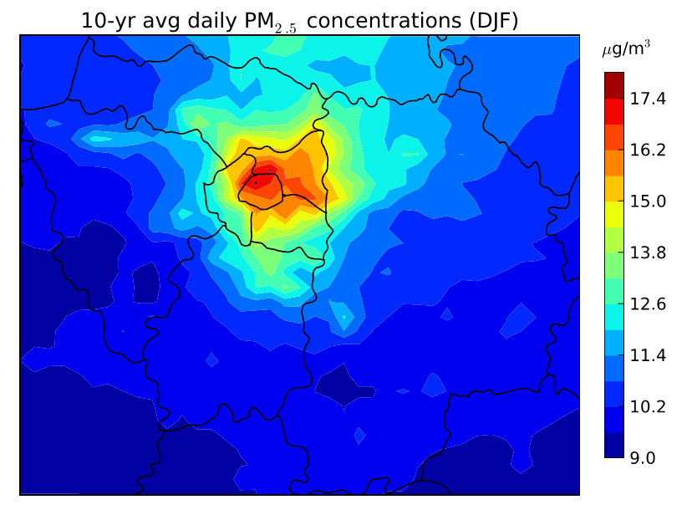
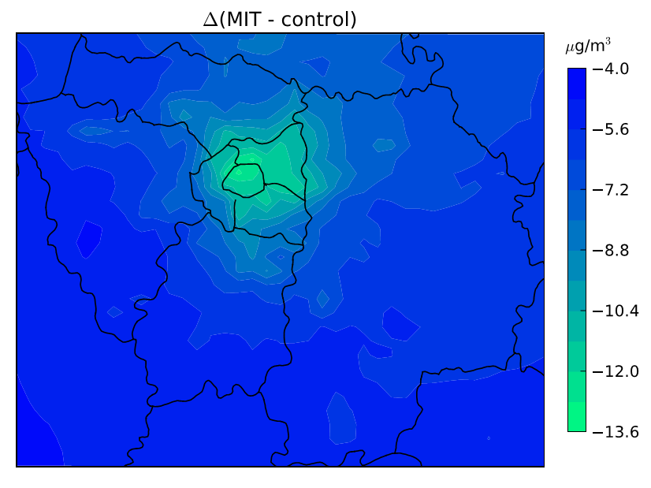
ACHIA
Laboratoire de Meteorologie Dynamique
Mid-21st century in Paris – PM2.5
Notes:
-Why this dates (to know where we are in time)
-Why start from 1991. nothing before (small pieces that where far from creating a solid parametarisation)
-all these from specific tree species

Slide 14
Thank you for your attention!
ACHIA
Laboratotie de Meteorologie Dynamique

