Slide 1
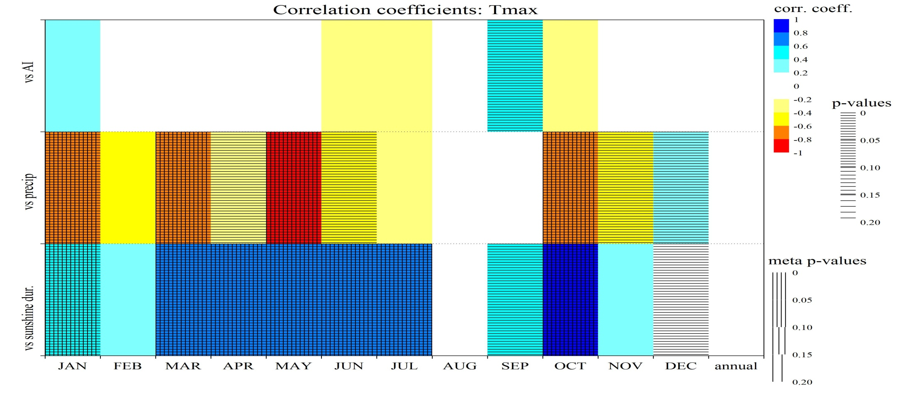
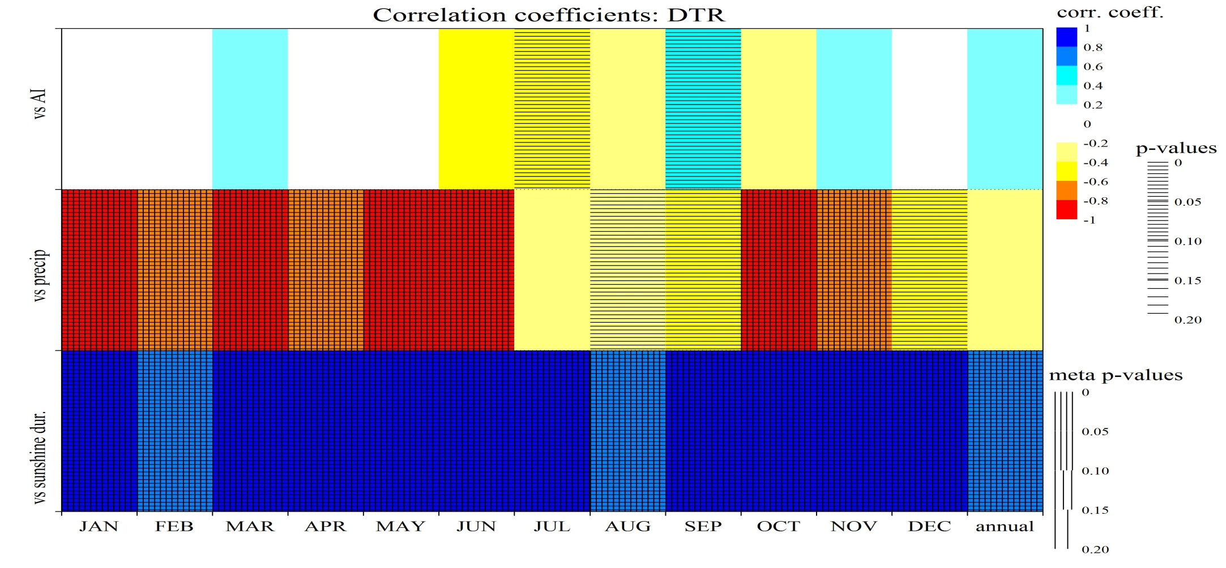
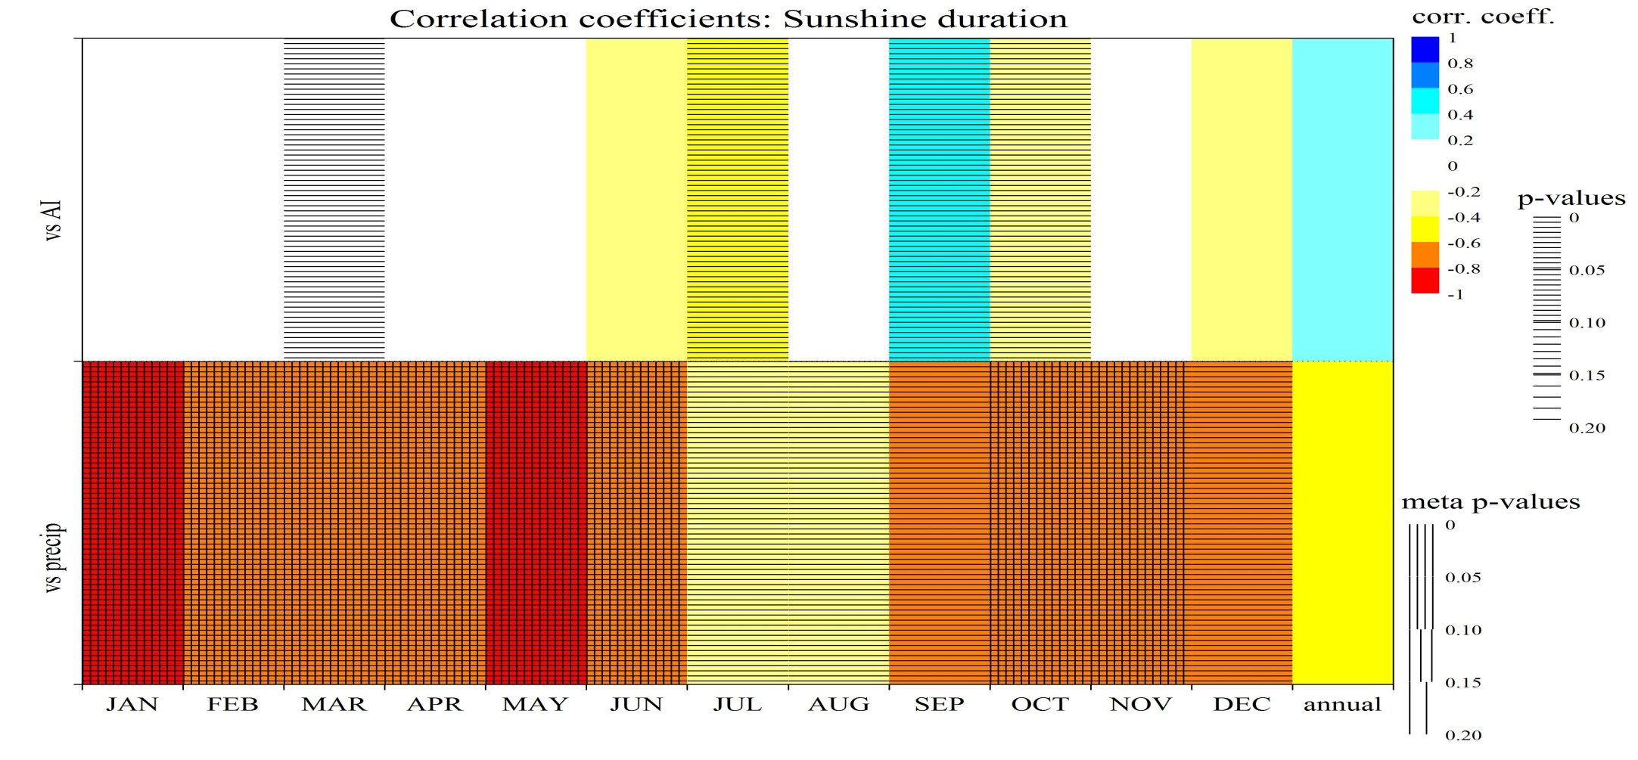
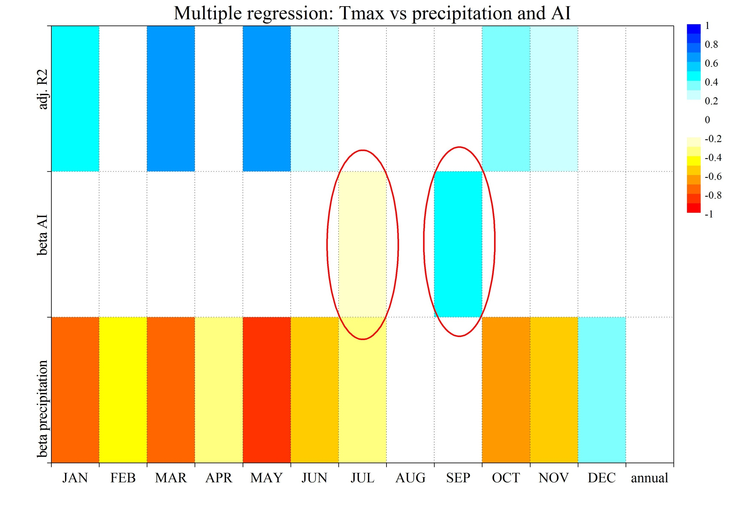
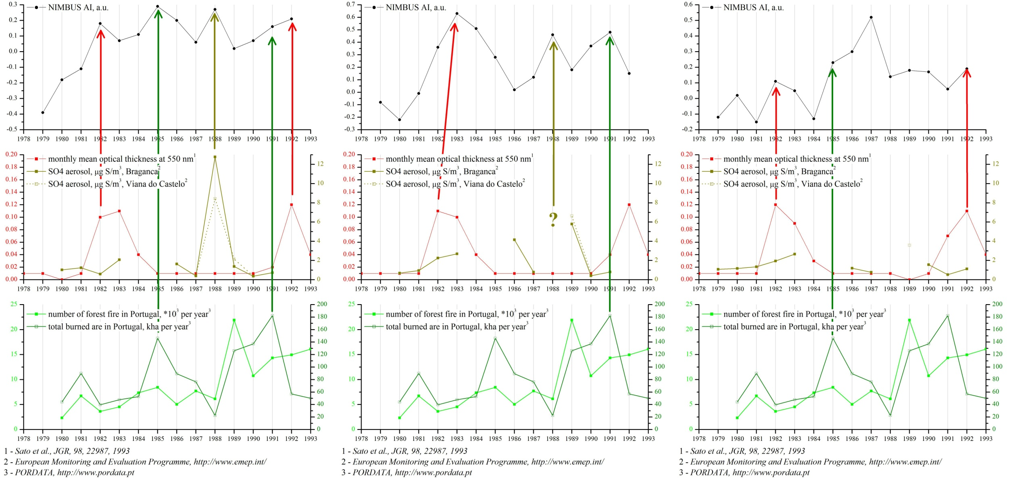
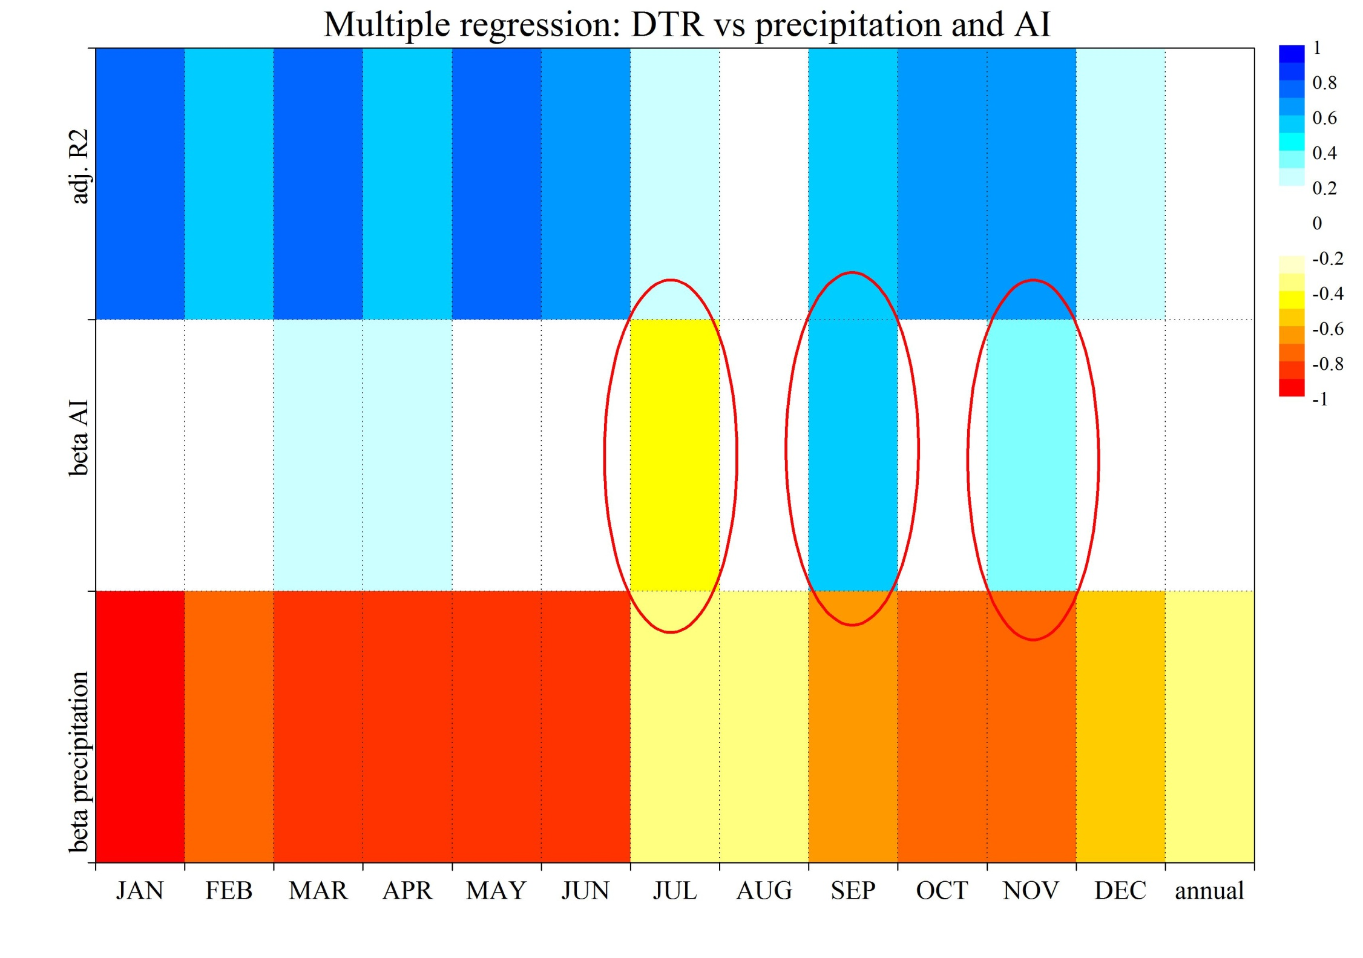
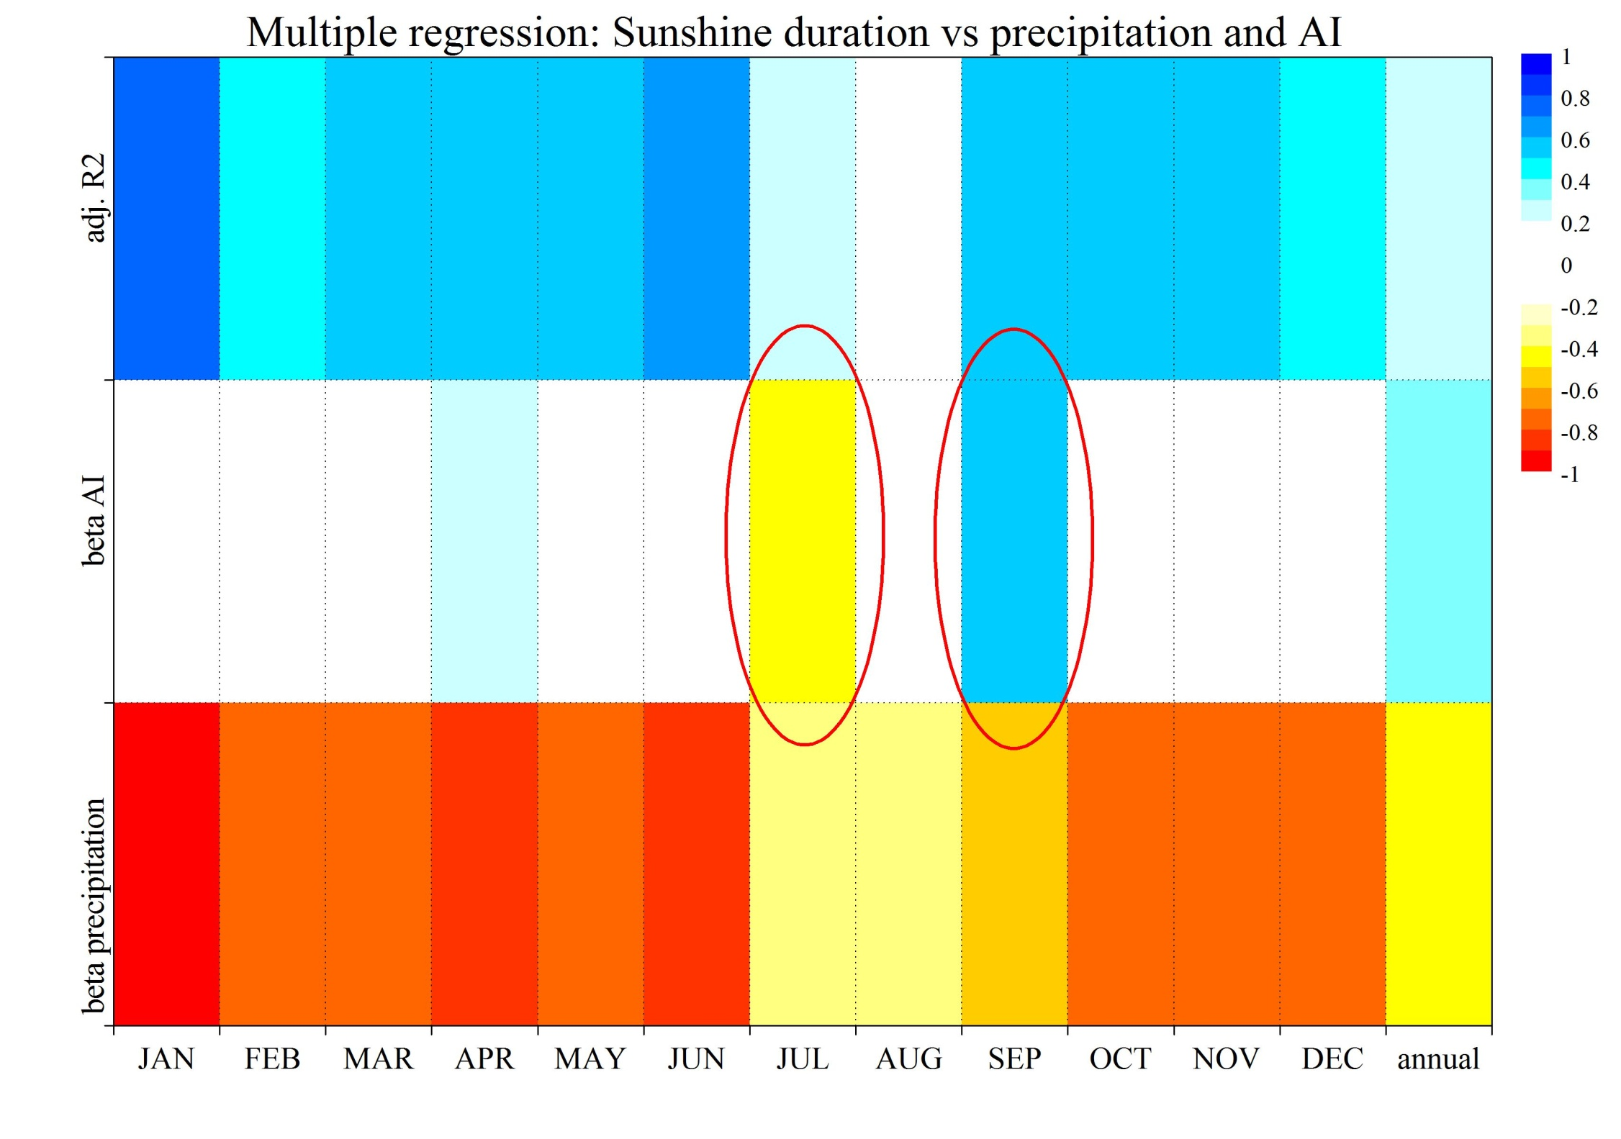
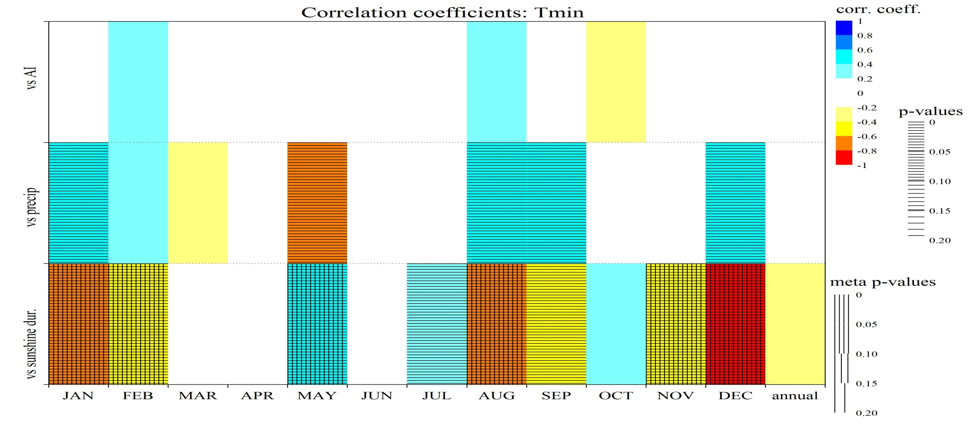
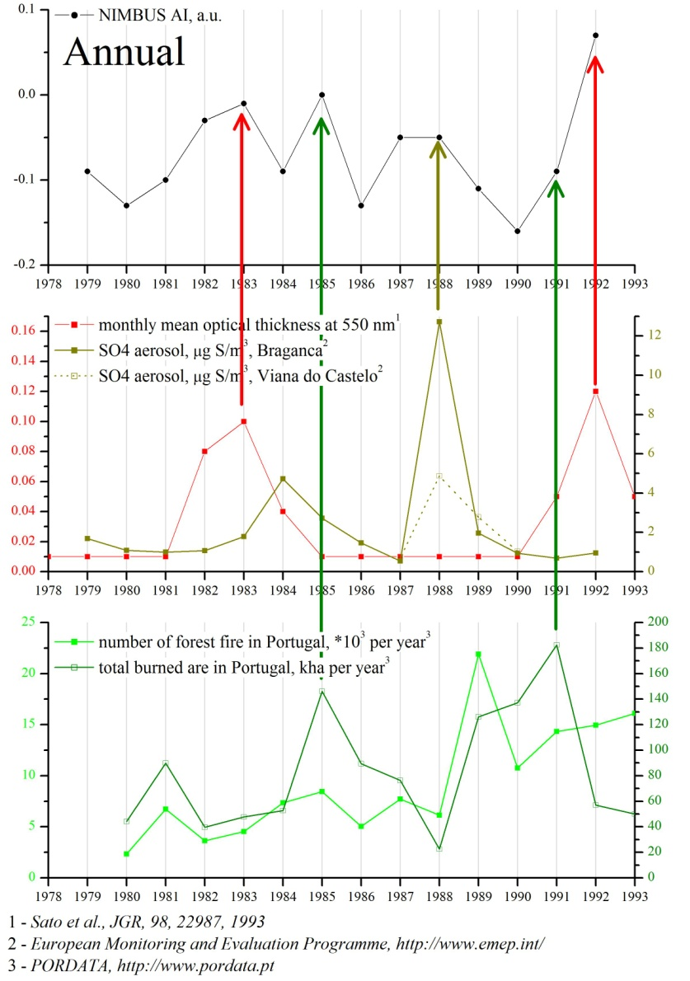
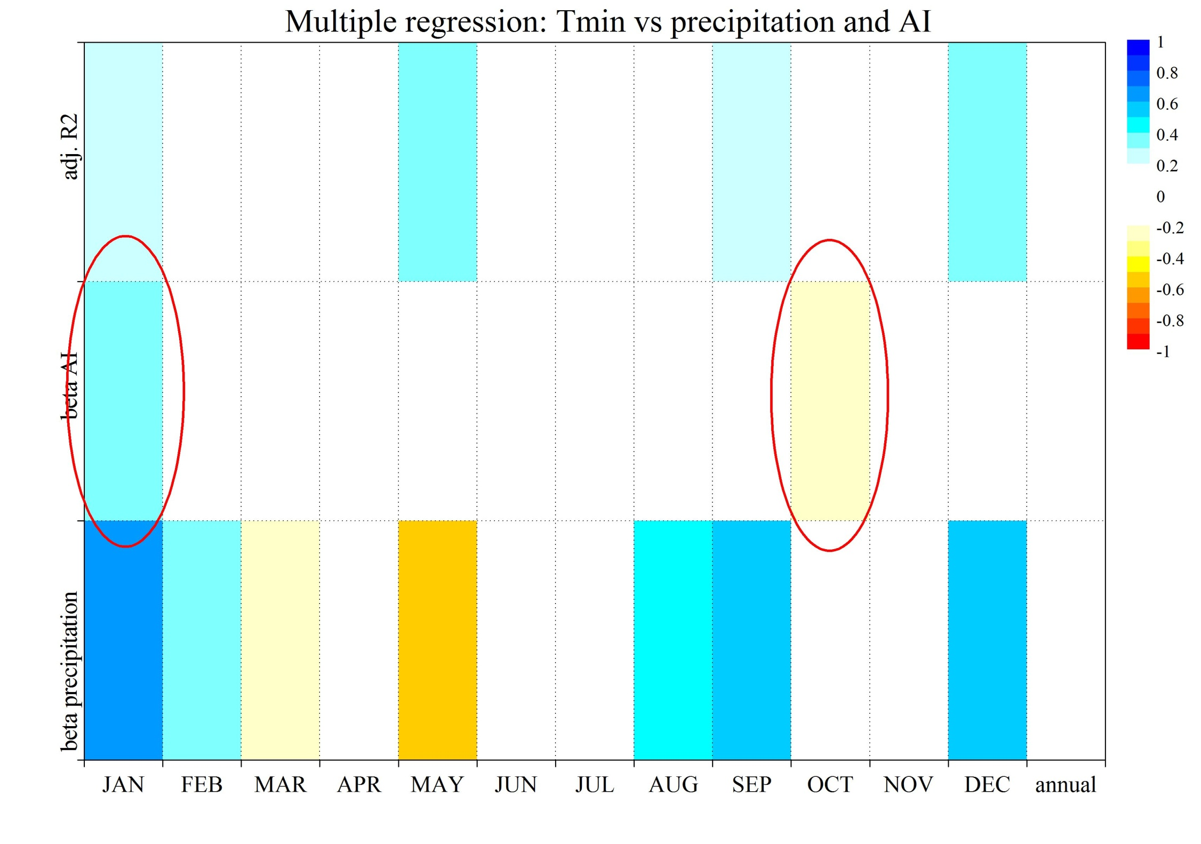
EGU2013-7661
The role of aerosol forcing in the variations of Portuguese temperature parameters
A. Morozova (1), I. Mironova(2)
(1) Centro de Geofísica da Universidade de Coimbra, University of Coimbra, Coimbra, Portugal (anna_m@teor.fis.uc.pt)
(2) St. Petersburg State University, Institute of Physics, St. Petersburg, Russia (irini.mironova@gmail.com)
Data and methods: time period: 1978.11.01-19993.05.06
Aerosol index (AI) from NIMBUS satellite – daily and monthly/annual around 2 places in Portugal
Sunshine duration, total precipitation during 24h, daily Tmin, Tmax and diurnal temperature range (DTR) measured at Coimbra IGUC station (Portugal) – daily, monthly/annual
Monthly mean optical thickness at 550 nm shows volcanic forcing - Sato et al., JGR, 98, 22987, 1993
SO4 aerosol, μg S/m³ , from European Monitoring and Evaluation Programme (http://www.emep.int/)
Data on forest fires in Portuga (PORDATA, http://www.pordata.pt)
Correlation analysis. Significance is calculated by Monte-Carlo methods both for singular (p-value) and multiple comparison (meta p-value).
Multiple regression models (best subset, maximized adj.R² – explained variance) - β coefficients show the magnitude of the relative contribution of each independent variable in the prediction of the dependent variable.
Aerosol sources Insolation control Insolation Temperature parameters
factors
Cloudiness-precipitation
Others
Forest fire
Volcanic dust & aerosols
Air pollution
Aerosols
Sunshine duration
Tmin
Tmax
DTR
Others
June July August
Figure 4
Figure 6
Figure 1
Figure 3
Temperature:
Tmax strongly depends on sunshine duration, cloudiness (↔ precipitation) and depends on at least in September. Regression models of Tmax include AI for July and September – Fig. 4.
For some months (mainly, in winter) Tmin anti-correlates with sunshine duration and cloudiness (↔ precipitation) but almost does not depend on AI. Multiple regression models of Tmin include AI only for January and October, but explained variance (adj. R²) is still very small – Fig.5.
DTR strongly and significantly correlates with sunshine duration, anti-correlates during most of the year with precipitation and has significant correlation coefficients with AI for July and September (same as Tmax!). Multiple regression models of DTR include AI for July, September and November – Fig. 6
Aerosols:
AI shows strong dependence on
volcanic activity (eruptions of El Chichon - 1982 & Pinatubo – 1991 are seen in AI)
air pollution presented here by measurements of SO4 aerosols
forest fires – increase of the number of fires and burned area corresponds to the increase in AI
This dependence exists both on monthly (especially, summer months) and annual scale - see Figs. 1-2.
Sunshine duration:
Monthly/annual precipitation is a proxy for amount of clouds during the same period
Sunshine durations is controlled mainly by cloudiness but also by AI
Sunshine duration strongly anti-correlates with precipitation amount for all months except summer
Only three months show significant dependence of the sunshine duration on AI (Fig. 3, top)
Multiple regression analysis shows the importance of the AI for sunshine duration variations for July and September: the AI and precipitation have comparable β values (Fig. 3, bottom).
Figure 2
Figure 5
Conclusions:
Daily Temperature Range strongly depends on sunshine duration
Sunshine duration depends, mostly, on cloudiness presented in this study by precipitation amount
For some months (July and September) there is more weak dependence of the sunshine duration on Aerosol Index.
Regression analysis confirms the dependence of DTR and sunshine duration on Aerosol Index.
The dependence of DTR on sunshine duration caused, most probably, by variations of maximum daily temperature (Tmax): clouds (and aerosols) limit the amount of downward solar radiation.
In turn, aerosol content variations show the influence of volcanic eruptions, local air pollution and forest fires
The work is done in the frame of SFRH/BPD/74812/2010 project

