Slide 1
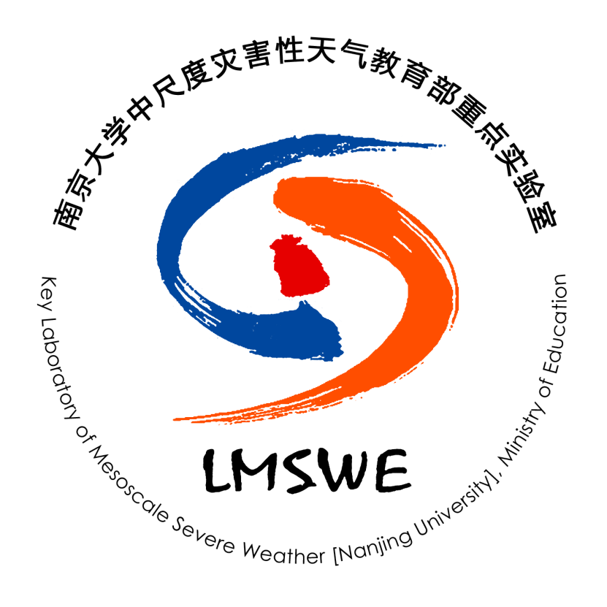
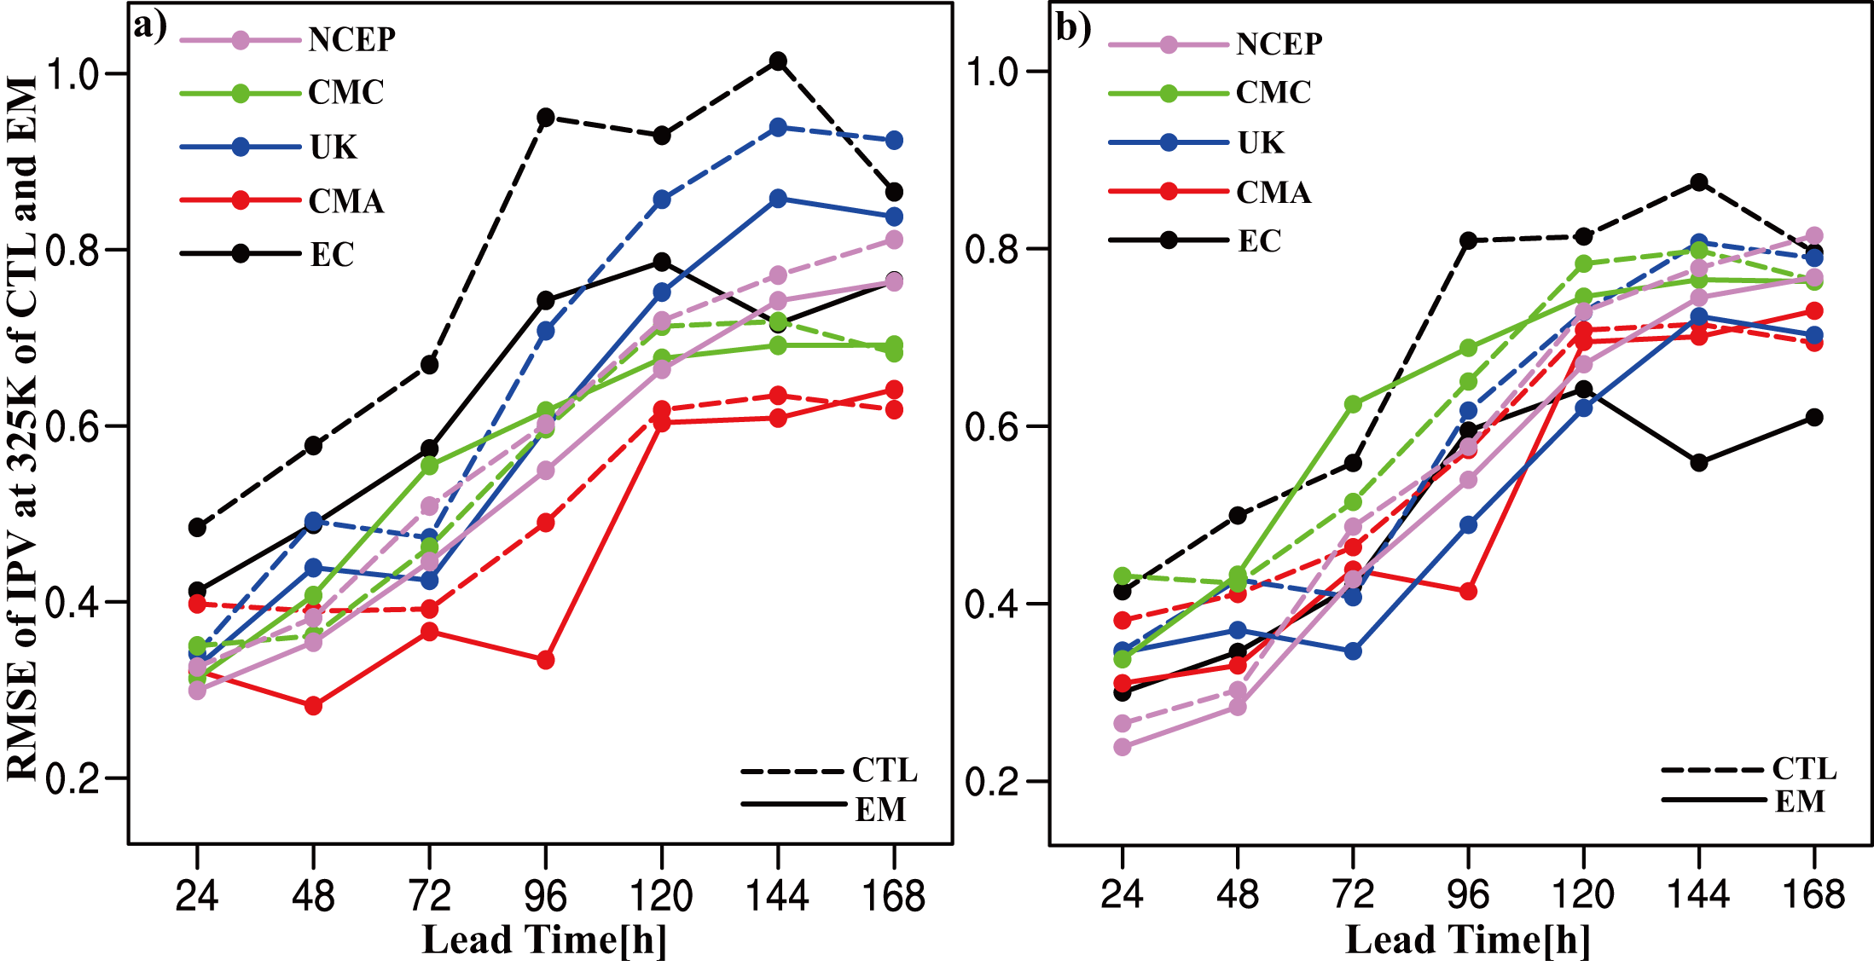
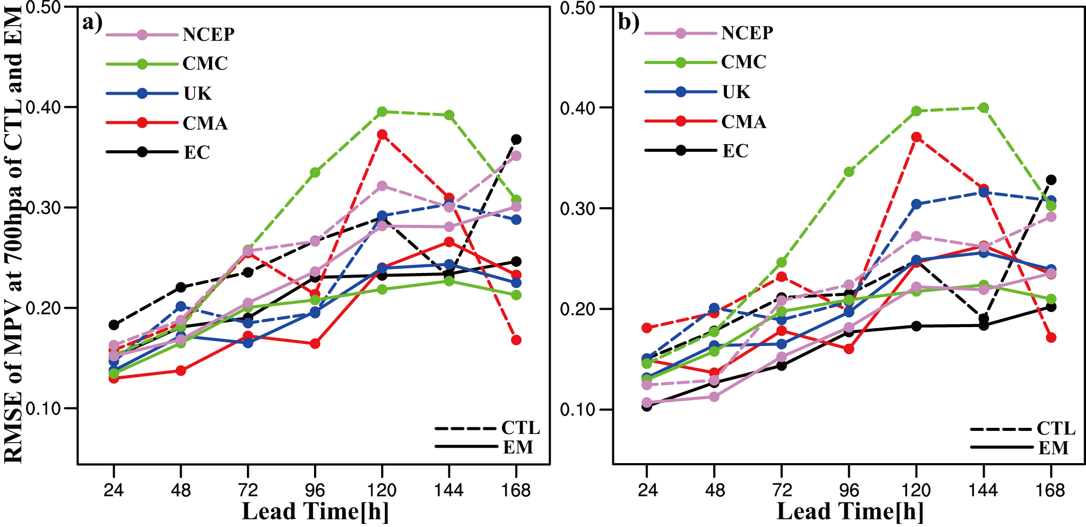
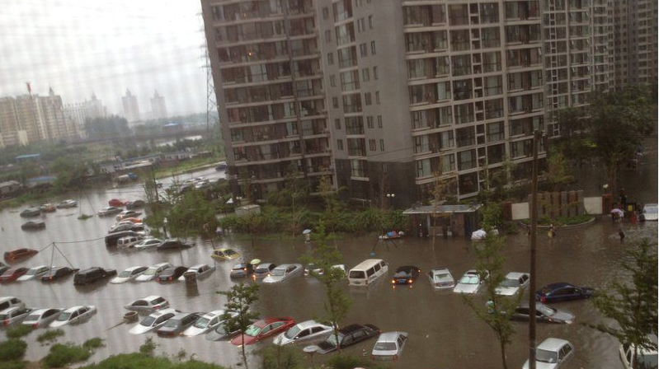
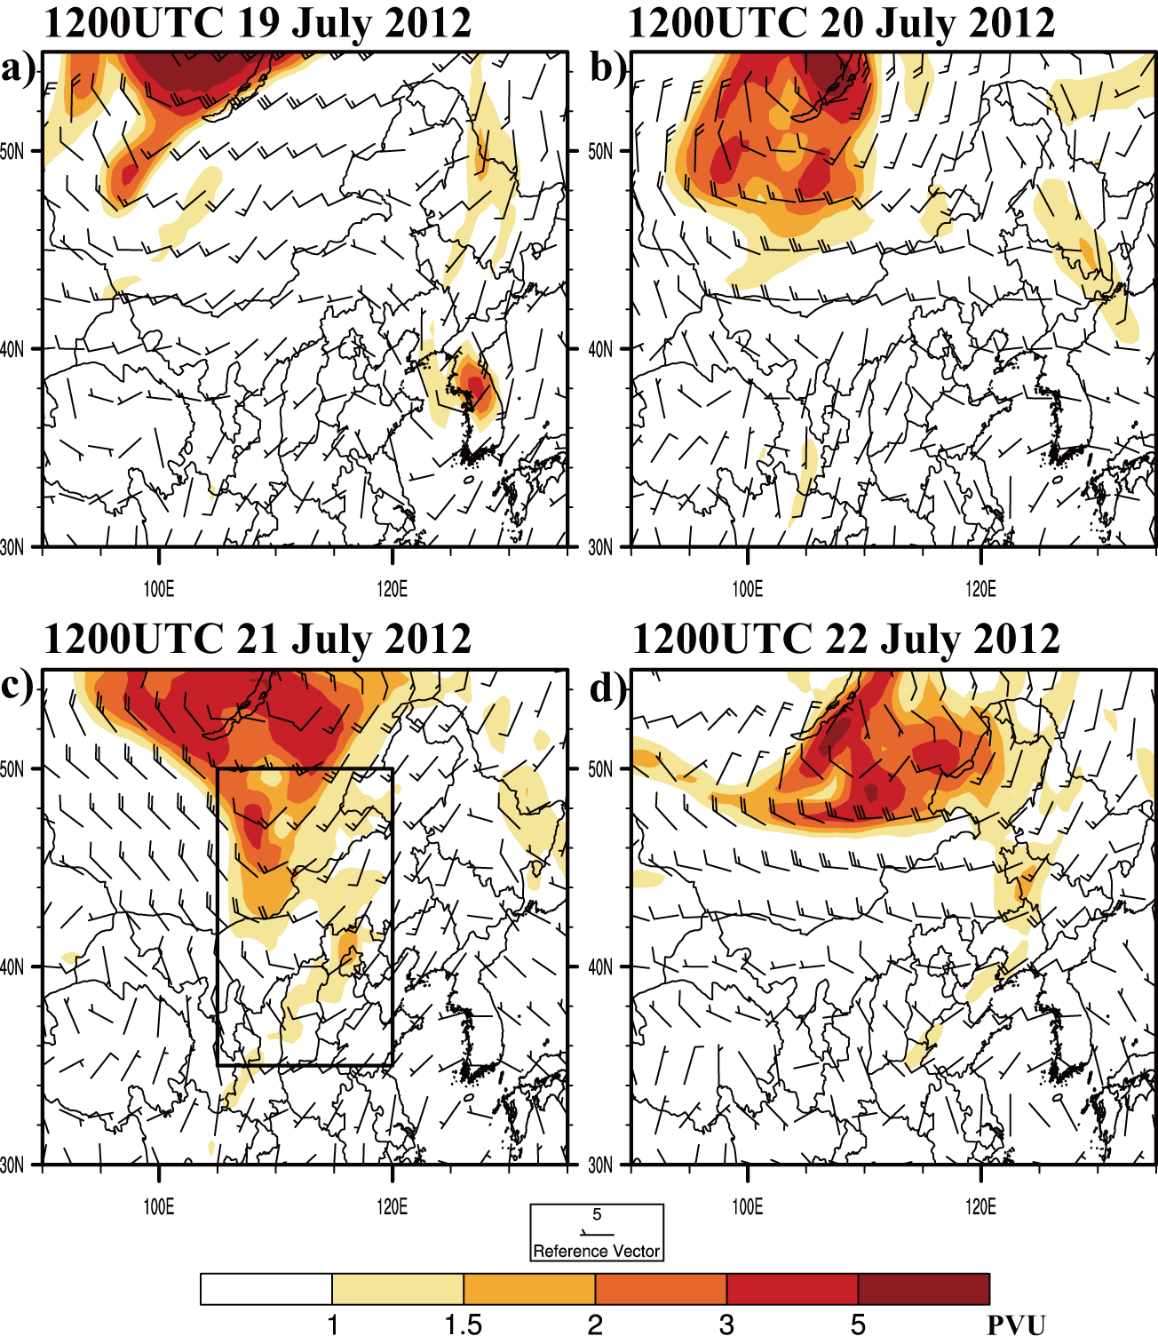
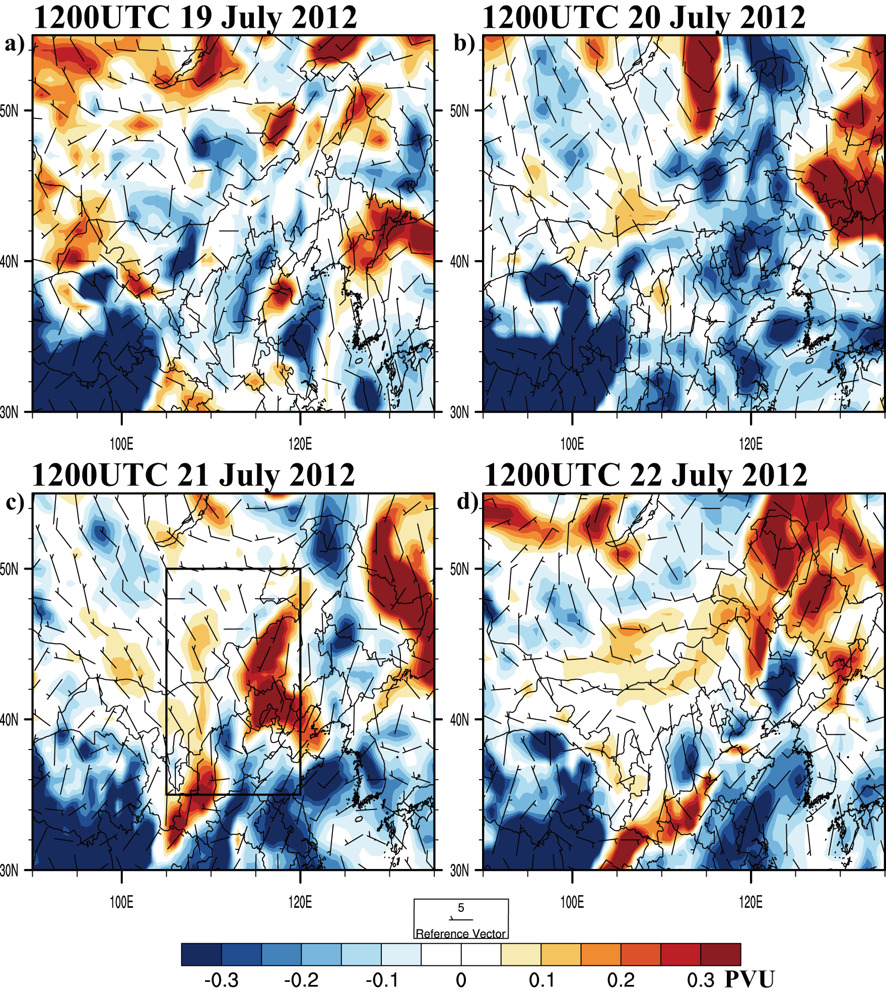
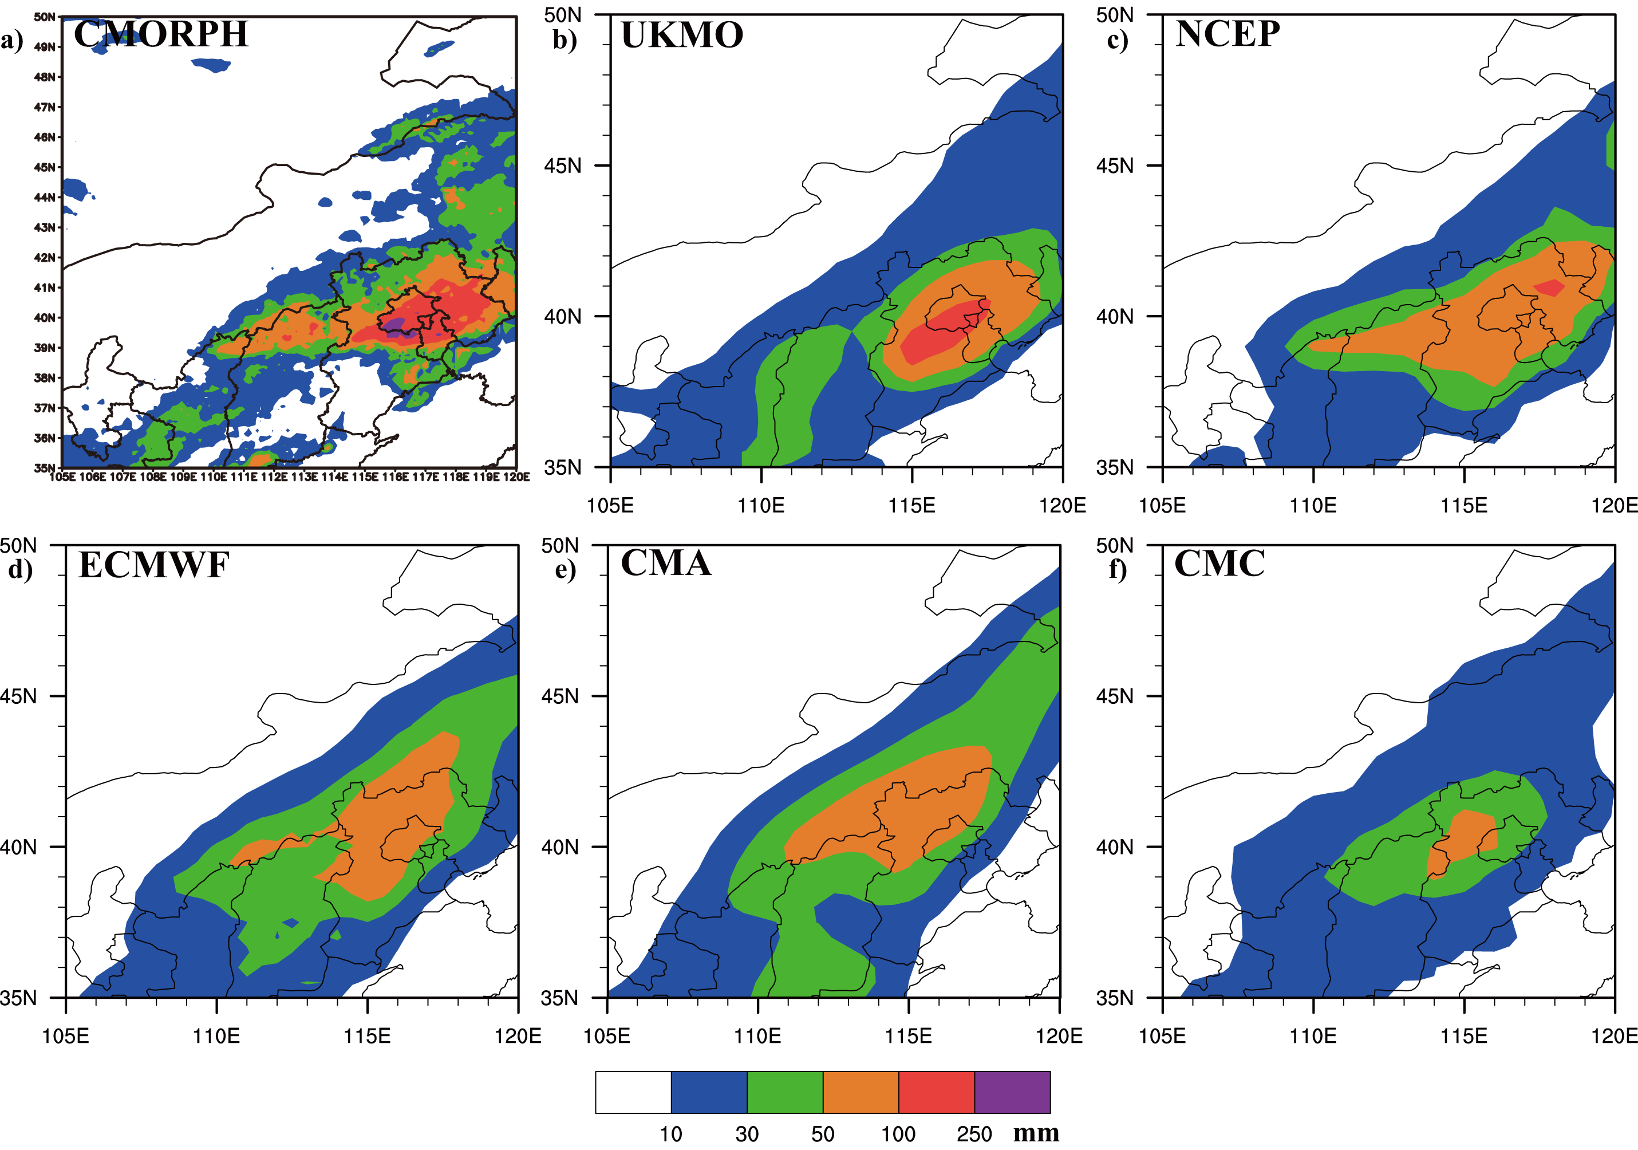
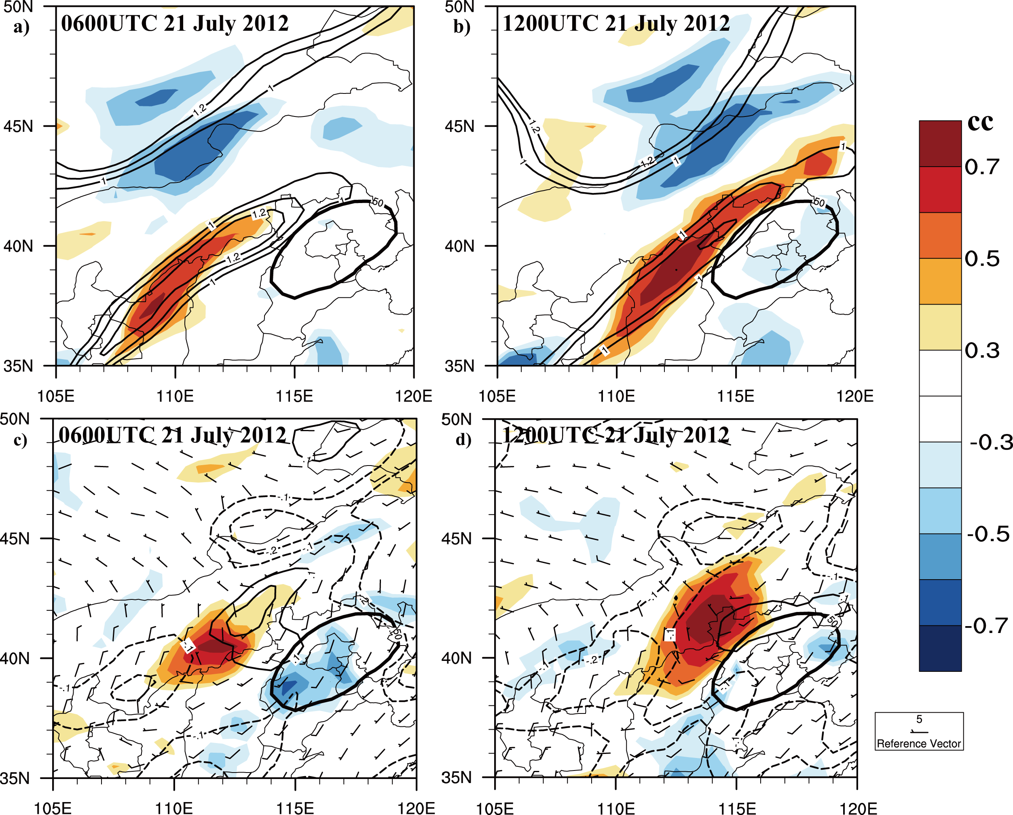
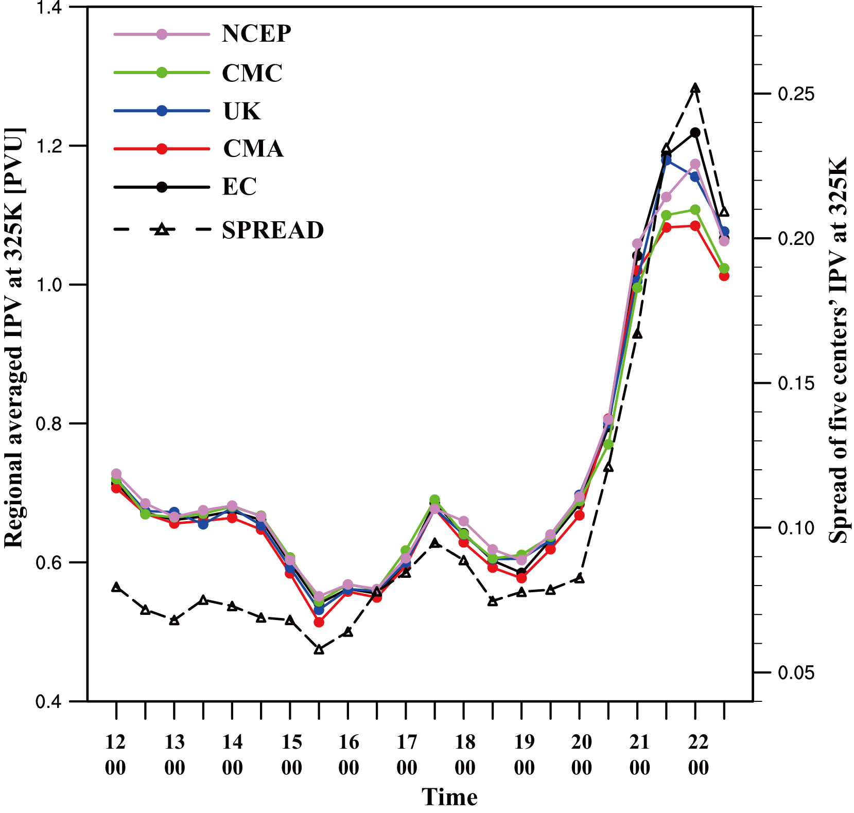
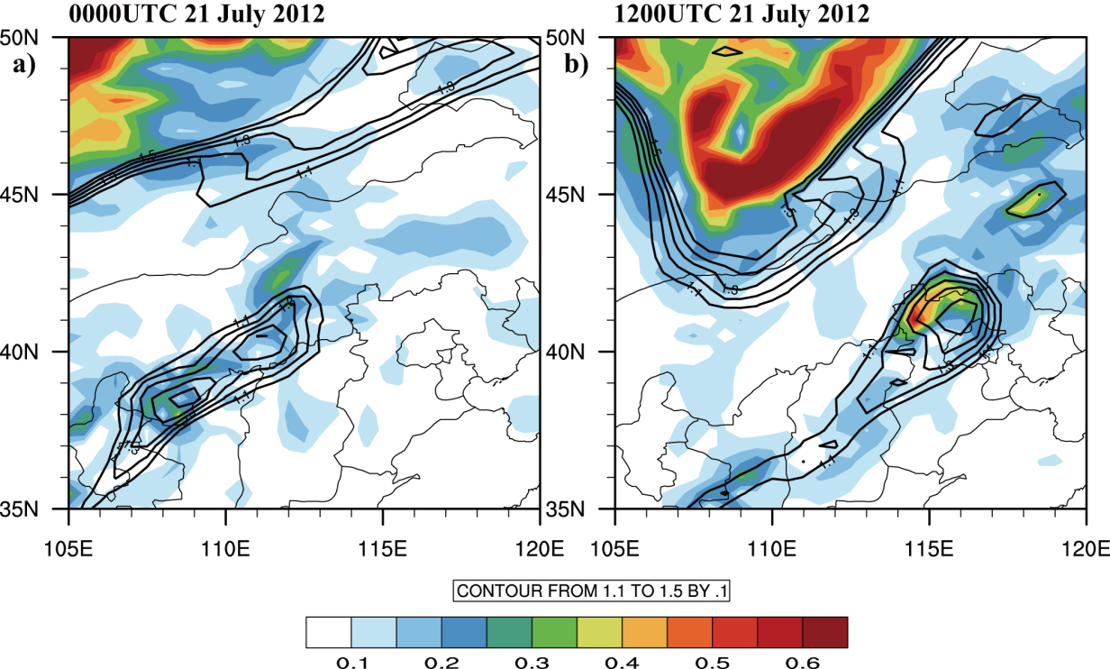
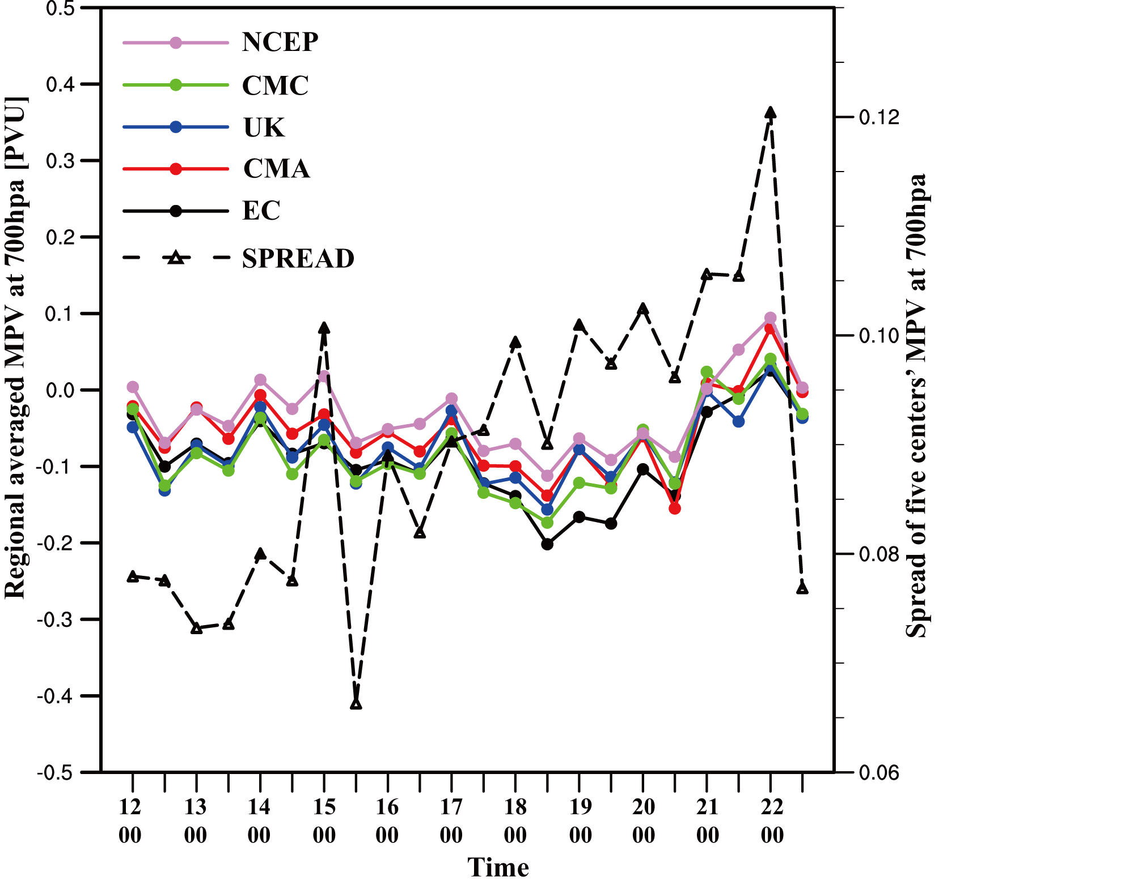
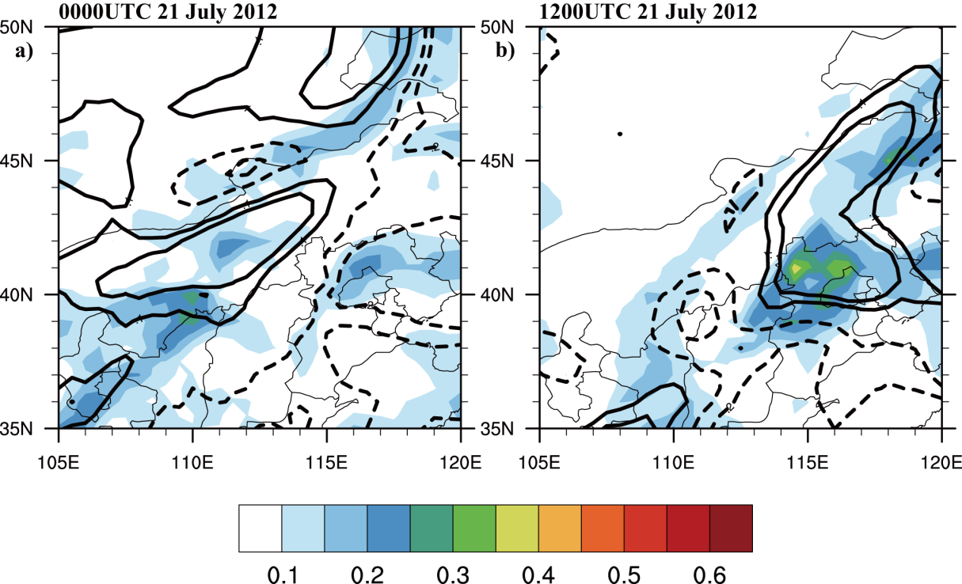
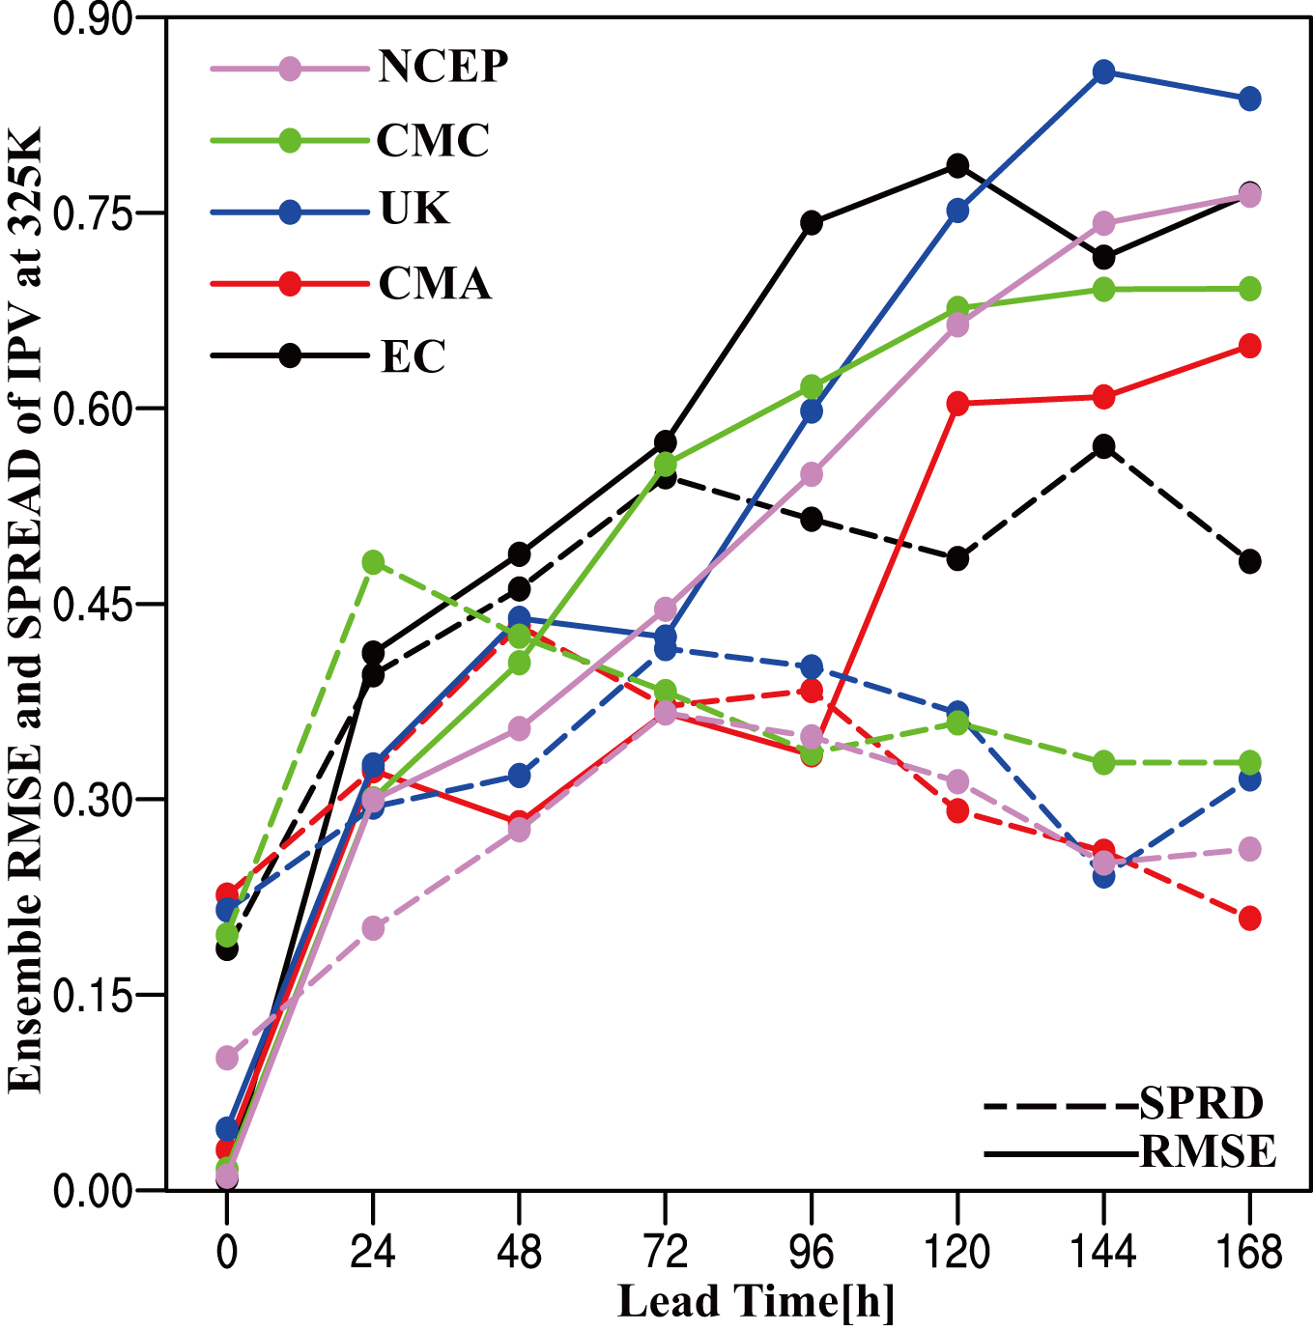
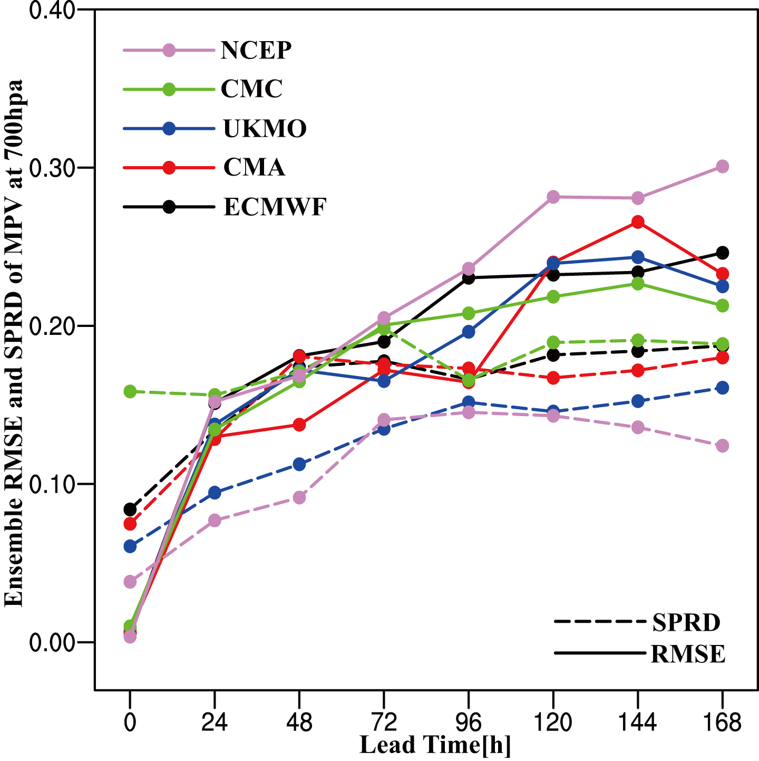
A Predictability study of a heavy rain event in Beijing using TIGGE
Xi Chen*, Huiling Yuan, and Xiang Su
Key Laboratory of Mesoscale Severe Weather/Ministry of Education, and School of Atmospheric Sciences
Nanjing University, Nanjing, 210093, China * e-mail: chenxizhongqiu@126.com
EGU Abstract #: EGU2013-87
Introduction Objectives
On 21 July 2012, the heaviest rainfall in 60 years caused significant loss of economy and life in Beijing, China.
To investigate the predictability of this heavy rain event from potential vorticity (PV) perspective using the Observing System Research and Predictability Experiment (THORPEX) Interactive Grand Global Ensemble (TIGGE) data
Maximum accumulated rainfall in Fangshan | 460 mm
Average annual rainfall | 630 mm
Affected people | >1.9 million
Death toll | 79
Direct economic losses | >￥11.6 billion
Isentropic potential vorticity (IPV) at 325K isentropic surface
Moist potential vorticity (MPV) at 700hpa
Relationship between IPV (MPV) and the heavy precipitation
Data
CMORPH merged automatic gauge data from National Meteorological Information Center in China (0.1°×0.1°, hourly)
EPS data of five centers (ECMWF, UKMO, NCEP, CMC, and CMA) from TIGGE(0.5°×0.5°, 6-hour)
Root mean square error (RMSE) of control (CTL) and ensemble mean (EM) forecast of IPV was calculated with respect to (a) each center’s own analysis IPV and (b) the mean of the five centers (valid at 1200UTC 21 July 2012)
Root mean square error (RMSE) of control (CTL) and ensemble mean (EM) forecast of MPV was calculated with respect to (a) each center’s own analysis IPV and (b) the mean of the five centers (valid at 1200UTC 21 July 2012)
PV perspective
Analysis field
Forecast field
Evolution of IPV from NCEP
Evolution of MPV from NCEP
Relationship between IPV (MPV) and the heavy precipitation
A high value region of IPV around 55°N and 100°E developed from northwest to southeast (Figs. a and b); At 1200UTC 21 July 2012, this region extended to the upper of Beijing and reached its southernmost extension (Fig. c); And then the high value region retreated northward and the impact on Beijing was to weaken (Fig. d).
Before the heavy rain happened, the convective instability intensified around Beijing (Fig. a and b); When the heavy rain happened, Beijing was occupied by the convective stability, and the heaviest rain located at the intersection of convective stability and instability (Fig. c); After the heavy rain, the strong convective stability around Beijing disappeared (Fig. d).
Spatial distribution of 24-h accumulated precipitation
Correlation coefficients between IPV (MPV) and heavy rainfall from UKMO
Observed 24-h accumulated precipitation ending at 0000UTC 22 July 2012 from CMORPH merged automatic gauge data (Fig. a). Ensemble mean forecasts from five centers were initialized at 1200UTC 20 July (Fig. b-f). UKMO showed the best precipitation forecast performance.
Spatial distribution of correlation coefficients between the predicted IPV (MPV) fields and predicted 24-h (12-36 h forecast) regional averaged heavy rainfall where ensemble mean forecasted precipitation larger than 50mm (black solid contour). The UKMO forecasts were initialized at 1200UTC 20 July. The validation times are shown in each panel (Figs. a and b for IPV, Figs. c and d for MPV).
Time series of regional averaged analysis IPV and ensemble spread of five centers’ analysis IPV (left figure), as well as the spatial distribution of this ensemble spread on 21 July 2012 (right figure)
Time series of regional averaged analysis MPV and ensemble spread of five centers’ analysis MPV (left figure), as well as the spatial distribution of this ensemble spread on 21 July 2012 (right figure)
Summary
Acknowledgements
Thank EGU for the Keith Runcorn Travel Award for Non-Europeans. Appreciate the support from the National Basic Research Program (973) fund (2013CB430106), the R&D Special Fund for Public Welfare Industry (meteorology) (GYHY201206005), Natural Science Foundation of China (41175087), and the graduate school of Nanjing University.
References
Wu, G., Y. Cai, and X. Tang, 1995: Moist potential vorticity and slantwise vorticity development. Acta Meteor. Sinica, 53, 337-405.
Wiegand, L., A. Twitchett, C. Schwierz, and P. Knippertz, 2011: Heavy precipitation at the Alpine south side and Saharan dust over central Europe: A Predictability Study Using TIGGE. Wea. Forecasting, 26, 957-974.
Su, X., and H. Yuan, 2013: The TIGGE ensemble predictions of Northern Hemisphere summer precipitation during 2008-2012. EGU Abstract ID: EGU2013-80.
Both of IPV at 325K isentropic surface and MPV at 700hpa showed obvious responses to this heavy rain event.
For this heavy rain event, ECMWF, UKMO and NCEP showed better forecast performance than CMC and CMA.
High correlation coefficients located at the high value region of ensemble mean forecasted IPV at 325K isentropic surface and the intersection of positive and negative ensemble mean forecasted MPV at 700hpa.
RMSE of ensemble mean forecast and ensemble spread of IPV (valid at 1200UTC 21 July 2012)
RMSE of ensemble mean forecast and ensemble spread of MPV (valid at 1200UTC 21 July 2012)

