Slide 1



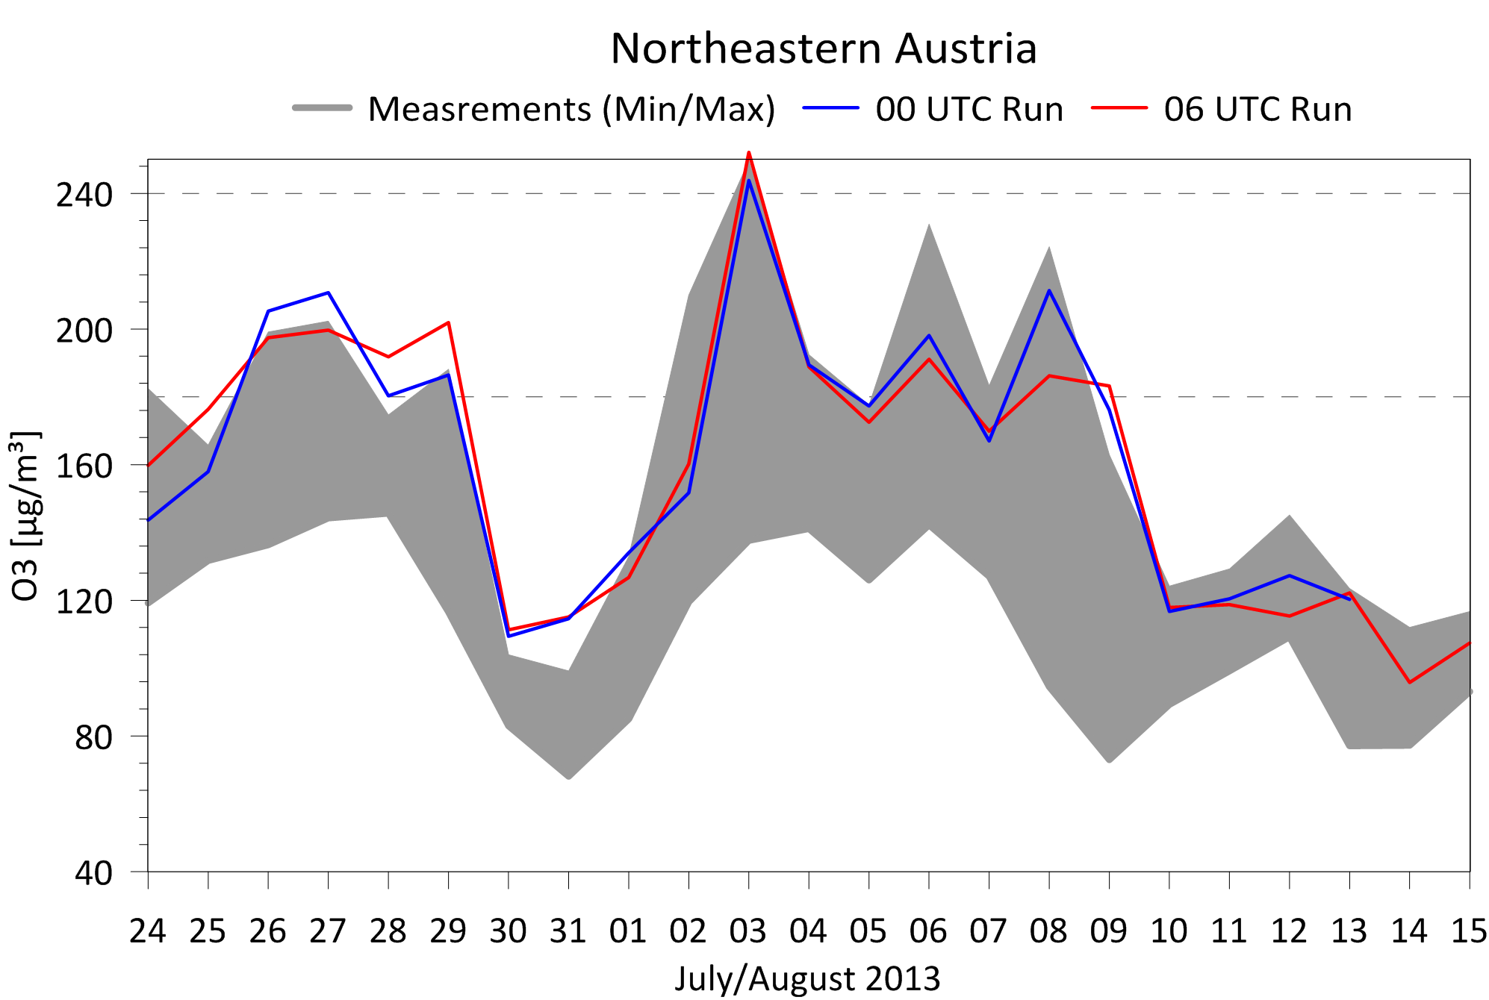
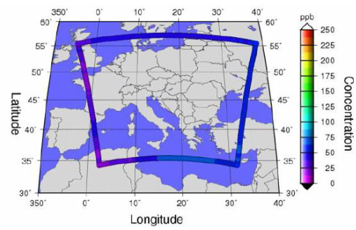
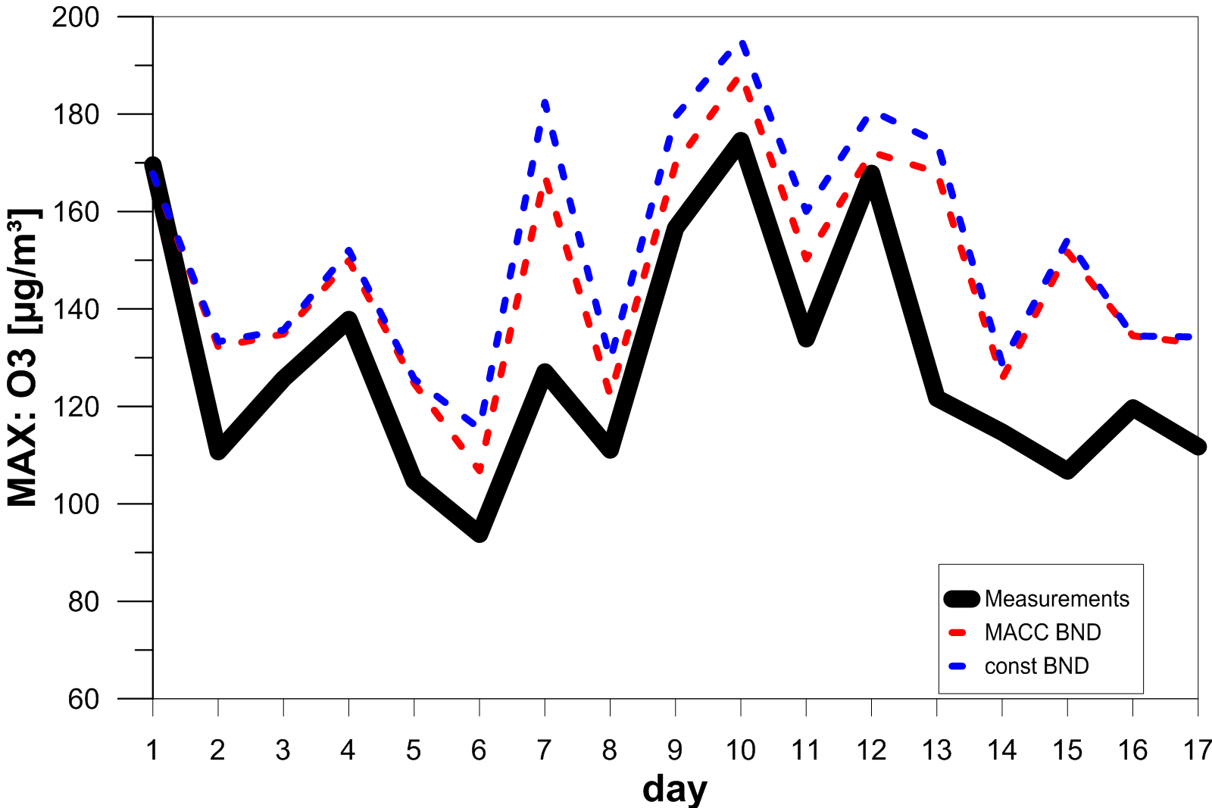
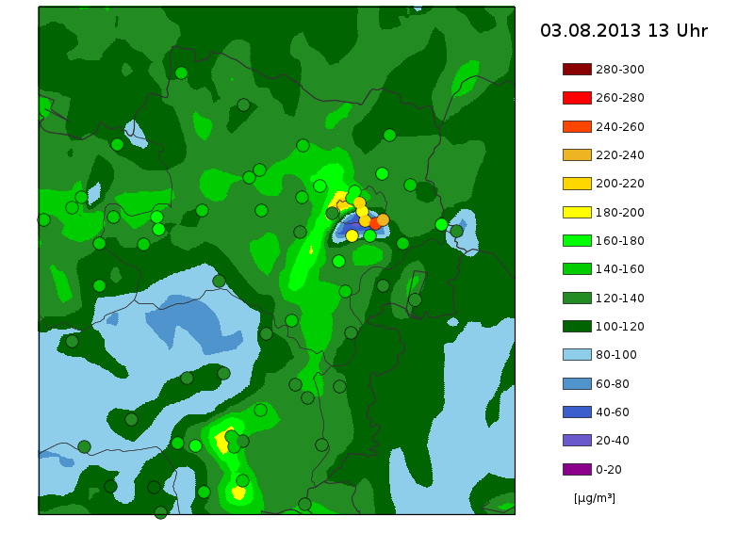
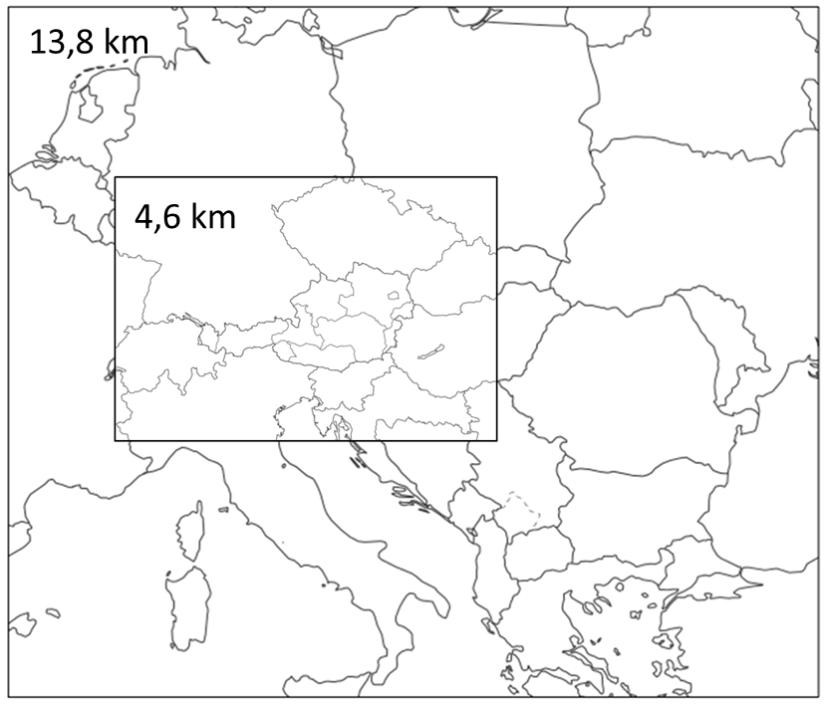
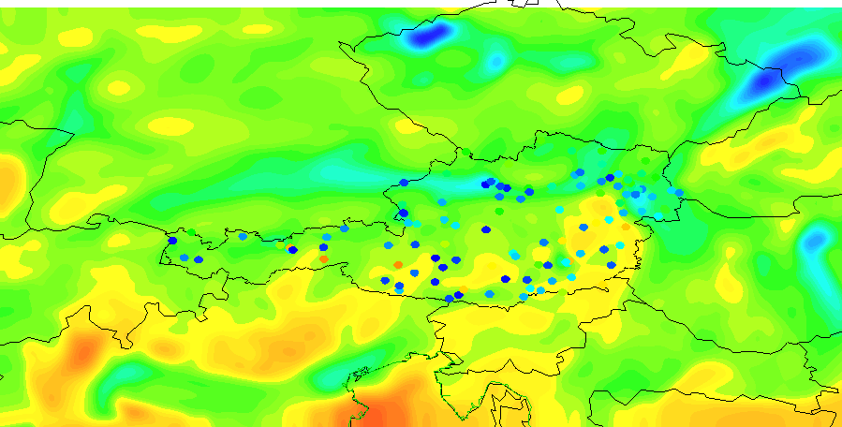
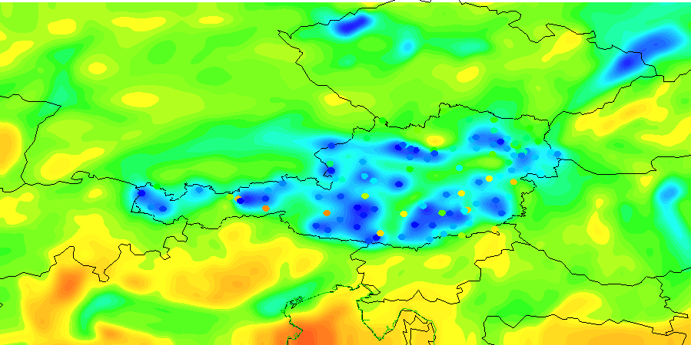
Development and evaluation of the operational Air-Quality forecast model for Austria ALARO-CAMx Claudia Flandorferª, Marcus Hirtlª, Bernd C. Krüger^{b} ªSection Environmental Meteorology, ZAMG – Central Institute for Meteorology and Geodynamics, Vienna, Austria ^{b}Institute of Meteorology, BOKU – University of Natural Resources and Life Sciences, Vienna, Austria
www.zamg.ac.at
1. Introduction
The Air-Quality model for Austria (AQA) is operated at ZAMG in cooperation with the University of Natural Resources and Life Sciences (BOKU) in Vienna by order of the regional governments since 2005. The modeling system is currently a combination of the meteorological model ALARO and the photochemical dispersion model CAMx. Two modeling domains are used with the highest resolution (5 km) in the Alpine region. Various extensions with external data sources have been conducted in the past to improve the daily forecasts of the model. Since 2013 O₃- and PM₁₀-observations from the Austrian measurement network have been assimilated daily using optimum interpolation. Dynamic chemical boundary conditions are obtained from Air-Quality forecasts provided by ECMWF in the frame of MACC-II. Additionally the latest available high resolved emission inventories for Austria are combined with TNO and EMEP data. The biogenic emissions are provided by the SMOKE model. ZAMG provides daily forecasts of O₃, PM₁₀ and NO₂ to the regional governments of Austria. The evaluation of these forecasts is done for the summer 2013 with the main focus on the forecasts of ozone. The measurements of the Air-Quality stations are compared with the punctual forecasts at the sites of the station and with the area forecasts for every province of Austria.
2. ALARO-CAMx
Model configuration Meteorological Model: ALARO, 61 vertical levels Photochemical Dispersion Model: CAMx (www.camx.com), 16 vertical levels, SAPRC99-Mechanism (Carter, 2000) with 73 trace gases and 211 chemical reactions 2 Model domains: 13,8 km and 4,6 km (Fig. 1) 2 Model runs: 00 UTC and 06 UTC. Data assimilation of the Austrian Measurement stations is only used in the 2nd run. The modeling system is described in several reports and pubilcations (Baumann-Stanzer et al, 2005a, Baumann-Stanzer et al., 2005b, Krüger et al. 2006a, Krüger et al., 2006b, Hirtl et al, 2011).
Emissions Anthropogenic emissions: The new emission data is a combination of Austrian inventories, TNO and EMEP inventory (Fig. 3). Before 2013 the emissions were based on the UNECE/EMEP database (webdab.emep.int), which has a resolution of 50 km. For Austria, Czech Republic, Slovakia and Hungary the emissions has been downscaled to a resolution of 5 km (Fig. 2). Biogenic emissions of hydrocarbon and nitrogen oxid are calculated by SMOKE (Sparse Matrix Kernel Emissions Modeling System, Houyoux and Vokovic, 1999) based on the actual meteorological data. Chemical boundary conditions The dynamic boundary conditions from ECMWF, developed in the MACC-Project (Monitoring Atmospheric Composition and Climate, www.gmes-atmosphere.eu) are used since 2013. Before 2013 the concentrations calculated in the framework of the EU-project CECILIA (Central and Eastern Europe Climate Change Impact and Vulnerability Assessment, www.cecilia-eu.org) are used. Data Assimilation Since 2013 the measurements of PM₁₀ and O₃ of all Austrian Air-Quality stations are used to optimize the initial conditions for the Air-Quality model. The optimum interpolation technique (Daley, 1991) is used for data assimilation.
3. Evaluation Results for O₃
In summer of 2013, two heat waves occurred. The first short-time heat wave was in June 2013. During this period one exceedance of the alert threshold value for ozone occurred. The second heat wave took place from the end of July to the mid of August. Due to very high temperatures (new temperature record for Austria measured in Bad Deutsch-Altenburg with 40.5°C) and long dryness episodes the information threshold value has been exceeded several times in the eastern regions of Austria. The alert threshold value has been exceeded one time in this period. The exceedance of the alert threshold has been measured at the station “Schwechat Sportplatz”, which is located in the southeast of Vienna (3rd August 2013, 13:00 UTC). The model was able to forecast this high O₃ concentration in time and nearly in the same intensity as the measurement, only the location of the maximum is slightly in the northwest of the station. The model shows a high hit rate in predicting events or non-events (95,6 %). Only 4,4 % of all daily maximum forecasts for O₃ predict an event when no event occurs respectively vice versa (Table 1).
Fig. 2: Emissions used before 2013 Fig. 3: Emissions used since 2013
Fig. 8: O₃ daily max during the second heat wave in Austria (06 UTC run with data assimilation)
Fig. 4: Example for MACC boundary conditions for O₃
Fig. 5: Improvement of O₃ daily max forecasts
due to MACC boundary conditions
Fig. 9: O₃ model forecast (06 UTC run)
Table 1: Hit rate for O₃ daily max
References Baumann-Stanzer, K., M. Hirtl und B. C. Krüger, 2005a: Pilotstudie zur Prognose von Sommersmog auf Basis operationeller regionaler Wettervorhersage in Österreich. Endbericht, Zentralanstalt für Meteorologie und Geodynamik und Institut für Meteorologie der Universität für Bodenkultur Wien, Mai 2005. Baumann-Stanzer, K., M. Hirtl und B. C. Krüger, 2005b: Testbetrieb des Modellsystems zur Prognose von Sommersmog auf Basis operationeller regionaler Wettervorhersage. Zwischenbericht, Zentralanstalt für Meteorologie und Geodynamik und Institut für Meteorologie der Universität für Bodenkultur Wien, Nov. 2005. Carter, W.P.L. , 2000: Implementation of the SAPRC-99 Chemical Mechanism into the Model-3 Framework, Report to the United States Environmental Protection Agency, http://www. cert.ucr.edu/~carter/absts.htm#s99mod3 Daley, R., 1991: Atmospheric Data Analysis. Cambridge Atmospheric and Space Science Series, Cambridge University Press. ISBN 0-521-38215-7, 457 pages. Houyoux MR and Vukovich JM, 1999: Updates to the Sparse Matrix Operator Kernel Emission (SMOKE) modeling system and integration with Models-3, presented at the Emission Inventory: Regional Strategies for the Future, October 26-28, Raleigh, NC, Air and Waste Management Association. Krüger, B. C., K. Baumann-Stanzer, und M. Hirtl, 2006a: Änderungen des Modellsystems zur Prognose von Sommersmog für Nordost-Österreich im Winter 2005/2006 - 2. Zwischenbericht -, Zentralanstalt für Meteorologie und Geodynamik und Institut für Meteorologie der Universität für Bodenkultur Wien, April 2006. Krüger, B. C., K. Baumann-Stanzer, und M. Hirtl, 2006b: Testbetrieb 2006 des Modellsystems zur Prognose von Sommersmog auf Basis operationeller regionaler Wettervorhersage. Zentralanstalt für Meteorologie und Geodynamik und Institut für Meteorologie der Universität für Bodenkultur Wien, Dezember 2006.
Fig. 1: Model domains
Fig. 6: O₃ forecast without data assimilation Fig. 7: O₃ forecast with data assimilation
measurement stations (dots)
Contact: Mag. Claudia Flandorfer, Section Environmental Meteorology, claudia.flandorfer@zamg.ac.at, Tel. 0043 1 360 26 / 2405, www.zamg.ac.at
Mag. Marcus Hirtl, Section Environmental Meteorology, marcus.hirtl@zamg.ac.at, Tel. 0043 1 360 26 / 2406, www.zamg.ac.at
European Geoscience Union, General Assembly 2014, Vienna, 27th April – 2nd May 2014

