Slide 1
Comparative evaluation of pooling strategy in soil metaproteomics Dong Liu¹, Katharina M. Keiblinger¹, Stephan Fuchs², Uwe Wegner², Christian Hentschker ², Kathrin Riedel², Dörthe Becher², Sophie Zechmeister-Boltenstern¹
1
2
University Greifswald
Institute of Microbiology, Germany

Slide 2
1.Introduction
(Metaproteomics – potential & challenges)
2. Hypothesis
3. Method & Material
4. Preliminary results
5. Take home message

Slide 3
1.Introduction
(Metaproteomics – potential & challenges)
Hypothesis
Method & Material
Preliminary results
Take home message

Slide 4
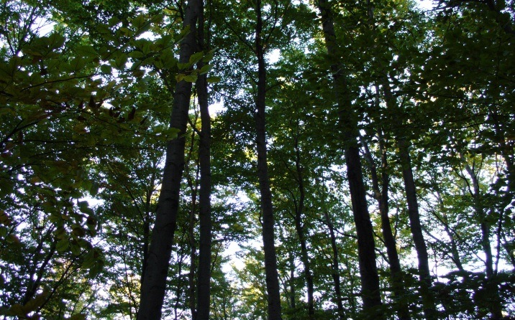
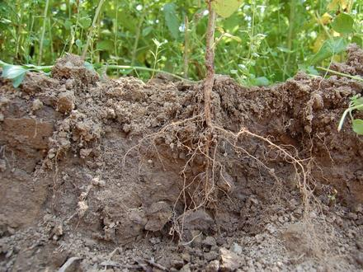
1.1 METAPROTEOMICS - DEFINITION
Community Proteomics or Environmental Proteomics
defined as large-scale characterization of the entire protein complement directly recovered from environmental samples
(Schneider & Riedel, Proteomics 2010)
beech forest
Litter
Soil
Notes:
Now – what do we understand under metaproteomics, which is probably the „youngest“ and most exciting discipline with the meta – omics field.
This is also reflected by the fact that the number of review articles about metaproteomics is almost as high as the number of original research articles
The term metaproteomics or synomyms such as community proteomics or environmental proteomics or community proteogenomics which means basically the same thing is defined as…….
So far only a limited number of terrestrial ecosystems have analysed by metaproteomics among them beech forest leaf litter decomposion, SOIL and PHYLLOSPHERE (Delmotte et al, Verholt et al.).
These are among the most complex samples for protein extraction.

Slide 5
1.2 POTENTIAL OF METAPROTEOMICS
ONE GENOME
TWO PROTEOMES
The metagenome tells us what potentially
can happen in an ecosystem, the metaproteome
tells us what actually happens.
Linking structure and function of microbial communities
Linking diversity and environmental processes
Notes:
Novel approach – soil community research
Distribution & Function
Simultaneous mapping of peptides to all known genomes and proteomes to get the identity of different organisms present in a sample

Slide 6
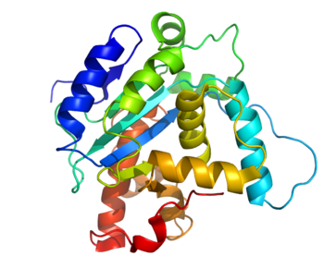
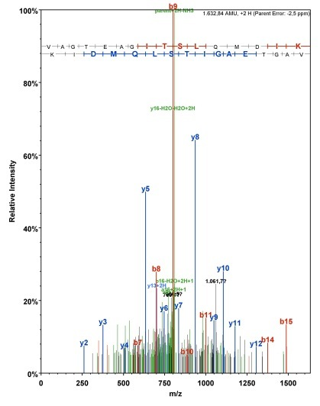
Possible advantages of pooling: kkk Reduction and optimization of individual samples and data evaluation → - shortening processing time ? - lowers high costs for chemicals and equipment ?
1.3 METAPROTEOMIC APPROACH involves MANY STEPS
1-dimensional
chromatography
enzyme
digestion
P
E
P
MS1
T
I
D
E
sequence
database
matching
gas phase
fragmentation
P
E
peak picking
MS2
P
E
P
T
D
I
P
E
E
P
D
E
search engine
8
Notes:
Explain shortly the individual steps and refer that you will explain it more detailed later in the talk

Slide 7
Introduction
(Metaproteomics – potential & challenges)
2. Hypothesis
Pooling
experiment
Method & Material
Preliminary results
Take home message

Slide 8
2.2 POOLING EXPERIMENT - HYPOTHESES
H1:The most abundant microorganisms will be
present and found in the pooled sample.
H2:The functional categorization of proteins within the pooled sample will be similar or almost equal to the individual samples.
10
Notes:
H1:The most abundant microorganisms will be present and found in the pooled sample, as it has been found for other molecular approaches (Andronov et al. 2012).
H2:The functional categorization of proteins within the pooled sample will be similar or almost equal to the individual samples, as the pooled sample is assumed to represent the soil at our experimental plot (mature beech stand).

Slide 9
Introduction
(Metaproteomics – potential & challenges)
Hypothesis
Pooling
experiment
3.Method & Material
Preliminary results
Take home message

Slide 10
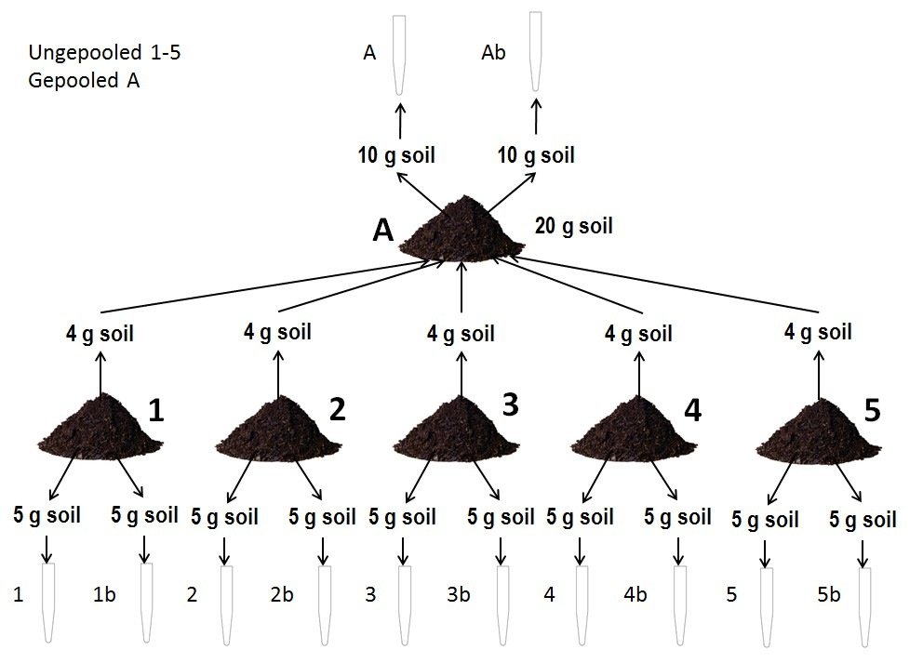
3.1 METHODS – POOLING APPROACH
unpooled 1-5
pooled A
复古风
复古风
Keiblinger kathi , Dong Liu et al. In preparation
12
Notes:
For the pooling the individual samples were kept frozen at -80°C béfore processing, and only put togehter at the extraction step.

Slide 11
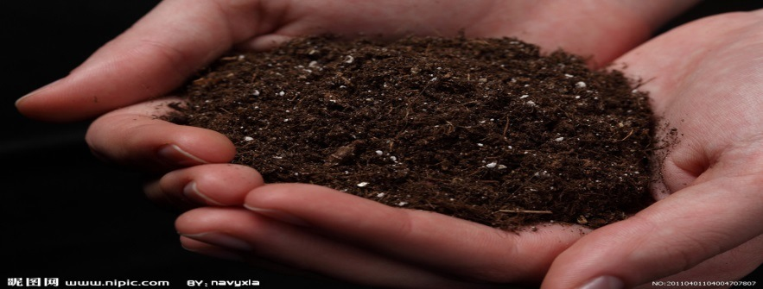
3.2 METHODS – WORK FLOW / EXTRACTION SCHEME
Sample Preparation
grinding in liquid nitrogen
in situ / whole-cell protein
extraction (SDS Tris-buffer)
centrifugation & concentration
proteins of soil microorganisms
Protein Separation
Protein assignment
to phylogenetic &
functional groups
1D-SDS-PAGE
cutting gel into slices
trypsin digestion
peptides of
soil microorganisms
Liquid Chromatography
Mass Spectrometry
(LC- MS/MS)
Data analyses
&
Database searches
Notes:
Data analysis were done with proteome discoverer were MS data were searched against XX() databases and finally the data were then subjected to a very stringent data validation workflow called PROPHANE which enabled us to sepatare the peptides to individual microbial phyla and to respective functions…
Liquid chromatography with tandem mass spectrometry was carried out on high sensitivity and mass-accuracy mass spectrometry (such as Thermo Scinetific Velos Orbitrap Elite /XL ),
,

Slide 12
Introduction
(Metaproteomics – potential & challenges)
Hypothesis
Pooling
experiment
Method & Material
4.Preliminary results
Take home message

Slide 13
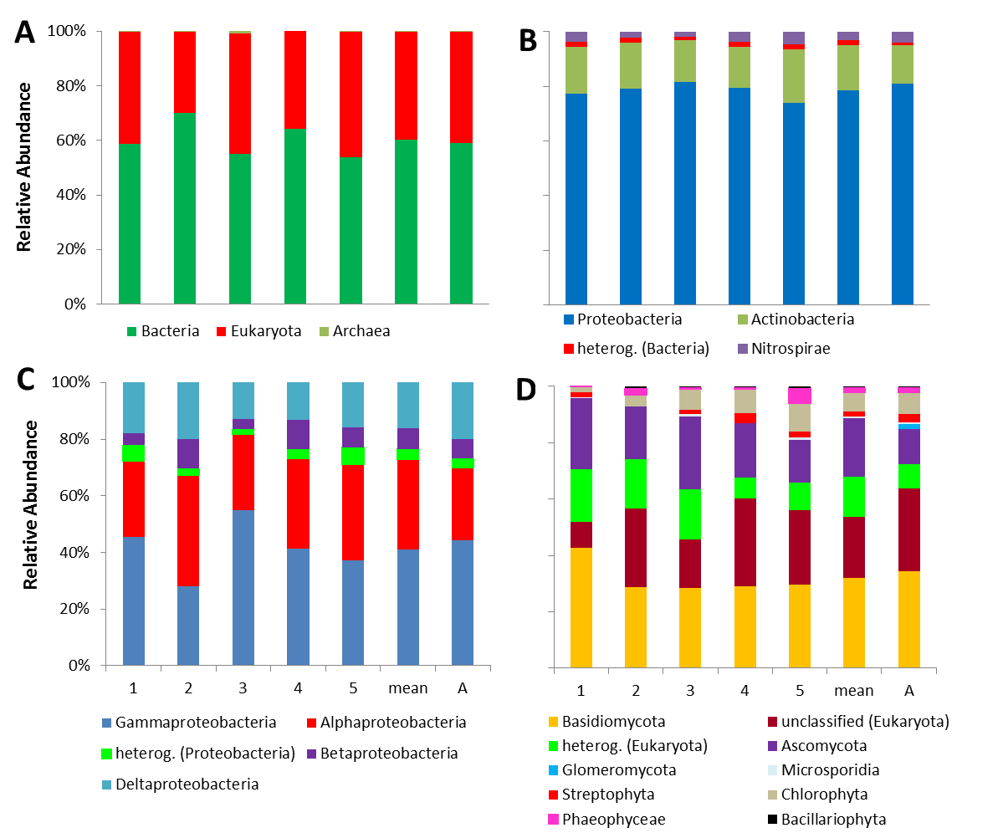
4.1 RESULTS – MICROBIAL COMMUNITY DISTRIBUTION
Major domains
Bacterial lineages
4/19/14
Proteobacteria
Eukaryota
18
Notes:
Change the order of C and D, then explain it with the order of Bacterial--→ proteobacteria
Explain Axis, and what is shown
And the individual figures A, B C and D
And probably some prelimniary assumptions from these results
All based on NSAFs (normalized spectral abundance factors) for six soil samples (“mean” is the average values of the individual samples 1 to 5; “A” refers to the pooled sample).
In the ´bar chart mean values of the two replicates are given!

Slide 14
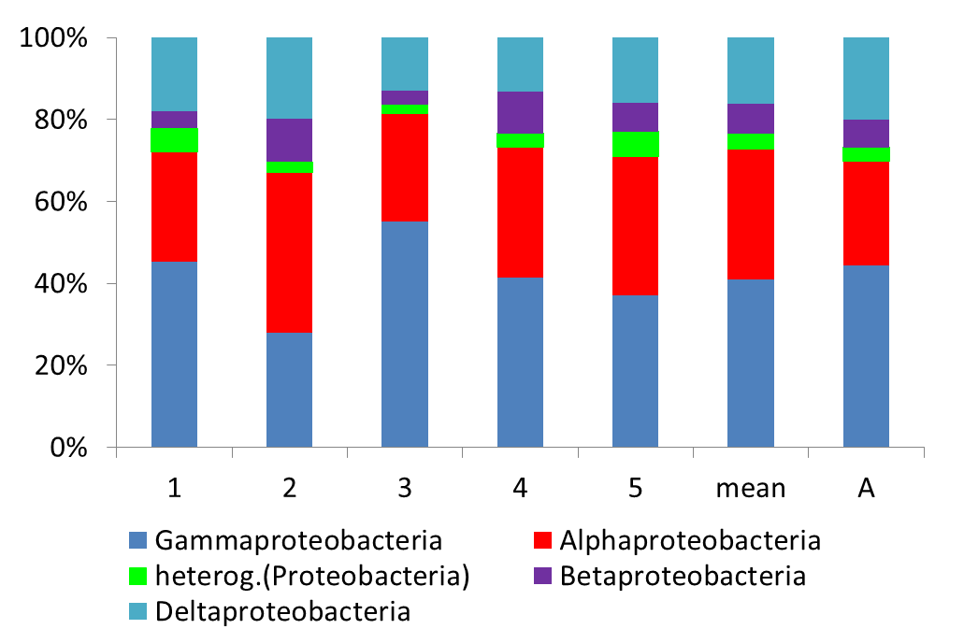
4.2 RESULTS – DISTRIBUTION of PROTEOBACTERIA
Relative abundance
H1: The most abundant microorganisms were found in the pooled sample A.
19

Slide 15
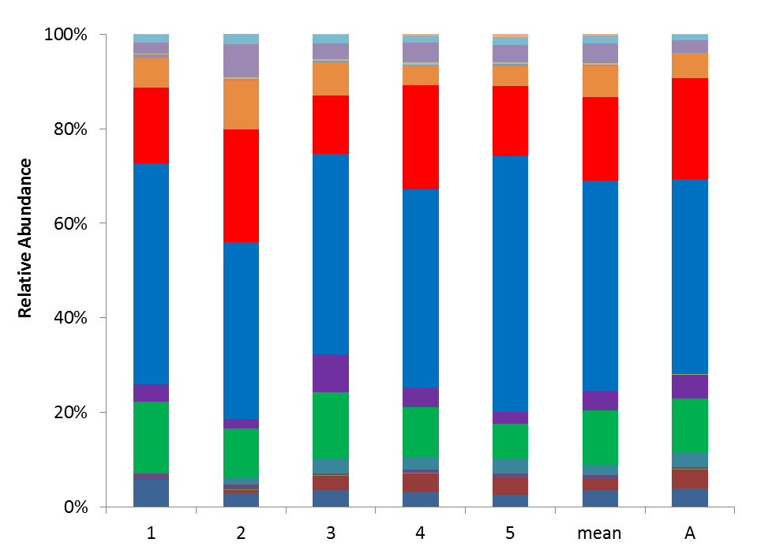
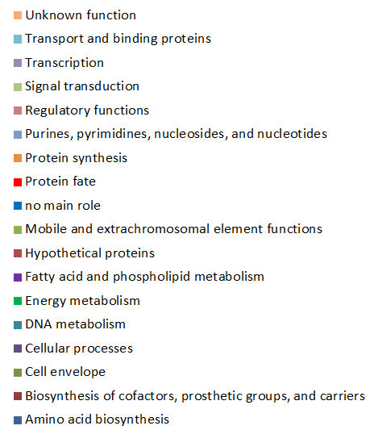
4.4 RESULTS – FUNCTIONAL CLASSIFICATION of
PROCARYOTIC PROTEINS
H2: The functional categorization of proteins within the pooled sample was similar to
the individual samples.
20

Slide 16
Introduction
(Metaproteomics – potential & challenges)
Experiment 1
pooling
Experiment 2
drying rewetting
Hypothesis
Experiment 1
pooling
Experiment 2
drying rewetting
Method & Material
Experiment 1
pooling
Preliminary results
5. Take home message

Slide 17
5.1 TAKE HOME MESSAGE
1. The application of pooling for extraction purposes strongly depends
on the research questions and hypotheses.
2. Pooling is a defensible practice for metaproteome analysis from
environmental samples recognizing the compromise between time
and cost.
10
Notes:
In my opinion I think it will be necessary to test soils from each site or experiment if pooling is suitable.
And The application of pooling for extraction purposes strongly depends on the research questions and hypotheses, wheter only the abundat MO are of importance or the hypotheses
Focus in individual mechansims or protein functions.
Finally from our experiment we suggest that Pooling is a defensible practice for metaproteome analysis from environmental samples recognizing the compromise between time and
cost.

Slide 18
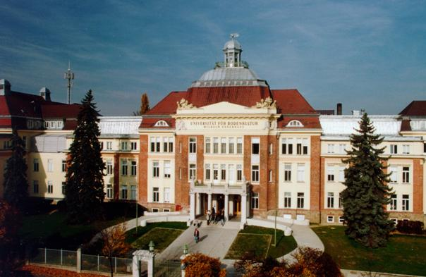
THANK YOU FOR YOUR ATTENTION

