Slide 1


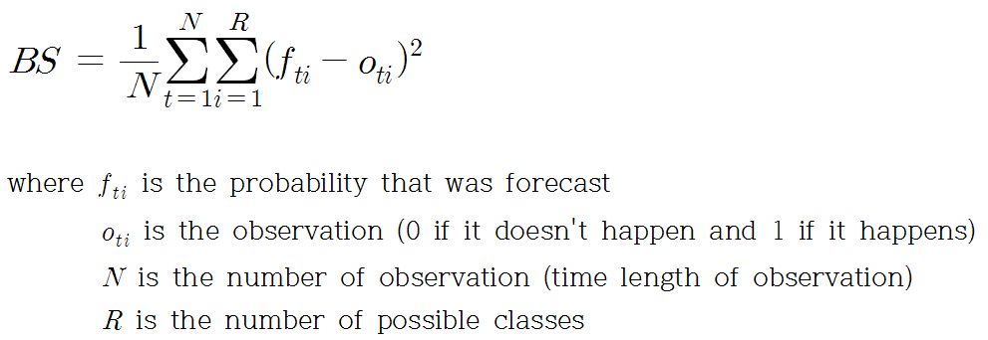
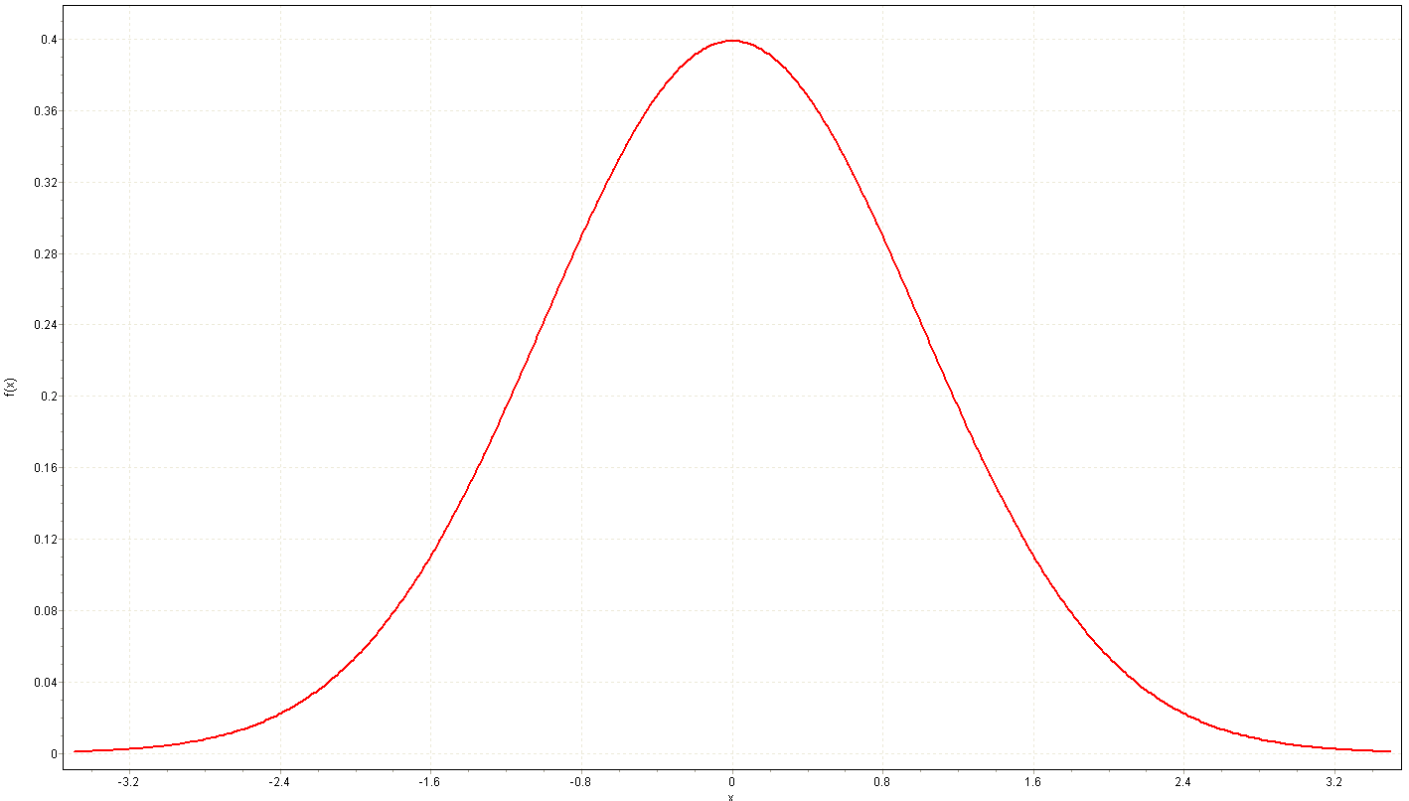



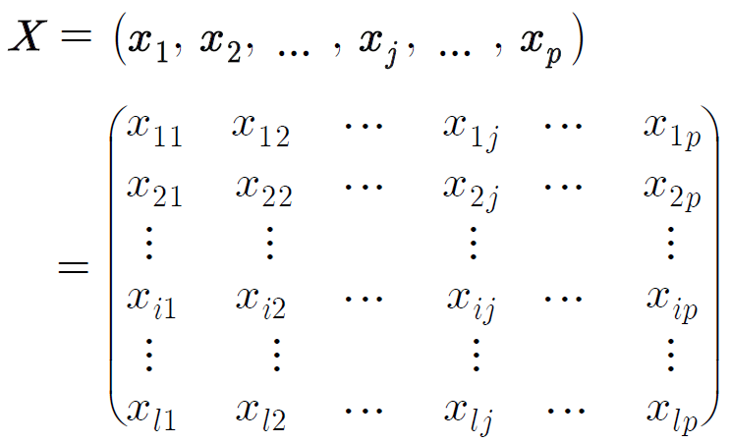
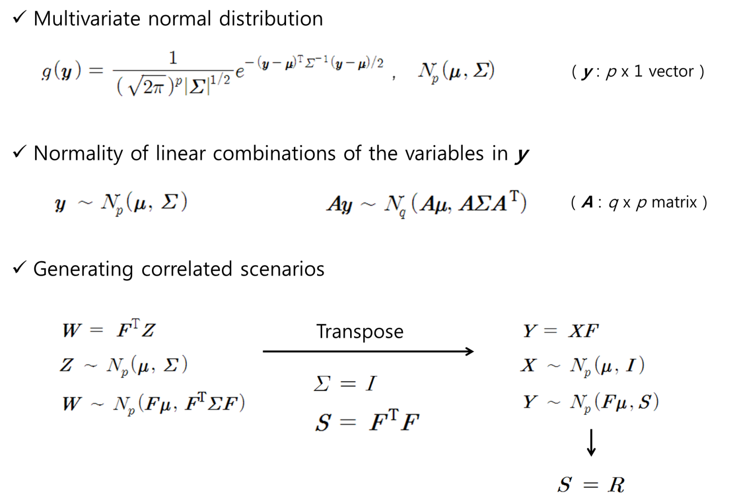

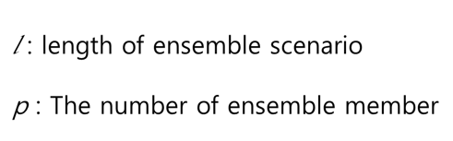
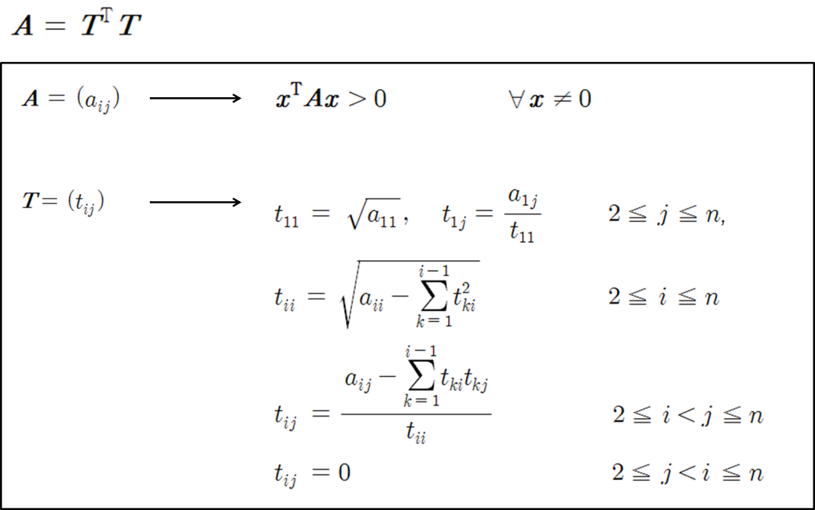
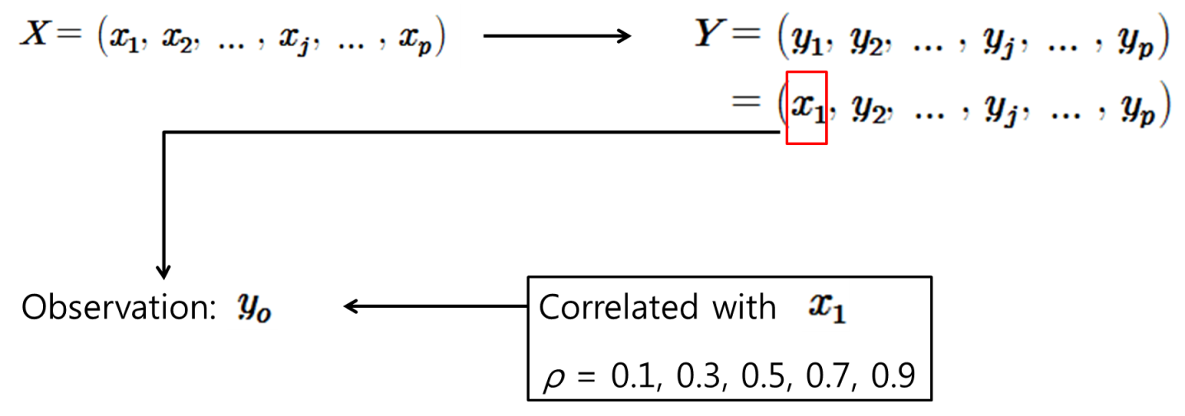
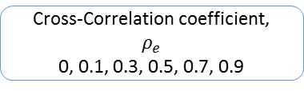
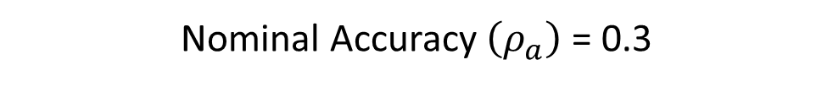
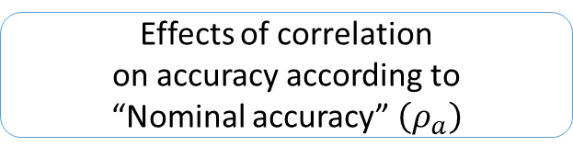
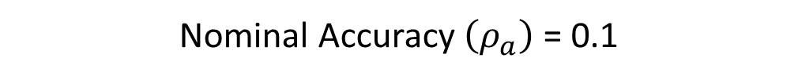
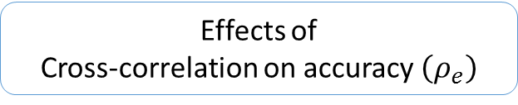

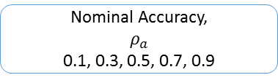
.
Effects of Cross-Correlation between Ensemble Members on Forecasting Accuracy
Kim, Young-Oh¹⁾ / Seo, Young-Ho²⁾ / Park, Dong Kwan³⁾
1)Professor, Department of Civil & Environmental Engineering, Seoul National University, Seoul, Korea ( yokim05@snu.ac.kr )
2)Master Student, Department of Civil & Environmental Engineering, Seoul National University, Seoul, Korea ( west0ho@snu.ac.kr )
3)Master Student, Department of Civil & Environmental Engineering, Seoul National University, Seoul, Korea ( donpark@snu.ac.kr )
Seoul National University
Hydrology Research Group
http://hrg.snu.ac.kr
1
Introduction
Evaluation & Analysis
Background
Brier score (originally introduced by Brier)
ESP(Ensemble Streamflow Prediction) is a numerical prediction method that is used to generate a sample set of possible future state for streamflow prediction and to analyze uncertainties.
Since 1970s, ESP has been effectively used to deal with uncertainties of hydrologic forecasts and is still an active research area for both of short- and long-range predictions.
‘Many ESP are designed to comprise of equally likely (equiprobable) ensemble members, and to have an adequate number of ensemble members in order to describe the full range of input probabilities(Cloke and Pappenberger, 2009).’
However, When there is a correlation between scenarios, the structure of ESP can be distorted. In addition, it is needed to study the effective number of ensemble which implies the minimum number that can maintain acceptable accuracy level of ESP in operational hydrology.
0 ≤ BS ≤ 2
33.3 %
33.3%
33.3%
Estimate the effective number of scenarios
(c)
(d)
Objectives
This study tried to identify the number of ensemble members to effectively improve the EPS using Brier score
Analyze the effects of cross-correlation between ensemble members on the accuracy of ESP as well as the number of ensemble members
The number of scenarios in relation to 90% of the range from the top of the Brier score curve is determined to be the effective number of scenarios, which should be between 3 and 100 scenarios.
Determine the effective number of scenarios of ensemble
Identifying the slope of the Brier score curve between each interval.
2
Methodology
The example of estimating the effective number of scenarios
Overview
(e)
(f)
Ensemble data matrix, X
Number of ensemble member,
p
3, 5, 7, 9, 12, 15, 20, 30, 50, 100
Figure 1 Behaviors of the Brier score of the generated ensemble forecasts as a function of the ensemble cross-correlation and the number of ensemble members: (a) for the nominal accuracy, = 0.1; (b) 0.3; (c) 0.5; (d) 0.7; (e) 0.9; and (f) integrated results
p x p Factorized matrix, F
Cholesky
decomposition
Correlation matrix, R
Table 1 Slope of the Brier score between each interval
Correlated ensemble matrix, Y
Cross-Correlation coefficient,
$ρ_{e}$
0, 0.1, 0.3, 0.5, 0.7, 0.9
Accuracy | Correlation | Interval of the number of ensemble members |  |  |  |  |  |  |  |  | 5% Slope
 |  | 3~5 | 5~7 | 7~9 | 9~12 | 12~15 | 15~20 | 20~30 | 30~50 | 50~100
0.1 | 0 | 0.0411 | 0.0175 | 0.0099 | 0.0057 | 0.0035 | 0.0020 | 0.0010 | 0.0004 | 0.0001 | 0.0021
 | 0.1 | 0.0395 | 0.0168 | 0.0091 | 0.0054 | 0.0035 | 0.0019 | 0.0010 | 0.0004 | 0.0001 | 0.0020
 | 0.3 | 0.0363 | 0.0147 | 0.0088 | 0.0054 | 0.0029 | 0.0017 | 0.0010 | 0.0004 | 0.0001 | 0.0018
 | 0.5 | 0.0326 | 0.0131 | 0.0082 | 0.0043 | 0.0023 | 0.0018 | 0.0007 | 0.0004 | 0.0001 | 0.0016
 | 0.7 | 0.0264 | 0.0106 | 0.0065 | 0.0038 | 0.0022 | 0.0012 | 0.0008 | 0.0003 | 0.0001 | 0.0013
 | 0.9 | 0.0164 | 0.0066 | 0.0046 | 0.0020 | 0.0018 | 0.0005 | 0.0004 | 0.0002 | 0.0000 | 0.0008
0.3 | 0 | 0.0331 | 0.0142 | 0.0079 | 0.0045 | 0.0026 | 0.0017 | 0.0008 | 0.0003 | 0.0001 | 0.0017
 | 0.1 | 0.0318 | 0.0140 | 0.0079 | 0.0043 | 0.0028 | 0.0015 | 0.0008 | 0.0003 | 0.0001 | 0.0016
 | 0.3 | 0.0300 | 0.0127 | 0.0076 | 0.0041 | 0.0025 | 0.0015 | 0.0008 | 0.0003 | 0.0001 | 0.0015
 | 0.5 | 0.0276 | 0.0116 | 0.0067 | 0.0039 | 0.0024 | 0.0014 | 0.0007 | 0.0003 | 0.0001 | 0.0014
 | 0.7 | 0.0239 | 0.0101 | 0.0057 | 0.0032 | 0.0023 | 0.0013 | 0.0005 | 0.0002 | 0.0000 | 0.0012
 | 0.9 | 0.0167 | 0.0060 | 0.0038 | 0.0023 | 0.0008 | 0.0014 | 0.0003 | 0.0002 | 0.0001 | 0.0008
0.5 | 0 | 0.0236 | 0.0098 | 0.0056 | 0.0034 | 0.0019 | 0.0012 | 0.0006 | 0.0002 | 0.0001 | 0.0012
 | 0.1 | 0.0232 | 0.0098 | 0.0060 | 0.0032 | 0.0020 | 0.0011 | 0.0006 | 0.0002 | 0.0001 | 0.0012
 | 0.3 | 0.0234 | 0.0097 | 0.0058 | 0.0031 | 0.0020 | 0.0010 | 0.0005 | 0.0003 | 0.0001 | 0.0012
 | 0.5 | 0.0221 | 0.0099 | 0.0049 | 0.0035 | 0.0016 | 0.0010 | 0.0007 | 0.0002 | 0.0001 | 0.0011
 | 0.7 | 0.0204 | 0.0090 | 0.0045 | 0.0032 | 0.0017 | 0.0010 | 0.0005 | 0.0002 | 0.0001 | 0.0010
 | 0.9 | 0.0149 | 0.0059 | 0.0038 | 0.0019 | 0.0009 | 0.0007 | 0.0004 | 0.0002 | 0.0001 | 0.0007
0.7 | 0 | 0.0112 | 0.0050 | 0.0026 | 0.0014 | 0.0010 | 0.0005 | 0.0003 | 0.0001 | 0.0000 | 0.0006
 | 0.1 | 0.0118 | 0.0051 | 0.0028 | 0.0018 | 0.0007 | 0.0007 | 0.0003 | 0.0001 | 0.0000 | 0.0006
 | 0.3 | 0.0133 | 0.0053 | 0.0037 | 0.0014 | 0.0010 | 0.0007 | 0.0003 | 0.0002 | 0.0000 | 0.0007
 | 0.5 | 0.0143 | 0.0063 | 0.0029 | 0.0020 | 0.0012 | 0.0007 | 0.0004 | 0.0001 | 0.0000 | 0.0007
 | 0.7 | 0.0143 | 0.0068 | 0.0029 | 0.0027 | 0.0009 | 0.0007 | 0.0004 | 0.0002 | 0.0000 | 0.0007
 | 0.9 | 0.0123 | 0.0052 | 0.0026 | 0.0018 | 0.0009 | 0.0006 | 0.0003 | 0.0001 | 0.0001 | 0.0006
Controlled accuracy
Nominal Accuracy,
$$ρ_{a}$$
0.1, 0.3, 0.5, 0.7, 0.9
Generating observation
The effective number can be defined as the closest natural number when its BS drops down to 90% of the difference between the minimum (at p = 100) and the maximum BS (at p = 3). ). This measure is denoted as (=16)
Evaluation
Effects of
Cross-correlation on accuracy $\left(ρ_{e}\right)$
Effects of correlation
on accuracy according to
“Nominal accuracy” $\left(ρ_{a}\right)$
Estimate the effective number of scenarios
The slope (i.e., the marginal improvement in BS/the increase in p), can be used to define the effective number. The maximum slope occurs at the interval between 3 and 5 and thus this study defines the alternative effective number ( ) as the larger number of the interval where its slope becomes 5% of the maximum slope
Generation of Correlated Ensemble Scenarios
Ensemble data matrix, X
Correlated ensemble matrix, Y
(*Bold indicates the interval closest to the 5% value of the max slope; i.e., the slope of 3~5)
3
Results
Nominal Accuracy $\left(ρ_{a}\right)$ = 0.1
Nominal Accuracy $\left(ρ_{a}\right)$ = 0.3
This study was motivated by a hypothesis that more ensemble members may be required when the members are cross-correlated because the existence of cross-correlation generally implies loss of information. A number of synthetic ensemble were generated for various cases of the ensemble cross-correlation, the number of ensemble members, and the forecasting accuracy levels.
In the case of inaccurate forecasts, the accuracy of ESP is improved as the ensemble cross-correlation decreases or as the number of ensemble members increases (Figure 1(a), (b), (c)).
Contrary to the first conclusion, when the forecasts are very accurate, the accuracy of ESP is improved as the ensemble cross-correlation increases. In particular, when the ensemble cross-correlation is low, the accuracy of ESP is deteriorated as the number of ensemble members increases (Figure 1(e)).
A certain accuracy range (around = 0.7) occurs where the ensemble cross-correlation does not affect the forecasting accuracy (Figure 1(d)).
Each Brier score curve was observed to be exponentially decreasing, therefore it is possible to determine the effective number of scenarios as it is hypothesized to converge. This study found 20 ~ 25 members can be recommended regardless of the ensemble cross-correlation.
Cholesky decomposition
Generating observation according to ‘Nominal’ accuracy
(a)
(b)

