Slide 1
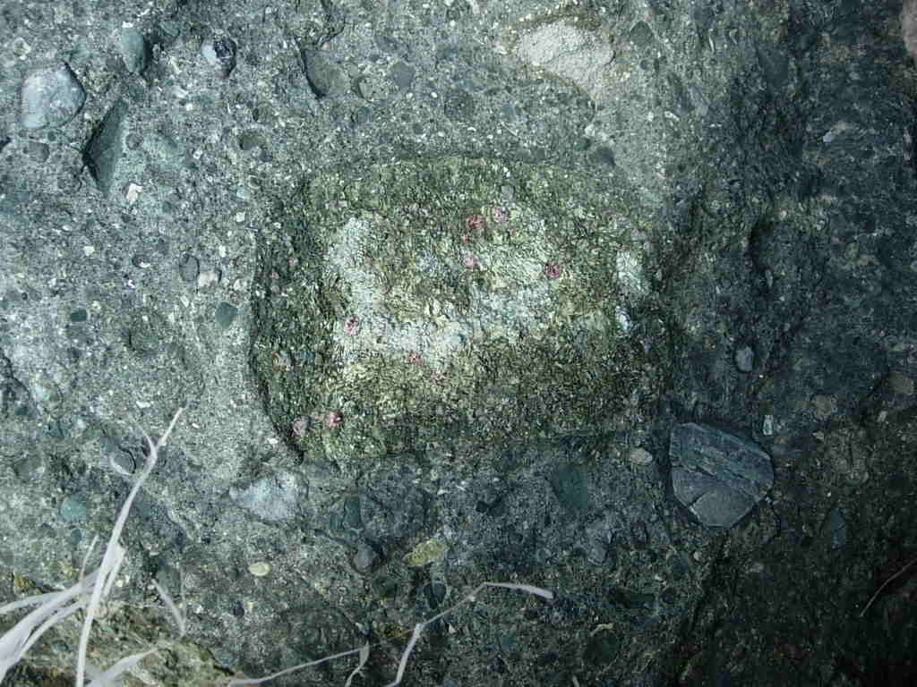
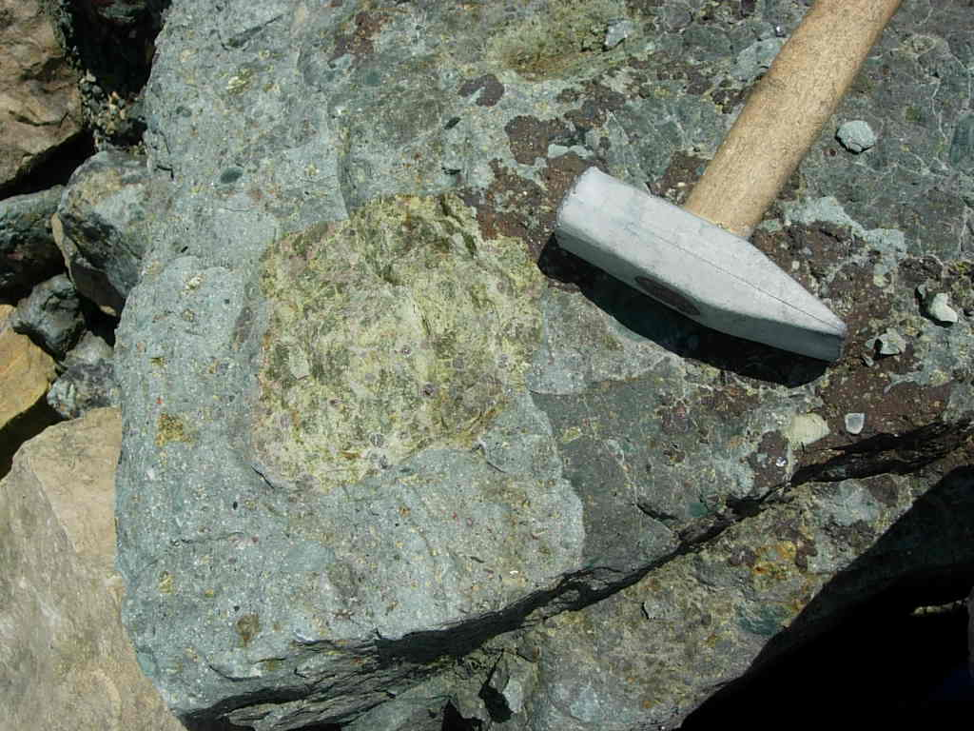
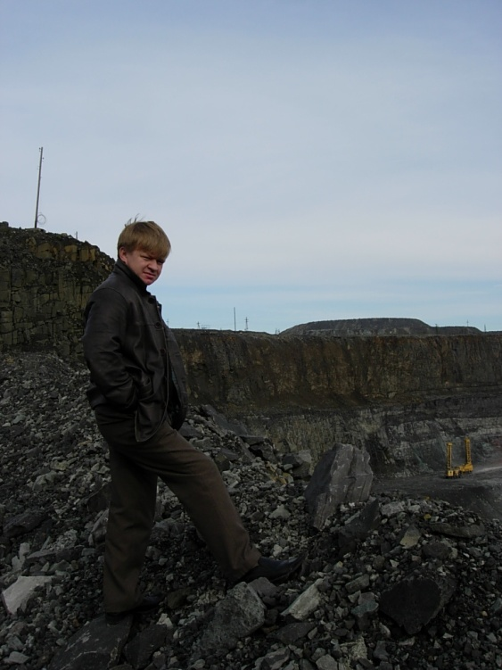
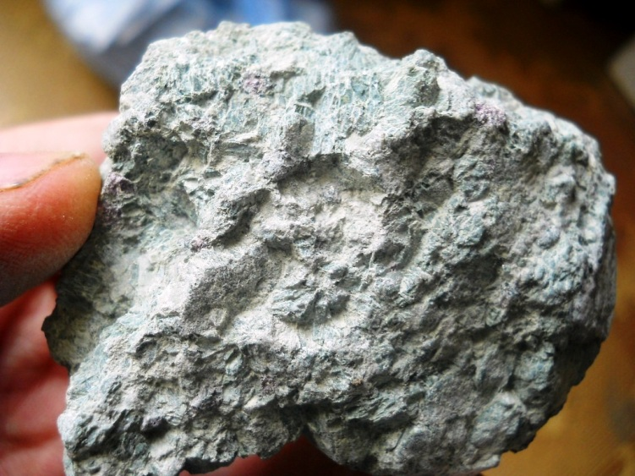
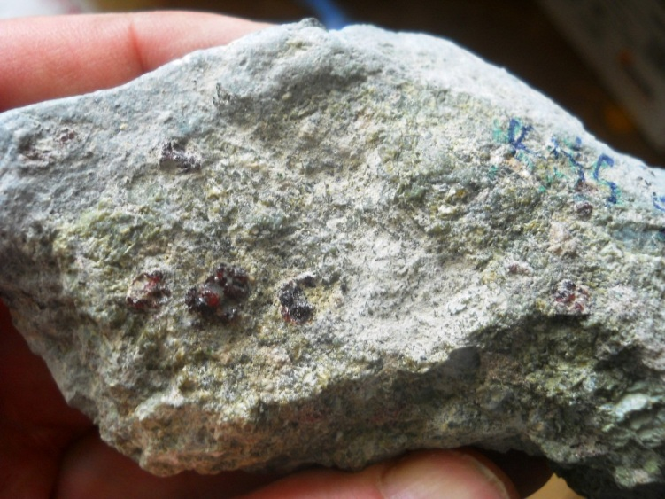
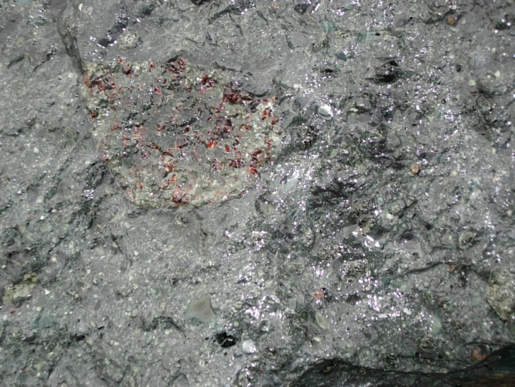
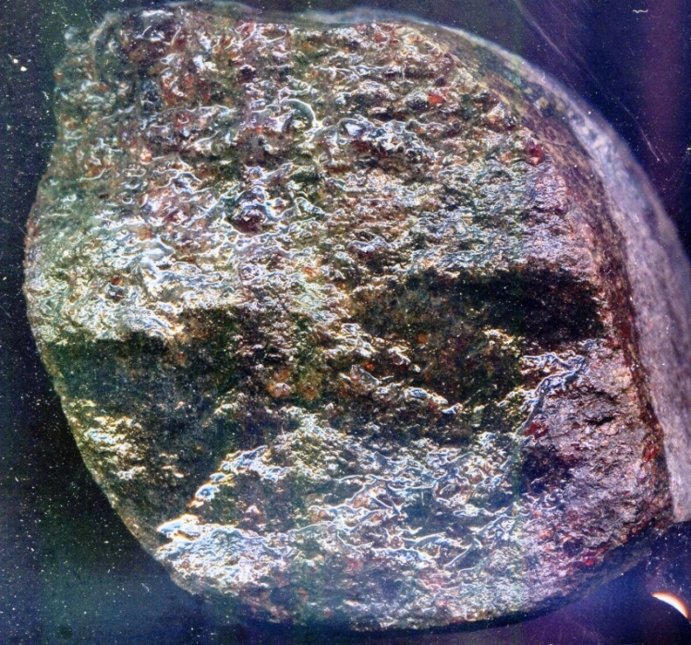
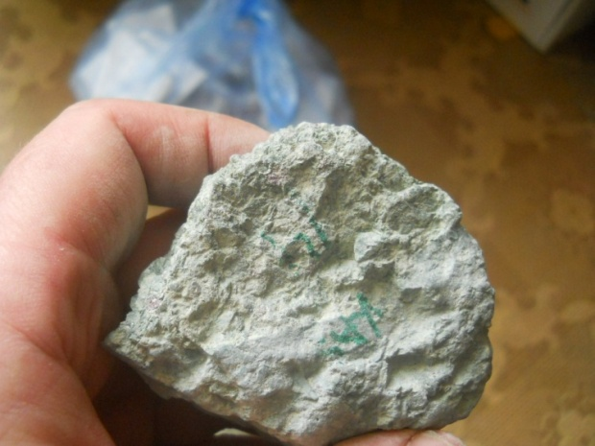
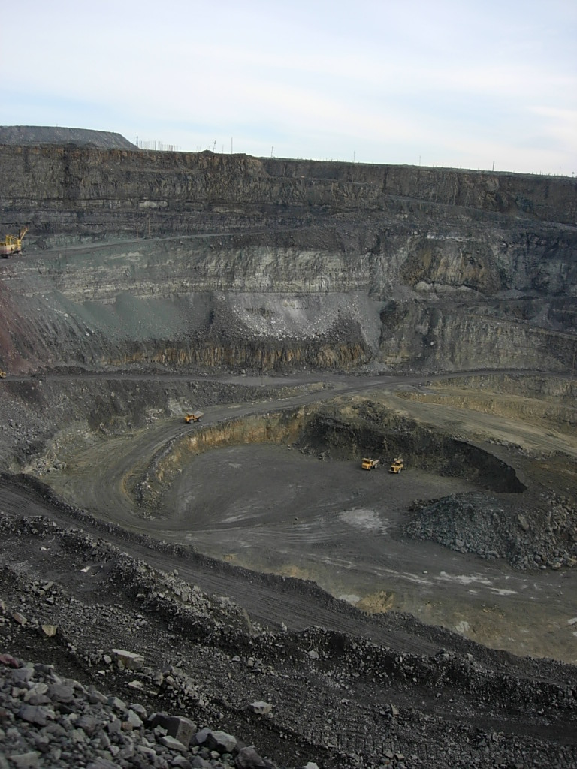
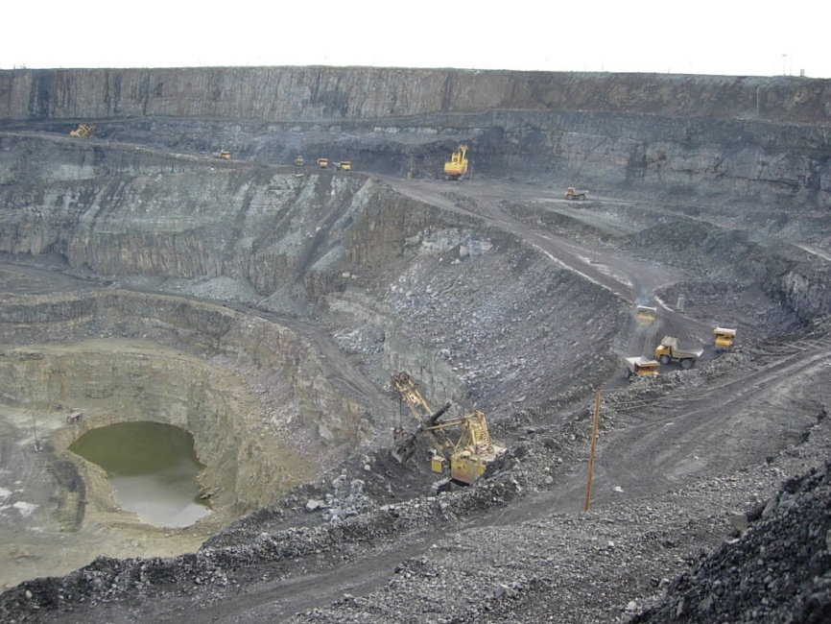
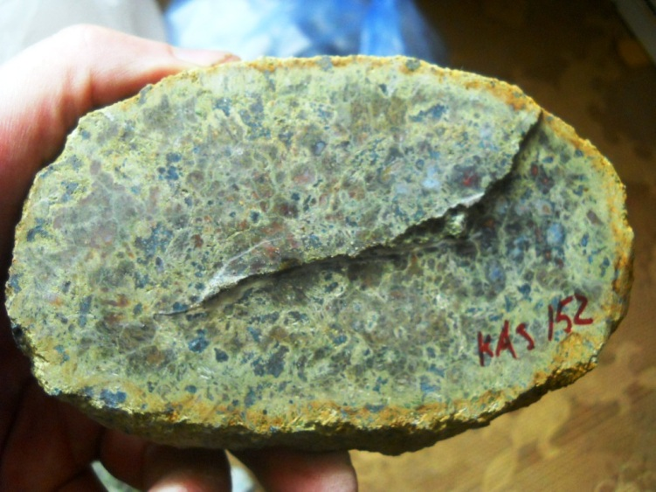
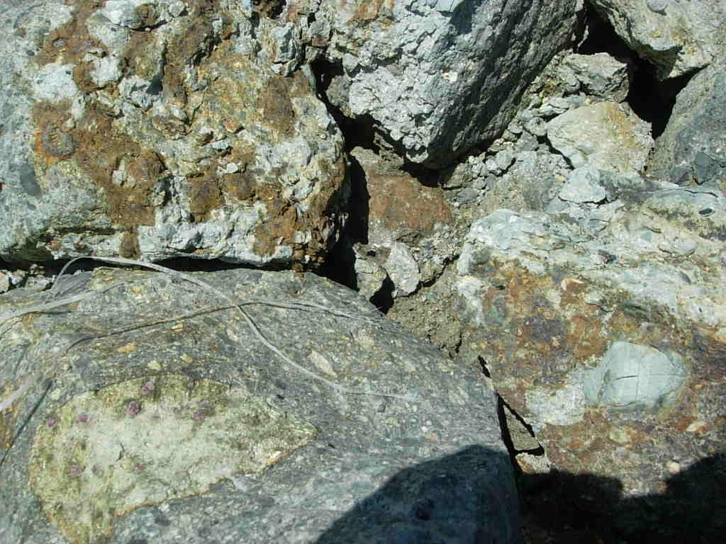
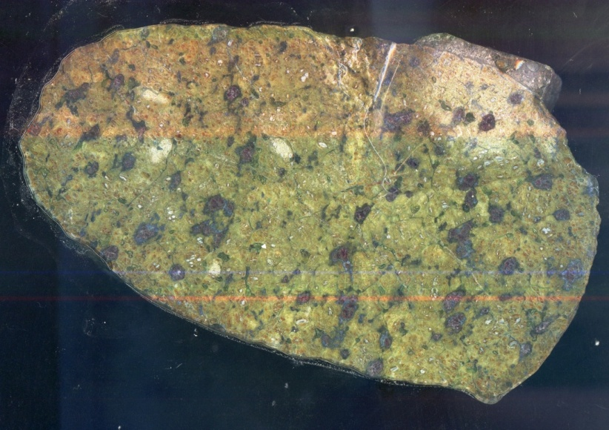
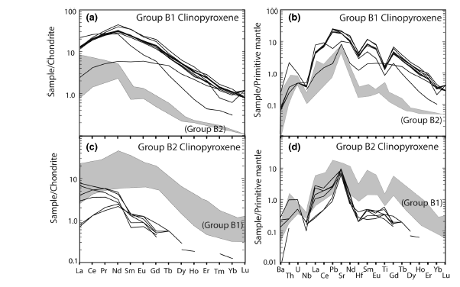
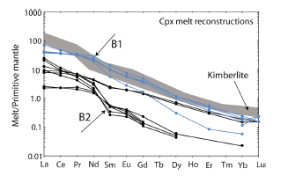
Garnet and chromite- bearing mantle peridotite xenoliths from
Komsomolskaya pipe, Alakit field, Yakutia
Igor Ashchepkov (1), Alla Logvinova (1), Nikolai Valdykin (2), Igor Makovchuk (3), Mikhail Karpenko (3),
Zdislav Spetsius (3), Olga Khmelnikova (1), and Stanislav Palessky (1)
Sobolev Institute of Geology and Mineralogy SD RAS, Koptyug ave 3, Novosibirsk, Russia (1)
Institute of Geochemistry SB RAS, Irkutsk Russia, (2), ALROSA Stock company, Russia (3)
Garnets
Fresh xenoliths in Alakit field in Siberian platform are rare. In the xenoliths from Komsomolskaya pipe there were found 30 xenoliths with fresh Cpx, Gar as well as chromites, phlogopites and ilmenites which allows to construct the Cpx - based geotherm which was before constructed for the Yubileynaya pipe (Ashchepkov et al., 2004). The comparison of the garnets from the breccias and porphyric kimberlites show more depleted and Cr- rich varieties of garnets as it is common for the other pipes. Only relatively fresh material from the dark - grey breccia good relatively fresh xenoliths could be used for the
mineral thermobarometry. Large xenolths from the Komsomolskaya pipe belong mainly to the Gar harzburgite or rarely refertilized lherzolite types as also detected on the Cr2O3 - CaO diagram where they belong mainly to the 5-11% Cr2O3 interval. The low Cr varieties are mainly referring to the Fe- enriched pyroxenites or to Phl metasomatites. In SCLM beneath Komsomolskaya pipe is essentially more heated then those beneath Yubileynaya and Sytykanskaya pipes and in lower part they are close to the PTXFO2 are closer in conditions to the ilmenites which determined the . Peridotites from the lithosphere base (7-6GPa) are enriched in Fe and belong to the porphyroclustic or deformed type by chemistry Fe# =0.14-0.15. the relatively HT conditions were determined also for the peridotites from the 5.0-4. GPa. The most of the Cpx- refertilized varieties give the conditions of the middle part of the mantle section. Their garnets are enriched in CaO probably reflection reactions with the Ca- rich protokimberlites. The Na- richterite bearin xenoliths are from the same PT interval The cold clot in the 60-5.5 GPa (34 mwm-2) are represented by the peridotites of low Fe# 7-9 Fe- low peridotites with the garnets of sub-Ca types.
But there are also varieties of reduced Cr and the Fe-enriched which are closer to the pyroxenites or Phl metasomatites which in Pt are from the upper part of mantle sections. The picroilmenites from the Komsomolskaya pipe belong to the two pressure intervals 6.5 to 5.0 and 5.0 to 4.0 GPa. They are forming two differentiations branches in the lower part of the mantle section. In the upper part the Cr- content is continuously rising together with Fe due to the AFC differentiation. But the typical metasomatic sporadic ilmenites are close in low Fe# 7-9 to the mantle peridotites. they are essentially higher in Cr2O3 to 4-6%. But ilmenites from refertilized peridotites have only 2-3 Cr2O3. The trace elements for the Cpx of mantle peridotites of refertilized type reveal high inclination of the REE patterns. they reveal Nb-Ta , Zr depression and varying peak in Pb but enrichment in U. Many of garnet shopw the slightly S- type REE pattern.
Grants 11-05-00060; 11-05-91060-PICS and joint research projects of IGM SB RAS and ALROSA Stock company 77-2, 65-03, 02-05.
Spinels
Amphiboles
TRE for
mantle peridotites
Clinopyroxenes
Komsomolskaya
TRE for eclogites
(Pettit- Fishes etc, 2014)
Ilmenites
Sytykanskaya

