Slide 1


Stream response as the sum of flow component responses
Mike Stewart
Aquifer Dynamics & GNS Science, NZ
m.stewart@gns.cri.nz
www.aquiferdynamics.com

Slide 2
This talk presents
new approaches for both
base flow separation and
recession analysis

Slide 3
Baseflow separation
The new method is based on tracer (e.g. stable isotope or chloride) evidence showing fast base flow response to rainfall due to celerity (‘bump’)
and slow recharge of aquifers during wet periods (‘rise’)
Hence the name ‘bump and rise’ method or BRM

Slide 4
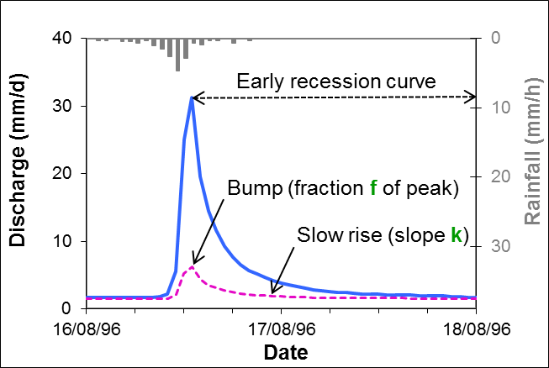
The BRM base flow separation method uses parameters f and k

Slide 5
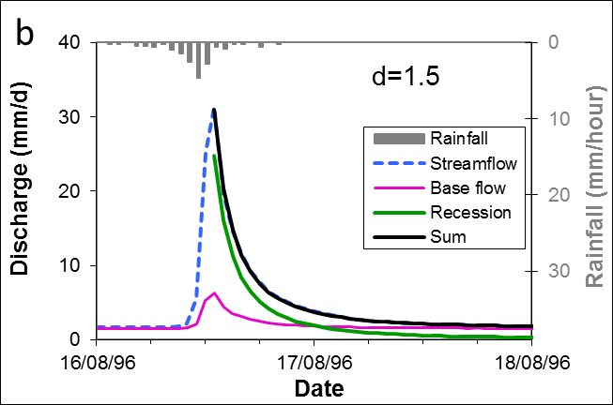
Optimisation process gives f and k
The sum of a fast recession and base flow is fitted to the streamflow by adjusting f and k

Slide 6
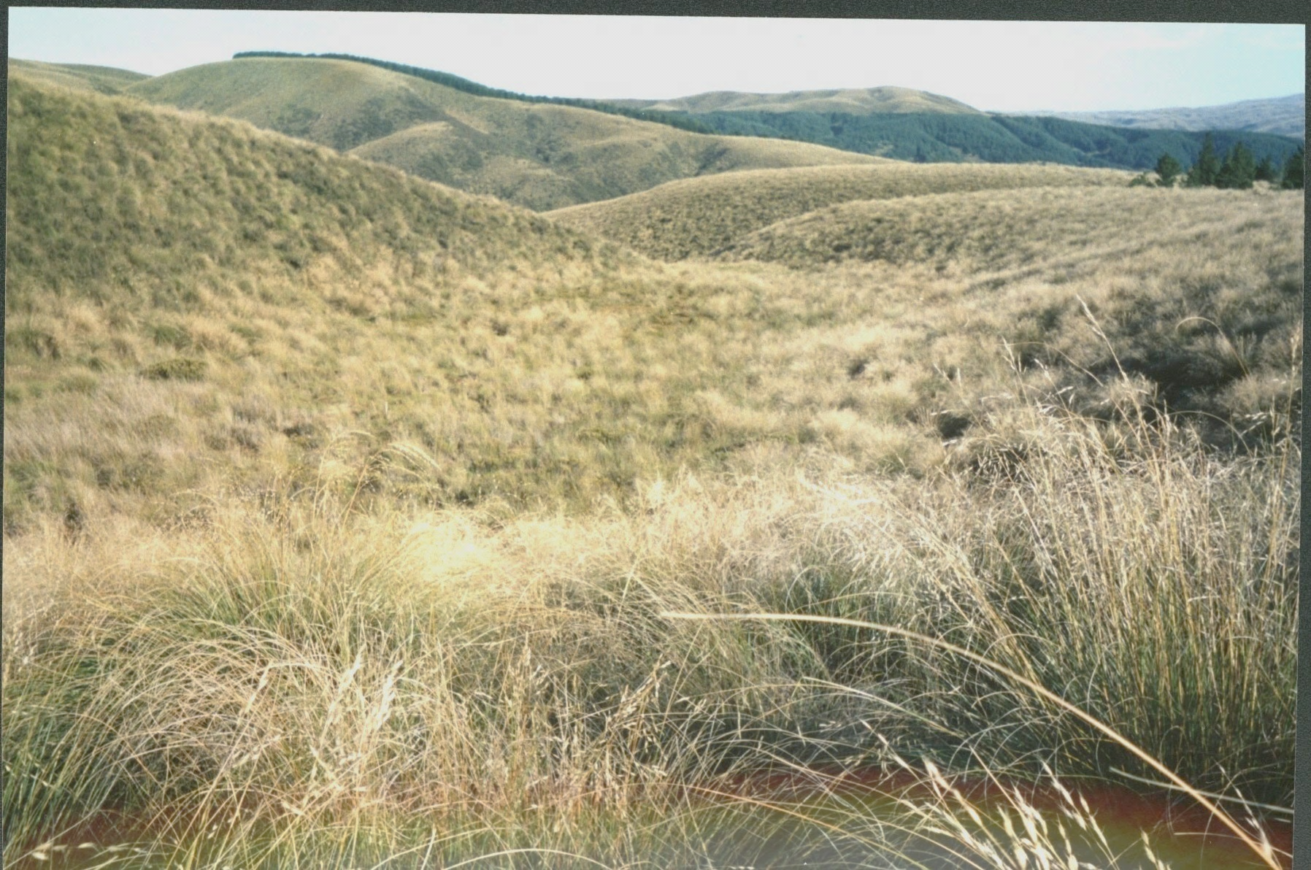
Glendhu GH1 Catchment: Tussock grassland
Outlet stream
Wetland

Slide 7
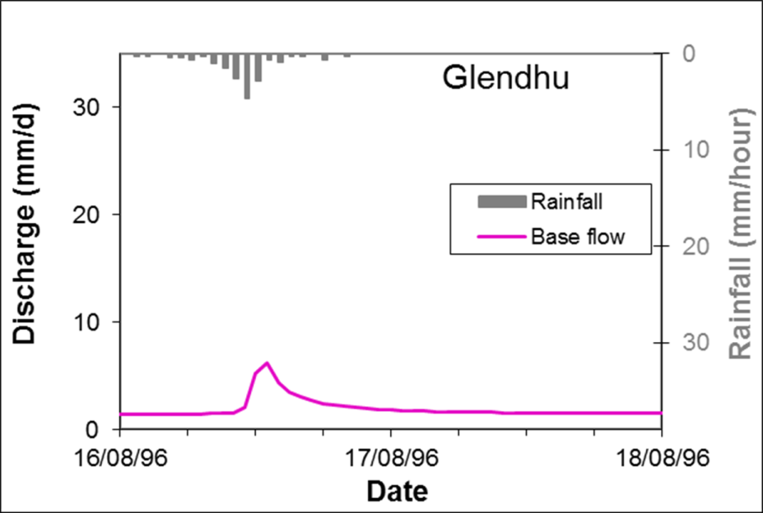
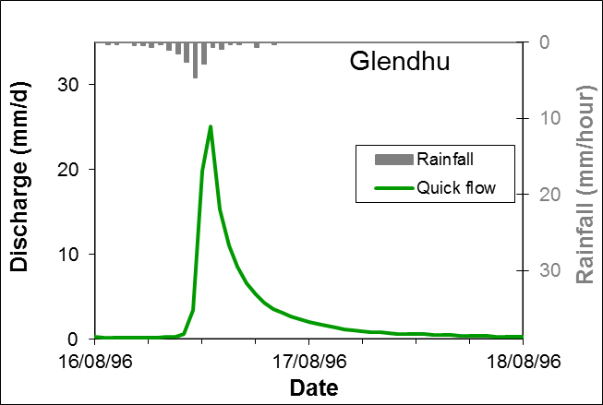
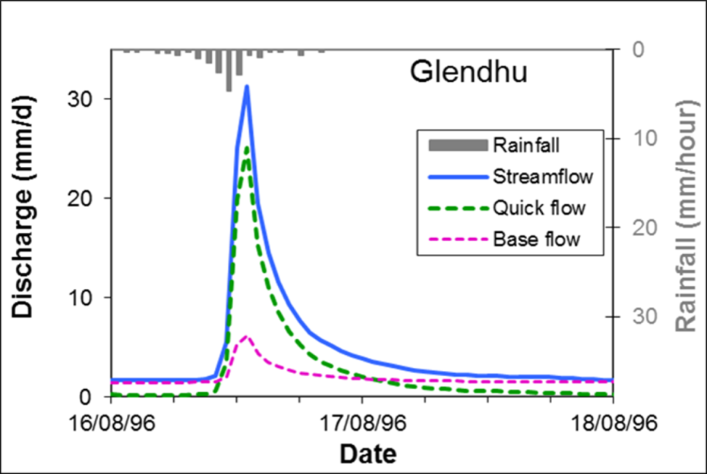
Example: Glendhu Catchment
1st stream (base flow)
2nd stream (quick flow)
Together they produce streamflow

Slide 8
The nature of base flow & quick flow
Base flow is | Quick flow is
Water with long transit times (average 10 years by tritium) Supplied by ‘slow’ storage reservoirs (groundwater) Responsive to rainfall on short time scales (as shown by tracers) Approximately 50% of total runoff | Water with short transit times (minutes to months) Supplied by ‘fast’ storage reservoirs (event water, soil water, perched water, bank storage/riparian zone water, ...) Equal to streamflow – base flow

Slide 9
Example: Glendhu Catchment
1st stream (base flow)
2nd stream (quick flow)
Together they produce streamflow

Slide 10
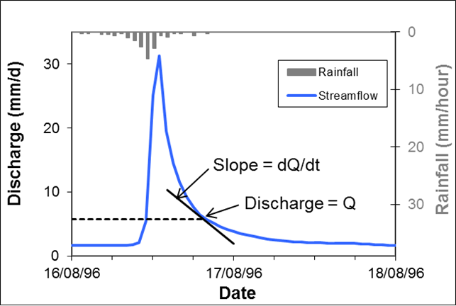
Recession analysis
The new method consists of analysing separated quick flow and base flow components as well as streamflow
The analysis is made by plotting discharge (Q) versus slope (dQ/dt) on log scales
This is called a ‘recession plot’

Slide 11
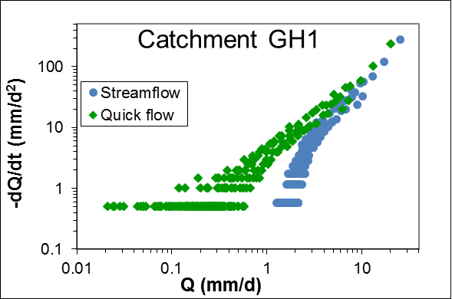
Recession plot for streamflow and quick flow (August 1996)

Slide 12

Analysing recessions
The power law expression is fitted to the points in the recession plot
$$−\frac{dQ}{dt}=cQ^{d}$$
Different values of exponent d indicate different types of storage reservoirs (e.g. d = 1 shows linear storage, d = 1.5 non-linear quadratic, etc.)

Slide 13
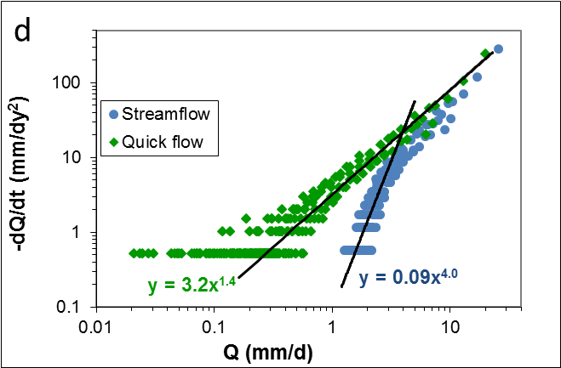
Streamflow has slope ~ 4,
quick flow has quadratic slope ~ 1.5
Catchment GH1

Slide 14
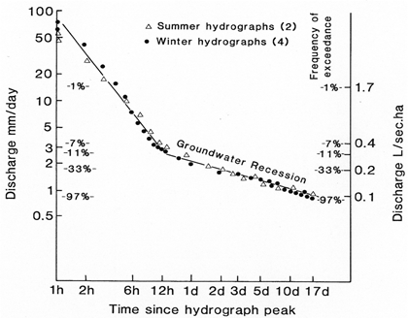
‘Master’ recession curve for GH1
Inflection point
From Pearce et al., 1984

Slide 15
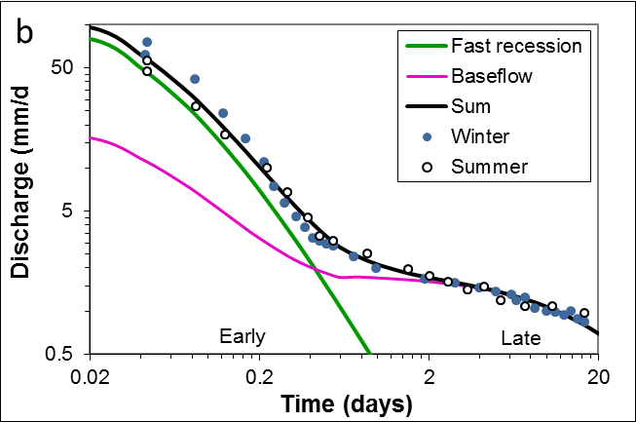
‘Master’ recession curve replotted
Fitted by the sum of the base flow and fast recession
Inflection point

Slide 16
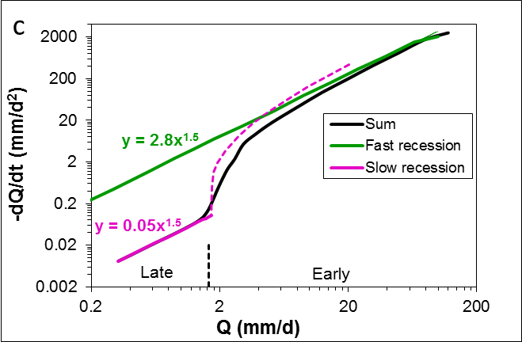
Recession plot of ‘master’ recession curve
This slope is
meaningless

Slide 17
Conclusions
A new evidence-based base flow separation method is presented
Using this, it is contended that recession analysis should be applied to separated components (quick flow and base flow) rather than to streamflow alone,
because the latter gives misleading results due to streamflow being a mixture of the two components

Slide 18
Conclusions (2)
When this is done, quick flow and base flow are found to have slopes on recession plots of 1.5, indicating that water is stored in quadratic reservoirs for both

Slide 19
References
Stewart M.K., 2013: New base flow separation and recession analysis methods for streamflow. Submitted to Water Resources Research, 11 Oct. 2013.
Pearce, A. J., L. K. Rowe, and C. L. O’Loughlin 1984: J.Hydrol. (NZ) 23, 60-72.

