Slide 1




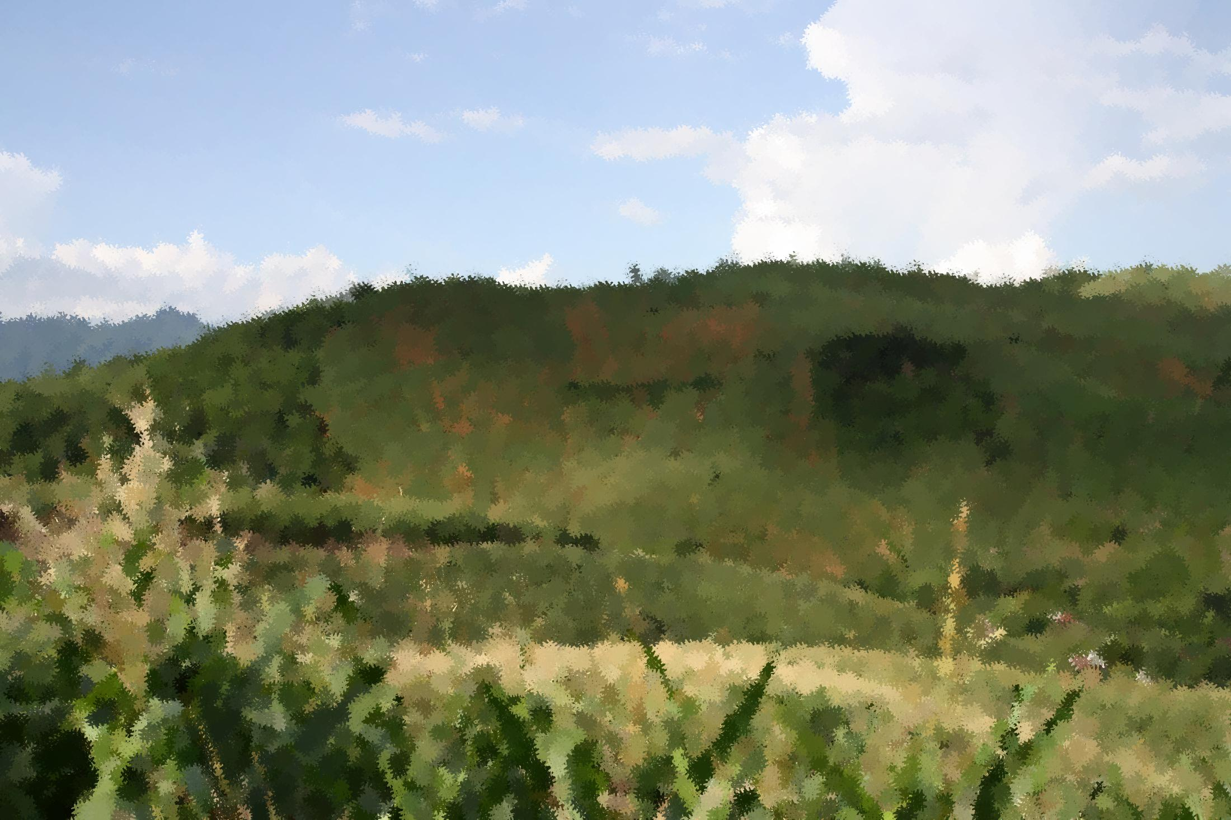
SFB 564
The Uplands Program
Effects of Land Use Change on
Soil Organic Carbon Dynamics
in Northwestern Vietnam
Volker Häring¹,
Holger Fischer²,
Georg Cadisch³,
Karl Stahr²
¹Dpt. of soil science and soil ecology, University of Bochum, Germany
²Institute of soil science and land evaluation, University of Hohenheim, Germany
³Institute of plant production in the tropics and subtropics, University of Hohenheim, Germany
EGU 2014
Notes:
1
1
1
1
Willkommen

Slide 2
Introduction
Understanding of SOC dynamics is relevant for:
Climate change
Soil fertility
SOC changes affect e.g.
Cation exchange capacity
Aggregate stability
Field capacity
Soils Athmosphere Vegetation
1500 Pg 730 Pg 500 Pg C
(IPCC et al., 2000)
Land use change from forest to crop lead to a net decline of 20-40% of initial SOC (Murty et al., 2002)
Soils are a large but labile C sink!
Notes:
Soil degradation and climate change are two global challenges, which are directly linked to each other by soil organic carbon (SOC) dynamics

Slide 3
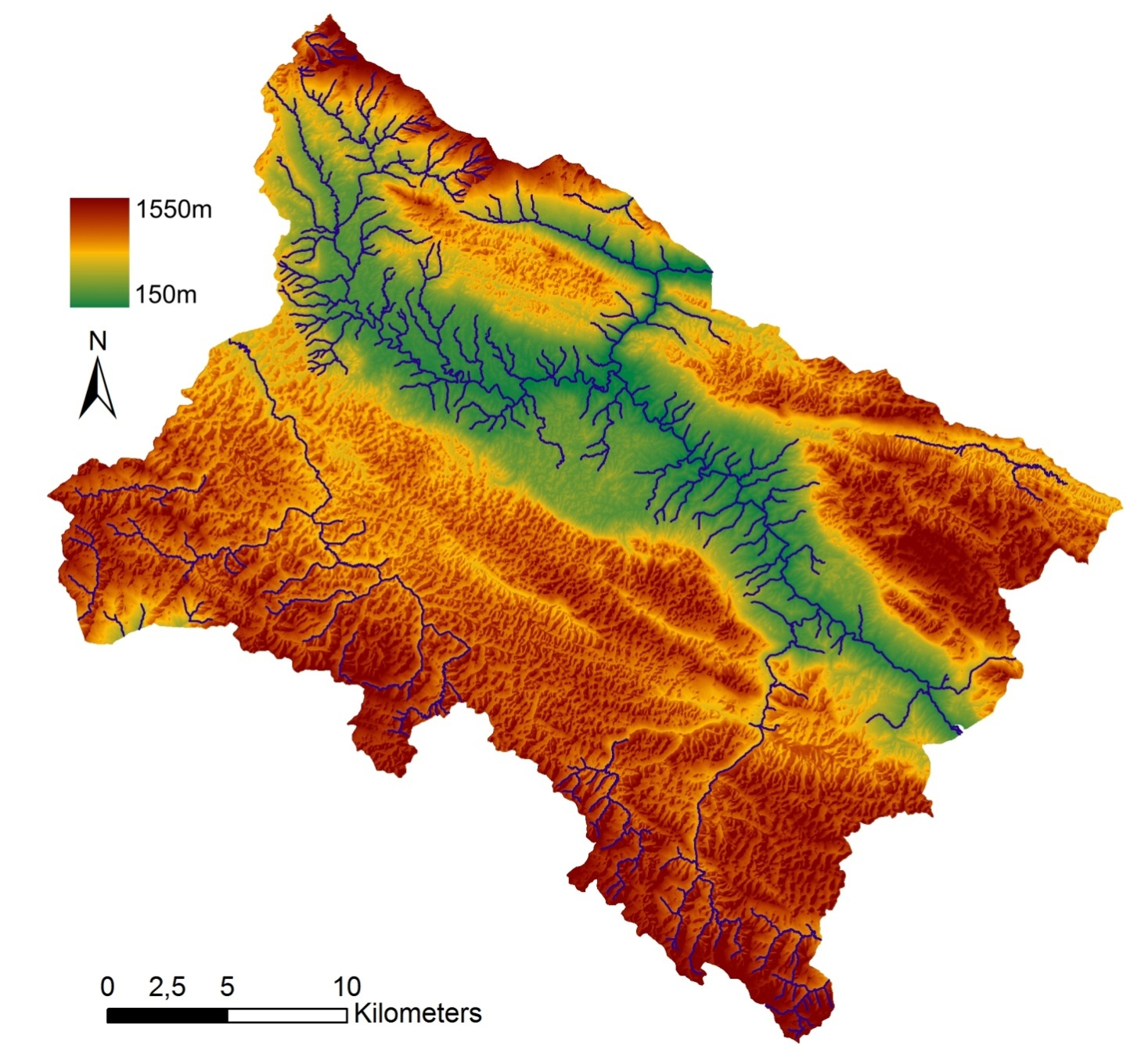
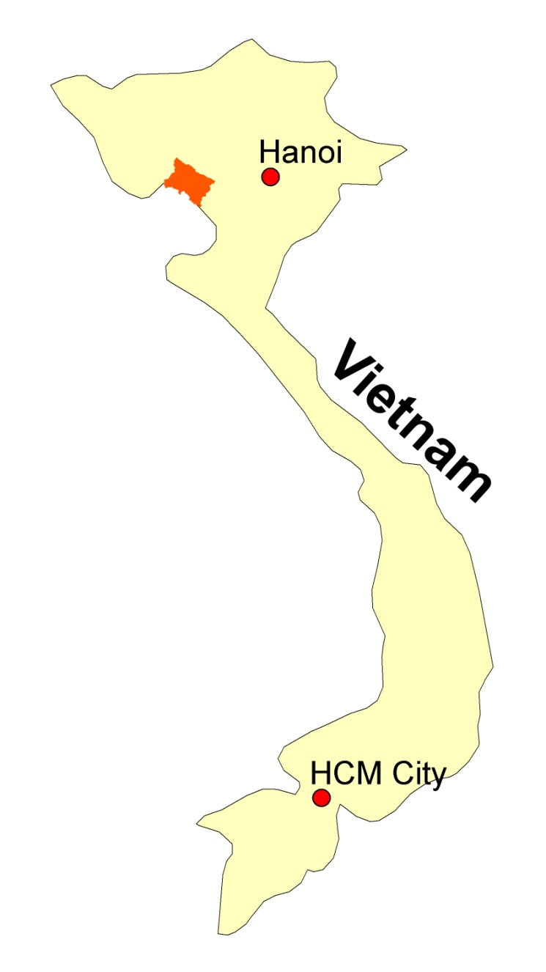
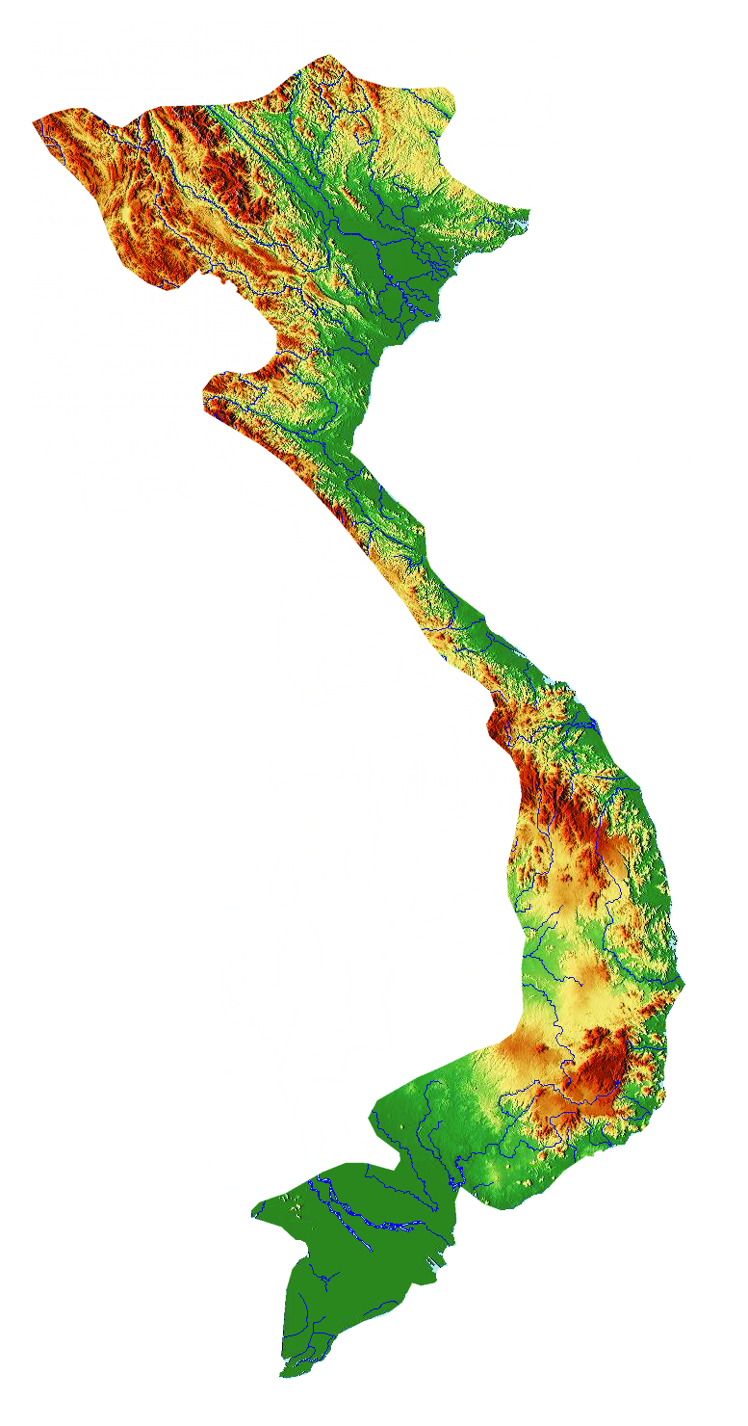
Research sites
Hanoi
Yen Chau
Cutanic Alisol (Chromic) on limestone
Cutanic Luvisol on clayey shale
Vietnam
Vertisol on marl
Research sites in
Yen Chau district

Slide 4
Aims & Methods
1. Determination of net SOC input, SOC decomposition, SOC erosion
Chronosequences
C_{org}, δ¹³C, bulk density
¹³⁷Cs
Sampling 0-30 cm depth
CIDE approach
2. Determination of the effects of tillage on SOC dynamics
Tillage vs. natural decomp.

Slide 5
CIDE (Carbon Input, Decomposition and Erosion)
CIDE overcomes traditional δ¹³C based mass balance approaches and more reliably determines C dynamics on erosion prone slopes
  CIDE considers past soil erosion
    Otherwise carbon budgeting underestimates C loss
  2. CIDE considers erosion induced soil profile truncation:
  Otherwise lower C content and higher δ¹³C are measured although no
  cultivation took place
Soil surface (t₁)
t₁
Sampling depth with mean value
t₀
Decomposition
Erosion
C Input
t₀
t₁
Häring et al. (2013a) EJSS 65 (5)
Notes:
The values derived from the unadjusted mass balance equation (equation 2), represented a combined effect of erosion induced subsoil incorporation and decomposition or SOC input.

Slide 6
SOC after land use change
Apparent net SOC change (depth of each site bulk density corrected)
Alisol
Luvisol
Vertisol
Means ±SE; n=5
Exponential net SOC decline with time on all soil types
Häring et al. (2013b) SBB 65, 158-167

Slide 7
SOC after land use change
Apparent forest and maize derived SOC change (based on total C, bulk density and δ¹³C)
Alisol
Luvisol
Vertisol
Maize SOC
Forest SOC
Means ±SE; n=5
Maize SOC input increased linearly with time
Input is low: After 15 years it is still one order of magnitude smaller than forest SOC
Häring et al. (2013b) SBB 65, 158-167
Notes:
After 15 years maize SOC was still one order of magnitude smaller than forest SOC.

Slide 8
SOC loss after land use change
CIDE derived total SOC loss and CIDE decomposition vs. unadjusted SOC loss
Alisol
Luvisol
Vertisol
R²=0.81
R²=0.84
R²=0.79
R²=0.69
R²=0.62
R²=0.32
R²=0.92
R²=0.65
R²=0.88
Means ±SE; n=5
CIDE total SOC loss is higher than apparent SOC loss (at 15 years) by
6% on Alisol
28% on Luvisol
32% on Vertisol
Häring et al. (2013b) SBB 65, 158-167
Notes:
The unadjusted measurements deliver on SOC loss rate: (1) loss of forest SOC
The CIDE approach delivered two rates: (1) forest derived SOC loss by decomposition, (2) SOC loss by soil erosion
The differences between CIDE adjusted and unadjusted values were quantified by comparing the mean values of all sites within a soil type.
CIDE approach yielded a higher total SOC loss, a lower decomposition than the unadjusted SOC loss.
The values derived from the unadjusted mass balance equation (equation 2), represented a combined effect of erosion induced subsoil incorporation and decomposition or SOC input.

Slide 9
SOC input after land use change
CIDE vs. apparent SOC input
Alisol
Luvisol
Vertisol
R²=0.15
R²=0.16
R²=0.88
R²=0.78
R²=0.81
R²=0.46
Means ±SE; n=5
CIDE SOC input is lower than apparent SOC input (at 15 years) by
14% on Alisol
21% on Luvisol
41% on Vertisol
Häring et al. (2013b) SBB 65, 158-167
Notes:
The maize SOC input rates were slow and not significantly different between the soil types (Figure 3, Table 5).
The rates ranged between 0.03 kg m⁻² a⁻¹ on Luvisol and Vertisol
Misrepresentation relative to the maize SOC stocks after 15 years derived from a linear fit

Slide 10
Tillage vs. natural decomposition
Evidence for tillage decomp. by change of forest derived SOC with depth and time
Alisol
Luvisol
Vertisol
R²=0.31
R²=0.03
R²=0.04
R²=0.04
R²=0.31
R²=0.10
Means ±SE; n=5
Häring et al. (2013b) SBB 65, 158-167
Decline of linear fits of ratios over time indicate that in one layer relative decomposition is higher than in the other
Decline between 0-10 & 10-20 cm but no significant decline between 10-20 & 20-30 cm
No significant decline in Vertisols at all depths
Tillage accelerated decomposition in the plough layer (0-10 cm) on Luvisol and Alisol
Notes:
Mean decomposition peaked in the top 10 cm of all soil types
The influence of soil depth on SOC dynamics was highlighted by plotting the proportion of CIDE adjusted forest derived SOC (relative to the sum of CIDE forest SOC [kg m⁻²] in 0-30 cm) and CIDE derived maize SOC input (relative to the sum of maize SOC [kg m⁻²] in 0-30 cm) of the sampled depth increments (0-10, 10-20 and 20-30 cm) against time
Weak correlations were found between time and the proportions of forest SOC among all depth increments and soil types.
These two observations were indicated by linear fits of forest SOC depth proportion against time, which slowly decrease at 0-10 cm and slowly increase at 20-30 cm on all soil types (Figure 5).

Slide 11
Tillage induced decomposition
Tillage decomposition rate calculated as offset between decline at 0-10 cm and parallel distribution of ratio with time
Alisol f(t) = 0.05t R² = 0.15
Luvisol f(t) = 0.04t R² = 0.40
Vertisol f(t) = 0.001t R² = 0.002
Means ±SE; n=5
Tillage decomposition accounted for 3 to 34% of total decomposition
Häring et al. (2013b) SBB 65, 158-167
Notes:
Mean decomposition peaked in the top 10 cm of all soil types
The influence of soil depth on SOC dynamics was highlighted by plotting the proportion of CIDE adjusted forest derived SOC (relative to the sum of CIDE forest SOC [kg m⁻²] in 0-30 cm) and CIDE derived maize SOC input (relative to the sum of maize SOC [kg m⁻²] in 0-30 cm) of the sampled depth increments (0-10, 10-20 and 20-30 cm) against time
Weak correlations were found between time and the proportions of forest SOC among all depth increments and soil types.
These two observations were indicated by linear fits of forest SOC depth proportion against time, which slowly decrease at 0-10 cm and slowly increase at 20-30 cm on all soil types (Figure 5).

Slide 12
Conclusions
A new approach (CIDE) to determine SOC dynamics on erosion prone slopes was presented
SOC loss on erosion prone sites is underestimated and SOC input overestimated with traditional approaches
Distribution of forest derived SOC with depth and time revealed tillage induced decomposition
Tillage increased decomposition (3-34% of total decomposition) in the plough layer
References:
Häring V. et al. (2013a): Improved ¹³C method to assess soil organic carbon dynamics on sites affected by soil erosion. EJSS 65 (5), 639‐650.
Häring V. et al. (2013b): Implication of erosion on the assessment of decomposition and humification of soil organic carbon after land use change in tropical agricultural systems. SBB 65, 158-167

Slide 13


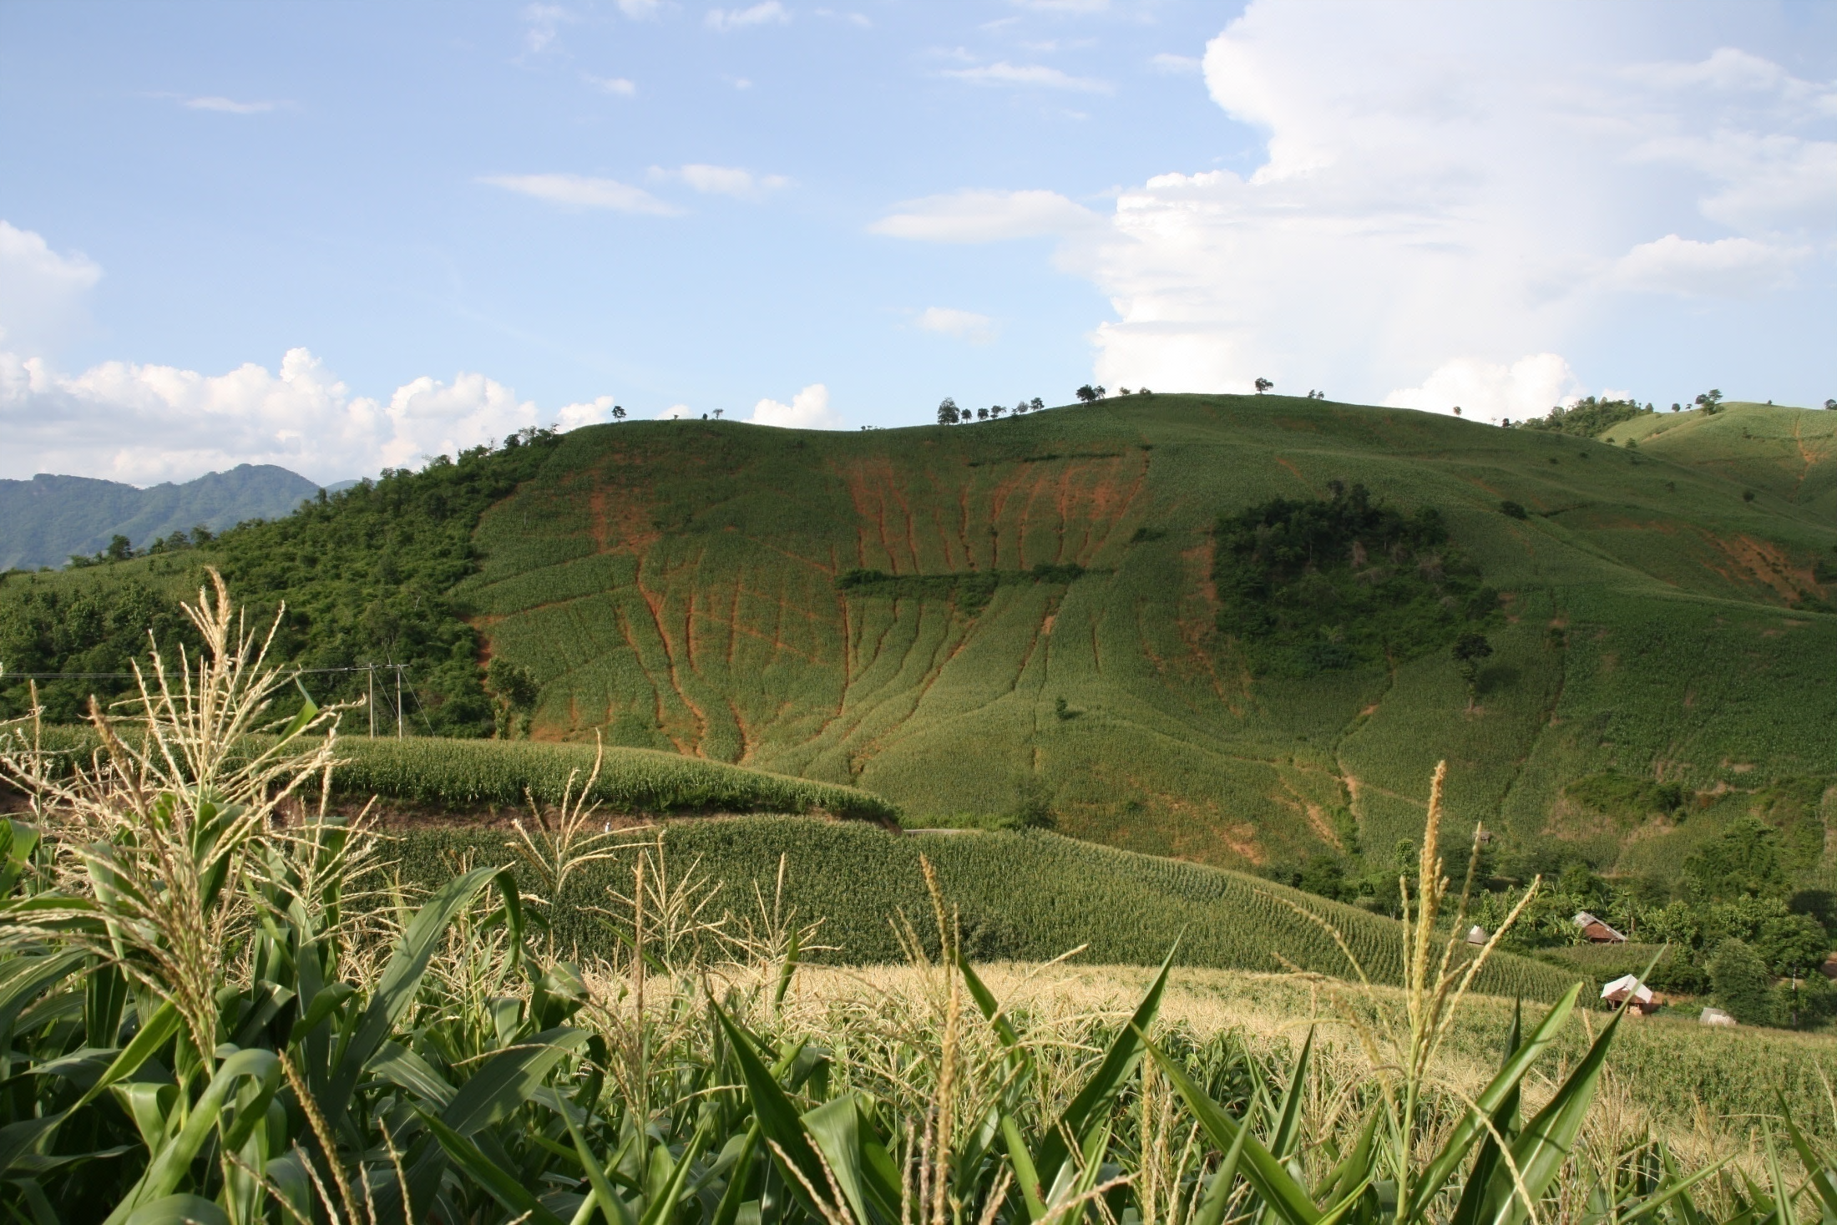
SFB 564
Thank you for your attention!
Acknowledgements
…the DFG for funding,
…Thuy Nguyen Huu and Nguyen Thuy Ha for field assistance,
…M.Sc. students Christian Schehle and Julia Auber
…Bachelor student Steffen Schweizer
…Trainees Nadja Reinhardt and Laura Kiff
…our Lab-Team in Hohenheim
…and all contributing farmers in Vietnam
Notes:
Between 1960 and 1975: 1 million kinh (lowland people) migrated into Uplands of northern Vietnam
Between 1960 and 1984: 300% population increase due to immigration + and high fertility rates

