Slide 1
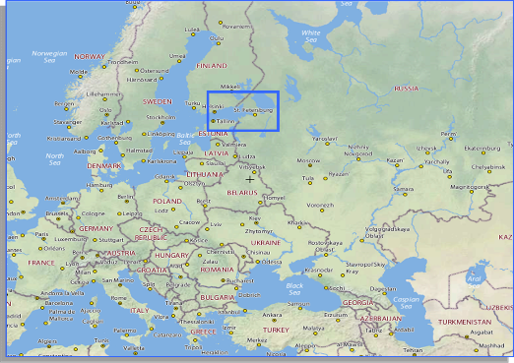
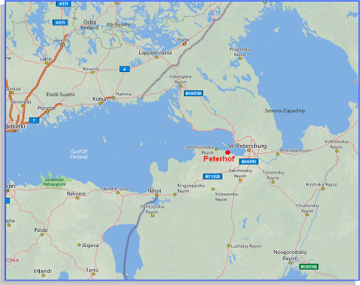
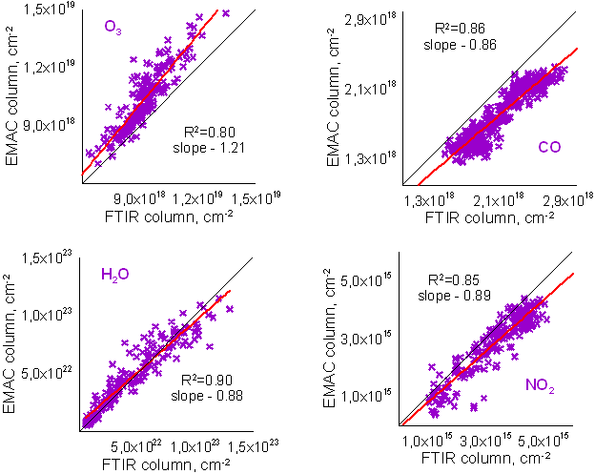
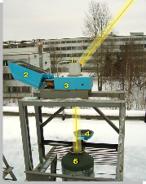
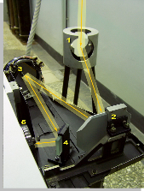
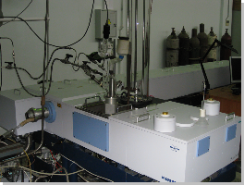
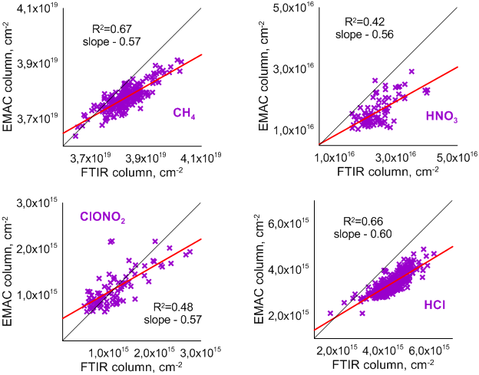
Comparison of ground-based FTIR measurements and EMAC model simulations of trace-gases columns near St. Petersburg (Russia) in 2009-2012
Yana Virolainen (1), Maria Makarova (1), Dmitry Ionov (1), Alexander Polyakov (1), Oliver Kirner (2), Yury Timofeyev (1), Anatoly Poberovsky (1), and Hamud Imhasin (1)
St.Petersburg State University, St. Petersburg, Russian Federation, (2) Steinbuch Centre for Computing, Karlsruhe Institute of Technology, Karlsruhe, Germany
The EMAC model is a numerical chemistry and climate simulation system that includes sub-models describing troposphere and middle atmosphere processes and their interaction with oceans, land and human influences. The simulation includes a comprehensive atmospheric chemistry setup for the troposphere, the stratosphere and the lower mesosphere. We applied the EMAC (ECHAM5 version 5.3.01, MESSy version 1.10) in the T42L39MAresolution, i.e. with a spherical truncation of T42 (corresponding to a quadratic Gaussian grid of approximately 2.8 by 2.8 degrees in latitude and longitude) with 39 vertical hybrid pressure levels up to 0.01 hPa.
Gas (number of days) | Method | Mean ± variability, cm⁻² | Bias ± SD, % | Correlation coefficient
H₂O (191) | FTIR | (4.49±2.99) × 10²² | -3.1 ± 21.5 | 0.95±0.01
 | EMAC | (4.62±2.79) × 10²²
O₃ (189) | FTIR | (9.25±1.24) × 10¹⁸ | -12.5 ± 8.2 | 0.91±0.01
 | EMAC | (10.4±1.7) × 10¹⁸
ClONO₂ (89) | FTIR | (1.12±0.50) × 10¹⁵ | -0.7 ± 32.5 | 0.70±0.06
 | EMAC | (1.13±0.41) × 10¹⁵
HNO₃ (89) | FTIR | (2.39±0.51) × 10¹⁶ | +33.2 ± 16.8 | 0.65±0.06
 | EMAC | (1.60±0.44) × 10¹⁶
HCl (309) | FTIR | (4.36±0.60) × 10¹⁵ | +22 ± 8.1 | 0.81±0.02
 | EMAC | (3.40±0.44) × 10¹⁵
CH₄ (232) | FTIR | (3.83±0.06) × 10¹⁹ | +1.4 ± 1.0 | 0.82±0.02
 | EMAC | (3.77±0.04) × 10¹⁹
CO (452) | FTIR | (2.12±0.33) ×10¹⁸ | +14.0 ± 5.7 | 0.93±0.01
 | EMAC | (1.82±0.31)×10¹⁸
NO₂ (233) | FTIR | (3.32±1.10) × 10¹⁵ | +14.1 ± 13.2 | 0.92±0.01
 | EMAC | (2.85±1.05) × 10¹⁵
Gases | Spectral windows, сm⁻¹ | Random error of measurement | Influenced gases
H₂O | 1110.00-1113.00 1117.30-1117.90 1120.10-1122.00 1196.00-1200.40 1220.50-1221.50 1251.75-1253.00 | 0.9-1.3% | N₂O, CO₂, CH₄, O₃
O₃ | 991.25-993.80 1001.47-1003.04 1005.00-1006.90 1007.35-1009.00 1011.15-1013.55 | 1-2% | H₂O, CO₂ , C₂H₄
ClONO₂ | 779.0-779.8 780.0-780.3 780.3-781.3 | 15-20% | H₂O, CO₂, O₃, HNO₃, C₂H₂
HNO₃ | 867.00-869.60 872.80-875.20 | 1-2% | H₂O, CO₂, NO₂
HCl | 2925.75-2926.00 2727.73-2727.83 2775.70-2775.80 2925.80-2926.00 | 2-5% | CH₄, H₂O
CH₄ | 2613.7-2615.4 2921.0–2921.6 2835.5-2835.8 | 0.3-0.5% | H₂O, HDO, CO₂, NO₂
CO | 2057.7-2058.0 2069.56-2069.76 2157.5-2159.15 | 1.1-1.4% | O₃,CO₂,OCS,N₂O,H₂O
NO₂ | 2914.590-2914.707 | 8-12% | CH₄, HDO
Instrumentation | solar FTIR-spectrometer Bruker 125HR
Spectral resolution | ~0.005 cm⁻¹
Location | Peterhof - St. Petersburg (59.88 N, 29.82 E)
Time series | 2009-2012

Slide 2
Comparison of ground-based FTIR measurements and EMAC model simulations of trace-gases columns near St. Petersburg (Russia) in 2009-2012
Seasonal cycle

Slide 3
Comparison of ground-based FTIR measurements and EMAC model simulations of trace-gases columns near St. Petersburg (Russia) in 2009-2012
Distribution of gases total columns

