Slide 1
Investigations on the links between rain intensity or reflectivity structure estimated from radar and drop size distributions
S. Hachani^{1,2} ,B. Boudevillain¹, Z. Bargaoui², and G. Delrieu¹
¹ University of Grenoble(UJF/ LTHE ) ² University Tunis el Manar (ENIT/LMHE)
EGU, General Assembly 2015 Vienna | Austria | 12 – 17 April 2015

Slide 2
1
DSD=Drop Size Distribution
DSD: Number of raindrops per unit of volume and class of diameters
(1)
M_{n}: Statistical moment of order n of DSD
Exemple of DSD
Measured with a disdrometer
(2)
R=M(3.67) : Rainfall intensity [mm/h]
(3)
Z=M(6) : Radar reflectivity factor [mm⁶ m⁻³]

Slide 3
2
DSD modelling
DSD modelling based on a Gamma function. Formulation proposed by Yu et al. (JAMC, 2014)
(4)
With
Nt : M₀
(5)
(6)
(7)
(8)
Nt : concentration of raindrop, µ: shape parameter, Dm: mean diameter, Dc: characteristic diameter
(9)

Slide 4
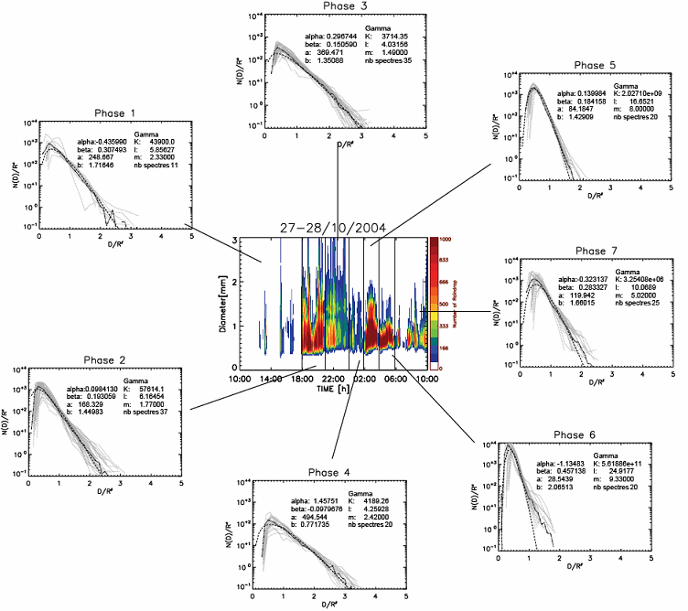
Temporal variability of DSD
3
- Need a spatial estimation of hydrological variables (KE, R...) with a large temporal repeatability.
R is measured by the gauge, it is a localized measure
R can be estimated thanks to Z (Radar reflectivity, spatial observation) but usually with static relationships (Z-R)
Variability of DSD ➔ Variability of its moments (N_{T}, LWC, R, KE, Z, …) and possible variability of the relationships between these moments
R=369,4Z^{1.35}
R=84.18Z^{1.42}
R=248.6Z^{1.71}
R=119.9Z^{1.66}
Z=aR^{b}
EC=aR^{b}
Static relationships
R=168.3Z^{1.44}
R=28.5Z^{2.06}
R=494.5Z^{0.77}
CHAPON (2008, AWR)
Notes:
Srval secance , for each squance is stable

Slide 5
Objectives
4
Among these moments, Z can be spatially observed by radar and is useful for hydrological applications
To deal with variability between Z and other moments and try to retrieve spatial DSD characteristics :
Use of combination of Z and other observed moments : R from raingauges, D₀ from polarimetric radar variable Z_{DR}, etc.
Use of some (but limited number !) local disdrometers (what spatial representativeness ?)
Exploitation of the 2D (horizontal) structure of radar reflectivity itself (this talk)
From Radar (Z + horizontal structure of Z) can we estimate the parameters of the DSD (Dc, Nt, μ) and calculate directly the moments?

Slide 6
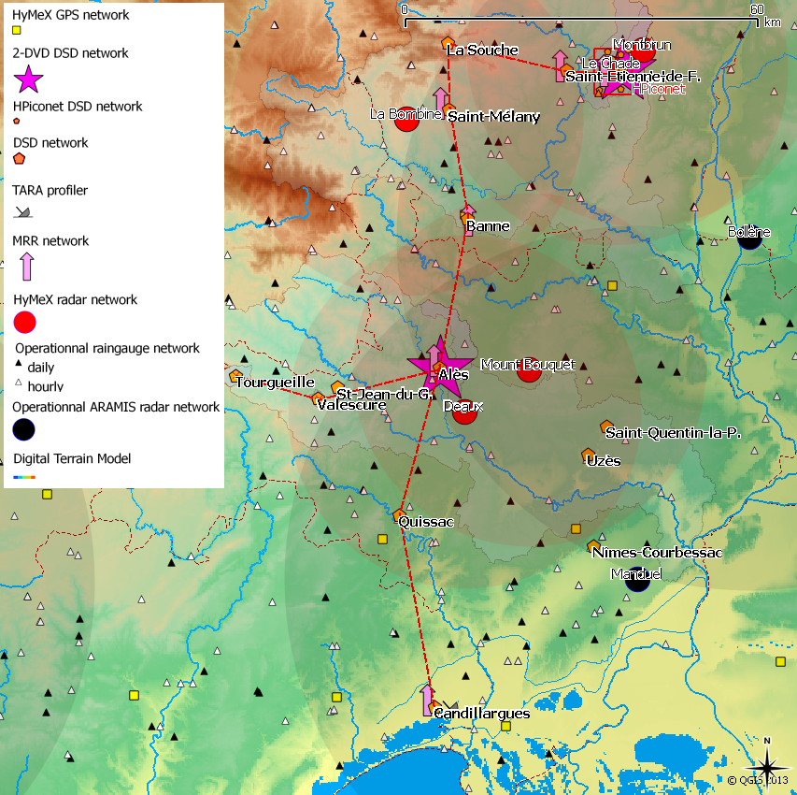
DSD and radar network
5
A dense network of DSD observation during 3 months
= SOP HyMEx (26 OTT Parsivel, 6 MRR, 4 X-band radars, 2 S-band radars, …) Sept.-Nov. 2012
Smaller network + larger times series
= EOP HyMEx / OHMCV (10 OTT Parsivel, 2 S-band radar) Progressively since 2010
The largest temporal series of DSD data
= Alès (1 OTT Parsivel, 2 s-band radar)
Since 2004 / OHMCV
Thanks to:
- EPFL
- LaMP
- LTHE
- DLR
- NASA
- CNRM
- University of Wageningen and Barcelona
Notes:
We use data from a dense network od DSD obsrevation durin 3 month. Logo hymex
Big compain in 2012 of hymex
Radar operationel bande S ( sband operationel radar) situé à 40 km.

Slide 7
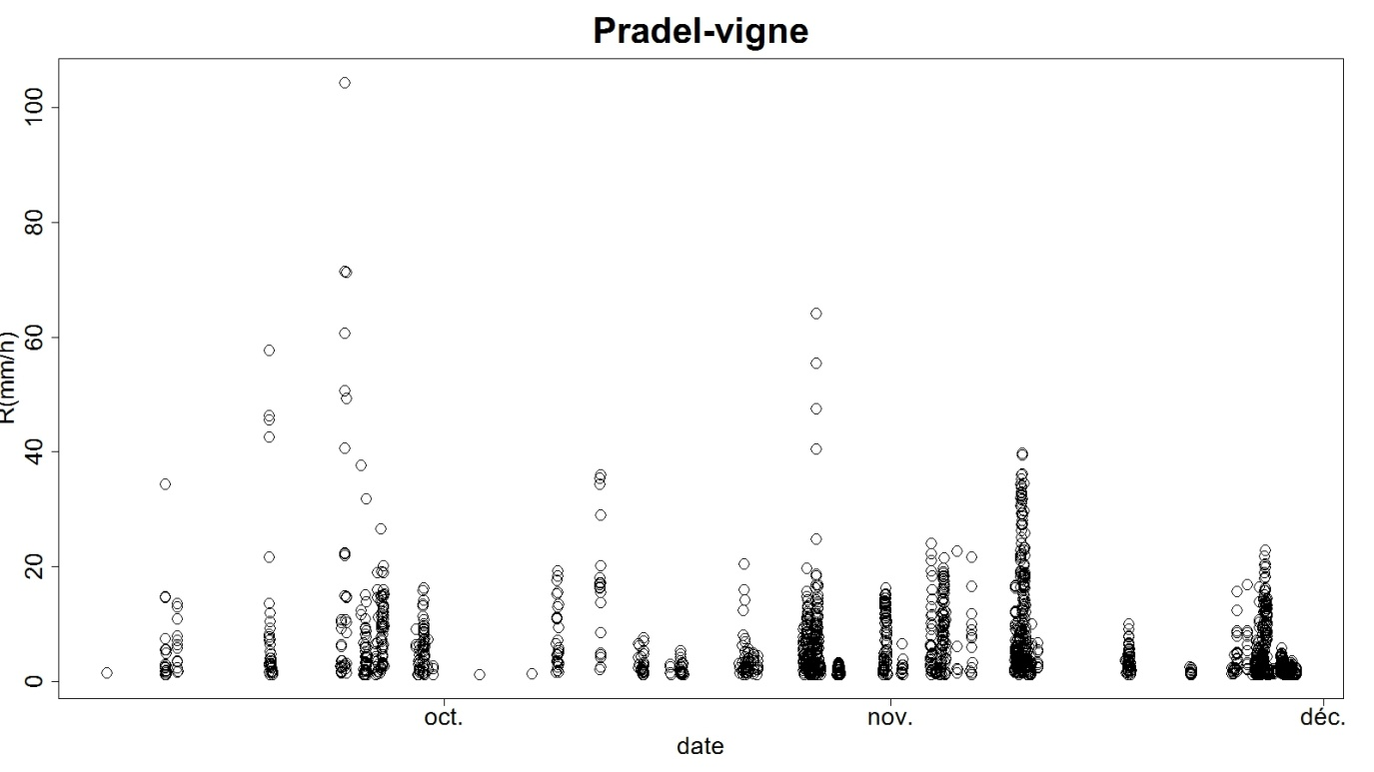
Studied events
6
R (mm/h) in 5 minutes , for all the events of the autumn of 2012
All the events in the autumn of 2012, I used 5 disdrometers (in the same area) and data of the operational S- band radar (Bollène, 40 km far away)

Slide 8
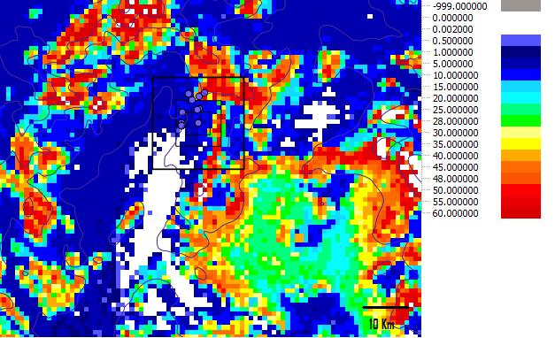
Methodology
7
Use of two types of products :
Raw Radar Reflectivity (5’, dBZ)
- Without ground clutters correction
- We chose the elevation angle : 1°25
- Correction from ground clutters :
* mean reflectivity during all the available events
* identification of the pixels corresponding to ground clutters (anomalous high value of Z)
*deletion of ground clutters for each radar image
Radar rainfall amount composite (5’, mm)
- Images corrected by Météo-France
Elimination of the ground clutters
Identification and correction of VPR
Composition of several elevation angles
Use of one or two Z-R static relationships
Correction with a factor depending on the ratio raingauge/radar identified the previous hour on the area
Extraction of 4 boxes with different sizes (1*1 Km², 5*5Km² ,10*10Km² and 20*20Km² )
Horizontal structure of radar image :
- Mean reflectivity or intensity
- Standard deviation of reflectivity or intensity
Gradient reflectivity or intensity
Intermittency for several thresholds
Image of mean reflectivity for all the event of the autumn of 2012 as an Illustration of the 4 boxes
Notes:
Des images propres ( lames eau)
Many correction stape

Slide 9
Results
8
Table 1 : correlation coefficient between the parameters of the DSD (Dc, Nt, µ) and the characteristics of the structure of radar images (mean of R, mean gradient of R and standard deviation of R) on the four sizes of the boxes, at the station of Villeneuve-de-Berg. Time integration is 5 minutes.
 | 1Km² box |  |  | 25Km² box |  |  | 100Km² box |  |  | 400 Km² box
 | Dc | Nt | µ | Dc | Nt | µ | Dc | Nt | µ | Dc | Nt | µ
Mean R | 0.52 | 0.11 | -0.29 | 0.58 | 0.18 | -0.26 | 0.60 | 0.24 | -0.26 | 0.60 | 0.27 | -0.26
Mean Grad R |  |  |  | 0.08 | 0.02 | -0.001 | 0.1 | 0.01 | -0.01 | 0.02 | 0.15 | -0.02
Std R |  |  |  | 0.45 | 0.07 | 0.17 | 0.47 | 0.12 | 0.17 | 0.49 | 0.13 | 0.19
Table 2: correlation coefficient between the parameters of the DSD and the characteristics of the structure
of radar images (mean of Z, mean gradient of Z and standard deviation of Z) on the four sizes of the boxes at the station of Villeneuve-de-Berg. Time integration is 5 minutes
 | 1Km² box |  |  | 25Km² box |  |  | 100Km²box |  |  | 400 Km² box
 | Dc | Nt | µ | Dc | Nt | µ | Dc | Nt | µ | Dc | Nt | µ
Mean Z | 0.78 | 0.52 | -0.54 | 0.80 | 0.56 | -0.55 | 0.78 | 0.54 | -0.49 | 0.65 | 0.40 | -0.43
Mean Grad Z |  |  |  | -0.08 | 0.02 | 0.02 | -0.21 | -0.09 | 0.11 | -0.11 | -0.14 | 0.09
Std Z |  |  |  | 0.78 | 0.55 | -0.53 | 0.71 | 0.40 | -0.37 | 0.57 | 0.27 | -0.34
Use of image of reflectivity
Notes:
R ( cumul de pluie en 5 minute) a un facteur 12 prés.
minus

Slide 10
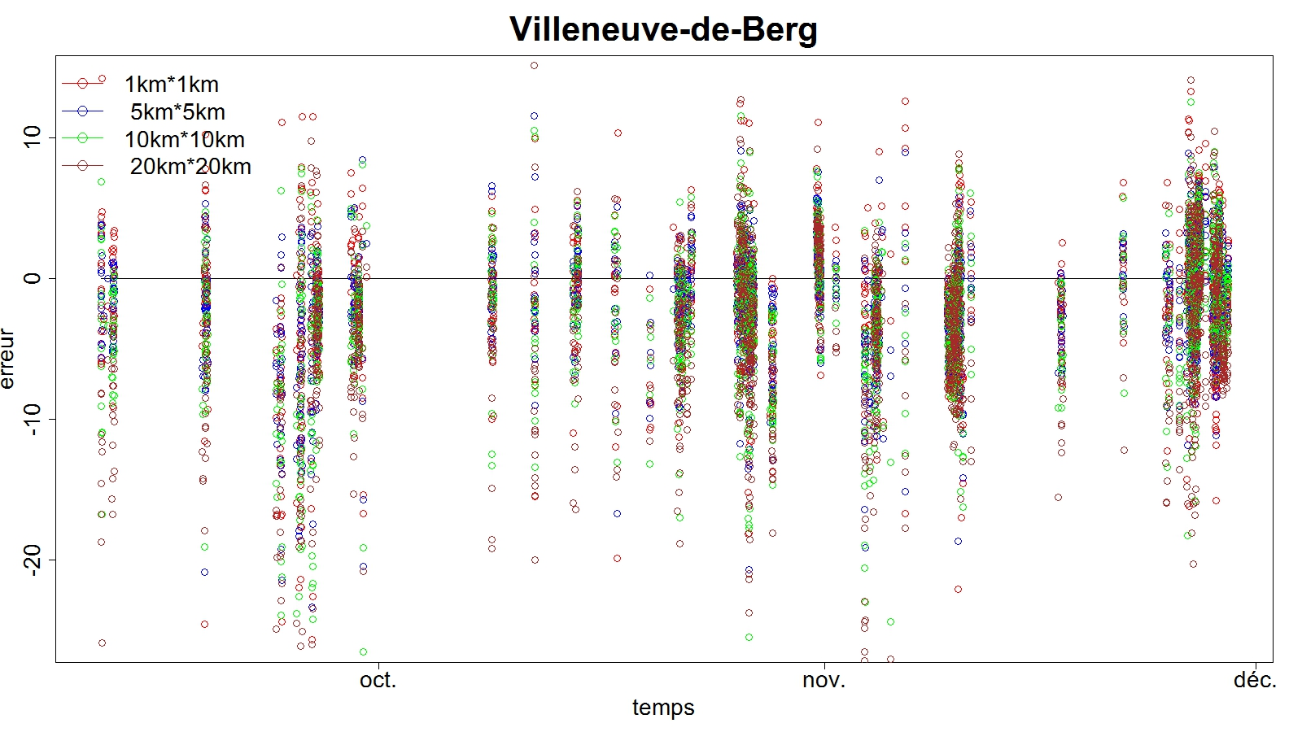
Best size of box
9
error
temporal evolution of error = Z_{mean}-Z_{disdro} for the station of Villeneuve-de-berg, Time integration
is 5 minutes
For the error <-10 and >10 dBZ, the 25km² box has always (5 stations and all the events ) the smallest number of errors
For this case, only 3.18% of the errors are outside the interval [-10,+10dBZ]
The result of correlation coefficient and the bias prompt us to use the 25km² box

Slide 11
Conclusions and perspectives
10
Conclusions
-the best product and box size to estimate DSD parameters (Nt, Dc, µ) with structure characteristics are :
- radar reflectivity
- 25 Km² box
Links between Mean Z in 25 Km² box and Dc and µ.
Not found yet links between actual structure of reflectivity and DSD parameters: we
don’t have links between the maximum or mean gradient (however usually used to determine convective areas !) and the DSD parameters.
Until now, we don’t have good results with the intermittency (corresponding to several dBZ threshold) but still in progress…
Perspectives
To study the intermittency
To study the vertical structure (with the different elevation angle) to found links between the structure of reflectivity and the DSD parameters
To seek relations thanks to a multi-criteria method
To seek relations between Z-R relationships and Z-structure (instead of DSD retrieval)
Notes:
Rajouter multicritére ( Z depend de 3 variables)

Slide 12
Thank you

