Slide 1





Ozonesondes during CAST
Do we find near zero-ozone concentration in the TTL?
Richard Newton, Geraint Vaughan, Hugo Ricketts
University of Manchester (UK)

Slide 2
Introduction to the CAST campaign
January–March 2014; aircraft campaign in Guam, ground campaign on Manus Island, PNG.
Ozonesondes on Manus launched to investigate minimum TTL ozone concentration.
The key source of uncertainty in ozonesonde measurements in the TTL is the background current.
Laboratory testing post-campaign needed to establish behaviour of some of the ozonesondes after a contamination event during CAST.

Slide 3
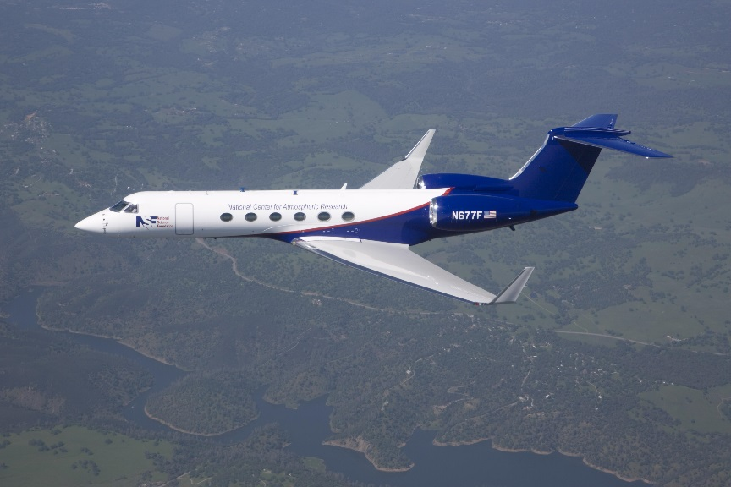
Ozonesonde profile validation
Previous conventions use either constant or pressure-dependent background current corrections.
Based on our laboratory tests, we use a constant correction for the uncontaminated ozonesondes, and a hybrid of the two for the contaminated sondes.
Aircraft fly-bys with the Gulfstream V occurred on 5 February (with a contaminated sonde) and 22 February (with two clean sondes).
First time that an aircraft-ozonesonde comparison has been made in the TTL.

Slide 4
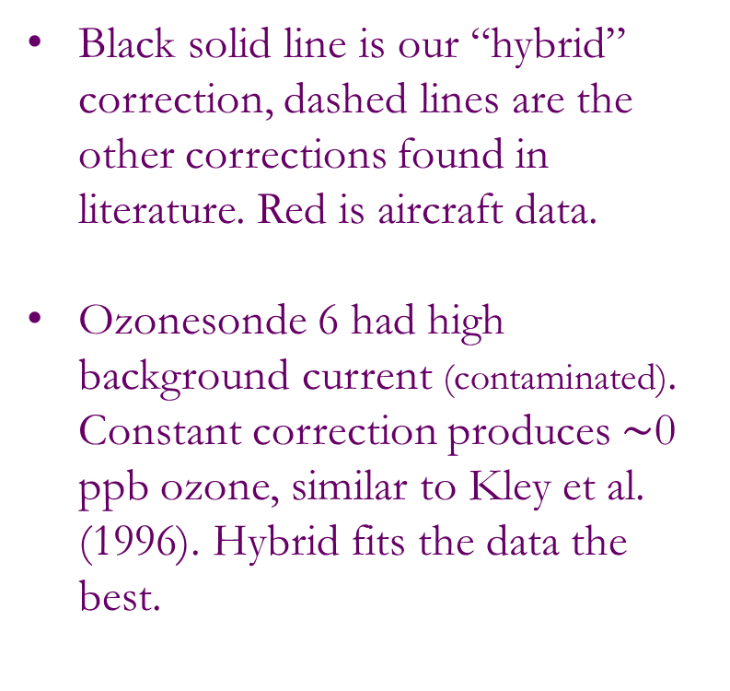
Ozonesonde profile validation: Results
Black solid line is our “hybrid” correction, dashed lines are the other corrections found in literature. Red is aircraft data.
Ozonesonde 6 had high background current (contaminated). Constant correction produces $\sim$0 ppb ozone, similar to Kley et al. (1996). Hybrid fits the data the best.

Slide 5
Ozonesonde profile validation: Results
Ozonesondes 34 and 35 were clean sondes. “Hybrid” correction mostly constant.
Both fit the aircraft data very well. The choice of the “hybrid” correction has been verified.

Slide 6
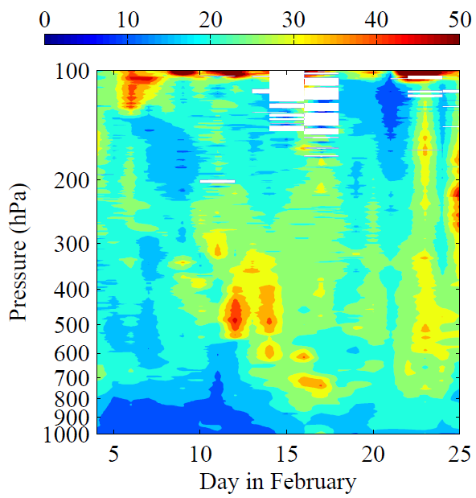
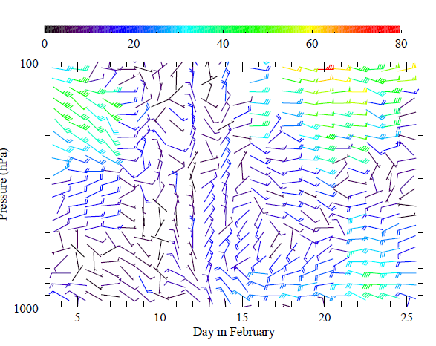
Results
Ozone higher in the TTL than in the lower troposphere at all times, except 21-23 February.
At this time, the values in TTL are consistent with those measured on the ground.
Ozone in the TTL is consistent with uplift by deep convection bringing surface air to the tropopause level.
During 21-23 February the low ozone (12 ppb) coincided with an easterly jet in the wind field.
Ozone concentration (ppb)
Wind speed (knots)

Slide 7
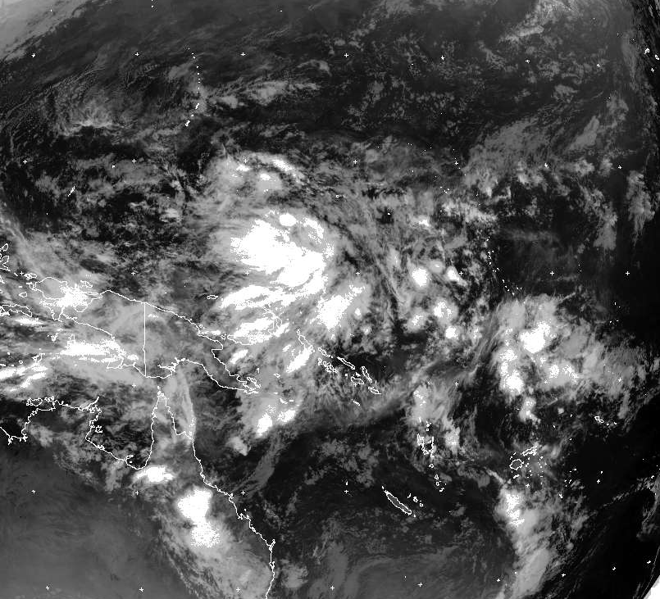
22 February low ozone event

Slide 8

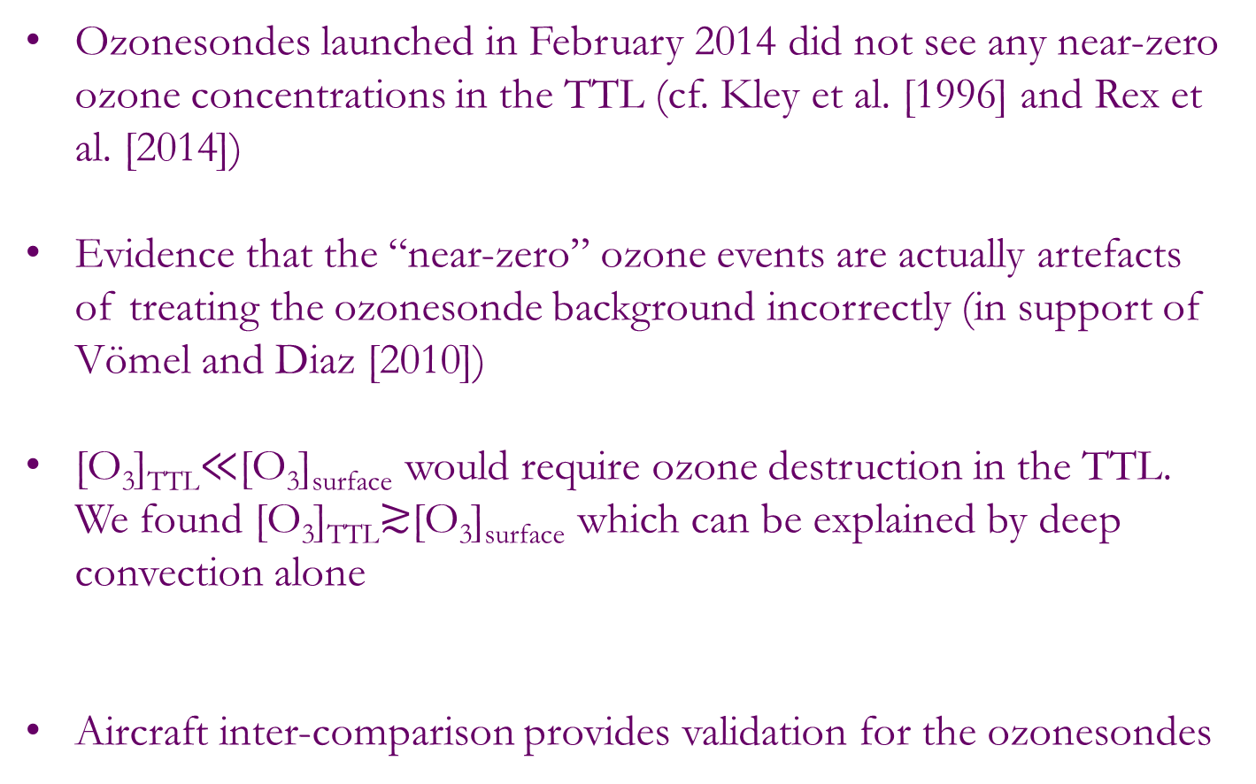
Summary of salient results
Ozonesondes launched in February 2014 did not see any near-zero ozone concentrations in the TTL (cf. Kley et al. [1996] and Rex et al. [2014])
Evidence that the “near-zero” ozone events are actually artefacts of treating the ozonesonde background incorrectly (in support of Vömel and Diaz [2010])
[O₃]_{TTL}$≪$[O₃]_{surface} would require ozone destruction in the TTL. We found [O₃]_{TTL}$≳$[O₃]_{surface} which can be explained by deep convection alone
Aircraft inter-comparison provides validation for the ozonesondes
Lowest TTL ozone measured was 12 ppb
Ozonesonde 6 has “near-zero” ozone if constant background current used
Lowest ozone concentrations coincided with the most vigorous convective uplift

