Slide 1
Surface structure, crystallographic and
ice-nucleating properties of cellulose
Naruki Hiranuma, Ottmar Möhler, Alexei Kiselev, Harald Saathoff, Peter Weidler,
Shuttha Shutthanandan, Gourihar Kulkarni, Evelyn Jantsch & Thomas Koop
Acknowledgement: INUIT (Ice Nuclei research UnIT)
200 nm
3 μm

Slide 2
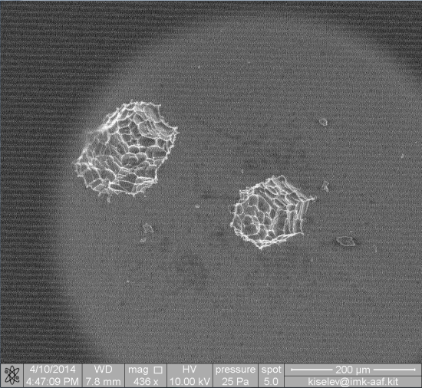
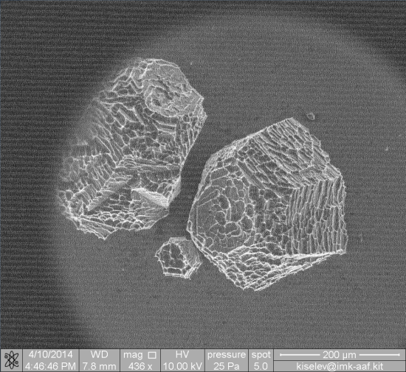
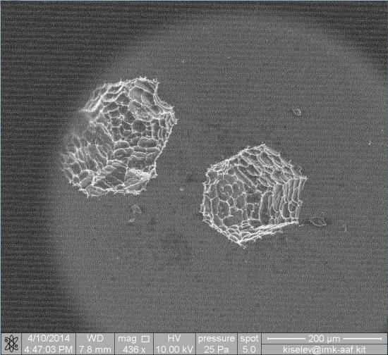
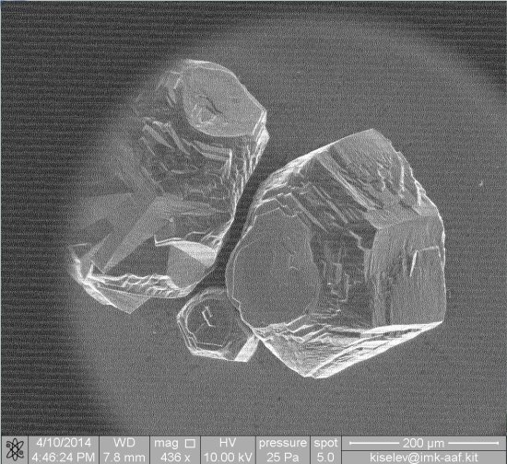
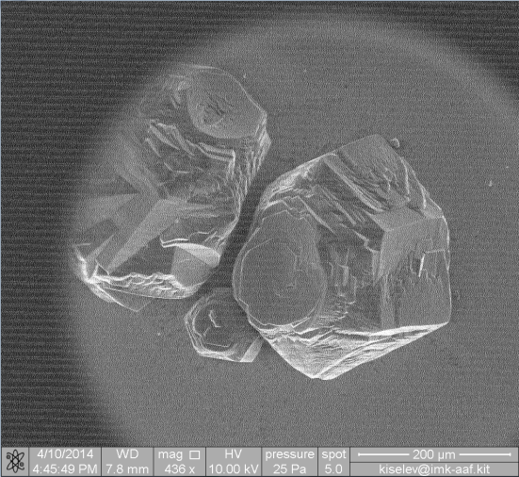
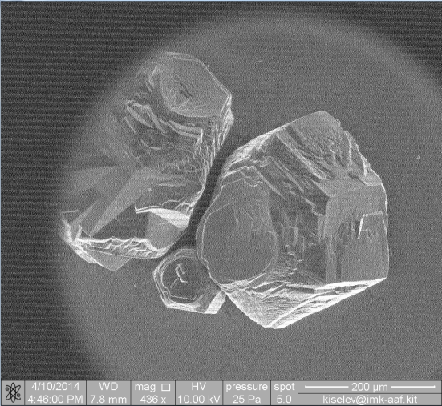
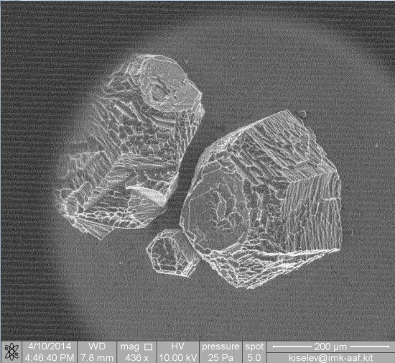
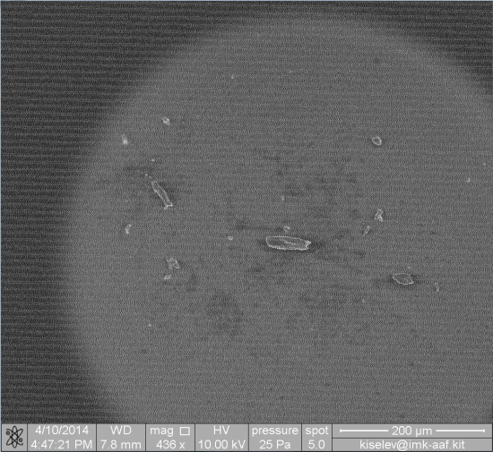
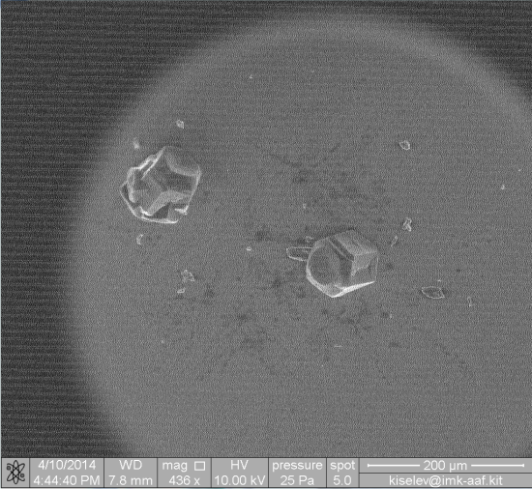
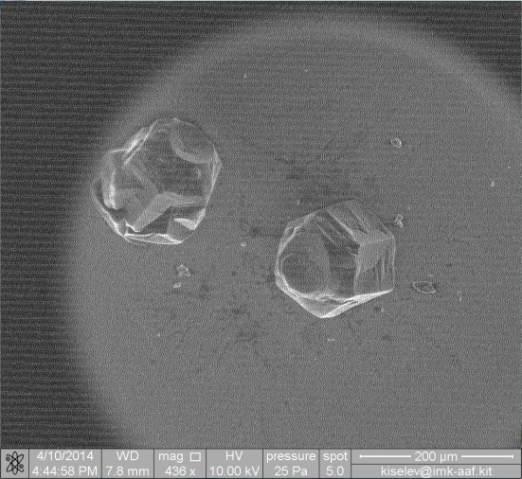
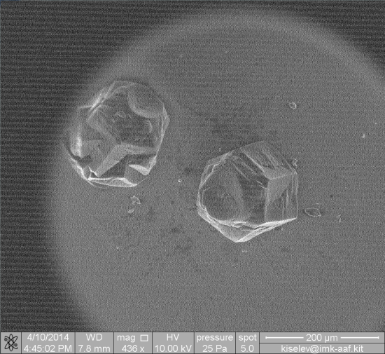
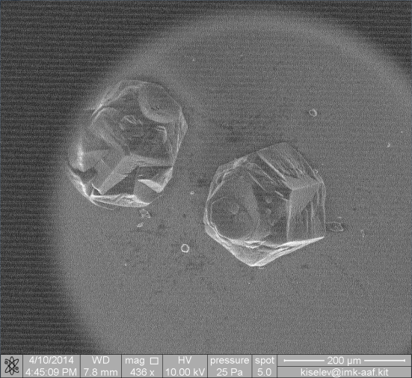
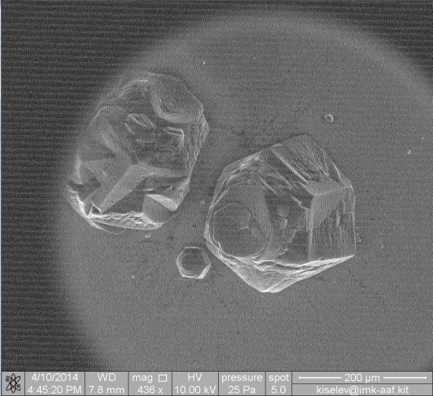
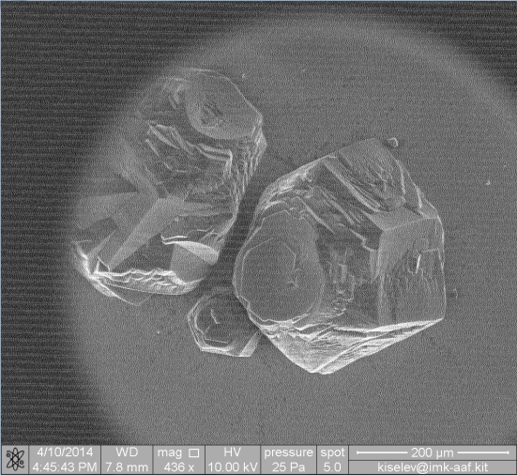
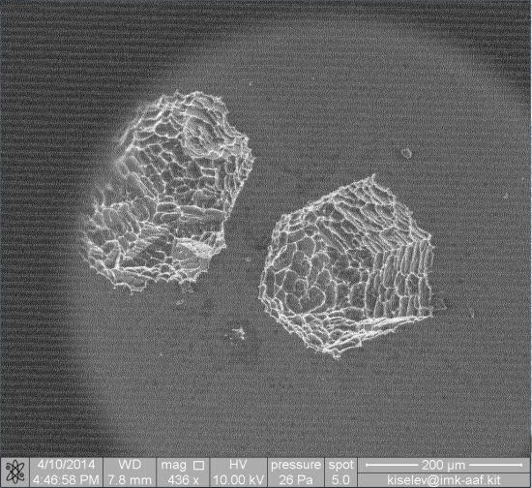
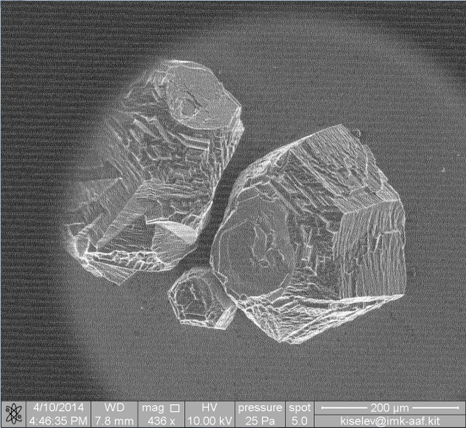
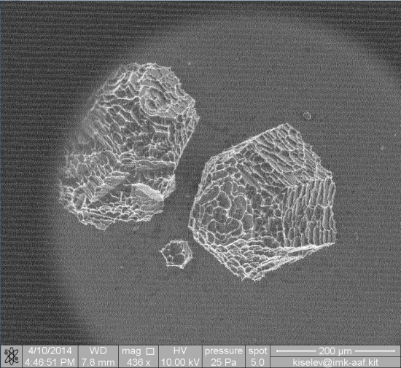
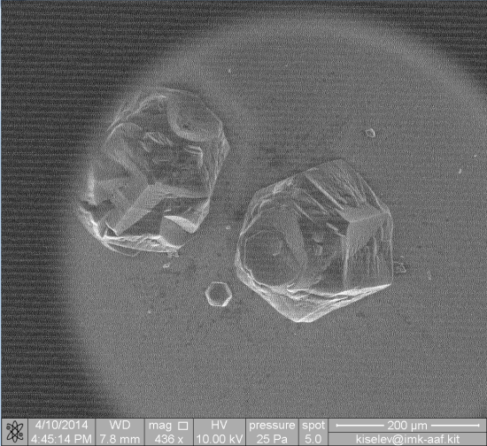
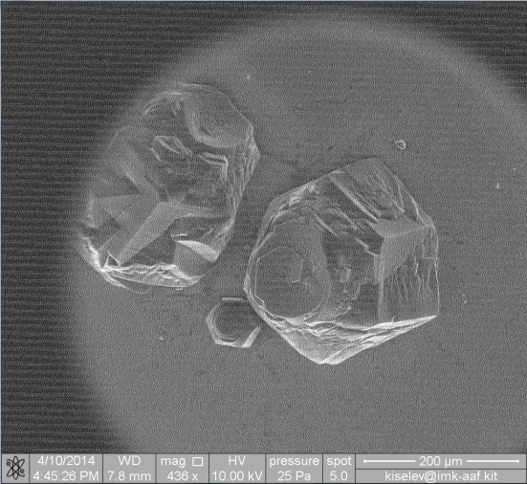
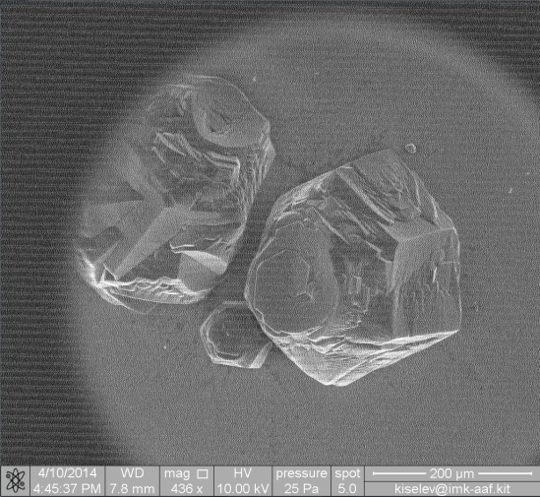
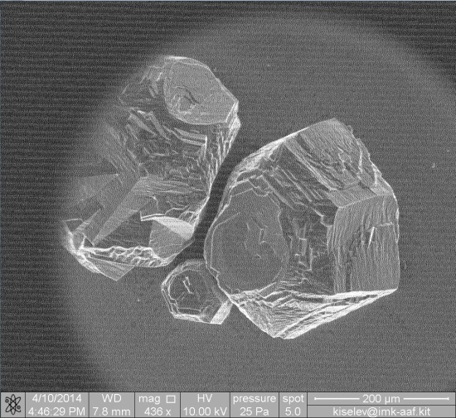
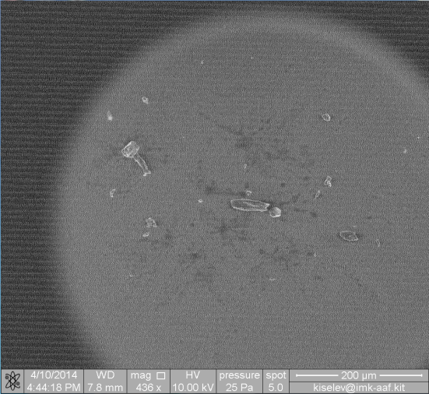
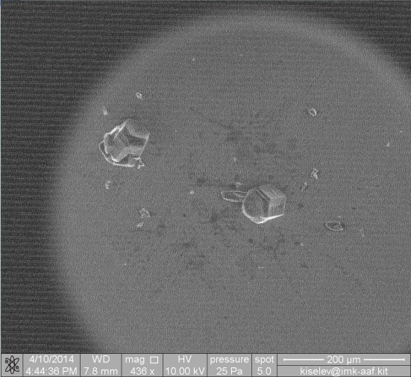
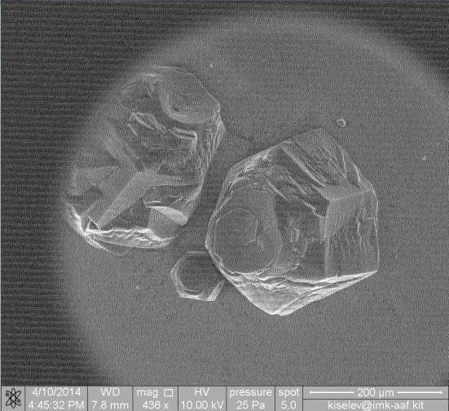
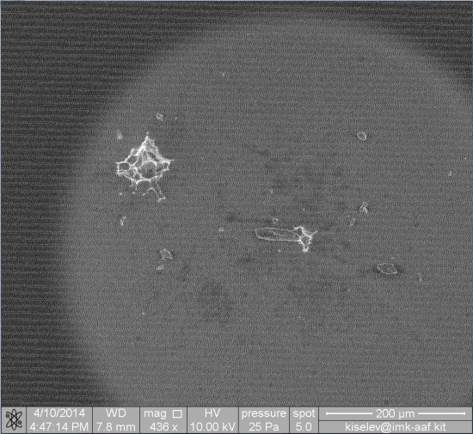
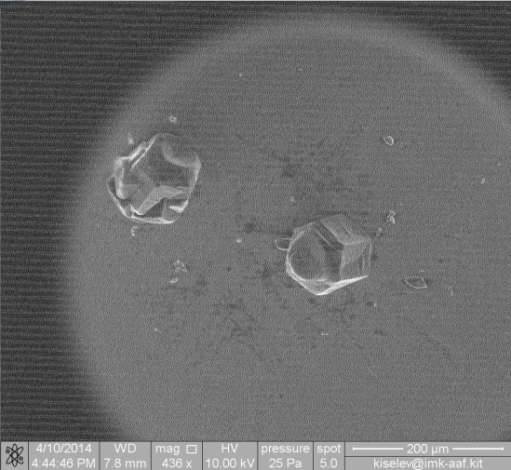
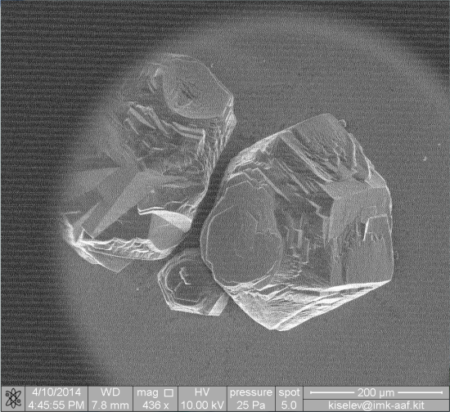
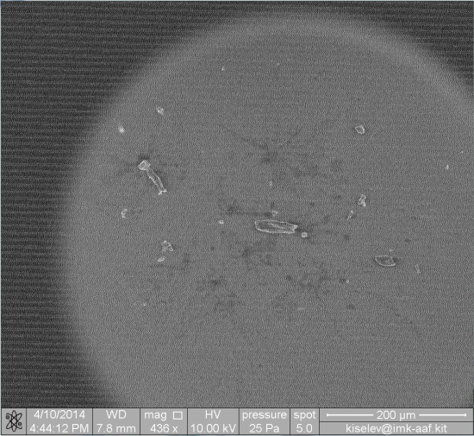
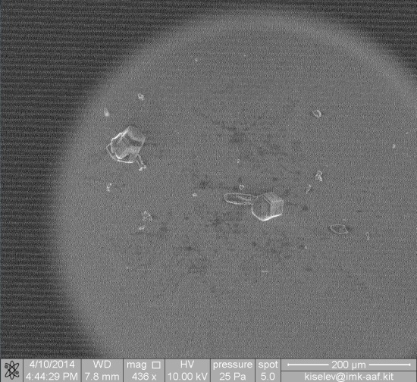
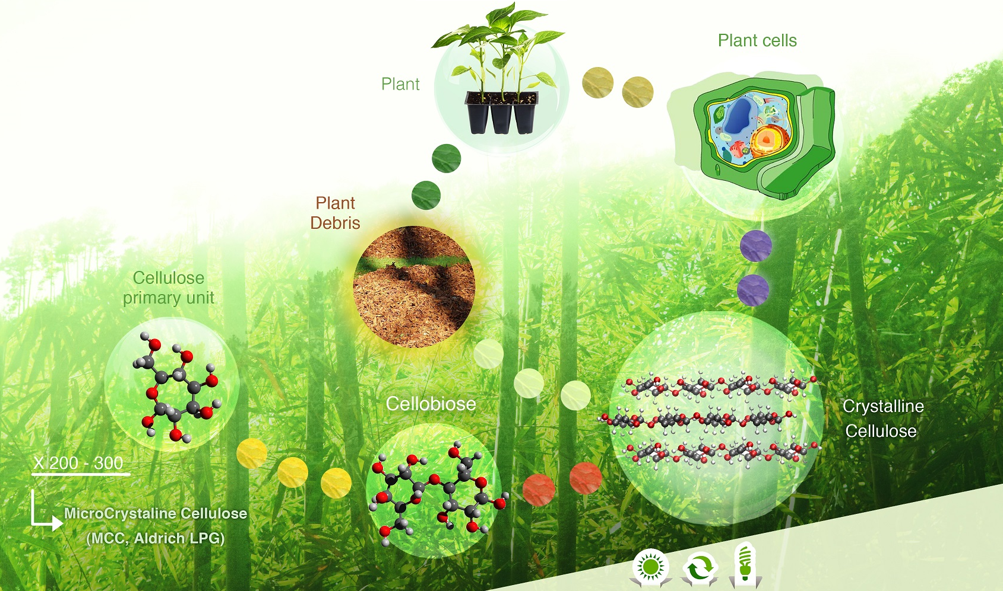
Cellulose Ice Nucleation
ESEM demonstration:
-40 ºC → -45 ºC → -40 ºC
Glucose
Introduction → Motivation → ❶Physics of Cellulose IN → ❷Airborne Cellulose Detection → ❸Atmospheric Relevancy → Summary

Slide 3
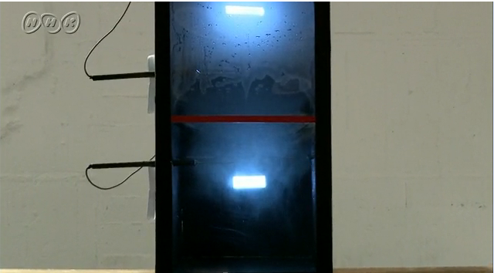
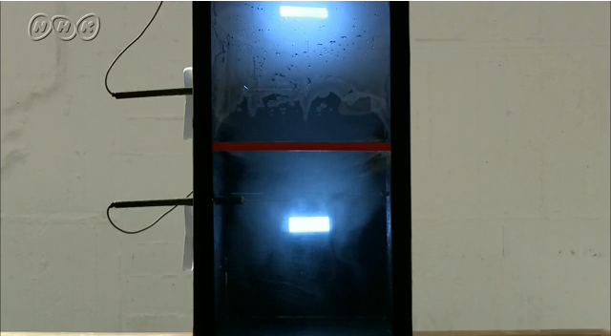
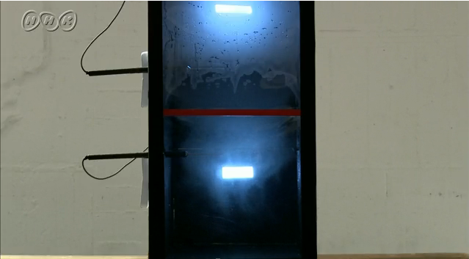
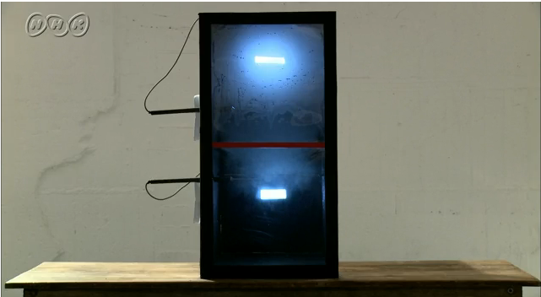
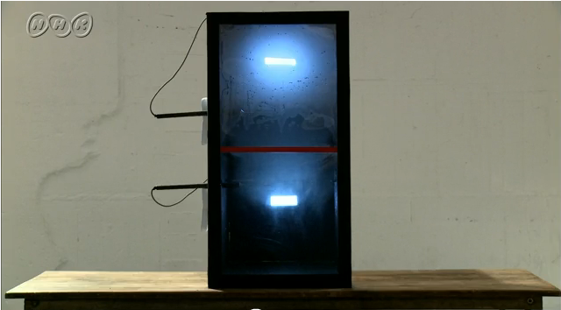
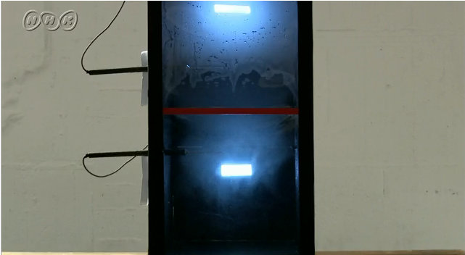
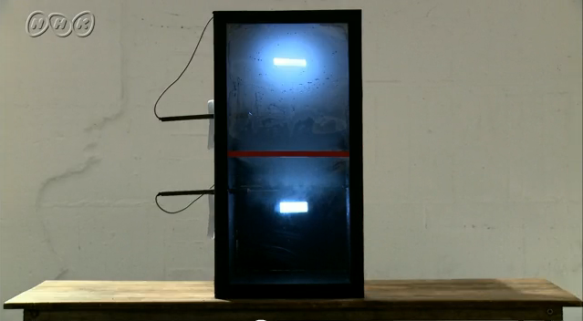
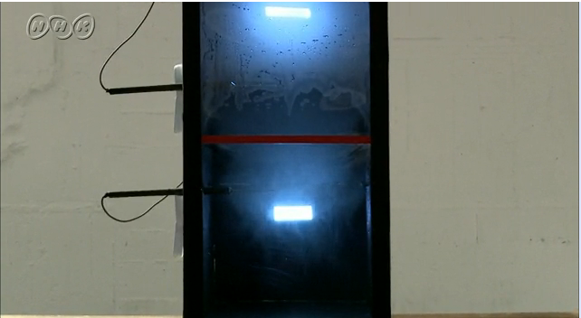
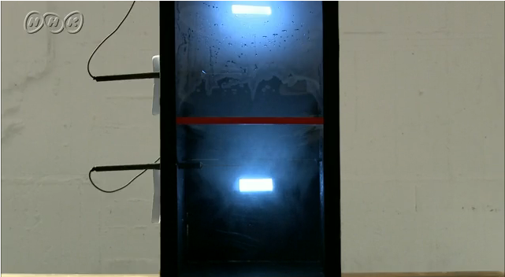
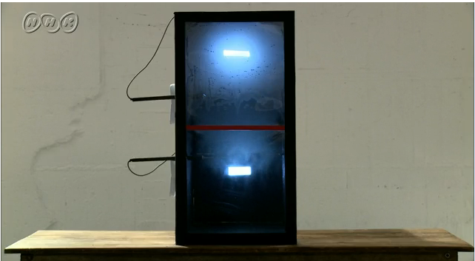
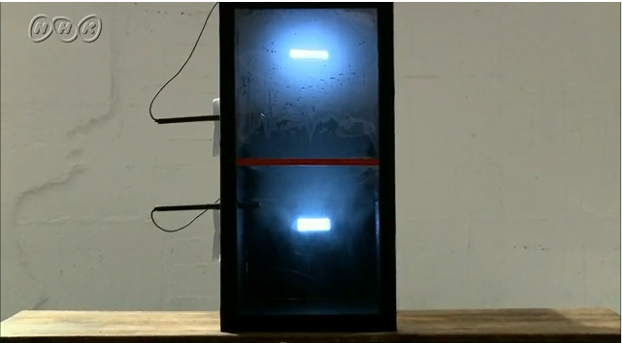
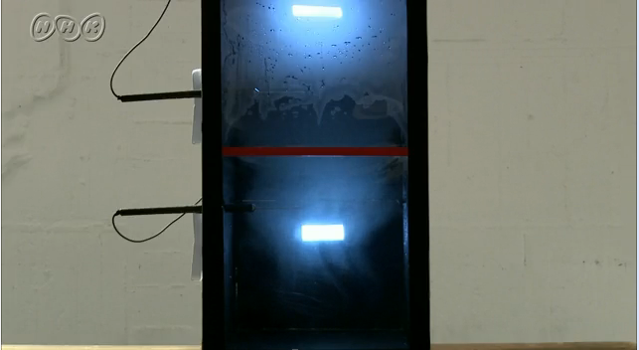
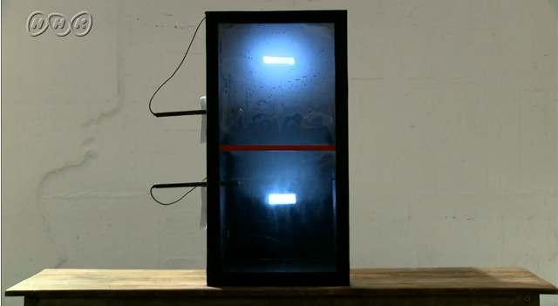
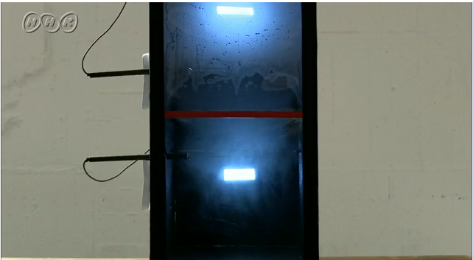
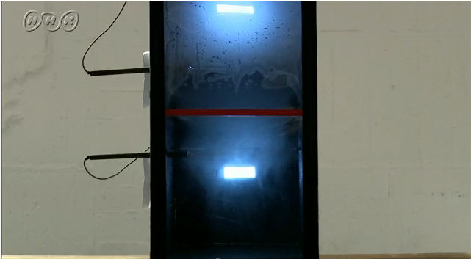
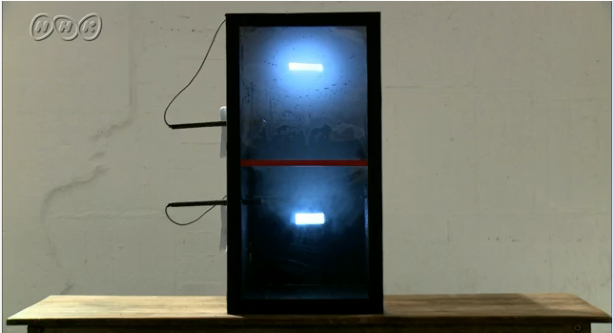
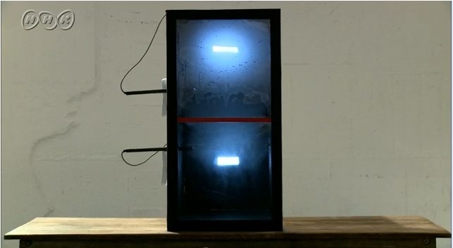
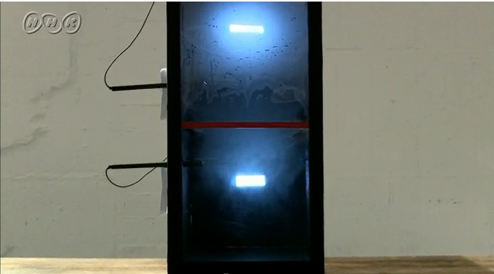
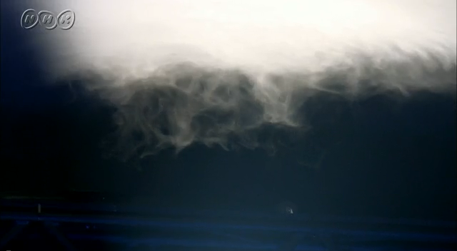
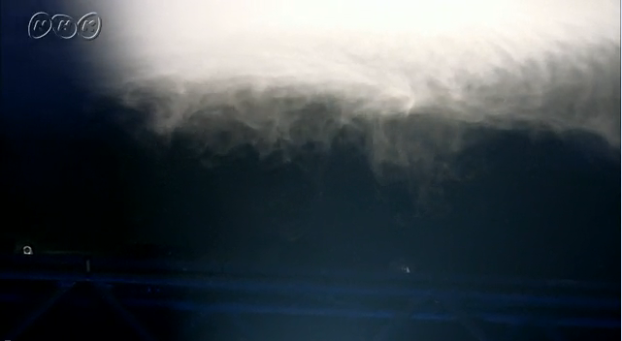
Cellulose Ice Nucleation Cont’d
Ice nucleation active surface-site density, n_{s}, spectra for immersion freezing of cellulose particles
by OPC
by SMPS/APS
Ref.: Hiranuma et al., 2015, Nature Geosci.
Image video: in the courtesy of NHK
Introduction → Motivation → ❶Physics of Cellulose IN → ❷Airborne Cellulose Detection → ❸Atmospheric Relevancy → Summary

Slide 4
Motivation = Unresolved Questions
Dr. Michel Rossi (PSI)
❶ What is the crystallographic properties of cellulose and its contribution to ice-nucleating ability?
Prof. Joachim Curtius (Uni. Frankfurt)
❷ Why have we overlooked such prevalent material as INP?
❸ What is the atmospheric relevancy of microcrystalline cellulose?
Introduction → Motivation → ❶Physics of Cellulose IN → ❷Airborne Cellulose Detection → ❸Atmospheric Relevancy → Summary

Slide 5
❶ What is the crystallographic properties of cellulose and its contribution to ice-nucleating ability?
Helium ion microscopy (HIM) imaging
X-ray diffraction (XRD) technique
There may be preferred sites on the cellulose surface where ice nucleation may be initiated (holes, pits, steps; Marcolli, 2014; ACP).
MCC; Aldrich, 435236
BET = 1.44 m² g⁻¹
FC; Sigma, C6288
BET = 1.31 m² g⁻¹
The structural properties of both cellulose materials are in agreement (i.e., P2₁ space group; a = 7.96 Å, b = 8.35 Å, c = 10.28 Å) and comparable to Cellulose Iβ = monoclinic crystal (Nishiyama et al. 2002; J. Am. Chem. Soc.).
Introduction → Motivation → ❶Physics of Cellulose IN → ❷Airborne Cellulose Detection → ❸Atmospheric Relevancy → Summary

Slide 6
❶ What is the crystallographic properties of cellulose and its contribution to ice-nucleating ability?
Helium ion microscopy (HIM) imaging
IN seems exceptional with respect of morphology
There may be preferred sites on the cellulose surface where ice nucleation may be initiated (holes, pits, steps; Marcolli, 2014; ACP).
MCC; Aldrich, 435236
BET = 1.44 m² g⁻¹
FC; Sigma, C6288
BET = 1.31 m² g⁻¹
(←→ Knopf et al., 2014; JGR)
Nucleation at edge =
site rich location?
Propagation along lattice-matched segment?
Introduction → Motivation → ❶Physics of Cellulose IN → ❷Airborne Cellulose Detection → ❸Atmospheric Relevancy → Summary

Slide 7
❷ Why have we overlooked cellulose as INP?
Ans. Due to the lack of reliable in situ instruments
Off-line quantification via “saccharification”: cumbersome…
In situ fluorescence detection (e.g., WIBS/UV-APS): highly depending on optics and operational emission thresh…
Refs: Sánchez-Ochoa et al., 2007; JGR
& Quiroz-Castañeda and Folch-Mallol, 2013; Intech Ch. 6
“Cellulose shows essentially no fluorescence at excitation at 280 nm, but weak fluorescence at 355 nm…”
Pöhlker et al., 2012; AMT
Introduction → Motivation → ❶Physics of Cellulose IN → ❷Airborne Cellulose Detection → ❸Atmospheric Relevancy → Summary

Slide 8
❷ Why have we overlooked cellulose as INP?
Single particle mass spec.: perhaps a potential solution?
Work in progress…
K
CO
Na
C
Fe
NO
Signal (a.u.)
Signal (a.u.)
m/z
m/z
OH
CN
C₂H
PO₃
H₂PO₄
Signal (a.u.)
Signal (a.u.)
0.0001
m/z
m/z
Prelim. PALMS mass spectra: in the courtesy of Maria Zawadowicz & Dan Cziczo (MIT)
Introduction → Motivation → ❶Physics of Cellulose IN → ❷Airborne Cellulose Detection → ❸Atmospheric Relevancy → Summary

Slide 9
❸ What is the atmospheric relevancy of microcrystalline cellulose?
BINARY
(Bielefeld Ice Nucleation ARaY)
20,000 RpM
Cooling
MCC; Aldrich,
435236
FC; Sigma,
C6288
Figure: Hiranuma et al., 2015, Nature Geosci.
BINARY Image: Budke et al., 2015, AMT
Introduction → Motivation → ❶Physics of Cellulose IN → ❷Airborne Cellulose Detection → ❸Atmospheric Relevancy → Summary

Slide 10
❸ What is the atmospheric relevancy of microcrystalline cellulose?
Cellulose vs. Sugar Beat Soil Dust (SBSD), Leaf Powder (LP01) & Lignin
Maple Leaf Powder LP01
Sugar Beat Soil Dust SBSD
Lignin
Introduction → Motivation → ❶Physics of Cellulose IN → ❷Airborne Cellulose Detection → ❸Atmospheric Relevancy → Summary

Slide 11
❸ What is the atmospheric relevancy of microcrystalline cellulose?
Cellulose vs. Sugar Beat Soil Dust (SBSD), Leaf Powder (LP01) & Lignin
Introduction → Motivation → ❶Physics of Cellulose IN → ❷Airborne Cellulose Detection → ❸Atmospheric Relevancy → Summary

Slide 12
❸ What is the atmospheric relevancy of microcrystalline cellulose?
Influence of atmo. relevant thin Sulfuric Acid (SA, 1 ppbv) quasi-coating
In situ SA production via:
SO₂ + OH → HSO₃
HSO₃ + O₂ → SO₃ + HO₂
O₃ + TME → … → OH + Acetone
SO₃ + H₂O → H₂SO₄
+ O₃
Introduction → Motivation → ❶Physics of Cellulose IN → ❷Airborne Cellulose Detection → ❸Atmospheric Relevancy → Summary

Slide 13
❸ What is the atmospheric relevancy of microcrystalline cellulose?
Influence of atmo. relevant thin Sulfuric Acid (SA, 1 ppbv) quasi-coating
In situ SA production via:
SO₂ + OH → HSO₃
HSO₃ + O₂ → SO₃ + HO₂
O₃ + TME → … → OH + Acetone
SO₃ + H₂O → H₂SO₄
+ O₃
AS3.5 B149-13244
Peckhaus et al.
AS3.5 B148-13225
Mohr et al.
Introduction → Motivation → ❶Physics of Cellulose IN → ❷Airborne Cellulose Detection → ❸Atmospheric Relevancy → Summary

Slide 14
Summary
❶ Does the crystalline properties of cellulose contribute to its ice-nucleating ability?
Ans. Yes. Followed by the nucleation at active sites.
❷ Why have we overlooked cellulose as INP?
Ans. Due to the lack of reliable in situ instruments. But SP-MS may be a
good potential solution.
❸ Is microcrystalline cellulose atmospheric relevant?
Ans. Yes – its n_{s} is similar to that of leaf litter and arable soil dust @ low T
(below –20 °C).
Take home messages
IN seems exceptional with respect of surface and crystalline properties
(←→ Knopf et al., 2014; JGR)
Efficient but accurate parameterization is needed = n_{s}
In-depth characterization of INA primary organic matter is needed
Keyword = “non-proteinaceous HUMIN”
Introduction → Motivation → ❶Physics of Cellulose IN → ❷Airborne Cellulose Detection → ❸Atmospheric Relevancy → Summary

Slide 15
Acknowledgements & Thank you for your attention
Funding
Helmholtz Association `Atmosphere and Climate (ATMO)'
Deutsche Forschungsgemeinschaft (DFG) Research Unit FOR 1525 (INUIT, grant No MO668/4-1 & KO2944/2-1)
Environmental Molecular Science Laboratory, located at Pacific Northwest National Laboratory
Technical support & useful discussion
T. Kisely (KIT)
M. Zawadowicz & D. J. Cziczo (MIT)
C. Budke (Bielefeld Uni)
R. Ulrich & Möhler’s group (KIT)
AIDA technical team
A. Abdelmonem (KIT)
C. Anquetil-Deck (KIT)
T. C. J. Hill & P. DeMott (CSU)
“Strong surface winds together with the topography modelled this lenticularis type of cloud over the Mallorca mountains. The micro-scale structure of such clouds also depends on biological aerosol particles like cellulose being dispersed with the wind from the vegetated but dry surface and mixed into the cloud.”
www.nature.com/ngeo/journal/v8/n4/full/ngeo2374.html
Introduction → Motivation → ❶Physics of Cellulose IN → ❷Airborne Cellulose Detection → ❸Atmospheric Relevancy → Summary

