Slide 1
Intuitive Visualization of Transient Flow: Towards a Full 3D Tool
EGU General Assembly 2015, Vienna, April 12th-17th 2015
ESSI3.1: Techniques and tools for effective visualization and sonification in the geosciences
Isabel Michel, Simon Schröder (Fraunhofer ITWM)
Torsten Seidel, Christoph König (delta h)

Slide 2
Intuitive Visualization of Transient Flow: Towards a Full 3D Tool
Motivation
First Step: STRING
Features
Visualization Process
Examples
Second Step: Full 3D Tool
Strengths and Current Restrictions of STRING
Challenges

Slide 3
Motivation
Visualization of geoscientific data is a challenging task especially when targeting a non-professional audience.
Idea: Animation of trajectories of 3D transient groundwater flow data via pathlets (short parts of pathlines)
Advantage of pathlets: Intuitive perception of the main characteristics of flow (velocity, direction) even for non-professionals

Slide 4
First Step: STRING
Software for intuitive 2D visualization (on planar and curved cuts) of 3D transient flow data
Developed at the Fraunhofer Institute for Industrial Mathematics (ITWM) in Kaiserslautern, Germany
In cooperation with delta h Ingenieurgesellschaft mbH, Witten, Germany

Slide 5
STRING: Features
3D transient flow data: interface to SPRING (water systems modeling software developed by delta h)
Illustration of flow velocity with the help of pathlets moving with the flow (Lagrangian character)
Intelligent, time-dependent seeding strategy based on the point management of the Finite Pointset Method (FPM) developed by ITWM
Horizontal and vertical 2D cuts in a 3D model as visualization planes
Time-dependent clipping regions (saturated zones, large data sets)
Time-dependent scalar fields in the background (continuous colormap, isosurfaces; contour lines)
Saving of rendered images as single frames together with geographic information
GUI for easy handling

Slide 6
STRING: Features
3D transient flow data: interface to SPRING (water systems modeling software developed by delta h)
Illustration of flow velocity with the help of pathlets moving with the flow (Lagrangian character)
Intelligent, time-dependent seeding strategy based on the point management of the Finite Pointset Method (FPM) developed by ITWM
Horizontal and vertical 2D cuts in a 3D model as visualization planes
Time-dependent clipping regions (saturated zones, large data sets)
Time-dependent scalar fields in the background (continuous colormap, isosurfaces; contour lines)
Saving of rendered images as single frames together with geographic information
GUI for easy handling
Uniqueness regarding intuitive visualization

Slide 7
STRING: Visualization Process – Easy 3D Case
Loading and processing of the geometrical information (only boundaries are required) and the simulation data set (vector and scalar fields).
Choosing a horizontal or vertical 2D cut.
Choosing clipping regions.
Choosing the scalar attribute illustrated in the background.
Choosing the pathlet density and filling the visualization plane with the initial pathlet configuration (“uniform distribution”).
(successive discrete hole search)

Slide 8
STRING: Visualization Process – Easy 3D Case
Loading and processing of the geometrical information (only boundaries are required) and the simulation data set (vector and scalar fields).
Choosing a horizontal or vertical 2D cut.
Choosing clipping regions.
Choosing the scalar attribute illustrated in the background.
Choosing the pathlet density and filling the visualization plane with the initial pathlet configuration (“uniform distribution”).
Iteration over all timesteps:
Movement of the pathlets for one time step
(solution of ODE with adaptive time step control, interpolation based on FPM-specific moving weighted least squares algorithm)

Slide 9
STRING: Visualization Process – Easy 3D Case
Loading and processing of the geometrical information (only boundaries are required) and the simulation data set (vector and scalar fields).
Choosing a horizontal or vertical 2D cut.
Choosing clipping regions.
Choosing the scalar attribute illustrated in the background.
Choosing the pathlet density and filling the visualization plane with the initial pathlet configuration (“uniform distribution”).
Iteration over all timesteps:
Movement of the pathlets for one time step.
Readjustment of the pathlet density through seeding and deletion.
Saving the current position of the pathlets.
Rendering the current state.
Go to i.

Slide 10
STRING: Examples – Saturated Zones in a Tailing Basin

Slide 11
Second Step: Full 3D Tool
Strengths of STRING:
Novel, unique, and intuitive animation of 3D transient flow problems enabling experts to more easily transport their findings to non-professionals as well as investigate details of a flow field
Intelligent, time-dependent seeding strategy (also applicable in 3D)
Generally suitable concept (not restricted to groundwater modeling)
Current Restrictions of STRING:
2D visualization of 3D transient flow data → not all features of a flow field can be visualized on planar and curved cuts of a 3D model
Lack of direct exploration and analysis of large 3D flow data sets
Aim: Extension of STRING to intuitive and interactive visualizations of entire 3D flow domains

Slide 12
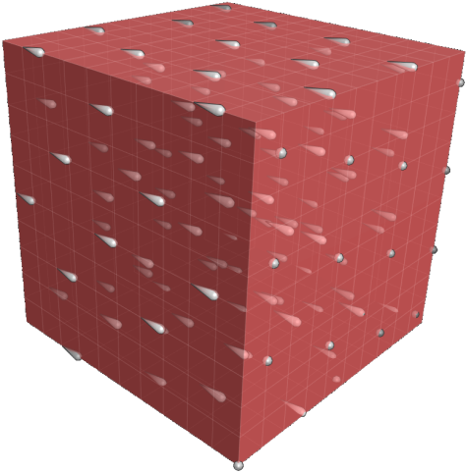
Second Step: Full 3D Tool
Challenges:
Ensure the intuitive character
Adapt the 3D seeding strategy
Enhance the depth perception (illumination, head tracking)
Ensure interactivity (data structure, OpenCL, OpenGL)
Consider specific demands on visualization of groundwater data (different scales in a mesh, saturated surfaces/groundwater level, flow in fractures)

Slide 13
Thank you for your attention!

