Slide 1
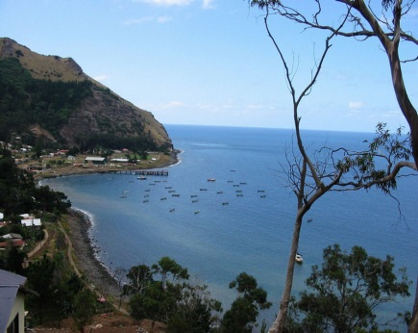
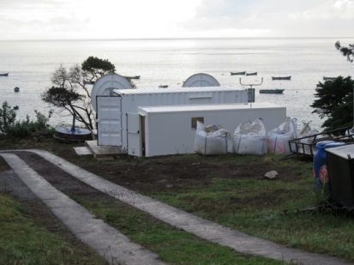
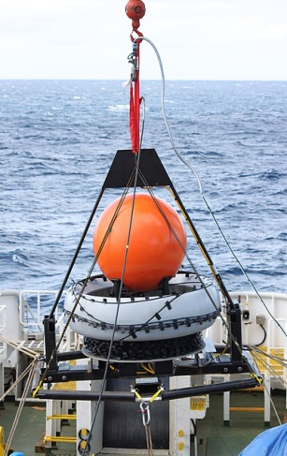
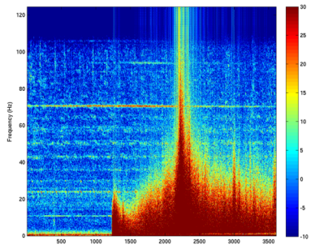
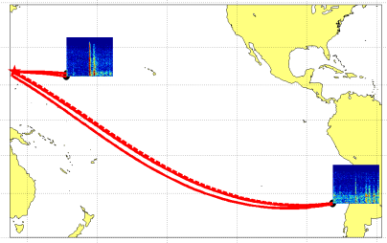
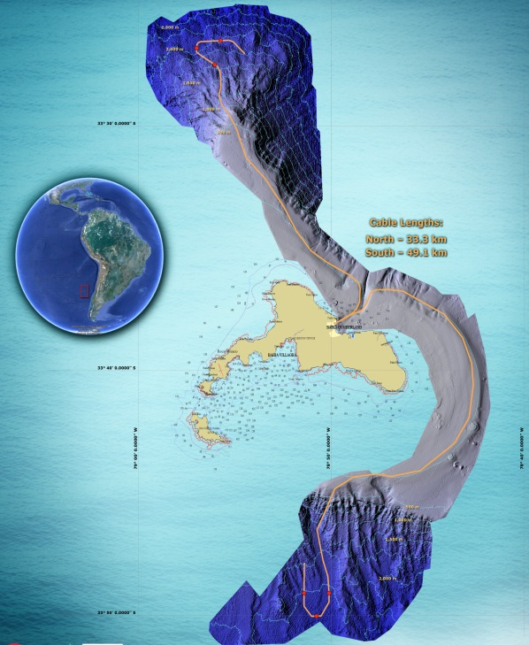
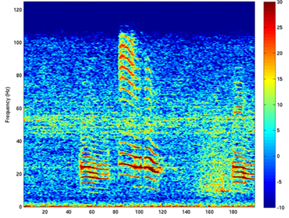
Welcome back HA03 - IMS Hydroacoustic station installation
Robinson Crusoe Island, Juan Fernadez Archipelago, Chile, March 2014
Georgios Haralabus, Jerry Stanley, Mario Zampolli, Lucie Pautet
CTBTO Vienna International Centre, Austria
12-17 April, 2015
HA03 hydroacoustic station, destroyed by a tsunami in 2010, was re-established in 2014.
HA03 is part of a global network of monitoring stations established by the Preparatory Commission for the Comprehensive Nuclear-Test-Ban Treaty Organization (CTBTO). After a huge engineering and logistical undertaking which took four years and cost over US$ 20 million, HA03 is now operational again. It was characterized as the most complex project in the history of the organization.
The re-establishment of HA03
The installation of HA03 consisted of three main phases:
1. First of all, a suitable plot of land for the CRF was identified in the village of San Juan Bautista; its elevation above sea level is important for tsunami risk mitigation. The CRF was installed in April 2013 to provide the data link from HA03 and IS14 to the CTBTO’s International Data Centre (IDC) in Vienna.
Performance of the newly established station HA03
The quality of the data arriving from the new HA03 hydrophones has been assessed and monitored continuously since the hydrophone nodes touched down at their designated locations on the sea floor. This was made possible through early real-time connection during deployment between the station’s shore equipment on the island, the underwater system, and the IDC in Vienna. Data from the IDC were sent back by satellite e-mail link to the installation ship and provided immediate feedback about the functioning of the system.
From day one, HA03 recorded a multitude of natural signals of interest, which made it possible to assess that the station was operating to the best of expectations. In addition to providing insights into the functioning of the station, the natural signals recorded are of general scientific interest, and will be available to researchers through the virtual Data Exploitation Centre (vDEC) system at the CTBTO or their respective National Data Centres. vDEC is a platform that enables researchers to access archived monitoring data and processing software.
Photo 2. The Central Recording Facility.
One major natural event recorded by the newly installed HA03 was the magnitude 8.2 earthquake which occurred on 1 April 2014 in Northern Chile. The first of the fast seismic waves travelling through the crust below the ocean and leaking acoustic energy into the water reached the hydrophone at approximately 1300 seconds (see figure 4).
Photo 1. San Juan Bautista village in the Juan Fernandez archipelago
HA03 and the 2010 tsunami devastation
The Juan Fernandez archipelago is situated around 670 km west of the Chilean mainland. There are three islands in this archipelago: Alejandro Selkirk, which is the largest and most westerly island, named after the castaway Scottish sailor who inspired Daniel Defoe’s famous novel ‘Robinson Crusoe’; the tiny uninhabited island of Santa Clara; and Robinson Crusoe Island where two CTBTO stations have been installed: infrasound station IS14 and hydroacoustic station HA03.
On 27 February 2010, a tsunami induced by an earthquake measuring approximately 9.0 on the Richter scale hit the island and destroyed HA03 and the Central Recording Facility (CRF) shared by the two stations (the other components of the infrasound station were not affected as they are located on the top of mountains hundreds of metres above sea level). The tsunami destroyed most of the coastal village of San Juan Bautista (Photo 1) and claimed 16 lives. Four years later, in parallel with the re-building of the San Juan Bautista shoreline, the CRF and the hydroacoustic station have been fully re-established.
2. The second step entailed the manufacturing and integration testing of the HA03 system, which was completed in December 2013.
3. Thirdly, the underwater system was deployed from 26 February 2014 to 5 March 2014.
System Acceptance Testing took place immediately after HA03’s installation and was completed on 10 March 2014.
Figure 4. Frequency content of the 1 April 2014 earthquake signal on an HA03 hydrophone versus time (in seconds) on the horizontal axis. The colour scale is in decibels (dB), with red colours denoting higher energy content.
Photo 3. A hydrophone node being launched into the water
Table 1. Names and locations of the triplets for all cabled hydrophone hydroacoustic stations
Deploying a system of this kind at sea is a complex operation, which differs in many ways from standard undersea telecommunications cable deployment activities. It is a challenge even for the most modern cable ships and experienced teams. The job was performed flawlessly by an experienced deployment team and the ship’s crew, who had to contend with some adverse conditions, such as rough seas and wind speeds of more than 30 knots (56 km/h) during some stages of the installation of the North triplet. Immediately after being connected to the CRF, HA03 started sending high quality data to the IDC in Vienna.
Underwater explosion-like signals arrived at HA03 and were registered by the IDC in April 2014. These sounds were generated by bursting underwater gas bubbles emitted by an undersea volcano near the Mariana Islands in the North Pacific Ocean, 15,000 km from Robinson Crusoe Island (see figure 5).
Station Name and State Responsible | Station Code | Latitude (deg. N) | Longitude (deg. E) | Sensor Depth (m) | Water Depth (m)
Cape Leeuwin, Aus. | HA01W | -34.892 | 114.153 | 1055 | 1558
Juan Fernandez Is., Chile | HA03N | -33.449 | -78.938 | 820 | 2000
Juan Fernandez Is., Chile. | HA03S | -33.823 | -78.846 | 810 | 2100
Crozet Islands, France | HA04N
Crozet Islands, France | HA04S
Diego Garcia/BIOT/Chagos Islands, UK. | HA08N | -6.342 | 71.014 | 1250 | 2300
Diego Garcia/BIOT/Chagos Islands, UK. | HA08S | -7.645 | 72.474 | 1350 | 1800
Ascension Island, USA. | HA10N | -7.845 | -14.480 | 847 | 2005
Ascension Island, USA. | HA10S | -8.941 | -14.648 | 860 | 1733
Wake Island USA. | HA11N | 19.713 | 166.891 | 750 | 1400
Wake Island USA. | HA11S | 18.508 | 166.702 | 750 | 1150
Figure 5. Frequency content of the hydrophone recordings at HA03 and HA11 pertaining to bursting underwater gas bubbles emitted by an undersea volcano near the Mariana Islands. The paths (in red) indicate the path travelled by the sound to reach the stations.
Figure 2. A schematic of the underwater cables and the position of the hydrophones with a map of the undersea topography around some of the island. The cables leading to the North and South hydrophone triplets (represented by orange lines) were 33 km and 49 km long respectively, with armouring and other protection applied to mitigate against risks from anchoring and local lobster fishing activities. The hydroacoustic moorings (the location of the hydrophones) are represented by red dots.
The ocean around Robinson Crusoe Island is also characterized by the strong presence of large whales. The whales’ calls are in the frequency band of the hydroacoustic station (see figure 6). Whales swimming towards the hydrophone triplets can be tracked by determining the direction of their calls.
Figure 6.A spectrogram of a whale’s ‘song’ recorded by the newly reconstructed HA03 station.
The hydroacoustic network
The hydroacoustic network is part of the International Monitoring System (IMS) and has 11 stations. Of the 11 hydroacoustic stations, five are T-phase stations which use seismometers to pick up waterborne signals from acoustic events coupled in the crust of coastal areas. The other six are cabled stations that utilize underwater hydrophones. All the cabled stations have two triplets of underwater hydrophones suspended in the water column in a horizontal triangular configuration with a separation of 2 kilometres (km), except for HA01 at Cape Leeuwin, which has only one.
The names and locations of the triplets for all the cabled hydrophone hydroacoustic stations are shown in Table 1.
A major feat for the CTBTO
The reconstruction of HA03 means large parts of the South Pacific Ocean are now covered by the station. This major accomplishment for the CTBTO has been made possible through the continuous support of the organization’s Member States.
In cooperation with United Nations Television, the CTBTO produced a video on how its dedicated staff completed the complex and demanding reconstruction of HA03, a station located in one of world’s most remote and fascinating islands:
http://www.unmultimedia.org/tv/21stcentury/detail/3861013196001.html
Disclaimer: The views expressed herein are those of the authors and do not necessarily reflect the views of the CTBTO Preparatory Commission.

