Slide 1
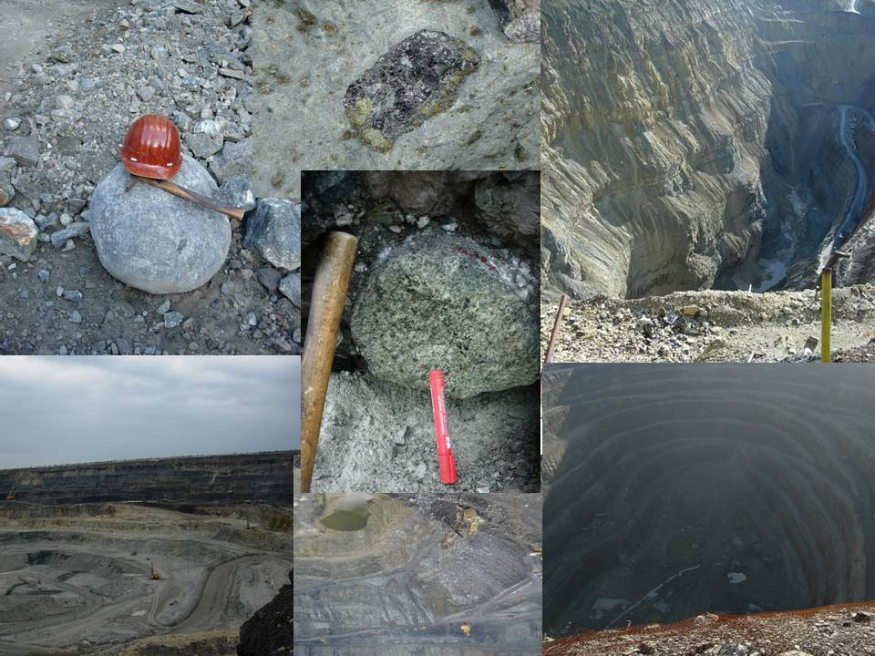

Universal CLINOPYROXENE barometer
Ashchepkov Igor
Institute of Geology
and Mineralogy,
Novosibirsk Russia
Institute of Geology
and Mineralogy,
Novosibirsk Russia

Slide 2
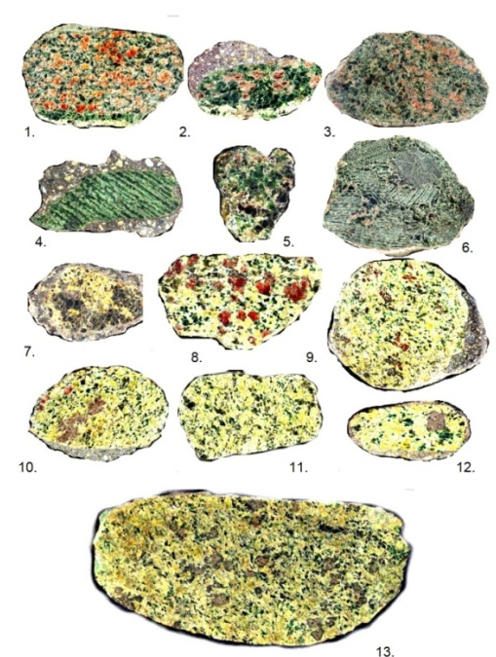
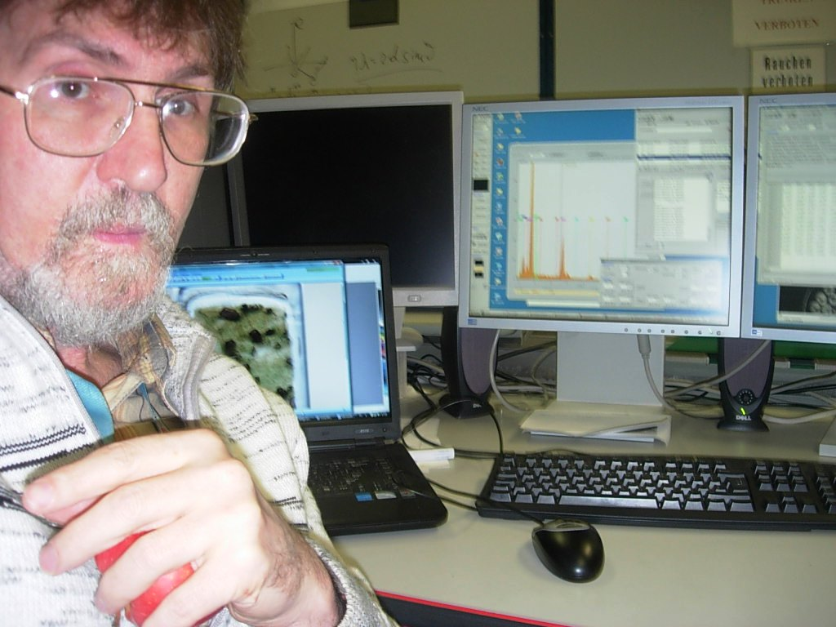
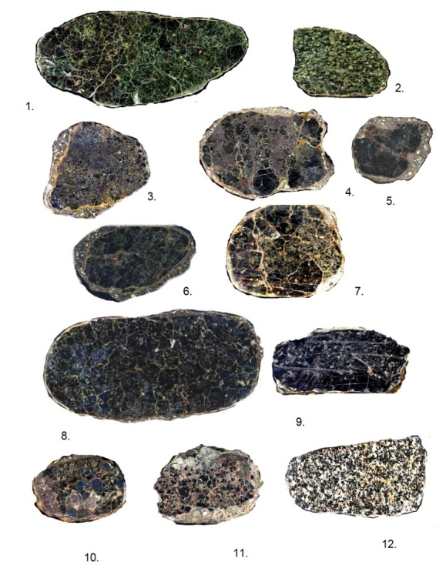
The Jd-Di thermobarometer (Ashchepkov, 2002; Ashchepkov et al., 2010; 2011) has been recalibrated to work
simultaneously in all systems: peridotitic, pyroxenitic and elcogitic. This allows us to calculate the PTX parameters
for all types of mantle eclogitic xenoliths which have quite different chemical features (Ashchepkov et al., 2010; 2012; 2013a,b;
Afanasiev et al., 2013).

Slide 3
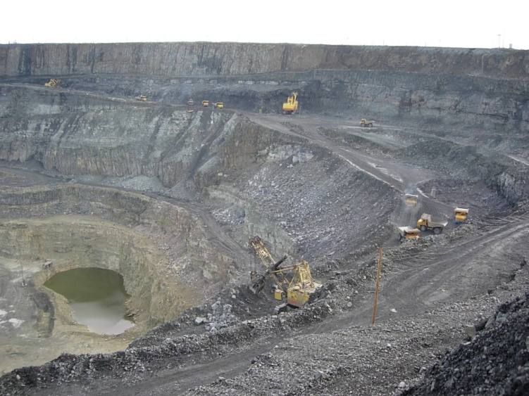
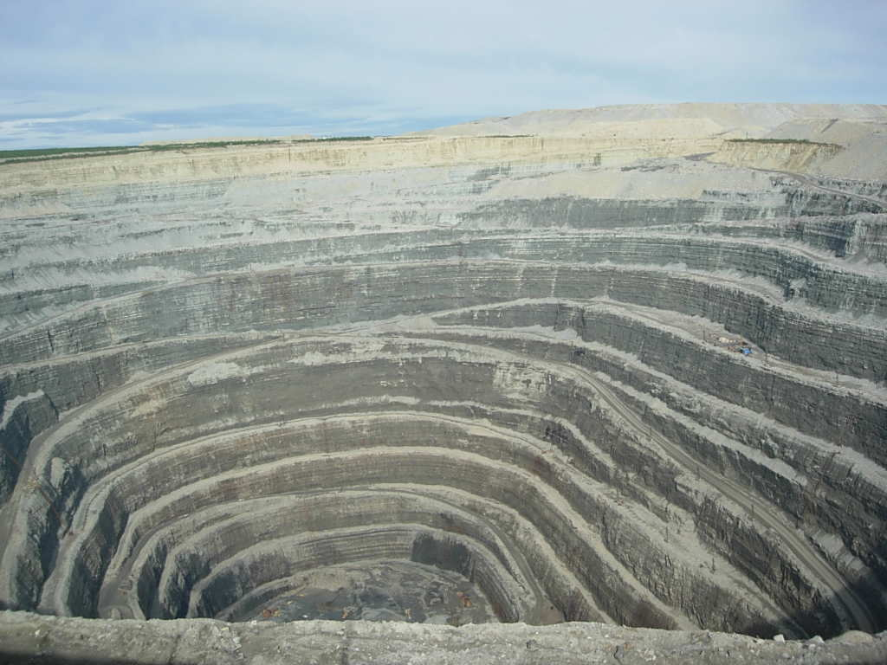
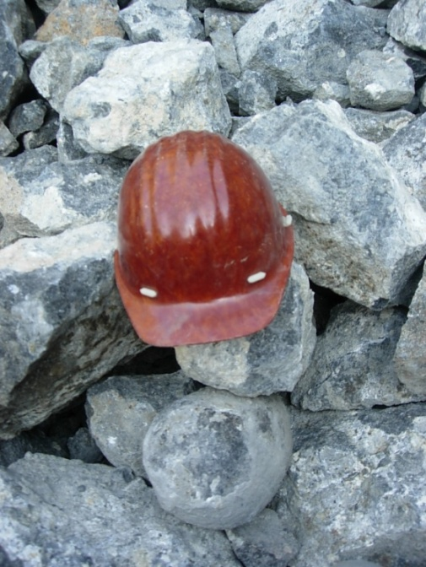
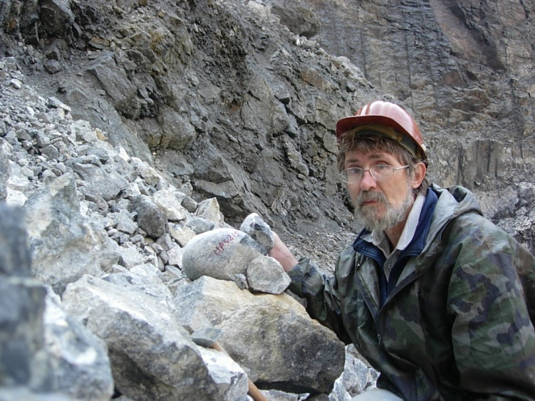
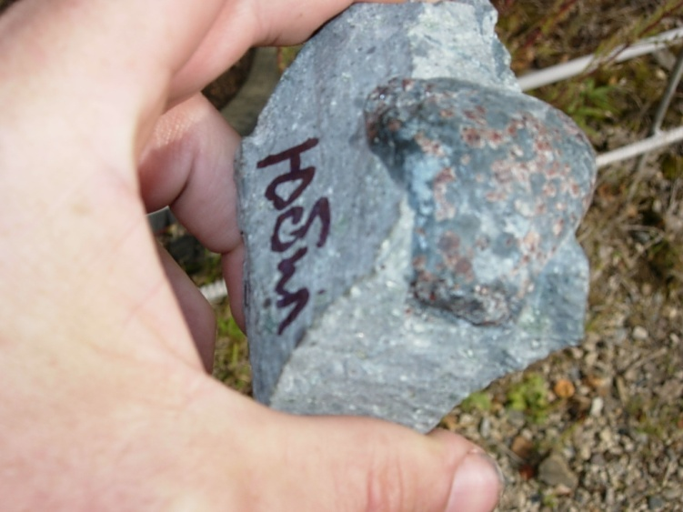
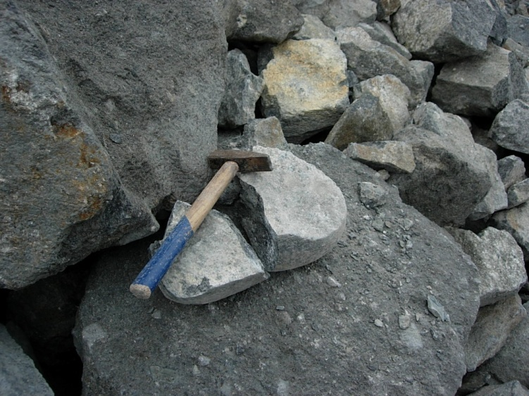
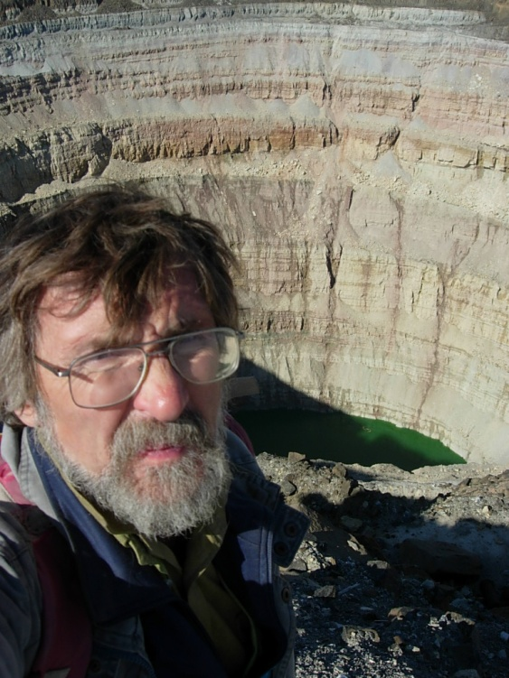
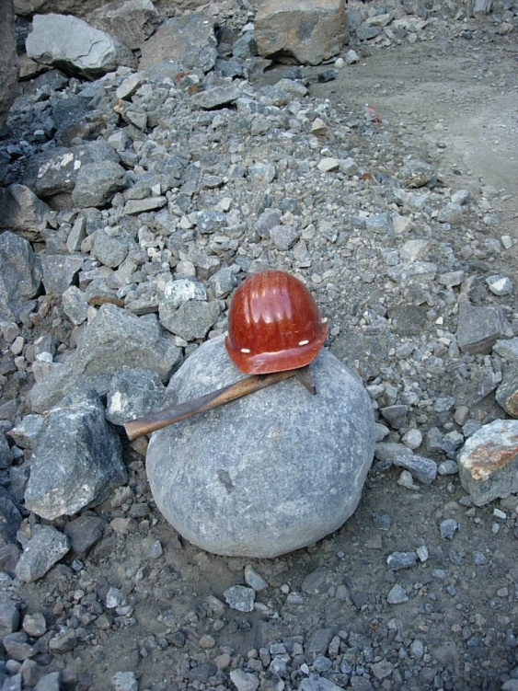
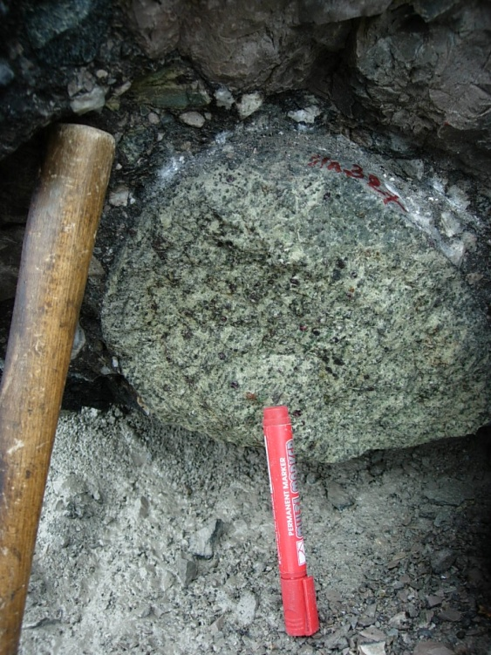
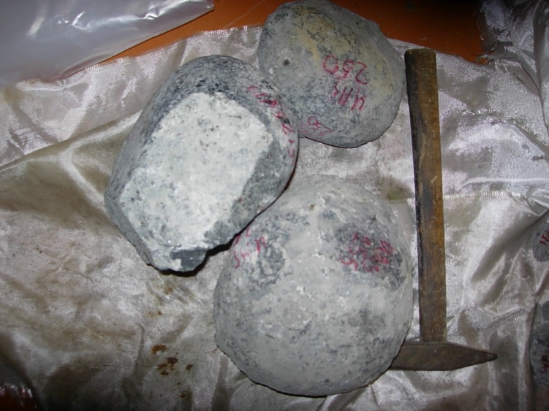

Slide 4
Transect Malo–Botuobinsky - Toluopka field
SSW NNE
a.
b.
c.

Slide 5
Daldyn SCLMT Udachnaya - Zagadochnaya
N S
b.
c. d.

Slide 6
P₀=a*TºK*Kd1/(1+b*Fe)-C (1), where а=0.04 и b= 2.44, C=-5.5 and, Kd1= Na/Ca*Mg/(Al+Cr)
P = a*T⁰K *ln (KD) /ΔV + b*ln* T⁰K /c* ΔV ⁰ + d Mulhopadyay (1991)
the Jd-Di internal clinopyroxene exchange: CaMgSi2O6 = NaAl Si2O6
Kd2= Na/Ca*Mg/ (AlIV+Cr-2*Ti+Fe3+).
P2=00.35*Kd2*TºK/(1+2.4*Fe)50*ln(1273/TºK(Al+Ti+Na)

Slide 7
Nimis ant Taylor themometer
TºK_{NT2000}=(23166+39.28*P)/(13.25+15.35*Ti+4.5*Fe-1.55*(Al+Cr-Na-K))+(ln(a_{En}^{Cpx})²), где a_{En}^{Cpx} =(1-Ca-Na-K)*(1-0.5*(Al+Cr+Na+K)).
Correction
T=T_{NT20002}+33.8*(Cr2O3+Al2O3)-137.5-25.8*(FeO-4.2)-11*Na2O+TiO2*8,

Slide 8
KD= (Al-0.01)*(( TºK -600)/700) ^{3/4}+Cr*((TºK -100)/900 +(4*Ti-0.0125)/( TºK -800)*700 +(Fe-0.23)*( TºK-900)/10000
P(Ash2011)=0.3* KD*TºK/(1+2.35*Fe+Fe*(TºC-600)/800)-40*ln(1273/TºC)*(7*Na+10*Cr15+Mg/4-Al-15*Ti)+
50*(Na+0.2*Al-2*Ti+0.05*Mg-0.22*Ca-0.7*Na/Ca)+7.5*Si - 20*Al*Na*Mg/Ca/(Al+Na-2*Ti-2*Fe3+) {5.1.4}

Slide 9
For the pyroxenes of group A:
AlCr=Al+Cr+(2*Ti-0.015)/(P-5)/P**2*40+0.55(Fe-0.2-0.21*Na)*0.18*P/62.5
The logarithmic dependence between P and KD was transformed to a lineal one. Final pressure equation for the eclogites is as follows:
P=0.325*(1-0.19*Na)/Al+0.01*Fe/Na +1.15*Cr)*KD* TºK **0.75/(1+5.5-2.5*Fe*P/60) *Fe) -log(1273/ TºK)*(Al+Ti+2.25*Na+1.5*Fe3+)*35 +(0.9-Ca)*10+Na/Al* TºK /300-1.5 -4*(Fe*33.2-4)+ (Ca*25.9-20)* TºK /2500
with further correction P=(0.00002*P**3-0.0036*P**2+0.875*P-9)*1.075 (Equation1 )
For the pyroxenes from "basaltic" eclogites of group B:
AlCr=Al+Cr+(4*Ti-0.0125)/(TºK-600)*500 +(Fe-0.205)*0.75
P=0.3525*(1-0.220*Na)/Al+0.015*Fe/Na) *KD* TºK **0.75/(1+8.5*Fe)
-log(1273/TºK)*(1.3*Al+Ti+0.5*Na+3.5*Fe3+)*35 +(0.9-Ca)*10
+Na/Al* TºK /100 (Equation 2 )
for the eclogites of group C high Fe and high Ca-Al eclogites the equation is slightly changing
P=0.335*(1-0.215*Na)/Al+0.012*Fe/Na) *KD* TºK **0.75/(1+5*Fe)
-log(1273/ TºK)*(Al+Ti+2.75*Na+2.5*Fe3+)*35 +(0.9-Ca)*10+Na/Al* TºK /300
+(Na-2.5)*Fe*( TºK -1500)/20+Ca/Mg*( TºK -1000)/75
(Equation 3)

Slide 11
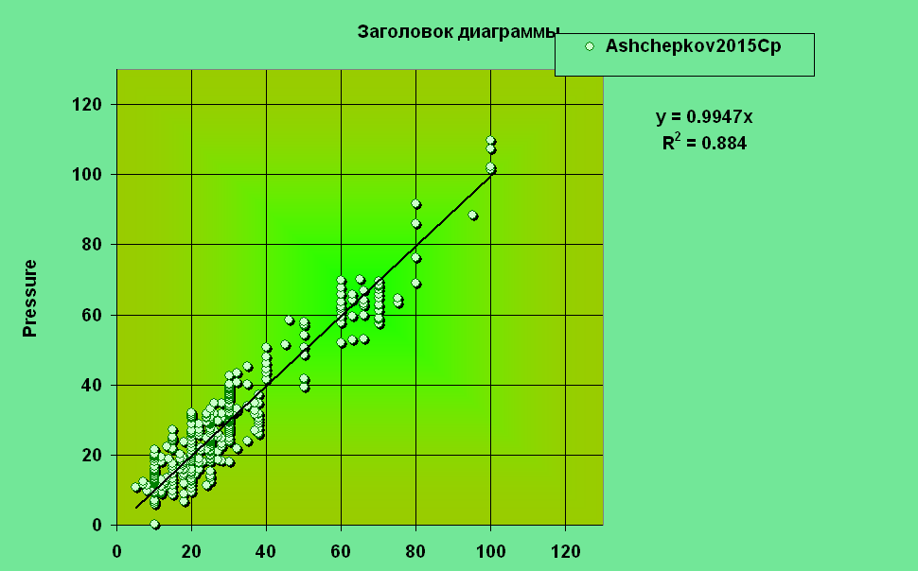
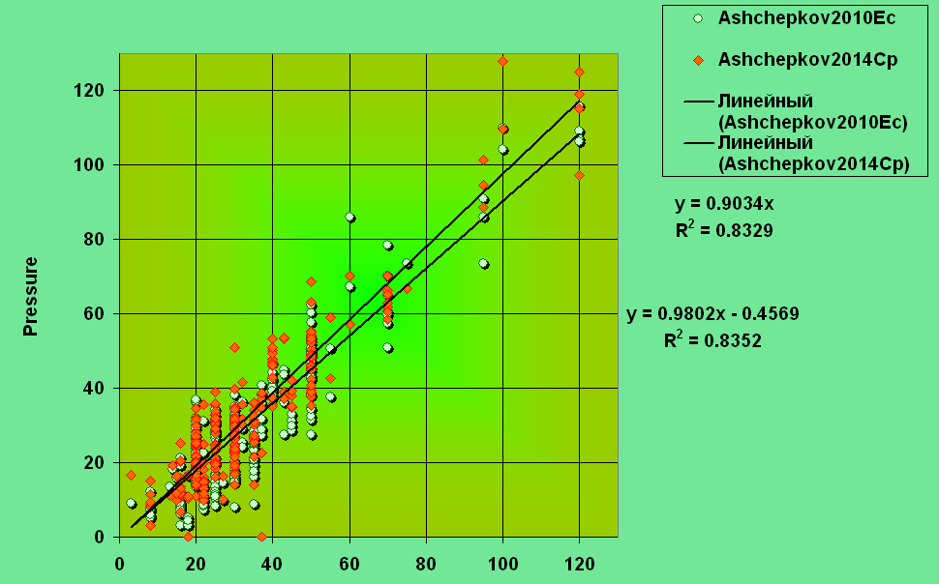
Final equation
AlCr=(Al-0.01) *((T0-600)/700)**0.75+Cr*(ToK-100)/1000+(4*Ti-0.0125)/ (T0-801)*650 +0.55*((Fe-0.23) *(T0-900)/10000-K)
P=0.26*(5+12*(Al+0.30*Na)*KD* TºK^0.75 /(1+Fe+ Fe*(TºK-600)/1000) -ln(1273/ TºK))*40*(7*Na-Al-15*Ti+10*Cr+Mg/4)+
7.5*Si-20*( Al*Na*Mg/Ca/(Al-2*Ti+Na-2*Fe/(Fe+Mg))+50*(Na+0.1*Al-2*Ti+0.05*Mg-0.22*Ca-0.7*Na)/Ca)

Slide 14
Alkaline basalt localities

Slide 15
Mantle Peridotites and pyroxenites (xenoliths from alkali basalts in South Siberia)

Slide 16
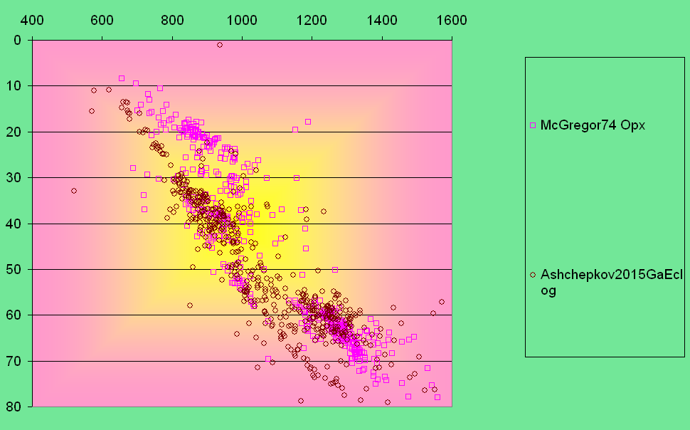

Slide 17
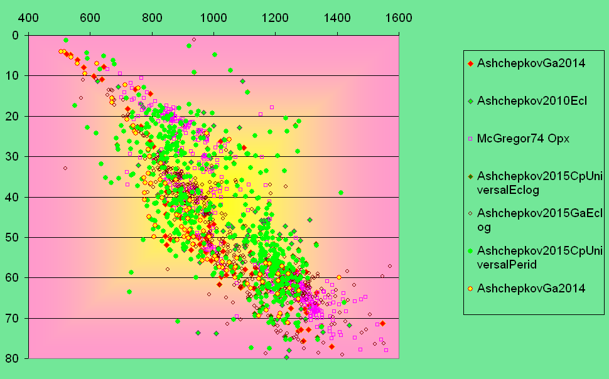

Slide 18
A)
B)

Slide 19
A)
B)
C)

Slide 20
A)
B)

Slide 21
Fig. 10

Slide 22
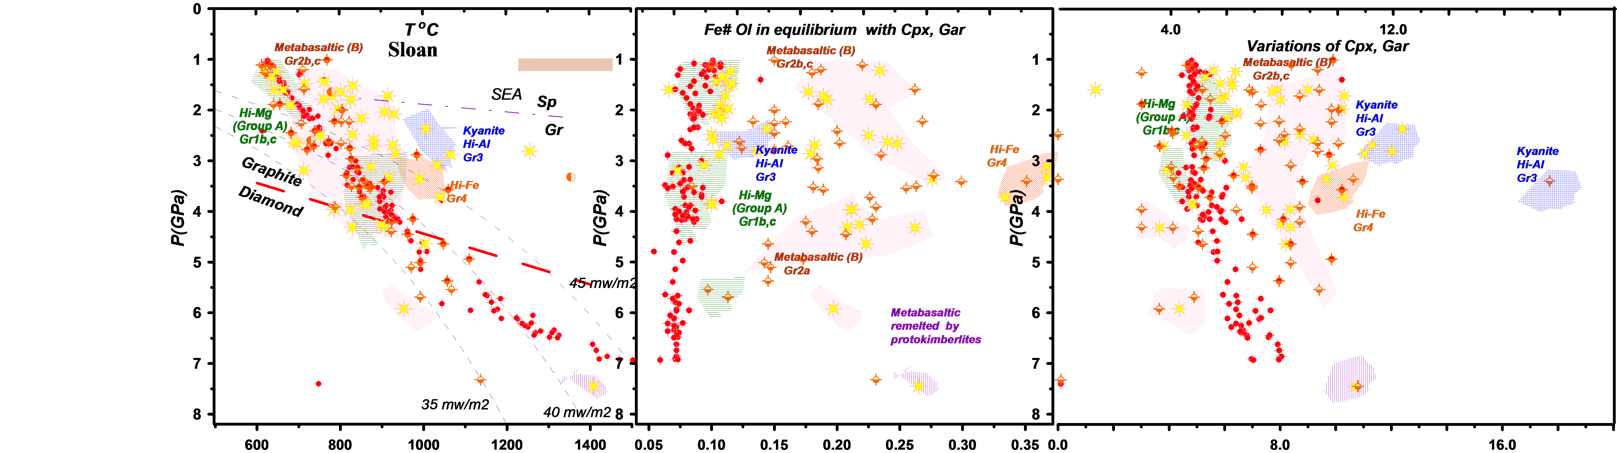
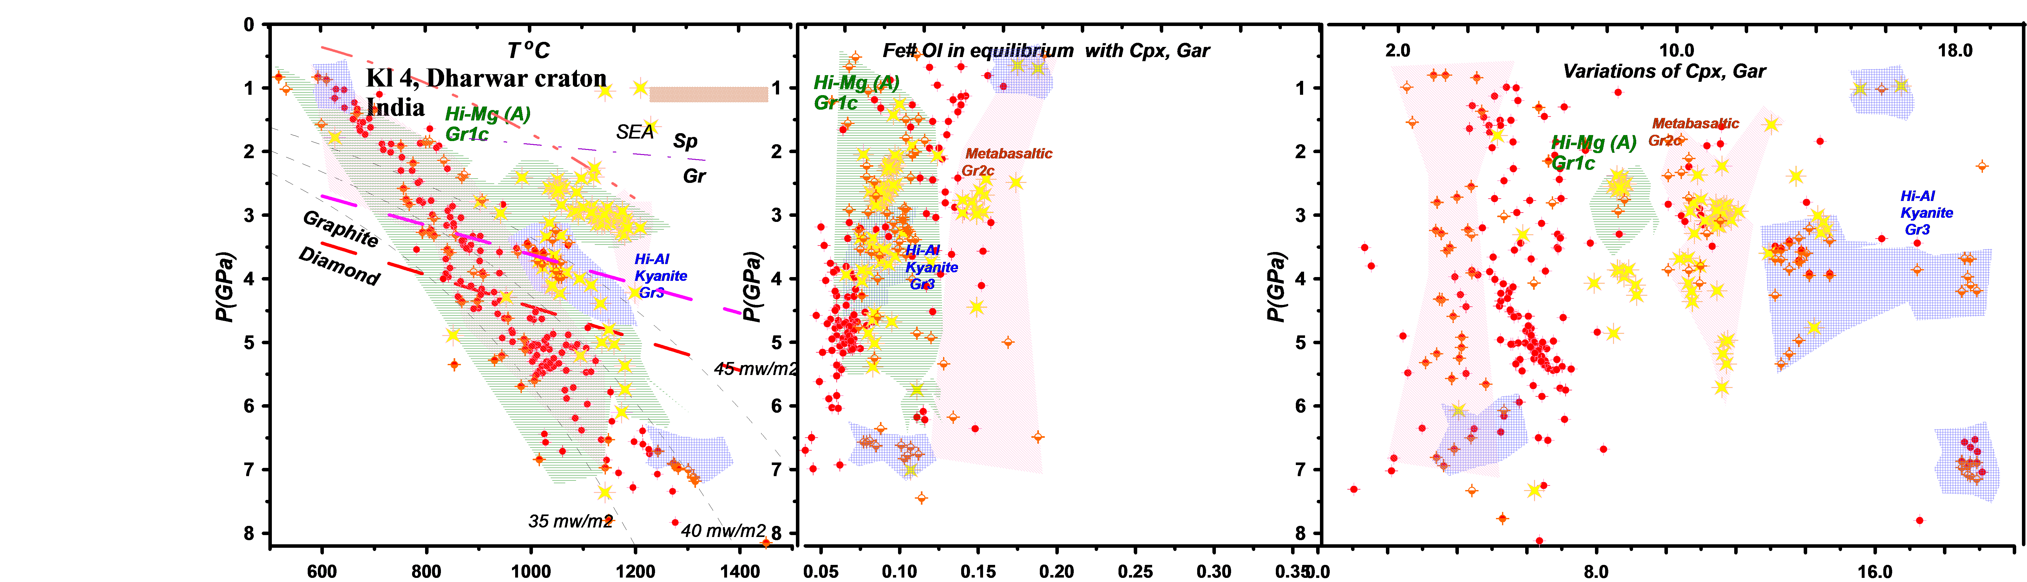
A)
B)
Fig.7. PTX diagram for xenoliths and mineral concentrates from: A) Sloan pipe, Front range field, Wyoming craton; B) Kl-4 pipe, Wajrakarur field; Dharwar craton. Symbols are the same as for Fig.3

Slide 23
SLMT in Daldyn – Alakit fields
Udachnaya - Krasnopresnenskaya
NE SW

Slide 24
Fig. 11
Transect through the southern part of Siberian craton
Ingashi - Manchary
WWS EEN

Slide 25
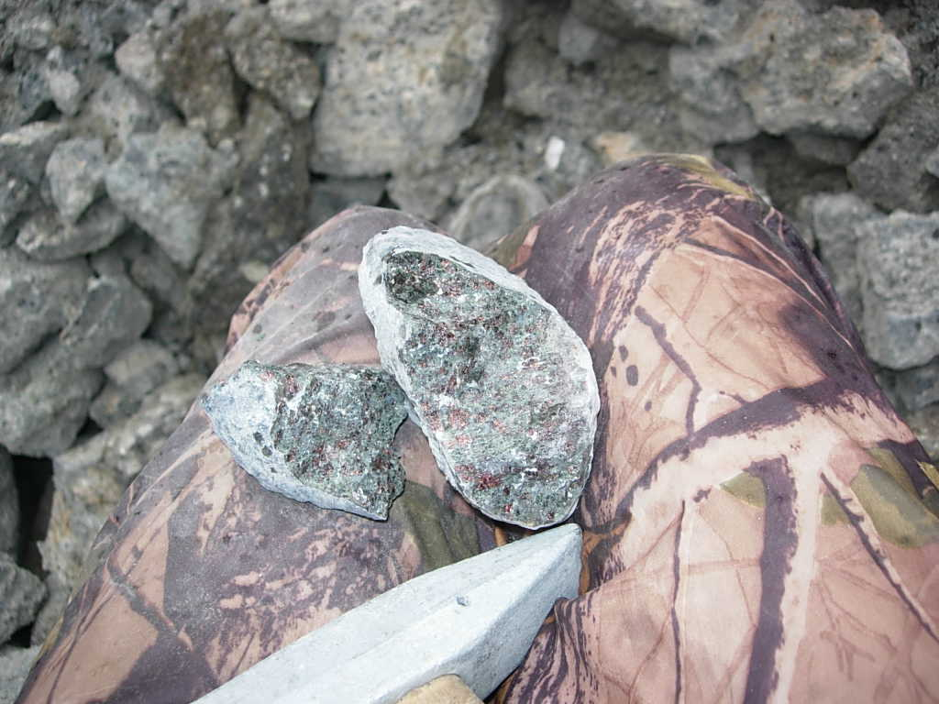
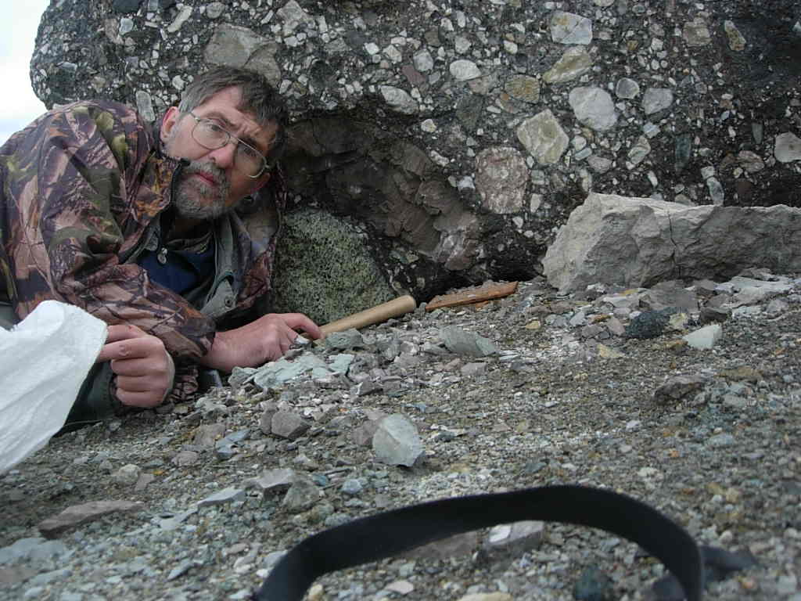
Acknowledgements
Grants RBRF -05-17105, 99-05-65288, 05-05-64718, 11-05- 60
77-2, 65-03, 02-05 projects UIGGM SD RAS and ALROSA Stock Company.
Special thanks to Sergey Kanakin and Nikolai Karmanov who helped in construction of PT program in initial stage

Slide 26
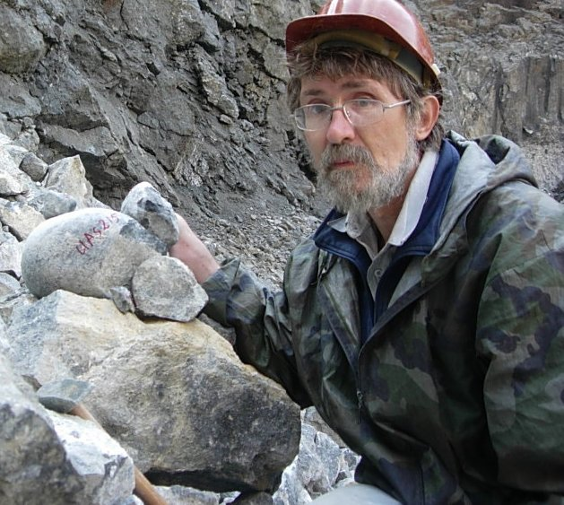
Thank you
for attention
Institute of Geology
and Mineralogy,
Novosibirsk Russia

