Slide 1
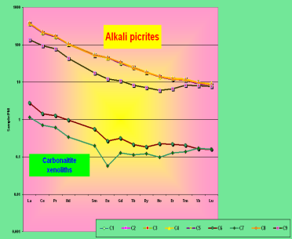
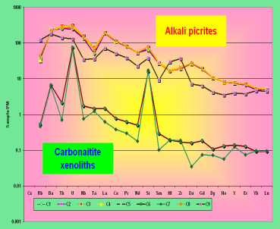
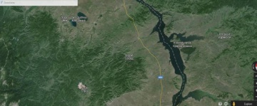
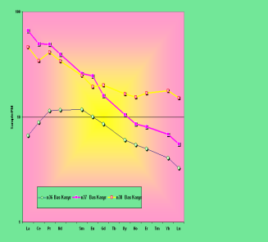
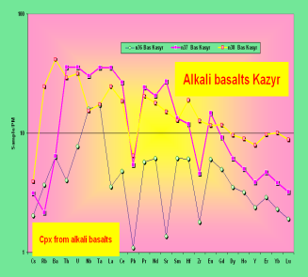

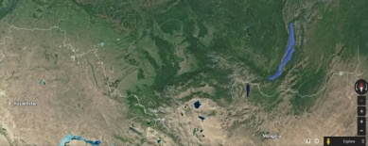
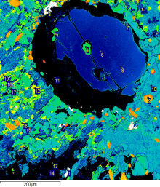
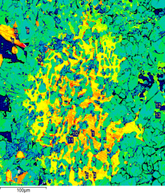
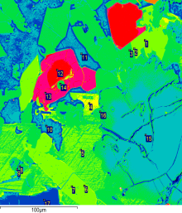
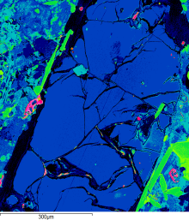
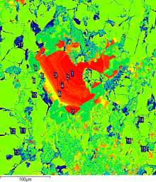
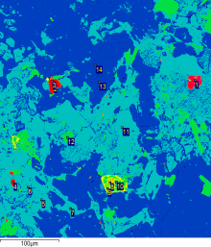
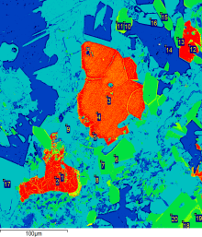
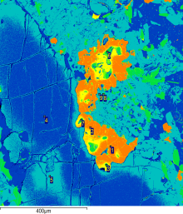
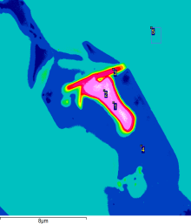
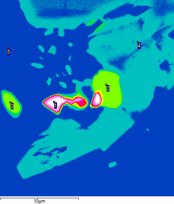
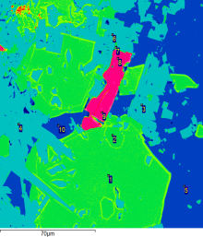
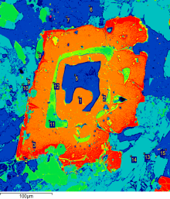
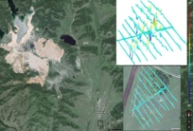
The alkali basaltic and picritic Magmatism in Minusa and Kusnetsk basin, geochemical study
Andrei Firsov (2), Igor Ashchepkov (1), Nikolai Karmanov(1), Leonid Rikhvanov (3), and Alexandr Wald (4)
(1) Institute of Geology and Mineralogy, Novosibirsk, Russian Federation, (2) Troﬁmuk Institute of Petroleum-Gas Geology and Geophysics SB RAS, Russian Federation,
(3) Tomsk Polytechnical University, Russian Federation, (4) Siberean Federal University, Krasnoyarsk, Russian Federation
Trace elements for Erba alkali picrite and carbonatie xenolith
Trace elements for Kazyr alkali basalts
in Kuznetsk Alatau
Mg-Ol xenolith with Chr inclusions
Phlogopite Apatite –Cpx intergrowths
Olivine in Sodalite Clinohumite
Apatite
Phlogopite CPx Nepheline intergrowths
Ti-Mgt Phlogopite CPx NephelineSodalite
Phlogopite Sodalite Nepheline intergrowths
Pentlandite
Mg-Ol
Apatite
Galenite with Fergussonite
Galenite with Phl and Nepheline
Epidote with Sodalite
Ti-Mgt-Cpx Nepheline Sodalite
The alkali basalts and picrites are widely distributed within the Minusa depressions. They manifest quite different episodes of the magmatic activity and plumes. Some of them relate to late Devonian which are parallel to magmatism in Vilyui rift and Tungus basin as well as to Agul basaltic plateau in Sayan Foothills and in Kuznetsk Alatau (385 -360 Ma) and are mainly represented by the alkali basalts (Rikhvanov et al., 1991). The others are close in time to the Late Devonian kimberlitic basaltic magmatism and camptonite dykes in West Sayan. The Early stage of the Permian –Triassic super plume in Minusa and Kusnetsk basin 250 -254 Ma (Rikhvanov et al., 1991). The major pulse of magmatic activity at 248 -245 MA was not appeared in southern margin. But the latest which is represented in Meimecha province Northern Siberia But the late or new Early Triassic stage at 230 -240 Ma was again manifested by the appearance of the alkali picrite ankaratrite dykes. The later alkaline magmatism in Late Jurassic – Cretaceaus stages which was appeared in the Northern Siberian provinces appeared in Southern Siberia were much less pronounced. The Latest episode of the Mezo- Cenozoic activity (Kutolin, Frolova, 1970; Ashchepkov et al., 1995) in the Kopiev uplift with the abundant mantle xenoliths in magma manifest another stages which possibly is related to the hydrous plumes. The trace elements of the magmas in the Minusa depression show rather high concentration if the incompatible elements in all stages which suggest primary enrichment in the metasomatic components probably due to the ancient subducted related magmatism starting from the Devonian stage (Vorontsov et al., 2013) which had the model ages of about 0.9 Ga (Vrublevskii et al., 2014 ). The high melting stages which should be followed by the depletion and homogenization of the source mantle at the Superplume stage and the erupted volcanic still demonstrated rather high La/Yb rations. An thus the alkali picrite volcanic of the Early Triassic stage still contain a lot of admixtures of the hydrous and carbonite bearing materials as well as high P, U, Th and incompatible elements due to te melting of the apatite- mica- amphibole bearing sources. The Meza –Cenozoic volcanic still keep such signatures abut much less. And in this stage in the mantle amount of metasomatic associations was not high (Ashchepkov et al., 1995). Nevertheless abundant pyroxenites in xenoliths containing not only monosulﬁdes but chalcopyrite suggest participations of the ancient subducted materials in their origin. This is also correlating with the presence here of the Co-Ni–Cu-Mo deposits which have enlarged concentration also in the volcanics and xenoliths. RBRF grants 05-05-64718, 03-05-64146; 11-05-00060a 11-05-91060-PICS
Olivine
Clinopyroxenes
Humite
Sodalite
Spinels
Phlogopite
Apatitess

