Slide 1
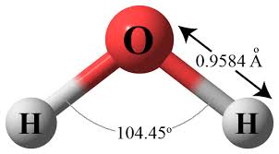
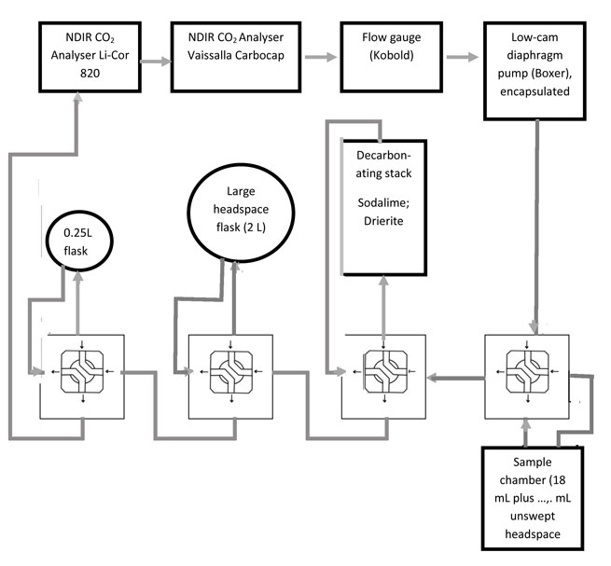
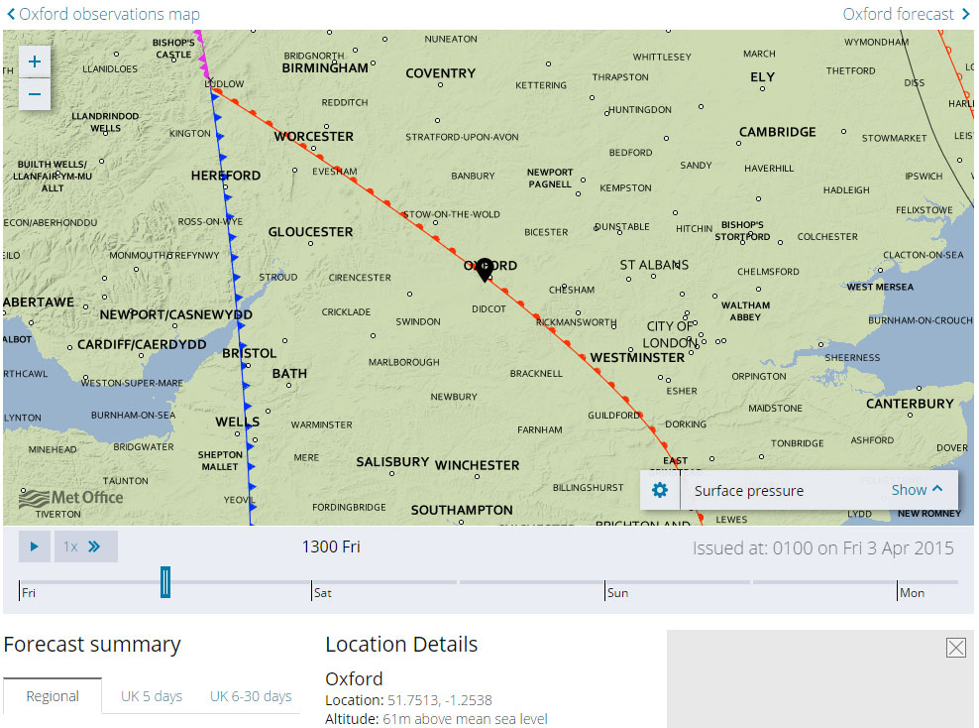
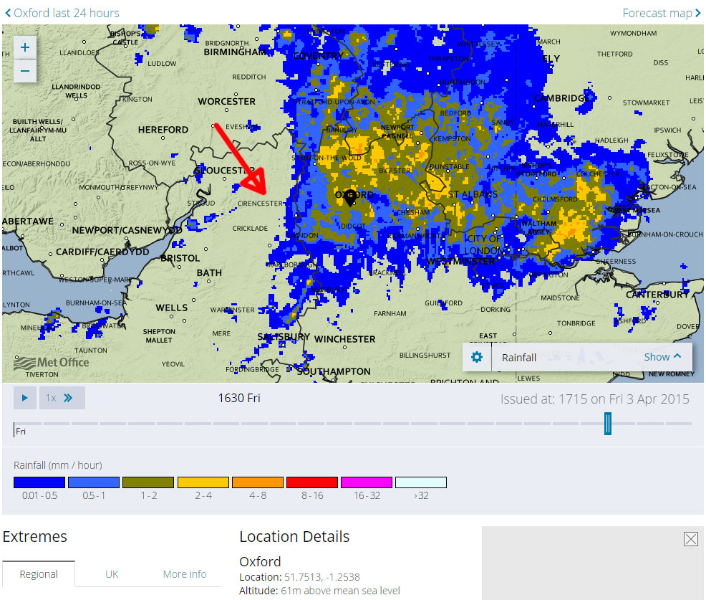
High resolution real-time analyses of precipitation at two UK ground locations:
Dissolved CO₂ as convection monitor?
Brian Durham, University of Oxford
Water structure: Do changes to the bond angle and bond length of water (density maximum 4 deg C) improve its low temperature capacity for dissolving CO₂?
Motivation
This poster addresses anomalous acidity values in UK rainfall, recorded while seeking a homeostatic mechanism in a planetary atmosphere friendly to complex carbon life forms for at least 400M years.
Fieldwork( Fig. 1)
The initial data was collected over two summer months in 2009 at Reading University’s Meteorological Observation Site, measured in real time by pH with RMS averages recorded at 60-second intervals. Figure 1 shows that acidity spikes are followed by c. 4-hour decay curves after rain had stopped, a phenomenon that was provisionally attributed to `volatile acidity’. The decay curve could be replicated indefinitely by recharging a rain sample with pure carbon dioxide (CO₂) and exposing it to fresh air.
3. Henry’s Law equilibrium (Figs 2 ; 3)
Assuming provisionally that the acid agent was CO₂, the rainfall had been supersaturated, the saturated equilibrium being represented by the baseline value following each decay cycle in Fig. 1. The equilibrium solubility of CO₂ in water is conventionally measured at 100.3KPa pressure of the solute gas. However for substantially lower pressures (Earth sea level = c 40Pa) the published data is not linear (Fig 3) . Indeed Kurt Buch (1925) reported a consistent positive deviation at pressures down to 100Pa (Fig 3). His values were on the high side relative to spectrometry in the present project, but his observation is here referred to as the `Buch Effect’.
The question?
How could rainwater be `supersaturated’ on arrival if it had formed in clouds with CO₂ solute pressure around 85% lower? Analytical methods generally are not equipped to contain supersaturation, perhaps explaining why such a transport might go unrecognised. Granat speculated `oversaturated’ CO₂ content, but concluded that his laboratory procedures would have eliminated it (1972).
A potential mechanism: (Fig. 5)
A recent communication to Faraday Discussions adds a temperature dimension to the Buch Effect, suggesting that CO₂ solubility tracks the molar volume of water at temperatures towards (and logically beyond) its density-maximum (FD 167 (2014), 462-3).
7. The hypotheses: This poster postulates:
1. Volatile acidity measured in Reading was CO₂;
2. It had diffused into cloud drops supercooled during convection;
3. It may be of value in modelling convection.
8. New work - replication of real-time pH analyses using gas-phase NDIR spectrometry (Fig. 4)
Real-time monitoring: A 200mm glass-packed column carries a 0.1 Lpm flow of CO₂ -free air, stripping CO₂ from a dosed feed of rainwater, the gas phase analysed by Li-Cor 820 and SenseAir K30 NDIR spectrometers;
Calibration: A headspace volume of 2.3L air (CO₂ -free) is re-cycled through 1mol rainwater for absolute content – headspace analysed by Li-Cor 820 NDIR spectrometer.
Initial results and synoptic Met data (Fig. 5)
Jointly Figs 1 and 5 confirm that, even with the Buch Effect, the saturated CO₂ content of rainwater is insignificant, the bulk CO₂ transport being the volatile component. Moreover the spikiness in each case suggests a link between CO₂ scavenging and convection.
Next steps
If CO₂ is being scavenged, is it on a scale that depletes the atmosphere. Conversations are starting with the universities of Manchester and Reading for assembling an archive of flight data and sonde data on variations in the mol fraction of CO₂ associated with convection. In parallel, an archive of 260 Oxford rainwater analyses for CO₂, ΔpH and Δconductivity is being studied for any trends in chemical scavenging.
Wider implications: `Volatile acidity’; the `Buch Effect’; and `convective scavenging’; are presented here as physical properties of the water molecule and hence operative in Earth atmosphere since the Carboniferous and before. The findings suggest therefore that some of the CO₂ capture presently attributed to photosynthesis and dry deposition is in fact wet deposition. This may be of value in modelling convection and atmospheric homeostasis.
Fig. 1 Field results 2009 This `spiky’ trace of acidity is a 7-day extract from the 2009 Reading series. Note the `decay curve’ over four hours after each spike, as the 4mL sample well equilibrates after rain had stopped. Following the rain of 18 July the equilibrium acidity (base line) is marginally higher than following other events that week (i.e. non-volatile acidity). Previous analyses (without measures to contain volatility) are likely to have reported only the equilibrium CO₂ content (base line).
Fig. 2
Solubility of CO₂ in pure water against temperatures at partial pressures c. 450 ppm of CO₂ . Values are RMS averages of 60 readings at the manufacturer’s 3% confidence level.
Henry’s Law and the `Buch Effect’
Fig 3
Log-log axes illustrate reported deviations from the Henry constant in the region of CO₂ partial pressures in Earth atmosphere. New values are RMS averages of 60 readings at the manufacturer’s 3% confidence level.
Fig. 4 Schematic CO₂ strippers
Left: real time analyser
air flow 0.1 L/min; rainwater dosed 17 mL/min;
Right: closed headspace for
absolute CO₂ values
2.3 L air circulated @ 0.8 L/min; rainwater 18 mL (= 1 mol), air flow directed by four Hamilton loop valves, optional 250mL flask for low end readings.
Li-Cor 820
NDIR analyser
Kobold
flow
meter
Rain
collector
Water-
level
setting
Peristaltic pump
Viton tubing
air
Stripping
column
air
Sodalime
stack
Water out
Experiment 6: CO2 stripper
Fig. 5 Preliminary results: On 4 April 2015 Oxford saw the passage of a warm sector (pressure chart 5b) with a series of rain events including that illustrated on the 16:30 radar image 5c, rain tracking south-eastwards (see red arrow). Calibration of stripped CO₂ is in progress, i.e. water-flow/air-flow/ completeness of stripping, but the similarity to [H3O+] Fig. 1 is evident.
* Research Associate, RLAHA, University of Oxford
Grateful thanks for generous financial assistance: Meteorology Department, University of Reading; Royal Meteorological Society; The Rainfall Organisation; and John Durham. Thanks for advice, support and discussion to: Neil Cape; Stephen Cox; Lennart Granat; Giles Harrison: Brian Howard; John Methven; Mirjam Orvomaa; Christian Pfrang; Mark Pollard; Christoff Salzmann; Mike Stroud; Holger Tost; Geraint Vaughan; Ana Vila Verde; Ray Weiss.
Brian Durham

