Slide 1
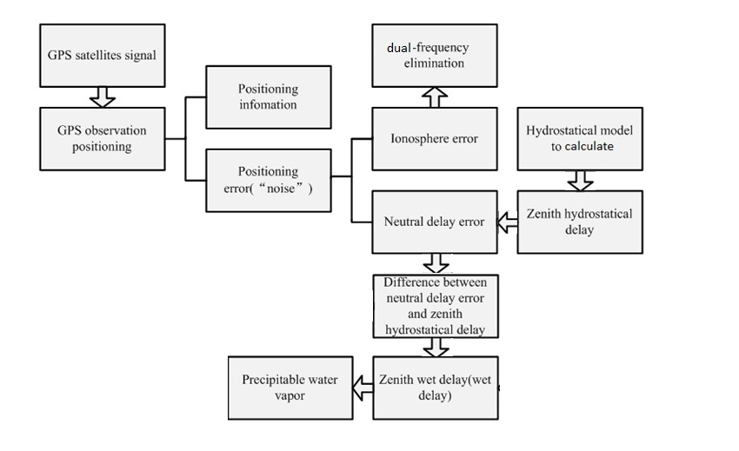
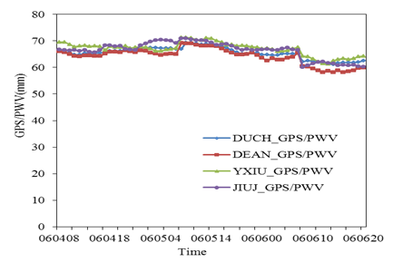
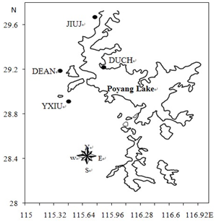
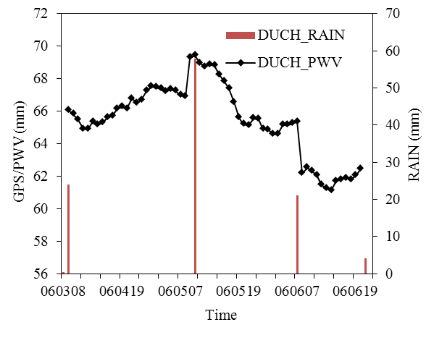
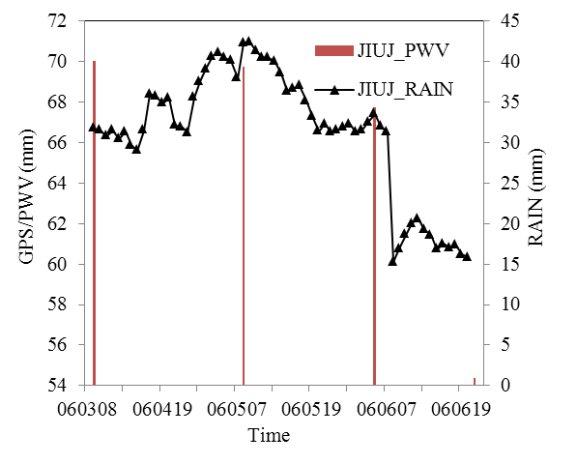
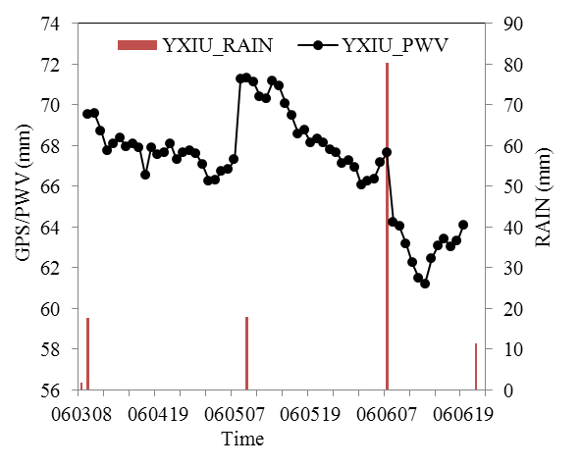
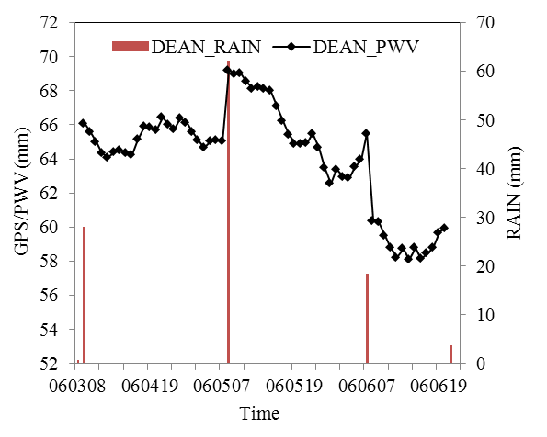
Analysis of Water Vapor Characteristics of Regional Rainfall Around Poyang Lake Using Ground-based GPS Observations
Cao Yujing ^{1,2}, Guo Hang ¹, Liao Rongwei³ , Uradzinski Marcin⁴
1.Nanchang University, China, 2. China Meteorological Administration, Engineering Consulting Center, China, 3. National Meteorological Information Center, China, 4. University of Warmia and Mazury in Olsztyn, Poland
1. Abstract:
Atmospheric precipitable water vapor of Poyang Lake area can be estimated using the ground-based Global Positioning System technology and the atmospheric precipitable water vapor change characteristics during the rainfall process can be analyzed.At the same time we can use National Centers for Environmental Prediction (NCEP) reanalysis data and high-density grid data analysis of weather system, water vapor transmission, convergence and precipitation power mechanism. The atmospheric precipitable water vapor and rainfall contrast analysis show that rainfall and precipitable water vapor are not directly in corresponding relation,, and their values are not always mutually corresponded. The value of rainfall is closely related with the water vapor transfer and water vapor convergence. In front of the rainfall the increasing process of GPS/PWV changes continuously, and increases suddenly in about 1 hour before the rainfall. The rainfall is not always smaller than the biggest value of GPS/PWV, and has the possibility to be bigger than the GPS/PWV values. GPS delivered PWV could be used to improve the near real time forecast/ short term forecast of precipitation.
2. Ground-based GPS inversion of atmospheric water vapor
3. Observations
Four stations were selected including Duchang Poyang Lake (DUCH), Jiujiang (JIUJ), DeAn (DEAN), and Yongxiu (YXIU) and at the same time, the IGS permanent stations Kunming, Lhasa, and Xian were used, too. Using these observations, the PWV in the Poyang Lake area can be estimated.
4. Analysis of GPS/PWV results
The Poyang Lake based on GPS/PWV time series (from June 4th , 8am to June 6th, 8pm). GPS/PWV time series are consistent and three days of atmospheric water vapor values are always above 58 mm.
5. The relationship between GPS/PWV and the rainfall
Data of high-density grid points was used to obtain the daily rainfall what is actually happening at each Poyang Lake measuring station from June 3th to June 8th, to compare with GPS/PWV of each Poyang Lake measuring station and analyze the relationship between them.
Figure presents the time series of GPS/PWV and the current rainfalls at four stations.
6. Analysis of synoptic sytuation
In order to analyze the influence of the weather system to the rainfall, the 500hPa geopotential height field
and the anomalous field of the geopotential height field was used.
From the 500hPa geopotential height field, we can realize that majority of areas in south of China was the negative anomalous areas which maximum value may reach 10gpm. Combining the geopotential height field in the same day, this indicated that the vice-high tended to East, and the center in Western Pacific was strong.
Majority of areas in China were the positive anomalous areas which maximum value may reach above 20gpm.
This indicated that the vice-high tended to West on this day, the central crestline lifted to North , and the central intensity had been weakened.
7. Analysis of precipitation dynamic conditions
8. Conclusions
To analyze the precipitation dynamic condition on three days, Figure gives vertical circulation anomalous fields:
1. Through analyzing the characteristics of GPS/PWV and rainfalls, we realized that the rainfalls do not agree with GPS/PWV directly, and their values are also not always mutually corresponded. The value of rainfall is closely related with the water vapor transfer and water vapor convergence.
2. Through the analysis we made, it was realized that in front of the rainfall the increasing process of GPS/PWV changes continuously, and increases suddenly in about 1 hour before the rainfall.
3. The rainfall is not always smaller than the biggest value of GPS/PWV, and has the possibility to be bigger than the GPS/PWV values.
4. GPS delivered PWV could be used to improve the near real time forecast/ short term forecast of precipitation.
6. Analysis of the source of water vapor
In order to analyze the source of the rainfalls , the sufficient supply as an essential condition should be studied. In the paper the water-vapor transfer field and the water- vapor flux field of divergence is presented. Through the water-vapor transfer field and the water- vapor flux field of divergence which was the average of four times a day, the source of water vapor transported to the south of China was mainly from the water-vapor transfer of the southwest of Bengal Bay and South Chain Sea and Western Pacific. To the corresponded water vapor flux field of divergence, the Yangtze valley and the nearby regions were convergence areas, the maximum value reached 4mm·d in Jiangxi province. Because there was sufficient water-vapor transfer and the water vapor collection, therefore it was advantageous for the occurrence of rainfall.
In order to describe the Integral rainfall process in the observation time for the Poyang Lake region, the rainfall distribution map of China and the JiangXi province which is obtained from the data of high-density grid points was used.

