Slide 1
ANGALASUT, an education and outreach project to create a bridge between scientists, local population in Greenland and the general public
P.Bourgain, Thouret F., Therkelsen L., Villez L., Scarpa D., Cornet V., Cousin-Klawinski A.
EGU - 04/15/2015
Notes:
With help of french and greenlandic teachers, who were the hard core of this project.

Slide 2
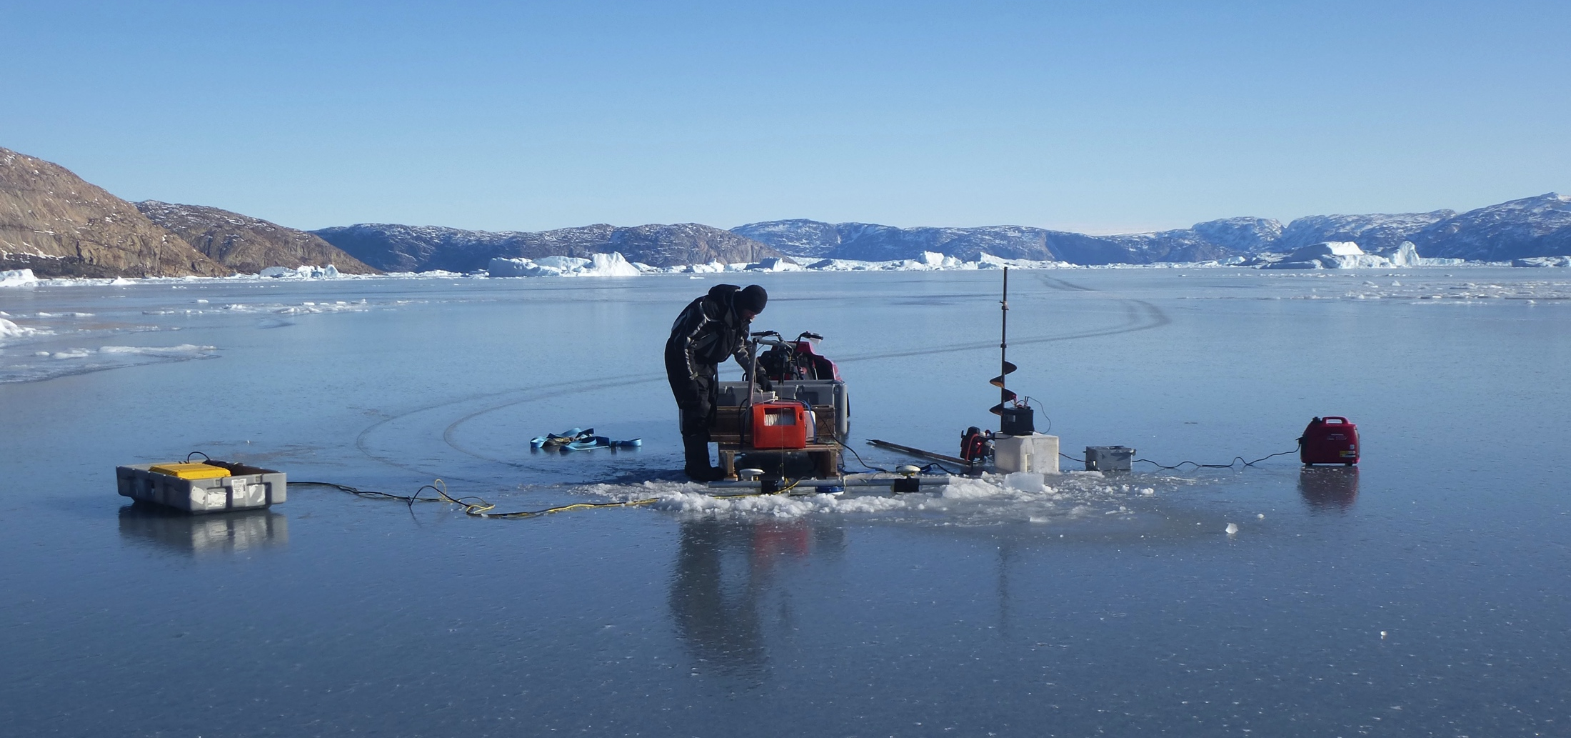
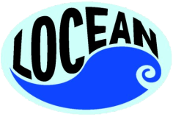
Scientific project :
“The Long Night Survey 2012-2013”
Notes:
This program was set up on the 2012-2013 school year, as part of an international scientific program dedicated to study the interactions between the ocean and glaciers on the western coast of Greenland, in the Uummannaq fjord.

Slide 3
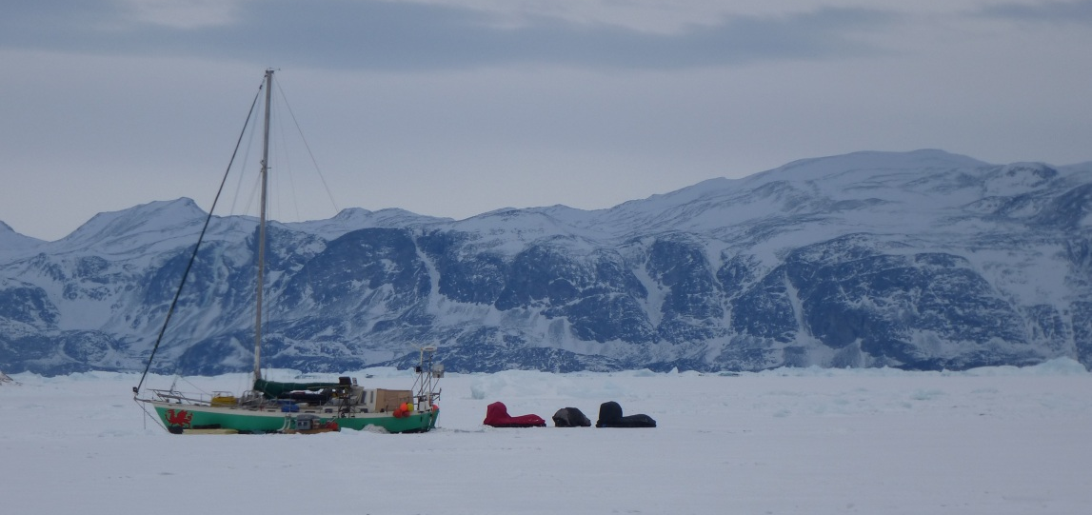
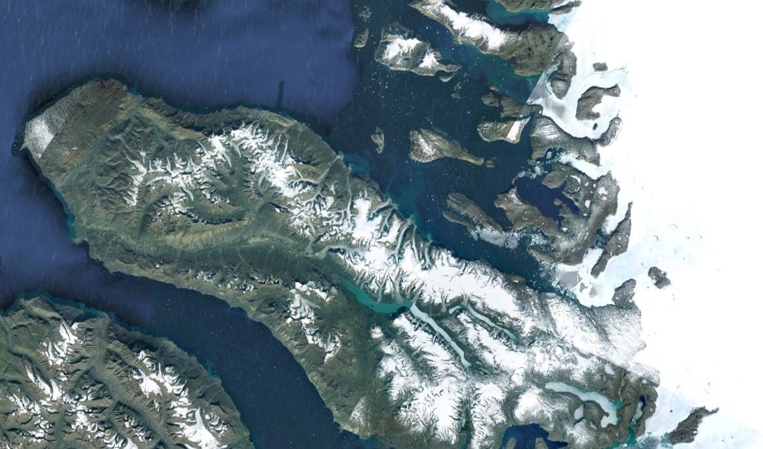
Ikerasak au Groenland
glacier Lille
Ikerasak
Uummannaq
Gambo
Ikerasak
glacier Store
Notes:
The expedition took place on board a sailing boat, Gambo, who was sailing in the Uummannaq fjord. During the winter, he was beset in sea ice close to the glaciers front, at the very end of the fjord.

Slide 4
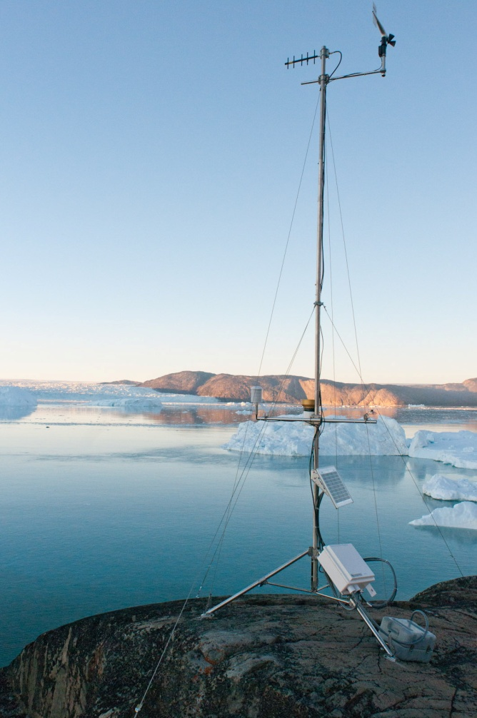
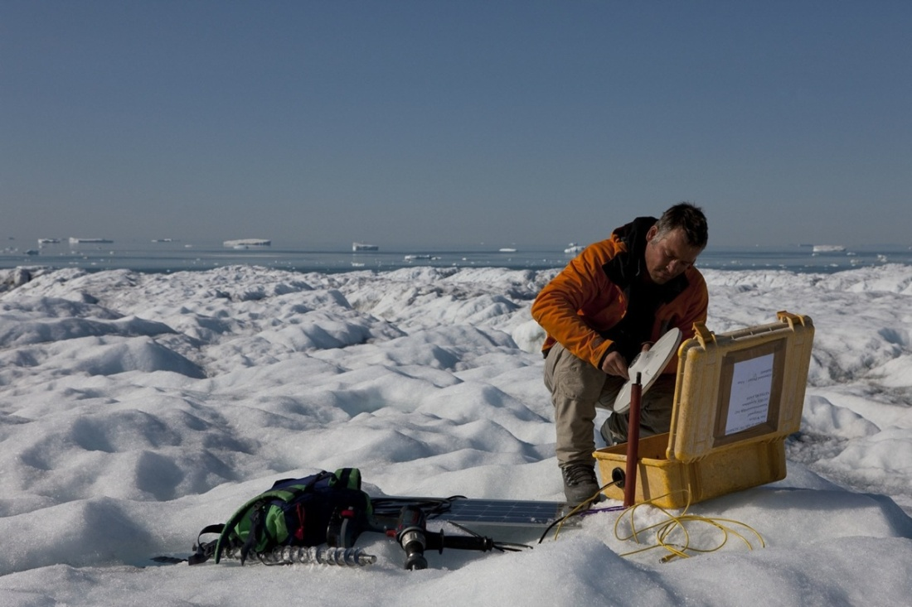
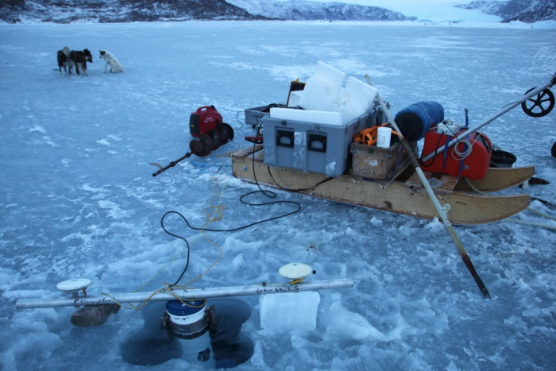
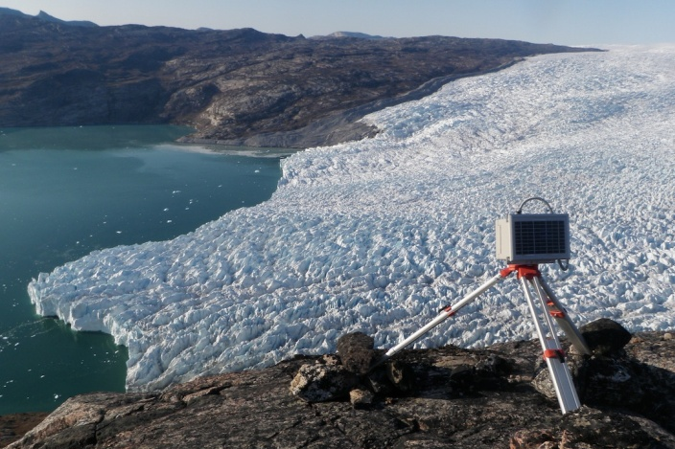
Ocean-glaciers interactions
A full year: 2012-2013
Meteo
GPS
Time Lapse
CTD+ ADCP
Notes:
During a full year, there was always a crew of 3 people on board, collecting the scientific observations.
Here are a few examples of what we were doing : GPS measurements, time lapse, oceanic observations and weather masts.

Slide 5
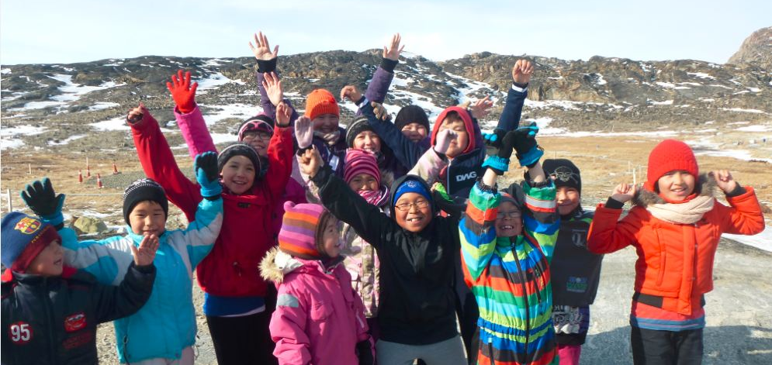
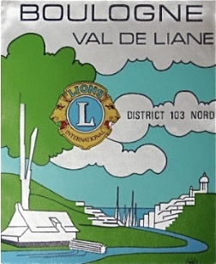
The educational project
Notes:
This scientific expedition was a great opportunity to set up an educational project with the nearby village, ikerasak.

Slide 6
Ikerasak au Groenland
Ikerasak village
glacier Lille
Ikerasak
Gambo
glacier Store
Notes:
Ikerasak counts 200 people. There are no cars and no running water.

Slide 7
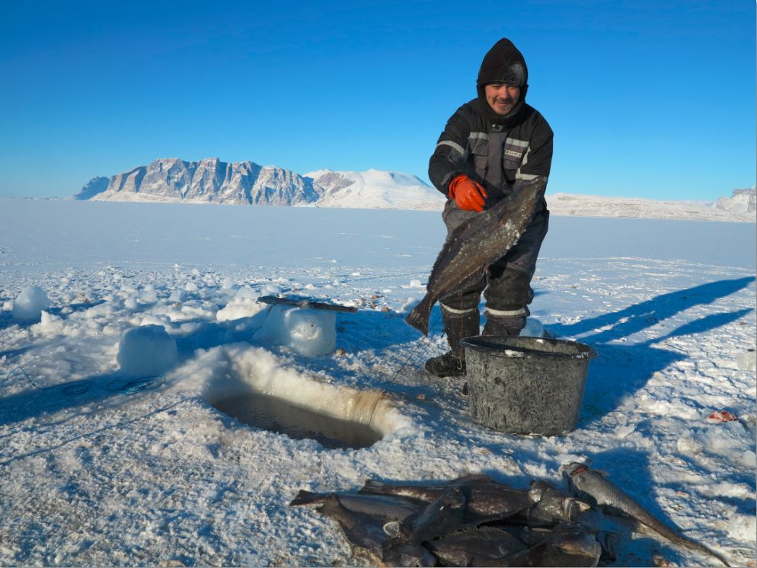
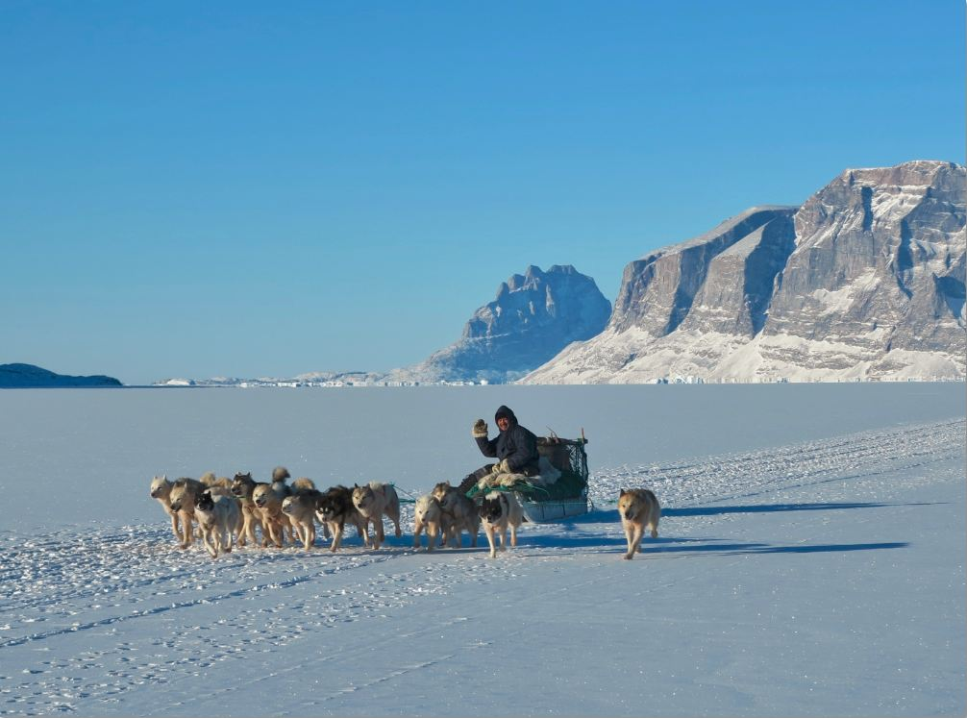
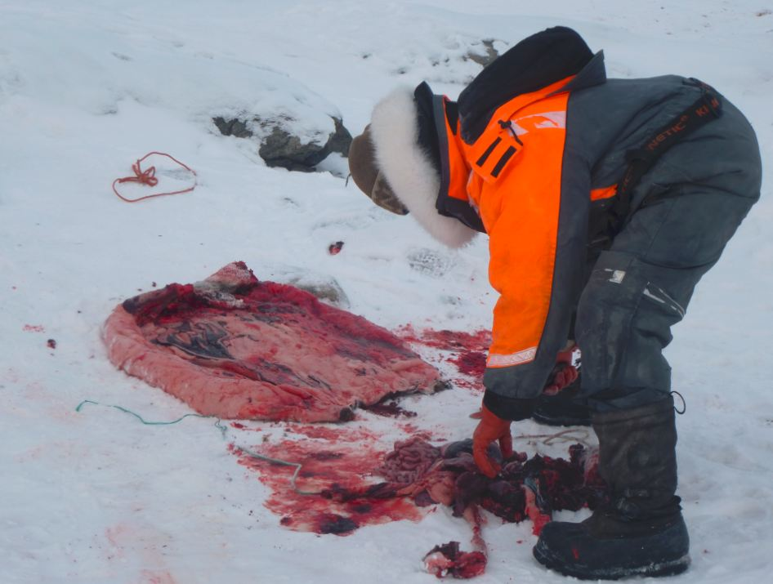
Still a traditional way of living
Notes:
It is still a very traditional place, with people being fishermen/hunters, most of them using dogsledges.

Slide 8
Objectives
In France
1-Educate about climate change and polar regions
2-Promote scientific studies and research
In Greenland
1- Explain why we are here
2-Promote interactions between scientists and local population
Cultural
Exchanges
3- Discover a new country, a new culture
Notes:
We were already in contact with these people, as they advised us on where to safely put the boat for the winter.

Slide 9
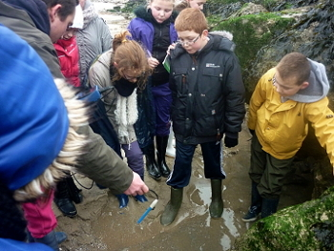
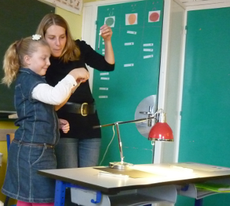
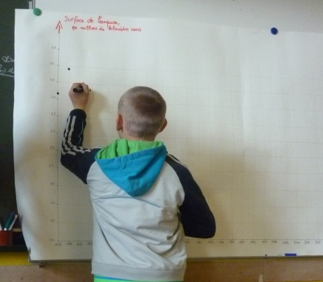
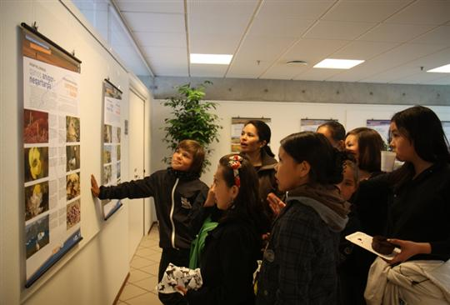
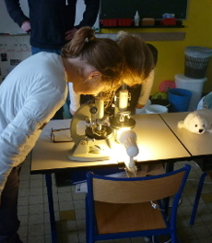
Workshops in France
Climate, Marine Biology, Arctic Fauna, Logistics, …
Notes:
Workshops took place both in classrooms and out on the field. Thery studied climate (albedo effect, sea ice evolution), marine biology, oceanography, arctic environment and logistics through simple experiments and activities.

Slide 10
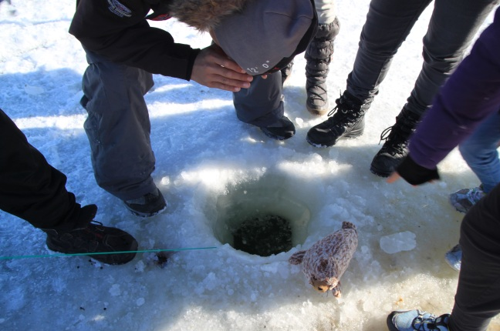
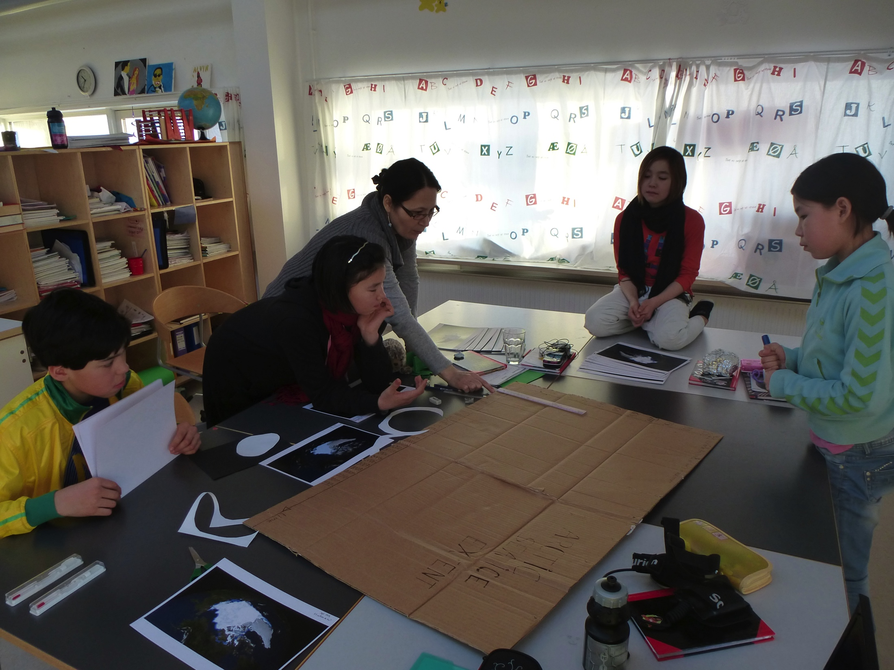
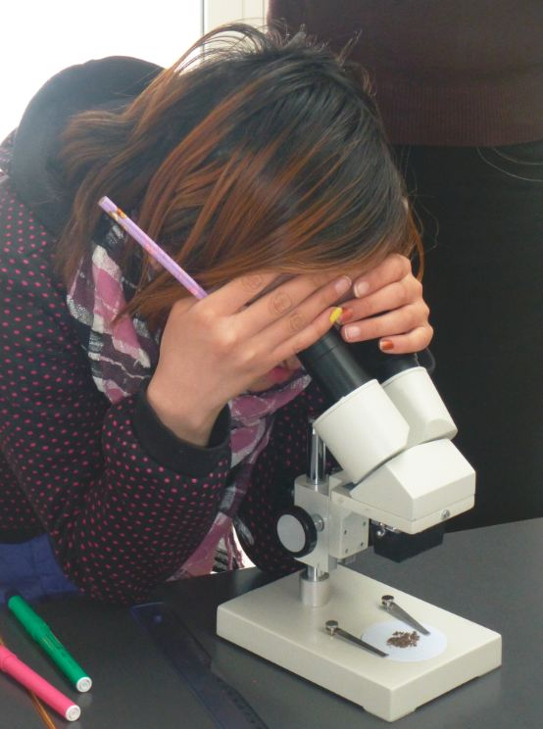
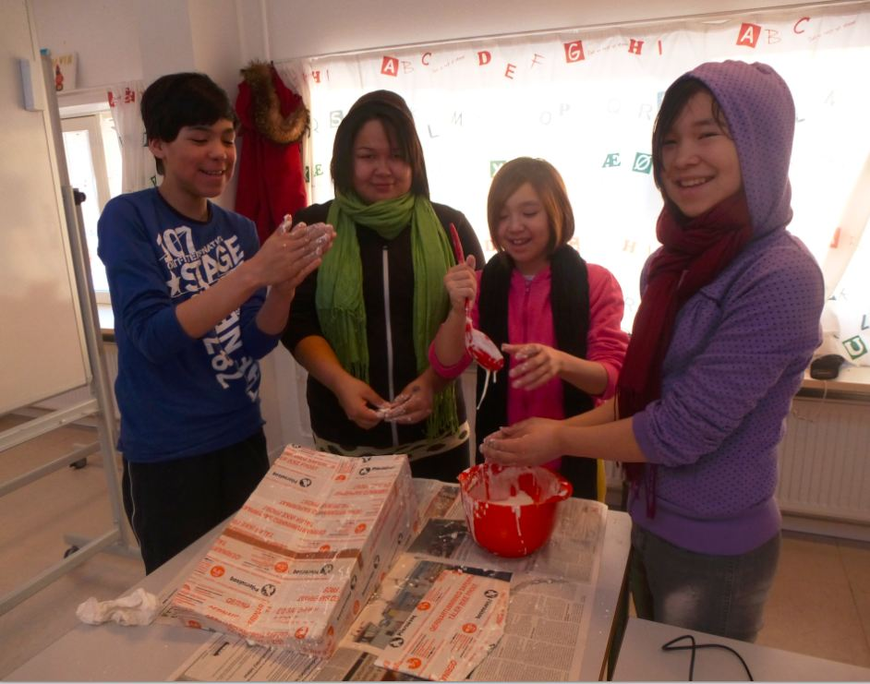
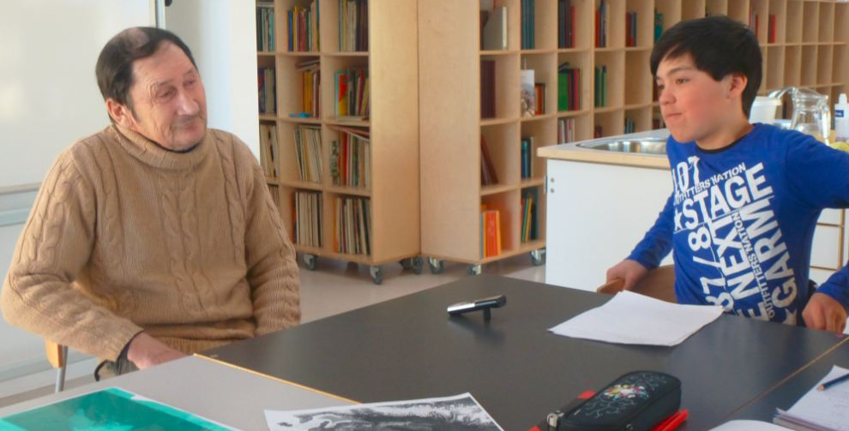
Workshops in Greenland
Oceanography, Glaciology, GPS training, interviews of Elders
Notes:
In Greenland, I spent a few months in the village to work with the children. They made simple experiments about ocean, sea ice,, glaciers. They went collecting seawater samples. And last but nos least, they interviewed Elders of the village about the evolution of the environment, some of their findings really surprised them.

Slide 11
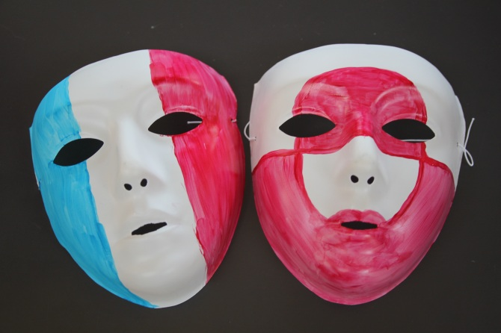
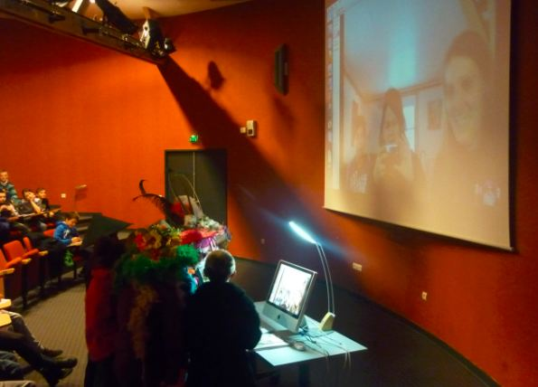
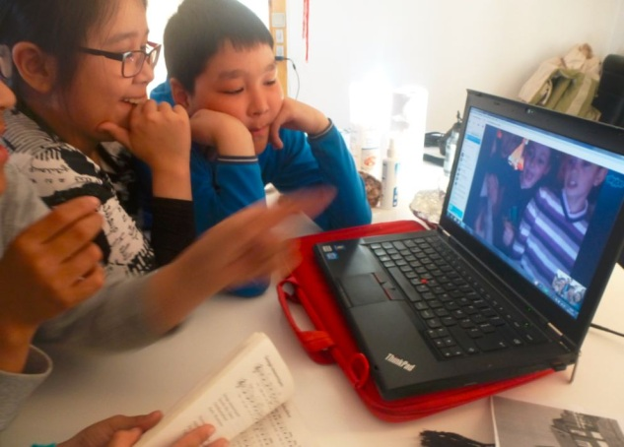
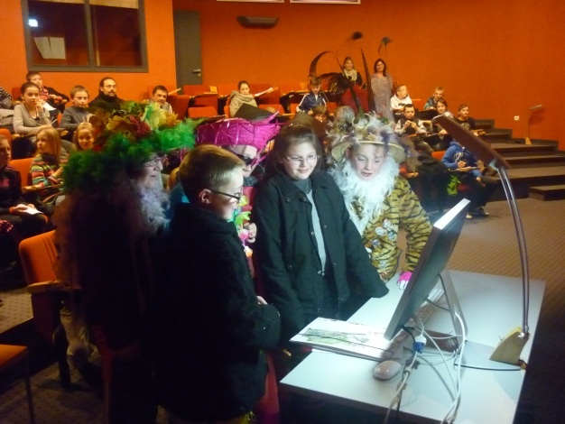
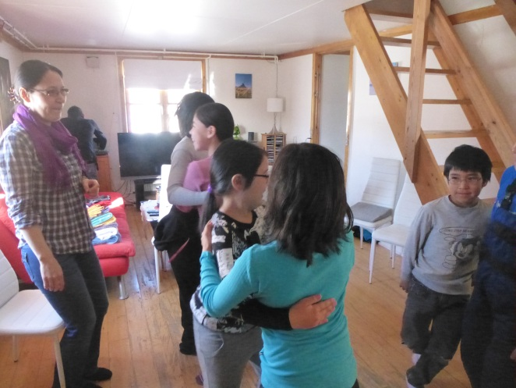
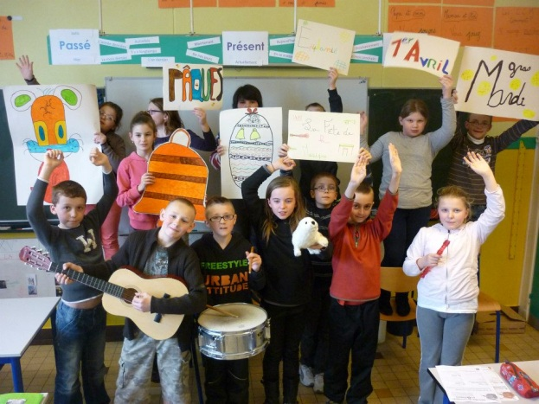
Cultural exchanges : video calls
Notes:
In addition, the 2 groups of children, who were the same age, exchanged about their culture and their environment. They had video calls and to overcome the problem of the language, they naturally used art to communicate : dance, songs, theatre…

Slide 12
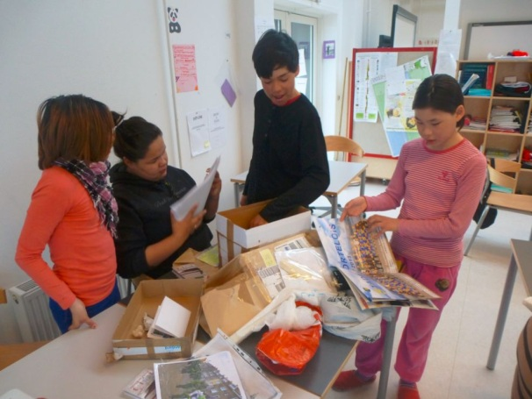
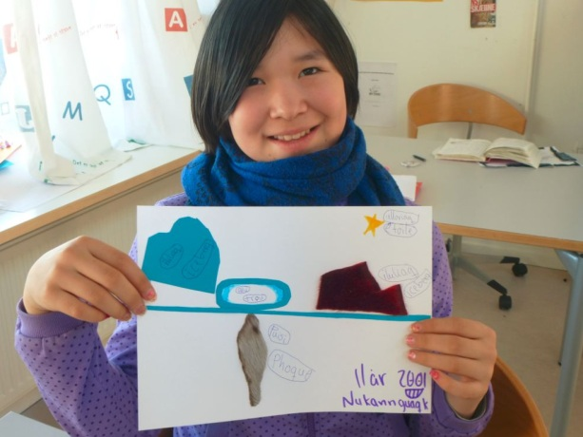
Cultural exchanges : mails
Notes:
They also exchanged mails (shells, drawings, …) where, we can see here the greeenlandic children, opening a mail coming from France….

Slide 13
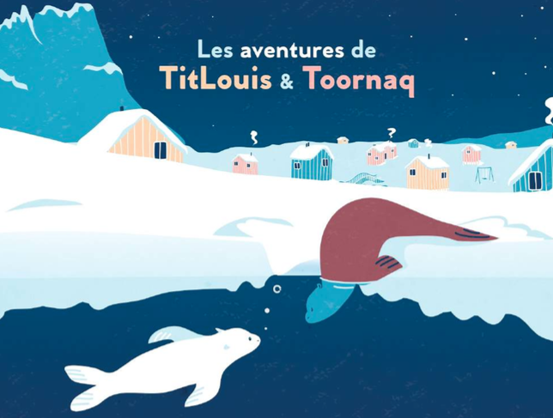
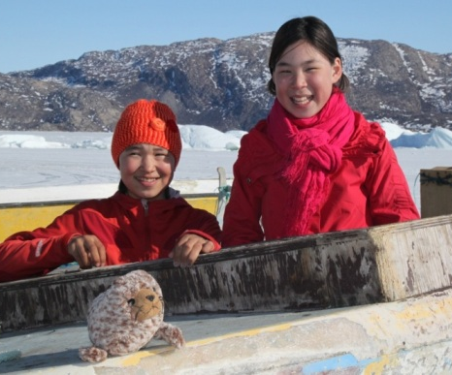
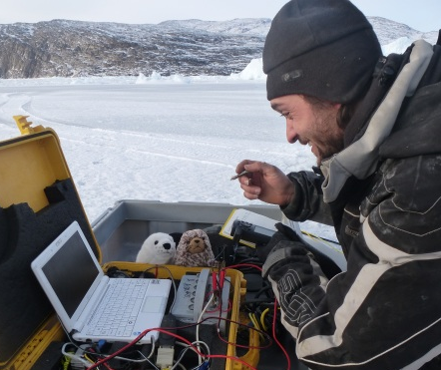
Stories of the mascots Titlouis & Toornaq
Notes:
As another way to communicate, each group had a mascott, a fur seal, who was photographed by the children to demonstrate something.
These exchanges inspired a book for children, with a documentary part, we are now trying to edit.

Slide 14
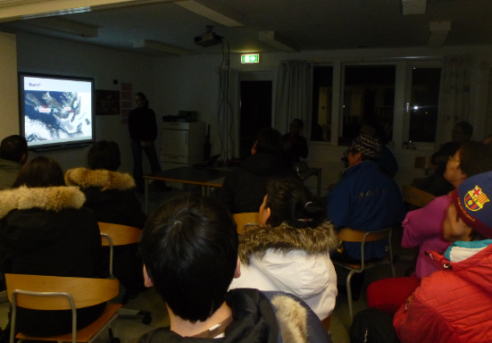
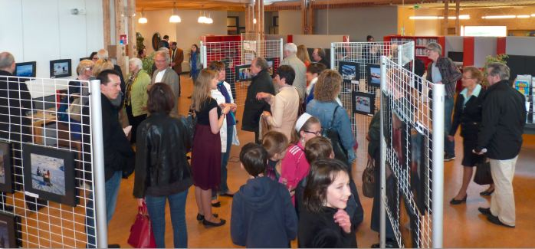
Public at large
Live interviews in sea center Nausicaa
Presentations in Greenland and France
Pictures exhibition
Notes:
The large pulic was also involded in the project. We had weekly live phone interviews with sea center Nausicaa in France.
Several presentations of the scientific and educational project were organized both in France and Greenland. A pictures exhibition was organized…

Slide 15
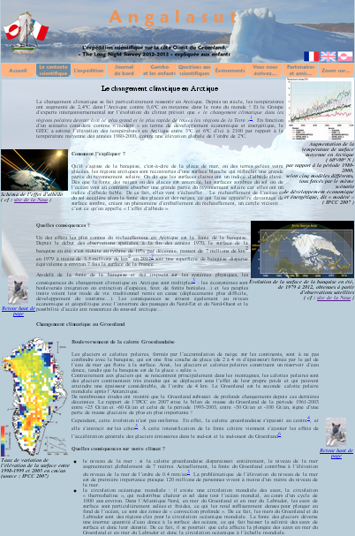
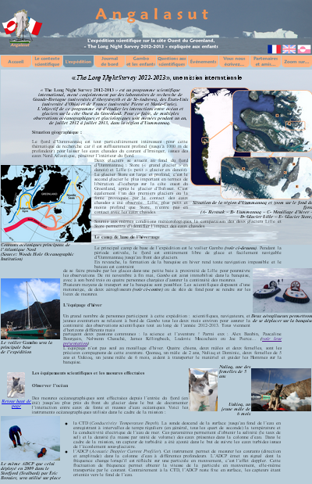
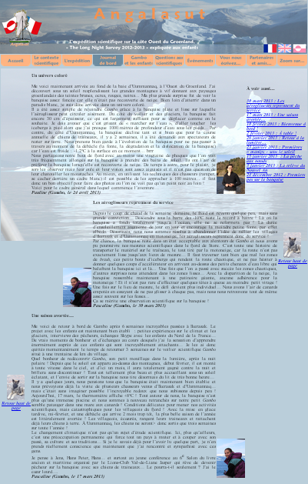
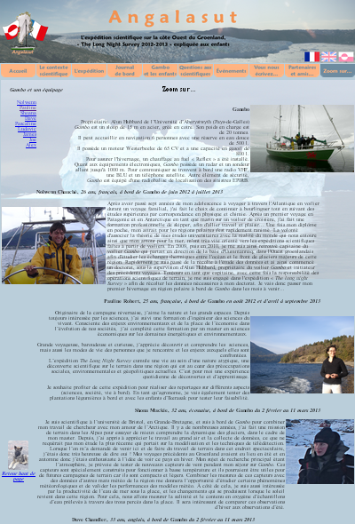
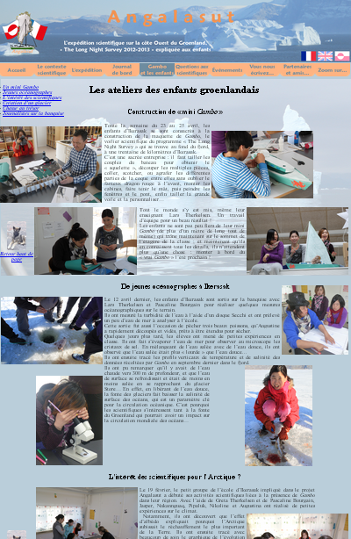
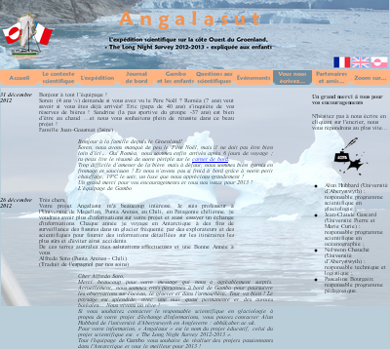
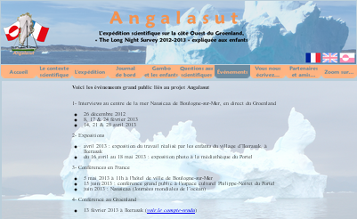
Trilingual website
www.angalasut.net
Notes:
A trilingual website was set up with scientific context, blogs, portraits, educational activities, a forum….
We were taking particular attention so that everybody could express itself.

Slide 16
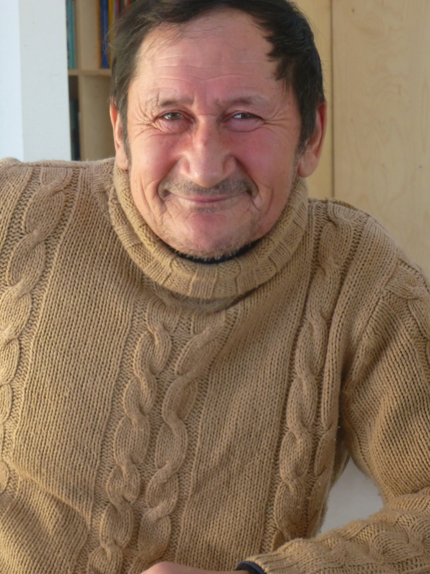
Importance of Traditional Knowledge
Jens Therkelsen, fisherman, 69
Lars Therkelsen, teacher, 48
« I started to fish when I was 14. At that time, sea ice was much thicker than today; it could reach 2 m thick ! »
« Since a few summers, one can see geese and other birds that we never saw in the past. It is not normal ! »
Notes:
Finally, this project was the opportunity to discuss with villagers who could testify on their changing environment over the past decades. Angalasut is a first step toward a future collaboration between scientists and villagers that would deserve further development... This is what I am now working on, as I am deeply convinced traditional knowledge is priceless to better understand the changing environment of the Arctic.

Slide 17
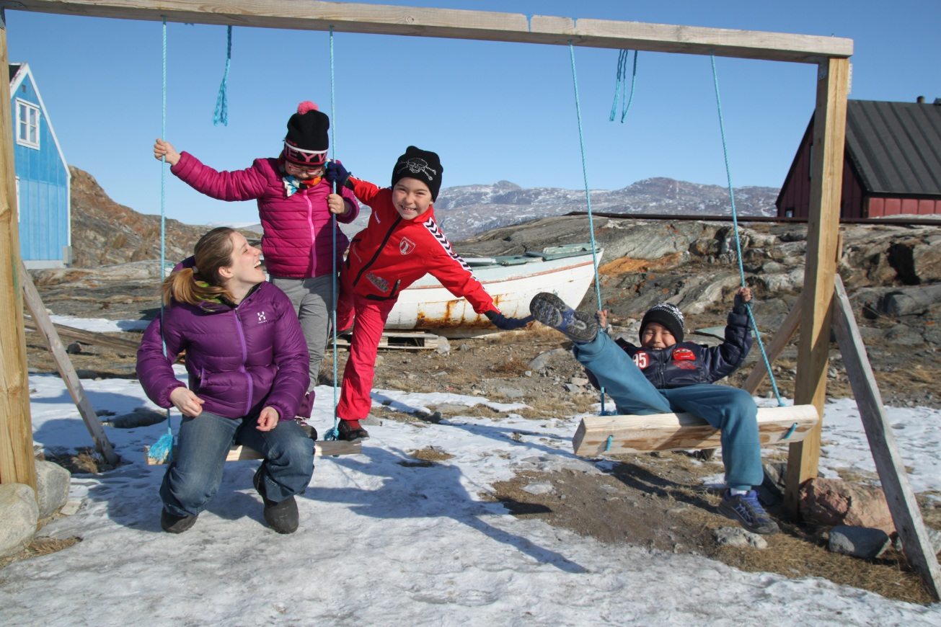
Qujanak !

