Slide 1
Microwave sensing
of tree trunks
Jana Ježová, Laurence Mertens,
Sébastien Lambot

Slide 2
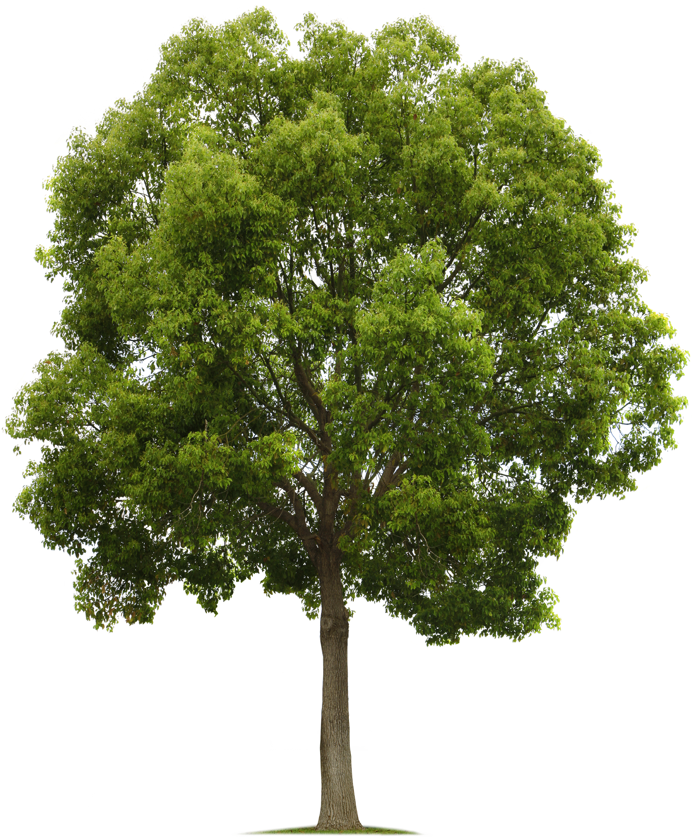
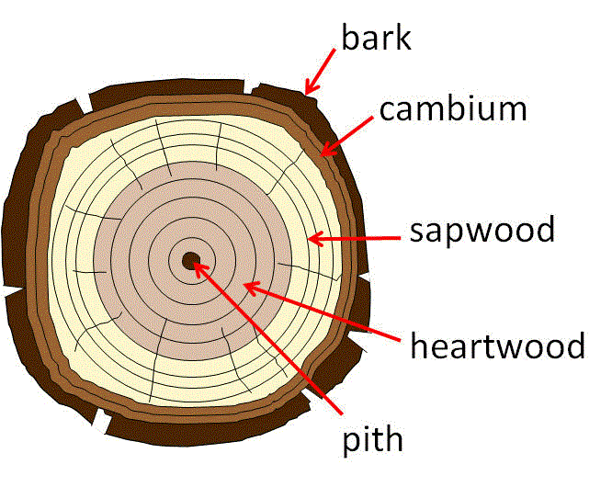
TREES
Importance (building material, energy, ecology,…)
Focused part: TRUNK

Slide 3
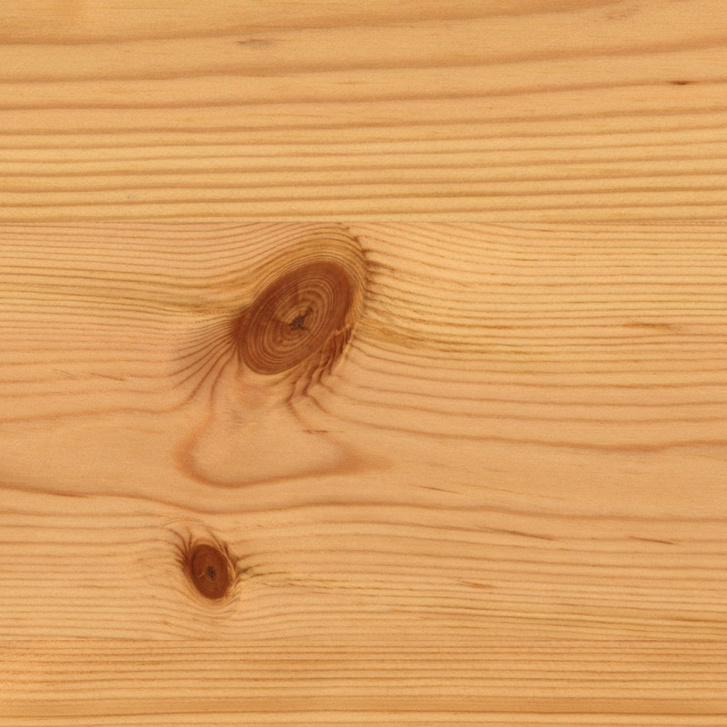
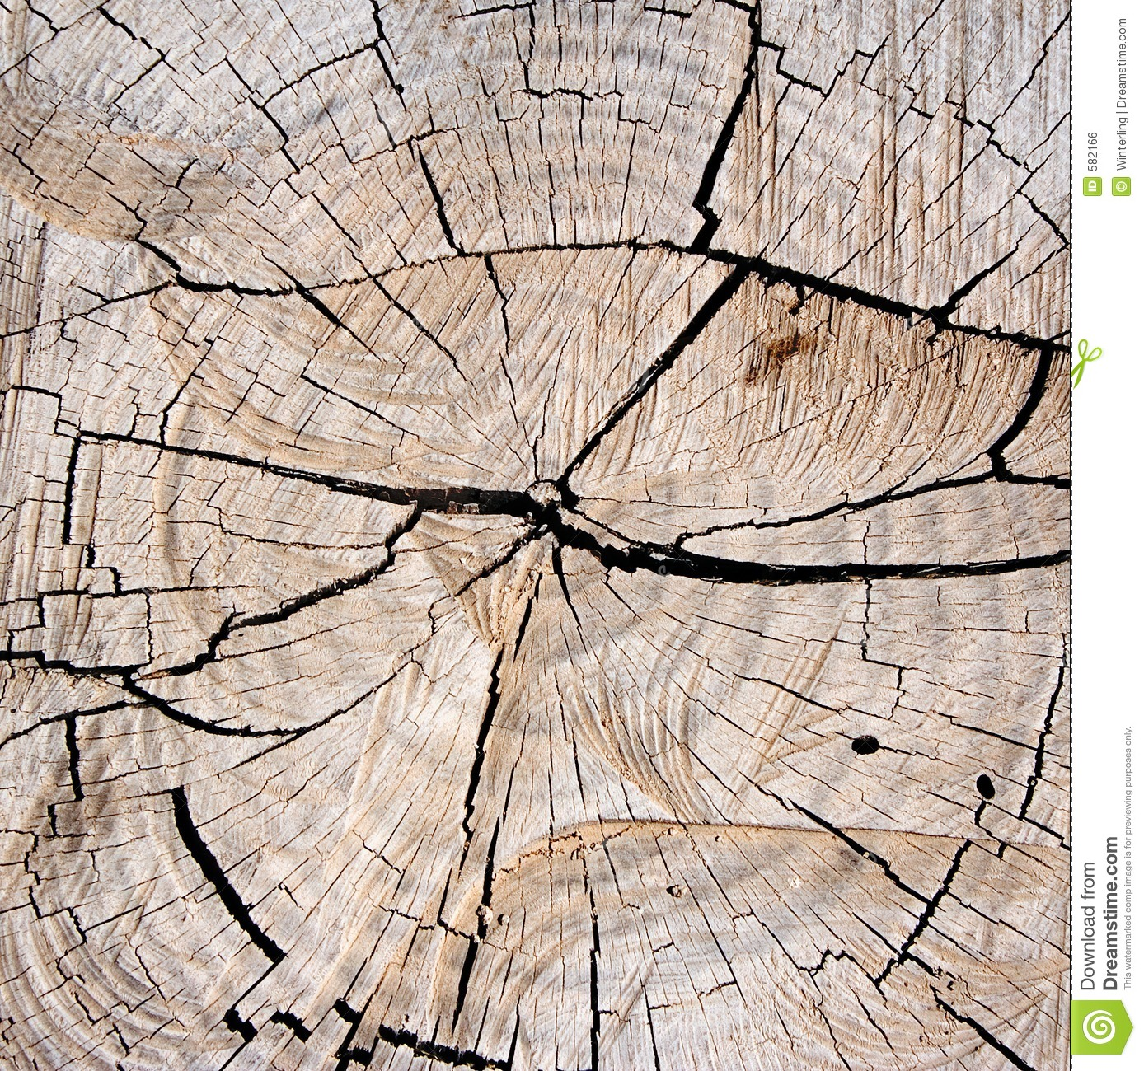
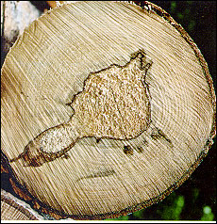
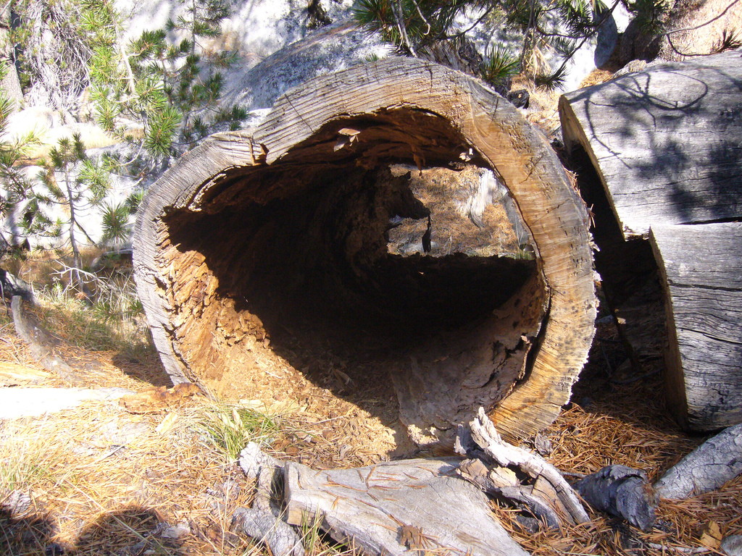
DEFECTS
Knots
Cracks
Decays
Holes

Slide 4
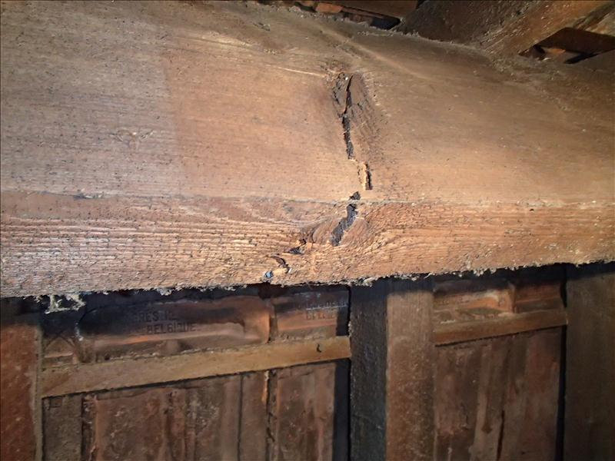
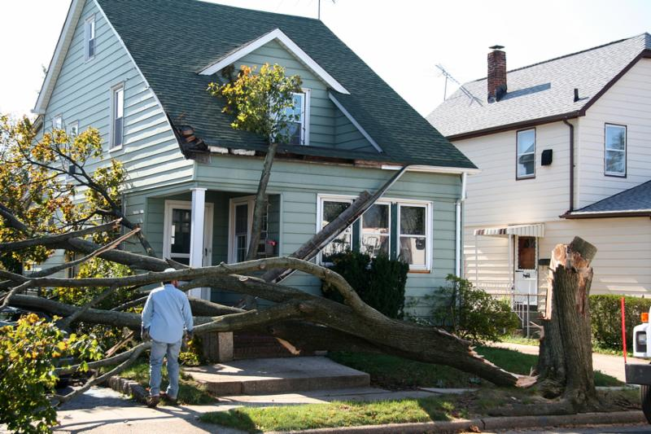
WHY TO DETECT DEFECTS
Wood function effects (mechanical, acoustic, etc.)
Human and infrastructure security risks

Slide 5
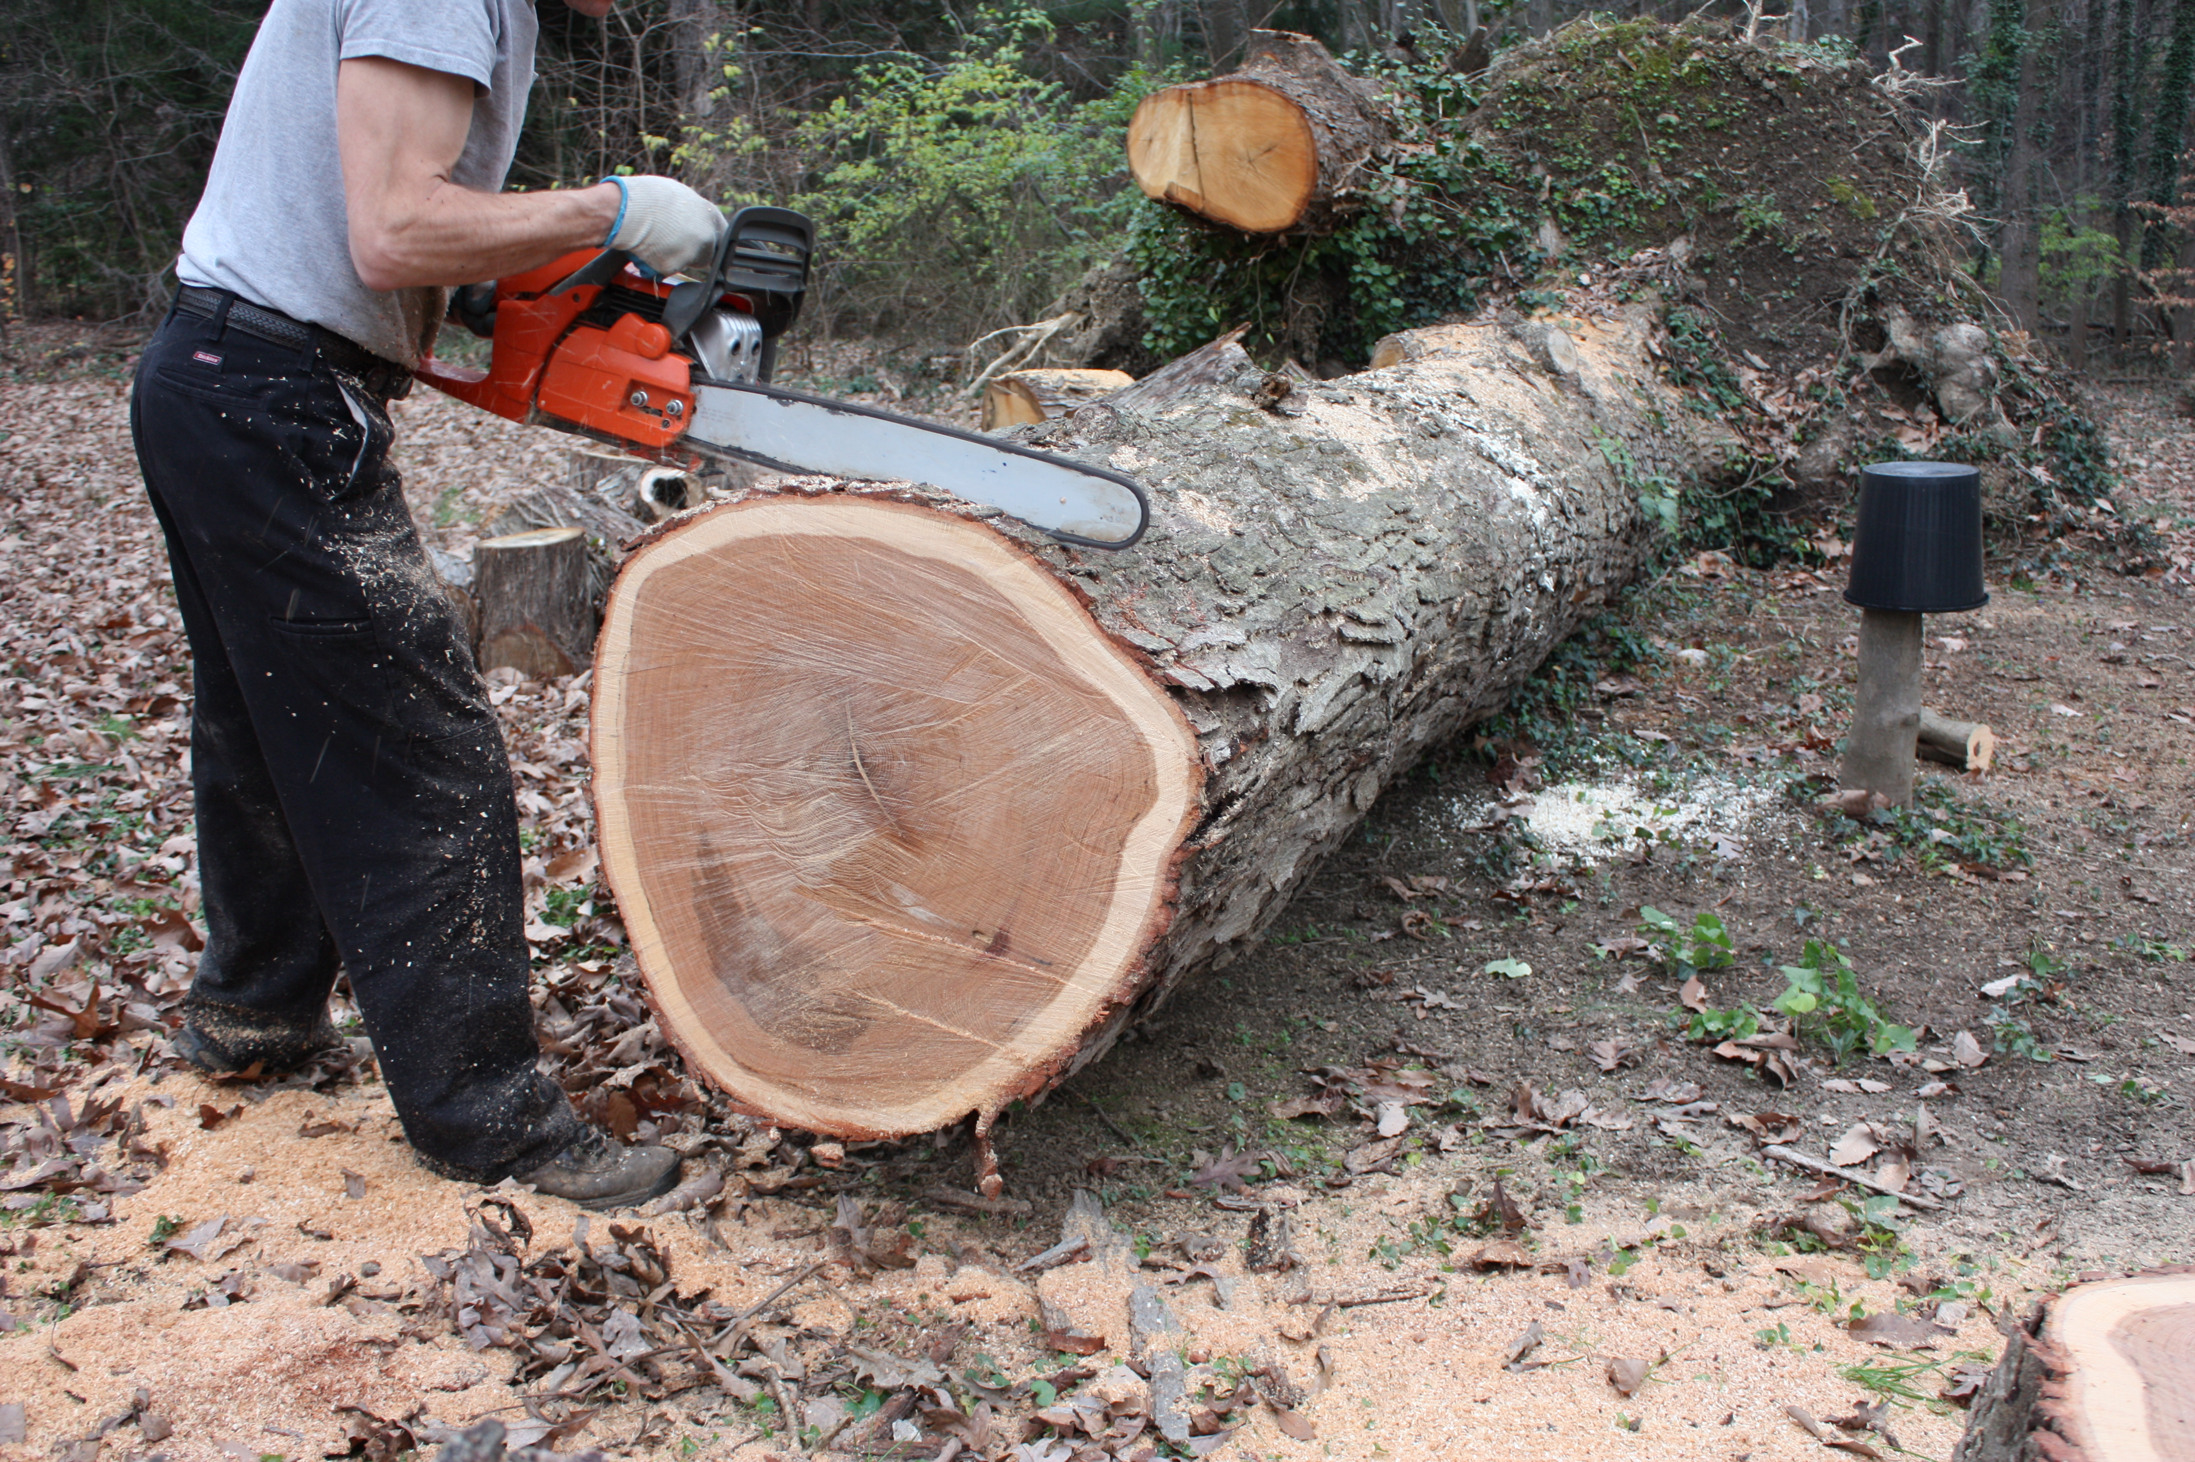
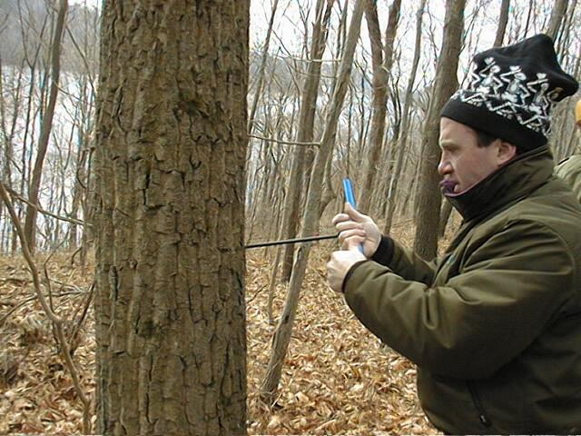
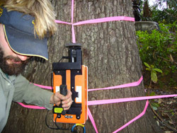
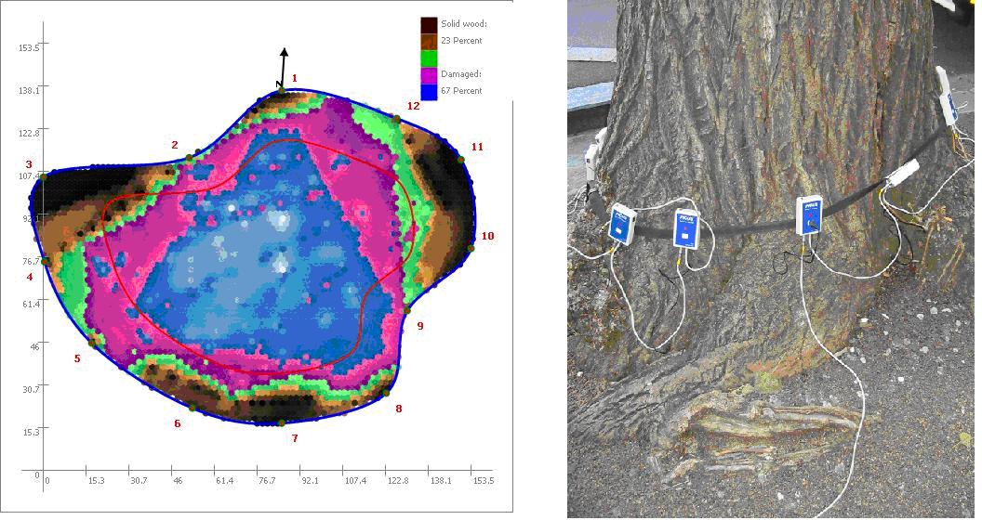
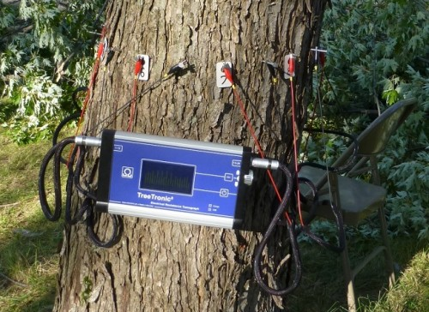
HOW TO DETECT DEFECTS
Invasively:
Chopping down
Core Drilling
Non-invasively:
Ultrasonic tomography
Electrical resistivity tomography
Georadar tomography

Slide 6
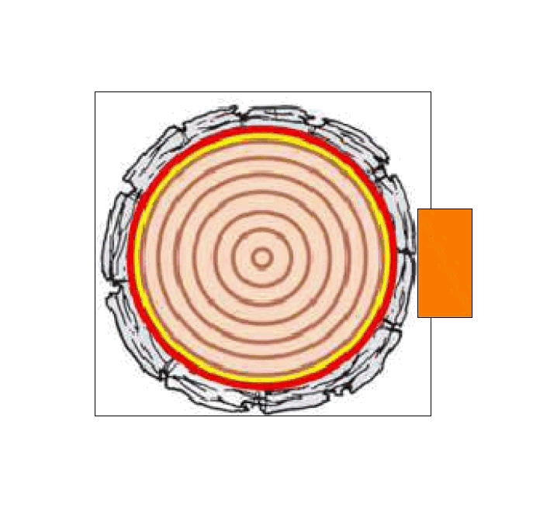
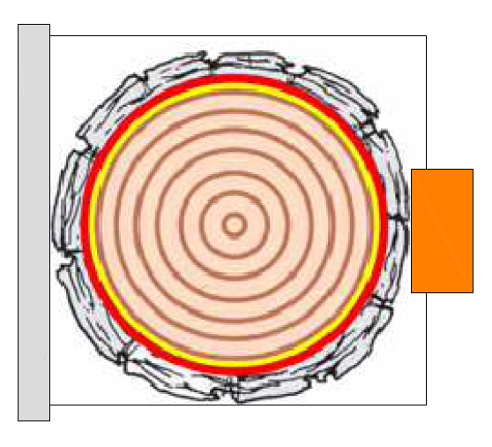
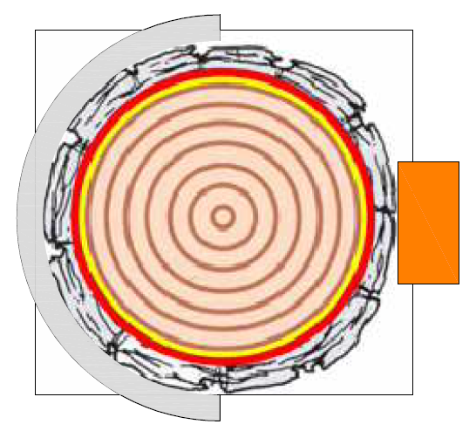
OBJECTIVE
Investigation of particular features in GPR images of tree trunks
Circumferential data acquisition geometry
Metal shield influence

Slide 7
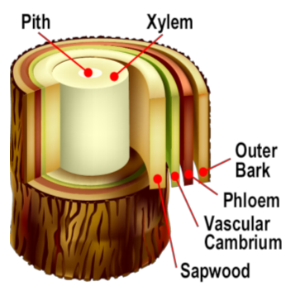
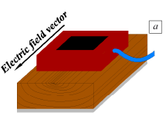
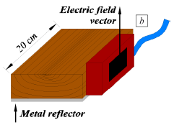
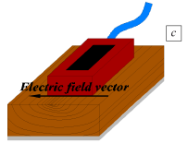
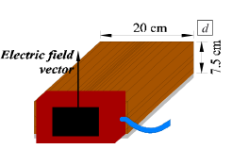
Trunk tomography: complex radar problem
High moisture:
Relatively high permittivity
Relatively high conductivity (attenuation)
Heterogeneity
Anisotropy: radial, longitudinal, tangential
Rodríguez-Abad et al. (2010)

Slide 8
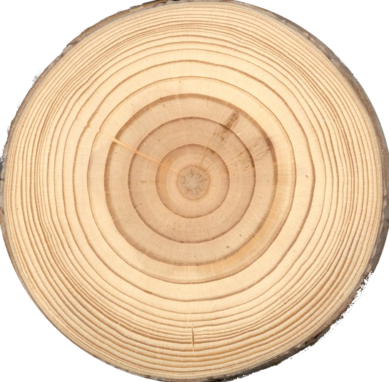
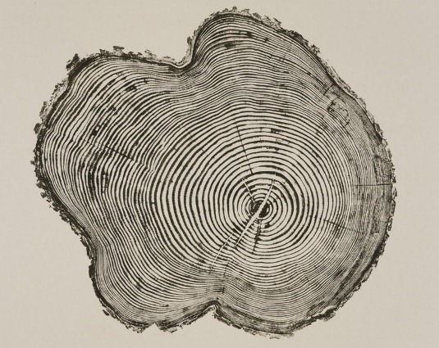
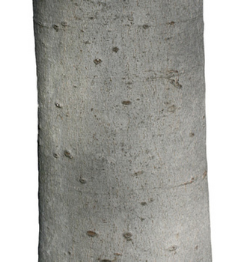
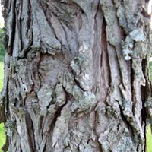
Trunk tomography: complex radar problem
Cross section:
Surface reflection from bark:
vs
vs

Slide 9
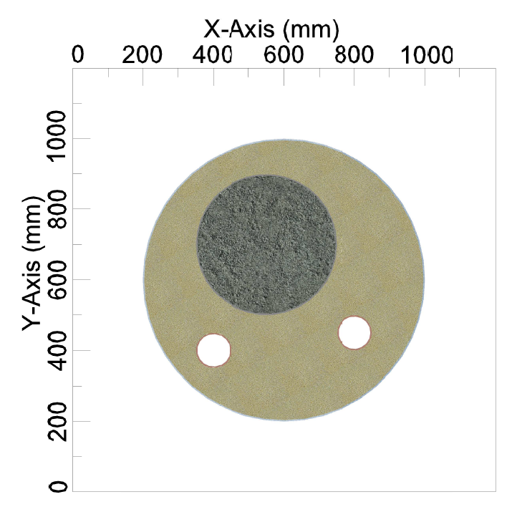
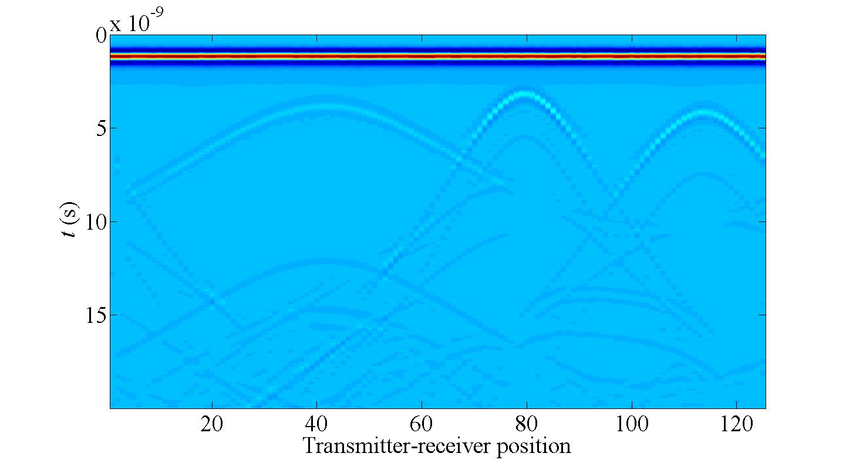
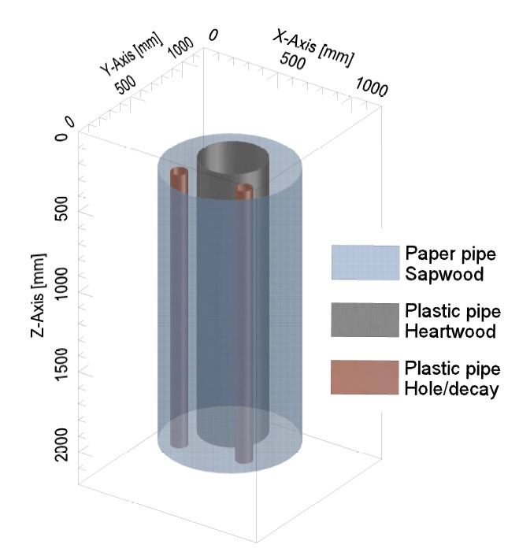
METHODOLOGY
Numerical simulations
Finite Difference Time Domain (FDTD)
Giannopoulos, A. (2005)
Laboratory model
2D

Slide 10
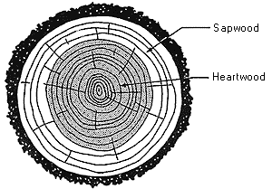
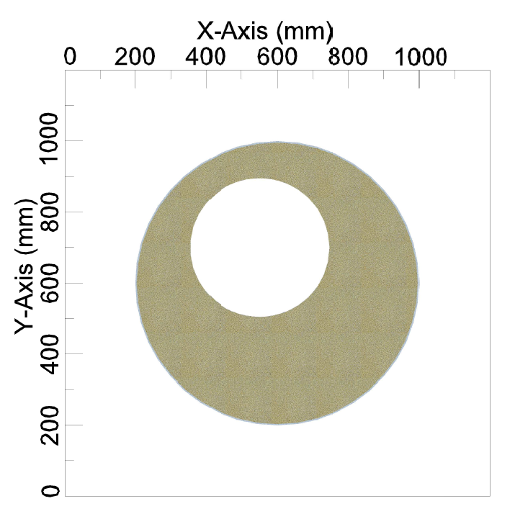
NUMERICAL SIMULATIONS
Configuration:
hole
Properties:
f: 900 MHz
Sand (S)
ε_{r}: 3
σ: 0,001 mS/m
Hole (H)
Free space
H
S
sand

Slide 11
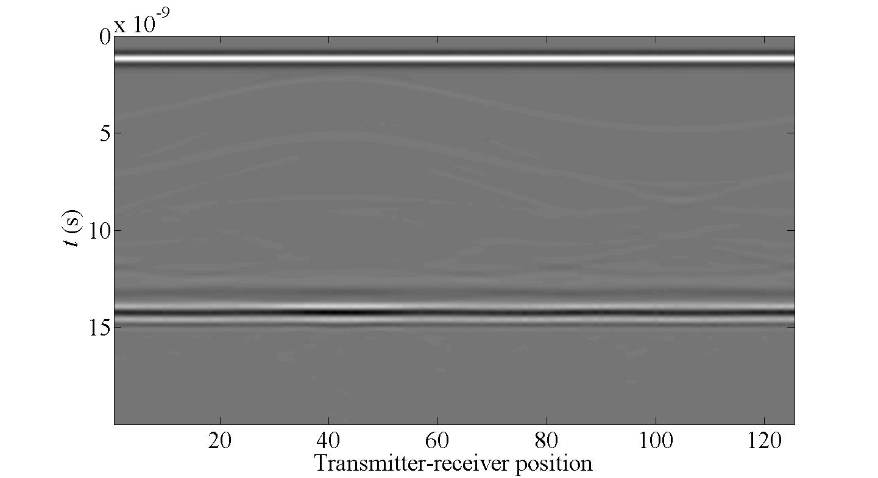
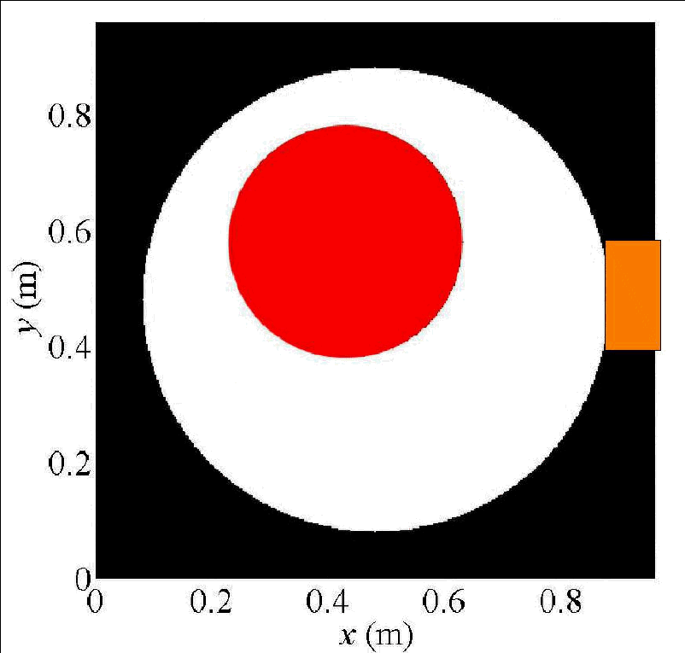
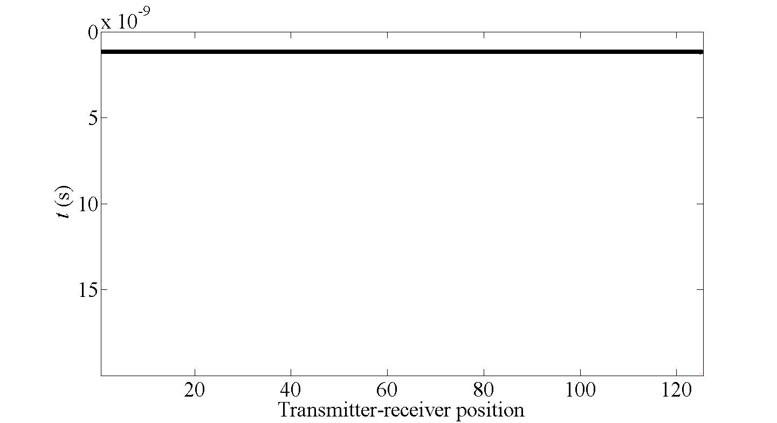
Scenario 1: reference
hole
sand
antenna

Slide 12
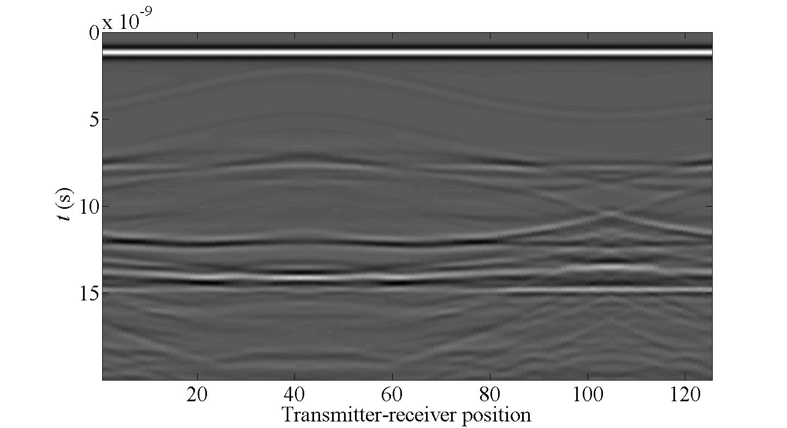
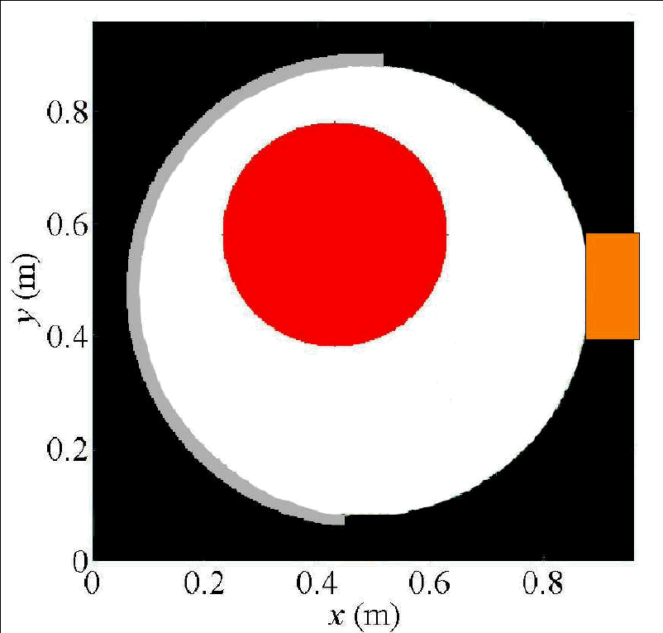
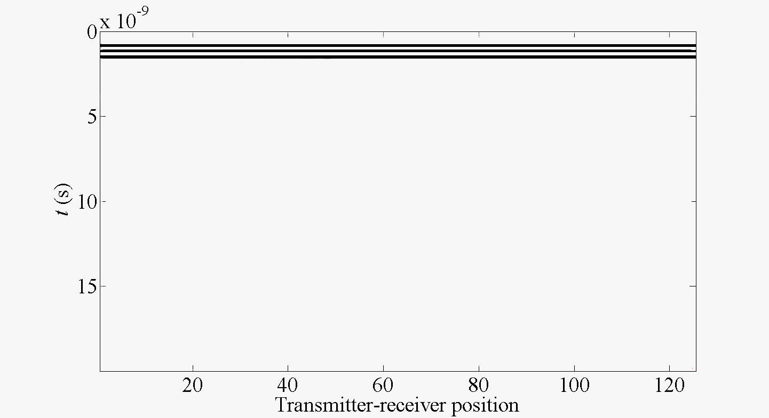
Scenario 2: metallic shield
hole
sand
antenna
metal shield

Slide 13
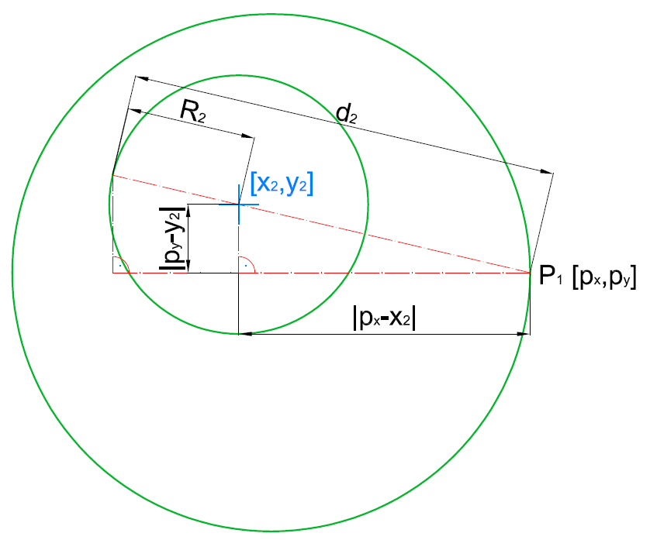
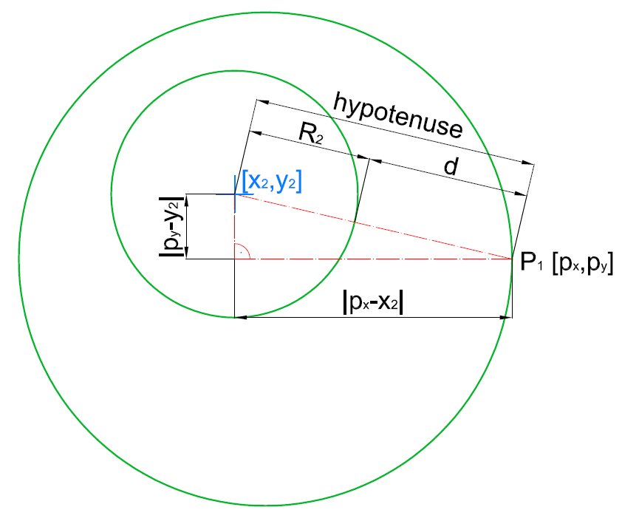
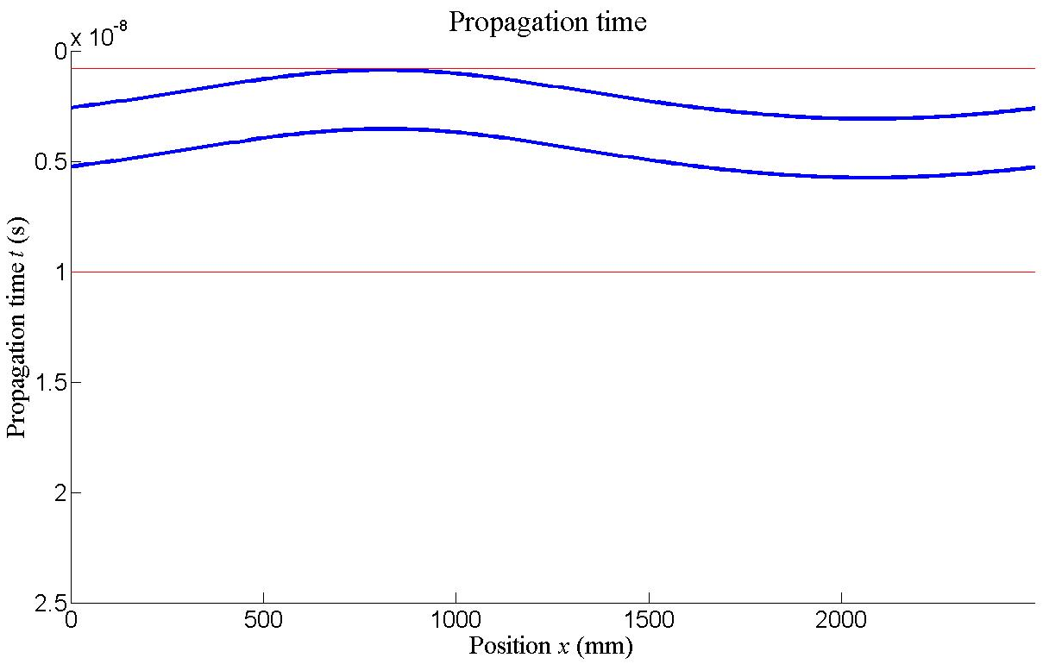
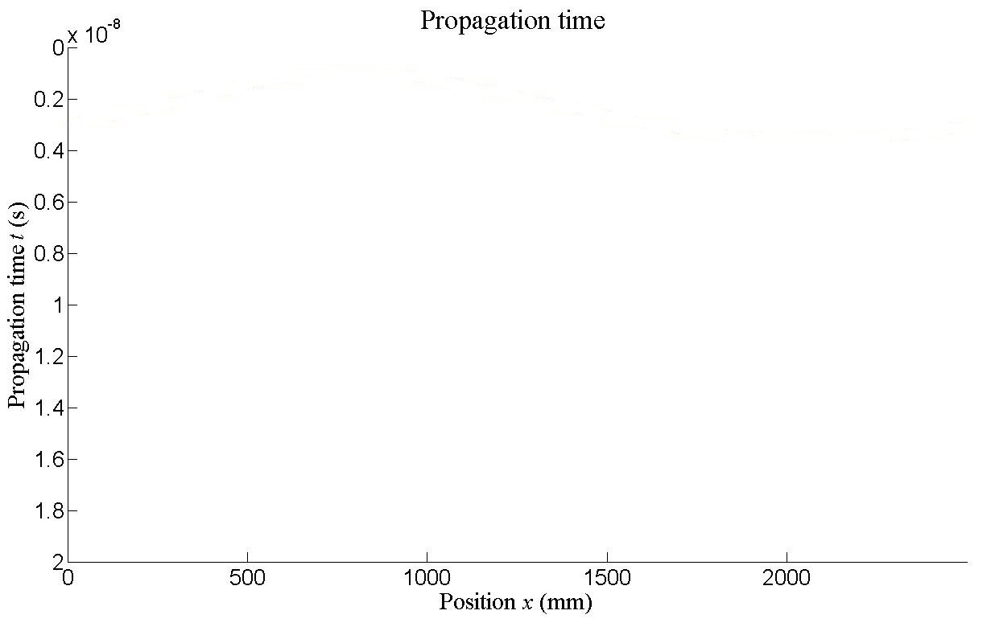
DESCRIPTION OF CURVE
t ………... propagation time (s)
v ………… velocity (m/s)
c ………… speed of light (m/s)
$εr$……….. dielectric constant (-)
d ………… distance (m)
x₂ ………. x coordinate of the center of a target (m)
y₂……….. y coordinate of the center od a target (m)
R₂ ………. radius of a target(m)
$$εr$$
$$v=\frac{c}{\sqrt{εr}}$$
$$t=\frac{2d}{v}$$
$$d=\sqrt{ {(px−x2)}^{2}+ {(py−y2)}^{2}} −R2$$
$$t=\frac{2(\sqrt{ {(px−x2)}^{2}+ {(py−y2)}^{2}} −R2 \text{)}\sqrt{εr}}{c}$$

Slide 14
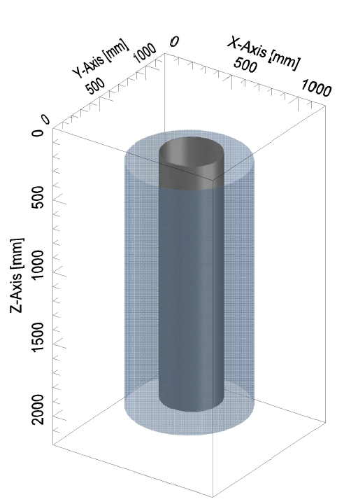
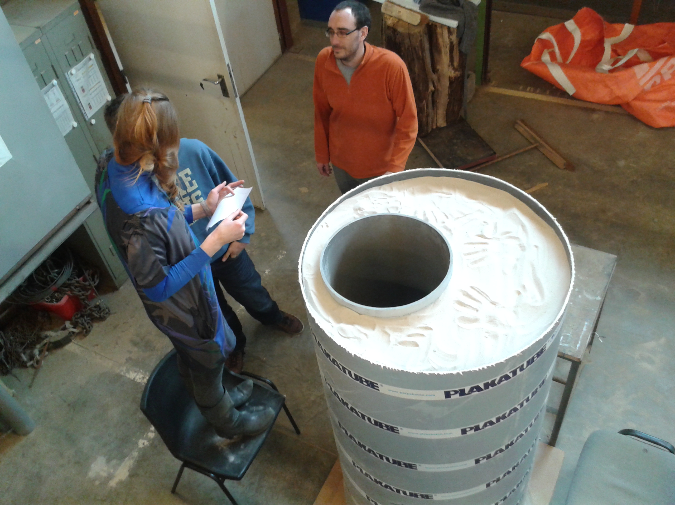
LABORATORY EXPERIMENT
To create compromise between numerical simulation and real trunk measurement
Very simple model of a tree
Using paper and plastic pipes
Filled with dry sand

Slide 15
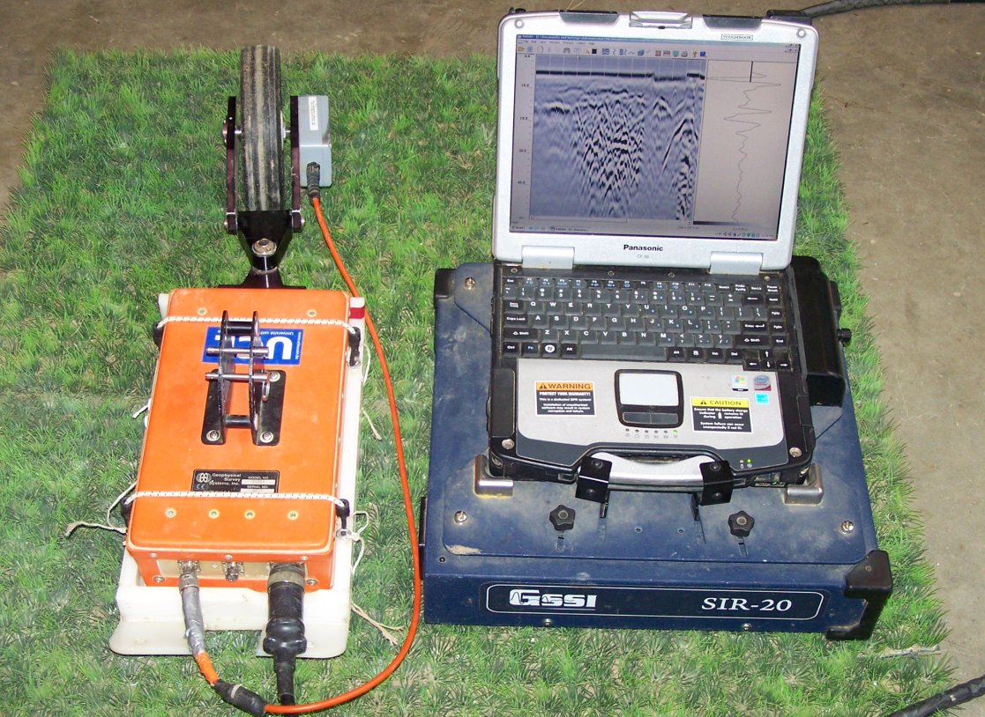
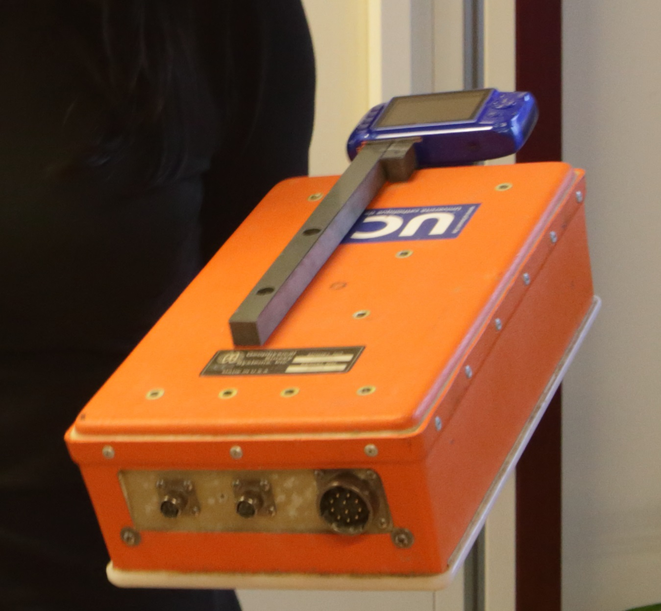
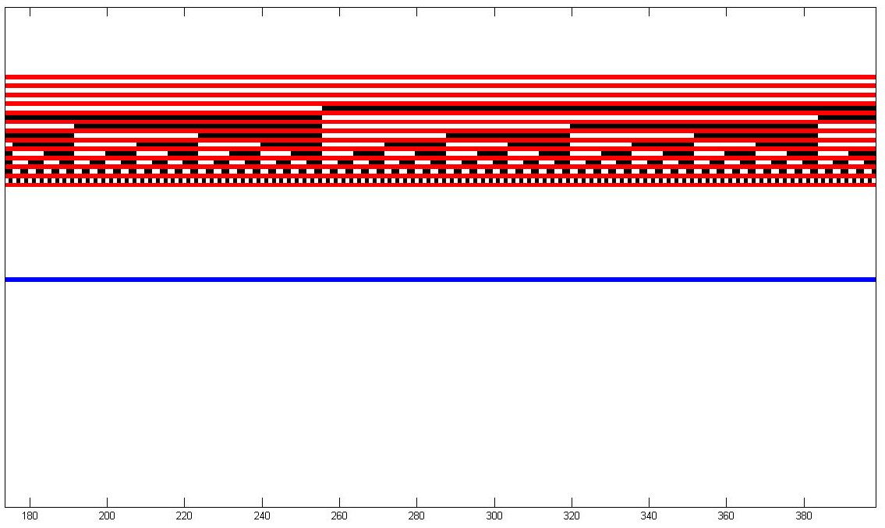
RADAR SYSTEM
GSSI SIR-20, 900 MHz antenna
Remove surveying wheel => easier manipulation
Fix a camera to the antenna to read a binary ruler
Find a way to recognize colors for several lightening conditions

Slide 16
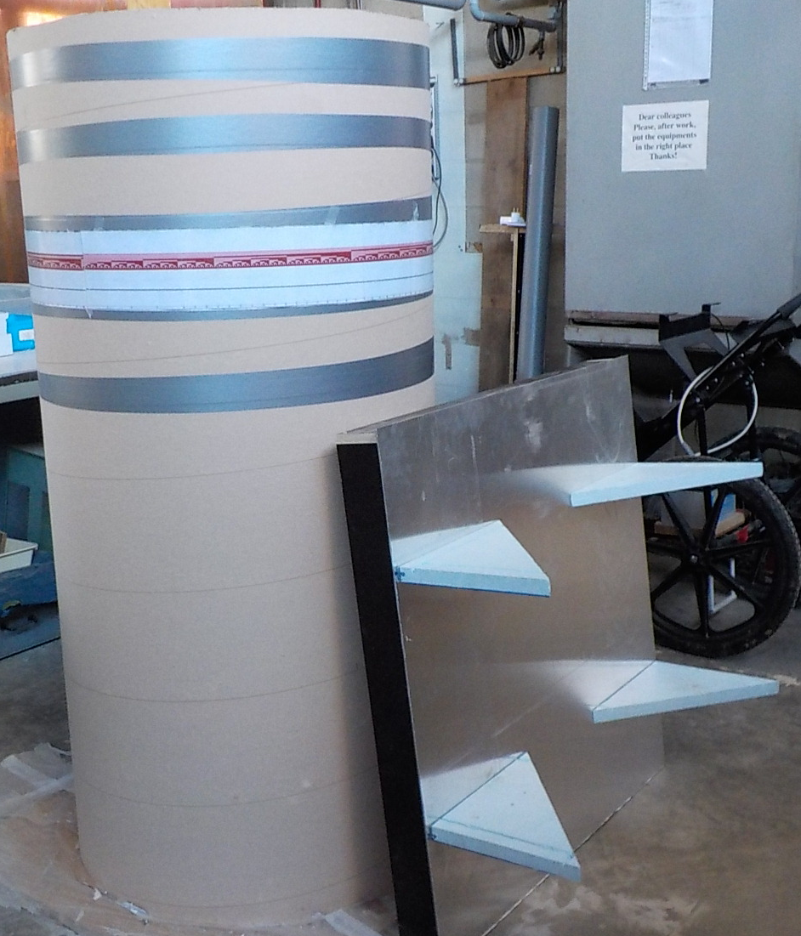
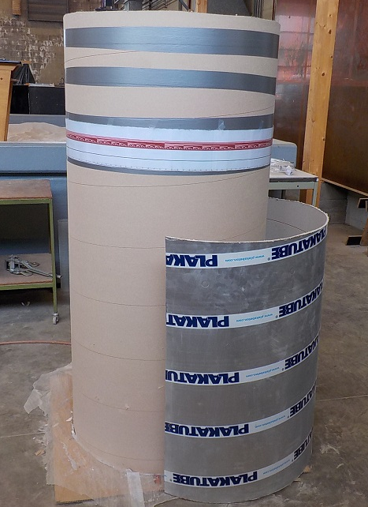
EFFECT OF A SHIELD
Surface
Metal shield
Opposite side
Target reflection curve

Slide 17
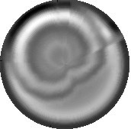
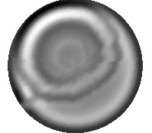
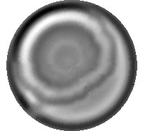
TIME WINDOWING AND POLAR REPRESENTATION
No shield
Flat shield
Circular
shield

Slide 18
CONCLUSION
First results: - shape of the reflection curve is comparable between laboratory model and numerical simulations
- for planar condition it’s hyperbola, for circular not
Shield: - significant improvement
- shape dependent => circular is better
- important for detection of the opposite side of the trunk

Slide 19
FURTHER PLANS
Lab model: - test more complex configurations
Transmission: - compare or combine with reflection mode
Real tree measurement: - different trunks (species, shapes, etc.)
Full wave inversion: - make tomographic reconstruction

Slide 20
THANK YOU FOR ATTENTION

