Slide 1
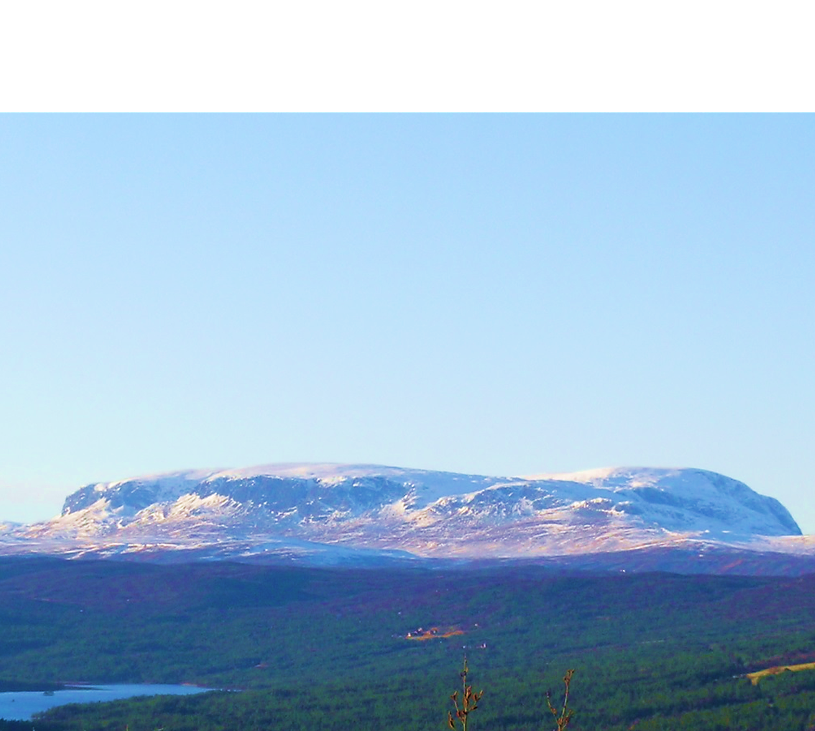

Passive margin high altitude low relief surfaces: old or new?
Testing the glacial/periglacial buzzsaw hypothesis on the landscape of Southern Norway
Ivar Berthling, Department of Geography, NTNU

Slide 2
The North Ridge
(Where did the Norwegian mountains come from anyway: a movie)
Scene #1: 100 years of harmony
  The standard model: Norways high altitude low relief surfaces (HALRS) ARE OLD PENEPLAINS, tectonically lifted to present altitude 10’s of Ma ago
Scene #2: The villains arrive
  The ICE model: HALRS are young (Pliocene-Pleistocene) features, CREATED BY COLD CLIMATE PROCESSES (glacial/periglacial buzzsaws)
Scene #3: War-time (The Mountain quarrel)
Scene #4: Hero arriving?

Slide 3
Periglacial landscapes?
A decade ago they did not exist
  André, M-F. 2003: Do periglacial landscapes evolve under periglacial conditions? Geomorphology 52.
  French, HM. 2007: The periglacial environment (3rd ed.)
HALRS: a story of glacier/permafrost interactions (in both the standard and the ICE model)
Cryo-conditioning of landscape evolution
  Berthling & Etzelmüller. 2011: The concept of cryo-conditioning in landscape evolution. Quaternary Research 75

Slide 4
The tests
Modelling
Dating
Landforms, field relationships
Measured slope fluxes
Supporting ICE
√
√
?
?

Slide 5
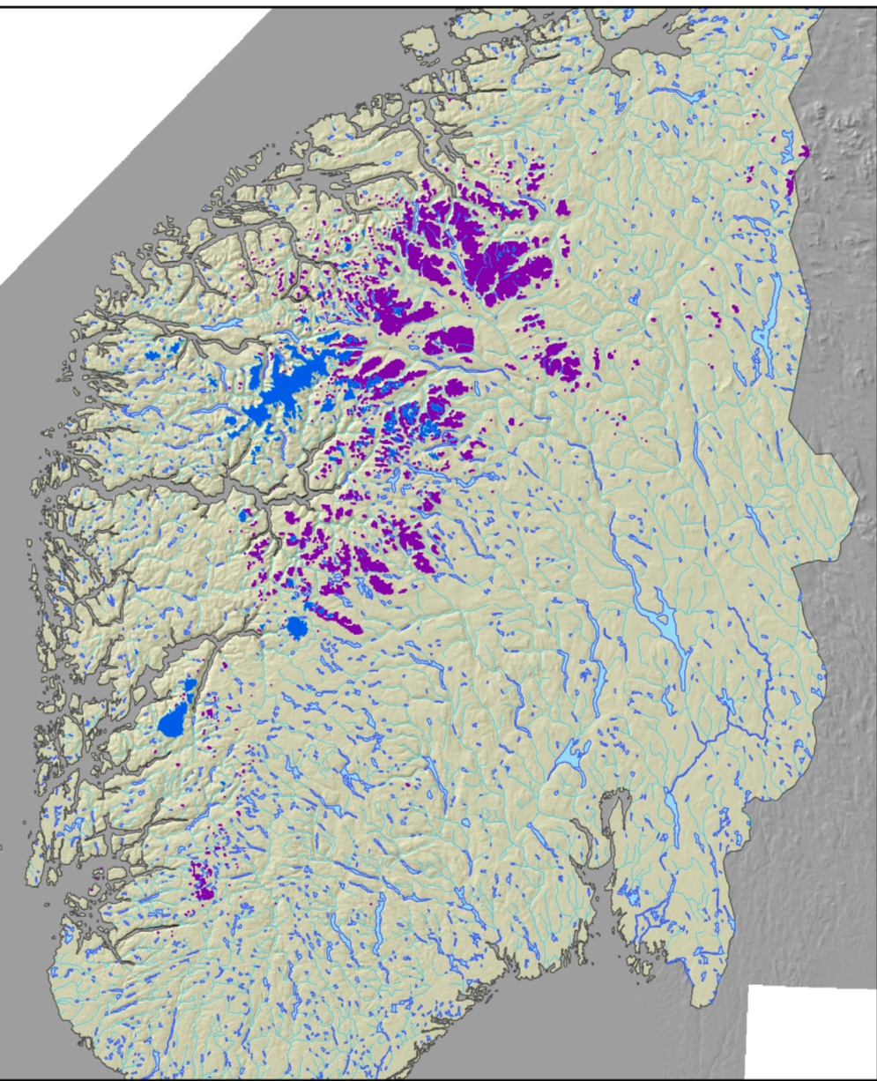
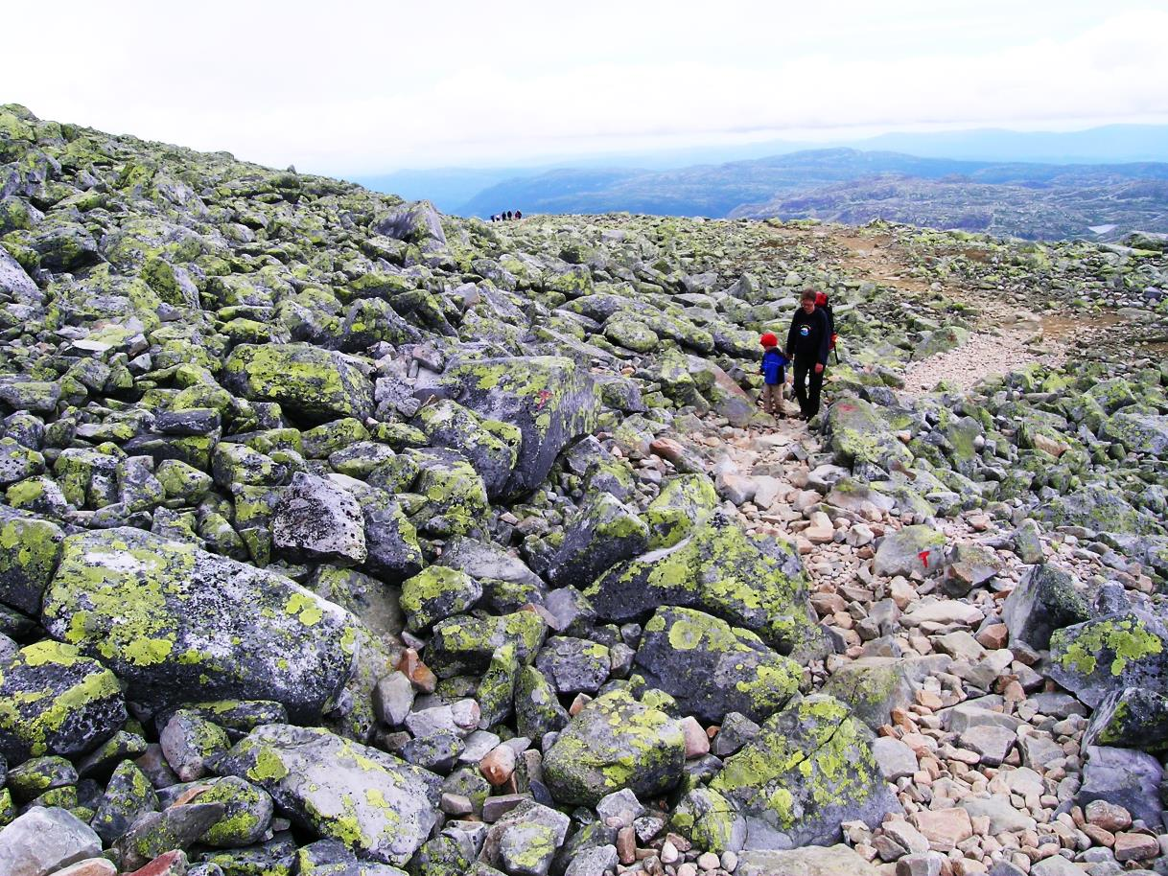
Blockfields
Above a certain altitude
Gisnås, K., et al. "CryoGRID 1.0: Permafrost distribution in Norway estimated by a spatial numerical model." Permafrost and Periglacial Processes 24.1 (2013): 2-19.

Slide 6
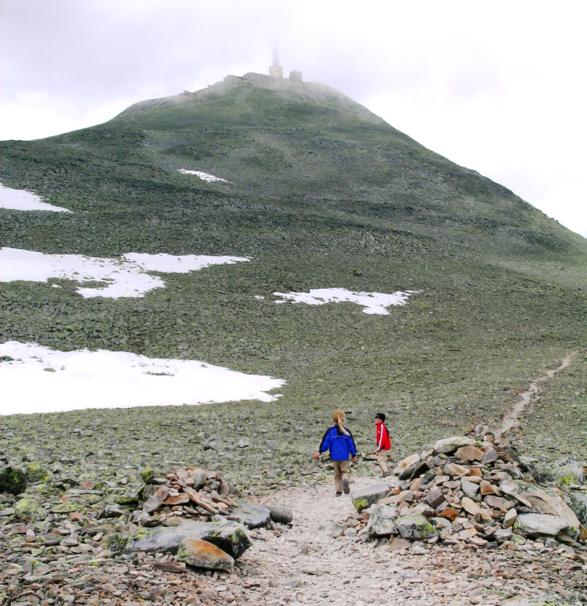
Blockfields
Old or new?
Gisnås, K., et al. "CryoGRID 1.0: Permafrost distribution in Norway estimated by a spatial numerical model." Permafrost and Periglacial Processes 24.1 (2013): 2-19.

Slide 7
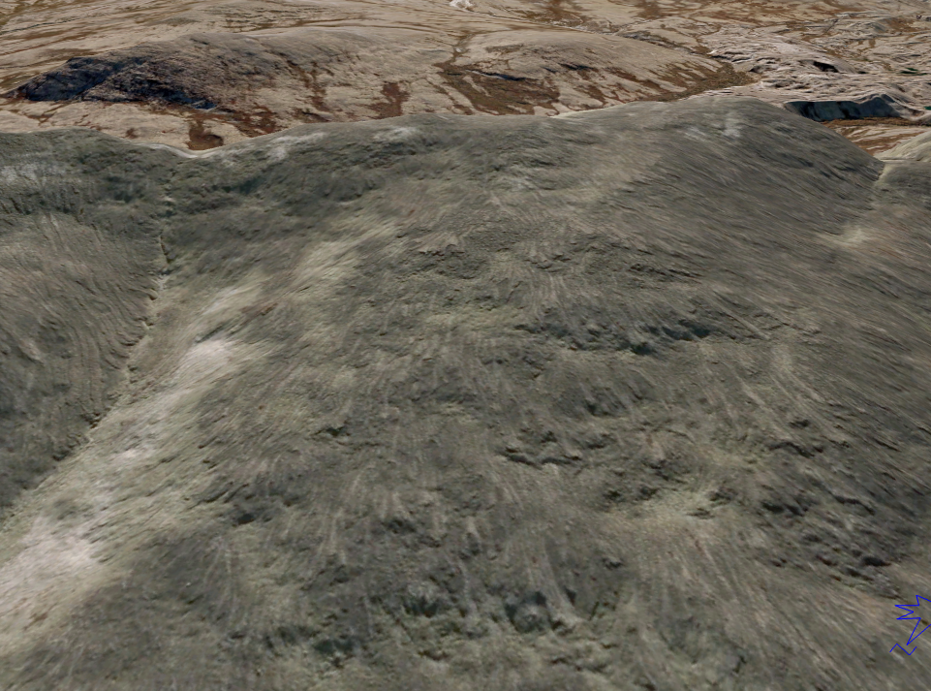
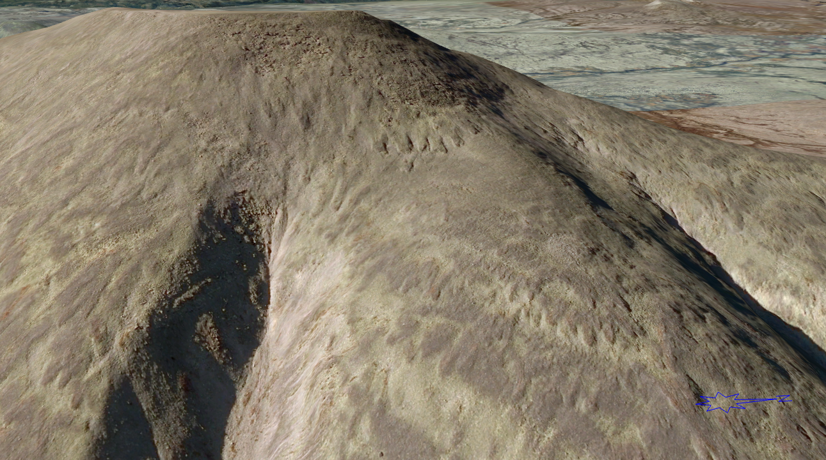
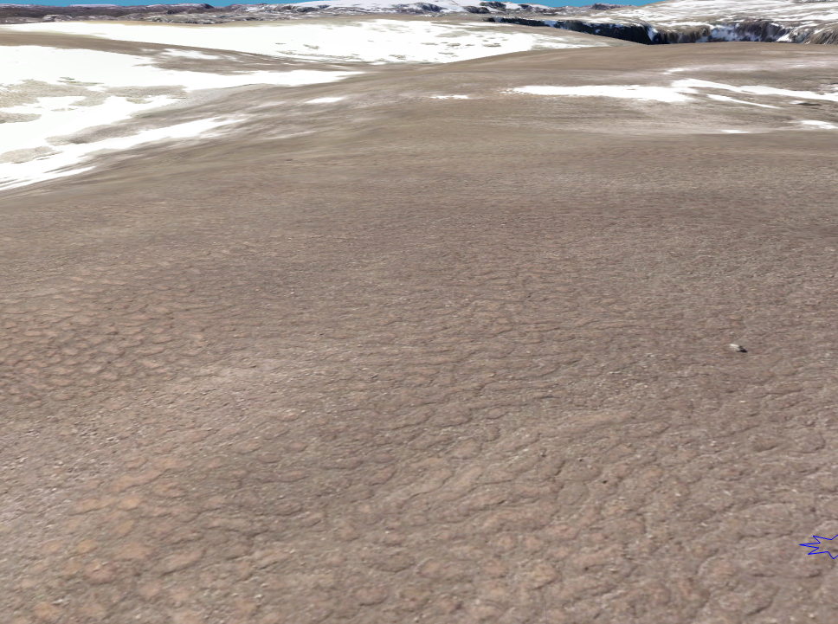
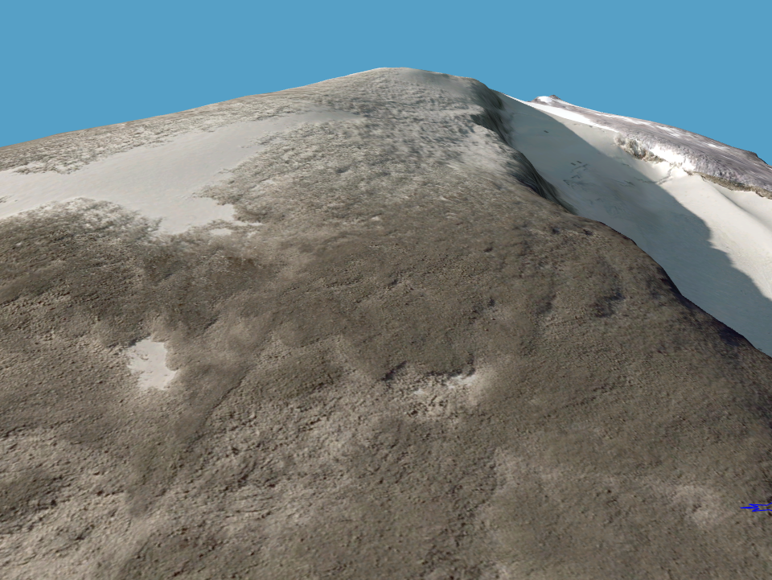
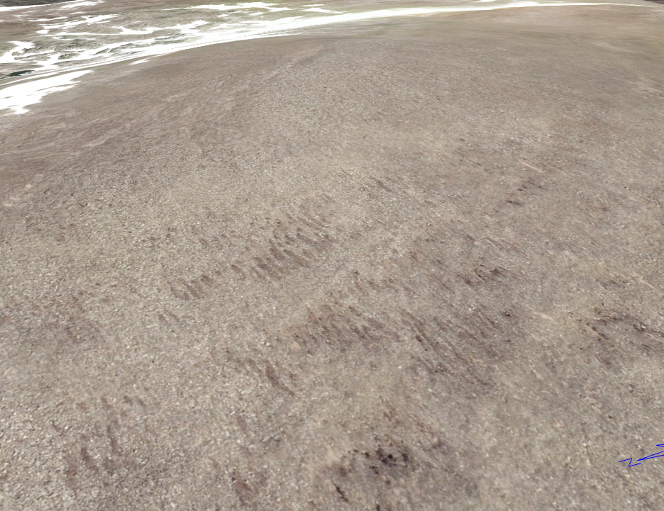
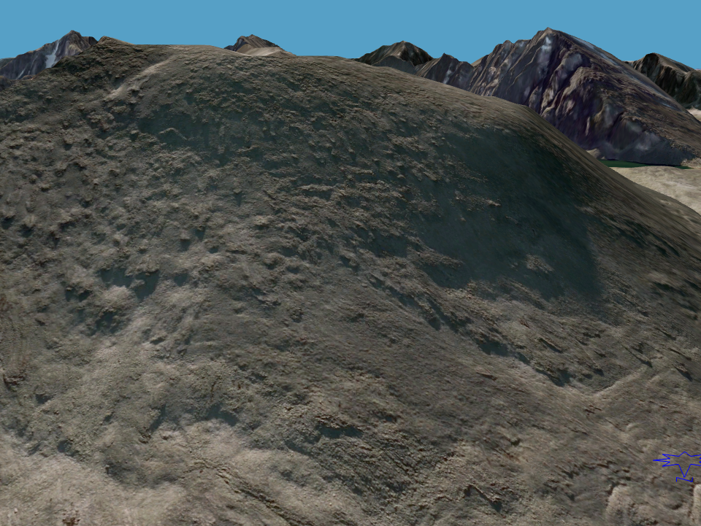
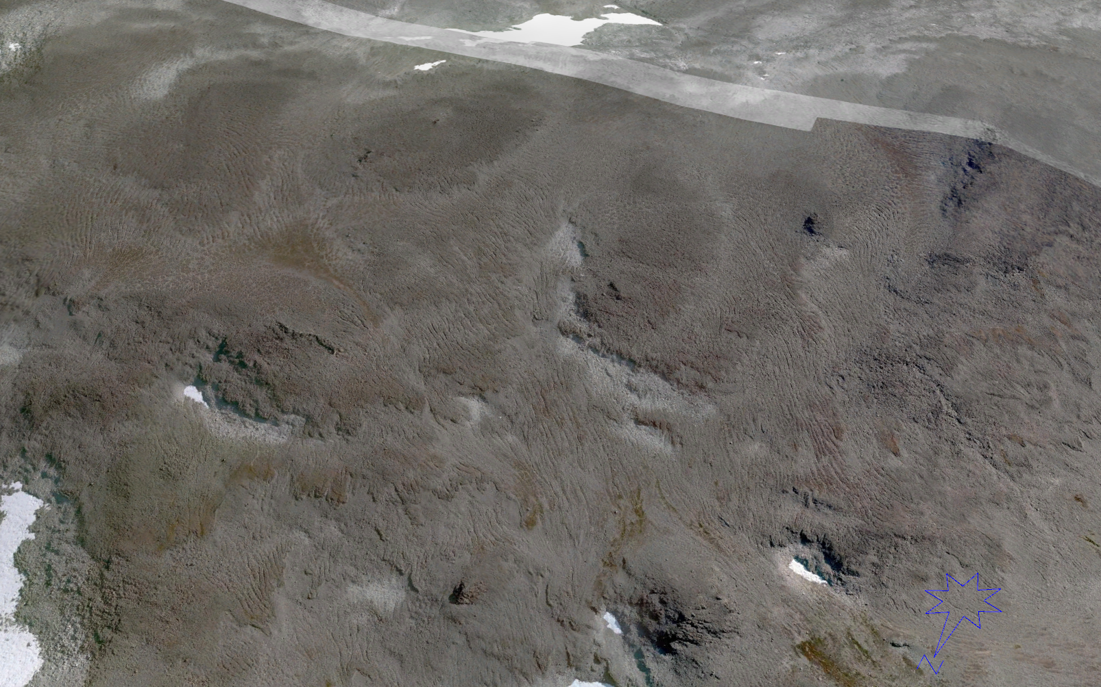
Creep landforms
Solifluction landforms tell a clear story on slope sediment fluxes
Are found in most settings

Slide 8
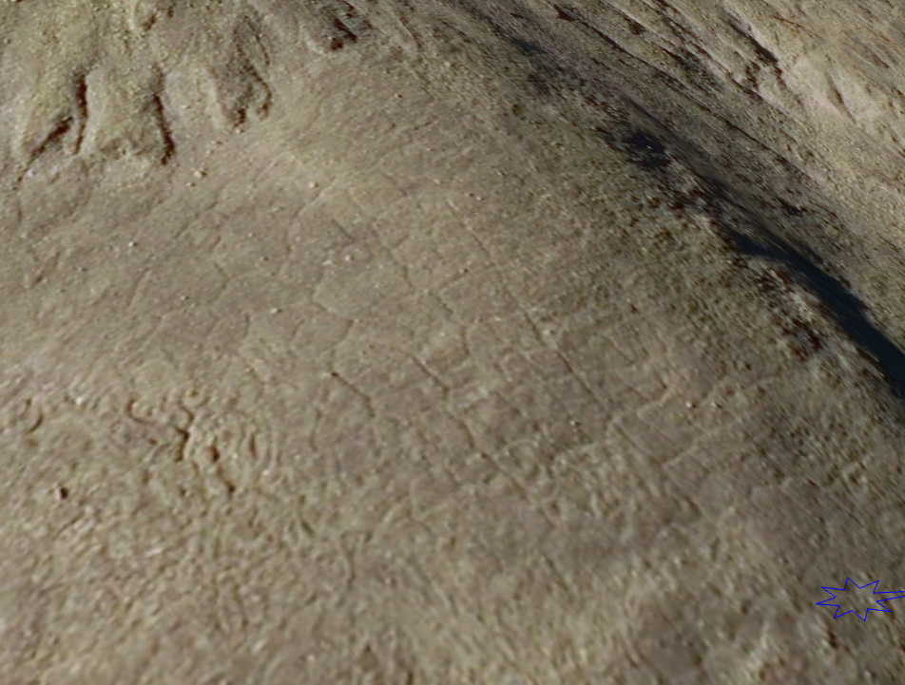
Signs for lack of creep?
Ice-wedge polygons
Geological structures protrude in blockfields

Slide 9
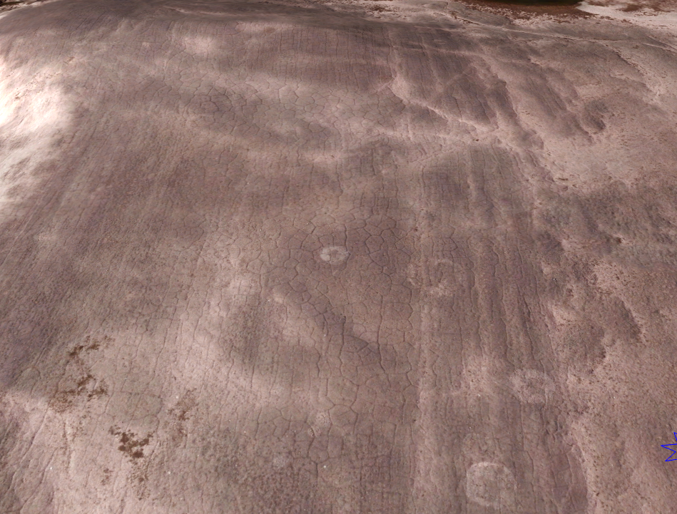
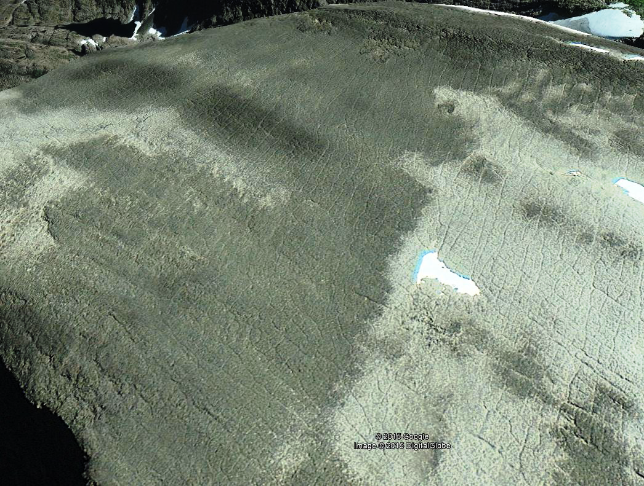
Signs for lack of creep?
Ice-wedge polygons
Geological structures protrude through the blockfields

Slide 10
Sediment fluxes?
Surface velocity (spatiotemporal variability)
Subsurface displacement profiles

Slide 11
Solifluction and landscape development
Finse, 1300 m a.s.l.
Area |  | Surface displacement (mm) |  |  | N | Standard deviation | Morphology
 | Slope (gon) | Average | Max. | Min.
A | 34 | 11.0 | 21 | 2 | 5 | 7 | No
C | 40 | 16.3 | 26 | 4 | 6 | 8 | No
E | 21 | 14.2 | 21 | 2 | 5 | 7 | Small, irregular lobes
F | 48 | 18.5 | 23 | 15 | 4 | 3 | No
G | 20 | 6.0 | 10 | 2 | 4 | 4 | No
H | 11 | 7.8 | 11 | 4 | 5 | 4 | No
I | 10 | 21.2 | 67 | 3 | 5 | 26 | Snowpatch
J | 18 | 39.9 | 93 | 0 | 27 | 21 | Snowpatch / lobe
K | 20 | 38.5 | 62 | 9 | 4 | 26 | Lobe
L | 20 | 15.2 | 26 | 5 | 5 | 9 | Small, irregular lobes
N | 10 | 6.0 | 11 | 1 | 4 | 4 | No
O | 14 | 29.5 | 38 | 2 | 4 | 8 | Snowpatch
P | 27 | 6.5 | 11 | 2 | 2 | 6 | No
Q | 5 | 6.8 | 9 | 5 | 4 | 2 | No
R | 29 | 5.3 | 9 | 3 | 4 | 3 | No

Slide 12
Solifluction and landscape development
Generalized depth profile used for sediment flux calculation
Depth profiles after two years displacement in the backing area of a solifluction lobe, measured by Rudberg columns

Slide 13
Solifluction and landscape development
Finse, 1300 m a.s.l.
N=89, 15 subfields | Solifluction lobes | Snow patches | No or small irregular lobes | Sum
Velocity (m/year) | 0.039 | 0.03 | 0.012
Average slope (gon) | 17 | 10 | 13
Geomorphic work* (J/m²year) | 1.54 | 1.72 | 5.81 | 9.07
Specific horizontal volumetric transport (m²/year) (Landscape diffusivity) | 0.0004 | 0.0006 | 0.0017 | 0.0027

Slide 14
For blockfields?
No direct measurements available
Alternative: volume of solifluction lobes
  Integrates displacements through a time period
  How long period?
Area | Altitude | Volume solifluction lobes | Gradient | Horisontal flux m²/years (5/8 kyears)
Falkangerhøgda | 880 | 724 | 0,160 | 0,001
Grønøysætra | 1180 | 2142 | 0,260 | 0,004
Platå Sørvest | 1275 | 375 | 0,220 | 0,001
Platå Øst | 1300 | 881 | 0,260 | 0,002
Grønøyskardet | 1380 | 1052 | 0,200 | 0,002
Ryphusan | 1200 | 4043 | 0,320 | 0,008
Ryphusan Sør | 1220 | 1991 | 0,190 | 0,004
Smedhamran | 1650 | 5315 | 0,510 | 0,006
Snøhetta | 2050 | 5437 | 0,380 | 0,006
Galdhøe | 2050 | 2496 | 0,310 | 0,003

Slide 15
For blockfields?
Roering et al 1990 Water Resources Research

Slide 16
Suggestions for future work
Mapping and distributed modelling of creep/solifluction landforms
Interferometry, SfM, TLS: spatial variability of surface creep at different resolution
Solifluction= f(T,P), depth-averaged profiles
Geophysics: thickness of weathering mantle
Surface wash, dissolved fluxes

Slide 17
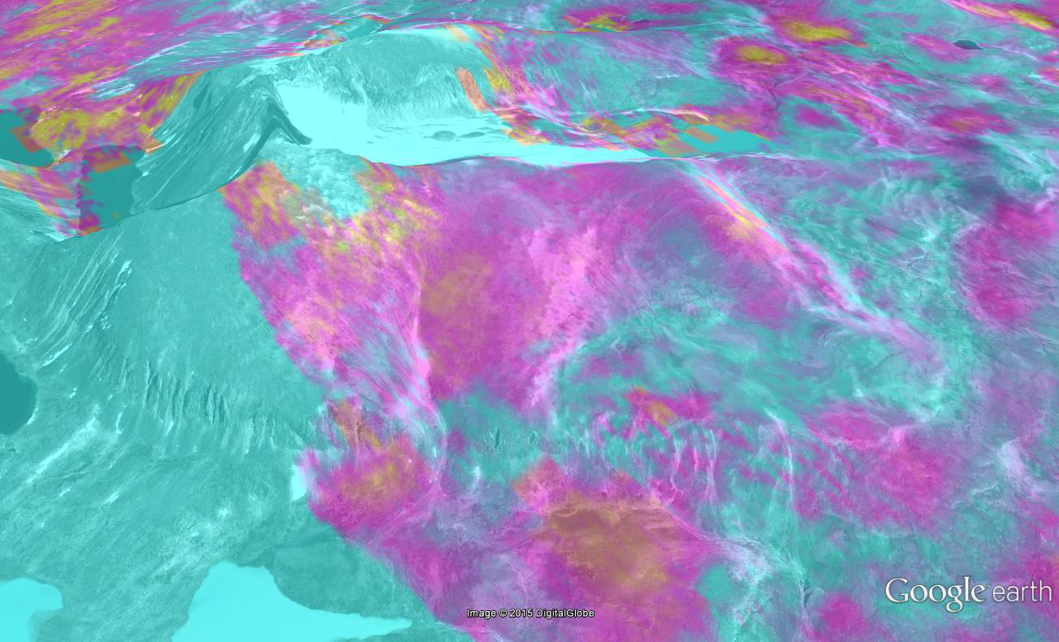
ALOS PALSAR, L-band, 9.9.2007 - 2.8.2010
Processing: Andreas Kääb, University of Oslo

Slide 18
Suggestions for future work
Mapping and distributed modelling of creep/solifluction landforms
Interferometry, SfM, TLS: spatial variability of surface creep at different resolution
Solifluction= f(T,P), depth-averaged profiles
Geophysics: thickness of weathering mantle
Surface wash, dissolved fluxes

Slide 19
Conclusions
HALRS show ample but not always consistent evidence of creep
Measured landscape diffusivity based on solifluction processes match values found in modelling experiments
Solifluction increase the overall sediment fluxes
Yes, we seem to have a bedrock perglacial landscape

