Slide 1
Architectures for Transport Infrastructure Monitoring in Smart Cities
Dr. Ingo Simonis
Director, Interoperability Programs & Science, OGC
March 2015

Slide 2
Open Geospatial Consortium (OGC)
Gegründet 1994
not for profit
Konsens-basiert
35+ OGC Standards
OGC Standards in mehreren hundert Softwareprodukten implemetiert
Große, weltweite Nutzer- und Entwicklercommunity
499 Mitglieder (Nov 2014)

Slide 3
Open Geospatial Consortium (OGC)
1994
Gegründet 1994
not for profit
Konsens-basiert
35+ OGC Standards
OGC Standards in mehreren hundert Softwareprodukten implemetiert
Große, weltweite Nutzer- und Entwicklercommunity
499 Mitglieder (Nov 2014)
Not for profit
35+ Standards
500+ Members
Consensus driven
3

Slide 4
OGC.Smart.Cities
OGC 14-115: OGC Smart Cities Spatial Information Framework

Slide 5
Smart City Indicators
Energy
Recreation
Water & Sanitation
Environment
Safety
Shelter
Education
Solid Waste
Telecom & innovation
Governance
Emergency Response
Finance
Transportation
Waste Water
Health
Urban Planning
Economy
defined by
ISO 37120

Slide 6
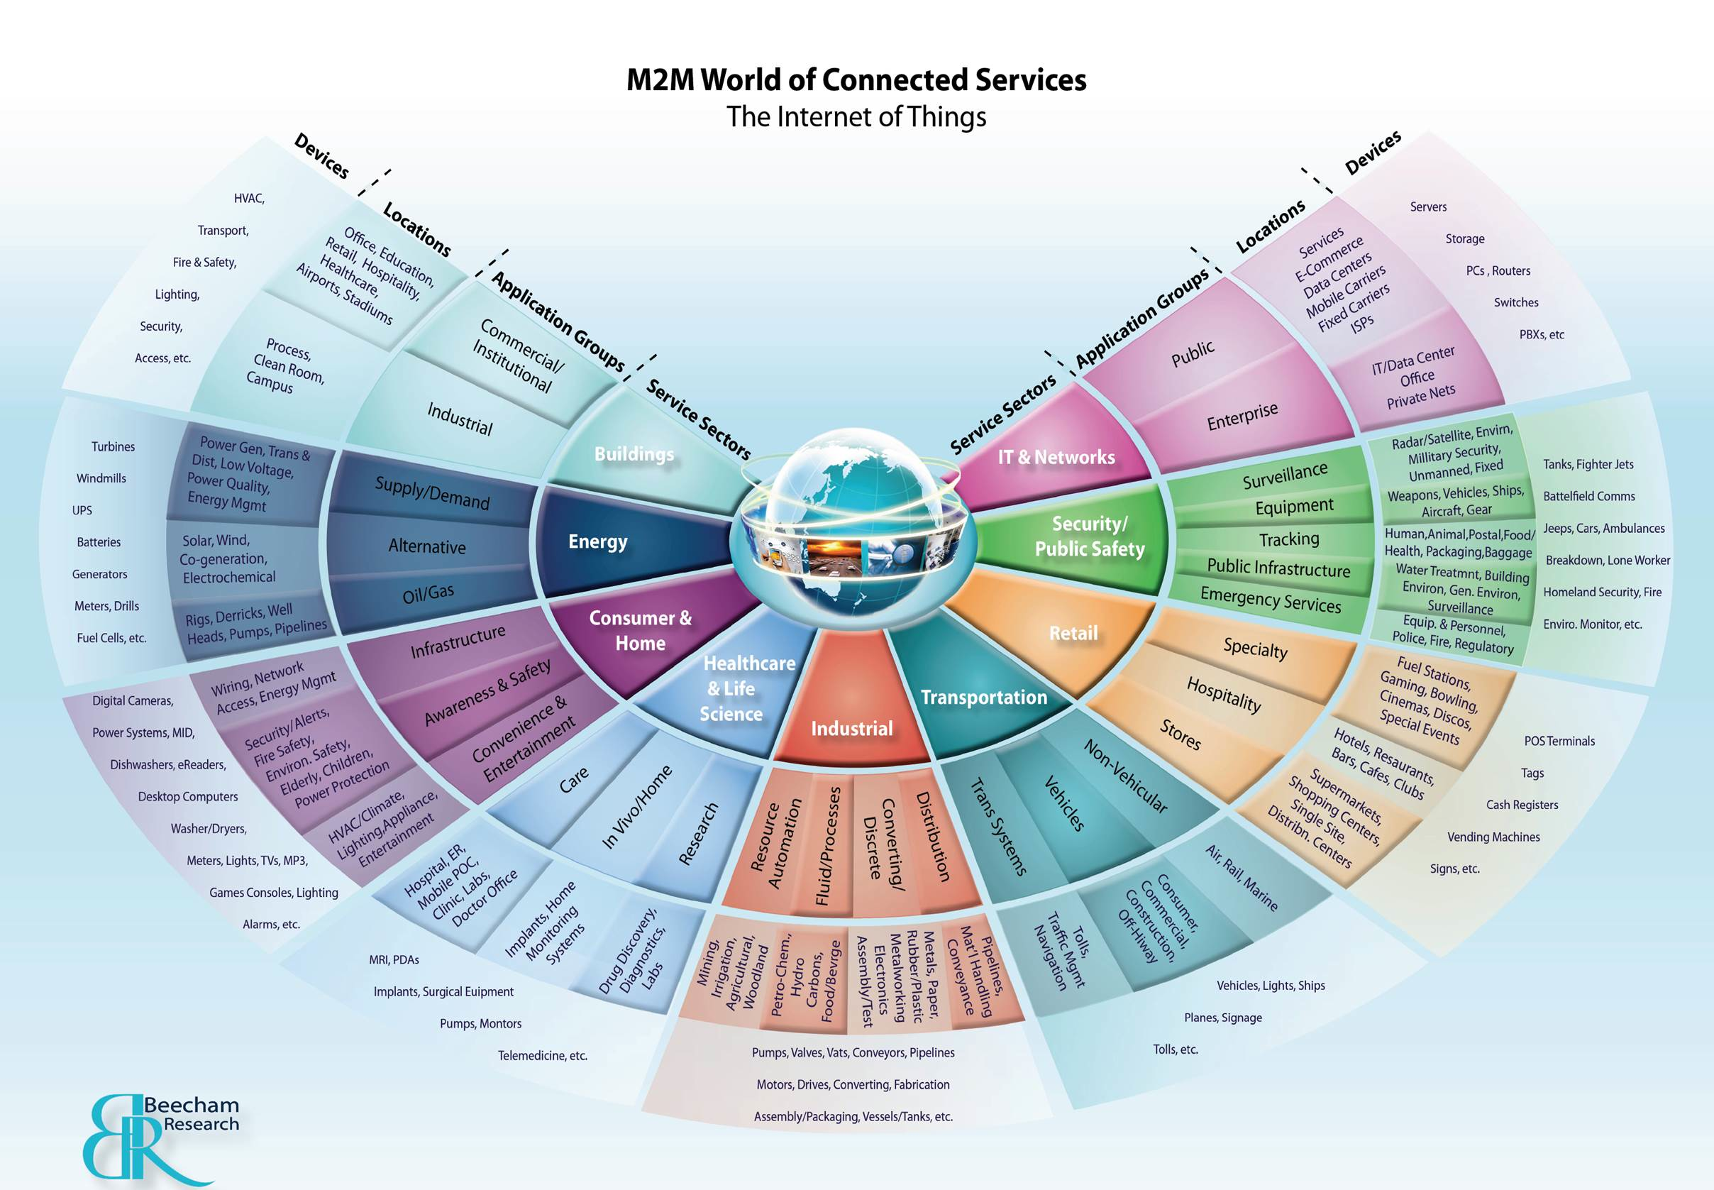
Vertical Pipes

Slide 7
Transport Infrastructure
Administration
Improved information basis
Carrying Business
Efficient traffic
Companies
Integration with simulation models
Tourism
Increased safety
Emergency Services
Reduced environmental pollution
Citizens & Visitors
Improved networks

Slide 8
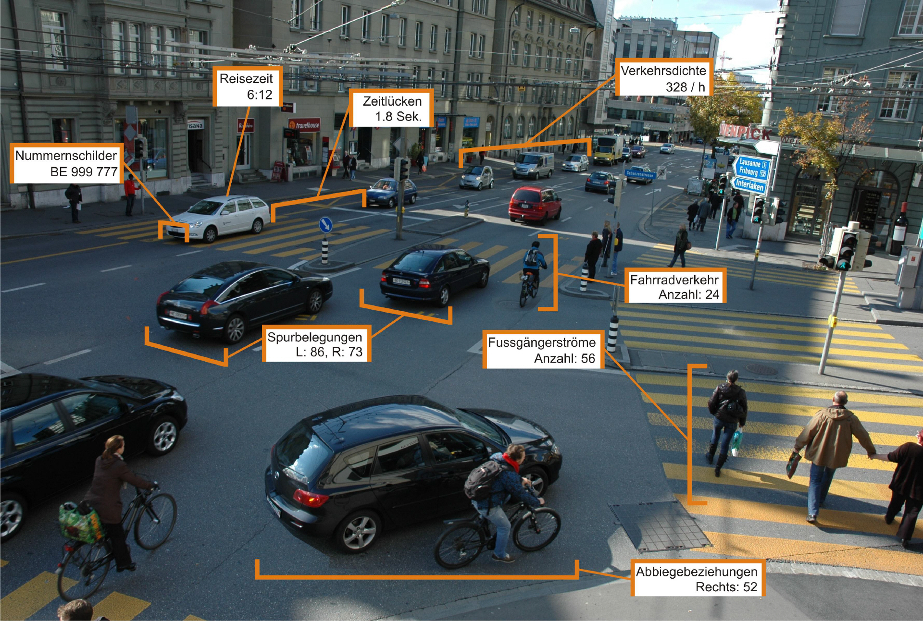
image by Swisstraffic.ch

Slide 9
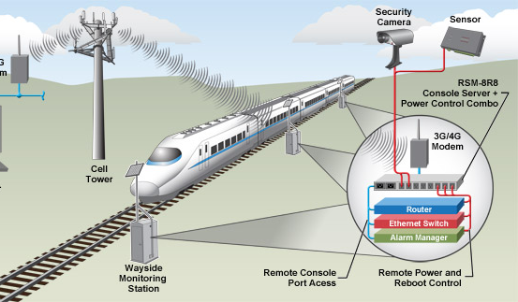
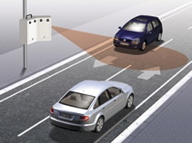
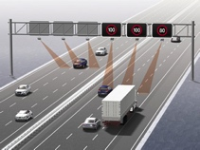
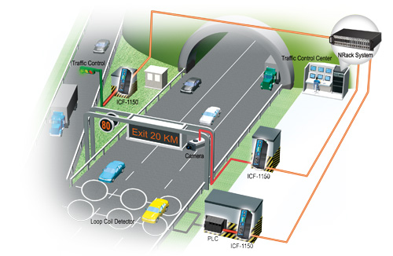
Combine and Process Observations
image by wti.com
image by viatraffic.de
image by moxa.com
© 2015 Open Geospatial Consortium

Slide 10
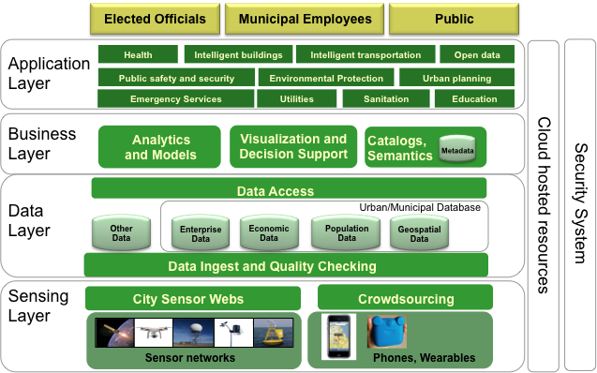
Smart Cities Enterprise Framework
Based on the ITU Focus Group on Smart Sustainable Cities

Slide 11
Key Services & Encodings
WFS
WCS
SOS
Data access services
retrieve and update information
allows selection & combination of data
supports various output formats
Processing services
Processing of data
Combination of spatial & non-spatial data
GML
JSON
KML
NetCDF
HDF,
BURF
GeoTIFF
WPS
TJS

Slide 12
Key Services
CSW
Catalog services
discover, browse, query metada
Visualization
rendering information
includes augmented reality
Workflows
orchestrate services into workflows
WMS
WMTS
KML
SLD
ARML

Slide 13
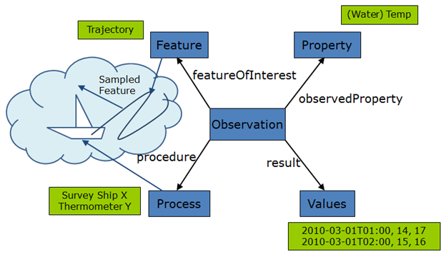
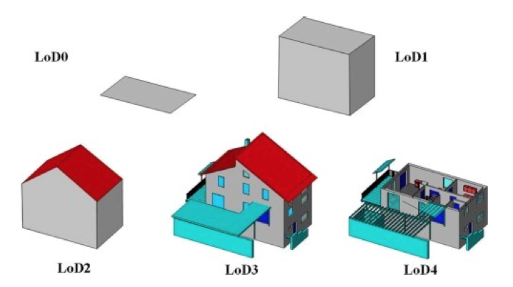
Data Models
CityGML
IndoorGML
InfraGML
SensorML
Swe
Common
O&M
© 2014 Open Geospatial Consortium

Slide 14
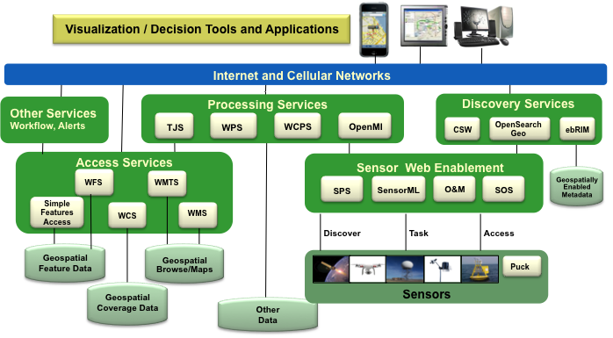
Smart Cities Enterprise Framework
OGC Services Architecture for interoperable access and processing of geospatial information for decision support

Slide 15
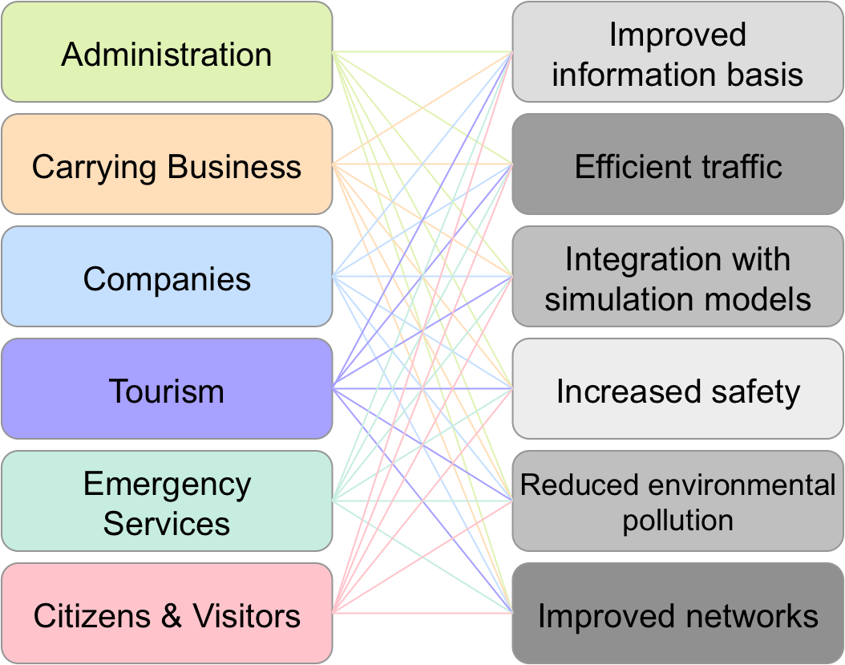
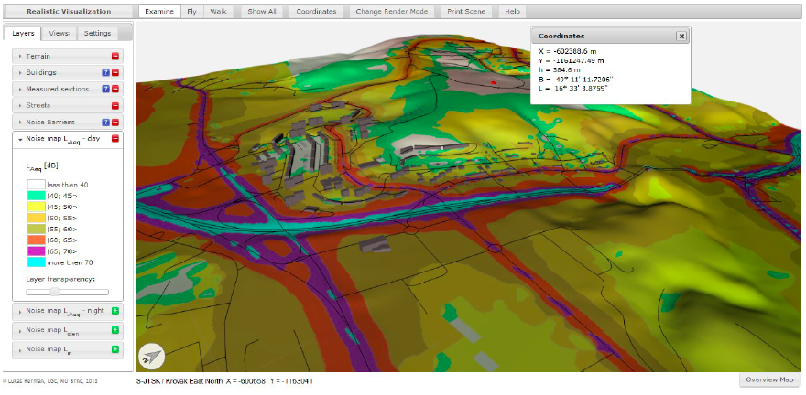
Towards a Spatial Information Architecture for Smart Cities
Understand complexity and opportunities
Urban Planning, 3D Information Management, Sensor Web Enablement, Land and Infrastructure,…
Run interoperability initiatives
Develop best practices and profiles
data integration
identify and develop profiles

Slide 16
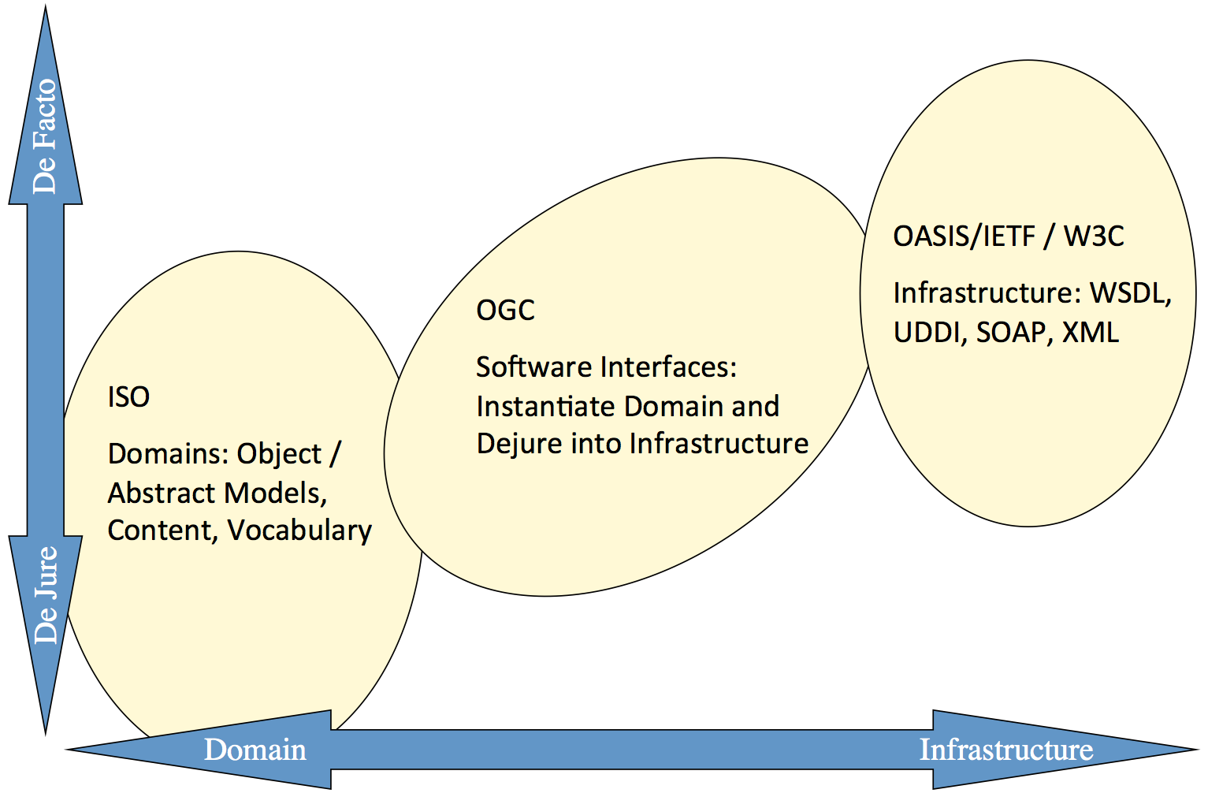
Towards a Spatial Information Architecture for Smart Cities
Coordination with other Standardization Development Organizations

Slide 17
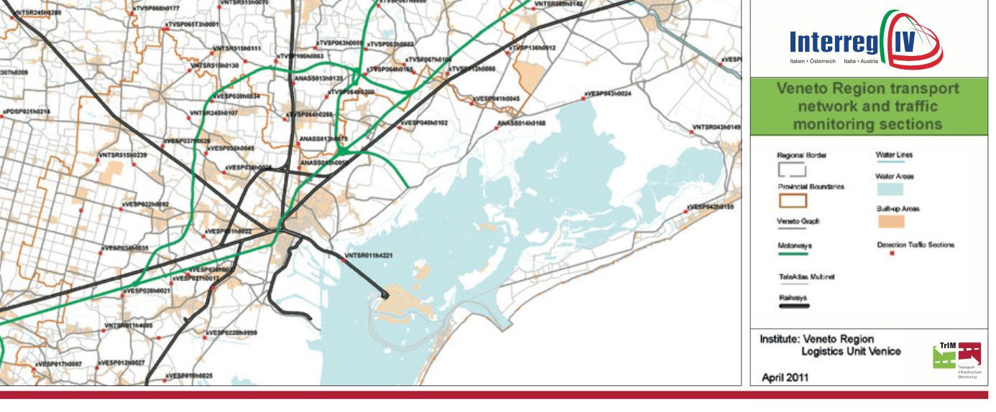
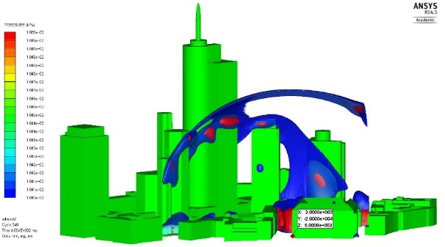
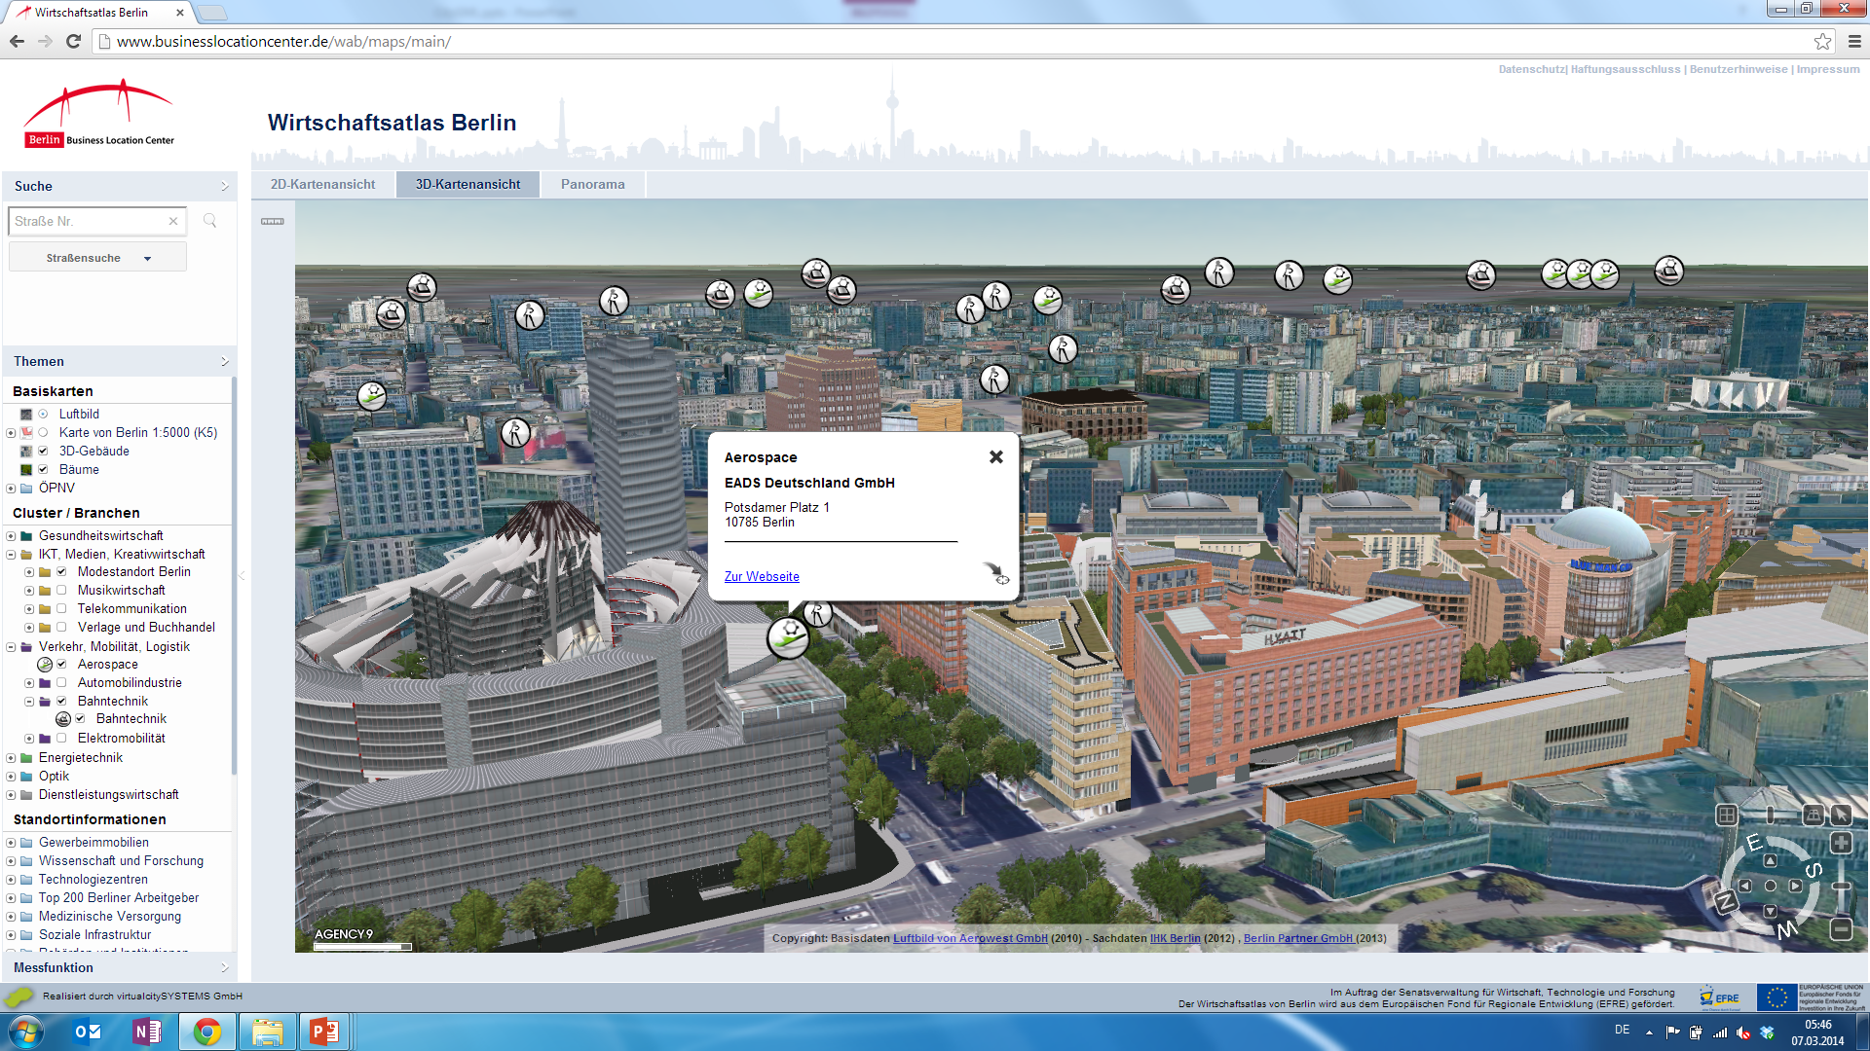
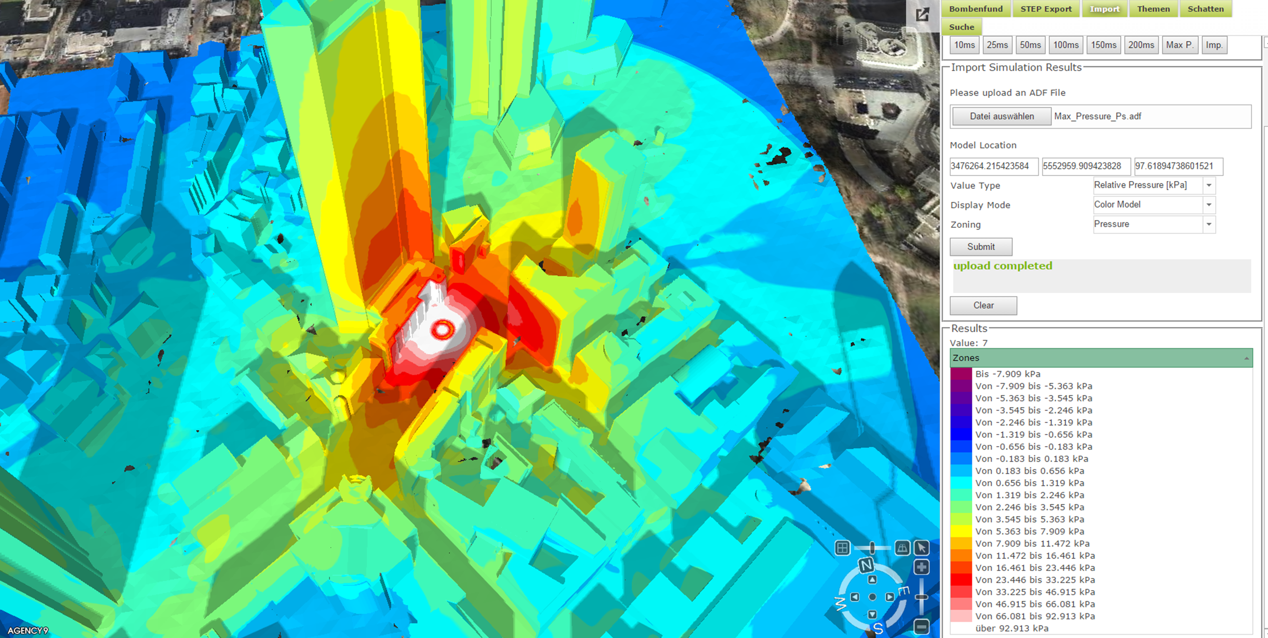
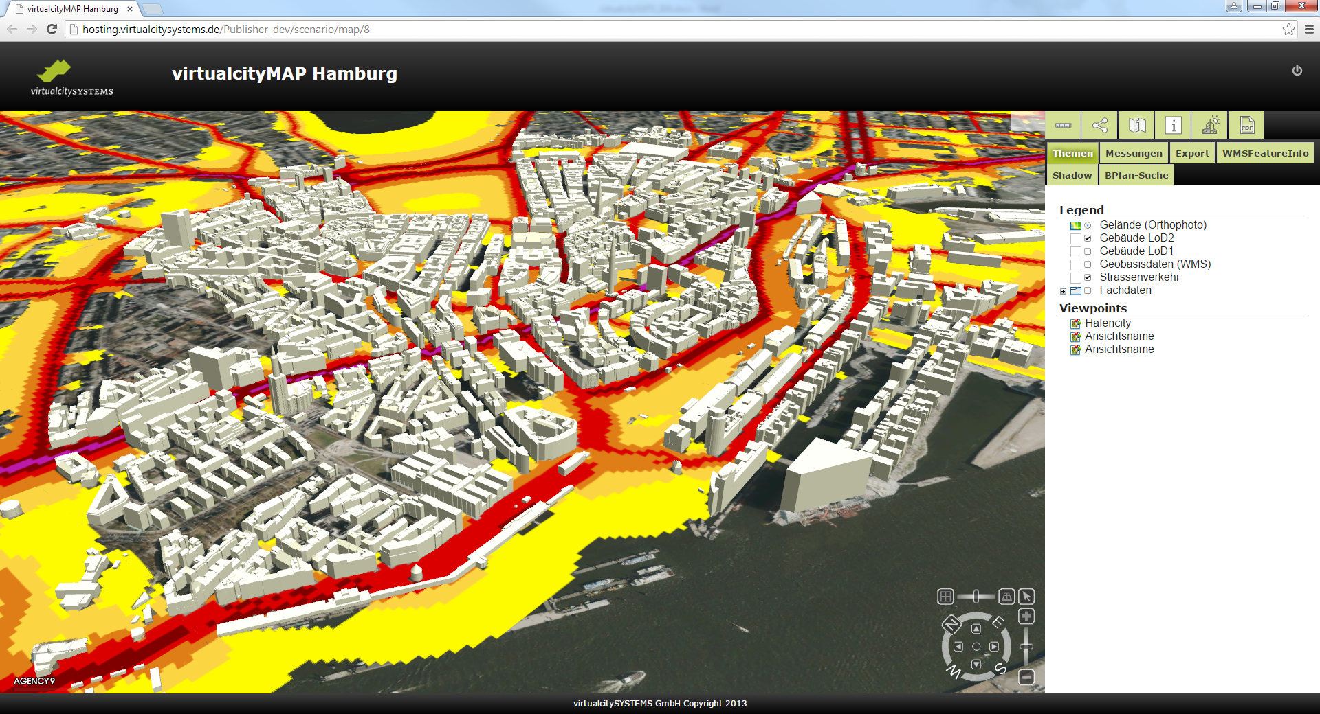
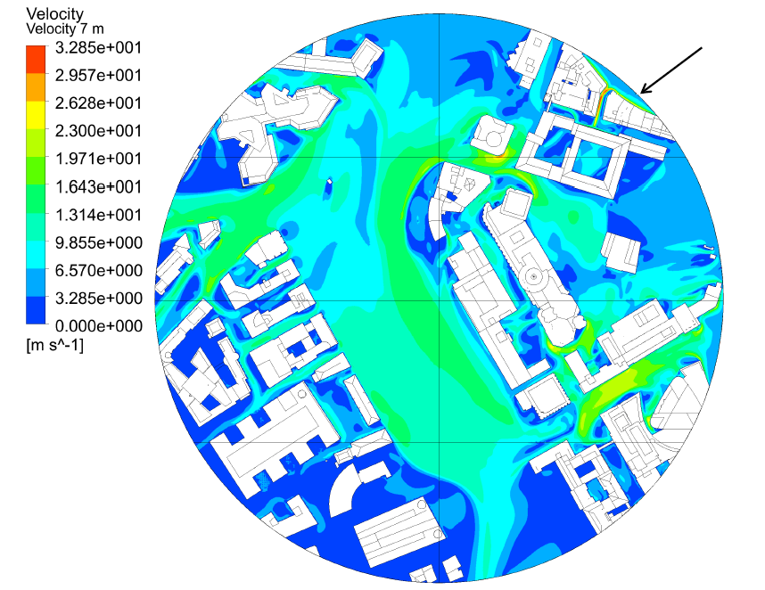
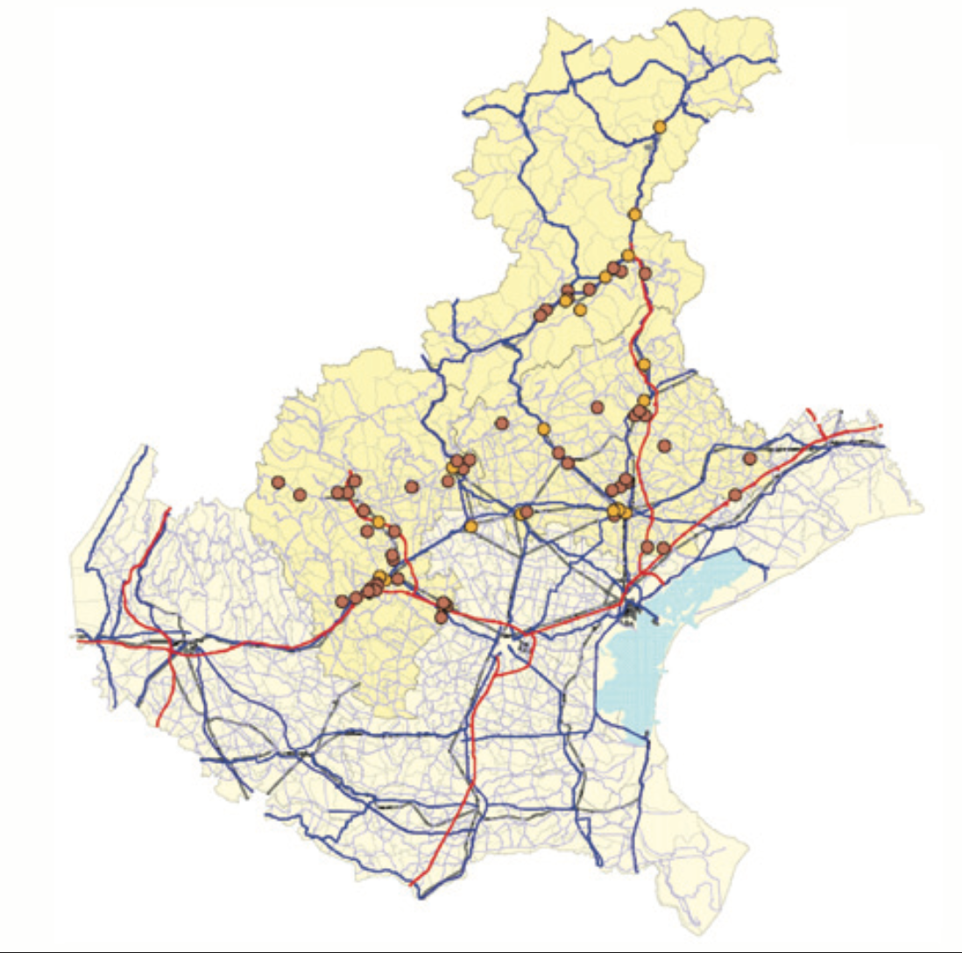
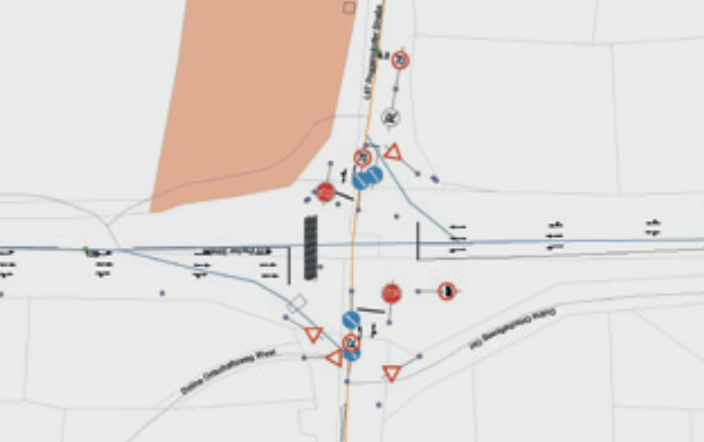
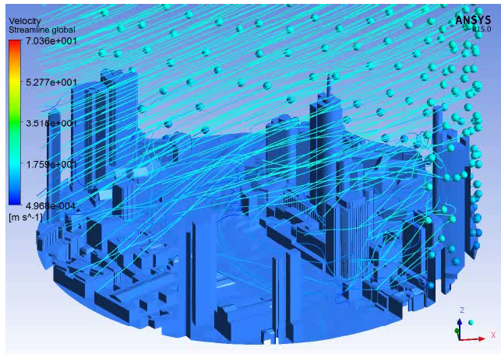
Pilots, Plugfests, CSA, R&D

Slide 18
Ingo Simonis
isimonis @ opengeospatial.org

