Slide 1
SINKS AS INTEGRATIVE ELEMENTS
OF THE ANTHROPOGENIC METABOLISM
Ulrich Kral, Paul H. Brunner
Vienna University of Technology
Non-recyclable
materials (=sink loads)
Primary
materials
SOURCES
Material cycle
Wastes
SINKS
Emissionen
Recyclable materials
Problem:
Sink loads pose risks
for human & environmental health.
Scope
Inventory
Impact assessment
Kral, U., P. H. Brunner, P. C. Chen, et al. 2014. Sinks as limited resources? A new indicator for evaluating anthropogenic material flows. Ecol Indic 46(0): 596-609.
Indicator score

Slide 2
X
Scope: Setting the scope of the assessment includes the selection of a substance, a reference region and a period of interest.
Non-recyclable
materials
Primary
materials
Wien
(Cu, Pb)
SOURCES
Material cycle
Wastes
SINKS
Schweiz
PFOS
Emissionen
Recycable materials
Problem:
Substance flows to sinks pose risks
for human & environmental health.
Scope
Inventory
Impact assessment
Indicator score

Slide 3
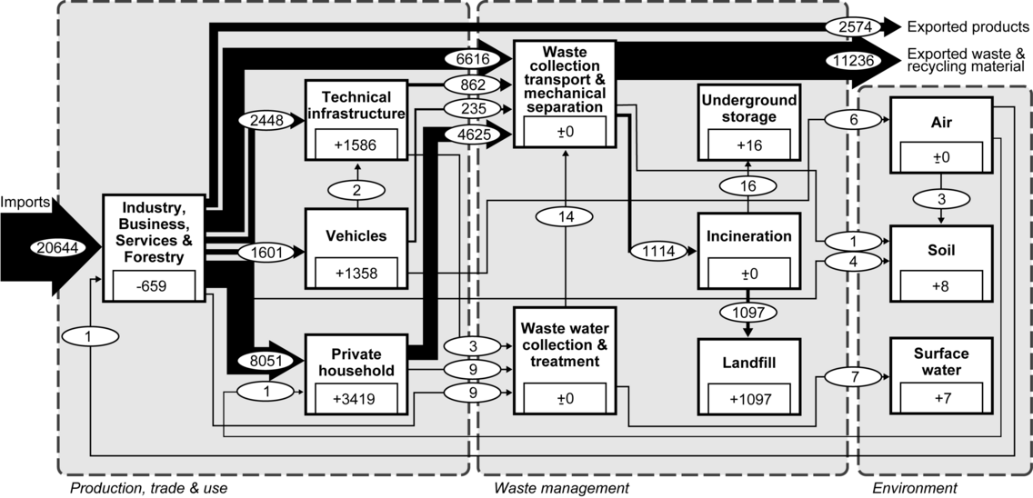
X
Inventory: It results the actual sink load in mass per time. First, the tool substance flow analysis (SFA) is applied to investigate regional substance flows. The software STAN is used for data reconciliation and error propagation in order to balance flows and stocks. Third, Sankey-diagrams are elaborated to present SFA results. Fourth, actual flows to sinks are summed up to result the actual sink load.
Copper in Vienna 2008
Non-recyclable
materials
Primary
materials
SOURCES
Material cycle
Wastes
SINKS
Emissionen
Actual
sink load:
1,128 t/a
Recycable materials
Problem:
Substance flows to sinks pose risks
for human & environmental health.
Kral, U., C.-Y. Lin, K. Kellner, et al. 2014. The Copper Balance of Cities. Journal of Industrial Ecology 18(3): 432-444.
Scope
Cu
Pb
Inventory
Impact assessment
Indicator score

Slide 4
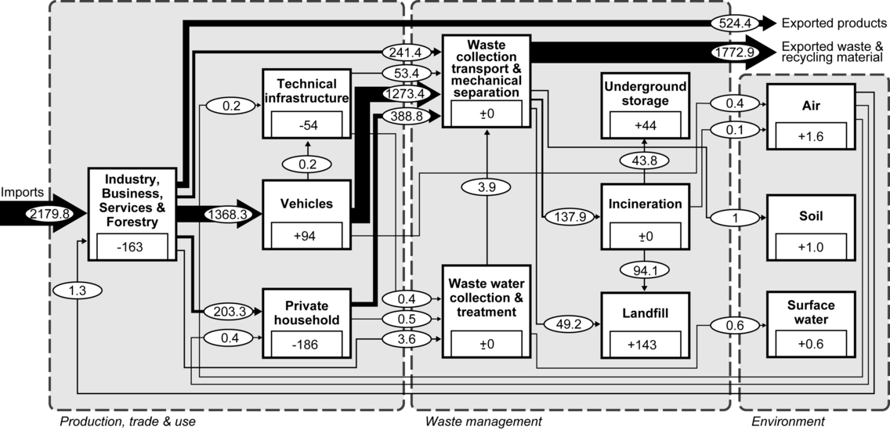
X
Inventory: It results the actual sink load in mass per time. First, the tool substance flow analysis (SFA) is applied to investigate regional substance flows. The software STAN is used for data reconciliation and error propagation in order to balance flows and stocks. Third, Sankey-diagrams are elaborated to present SFA results. Fourth, actual flows to sinks are summed up to result the actual sink load.
Lead in Vienna 2008
Non-recyclable
materials
Primary
materials
SOURCES
Material cycle
Wastes
SINKS
Emissionen
Actual
sink load:
191 t/a
Recycable materials
Problem:
Substance flows to sinks pose risks
for human & environmental health.
Scope
Cu
Pb
PFOS
Inventory
Impact assessment
Indicator score

Slide 5
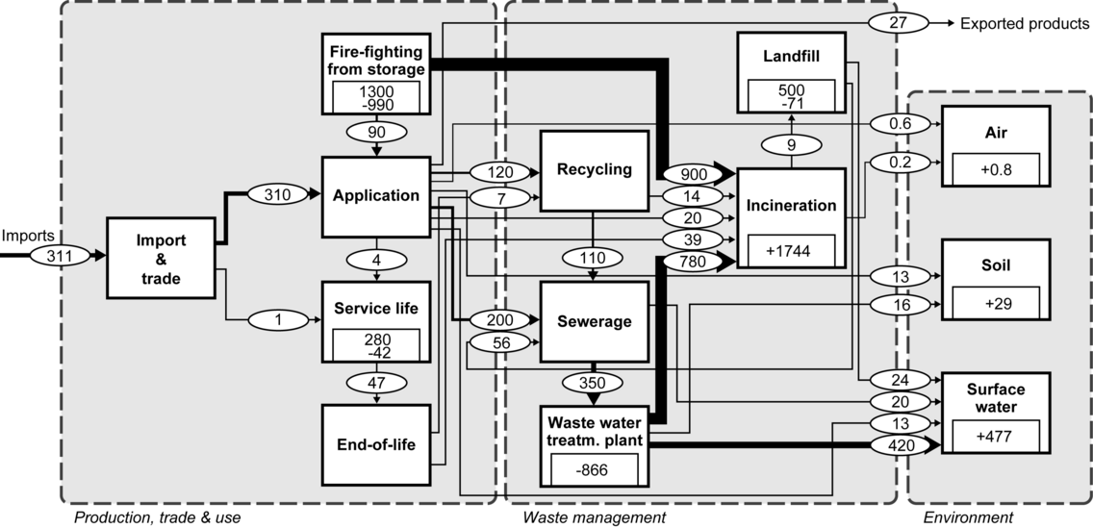
X
Inventory: It results the actual sink load in mass per time. First, the tool substance flow analysis (SFA) is applied to investigate regional substance flows. The software STAN is used for data reconciliation and error propagation in order to balance flows and stocks. Third, Sankey-diagrams are elaborated to present SFA results. Fourth, actual flows to sinks are summed up to result the actual sink load.
PFOS in Switzerland 2006
Non-recyclable
materials
Primary
materials
SOURCES
Material cycle
Wastes
SINKS
Emissionen
Actual
sink load:
2,263 t/a
Recycable materials
Problem:
Substance flows to sinks pose risks
for human & environmental health.
Scope
Pb
PFOS
Inventory
Impact assessment
Indicator score

Slide 6
X
Impact assessment: It results the acceptable sink load in mass per time. First, normative criteria (NC) and reference values are defined along the cause-effect chain. Criteria are derived from goal oriented frameworks with respect to waste and emissions such as regulations. Second, each actual flow is varied as long as the reference value is achieved, resulting the critical flow. Third, acceptable flows are determined and summed up to result the acceptable sink load.
Copper in Vienna 2008
Non-recyclable
materials
1128 t Cu/a
into sinks
Primary
materials
1.097 t/a
2.076 t/a
1.09 7t/a
16 t/a
16 t/a
16 t/a
8 t/a
1 t/a
1 t/a
7 t/a
2 t/a
2 t/a
Actual flow
Critical flow
Acceptable flow
SOURCES
Material cycle
Wastes
SINKS
Emissionen
Landfill
Underground storage
Urban soil
River Danube
Recycable materials
Problem:
Substance flows to sinks pose risks
for human & environmental health.
Acceptable
sink load:
1,117 t/a
NC
Landfill capacity
Legal standards
Accumulation of Cu in top soil
Legal standards
Scope
Cu
Pb
Inventory
Impact assessment
Indicator score

Slide 7
X
Impact assessment: It results the acceptable sink load in mass per time. First, normative criteria (NC) and reference values are defined along the cause-effect chain. Criteria are derived from goal oriented frameworks with respect to waste and emissions such as regulations. Second, each actual flow is varied as long as the reference value is achieved, resulting the critical flow. Third, acceptable flows are determined and summed up to result the acceptable sink load.
Lead in Vienna 200
Non-recyclable
materials
Primary
materials
191 t Pb/a
into sinks
144 t/a
233 t/a
123 t/a
44 t/a
44 t/a
44 t/a
1.6 t/a
6.1 t/a
1.6 t/a
0.6 t/a
0.6 t/a
0.6 t/a
1 t/a
1 t/a
1 t/a
Actual flow
Critical flow
Acceptable flow
SOURCES
Material cycle
Wastes
SINKS
Emissionen
Landfill
Underground storage
Air
Water
Soil
Acceptable
sink load:
176 t/a
Recycable materials
Problem:
Substance flows to sinks pose risks
for human & environmental health.
NC
Landfill capacity
Legal standards
Human health risk
Scope
Cu
Pb
PFOS
Inventory
Impact assessment
Indicator score

Slide 8
X
Impact assessment: It results the acceptable sink load in mass per time. First, normative criteria (NC) and reference values are defined along the cause-effect chain. Criteria are derived from goal oriented frameworks with respect to waste and emissions such as regulations. Second, each actual flow is varied as long as the reference value is achieved, resulting the critical flow. Third, acceptable flows are determined and summed up to result the acceptable sink load.
PFOS in Switzerland 2006
Non-recyclable
materials
Primary
materials
<0.01 t/a
- t/a
- t/a
Actual flow
Critical flow
Acceptable flow
2.26 t PFOS/a
into sinks
1.74 t/a
1.74 t/a
1.74t/a
0.48 t/a
0.74 t/a
0.42 t/a
0.03 t/a
- t/a
- t/a
0.09 t/a
0.09 t/a
0.09 t/a
SOURCES
Material cycle
Wastes
SINKS
Emissionen
Acceptable
sink load:
2.17 t/a
Incinerator
Water
Soil
Landfill
Air
Recycable materials
Problem:
Substance flows to sinks pose risks
for human & environmental health.
NC
Mineralization capacity
U.S. EPPA Prov. Health advisory / n.a.
n.a.
accepted
n.a.
Scope
Pb
PFOS
Inventory
Impact assessment
Indicator score

Slide 9
X
A new indicator...
...with respect to sink limitation
We propose to use a single score indicator λ on a substance specific base. It quantifies the environmental acceptable share of a substance to sink processes. It ranges from 0% to 100%. Either all actual flows are fulfilling criteria of acceptability (λ = 100%) or at least one flow is unacceptable (0% < λ < 100%).
Non-recyclable
materials
Copper in Vienna 2008
Primary
materials
$$\text{λ}=99\%$$
SOURCES
Material cycle
Wastes
SINKS
Measures to increase the indicator score:
Elaborating legal limits for heavy metals in urban soils
Monitoring loads to urban soil and river Danube
Reducing airborne emissions
Emissionen
Recycable materials
Problem:
Substance flows to sinks pose risks
for human & environmental health.
$$\text{λ}=\frac{Acceptable sink load}{Actual sink load}∗100$$
Scope
Cu
Pb
Inventory
Impact assessment
Indicator score

Slide 10
X
A new indicator...
...with respect to sink limitation
We propose to use a single score indicator λ on a substance specific base. It quantifies the environmental acceptable share of a substance to sink processes. It ranges from 0% to 100%. Either all actual flows are fulfilling criteria of acceptability (λ = 100%) or at least one flow is unacceptable (0% < λ < 100%).
Non-recyclable
materials
Lead in Vienna 2008
Primary
materials
$$\text{λ}=92\%$$
SOURCES
Material cycle
Wastes
SINKS
Measures to increase the indicator score:
Optimizing recycling rates
Expanding landfill capacities
Emissionen
Recycable materials
Problem:
Substance flows to sinks pose risks
for human & environmental health.
$$\text{λ}=\frac{Acceptable sink load}{Actual sink load}∗100$$
Scope
Cu
Pb
PFOS
Inventory
Impact assessment
Indicator score

Slide 11
X
A new indicator...
...with respect to sink limitation
We propose to use a single score indicator λ on a substance specific base. It quantifies the environmental acceptable share of a substance to sink processes. It ranges from 0% to 100%. Either all actual flows are fulfilling criteria of acceptability (λ = 100%) or at least one flow is unacceptable (0% < λ < 100%).
Non-recyclable
materials
PFOS in Switzerland 2006
Primary
materials
$$\text{λ}=96\%$$
SOURCES
Material cycle
Wastes
SINKS
Measures to increase the indicator score:
Managing the stockpiles
Minimize and eliminate emissions
Conducting research regarding the cause of PFOS generation in waste water treatment plants
Emissionen
Recycable materials
Problem:
Substance flows to sinks pose risks
for human & environmental health.
$$\text{λ}=\frac{Acceptable sink load}{Actual sink load}∗100$$
Scope
Pb
PFOS
Inventory
Impact assessment
Indicator score

