Slide 1
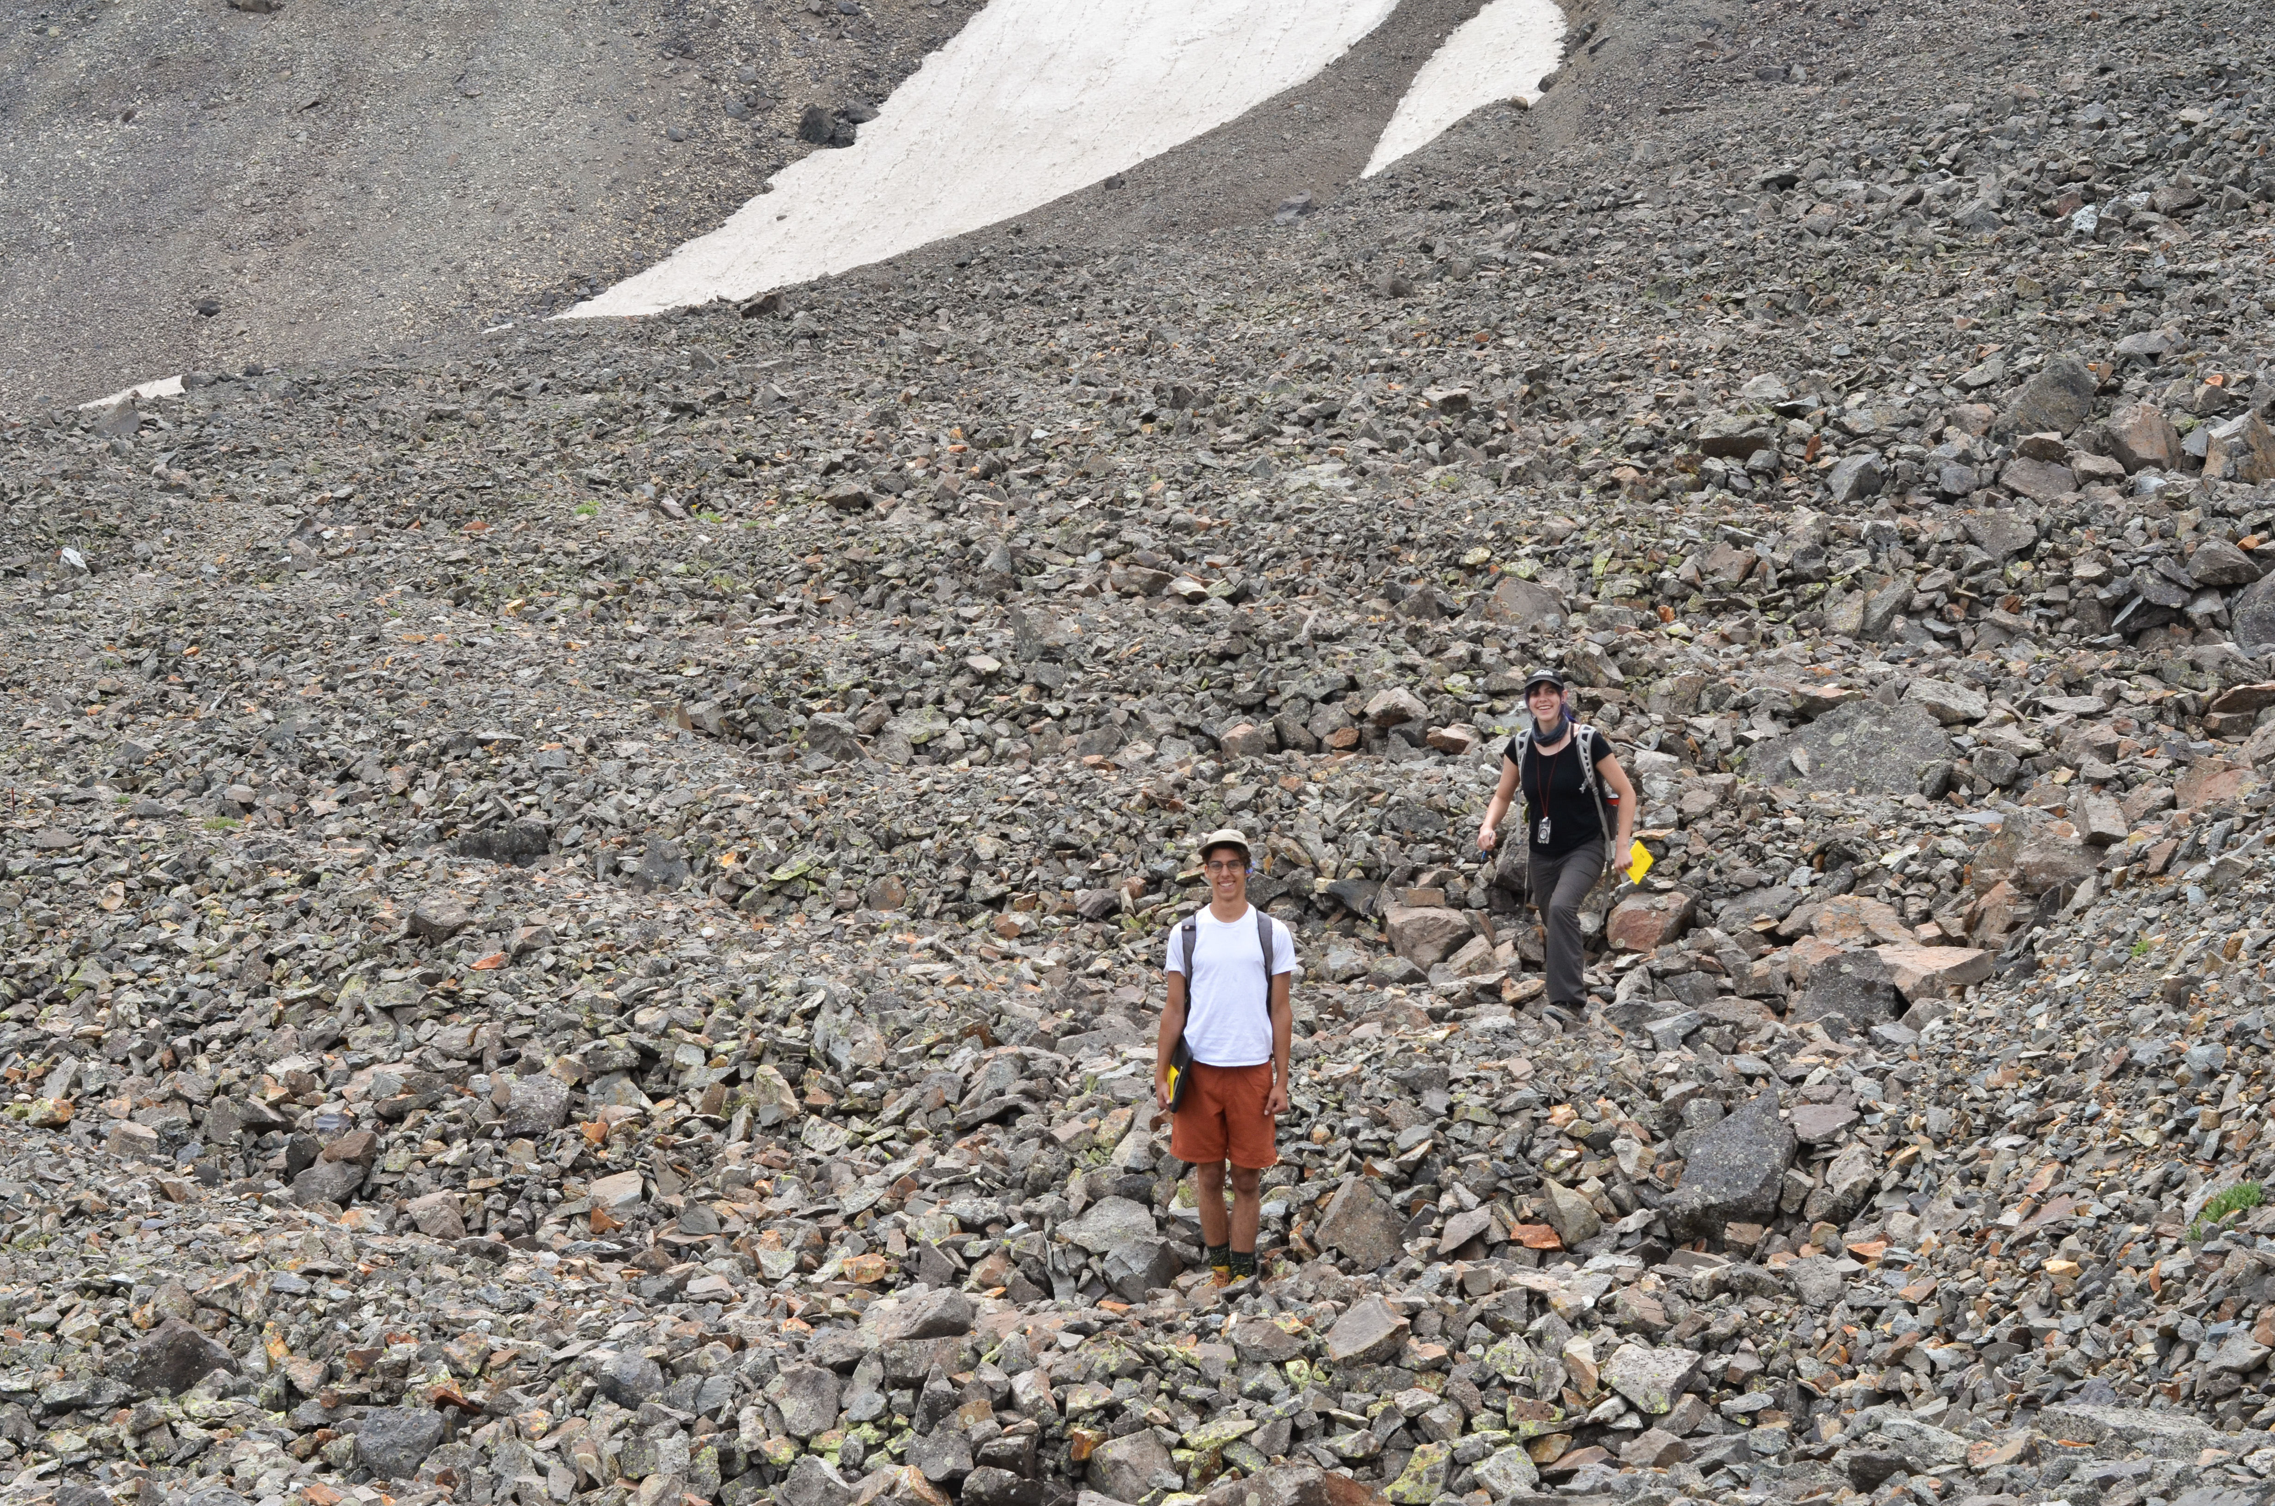
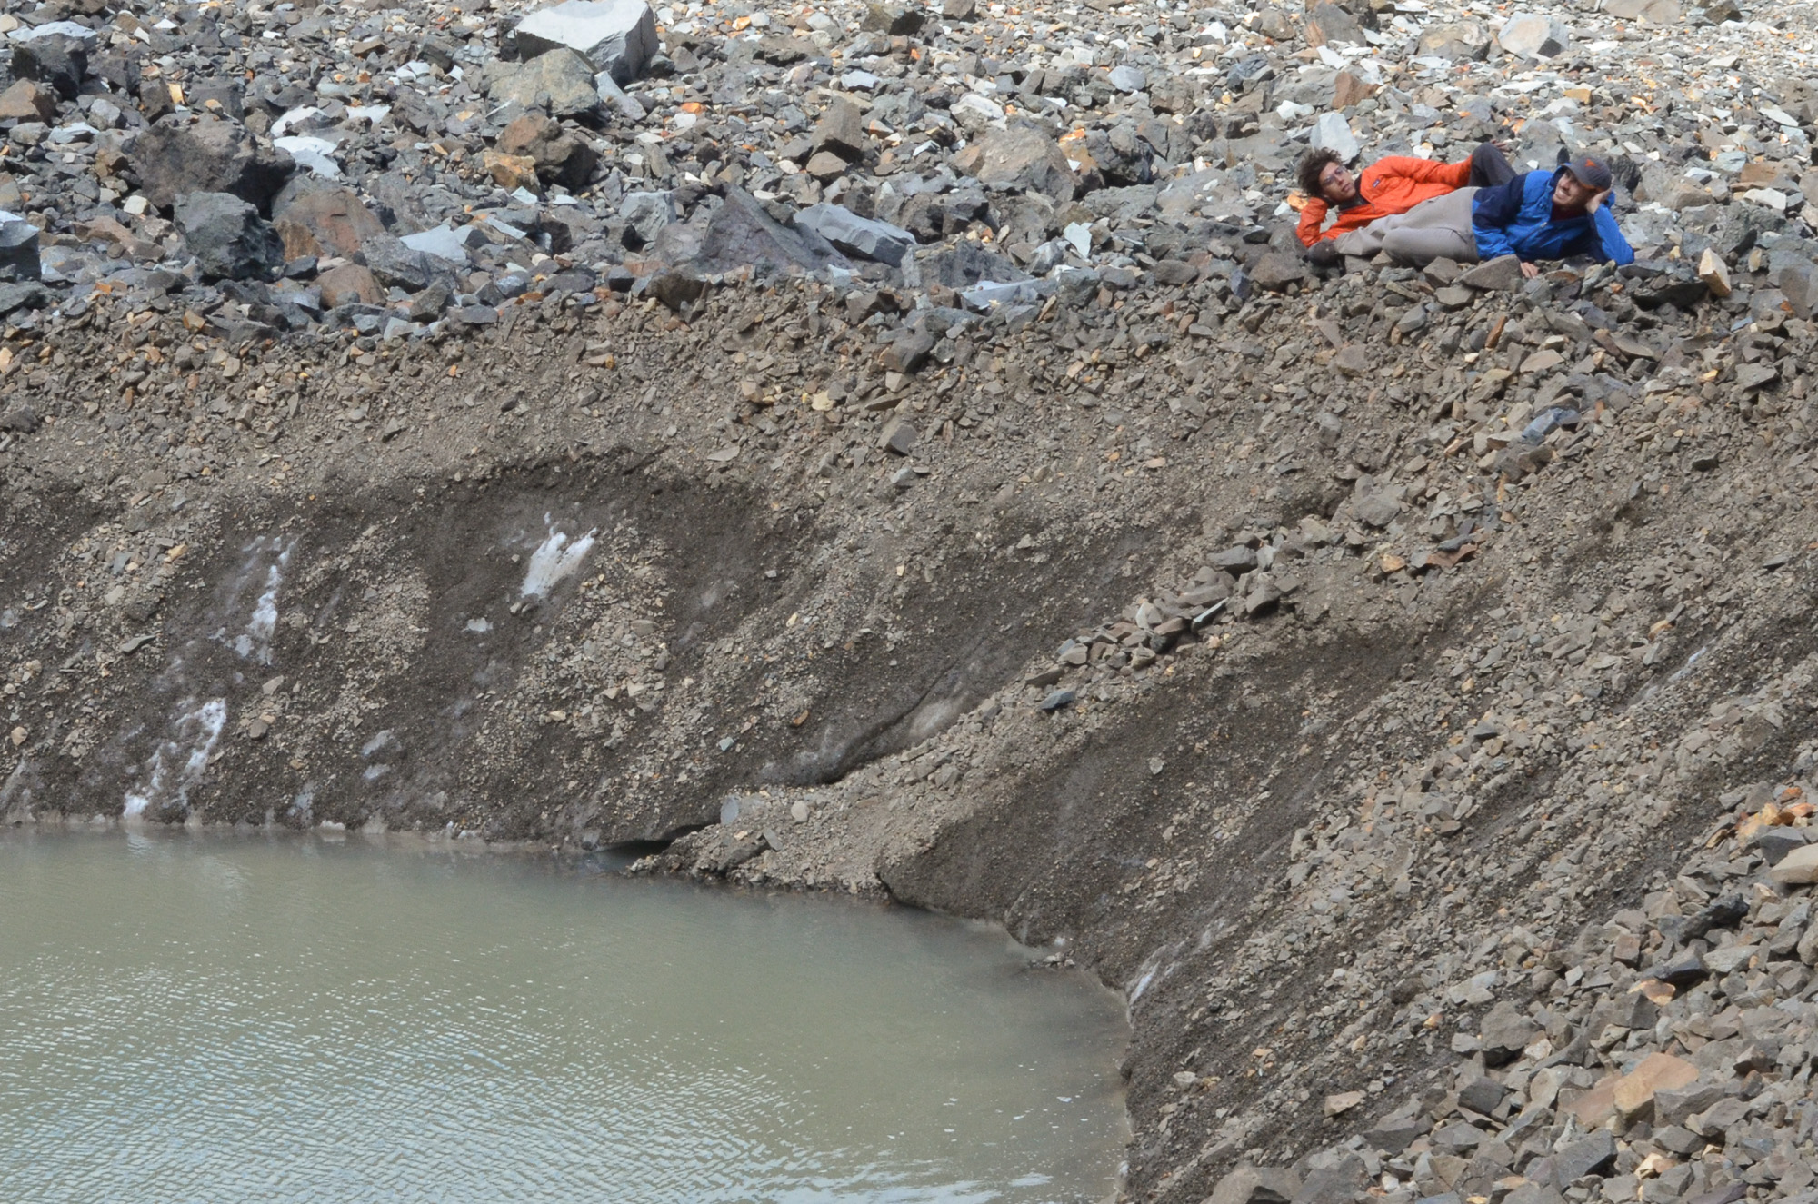
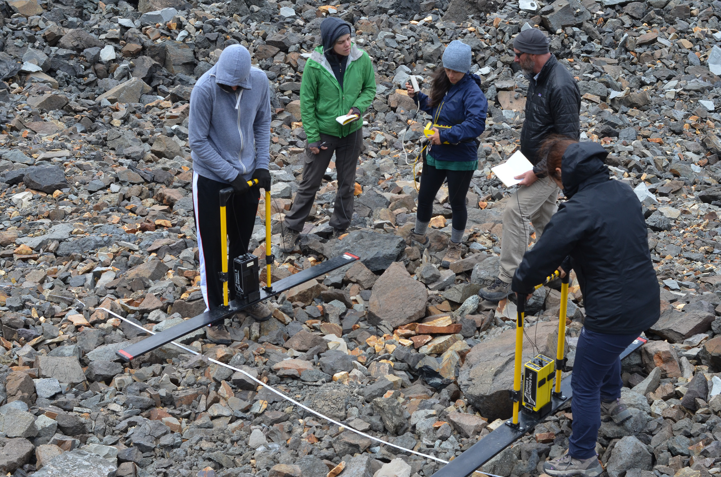
A possible climate signal in the surface morphology and internal structure of Galena Creek Rock Glacier, Wyoming
Eric Petersen¹, John Holt¹, Joseph Levy¹, Cassie Stuurman¹, Stefano Nerozzi¹, Benjamin Cardenas², Dan Aylward², James Pharr³, Logan Schmidt¹, William Hoey³, Parvathy Prem³, Jackie Rambo², YeJin Lim², and Kian Maharaj²
¹University of Texas Institute for Geophysics (UTIG), University of Texas at Austin, USA
²Jackson School of Geosciences, University of Texas at Austin, USA
³Dept. of Aerospace and Engineering Mechanics, University of Texas at Austin, USA

Slide 2
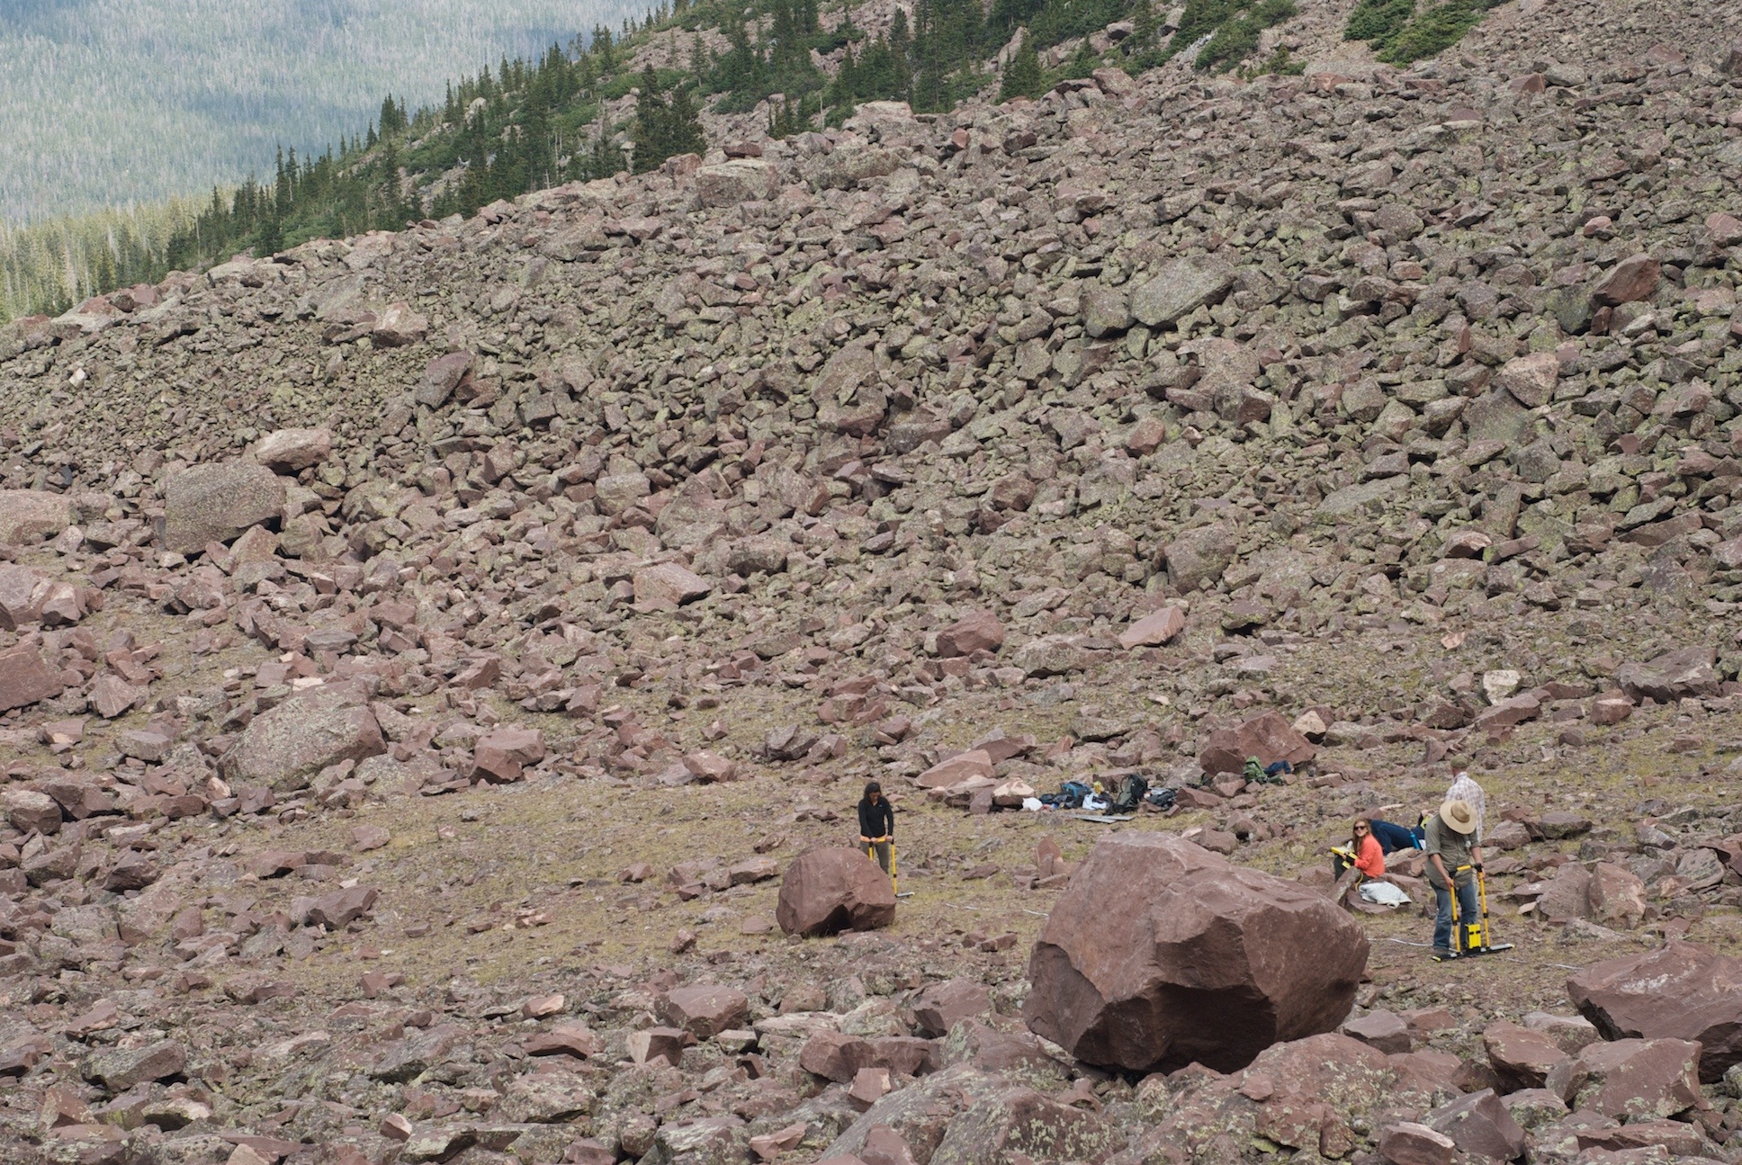
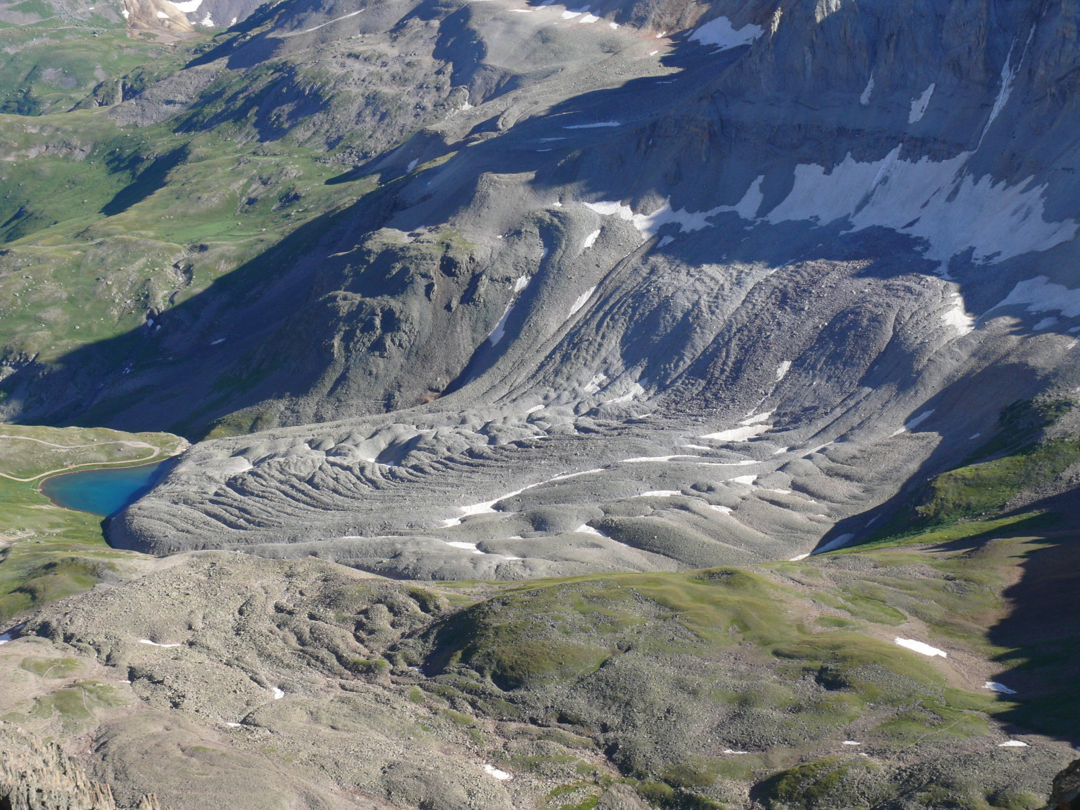
Intro: Rock Glaciers
Luigi Rock Glacier, Utah
Debris-covered ice rich mass
30%-100% bulk ice
Distinctive viscous flow morphology
Debris insulates ice from ablation
High potential as climate record
Gilpin Peak Rock Glacier, Colorado

Slide 3
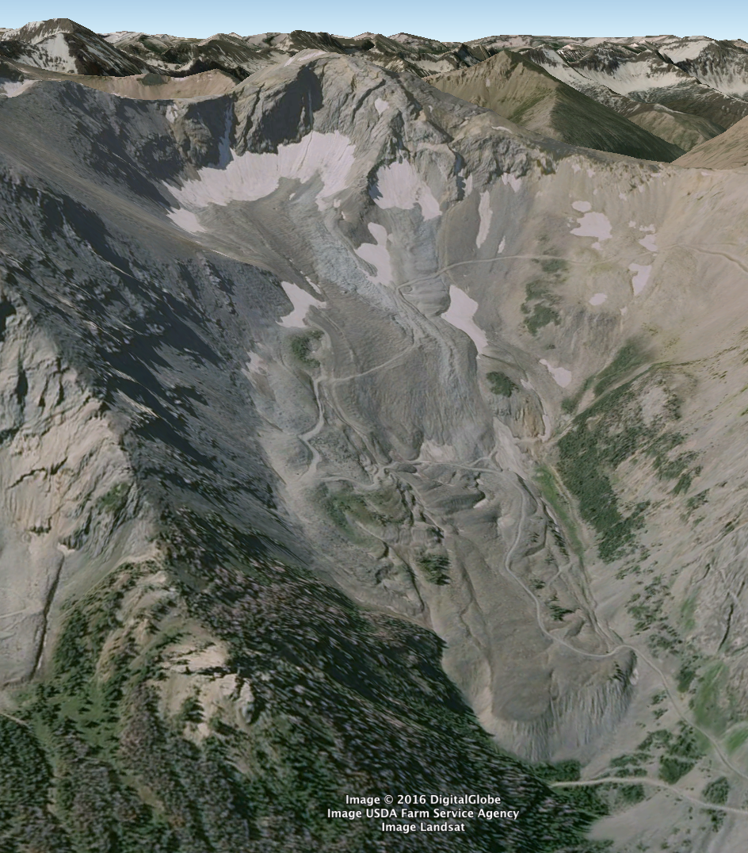
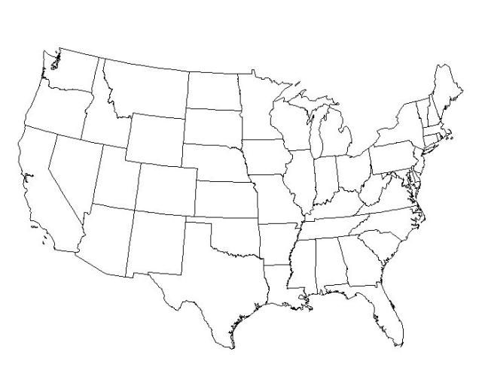
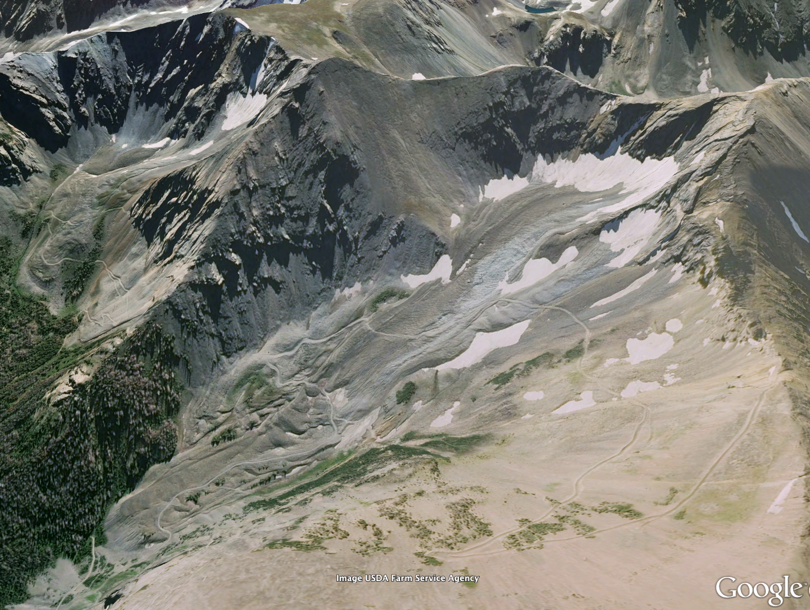
Intro: Galena Creek Rock Glacier (GCRG)
Flows from north-facing cirque in the Absaroka Range, WY
~3100 – 2700 m.a.s.l.
1.6 km long, 240-300 m wide
Location
Perspective View
Flow

Slide 4
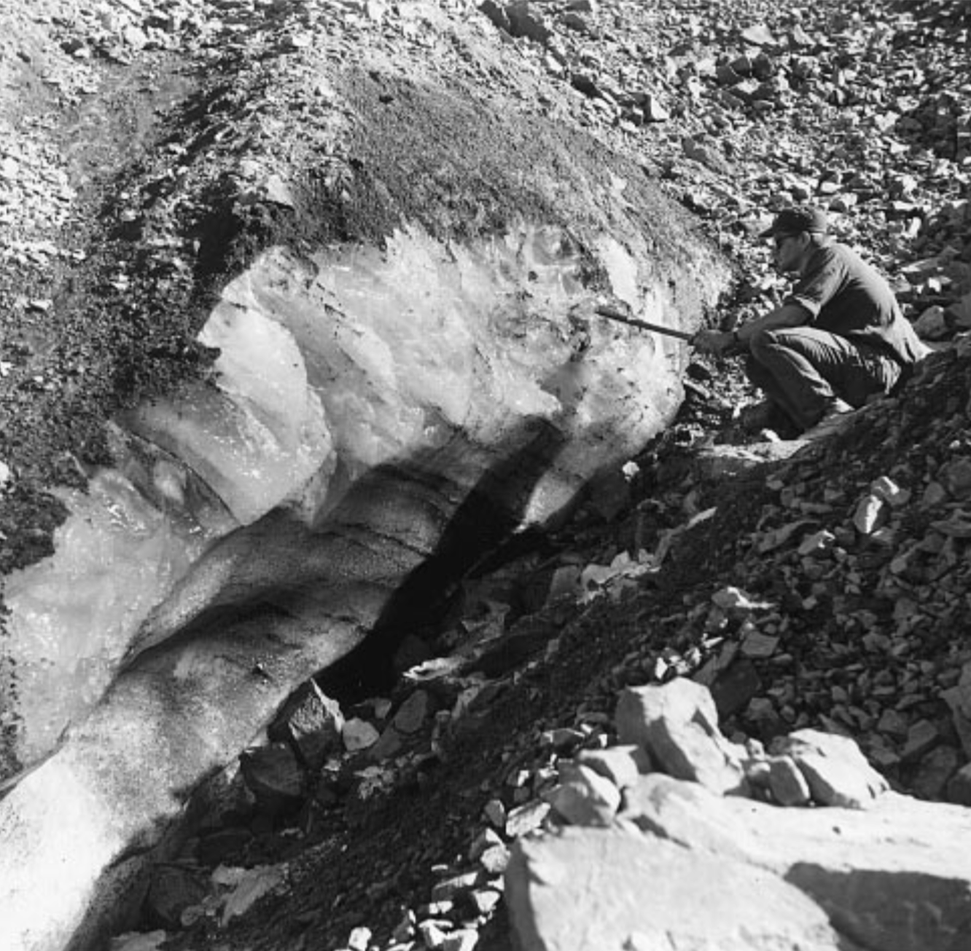
Background
Potter (1972), Ice Exposure:
Clark et al. (1996) Ice Core
9.5 m clean, layered ice under ~1 m surface debris.
Est. ~2000 yrs old
Potter et al. (1998) Surface Velocities
Up to 80 cm/yr
Glacier exits cirque at 16-45 cm/yr.
Upper 2/3 GCRG = debris-covered glacier

Slide 5
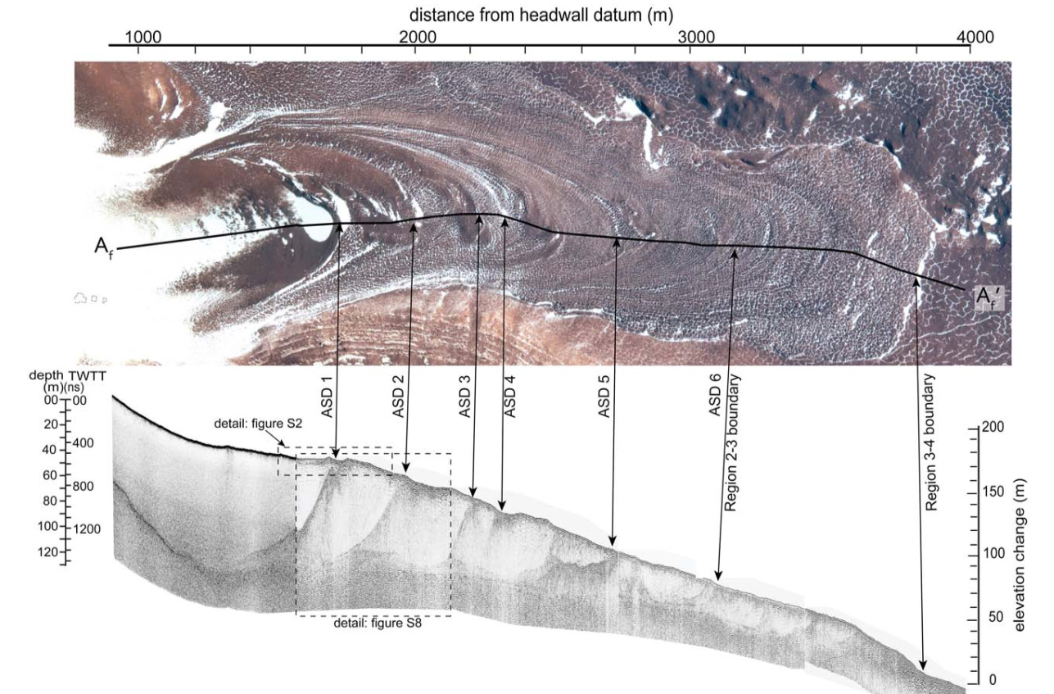
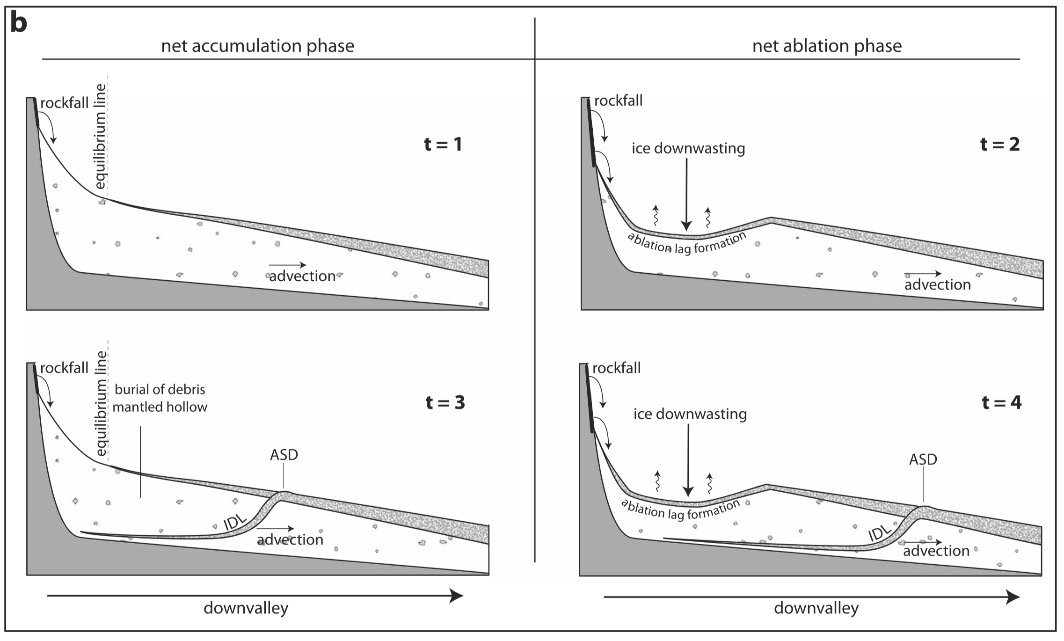
Background: MacKay et al. (2014) Model
Mullins debris-covered glacier in Antarctica.
Net ablation periods:
Debris layer forms
Net accumulation periods:
Burial of debris layer
→ Englacial debris bands & surface ridges preserve climate history

Slide 6
GCRG: Transverse Surface Ridges
s

Slide 7
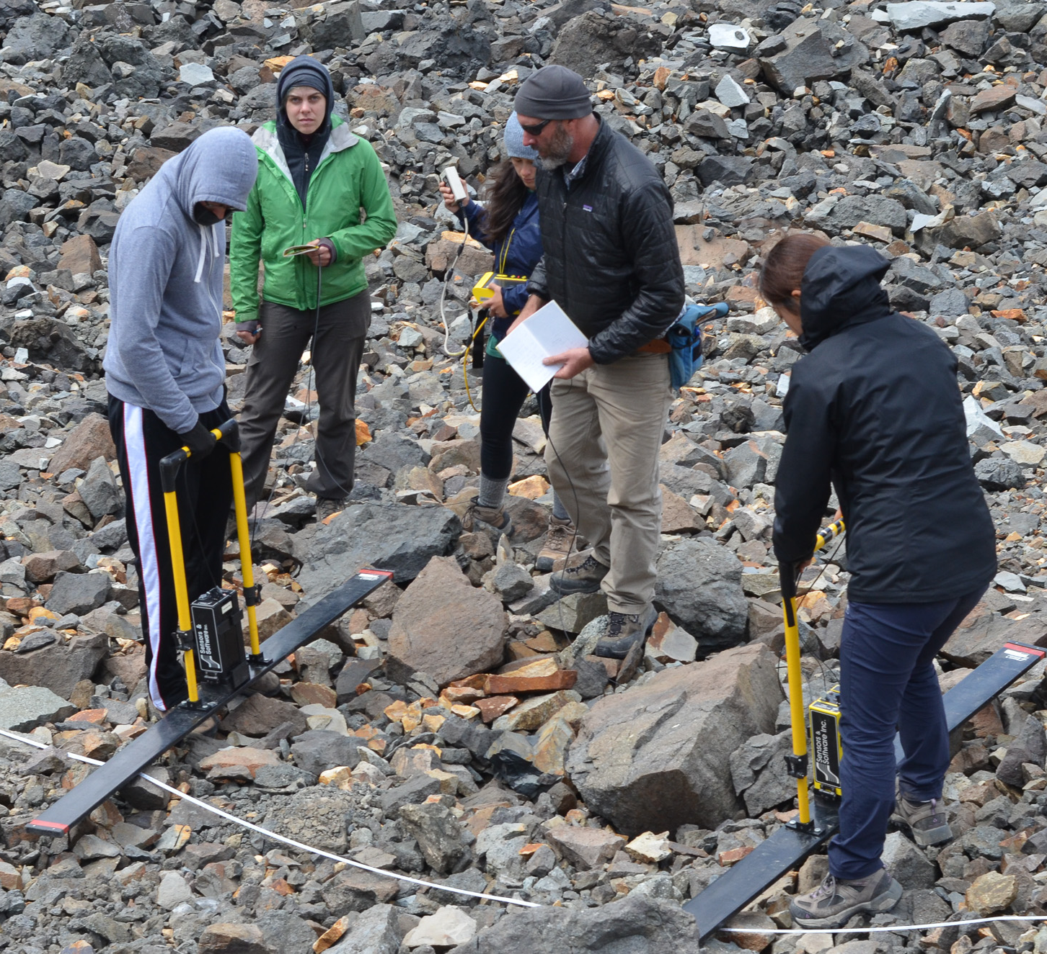
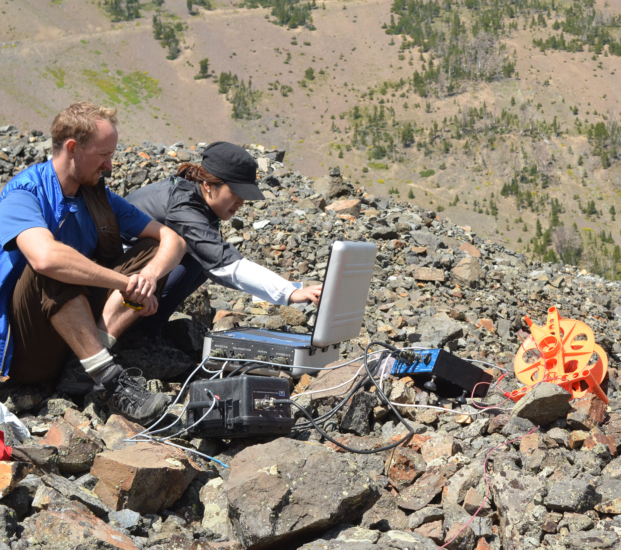
Purpose of this Study
August 2015: investigate internal structure of GCRG to:
Constrain its accumulation history
Investigate possible climate signals
Methods
Ground-penetrating radar (GPR)
PulseEKKO Pro, 50 & 100 MHz
2D imaging of subsurface structure
Transient Electromagnetic (TEM)
1D depth models of subsurface conductivity inverted from data
→ estimates of GCRG thickness
Ground-based photogrammetry
DEMs at 10s cm resolution

Slide 8
Results: Mid-Glacier

Slide 9
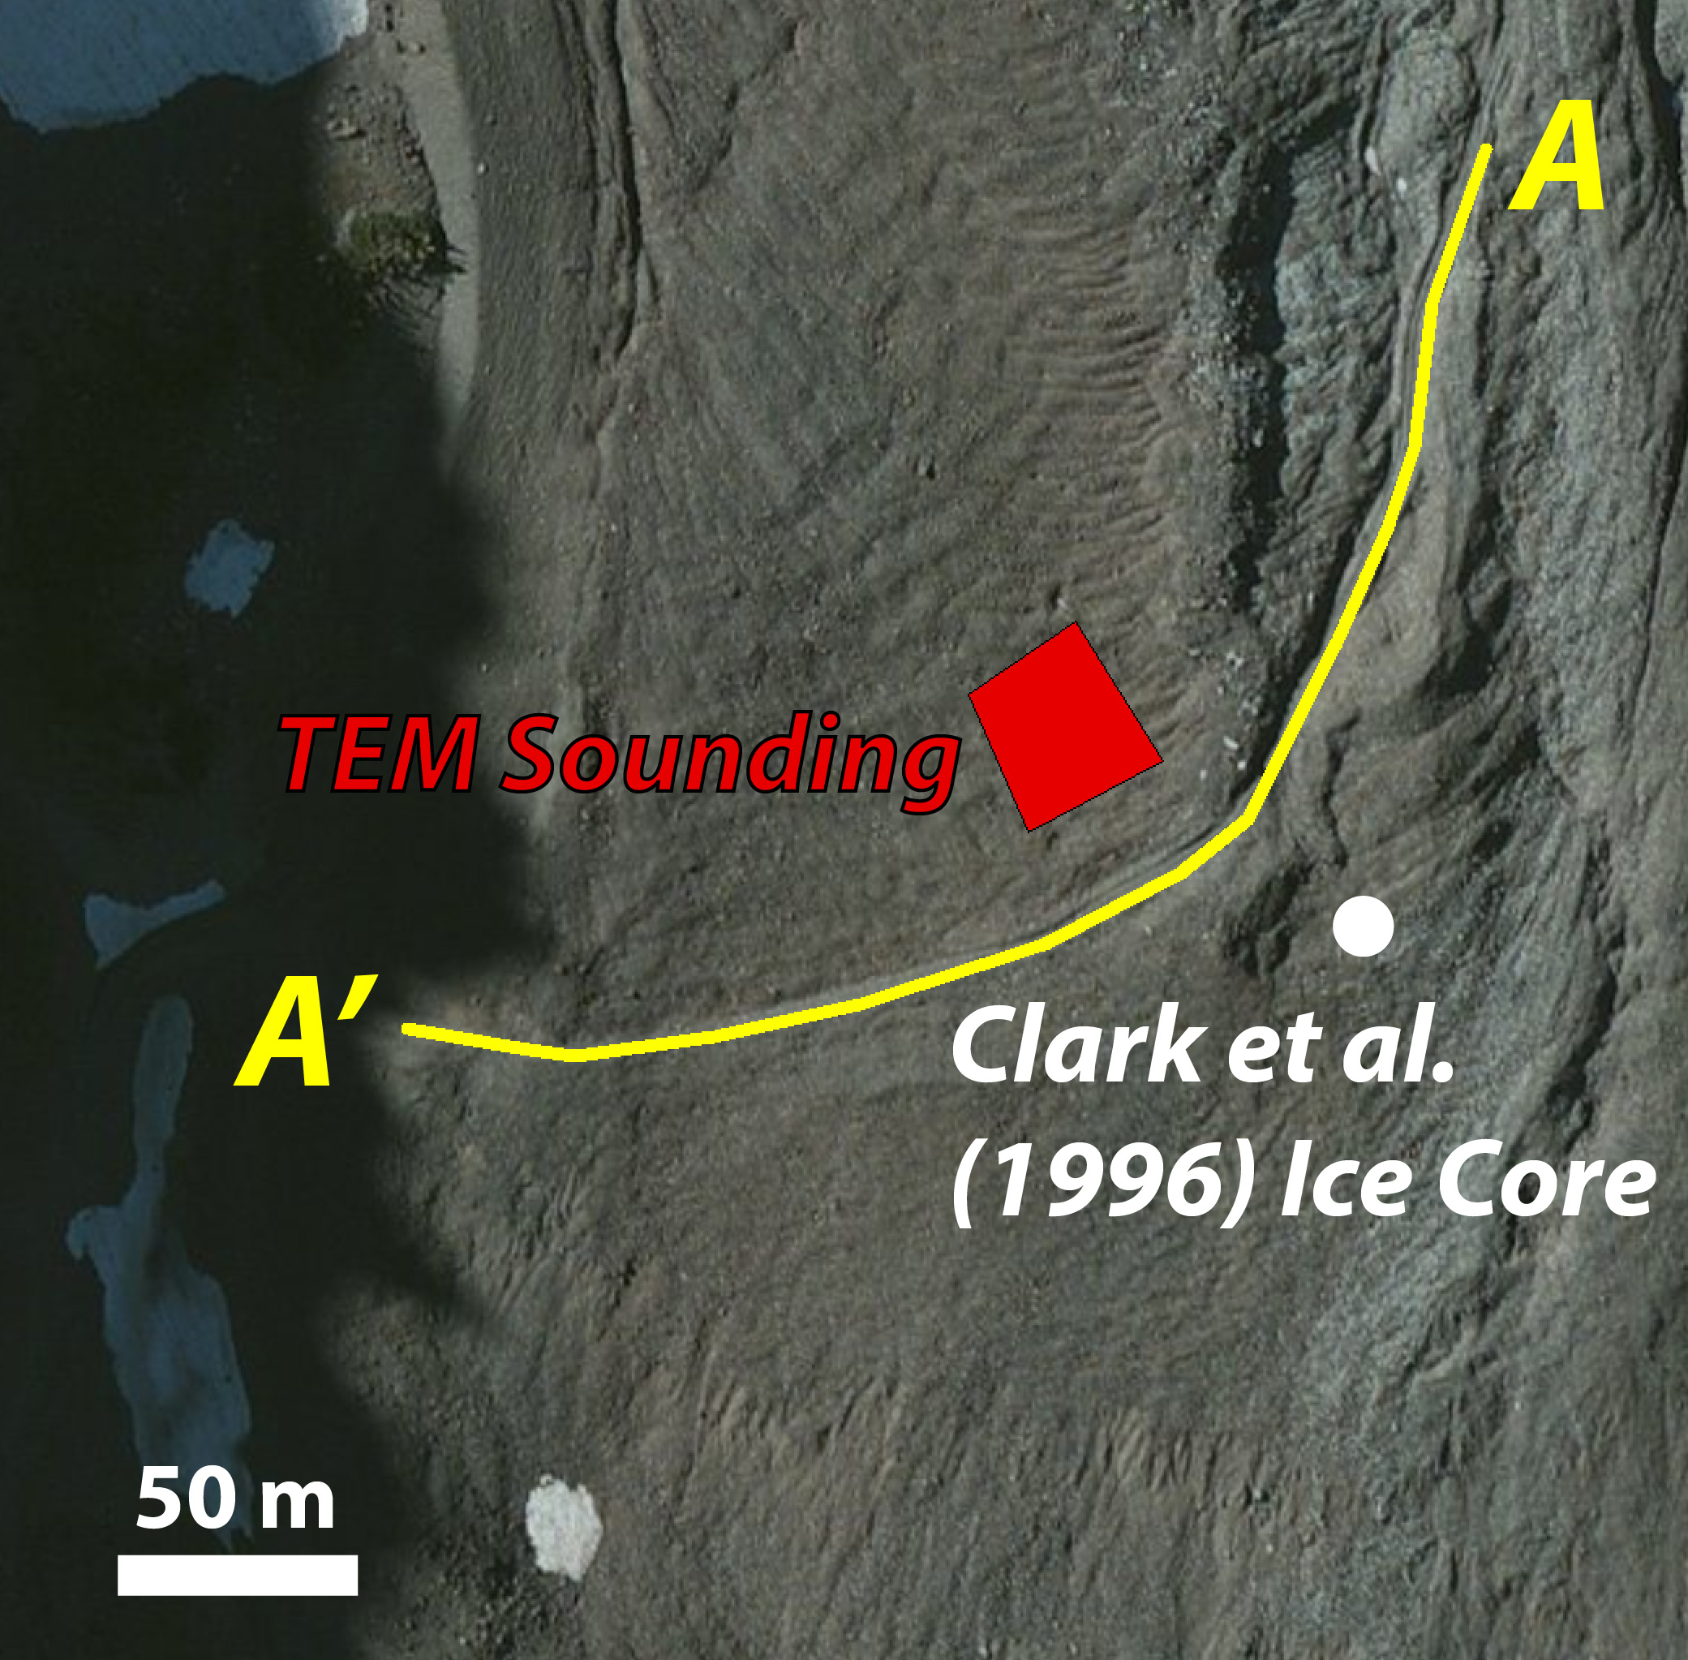
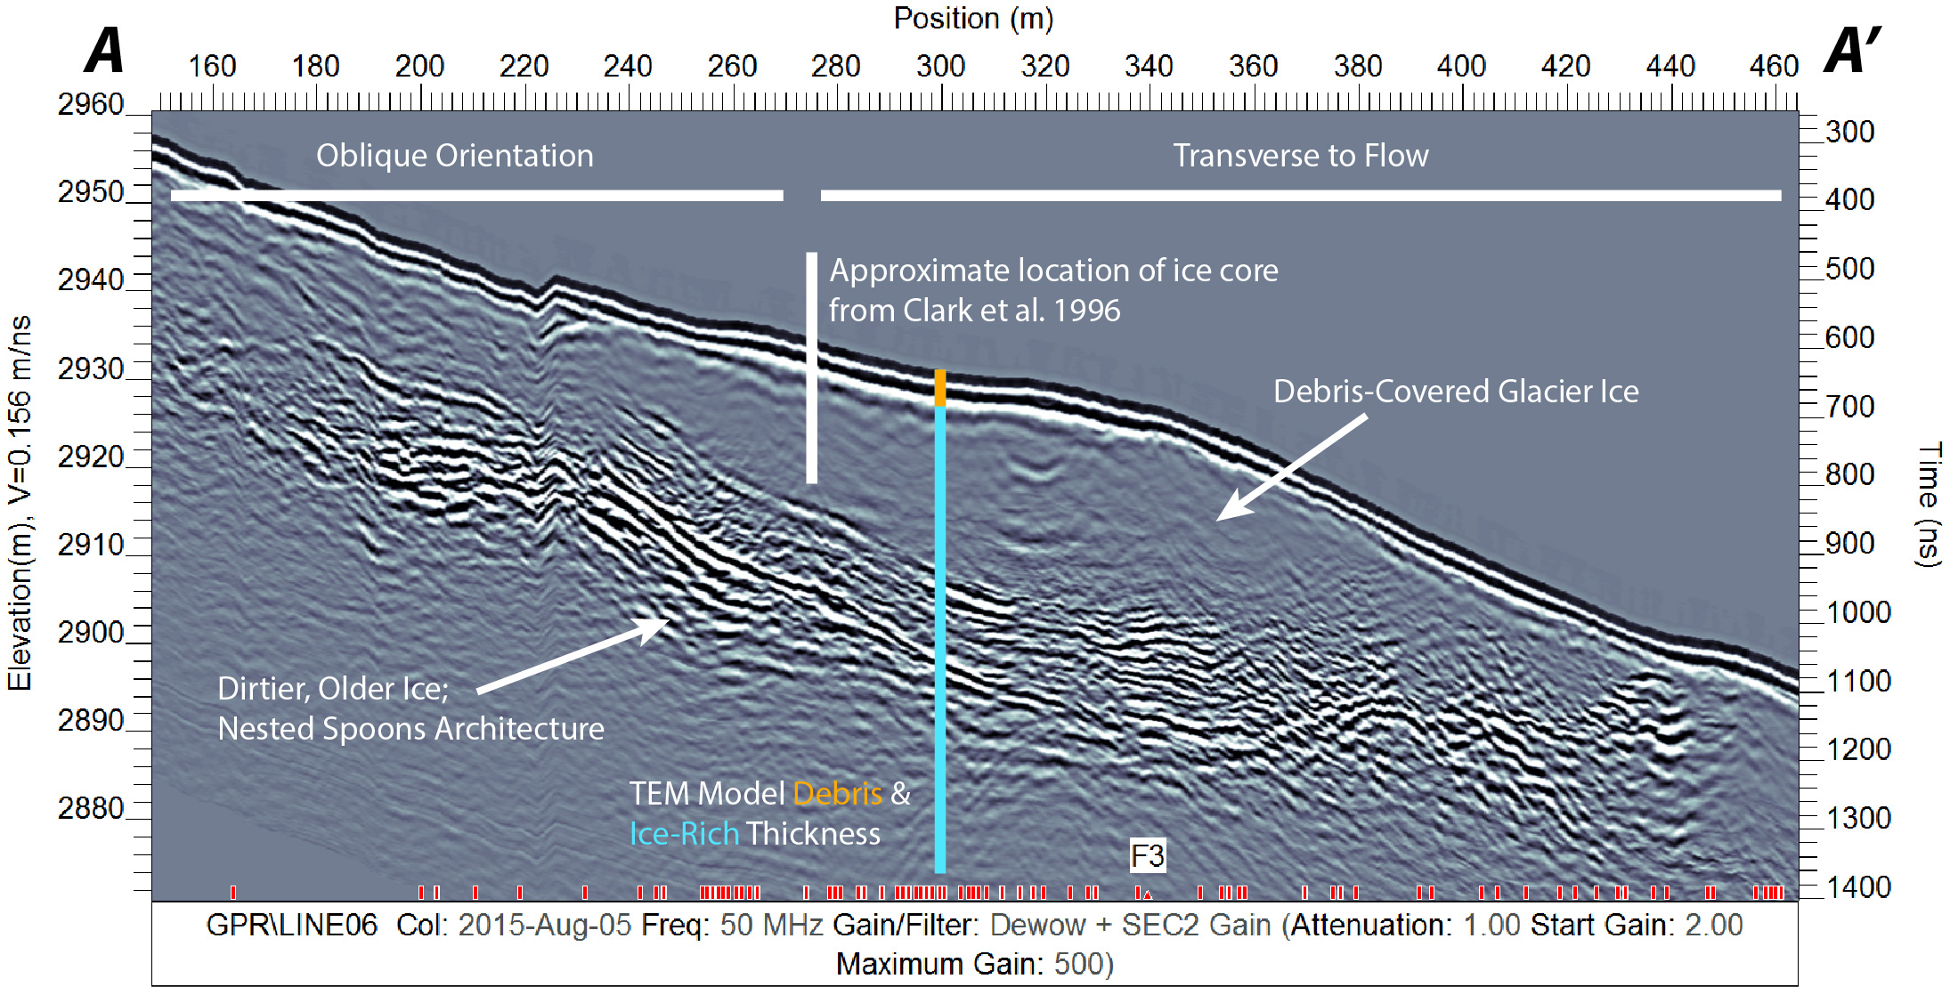
Results: Mid-Glacier
50 MHz GPR:
Clean ice up to 20 m thick
Deeper zone of higher scattering & series of spoon-shaped reflectors
TEM: ice thickness ~55m, surface debris ~1.5m thick

Slide 10
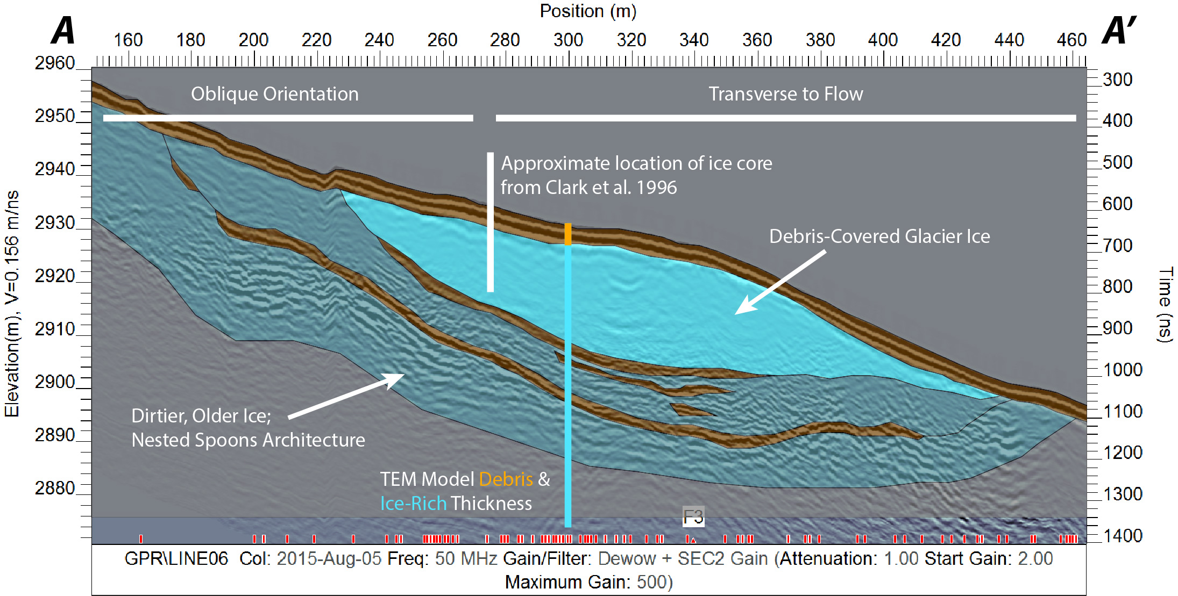
Results: Mid-Glacier
50 MHz GPR:
Clean ice up to 20 m thick
Deeper zone of higher scattering & series of spoon-shaped reflectors
TEM: ice thickness ~55m, surface debris ~1.5m thick

Slide 11
Results: Cirque

Slide 12
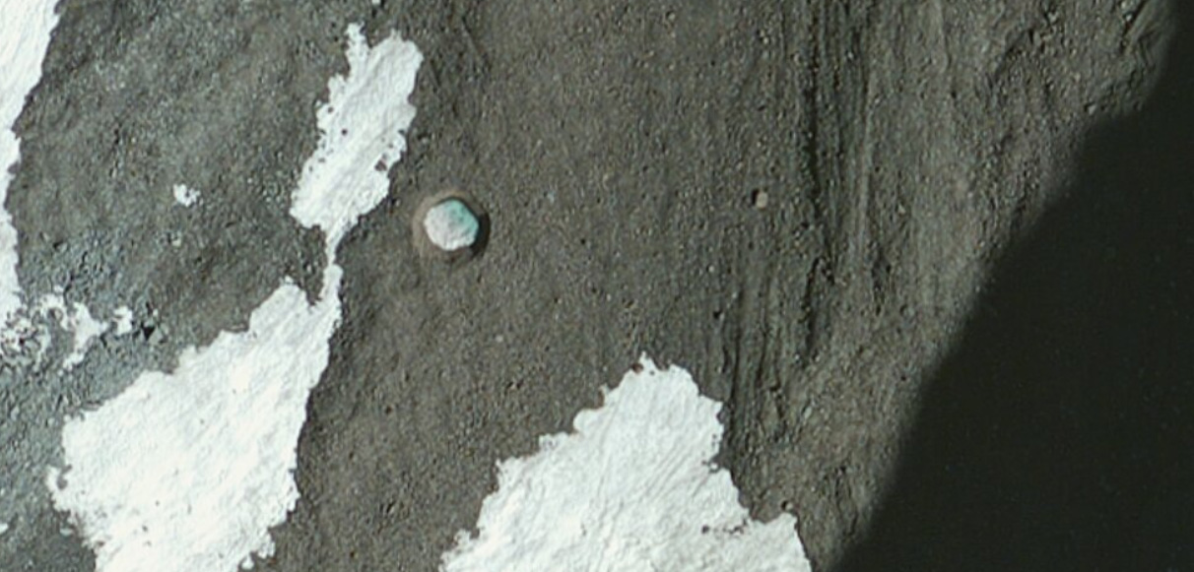
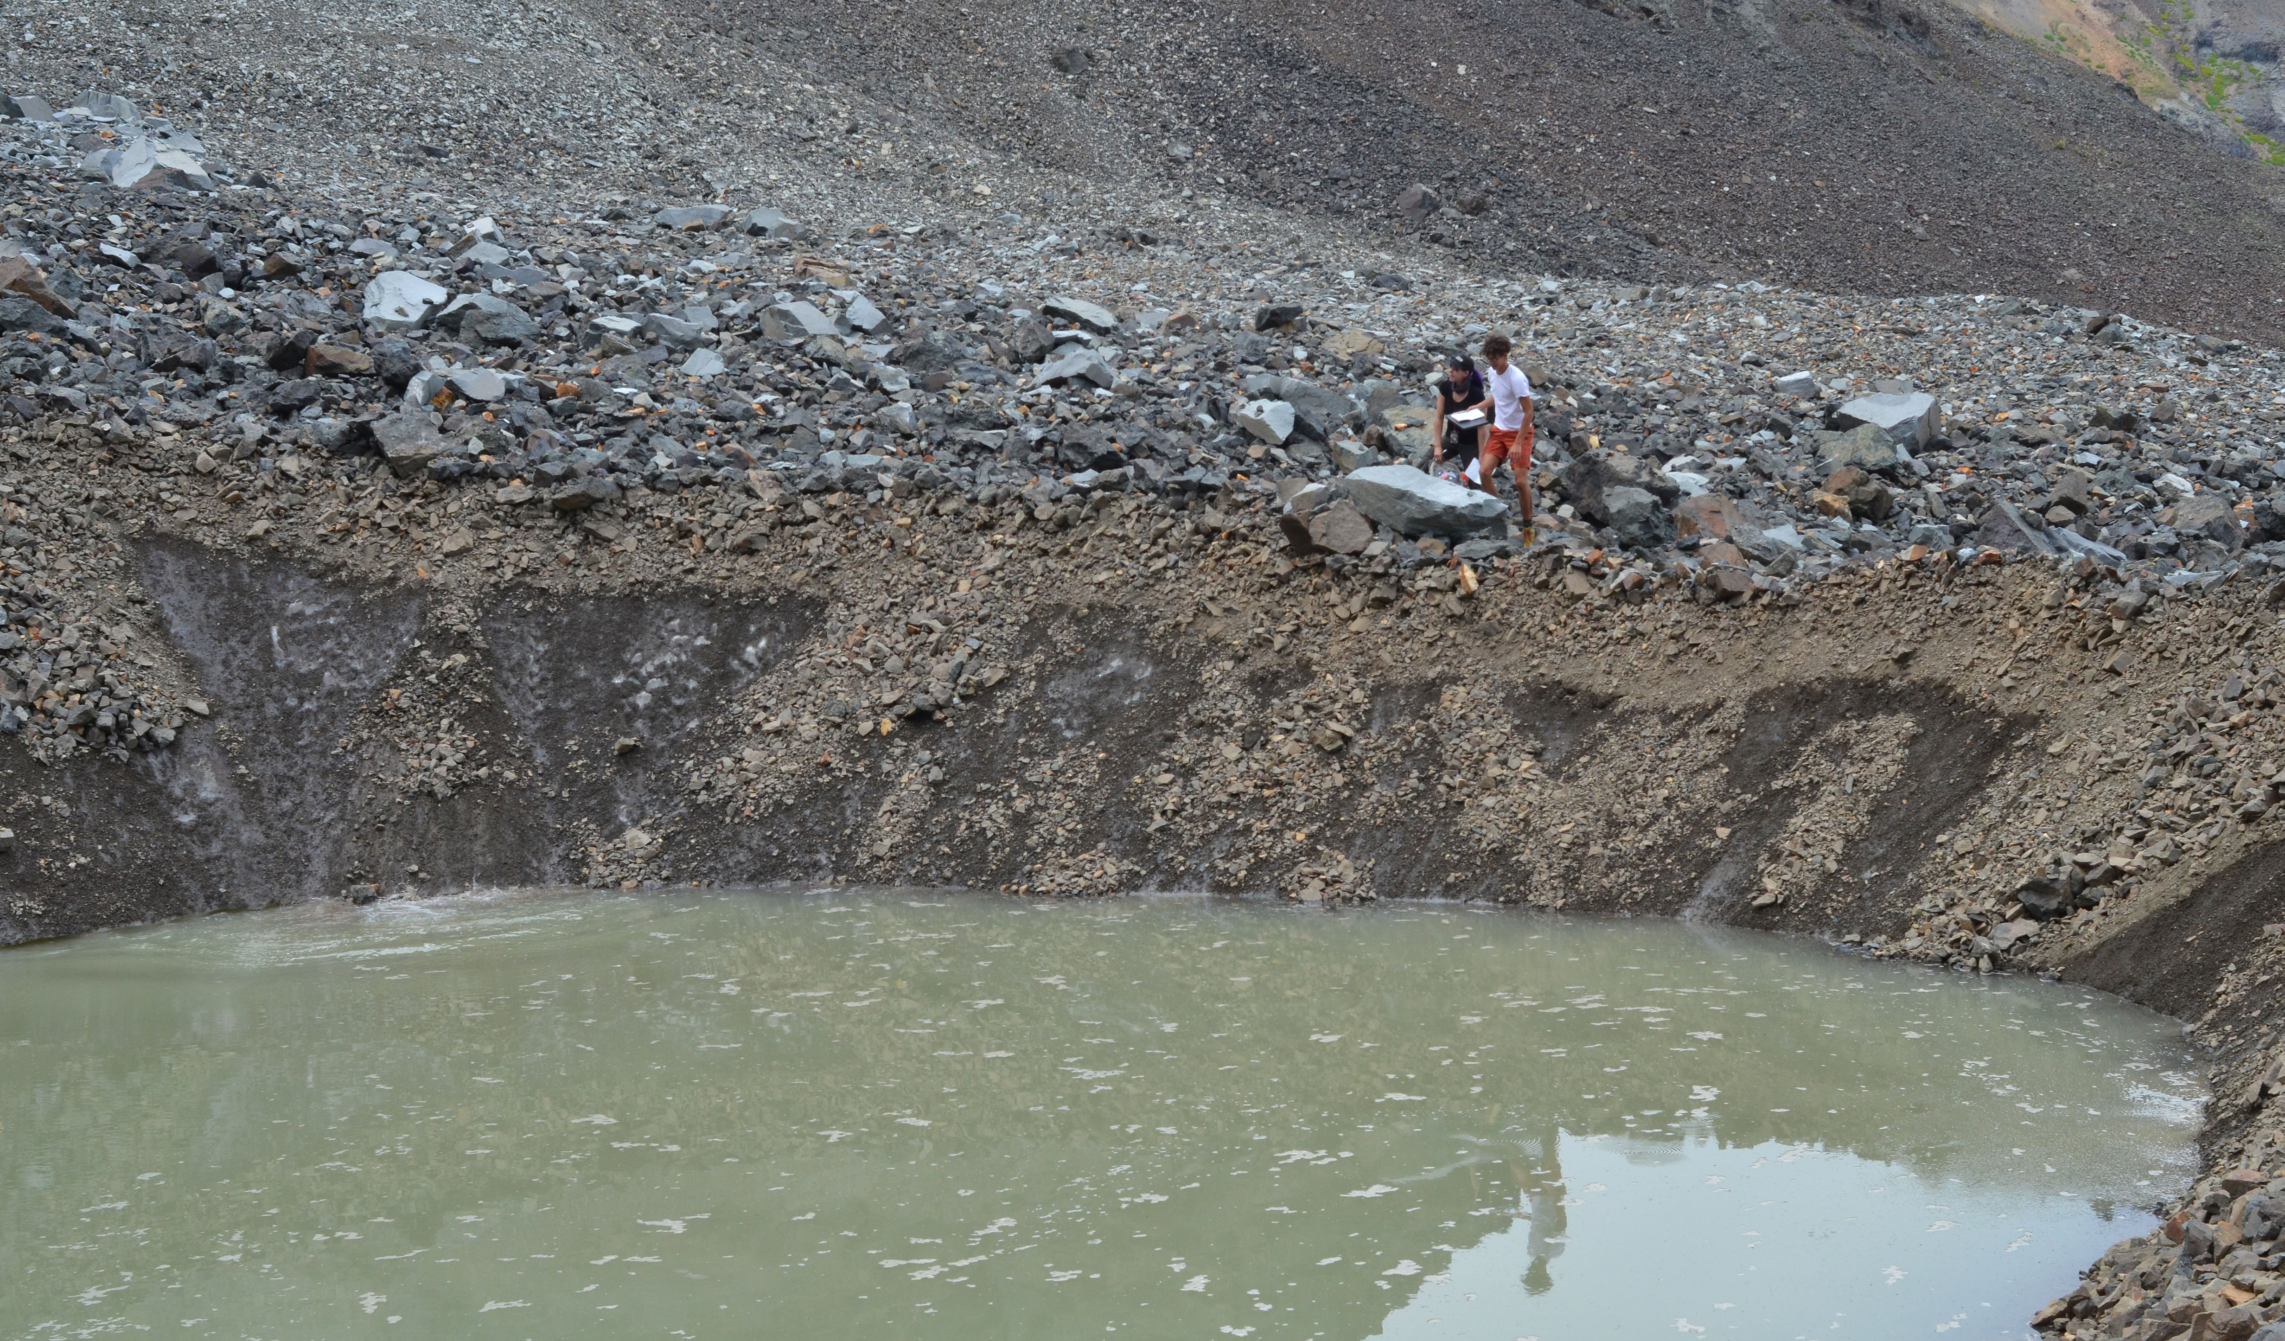
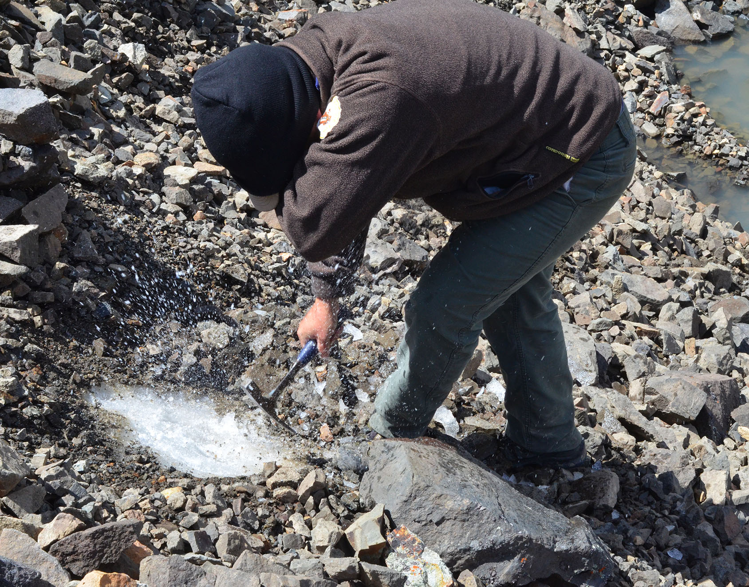
Cirque: Thermokarst Pond
• August 2015: ~40 m wide
• Surface debris layer ~1-1.5m thick
• Clean glacial ice underneath

Slide 13
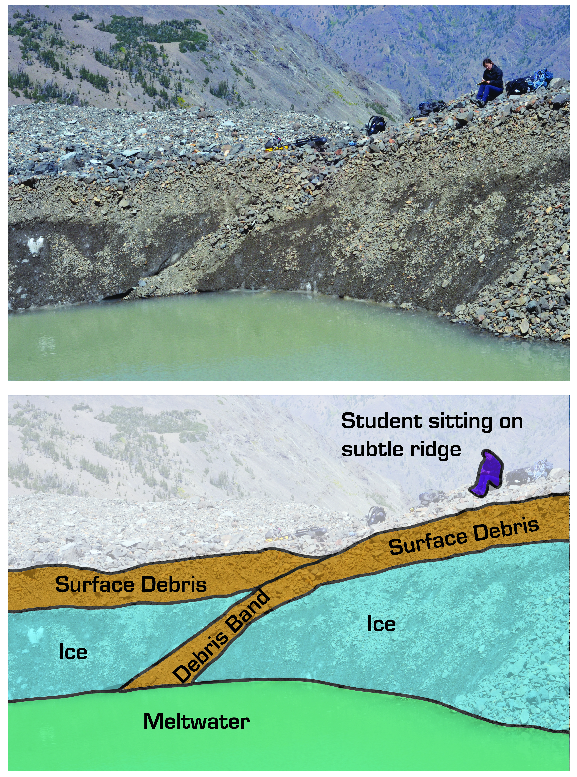
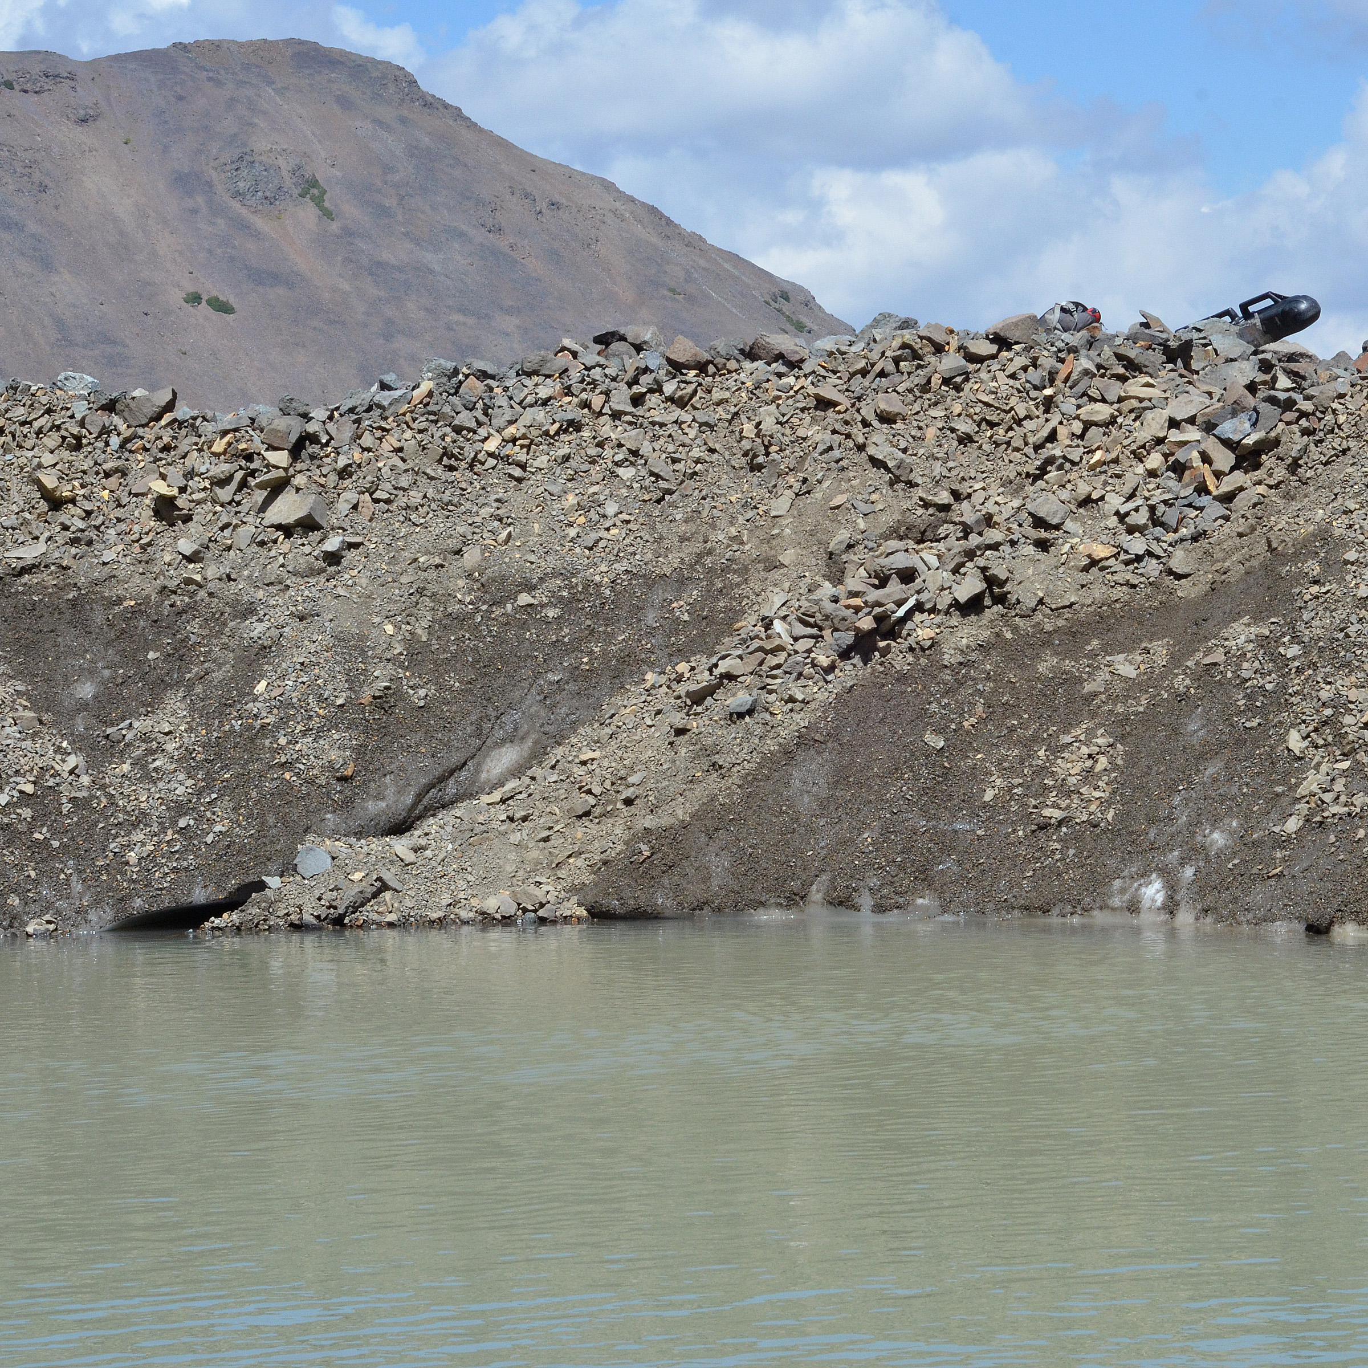
Englacial Debris Band
~0.5m thick
Relative up-glacier dip ~30⁰
Associated with surface ridge

Slide 14
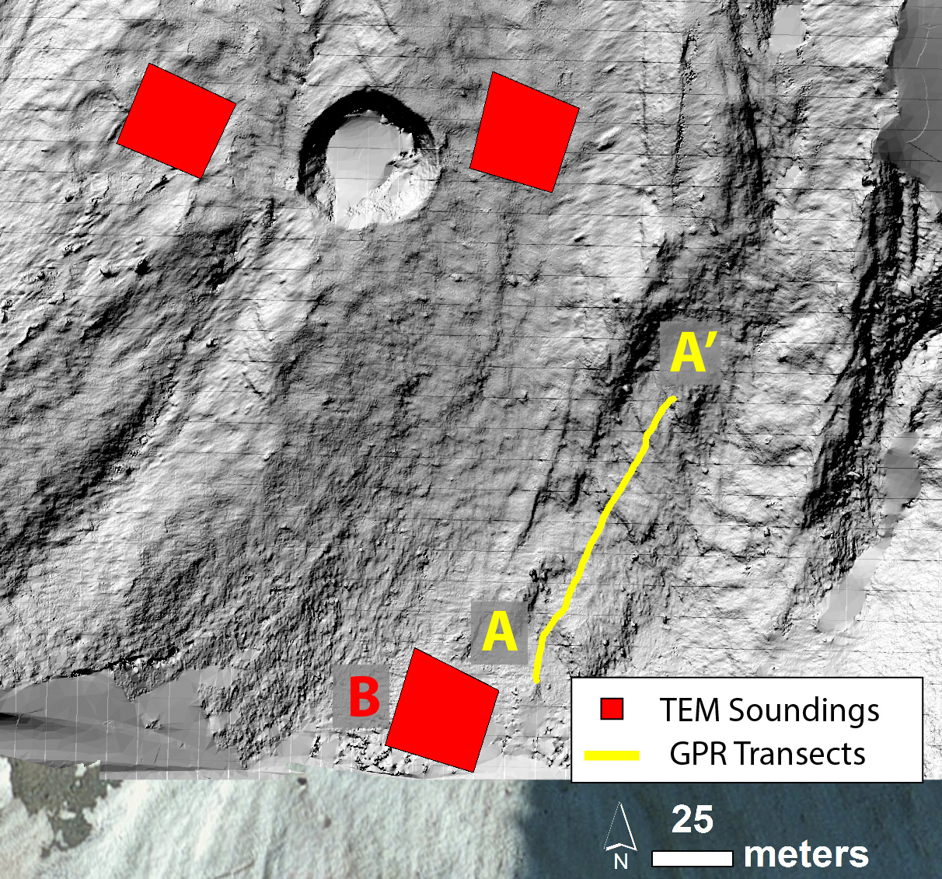
Results: DEM & 100 MHz GPR
Ridges well resolved in DEM produced of cirque area
Ridge definition is ambiguous at > 10s m horizontal scale
Surface ridge spacings range between 6 and 18 m.
Corresponds to flow timescales of ~15-40 yrs and ~40-120 yrs.
Strong, continuous reflectors intersect surface near ridges, at angles of ~25-35⁰
A
A’

Slide 15
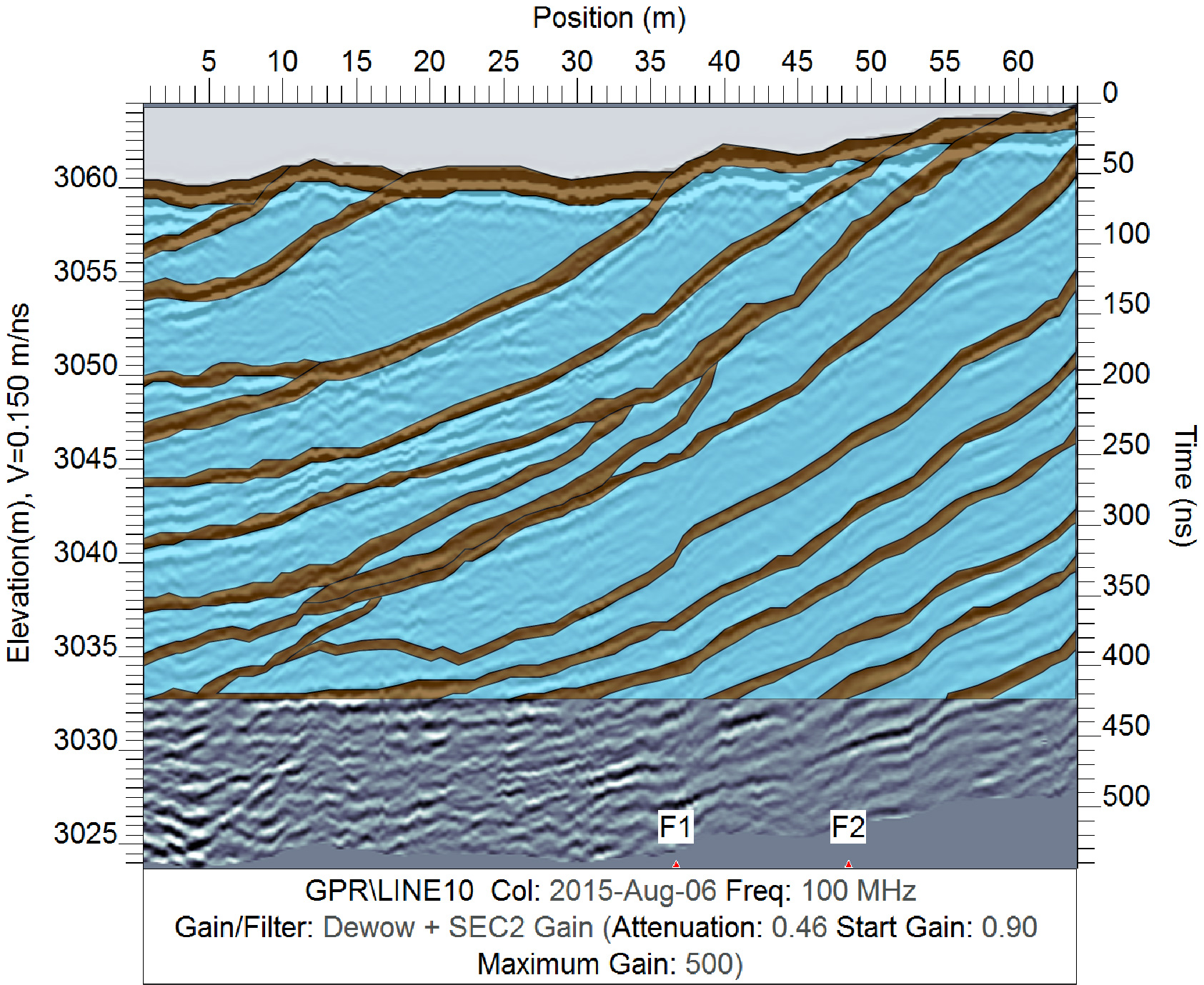
Results: DEM & 100 MHz GPR
Ice units can be as thick as ~8 m.
Some englacial debris bands and glacial units are entirely buried and do not intersect the surface.
A
A’

Slide 16
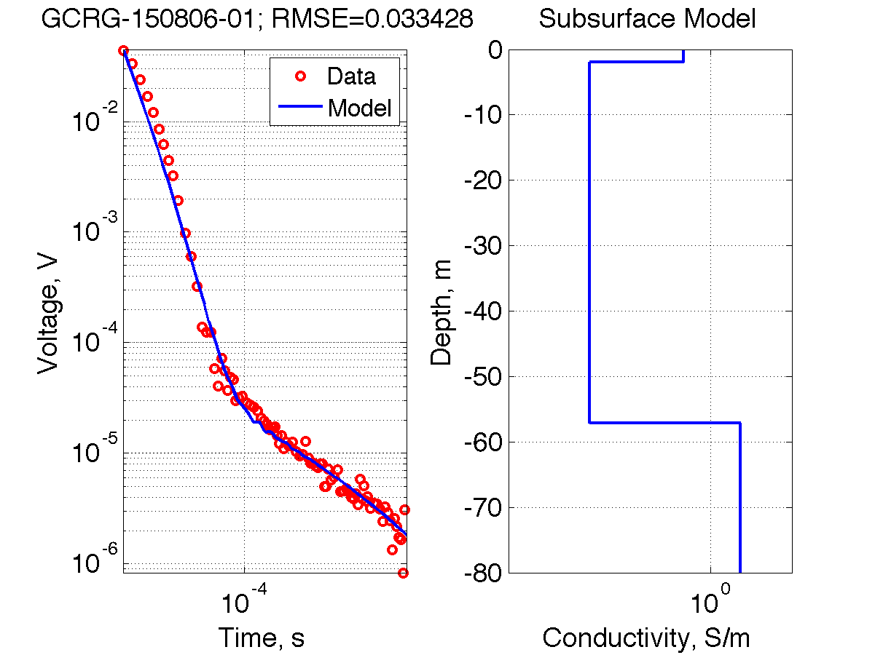
50 MHz GPR
Series of reflectors at ~35-55m depth may be base of ice?
A
A’
B: TEM Sounding, glacier ~57m thick

Slide 17
Summary & Discussion
Mid-glacier
Recent clean ice body observed over series of ancient dirty ice bodies.
High glacier in Cirque
Ground truth reveals englacial debris band
GPR images complex englacial debris band structure associated with surface ridges
Sub-centennial timescales and complex structure doesn’t seem consistent with model of MacKay et al. 2014.

Slide 18
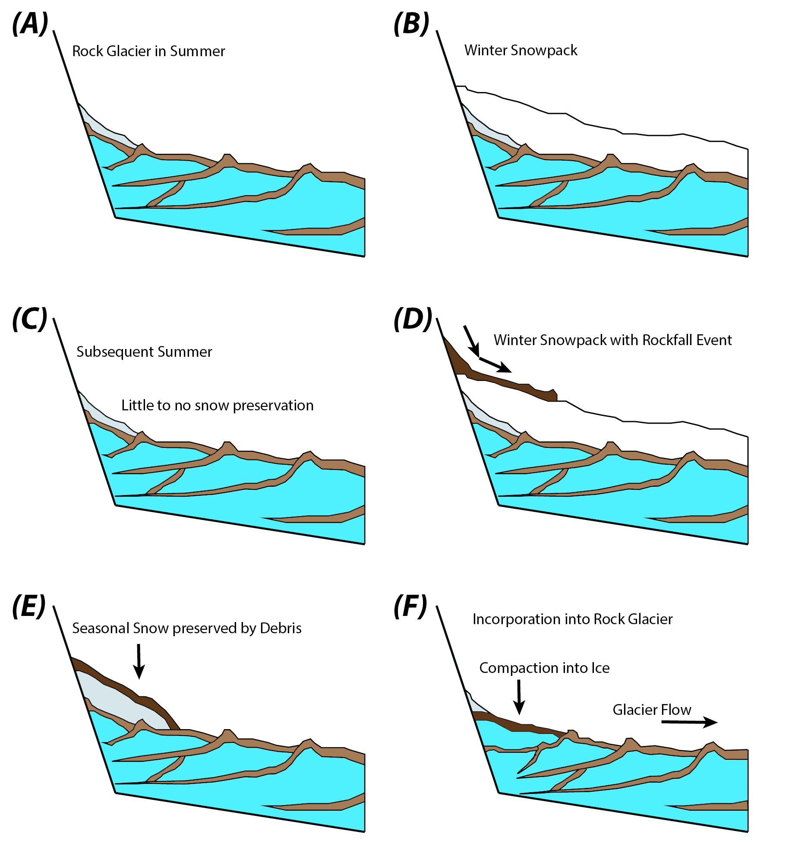
Debris-Facilitated Accumulation
Rockfall events preserve seasonal snow
Burial of up to ~15-20m of snowpack
Recurrence on multi-decadal timescale
Complex structure predicted.

Slide 19
Accumulation Models
Debris-Facilitated Accumulation (proposed for this study)
Cycles of Traditional Accumulation (MacKay et al. 2014)
Glacier units localized, with transverse overlap
Associated ridges are discontinuous
Glacier units contain < 10s years of accum.
Burial of previous units → complex structure
No climate record preserved.
Glacier units continuous across glacier
Associated ridges are continuous
Glacier units contain many years of accum.
Generally simple structure
Climate record preserved.

Slide 20
Conclusions
Mid-glacier internal structure shows evidence for an extended period of “traditional glacier” accumulation
High cirque internal structure seems consistent with Debris-Facilitated Accumulation
Additional tests are needed (transverse GPR, coring of glacier units).
→ Traditional glacier accumulation during high accum. periods; debris-facilitation during low accum. periods?
References
Potter, 1972, “Ice-Cored Rock Glacier, Galena Creek, Northern Absaroka Mountains, Wyoming,” GSA Bulletin 83(10),
3025-3058.
Clark et al., 1996, “Old ice in rock glaciers may provide long-term climate records,” EOS, Transactions AGU 77(23),
217-222.
Ackert, Jr., “A rock glacier/debris-covered glacier system at Galena Creek, Absaroka Mountains, Wyoming,” Geografiska Annaler: Series A, Physical Geography 80(3-4), 267-276.
Potter Jr. et al., 1998, “Galena Creek rock glacier revisited—New observations on an old controversy,” Geografiska Annaler: Series A, Physical Geography 80(3-4), 251-265.
MacKay et al., 2014, “Cold-based debris-covered glaciers: Evaluating their potential as climate archives through studies of ground-penetrating radar and surface morphology,” JGR: Earth Surface 119(11), 2505-2540.

Slide 21
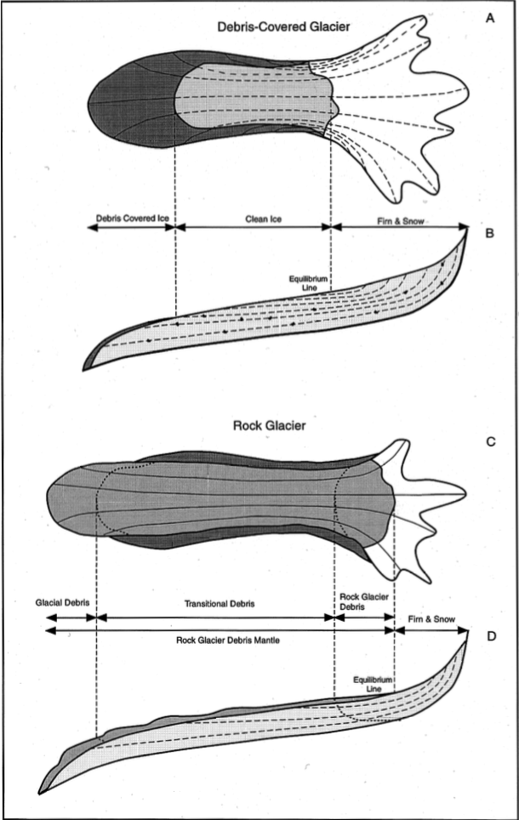
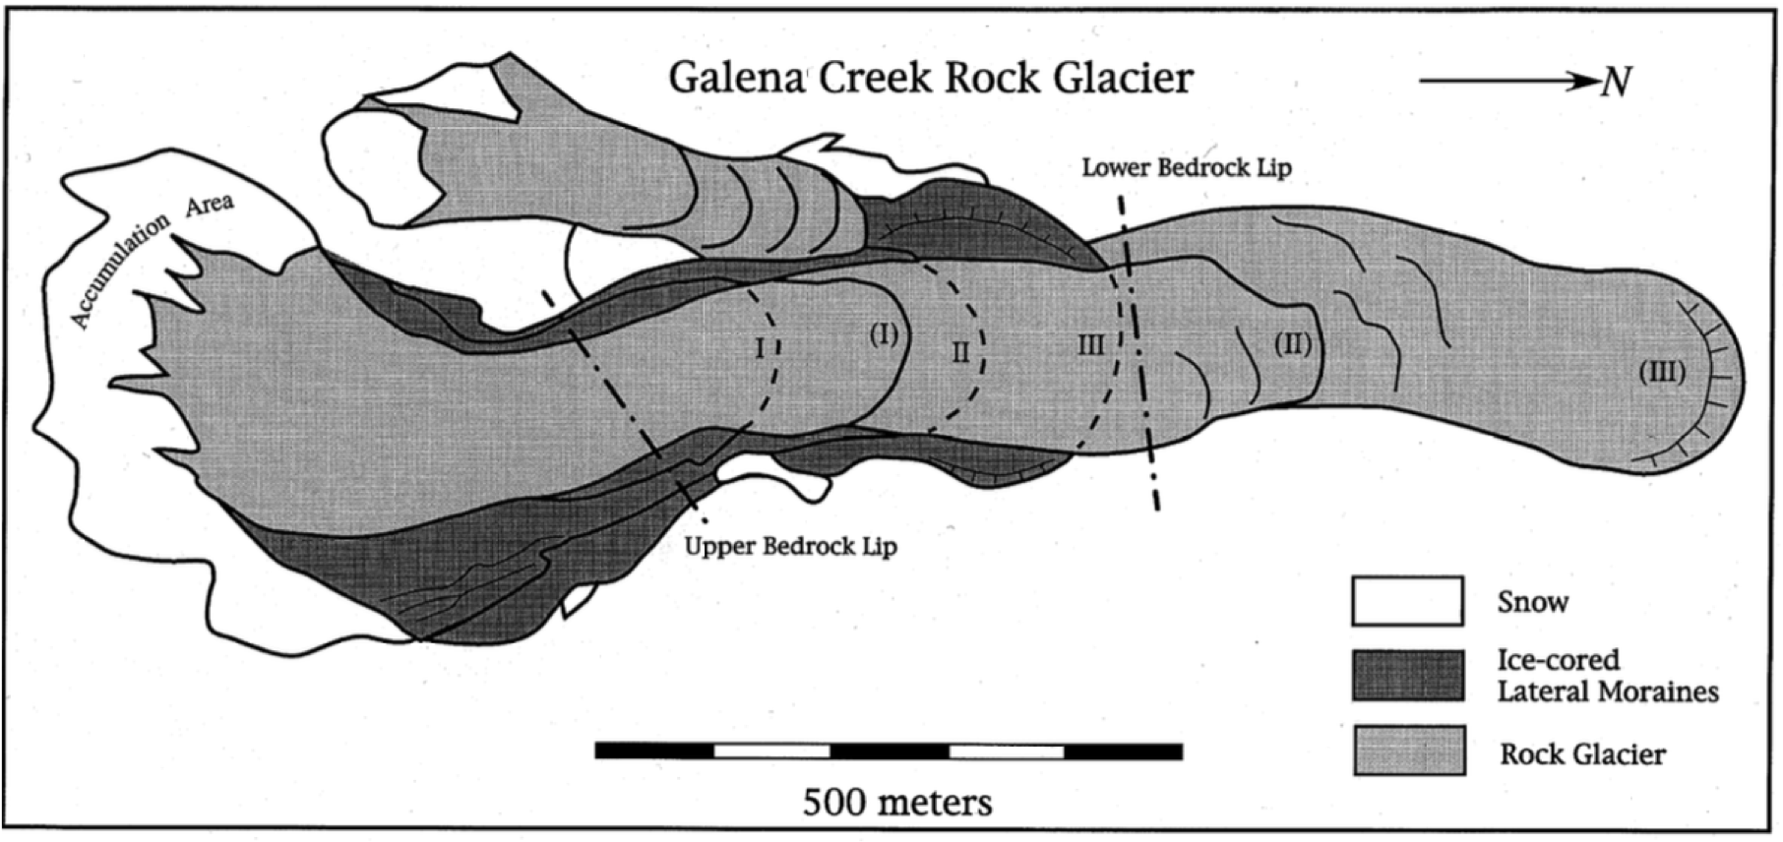
Background: Alternating Modes
High accumulation mode
Bare clean ice
Low accumulation mode
Full, insulating debris cover
Continued advance
Ackert Jr. (1998)

Slide 22
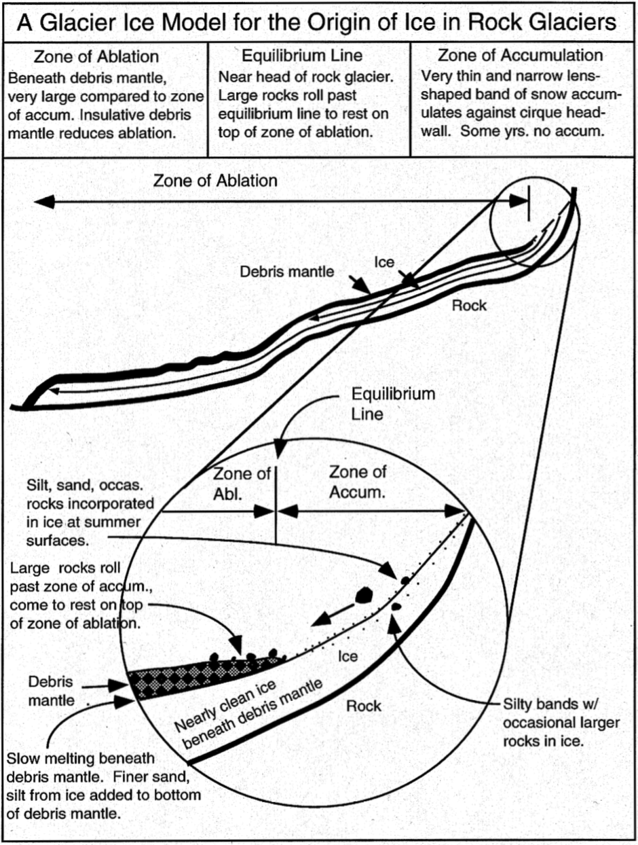
Background: Potter (1972) Accumulation Model
Steady State: accumulate 4-7 cm ice or 15-25 cm snow / yr.
Perennial snow = small accum. zone
Rockfall runs past accum. zone, resting on glacier ice
No endemic internal structure
Inconsistent with Clark (1996)’s attempt at coring?

Slide 23
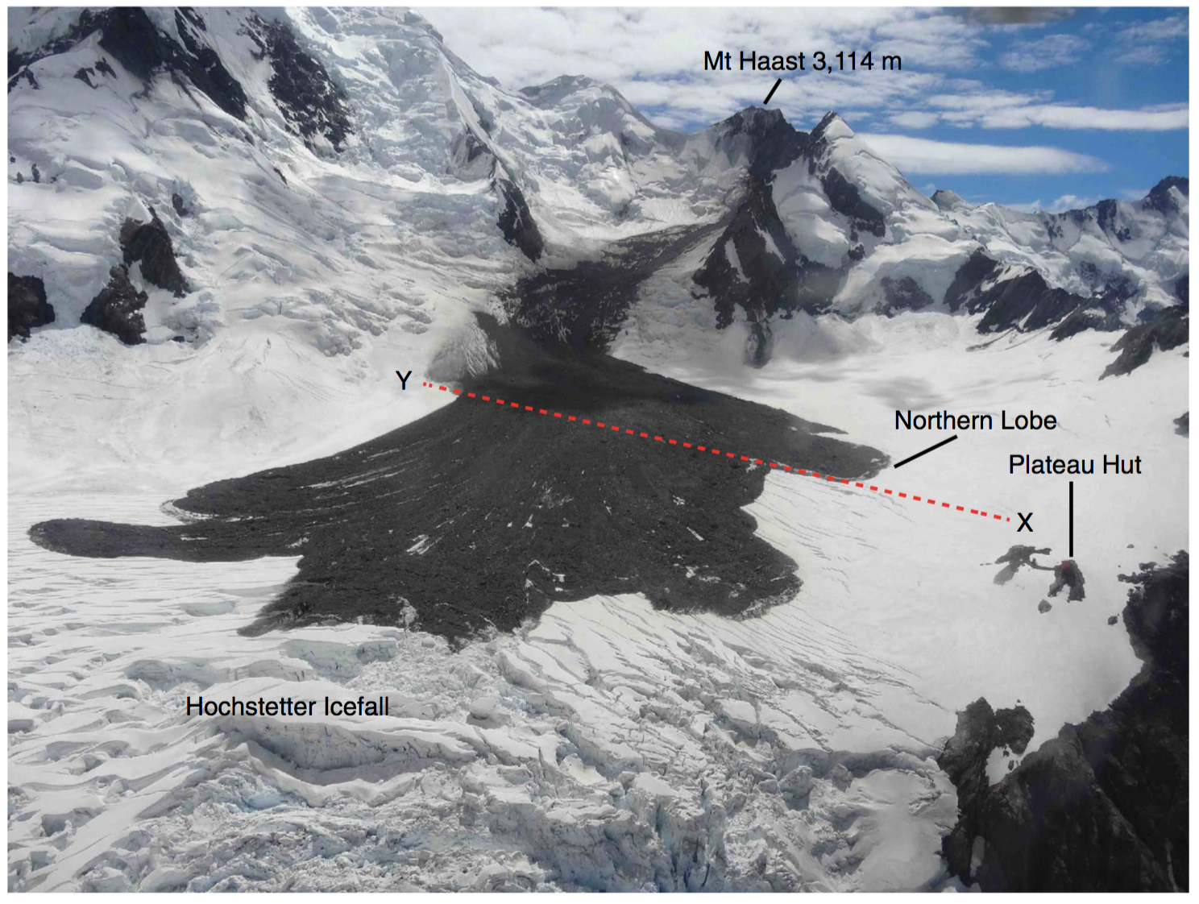
Debris Avalanche on Clean Glacier
Dunning et al., 2015, “Rapid sequestration of rock avalanche deposits within glaciers,” Nature Communications 6:7964.
Broadly consistent thickness of 1-2m

Slide 24
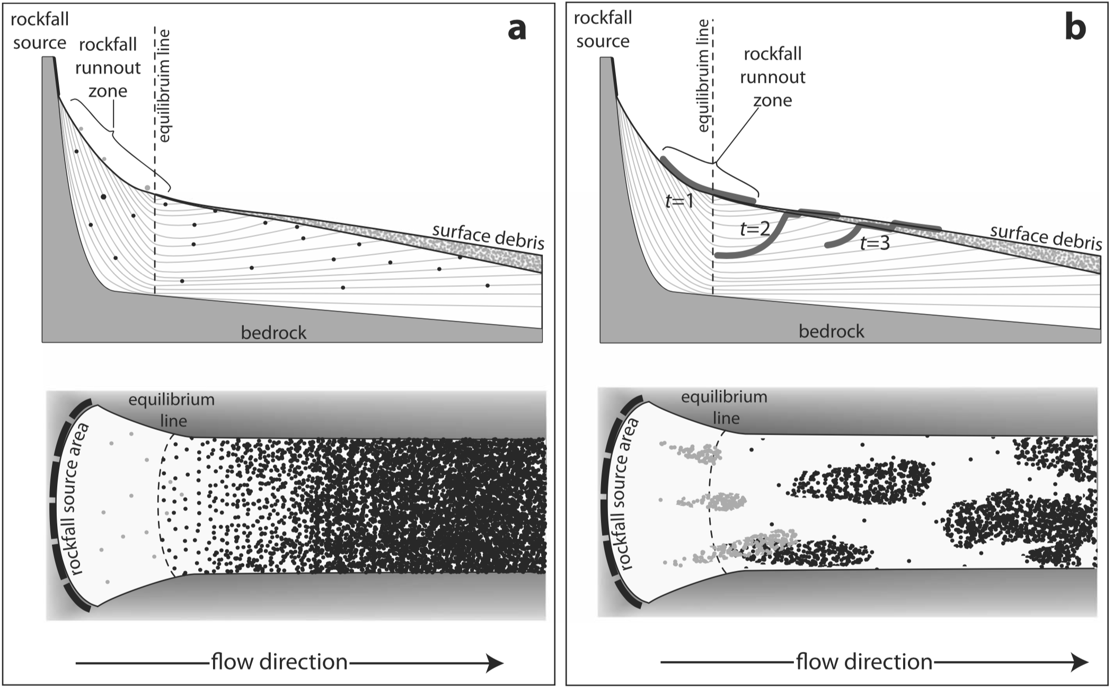
Debris Fall Character

