Slide 1
A High Order Element Based Method for the Simulation of Velocity Damping in the Hyporheic Zone of a High Mountain River
1. The Problem
2. Numerical Approach
3. Data Gathering and Analysis
4. Results and Discussion
5. Conclusions
6. For the Future
Antonio Preziosi-Ribero¹, Jorge Peñaloza-Giraldo² , Jorge Escobar-Vargas² , Leonardo Donado-Garzón¹
Universidad Nacional de Colombia, Sede Bogotá, Facultad de Ingeniería, Grupo de Investigación de Ingeniería de los Recursos Hidráulicos.
Facultad de Ingeniería, Pontificia Universidad Javeriana, Bogotá Colombia.

Slide 2
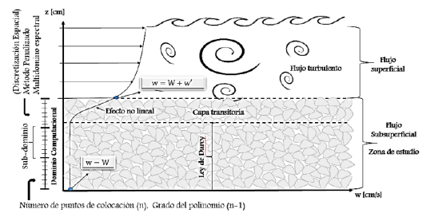
1. THE PROBLEM
How does water slow down when leaving a river and entering the porous media?
How long does it take to the velocity to reach a constant value?
How thick is the transition layer where velocity damps?
Can we use a simplification of the Navier-Stokes equations?
Conceptual model of velocity damping ¹
$$\frac{∂w}{∂t}+w\frac{∂w}{∂z}=−\frac{1}{ρ}\frac{∂P}{∂z}+θ\frac{∂^{2}w}{∂z^{2}}+g$$
1D Navier-Stokes Equation
HOME
J. A. Peñaloza Giraldo et al., Procedia Environmental Sciences, 25 (2015), 206-213

Slide 3
2. NUMERICAL APPROACH
1D Model using velocity in the vertical axis (z)
Use of Burgers Equation
Spectral Multi-Domain Penalty Method (SMPM)
Special mesh structuring in order to capture the top zone more accurately (1 m domain)
Total time of simulation is two seconds (2 s)
$$\frac{∂w}{∂t}+w\frac{∂w}{∂z}=−\frac{1}{ρ}\frac{∂P}{∂z}+θ\frac{∂^{2}w}{∂z^{2}}+g$$
$$\frac{∂w}{∂t}+w\frac{∂w}{∂z}=−\frac{1}{ρ}\left(ρg\right)+ θ\frac{∂^{2}w}{∂z^{2}}+g$$
$$\frac{∂w}{∂t}+w\frac{∂w}{∂z}=θ\frac{∂^{2}w}{∂z^{2}}$$
HOME

Slide 4
2.1. NUMERICAL METHOD
$$\frac{∂w}{∂t}+\underset{N(w)}{\underbrace{\frac{1}{2}\left[w∙\frac{∂w}{∂z}+w\left(w∙w\right)\right]}}=\underset{L(w)}{\underbrace{θ\frac{∂^{2}w}{∂z^{2}}}}$$
$$\frac{\hat{w}−\sum_{q=0}^{J_{i}−1}{α_{q}w^{n−q}}}{∆t}=\sum_{q=0}^{J_{e}−1}{β_{q}N(w^{n−q})}$$
$$\frac{γ_{0}w^{n−1}−\hat{w}}{∆t}=θ\frac{∂^{2}w}{∂t^{2}}{\left.​\right|}^{n+1}$$
N(w): Solved using a third order Adams - Bashforth explicit scheme
L(w): Solved using GMRES solver due to the non symmetrical matrix structure
HOME

Slide 5
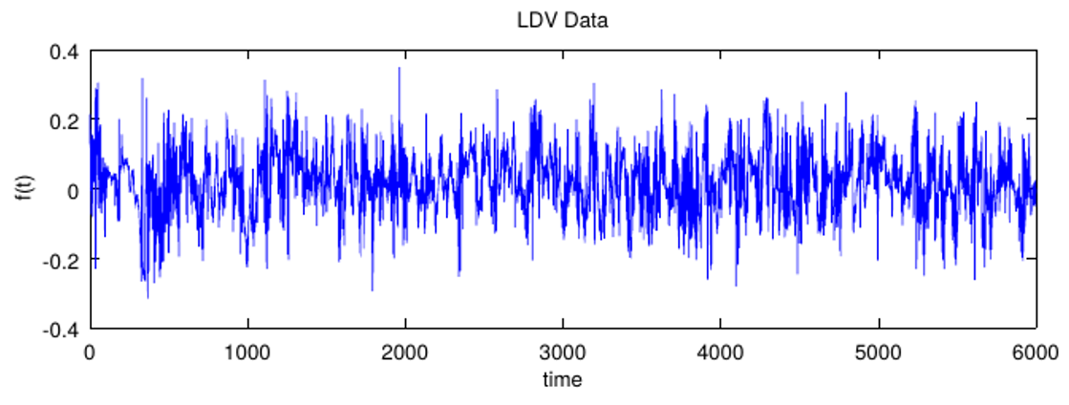
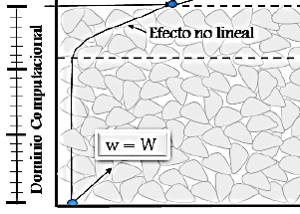
2.1. NUMERICAL METHOD
Top Boundary:
Measured Velocities
Initial Condition:
Mean velocity of measured velocity
Bottom Boundary:
Neumann Condition
Model Boundary Conditions ¹
$$\frac{∂w}{∂z}=0$$
HOME
J. A. Peñaloza Giraldo et al., Procedia Environmental Sciences, 25 (2015), 206-213
J. A. Peñaloza Giraldo et al., Procedia Environmental Sciences, 25 (2015), 206-213

Slide 6
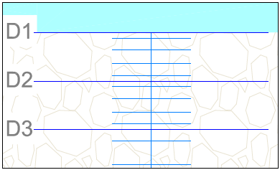
2.2. Mesh Structure
Total Domain 1 m
Subdomains 6
Points per subdomain 6
Total Points in Mesh 36
Smaller gap 3,6 mm
HOME

Slide 7
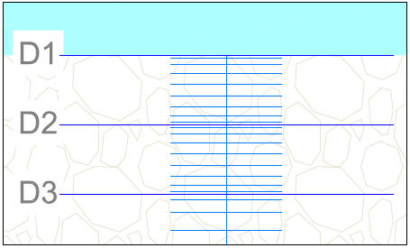
2.2. Mesh Structure
Total Domain 1 m
Subdomains 6
Points per subdomain 10
Total Points in Mesh 60
Smaller gap 1,26 mm
HOME

Slide 8
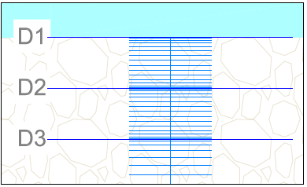
2.2. Mesh Structure
Total Domain 1 m
Subdomains 6
Points per subdomain 16
Total Points in Mesh 96
Smaller gap 0,47 mm
HOME

Slide 9
2.3. Apparent Viscosity
$$θ=\frac{φ}{K}\frac{gd^{2}}{32}$$
$d=$ Grain size
$d_{s}=$ Sediment Diameter
$φ=$ Mean Porosity
$K=$ Hydraulic Condictivity
$g=$ Gravity constant
$θ_{0}=$ Cinematic Viscosity of water
$$K= \frac{\left(5.6×{10}^{−3}\right)φ^{3}d_{s}^{2}}{{\left(1−φ\right)}^{2}}\frac{g}{θ_{0}}$$
$$θ=\left(\frac{θ_{0}}{32}\right)\left(\frac{1}{5.6×{10}^{−3}}\right){\left(\frac{d}{d_{s}}\right)}^{2}$$
HOME

Slide 10
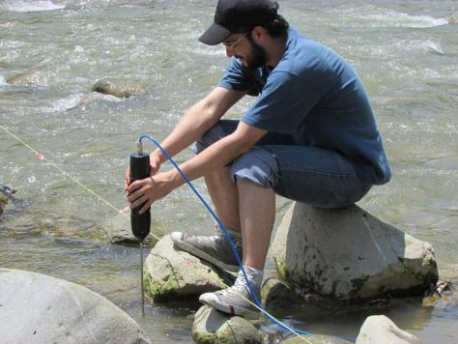
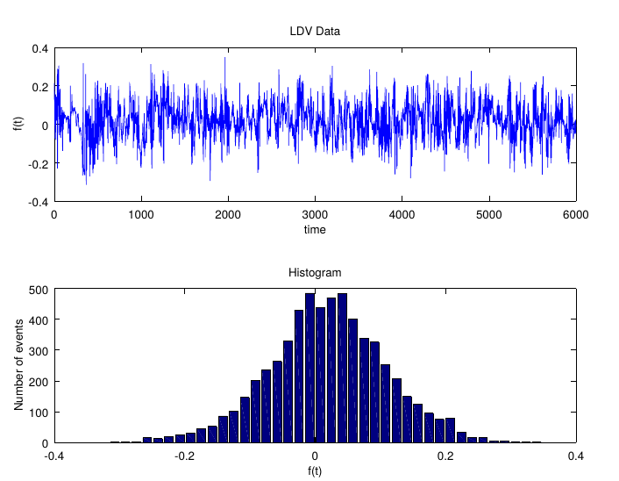
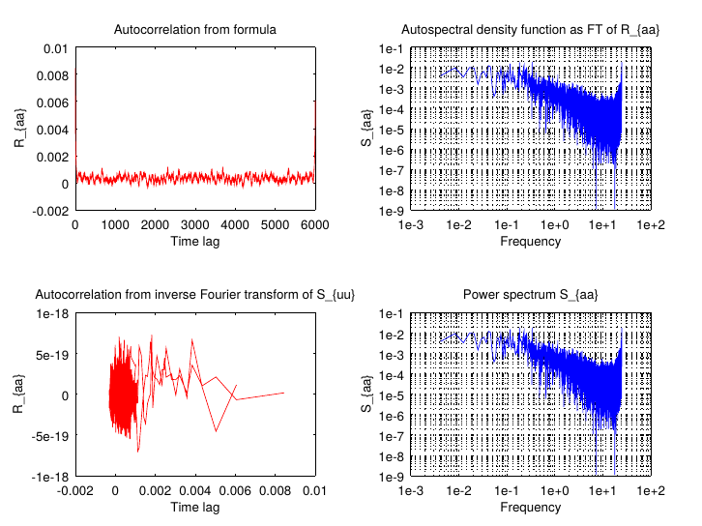
3. DATA GATHERING AND ANALYSIS
HOME

Slide 11
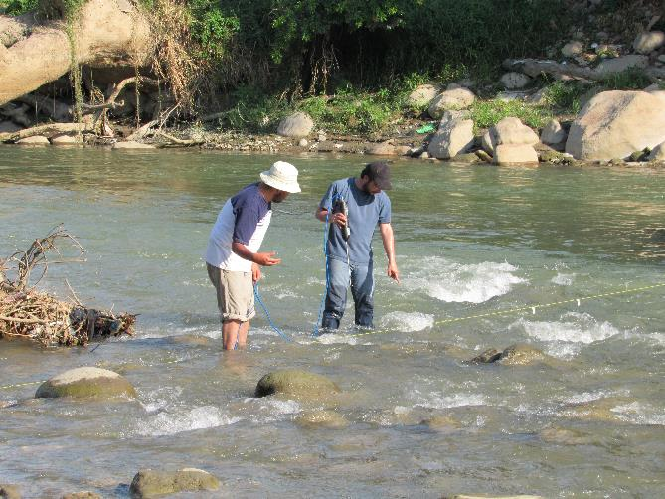
3. DATA GATHERING AND ANALYSIS
HOME

Slide 12
4. RESULTS AND DISCUSSION
36 point mesh – Δt = 0.005 s
60 point mesh Δt = 0.0005 s
96 point mesh Δt = 0.00005 s
MESH REFINEMENT COMPARISON
HOME

Slide 13
4. RESULTS AND DISCUSSION
FILTER = 6.0
FILTER = 7.0
FILTER = 8.0
SPECTRAL FILTER COMPARISON
HOME

Slide 14
4. RESULTS AND DISCUSSION
nu = 0.010
nu = 0.015
nu = 0.020
APPARENT VISCOSITY COMPARISON
HOME

Slide 15
4. RESULTS AND DISCUSSION
Velocity decay is high in the top of the domain and it reaches a constant value
There is no velocity accumulation inside the domain
When viscosity is higher the zone where velocity decays is thinner
The used filter values are aceptable, since the results are similar between them
The model discretization allows capturing the velocity damping in the critical zone of the phenomena
The velocity in the bottom of the domain is similar to velocities in porous media
HOME

Slide 16
5. CONCLUSIONS
Velocity damps in an exponential form while moving to the bottom
Velocity reaches a constant value between 15 and 20 cm below the top boundary
Velocity does not accumulate, thus there is no velocity increase in the porous media
The Burgers Equation used represents the velocity damping phenomena
The SMPM is suitable to solve high non linear equations like the Burgers Equation
The mesh refinement used captures the velocity damping with high precision where it is needed
HOME

Slide 17
6. FOR THE FUTURE
Improve mesh refinement since the subdomain size decreases exponentially after 6 subdomains
Use real data from river beds in order to obtain more realistic $θ$
Measure velocities in different water level conditions to explore the size of the velocity damping zone
Compare results with different numerical methods like finite elements or finite differences
Include water chemistry tests to check for GW-SW interactions
Extend our study to deeper rivers and other wáter bodies
HOME

