Slide 1
Surveying perceptions of landslide risk management in Norway
Jessica Ka Yi Chiu & Unni Eidsvig, Norwegian Geotechnical Institute (NGI)
Opinions and perceptions can provide insights on areas for improvement in landslide risk management strategies.
The Risk Management Index (RMI), proposed by Cardona et al. (2004), is a well-established method to measure perceptions of disaster management of selected actors holistically. The RMI is measured based on opinion questionnaires to technical staff, decision-makers, and stakeholders involved in all stages of risk reduction strategies.
The RMI method
List of indicators
The survey
Target participants
Survey results
2050 evaluations
General comments
Insights on communication of the topic
about

Slide 2
Surveying perceptions of landslide risk management in Norway
Jessica Ka Yi Chiu & Unni Eidsvig, Norwegian Geotechnical Institute (NGI)
The RMI method was modified to be implemented in landslide hazards and to fit with Norwegian conditions.
An opinion survey was conducted in 2015 to measure perceptions of landslide risk management in Norway. Perceptions were surveyed for two time periods: 2015 and 2050, and three administrative levels: national, county, and municipality.
The RMI method
List of indicators
The survey
Target participants
Survey results
2050 evaluations
General comments
Insights on communication of the topic
about

Slide 3
Surveying perceptions of landslide risk management in Norway
Jessica Ka Yi Chiu & Unni Eidsvig, Norwegian Geotechnical Institute (NGI)
The RMI method
The Risk Managemet Index (RMI) is a system of four 'composite indicators' (hereinafter ‘policy indices’), each of which represents a public policy and comprises of several component indicators.
The RMI method
RMI
List of indicators
The survey
RMI
RMI
RMI
RI
RMI
DM
FP
Policy index
Target participants
RR
Governance &
R
isk
R
D
isaster
isk
R
eduction
F
I
inancial
dentification
M
anagement
P
Survey results
rotection
2050 evaluations
RI1
RI2
RI3
RR1
RR2
RR3
DM1
DM2
DM3
FP1
FP2
FP3
Component indicator
General comments
RI4
RI5
RI6
RR4
RR5
RR6
DM4
DM5
Insights on communication
of the topic

Slide 4
Surveying perceptions of landslide risk management in Norway
Jessica Ka Yi Chiu & Unni Eidsvig, Norwegian Geotechnical Institute (NGI)
The RMI method
Each policy index takes a scale from 0 to 100.
The RMI is defined as the average of the four policy indices, thus also varies from 0 to 100.
The RMI method
RMI (0 to 100)
RMI
+ RMI
+ RMI
+ RMI
=
RI
RR
4
DM
FP
List of indicators
The survey
RMI
RMI
RMI
RI
RMI
DM
FP
Policy index
Target participants
RR
Governance &
R
(0 to 100)
isk
R
D
isaster
isk
R
eduction
F
I
inancial
dentification
M
anagement
P
Survey results
rotection
2050 evaluations
RI1
RI2
RI3
RR1
RR2
RR3
DM1
DM2
DM3
FP1
FP2
FP3
Component indicator
General comments
RI4
RI5
RI6
RR4
RR5
RR6
DM4
DM5
Insights on communication
of the topic

Slide 5
Surveying perceptions of landslide risk management in Norway
Jessica Ka Yi Chiu & Unni Eidsvig, Norwegian Geotechnical Institute (NGI)
The RMI method
Each policy index is quantified by the weighed values of its indicators. The weighed values are based on performance levels and relative weights, which are attributed to the indicator via
separate questionnaires.
The RMI method
RMI (0 to 100)
RMI
+ RMI
+ RMI
+ RMI
=
RI
RR
4
DM
FP
List of indicators
The survey
RMI
RMI
RMI
RI
RMI
DM
FP
Policy index
Target participants
RR
Governance &
R
(0 to 100)
isk
R
D
isaster
isk
R
eduction
F
I
inancial
dentification
M
anagement
P
Survey results
rotection
2050 evaluations
RI1
Component indicator
RI1
RI2
RI3
RR1
RR2
RR3
DM1
DM2
DM3
FP1
FP2
FP3
Performance level: 1
-
General comments
see example
•
5
RI4
RI5
RI6
RR4
RR5
RR6
DM4
DM5
•
Relative weight
Insights on communication
of the topic

Slide 6
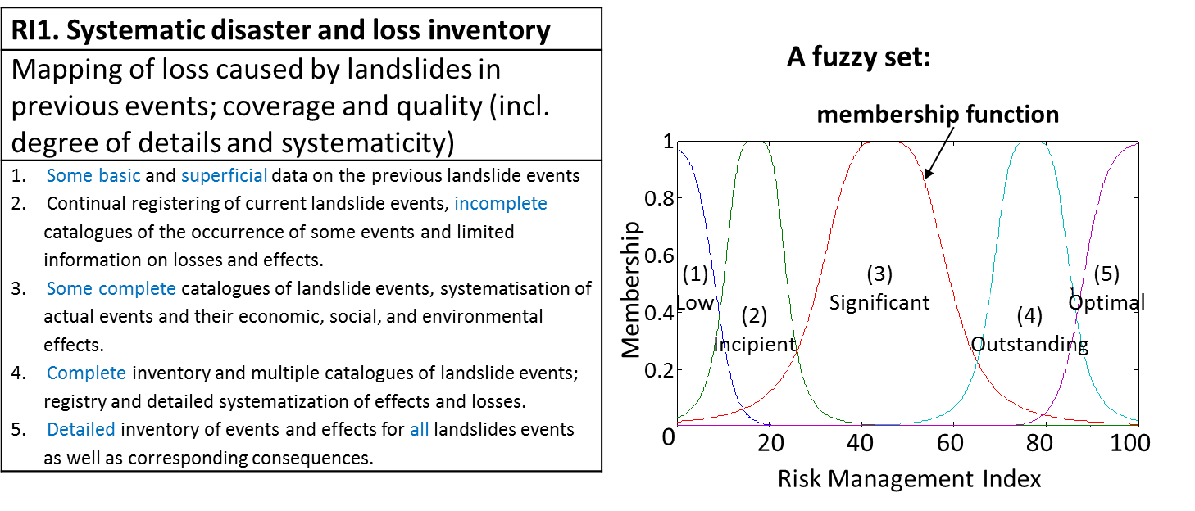
Surveying perceptions of landslide risk management in Norway
Jessica Ka Yi Chiu & Unni Eidsvig, Norwegian Geotechnical Institute (NGI)
The RMI method
Performance level
Relative weights
Each policy index is quantified by the weighed values of its indicators. The weighed values are based on performance levels and relative weights, which are attributed to the indicator via
separate questionnaires.
X
1. Low 2. Incipient 3. Significant 4. Outstanding 5. Optimal
Each management performance level represents a membership function of a fuzzy set. The fuzzy sets theory gives flexibility to modelling which uses these qualitative expressions.
The RMI method
RMI (0 to 100)
RMI
+ RMI
+ RMI
+ RMI
=
RI
RR
4
DM
FP
List of indicators
The survey
RMI
RMI
RMI
RI
RMI
DM
FP
Policy index
Target participants
RR
Governance &
R
(0 to 100)
isk
R
D
isaster
isk
R
eduction
F
I
inancial
dentification
M
anagement
P
Survey results
rotection
2050 evaluations
RI1
Component indicator
RI1
RI2
RI3
RR1
RR2
RR3
DM1
DM2
DM3
FP1
FP2
FP3
Performance level: 1
-
General comments
see example
•
5
RI4
RI5
RI6
RR4
RR5
RR6
DM4
DM5
•
Relative weight
Insights on communication
of the topic

Slide 7
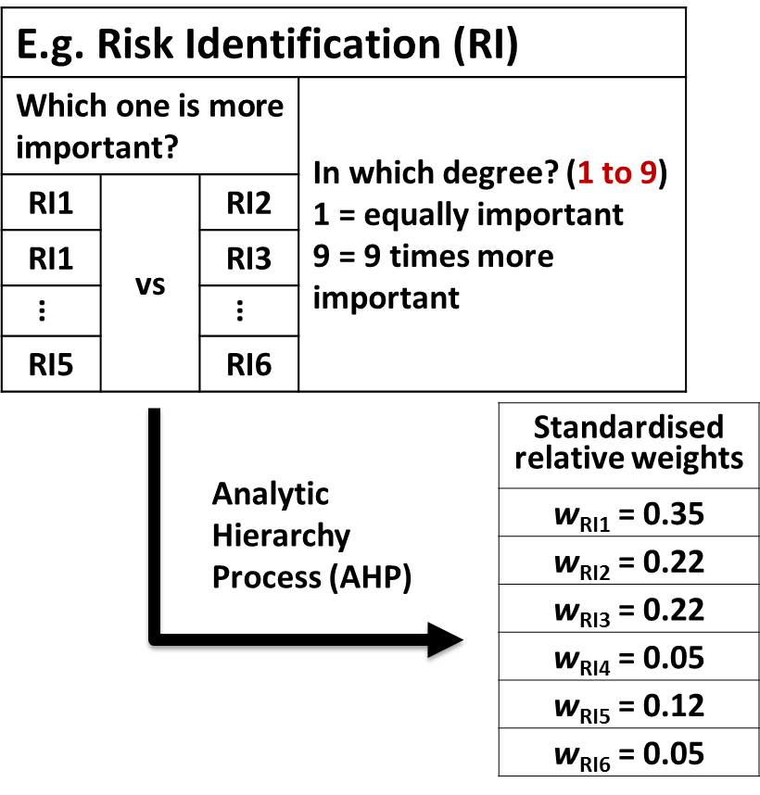
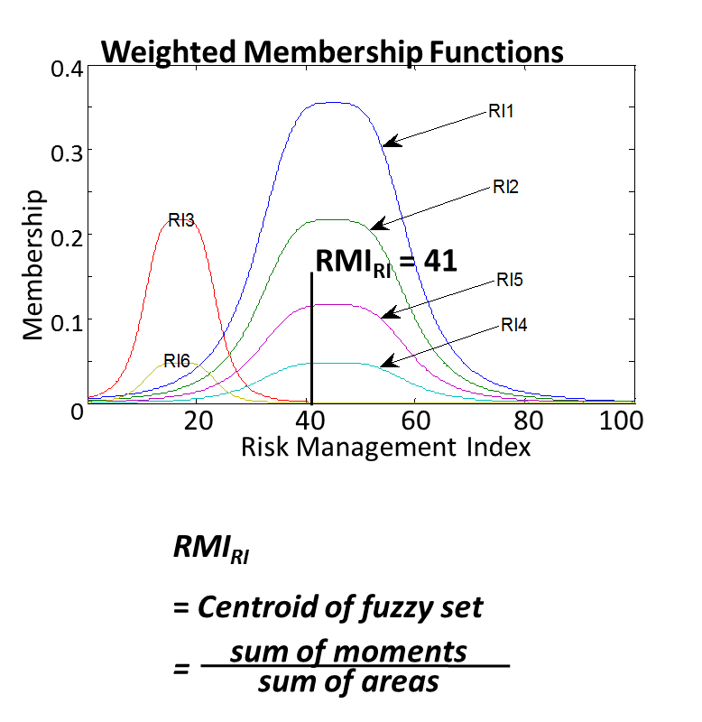
Surveying perceptions of landslide risk management in Norway
Jessica Ka Yi Chiu & Unni Eidsvig, Norwegian Geotechnical Institute (NGI)
The RMI method
Performance level
Relative weights
Each policy index is quantified by the weighed values of its indicators. The weighed values are based on performance levels and relative weights, which are attributed to the indicator via
separate questionnaires.
X
The process of allocating the weights follows the Analytic Hierarchy Process (AHP). Each component indicator within a public policy are compared pairwise. The calculated relative weights give heights to the membership functions. A policy index (e.g. RMI_{RI}) is the concentrated value of the fuzzy set.
The RMI method
RMI (0 to 100)
RMI
+ RMI
+ RMI
+ RMI
=
RI
RR
4
DM
FP
List of indicators
The survey
RMI
RMI
RMI
RI
RMI
DM
FP
Policy index
Target participants
RR
Governance &
R
(0 to 100)
isk
R
D
isaster
isk
R
eduction
F
I
inancial
dentification
M
anagement
P
Survey results
rotection
2050 evaluations
RI1
Component indicator
RI1
RI2
RI3
RR1
RR2
RR3
DM1
DM2
DM3
FP1
FP2
FP3
Performance level: 1
-
General comments
see example
•
5
RI4
RI5
RI6
RR4
RR5
RR6
DM4
DM5
•
Relative weight
Insights on communication
of the topic

Slide 8
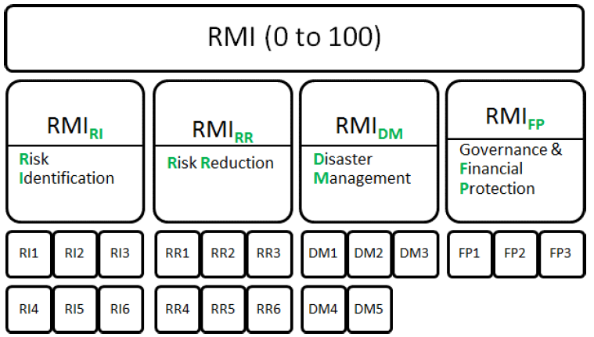
Surveying perceptions of landslide risk management in Norway
Jessica Ka Yi Chiu & Unni Eidsvig, Norwegian Geotechnical Institute (NGI)
List of indicators
Risk Identification (RI)
RI1. Systematic disaster and loss inventory
RI2. Hazard monitoring and forecasting
RI3. Hazard evaluation and mapping
RI4. Vulnerability and risk assessment
RI5. Public information and community participation
RI6. Training and education in risk management
The RMI method
List of indicators
The survey
Target participants
Survey results
Risk Reduction (RR)
RR1. Land use and urban planning
RR2. Hydrographic basin intervention and environmental protection
RR3. Implementation of hazard-event control and protection techniques
RR4. Housing improvement and relocation from prone-areas
RR5. Updating and enforcement of safety standards and construction codes
RR6. Reinforcement and retrofitting of public and private assets
Public policy
2050 evaluations
General comments
Component Indicators
Insights on communication
of the topic

Slide 9
Surveying perceptions of landslide risk management in Norway
Jessica Ka Yi Chiu & Unni Eidsvig, Norwegian Geotechnical Institute (NGI)
List of indicators
The RMI method
Disaster Management (DM)
DM1. Emergency preparedness and continuity planning
DM2. Information and warning systems
DM3. Emergency response
DM4. Community preparedness and training
DM5. Rehabilitation and reconstruction planning
List of indicators
The survey
Target participants
Survey results
Governance and Financial Protection (FP)
FP1. Inter-institutional organisation and strengthening
FP2. Budget allocation and mobilisation
FP3. Insurance and disaster funds
2050 evaluations
General comments
Insights on communication
of the topic

Slide 10
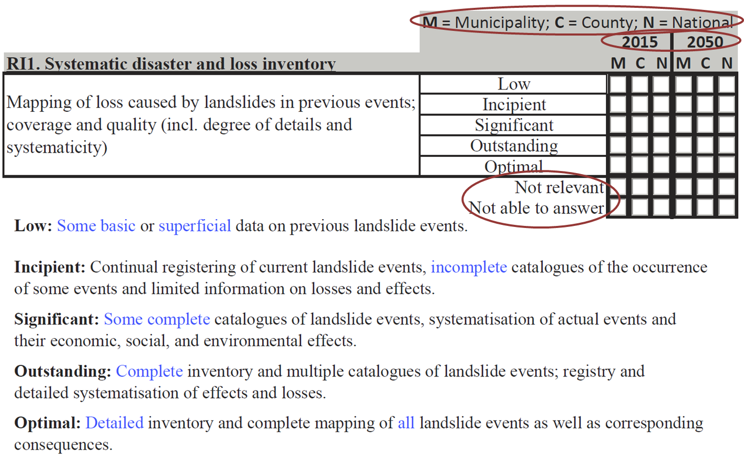
Surveying perceptions of landslide risk management in Norway
Jessica Ka Yi Chiu & Unni Eidsvig, Norwegian Geotechnical Institute (NGI)
The survey
Questionnaires were sent via email.
The 1st questionnaire collects ratings of performance level for each component indicator (see example of RI1 below).
The RMI method
Three admin. levels
Two time periods
List of indicators
The survey
Target participants
Can also choose other
answers…
Survey results
2050 evaluations
General comments
Insights on communication
of the topic

Slide 11
Surveying perceptions of landslide risk management in Norway
Jessica Ka Yi Chiu & Unni Eidsvig, Norwegian Geotechnical Institute (NGI)
The survey
The 1st questionnaire also collects other information/opinions:
Other information:
Organisation
Title/occupation
Discipline in risk management
Norwegian counties/municipalities most familiar with regarding landslide risk management
Other opinions:
Factors considered for evaluation of 2050
Comments about landslide risk management in Norway
Comments about the survey
The RMI method
List of indicators
The survey
Target participants
Survey results
2050 evaluations
General comments
Insights on communication
of the topic

Slide 12
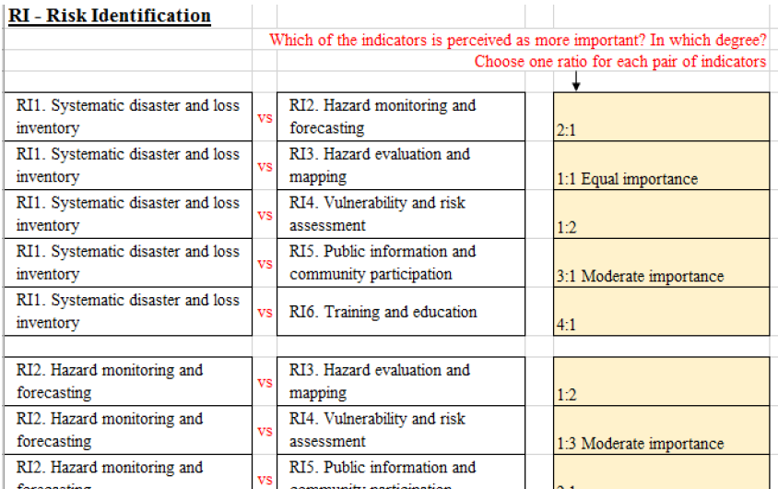
Surveying perceptions of landslide risk management in Norway
Jessica Ka Yi Chiu & Unni Eidsvig, Norwegian Geotechnical Institute (NGI)
The survey
Experts of specific public policies were invited to answer the 2nd questionnaire for allocation of relative weights.
The RMI method
List of indicators
The survey
Target participants
Survey results
2050 evaluations
General comments
Insights on communication
of the topic

Slide 13
Surveying perceptions of landslide risk management in Norway
Jessica Ka Yi Chiu & Unni Eidsvig, Norwegian Geotechnical Institute (NGI)
Target participants
Participants were invited from…
Government agencies
Local authorities
Consultants
Contractors
Reseach institutes
Academica bodies
Municipalities
County governors
The RMI method
List of indicators
The survey
Target participants
Survey results
2050 evaluations
General comments
Insights on communication
of the topic

Slide 14
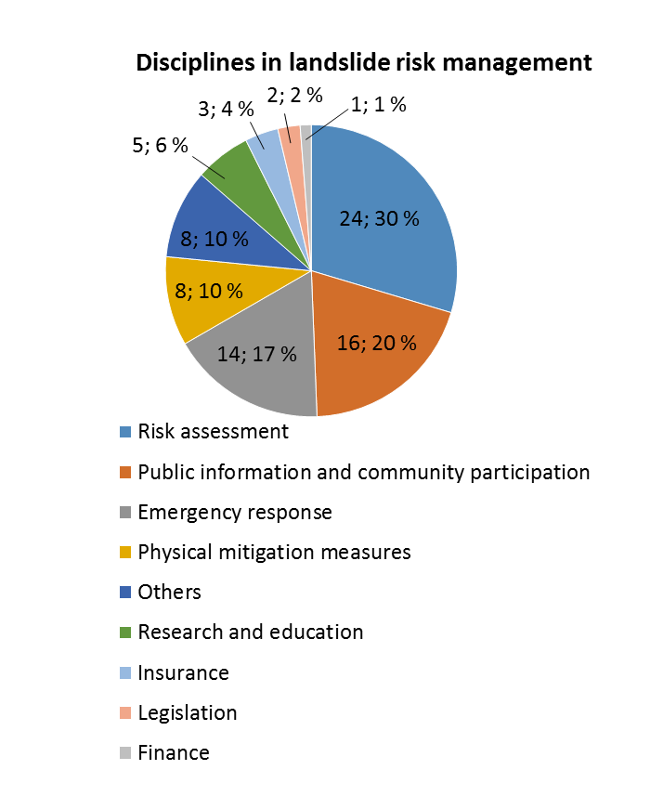
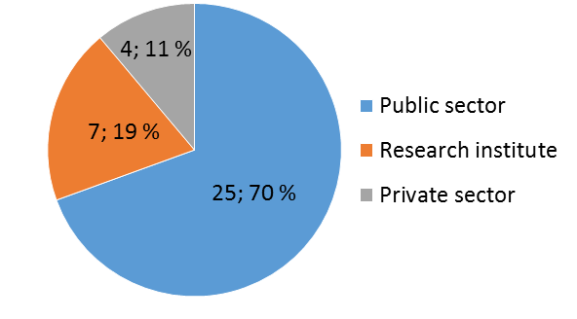
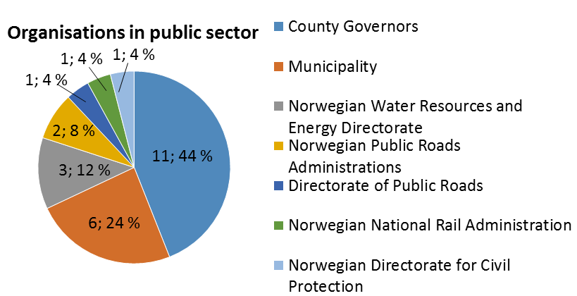
Surveying perceptions of landslide risk management in Norway
Jessica Ka Yi Chiu & Unni Eidsvig, Norwegian Geotechnical Institute (NGI)
Survey results
Response: 36 (~ 60% response rate)
The RMI method
List of indicators
The survey
Target participants
Survey results
2050 evaluations
General comments
Insights on communication
of the topic

Slide 15
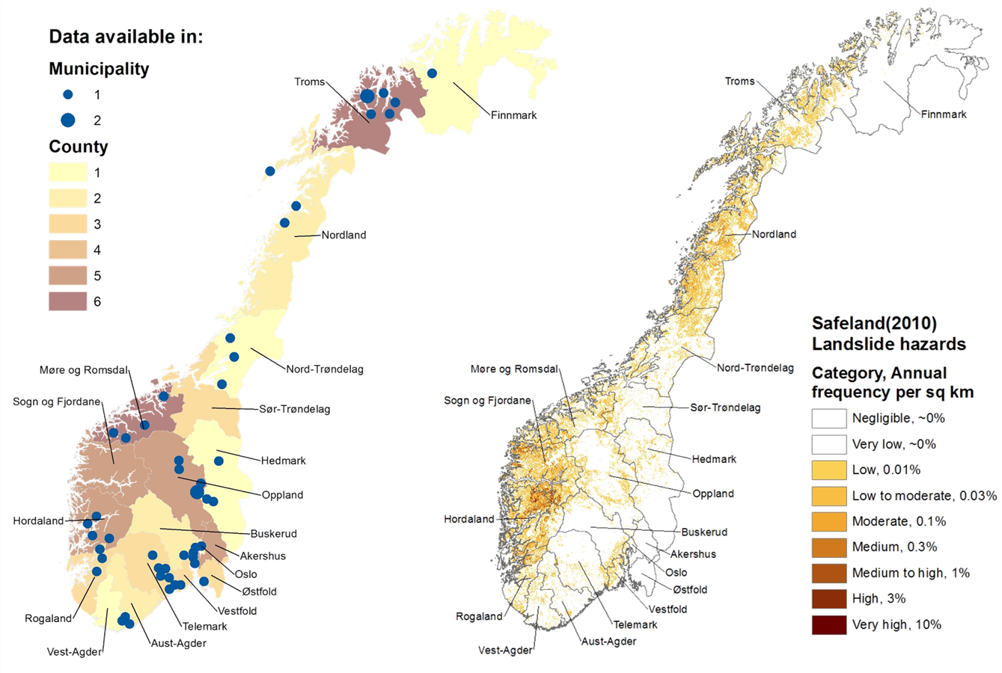
Surveying perceptions of landslide risk management in Norway
Jessica Ka Yi Chiu & Unni Eidsvig, Norwegian Geotechnical Institute (NGI)
Survey results
Data are available for all counties and 48 (out of 438) municipalities in Norway.
The RMI method
List of indicators
The survey
Target participants
Survey results
2050 evaluations
General comments
Insights on communication
of the topic

Slide 16
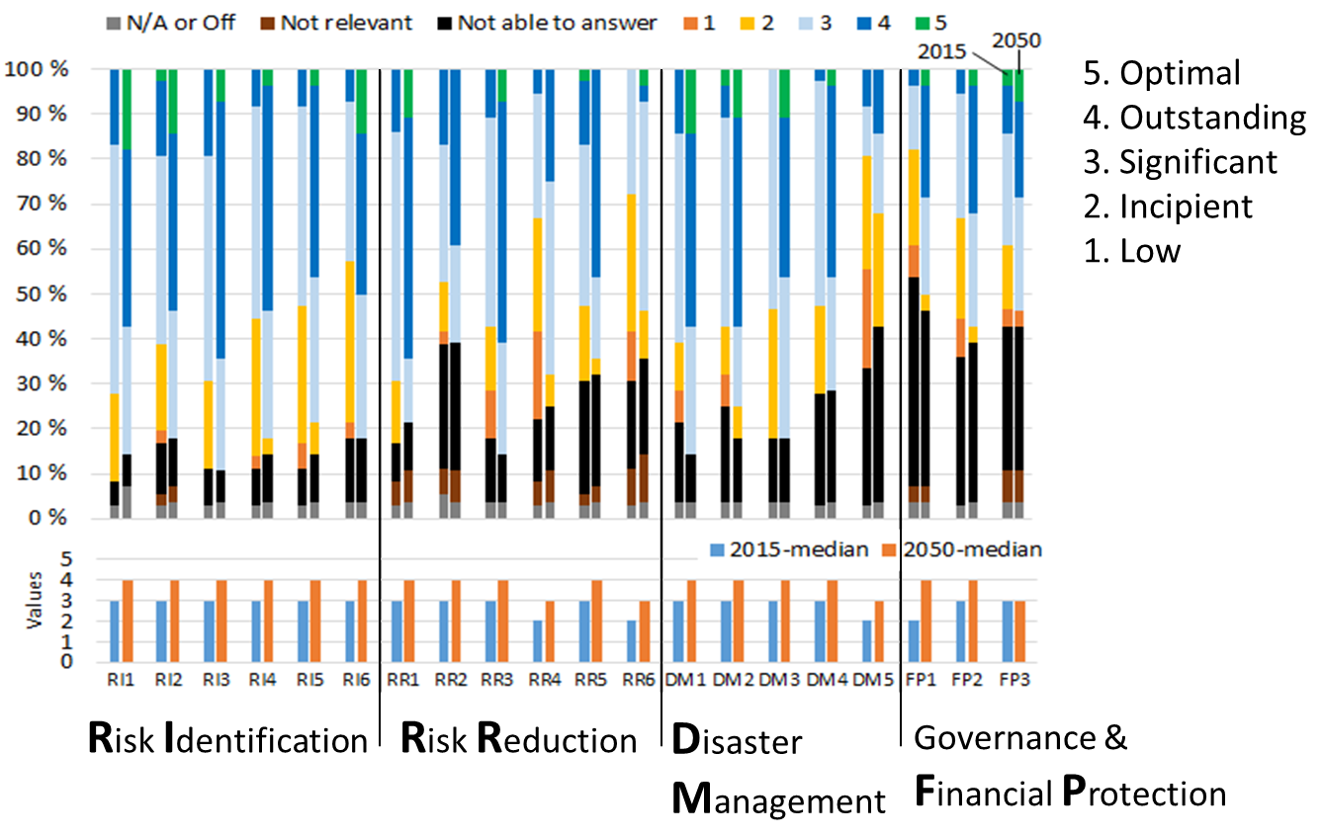
Surveying perceptions of landslide risk management in Norway
Jessica Ka Yi Chiu & Unni Eidsvig, Norwegian Geotechnical Institute (NGI)
Survey results
National level perceptions on performance level
Level 3 ‘significant’ in 2015 to level 4 ‘outstanding’ in 2050 in general.
You may choose to show the following:
The RMI method
List of indicators
Indicators with highest % ‘non-performance level’ data
The survey
Target participants
Indicators with relatively poor performance level
Survey results
2050 evaluations
General comments
Clear
Insights on communication
of the topic

Slide 17
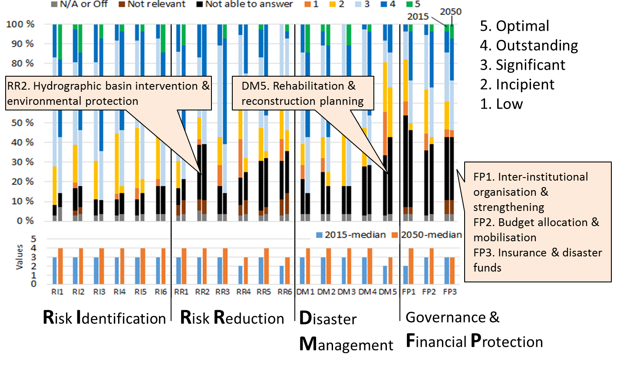
Surveying perceptions of landslide risk management in Norway
Jessica Ka Yi Chiu & Unni Eidsvig, Norwegian Geotechnical Institute (NGI)
Survey results
National level perceptions on performance level
Level 3 ‘significant’ in 2015 to level 4 ‘outstanding’ in 2050 in general.
You may choose to show the following:
The RMI method
List of indicators
Indicators with highest % ‘non-performance level’ data
The survey
Target participants
Indicators with relatively poor performance level
Survey results
2050 evaluations
General comments
Clear
Insights on communication
of the topic

Slide 18
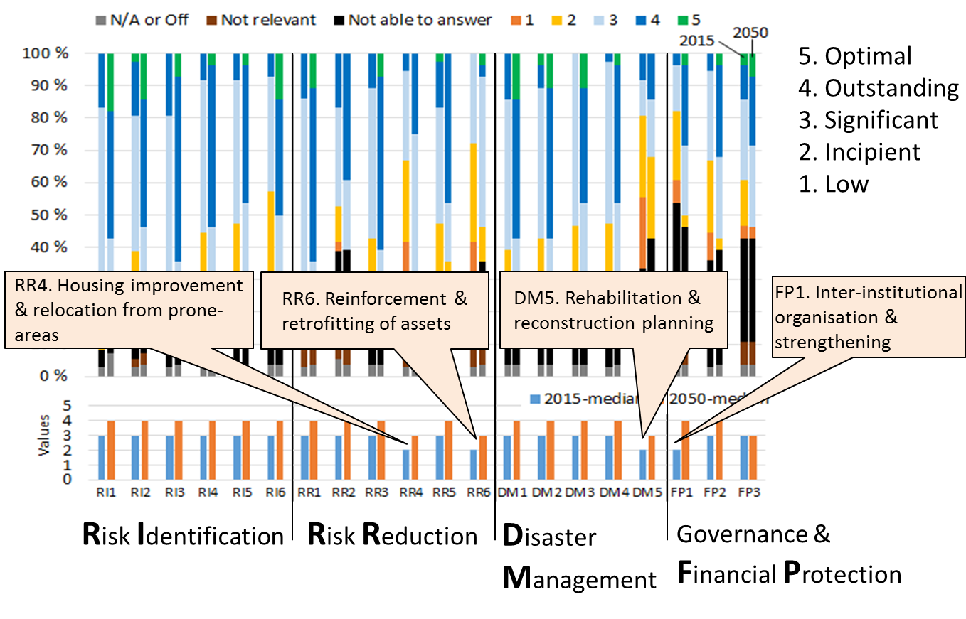
Surveying perceptions of landslide risk management in Norway
Jessica Ka Yi Chiu & Unni Eidsvig, Norwegian Geotechnical Institute (NGI)
Survey results
National level perceptions on performance level
Level 3 ‘significant’ in 2015 to level 4 ‘outstanding’ in 2050 in general.
You may choose to show the following:
The RMI method
List of indicators
Indicators with highest % ‘non-performance level’ data
The survey
Target participants
Indicators with relatively poor performance level
Survey results
2050 evaluations
General comments
Clear
Insights on communication
of the topic

Slide 19
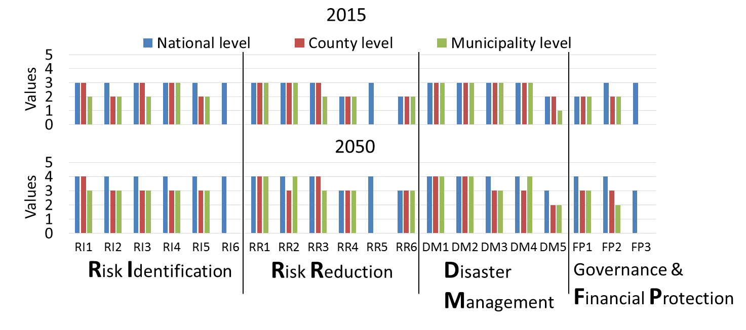
Surveying perceptions of landslide risk management in Norway
Jessica Ka Yi Chiu & Unni Eidsvig, Norwegian Geotechnical Institute (NGI)
Survey results
Performance (medians) for different administrative levels
Performance at national level is generally better than sub-national levels. Greater differences perceived for 2050.
You may choose to show the following:
The RMI method
Indicators only applicable for national levels
List of indicators
The survey
Counties perceived better than municipalities
(2050, may also for 2015)
Target participants
Survey results
2050 evaluations
Municipalities perceived better than counties
(2050 only)
General comments
Insights on communication
of the topic
Clear

Slide 20
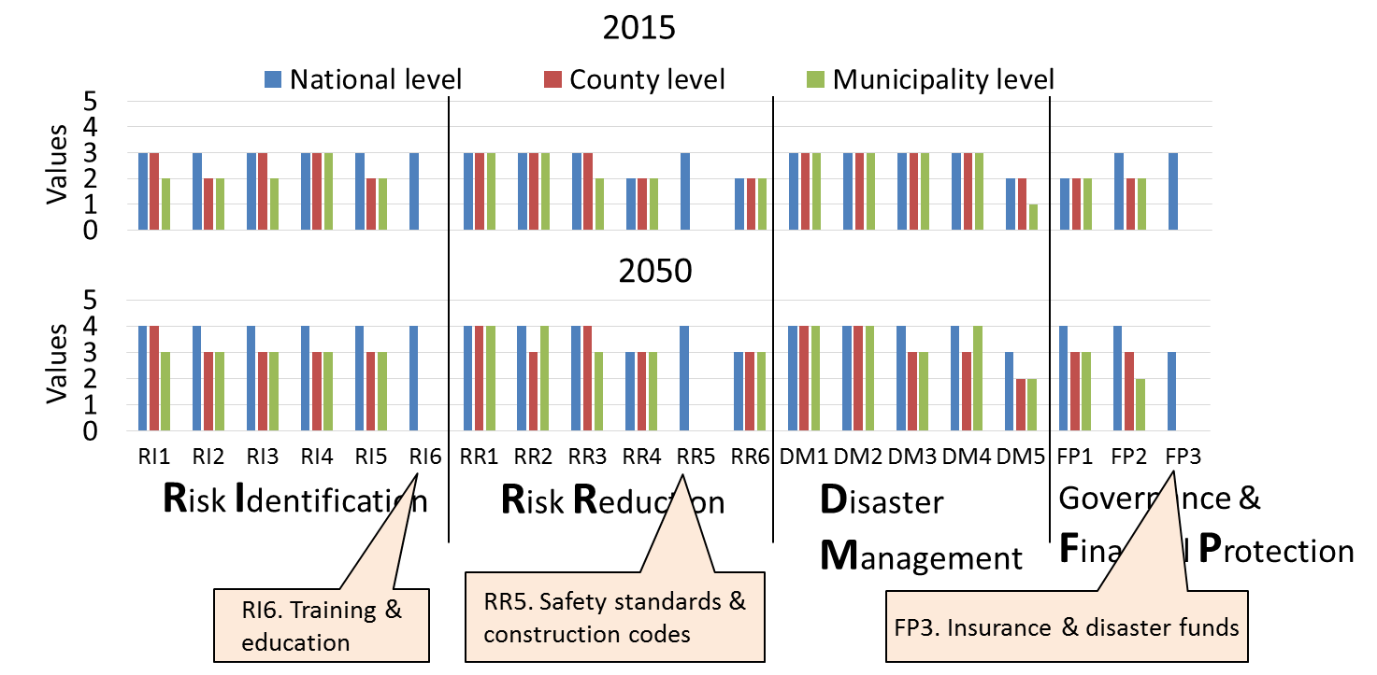
Surveying perceptions of landslide risk management in Norway
Jessica Ka Yi Chiu & Unni Eidsvig, Norwegian Geotechnical Institute (NGI)
Survey results
Performance (medians) for different administrative levels
Performance at national level is generally better than sub-national levels. Greater differences perceived for 2050.
You may choose to show the following:
The RMI method
Indicators only applicable for national levels
List of indicators
The survey
Counties perceived better than municipalities
(2050, may also for 2015)
Target participants
Survey results
2050 evaluations
Municipalities perceived better than counties
(2050 only)
General comments
Insights on communication
of the topic
Clear

Slide 21
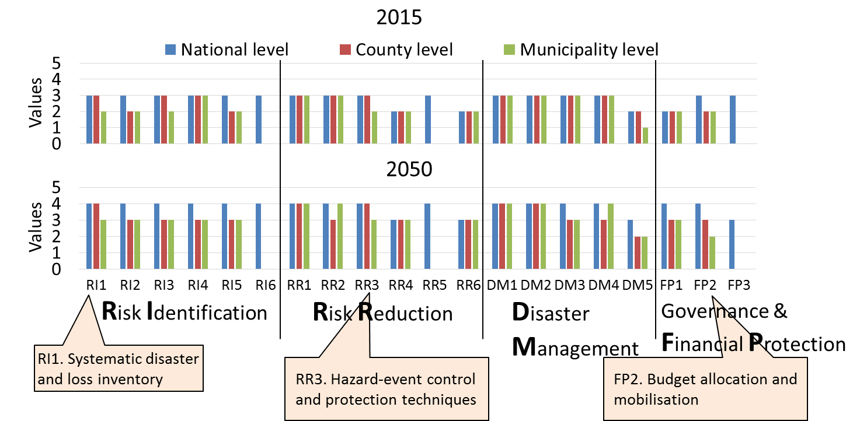
Surveying perceptions of landslide risk management in Norway
Jessica Ka Yi Chiu & Unni Eidsvig, Norwegian Geotechnical Institute (NGI)
Survey results
Performance (medians) for different administrative levels
Performance at national level is generally better than sub-national levels. Greater differences perceived for 2050.
You may choose to show the following:
The RMI method
Indicators only applicable for national levels
List of indicators
The survey
Counties perceived better than municipalities
(2050, may also for 2015)
Target participants
Survey results
2050 evaluations
Municipalities perceived better than counties
(2050 only)
General comments
Insights on communication
of the topic
Clear

Slide 22
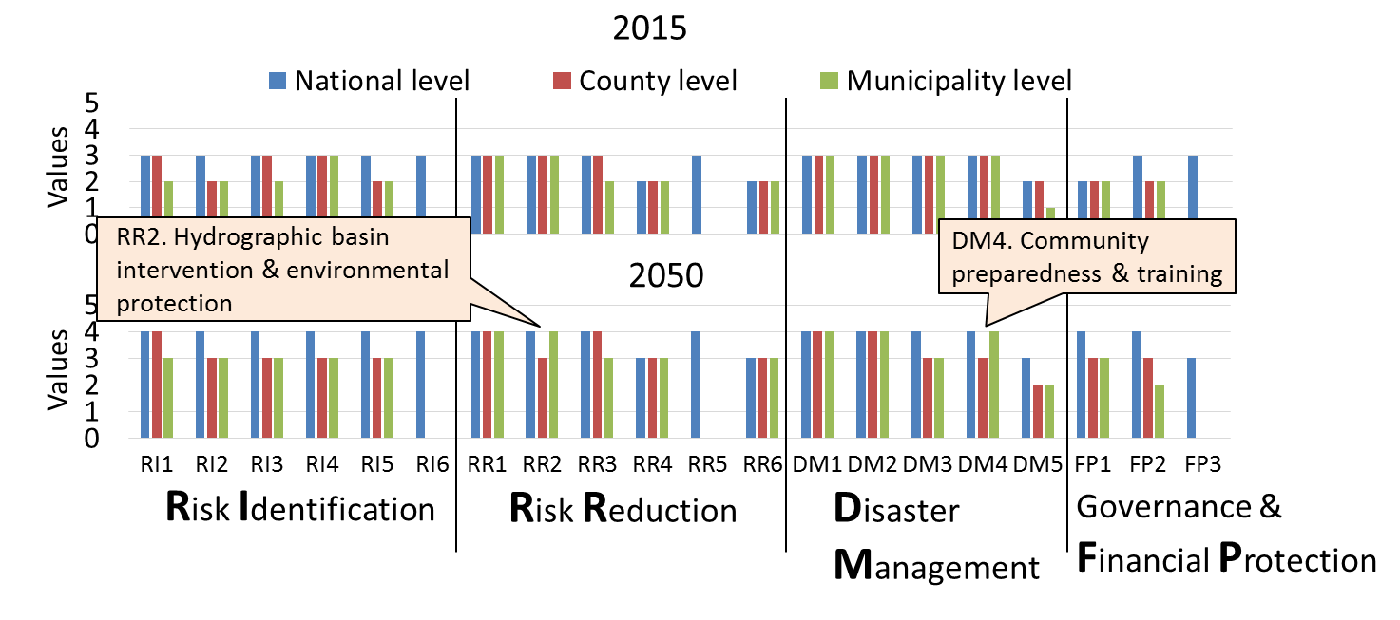
Surveying perceptions of landslide risk management in Norway
Jessica Ka Yi Chiu & Unni Eidsvig, Norwegian Geotechnical Institute (NGI)
Survey results
Performance (medians) for different administrative levels
Performance at national level is generally better than sub-national levels. Greater differences perceived for 2050.
You may choose to show the following:
The RMI method
Indicators only applicable for national levels
List of indicators
The survey
Counties perceived better than municipalities
(2050, may also for 2015)
Target participants
Survey results
2050 evaluations
Municipalities perceived better than counties
(2050 only)
General comments
Insights on communication
of the topic
Clear

Slide 23
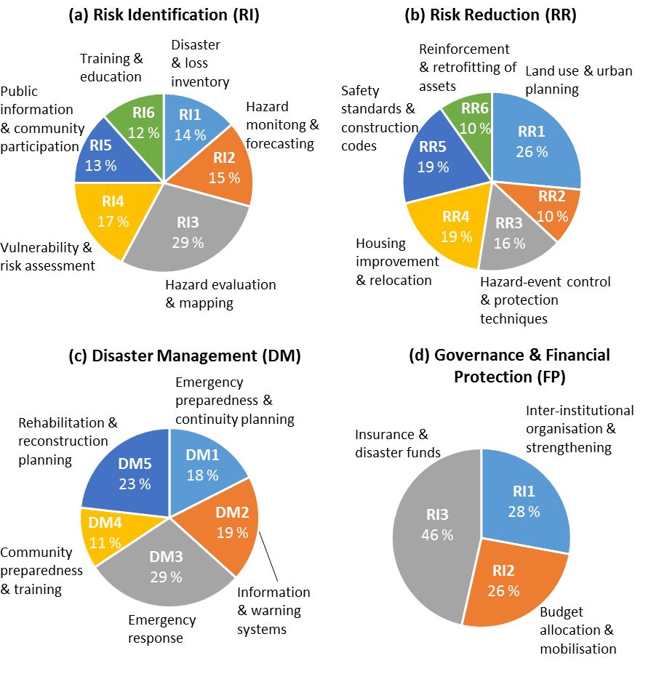
Surveying perceptions of landslide risk management in Norway
Jessica Ka Yi Chiu & Unni Eidsvig, Norwegian Geotechnical Institute (NGI)
Survey results
Relative weights
The RMI method
List of indicators
The survey
Target participants
Survey results
2050 evaluations
General comments
Insights on communication
of the topic

Slide 24
Surveying perceptions of landslide risk management in Norway
Jessica Ka Yi Chiu & Unni Eidsvig, Norwegian Geotechnical Institute (NGI)
Survey results
The RMI method
Relatively negative perceptions
+
Relatively high relative weights
↓
Areas for improvement?
List of indicators
The survey
Target participants
Survey results
2050 evaluations
General comments
Insights on communication
of the topic

Slide 25
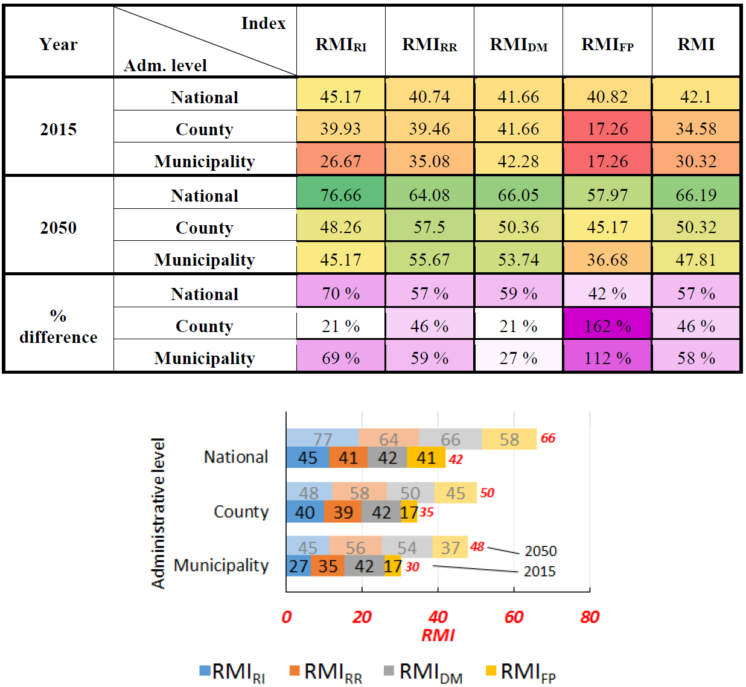
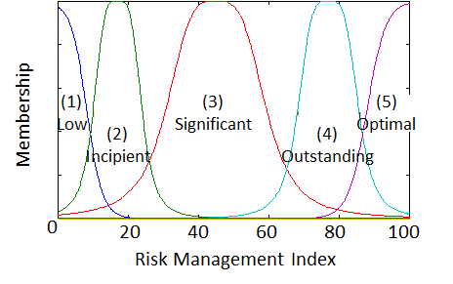
Surveying perceptions of landslide risk management in Norway
Jessica Ka Yi Chiu & Unni Eidsvig, Norwegian Geotechnical Institute (NGI)
Survey results
RMI results
The RMI method
2015
2050
List of indicators
The survey
Target participants
Survey results
2050 evaluations
General comments
Risk Identification
Risk Reduction
Insights on communication
of the topic
Disaster Management
Governance & Financial Protection

Slide 26
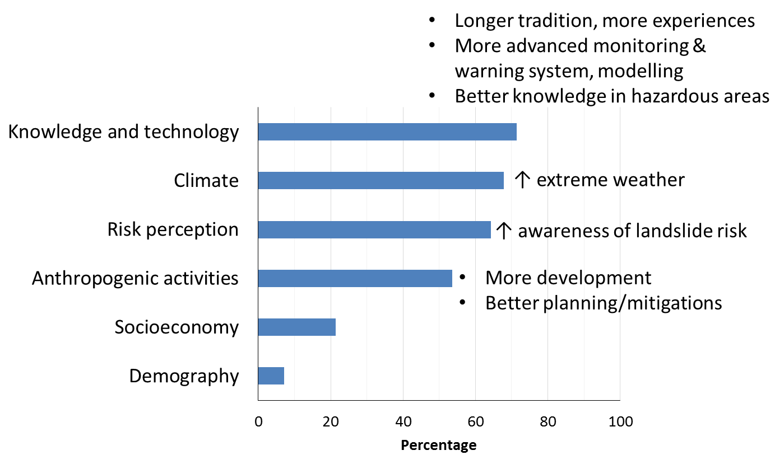
Surveying perceptions of landslide risk management in Norway
Jessica Ka Yi Chiu & Unni Eidsvig, Norwegian Geotechnical Institute (NGI)
2050 evaluations
Participants were asked to select at most three factors that dominate their evaluation of perceptions for 2050. Knowledge and technology, climate, risk perception, and anthropogenic activities are the most popular factors being considered.
The RMI method
List of indicators
The survey
Target participants
Survey results
2050 evaluations
General comments
Insights on communication
of the topic

Slide 27
Surveying perceptions of landslide risk management in Norway
Jessica Ka Yi Chiu & Unni Eidsvig, Norwegian Geotechnical Institute (NGI)
General comments
About landslide risk management in Norway
Positive
Been improving in general
More focus on media, which arouses awareness
Improvement in organisation and mapping work
Negative
National responsibility is fragmented and not coordinated, and lags behind other administrative levels
Most municipalities: too little knowledge in risk identification and reduction
Mapping work inadequate
Too little focus on existing developed areas and infrastructure (and between).
Recommendations
More resources for mapping and mitigation measures
Overview and sharing of data
The RMI method
List of indicators
The survey
Target participants
Survey results
2050 evaluations
General comments
Insights on communication
of the topic

Slide 28
Surveying perceptions of landslide risk management in Norway
Jessica Ka Yi Chiu & Unni Eidsvig, Norwegian Geotechnical Institute (NGI)
General comments
About the survey
Positive
Good and relevant questions
Systematic
Good with explanations of criteria
Negative
Too difficult
Too comprehensive
Some criteria are unclear
Too many technical terms
Recommendations
Simpler wordings
Interview
The RMI method
List of indicators
The survey
Target participants
Survey results
2050 evaluations
General comments
Insights on communication
of the topic

Slide 29
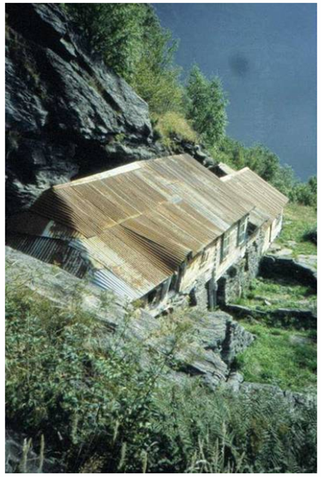
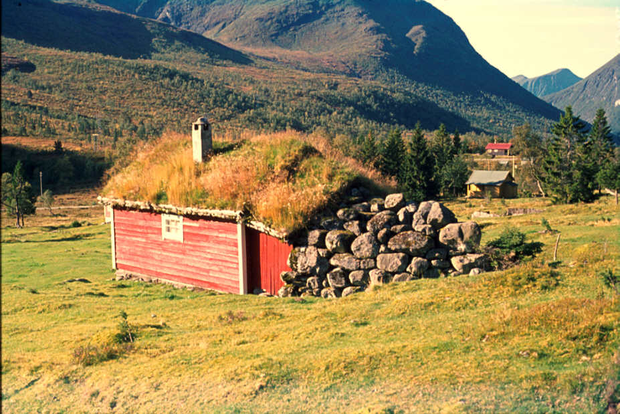
Surveying perceptions of landslide risk management in Norway
Jessica Ka Yi Chiu & Unni Eidsvig, Norwegian Geotechnical Institute (NGI)
Insights on communication of the topic
Surveying the public? –> compare experts’ and public opinions
Development of a common terminology/language in landslide risk management in Norway.
The RMI method
List of indicators
Surveying the public?
The survey
Target participants
Mutual understanging among people with different backgrounds
To assess effectiveness of risk communication between public and experts;
To justify whether mitigation strategies can meet public’s need
Survey results
2050 evaluations
General comments
Insights on communication
of the topic

Slide 30
This project is supported by Klima 2050
Klima 2050 will reduce the societal risks associated with climate changes and enhanced precipitation and flood water exposure within the built environment.
Klima 2050 is a Centre for Research-based Innovation (SFI) financed by the Research Council of Norway and the consortium partners. The SFI status enables long-term research in close collaboration with trade and industry, as well as other research partners aiming to strengthen Norway's innovation ability and competitiveness within climate adaptation. The composition of the consortium is vital in order to being able to reduce the societal risks associated with climate change.

