Slide 1
Which level of model complexity is justified by your data? A Bayesian answer
Anneli Schöniger, Walter A. Illman, Thomas Wöhling, Wolfgang Nowak
22/04/2016, EGU General Assembly 2016

Slide 2
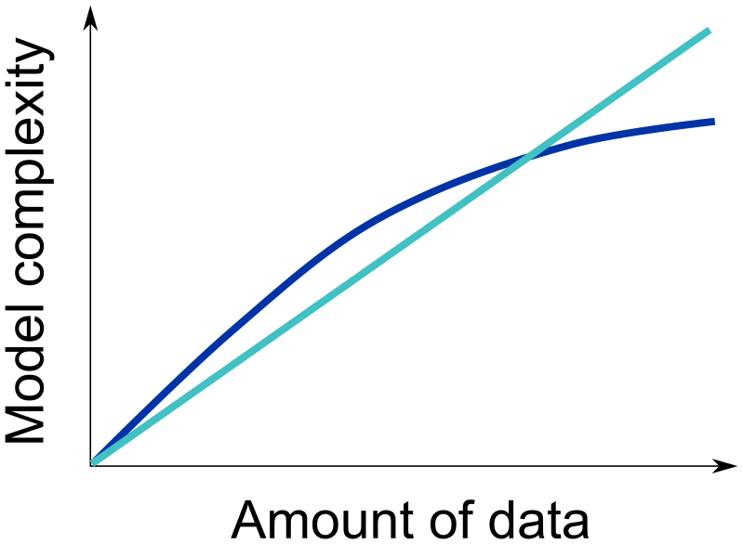
Model Complexity in Subsurface Hydrology
When building subsurface flow or transport models, there are abundant choices of conceptualizations, covering wide ranges of model complexity
Which level of model complexity should we choose?
In the light of data: Which level of model complexity is justified by the available data?

Slide 3
Authors & Motivation of This Study
Anneli Schöniger
Walter A. Illman
Thomas (Eddy) Wöhling
Wolfgang Nowak

Slide 4
Bayesian Model Selection / Averaging (BMA)
Posterior model probabilities are used as weights for
model ranking
model selection
model averaging
uncertainty estimation
BMA implicitly follows the principle of parsimony or „Occam‘s razor“: The weights reflect an optimal tradeoff between performance and complexity
Calibration data set d
Model M1
Model M2
Model M3
Model M4
Draper (1995), Hoeting et al. (1999), Schöniger et al. 2014 (WRR)
Posterior model weights P
Gull 1988 (Acta Appl. Math.)

Slide 5
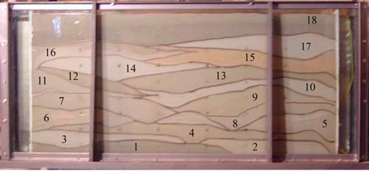
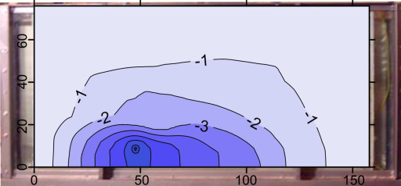
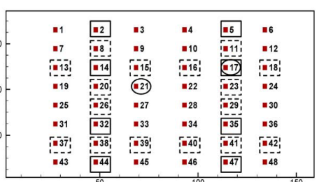
Application: Groundwater Flow Modelling
Inversion of hydraulic tomography data to infer distribution of aquifer parameters
Which parameterization to choose? Too simple vs. too complex
Illman et al. 2010 (WRR)
Geostatistical
Interpolated
Zonated
Homogeneous
Increasing complexity
Schöniger et al. 2015 (JoH)

Slide 6
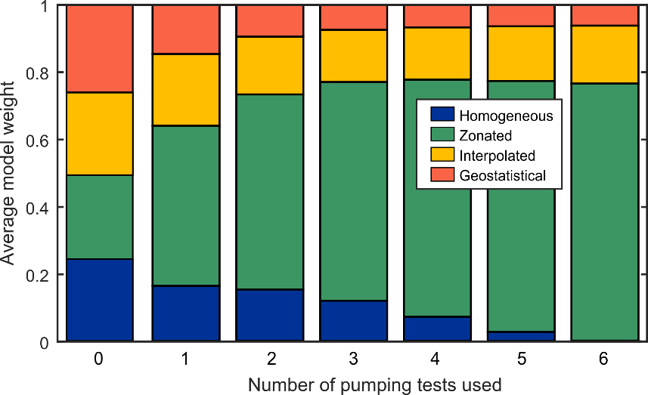
Results of BMA Analysis
BMA favours the zonation approach over the more flexible approaches
Is it actually closest to the true structure, or just parsimonious (remember the tradeoff implicit in BMA)?
Schöniger et al. 2015 (JoH)

Slide 7
How to Interpret Model Weights in Light of Data?
For an infinite amount of data, there is no need for a tradeoff
Enough information about the system to choose the right model
BMA will identify the true complexity (as opposed to other model selection techniques )
For a finite amount of data, identification is harder
Difficulty in distinguishing models
When in doubt, BMA prefers simpler models (performance –parsimony tradeoff)
Test whether all models in the set could be identified (justified) if they were actually the true one
Burnham & Anderson 2004

Slide 8
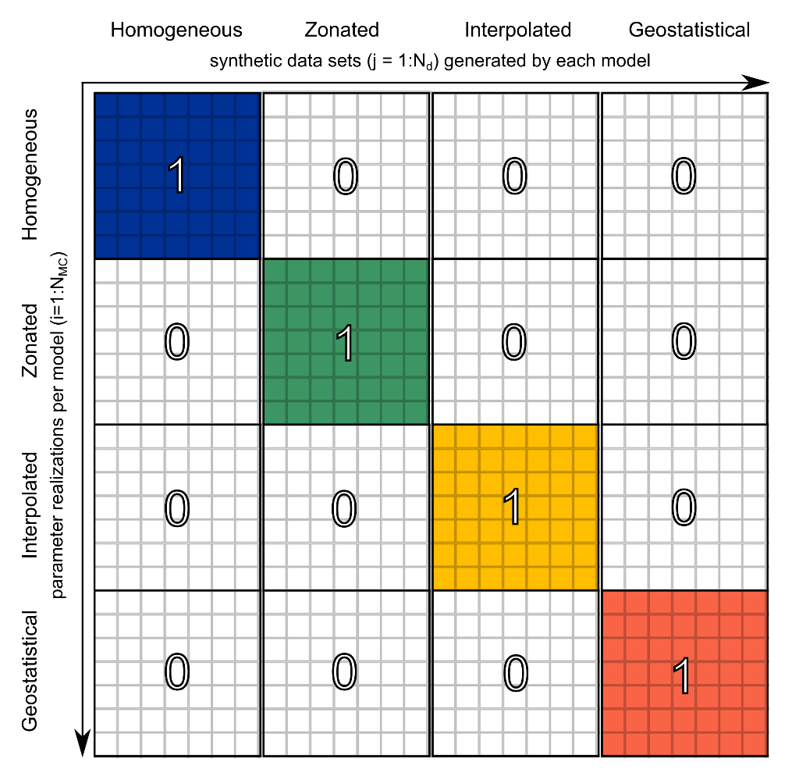
Concept of a Model Confusion Matrix
True model
Candidate model
Schöniger et al. 2015 (JoH)

Slide 9
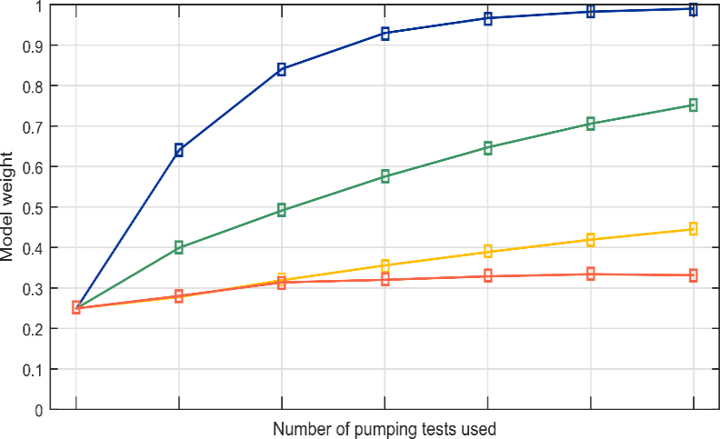
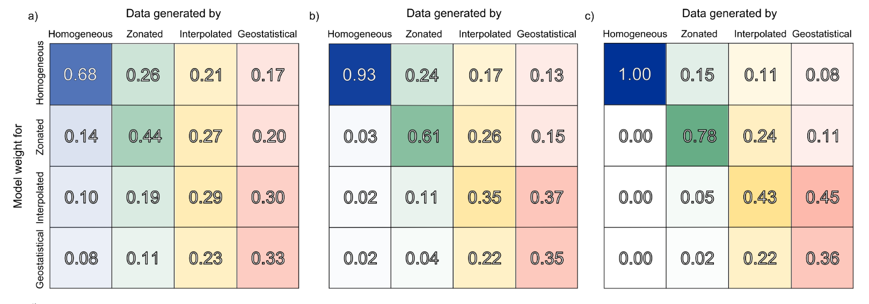
Model Justifiability as a Function of Data Set Size
Increasing complexity
Homogeneous
Zonated
Increasing complexity
Interpolated
Geostatistical
Increasing data set size
Schöniger et al. 2015 (JoH)

Slide 10
Results of the Justifiability Analysis
The most complex geostatistical model is not yet justifiable with the available data
Schöniger et al. 2015 (JoH)

Slide 11
Really... A Zonated Model is Best?!
The zonated model is actually a best-case scenario, because it benefits from (almost) perfect geological knowledge
How would a geologically uninformed zonated model perform?

Slide 12
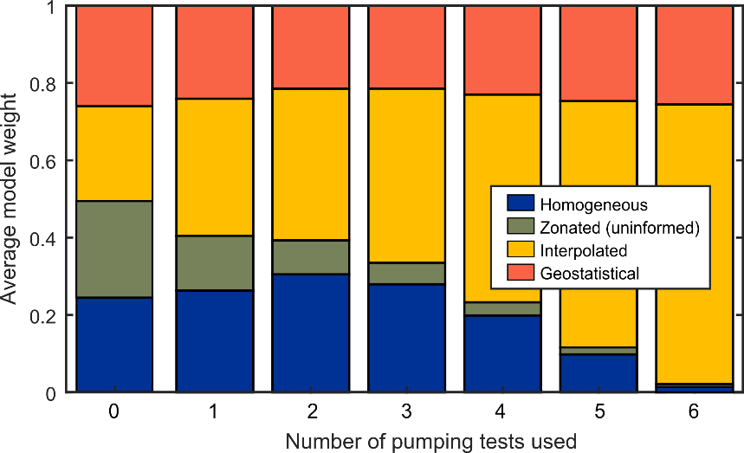
Results of Repeated BMA Analysis
The performance depends greatly on the quality of prior geological information
A combination of geological knowledge and a stochastic description of heterogeneity at smaller scales could be promising
Schöniger et al. 2015 (JoH)

Slide 13
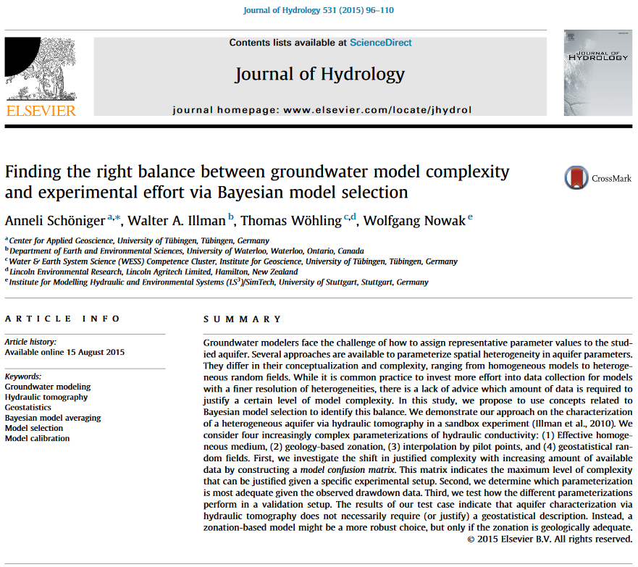
Take-Home Messages
The proposed model justifiability analysis provides support for model evaluation and model selection in the light of limited data;
It is a straightforward extension of Monte Carlo-based Bayesian model averaging (BMA) and helps to interpret BMA results;
And it provides information about model (dis-)similarity.
Special Issue in Journal of Hydrology: “Groundwater flow and transport in aquifers: Insights from modeling and characterization at the field scale”

Slide 14
Which level of model complexity is justified by your data? A Bayesian answer
anneli.schoeniger@uni-tuebingen.de

