Slide 1
Annual and semi-annual cycle of equatorial Atlantic circulation associated with basin mode resonance
Peter Brandt (1), Martin Claus (1), Richard J. Greatbatch (1), Robert Kopte (1), John M. Toole (2), William E. Johns (3), and Claus W. Böning (1)
(1) GEOMAR, Kiel, Germany
(2) Woods Hole Oceanographic Institution,Woods Hole, MA, USA
(3) RSMAS/MPO, University of Miami, Miami, FL, USA

Slide 2
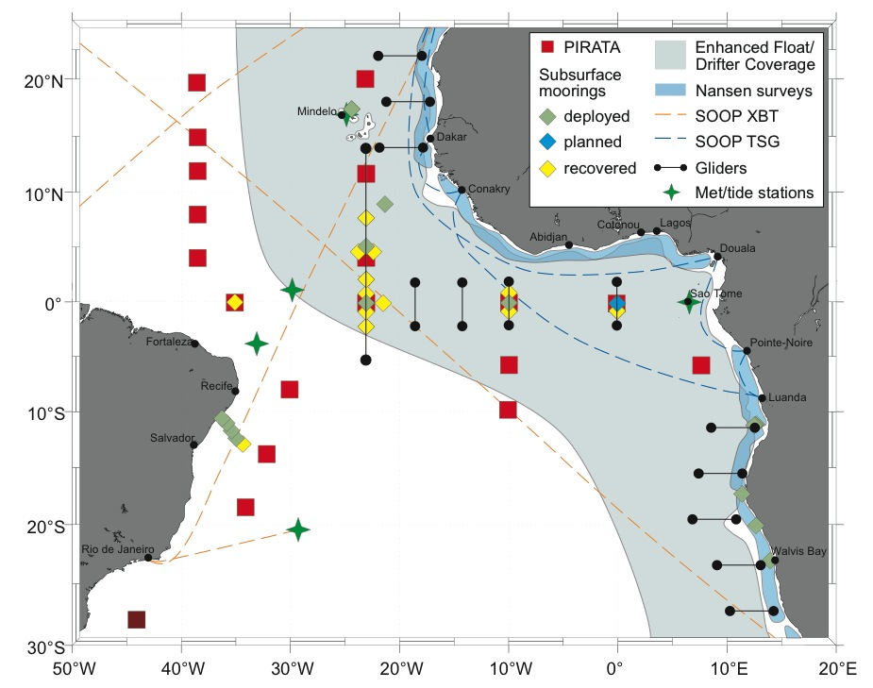
Equatorial circulation variability with focus on seasonal variability
Equatorial mooring at 23°W within different programs
(BMBF Nordatlantik, SFB754) in cooperation with PIRATA:
full-depth zonal velocity with different instrumentation
Equatorial
Undercurrent
Equatorial
Deep Jets with
downward phase
and upward energy
propagation
Study is based on equatorial velocity data, and simulations
with a general circulation model and a reduced gravity model

Slide 3
Baroclinic mode decomposition
Mean temperature/salinity profile at 23°W is used to calculate vertical structure functions (baroclinic modes) and corresponding phase velocities, c_{gw}
Phase velocities will be used to setup the linear reduced-gravity model
Blue: 4th baroclinic mode
Red: 2nd baroclinic mode
Yellow: mean zonal velocity with EUC core at about 70m depth

Slide 4
Kinetic energy distrubution at 23°W
Frequency spectra of observed zonal velocity from the equator, 23°W and baroclinic mode spectra of the annual (solid) and semi-annual (dashed) cycles

Slide 5
Horizontal structure of dominant variability in TRATL01
maximum zonal velocity amplitude at the equator in mid-basin
meridionally broader structure for the 2nd baroclinic mode
generally westward phase propagation
Strong similarities with resonant equatorial basin modes
2nd baroclinic mode, semi-annual cycle
4th baroclinic mode, annual cycle

Slide 6
Equatorial Basin Modes
Basics:
Cane and Moore (1981) described low-frequency standing equatorial modes composed of equatorial Kelvin and long Rossby waves
Period of the gravest basin mode:
Applications:
Resonance of 2nd baroclinic mode semi-annual cycle in the Indic (Jensen 1993, Han et al. 1999) and Atlantic (Thierry et al. 2004, Ding et al. 2009)
Resonance of intraseasonal variability in the Indic (Han et al. 2005, Fu 2007)
EDJ behavior (Johnson and Zhang 2003, d‘Orgeville et al. 2007, Greatbatch et al. 2012)

Slide 7
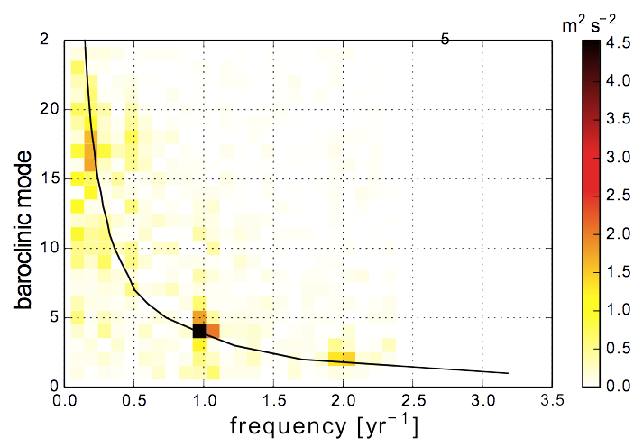
Energy of zonal flow at 23°W:
basin mode oscillations
Most of the energy is concentrated on only three frequencies
All peaks are associated with resonant linear equatorial basin modes
Black line: basin mode
characteristic

Slide 8
Basin mode resonance in the
reduced-gravity model
RMS zonal velocity in a reduced-gravity model forced by harmonically oscillating, spatially uniform zonal wind stress for a square basin (solid line) and a realistic coastline basin (dashed line)
4th baroclinic mode
2nd baroclinic mode

Slide 9
Basin mode simulations with the
reduced-gravity model
harmonically oscillating, zonal and meridional wind forcing derived from observations (NCEP-DOE AMIP-II Reanalysis product)
realistic coastline basin
2nd baroclinic mode, semi-annual cycle
4th baroclinic mode, annual cycle

Slide 10
Horizontal structure of dominant variability in TRATL01
Comparison with the GCM solution
2nd baroclinic mode, semi-annual cycle
4th baroclinic mode, annual cycle

Slide 11
Basin mode simulations with the
reduced-gravity model
Some characteristics simulated by the GCM TRATL01 are reproduced by the linear reduced-gravity model
Basin modes are governed by linear wave dynamics
2nd baroclinic mode, semi-annual cycle
4th baroclinic mode, annual cycle

Slide 12
Reconstruction of Equatorial Undercurrent core velocity and core depth at 23°W
EUC core velocity is dominated by the 4th baroclinic mode semi-annual cycle and the EUC core depth by the 2nd baroclinic mode semi-annual cycle
Observations
Reconstructions
Core Velocity
(cms⁻¹)
Core Depth
(m)
At mean EUC core depth,
4th baroclinic mode (blue) is
close to zero and 2nd baroclinic
mode (red) large

Slide 13
Summary
Resonant equatorial basin modes are ubiquitous features of the equatorial Atlantic Ocean
      Equatorial deep jets (baroclinic mode 15-20)
      Annual cycle (baroclinic mode 4)
      Semi-annual cycle (baroclinic mode 2)
Basin modes are governed by linear wave dynamics
Seasonal variability of the Equatorial Undercurrent can largely be explained by the linear superposition of the two dominant equatorial basin modes
Amplitude and phase of the seasonal cycle in GCMs depends on the basin resonance, i.e. on vertical density structure, strength of the thermocline, etc.

