Slide 1
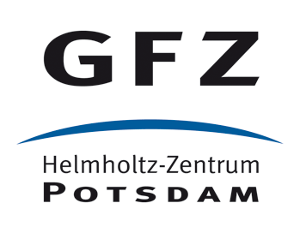
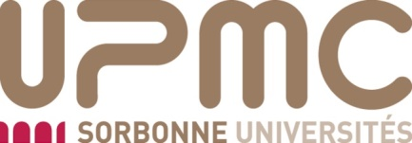
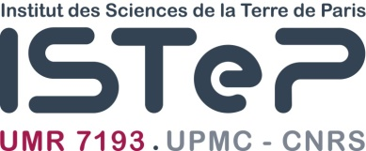
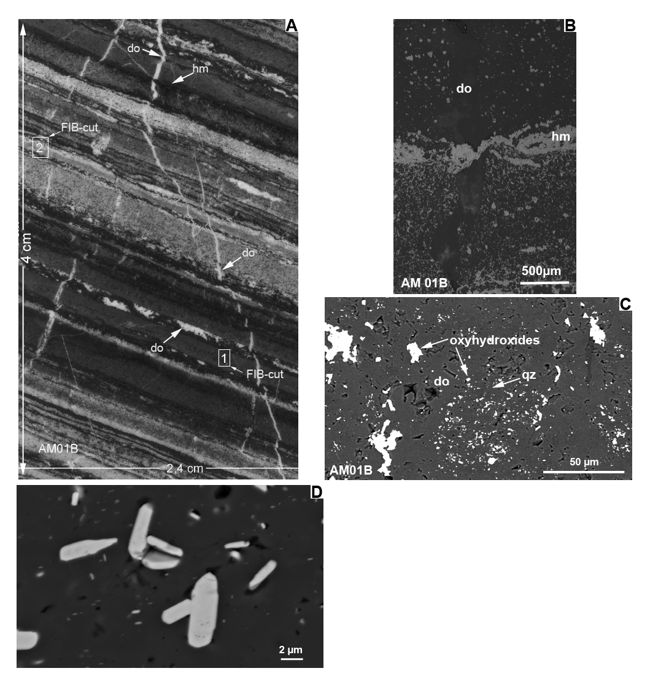
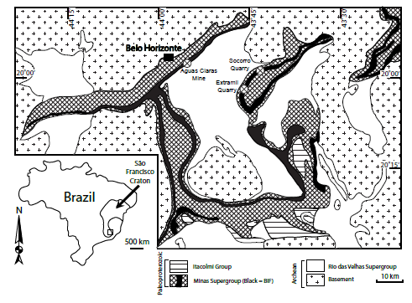
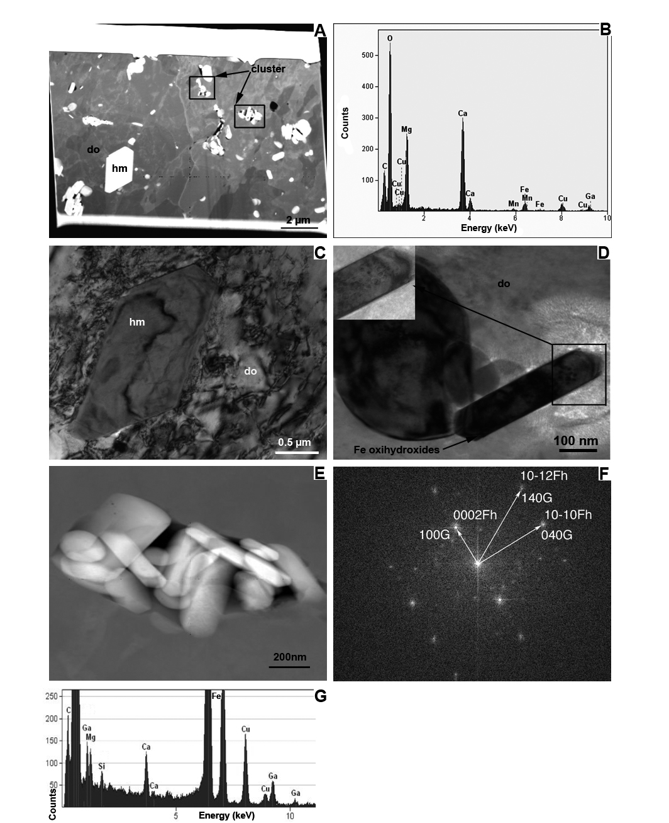
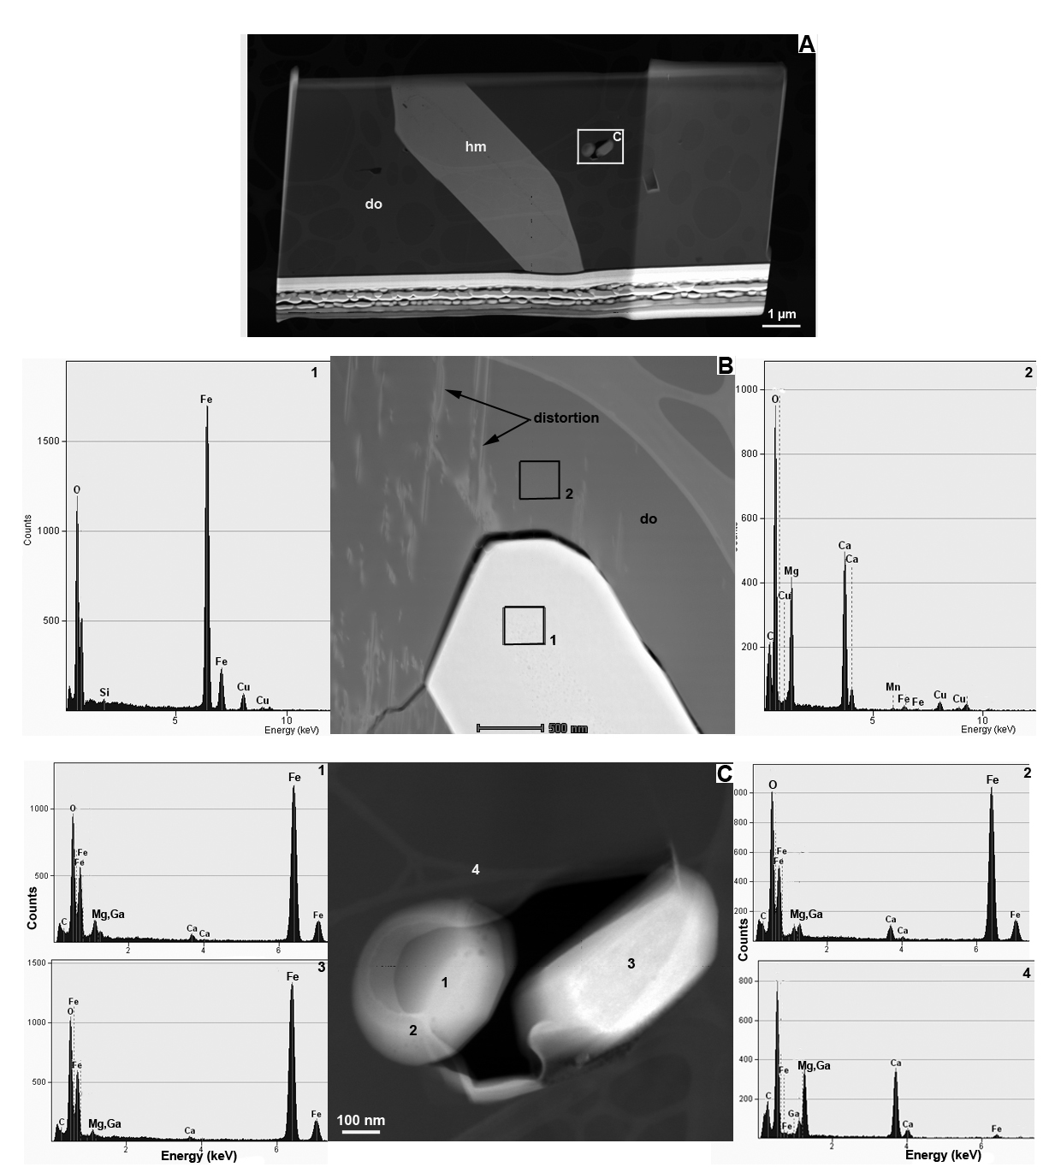
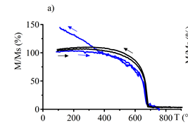
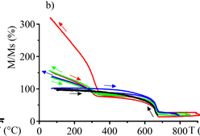
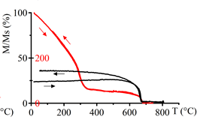
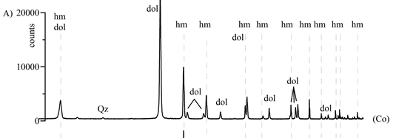
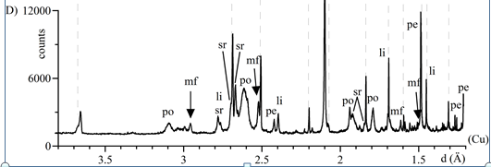
Key parameters for low-grade fine-grained iron ore valorization:
lower environmental impact through reduced waste
Christiane Wagner ¹⁾, Beate Orberger ²⁾, Alina Tudryn ²⁾, Benoît Baptiste ³⁾, Richard Wirth ⁴⁾, Rachel Morgan ²⁾, Serge Miska²⁾
Sorbonne Universités, UPMC, Univ Paris 06, CNRS, ISTeP, 4 Place Jussieu, F-75005, Paris, France; christiane.wagner_raffin@upmc.fr; (2) Université Paris-Sud, Laboratoire GEOPS, UMR 8148 (CNRS-UPS), Bât. 504, 91405 Orsay, France; (3) Sorbonne, Universités, UPMC, Univ Paris 06, CNRS, IMPMC, 4 Place Jussieu, F-75005, Paris, France ; (4) Helmholtz Centre Potsdam, GFZ German Research Centre for Geosciences, Section 3.3, Telegrafenberg, 14473-Potsdam, Germany
Vienne - 2016
INTRODUCTION
High grade iron ores such as itabirites (35-50 % Fe) in the Minas Geraïs (Brazil) are fine grained (< 50 μm), requiring fine grinding in order to liberate the iron oxides. The sintering step is the major dust source during iron ore production. The here produced fines are pelletized and commercialized, with increasing pelletization since 2012 (Lu, 2015).
Low-grade banded iron formations (BIFs) (15 - 35 % Fe), contain micro- and nano- metric iron-bearing inclusions within quartz and/or carbonates, mainly dolomite (~ 20 - 50 µm). These ore types present two major environmental risks:
they are often stocked as tailings. For example, the recent disaster (5th of November 2015) in the Minas Geraïs district, Brazil, was caused by the collapse of the Fundão tailings dam at an open cast mine.
during beneficiation significant amounts of dust are generated also leading to metal loss.
IRON PRODUCTION IN BRAZIL
Brazil is the second largest iron ore producer outside China. The largest deposits are located in the Carajas region, the Amazon basin (Para state) and the Iron Quadrangle in the state of Minas Geraïs.
ORE CHARACTERISTICS
Low grade laminated BIF was studied from a drill core at Àguas Claras Mine, Iron Quadrangle, Brazil.
The chemical composition:
Main macroscopic-microscopic features of the dolomite BIF
Dolomite bands (white) alternating with iron oxide bands
Hematite vein crosscutting dolomite
Hazardous elements:
As < 20 ppm
Cd < 0.7 ppm
Cr < 50 ppm
Pb < 60 ppm
U < 1 ppm
Mt
Holmes & Lu, 2015
Àguas Claras
Coarse dolomite grain with numerous
iron oxyhydroxide inclusions
Electron microprobe analyses of dolomite crystals: homogeneous composition; on average 29 wt. % CaO, 21 wt. % MgO and 0.4 wt. % MnO. The highly variable FeO contents up to 7 wt. % are related to the presence of iron oxy hydroxide inclusions within the dolomite crystals (Morgan et al. 2013).
381 Mt of total iron ore production.
61 Mt are produced from fines.
Iron Quadrangle in Minas Geraïs (Spier et al, 2007)
Micro- and nanometric
iron oxyhydroxide inclusion in
porous dolomite
Iron oxyhydroxide inclusion characteristics in dolomite
Focus ion beam transmission electron microscopy (FIB-TEM)
Curie Balance analyses and Related X-Ray-Diffraction Spectra
Implication for Low grade
iron ore beneficiation
A) Low angle grain boundary between two dolomite crystals with inclusions of euhedral hematite; clusters of nanometric goethite and/or ferrihydrite in porous dolomite.
HAADF overview
Whole rock
750°C
Whole rock
Decarbonated sample+ standard dolomite
2 heating steps
800°C
920°C
EDX dolomite
FIB-Foil
Overview
Euhedral
hematite
920 °C
These findings promote the economic use of low grade ores rather than their stockpiling as tailings.
The presence of OH-bearing goethite reduces the sintering temperature. After having separated coarse hematite from barren dolomite and quartz, a low temperature sintering of the inclusion-bearing dolomite/quartz leads to transformations into phases with higher magnetic susceptibilities (such as hematite and magnesioferrite).
The entire Fe and Fe/Mg oxide feed can then pass through wet-high intensity magnetic separation after crushing. Intelligent processing of these ore types can minimize the two above mentioned risk factors.
850 °C
800°C
EDX hematite
Dislocations in
dolomite
Decarbonated 950°C
680 °C
EDX dolomite
C) BF of hematite, high density dislocations in dolomite.
Whole rock shows thermomagnetic behaviour of hematite.
Upon each incremental T° increase, the proportion of the new magnetic phase increases.
When heated until 920 °C an increase in the magnetization is observed during cooling below 350 °C.
D) BF image of euhedral iron hydroxide in a cluster.
Hematite crystal
In void inclusion
EDX
hematite
Whole rock
E) STEM images of the clusters within the porous dolomite showing iron hydroxide platelets fully enclosed within dolomite.
These experiences show that the formation of the new magnetic mineral results from two processes:
1- at T° > 680 °C and < 900 °C
2- above 900 °C.
EDX analysis of the lath (Fig. D): presence of Silica
A new magnetic mineral appears upon cooling below 350 °C as identified in XRD spectrum D.
F) FFT diffraction pattern of the laths of Fig. D: double indexed ferrihydrite (Fh) and goethite (G).
Raman spectra collected from iron oxy hydroxide inclusions in coarse and porous dolomite show the characteristics bands of hematite.
Residue from Curie balance

