Slide 1
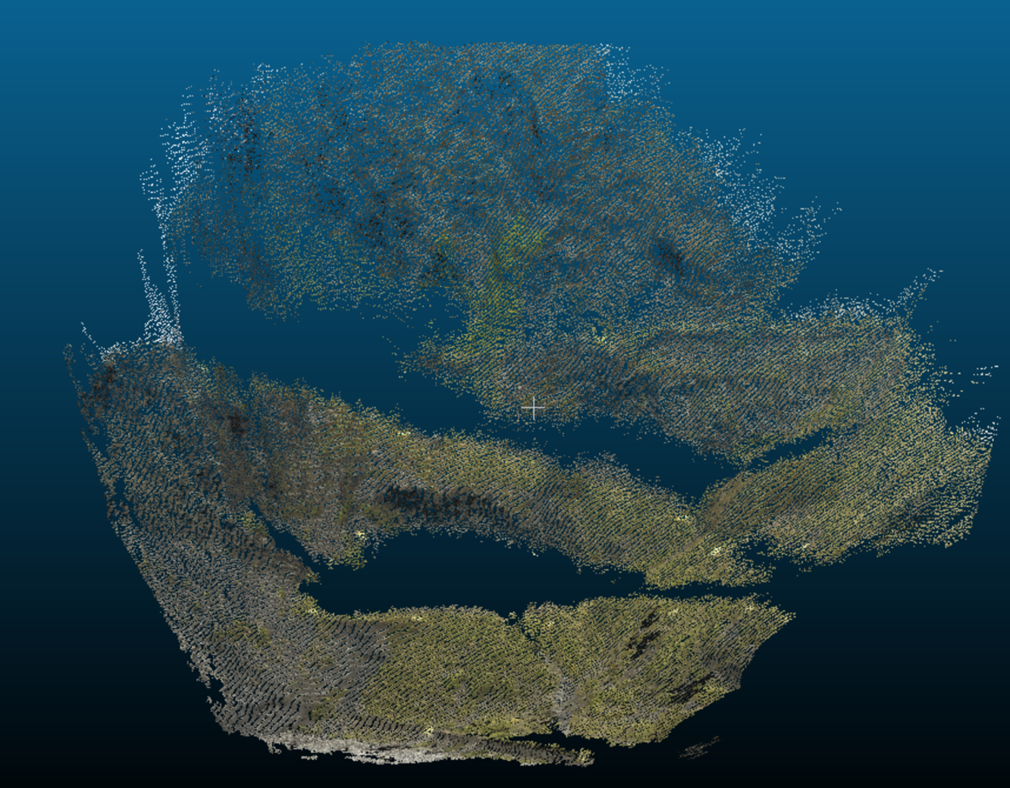
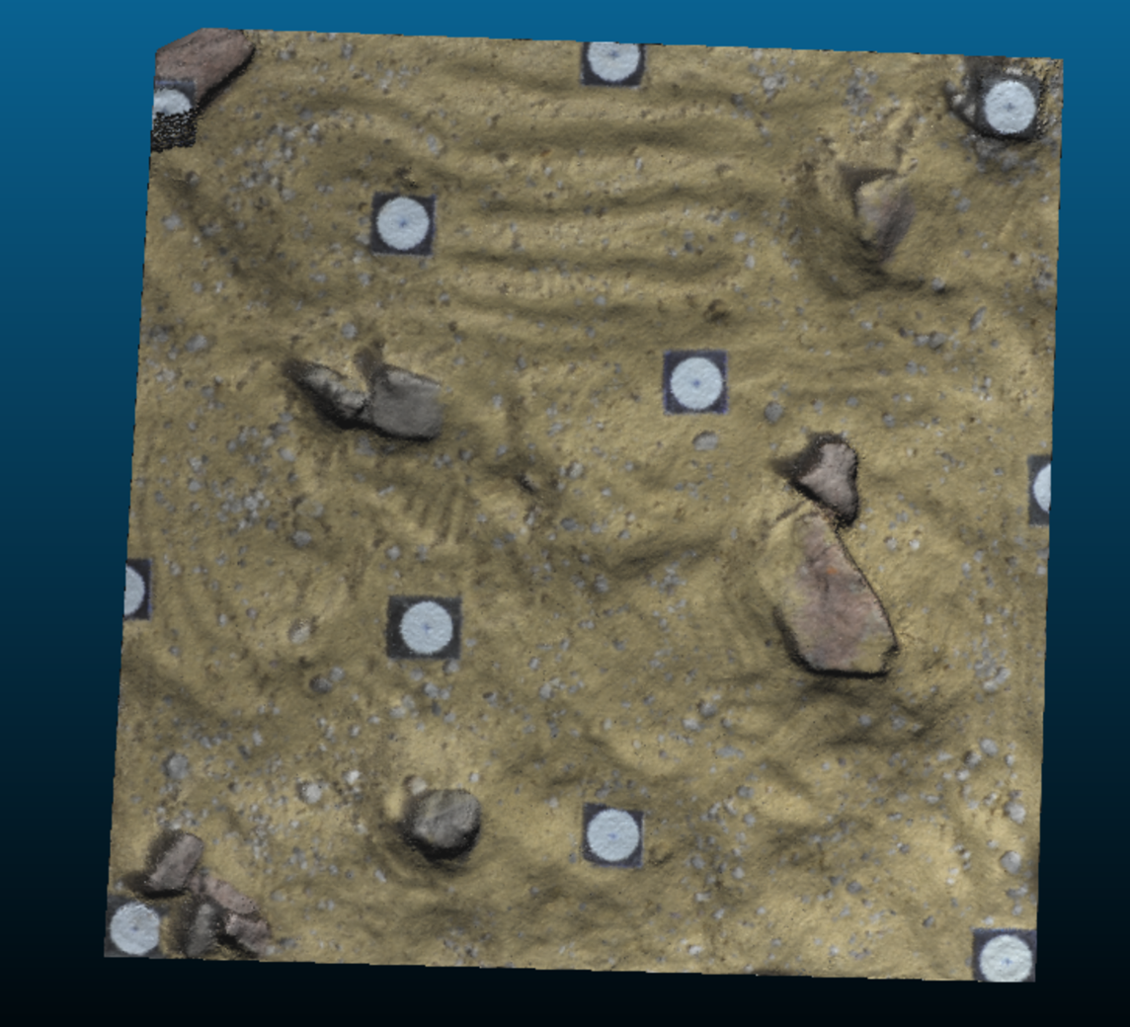
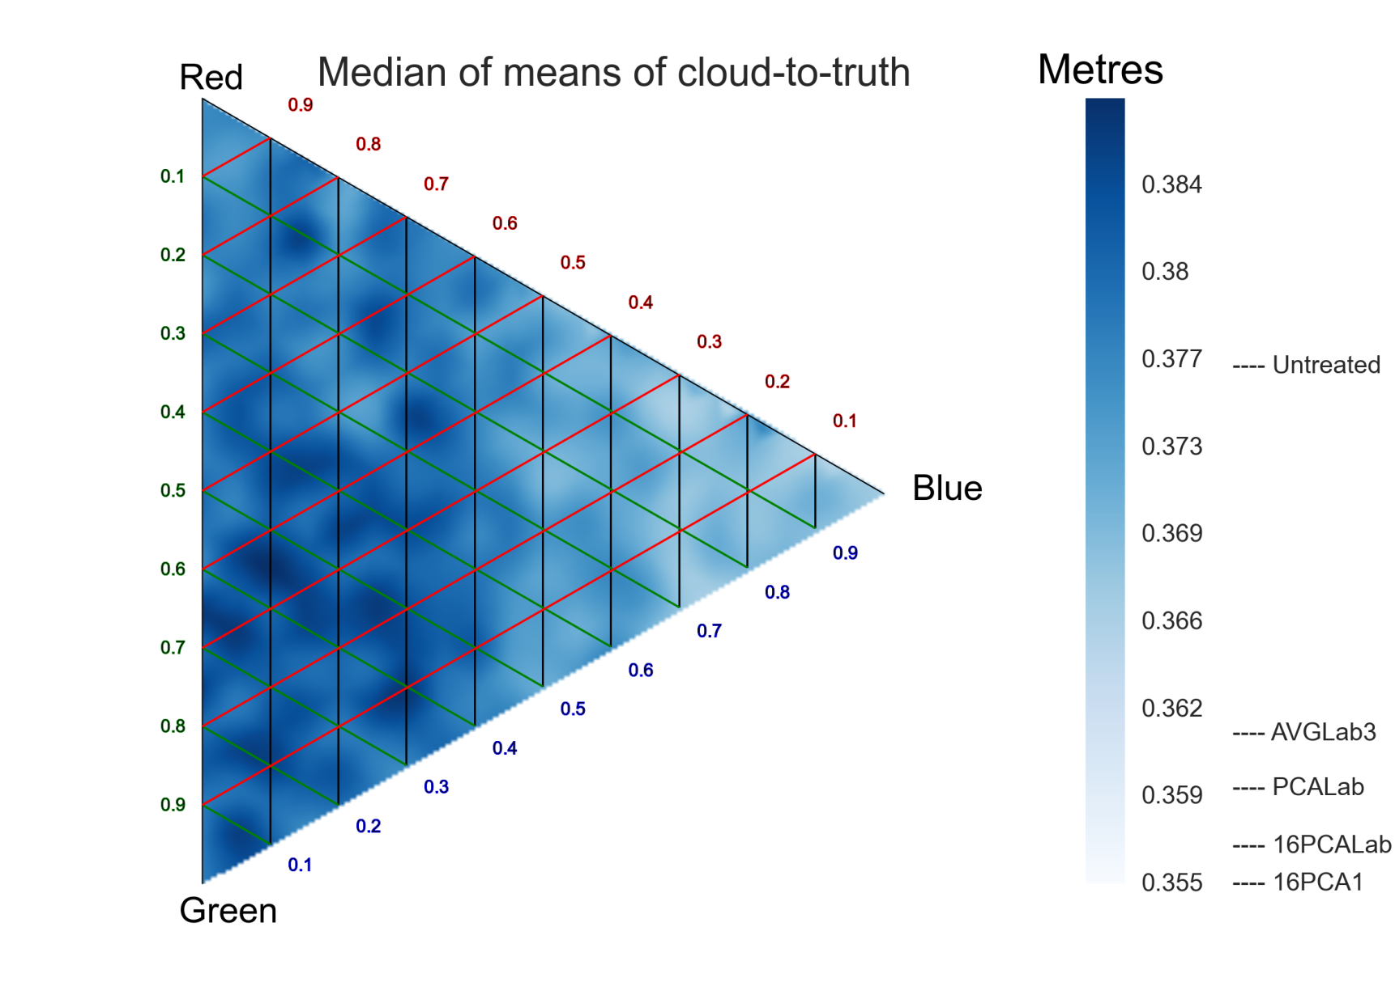
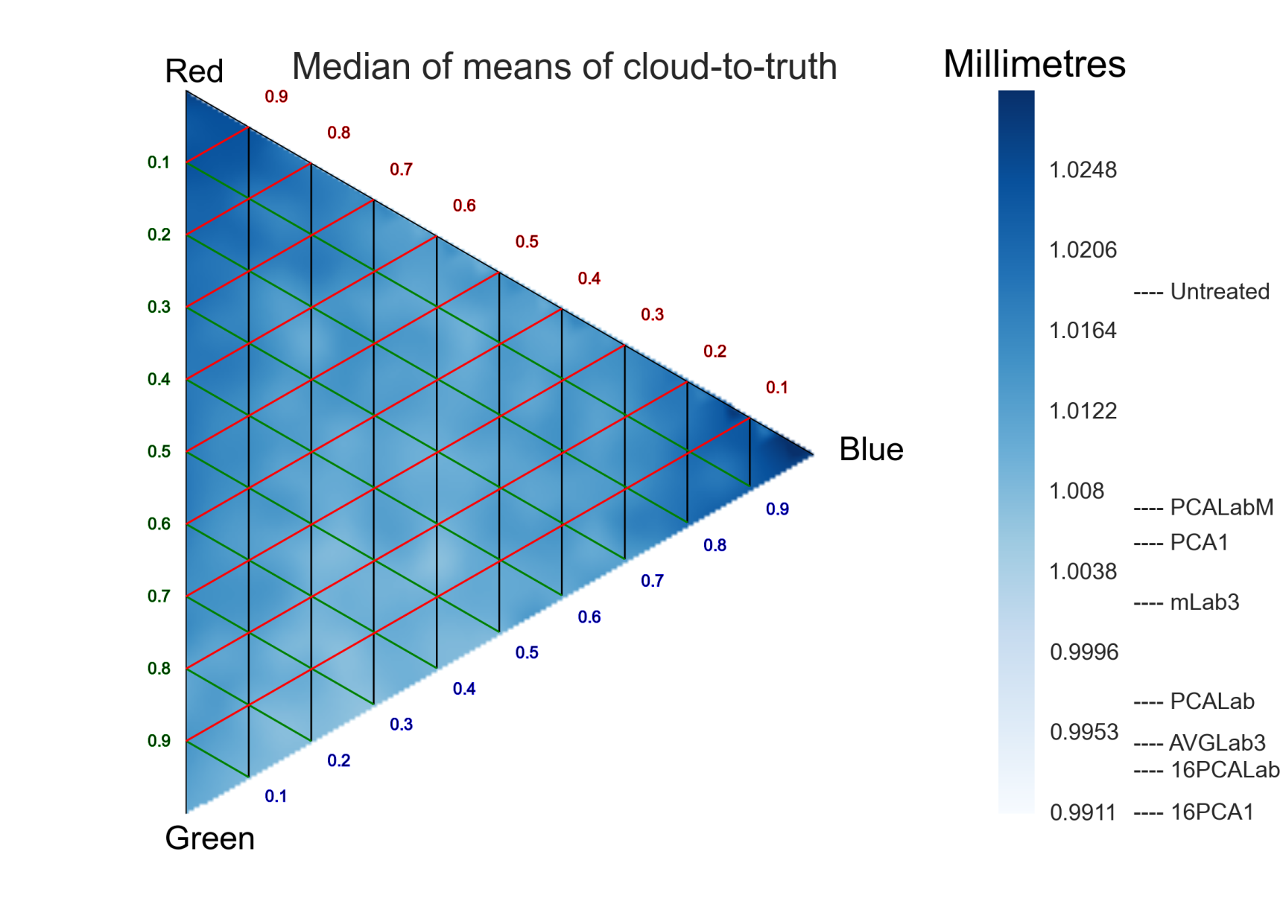
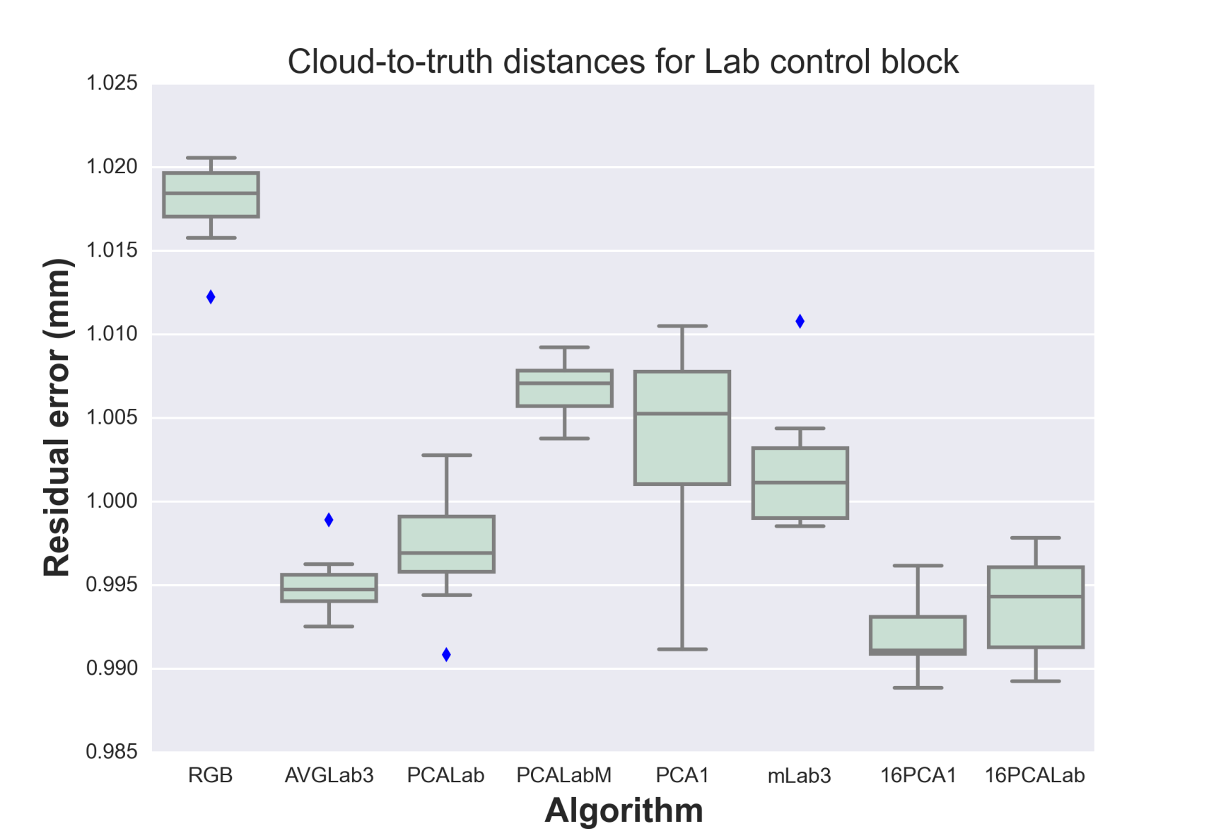
Contrast optimization for structure-from-motion surveys
James O’Connor¹ (James.OConnor@kingston.ac.uk), Mike Smith¹, Mike R. James²
¹School of the Natural and Built Environment, Kingston University, ²Lancaster Environment Centre, Lancaster University
1. Introduction
Motivation: Structure-from-motion (SfM) is a technology which takes multiple 2D photos of a common scene as an input and projects the data into 3D. Feature based SfM pipelines take single channel (grayscale) images as inputs. Within this contribution we review the results from varying this channel.
Research question: Can we improve the accuracy of SfM models by generating appropriate greyscale channels from RGB images?
3. Description of other algorithms
PCA1 : First Principal Component (PC) of each RGB image
PCALab : First PC of each image after conversion to LAB colourspace
16PCA1/16PCALab: 16 bit First PC of first two algorithms
AVGLab3 : Taken from Verhoeven et al. (2015), seeks to maximise statistical information in a single image
PCALabM : Multi-image decolourization. Images are concatenated before taking first PC in order to ensure global consistency (Bennedetti et al. 2012)
mLab3 : AVGLab3, but with masking of unimportant regions before applying the workflow
Figure 2. Constitution Hill overview
2. Methods
a. SfM software takes greyscale images as inputs
b. By altering this greyscale input, we intend to optimise contrast and improve outputs
c. Experiment: Take greyscale images made using different combinations of the Red, Green and Blue colour bands. Test other operators and compare accuracies
d. Measure accuracy against a very high quality terrestrial laser scan
e. Create greyscale image subsets generated by imposing the constraint that the Red, Green and Blue image bands must sum to 1. Bands are incremented by .05 per set and all permutations generated
f. 231 image subsets are constructed with 10 models generated for each set. Error (Cloud-to-truth) surfaces are then generated for the entire dataset
g. Data augmented with further algorithms
h. Two datasets used, one a 9 image block of a Welsh coastal cliff (Figure 2, Westoby et. al 2012) and one a 21 image block of a lab controlled scene (courtesy of Annette Eltner, figure 2)
Figure 3. Lab control overview
4. Results
Combinations of RGB images mapped onto a triangle, showing distance to reference laser scan (Figure 4 and 5)
Median of mean absolute cloud-to-truth distance for 10 runs presented
Other algorithms listed in colourbar and figure 6
Red coefficient
Green coefficient
Blue coefficient
5. Discussion
Cloud to cloud errors shown to be reduced by up to 6% (Constitution hill) vs untreated images using simple contrast enhancement techniques
Multi-image decolorization shown to not perform as well as image-specific techniques in dataset b
Range of differences appear to depend on number of images within each block
Figure 4. Results from Constitution Hill block
Red coefficient
Terrestrial laser scanner
JPGs from camera
Green coefficient
Blue coefficient
6. Future work
Bit depth will be investigated to see if further contrast enhancement can be achieved
Number and geometry of images further studied to see if accuracy can be increased
RAW image workflows currently being investigated to maximise value from consumer-grade cameras
Ground Control Points
Image processing
Figure 5. Results from Lab control block
Agisoft Photoscan
10 runs
per set
Clip edges
Acknowledgments
Annette Eltner and Matt Westoby for providing the datasets. Geert Verhoeven for sharing the code from his work
Contact: jp-oconnor.com
References
Benedetti L, Corsini M, Cignoni P, Callieri M and Scopigno R (2012) Color to gray conversions in the context of stereo matching algorithms. Machine Vision and Applications 23(2): 327-348.
Verhoeven G, Karel W, Štuhec S, Doneus M, Trinks I and Pfeifer N (2015) Mind Your Grey Tones–examining the Influence of Decolourization Methods on Interest Point Extraction and Matching for Architectural Image-Based Modelling. : ISPRS.
Westoby M, Brasington J, Glasser N, Hambrey M and Reynolds J (2012) ‘Structure-from-Motion’photogrammetry: A low-cost, effective tool for geoscience applications. Geomorphology 179: 300-314.
Evaluation
Cloud-to-truth distance
Dense cloud
Figure 1. Workflow applied
Figure 6. Results of other operations for lab control block

