Slide 1


Comparison Of High Resolution Terrestrial Laser Scanning And Terrestrial Photogrammetry For Modeling Applications
Samed ÖZDEMİR¹ Temel BAYRAK²
1 Gümüşhane University, Geomatics Engineering, Gümüşhane, Turkey
2 Sinop University, Geomatics Engineering, Sinop, Turkey
Corresponding Author: samedozdemirr@gmail.com
European Geosciences Union General Assembly 2016

Slide 2
OUTLINE
1. Introduction
1.1. Laser Scanner
1.2. Terrestrial Photogrammetry
2. Test Cases
2.1. Test Setup
2.2. Time of Flight Laser Scanner
2.3. Accuracy of Single Measurements
2.4. 3D Geometry Comparison
2.5. Planimetric and Volumetric Comparison
3. Conclusions
European Geosciences Union General Assembly 2016

Slide 3
1. Introduction
2. Test Cases
3. Conclusions
In this study, terrestrial laser scanner and terrestrial photogrammetric methods’ spatial and model accuracies investigated under various conditions which include measuring targets at different instrument to object distances then investigating the accuracy of these measurements, modeling an irregular shaped surface to compare two surfaces volume and surface areas, at last comparing dimensions of known geometrical shaped small objects. Also terrestrial laser scanners and terrestrial photogrammetric methods most suitable application conditions investigated in terms of cost, time, mobility and accuracy.
European Geosciences Union General Assembly 2016

Slide 4
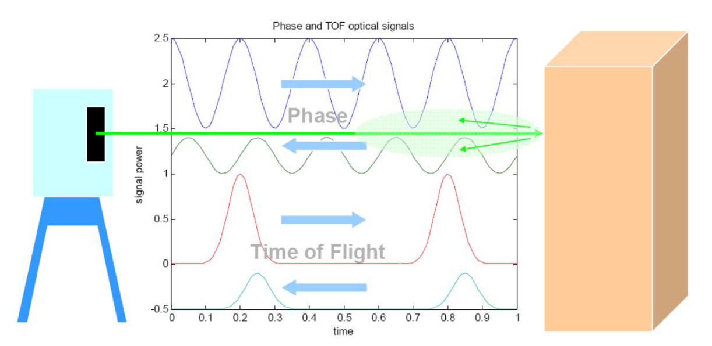
1.1. Laser Scanner
2. Test Cases
3. Conclusions
3 types of terrestrial laser scanners (TLS) widely used in modeling applications: Time of Flight, Phase Based and Triangulation laser scanners. Time of Flight Laser scanners, measures time between emitted and reflected laser pulse.
Phase Based Laser Scanners, phase difference measured between emitted and reflected modulated continous wave laser beam.
European Geosciences Union General Assembly 2016

Slide 5
1.1. Laser Scanner
2. Test Cases
3. Conclusions
Comparison of 3 types of laser scanners in terms of range, distance resolution, scan rate.
 | Triangulation | Phase Based | Time of Flight
Range | Up to 10 m | Up to 100m | 100 m and higher
Distance Resolution | 0.1 mm | 0.1 mm | 1 mm
Scan Rate | Very Fast | Fast | Slow
Advantages | Fast data acquisition, low noise, high resolution | High accuracy, fast data acquisition, low noise | High measurement range
Disadvantages | Short range, limited field of view, weak low light performance | Comparatively short range | Low accuracy, high noise, slow scan speed
European Geosciences Union General Assembly 2016

Slide 6
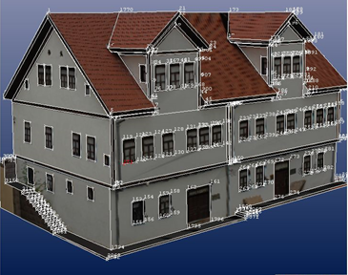
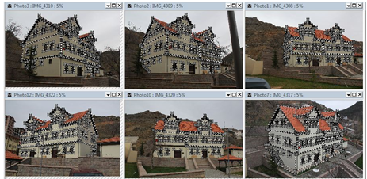
1.2. Terrestrial Photogrammetry
2. Test Cases
3. Conclusions
Photogrammetry is a technique of representing and measuring 3D objects using data stored on 2D photographs, which are the base for rectification. At least two projections are necessary to obtain information about three space coordinates, that is, from two photographs of the same object its true size can be determined and 3D model constructed.
European Geosciences Union General Assembly 2016

Slide 7

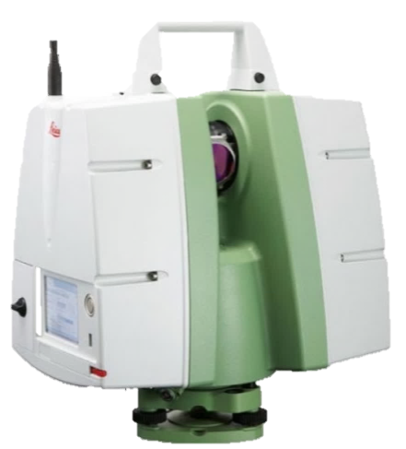
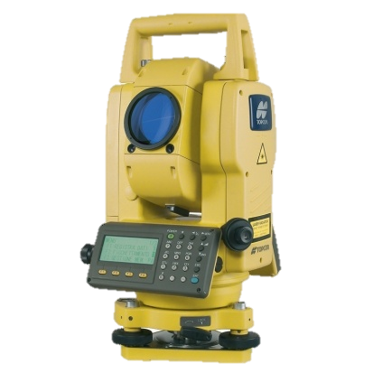
1. Introduction
2.1. Test Setup
3. Conclusions
Canon 550d DSLR non-metric camera with 18-5mm Lens
Leica C 10 Scanstation Time of Flight Laser Scanner
Topcon GPT 3100NW total station used for determining absolute positions of points and also for georeferencing the models.
3 methods used to investigate the accuracy of TLS and TP. Which are;
Different instrument to target distance testing area with equally distributed control points.
Measuring dimensions of a set of regular shaped small objects
Measuring an irregular shaped surface
European Geosciences Union General Assembly 2016

Slide 8
1. Introduction
2.2. Time of Flight Laser Scanner
3. Conclusions
Leica ScanStation C10 time of flight laser scanner used in this study.
Laser point clouds merged and referenced in Leica Cyclone software.
Maximum range: 300m
Scan rate : 50,000 pts/s
Horizontal FOV:360 degrees, Vertical FOV:270 degrees
Accuracy of single measurement; position: 6 mm; distance: 4 mm
European Geosciences Union General Assembly 2016

Slide 9
1. Introduction
2.2. Camera and Photog. Software
3. Conclusions
Canon 550d DSLR with 18-5mm Lens and Photomodeler Scanner software
Sensor Type | CMOS
Sensor Size | 22.3 x 14.9 mm
Pixel Count | 18 million
Aspect Ratio | 3:2
Crop Factor | 1.6x
ISO sensitivity | 100 - 6400
Shutter Speed | 30- 1/4000 second
Image Size | 5184 x 3456 pixel (8 bit JPEG)
Photomodeler Scanner software
PhotoModeler Scanner
Smart Match | Automatically matching corresponding points from images
Dense Surface | Dense point cloud creation from image pairs
Statistical Outlier Removal Neighborhood Based Outlier Removal | Cleaning noise and outliers
Triangulation | Surface construction from dense point cloud
European Geosciences Union General Assembly 2016

Slide 10
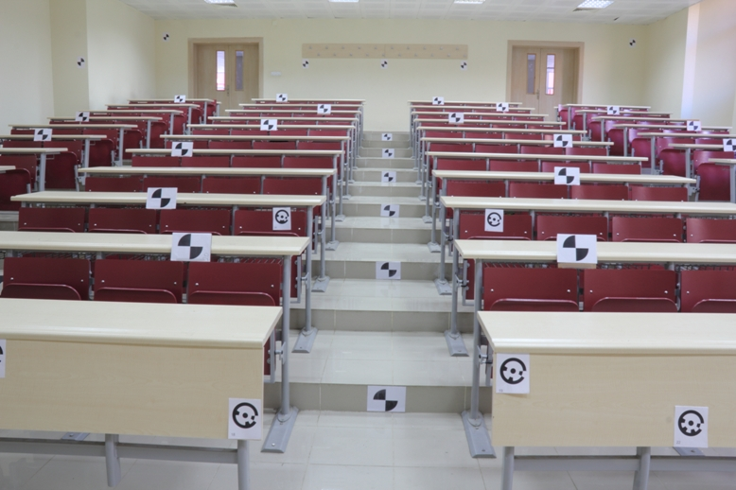
1. Introduction
2.3. Accuracy of Single Measurements
3. Conclusions
Instrument to point distances varying between 1.5 and 15 m
36 point coordinates acquired with TP and TLS
Compared with the coordinates from total station
European Geosciences Union General Assembly 2016

Slide 11
1. Introduction
2.3. Accuracy of Single Measurements
3. Conclusions
Standard deviation and weighted accuracy of single measurements
Non Weighted Computed Values | Terrestrial Photogrammetry (mm) |  |  | Terrestrial Laser Scanner (mm)
 | Sx | Sy | Sz | Sx | Sy | Sz
Standard Deviation | 15.549 | 42.766 | 11.249 | 2.050 | 1.342 | 1.316
Position Accuracy | 46.875 |  |  | 2.781
Weighted Computed Values | Terrestrial Photogrammetry (mm) |  |  | Terrestrial Laser Scanner (mm)
 | Sx | Sy | Sz | Sx | Sy | Sz
Standard Deviation | 19.332 | 43.796 | 13.323 | 1.633 | 1.270 | 0.870
TLS has a consistent accuracy along the measuring range even it is 15 m long
TP however showed acceptable 2D accuracy but performed poor determining the distance to object
European Geosciences Union General Assembly 2016

Slide 12
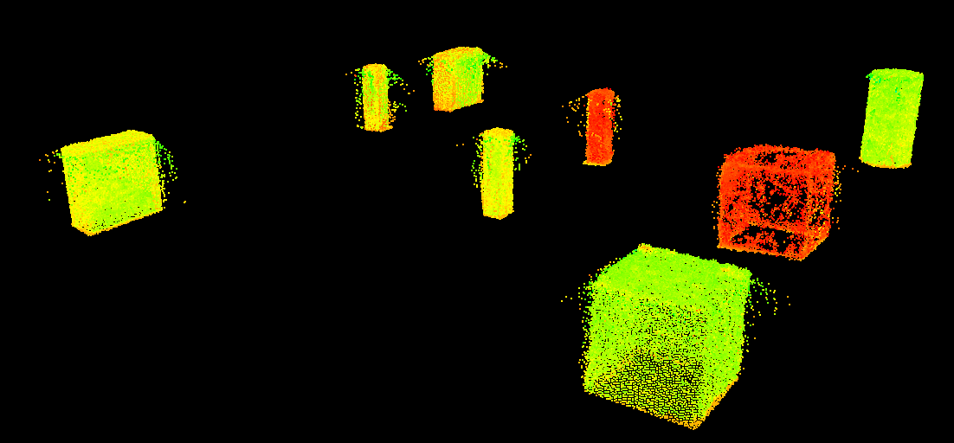
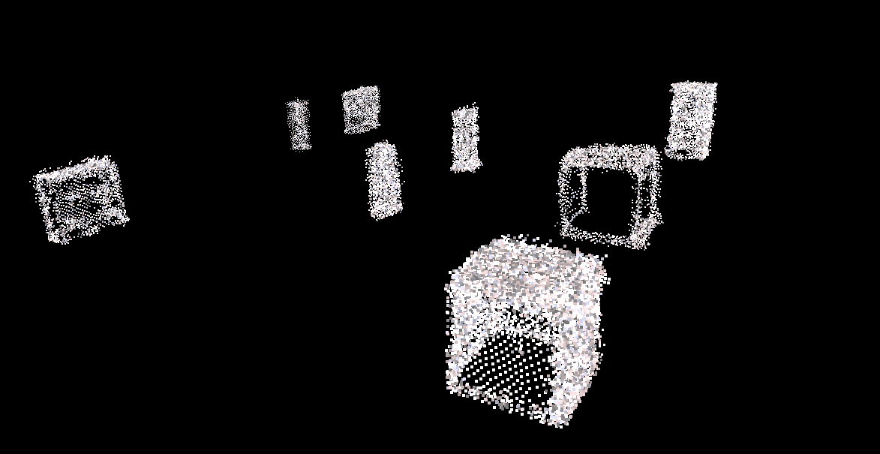
1. Introduction
2.4. 3D Geometry Comparison
3. Conclusions
Laser scanner point cloud
Photogrammetric point cloud

Slide 13
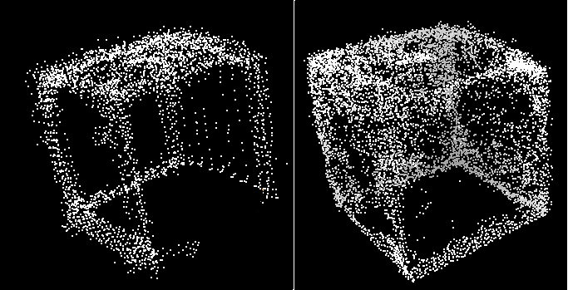
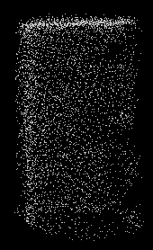

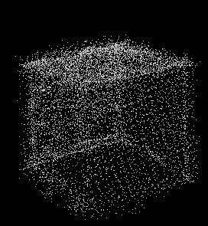
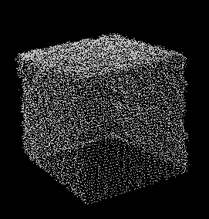
1. Introduction
2.4. 3D Geometry Comparison
3. Conclusions
Left point clouds generated by terrestrial photogrammetry
Right point cloud acquired by terrestrial laser scanner

Slide 14
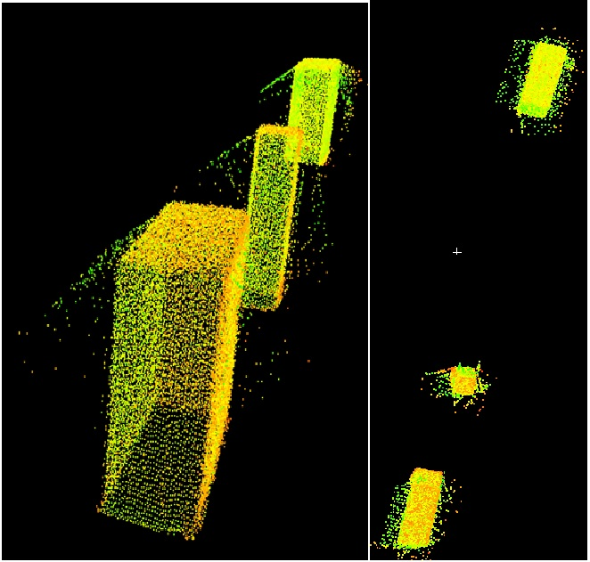
1. Introduction
2.4. 3D Geometry Comparison
3. Conclusions
Depending on scanner position and distance to object, edge effect is evident.

Slide 15
1. Introduction
2.4. 3D Geometry Comparison
3. Conclusions
Object dimensions comparison
Object Dimensions (cm) | Terrestrial Photogrammetry (cm) | Terrestrial Laser Scanner (cm) | Error of Terrestrial Photogrammetry (cm) | Error of Terrestrial Laser Scanner (cm)
15.00 | 14.90 | 15.03 | 0.10 | -0.03
6.10 | 6.00 | 6.12 | 0.10 | -0.02
15.00 | 14.80 | 15.00 | 0.20 | 0.00
6.10 | 5.90 | 6.05 | 0.20 | 0.05
15.00 | 14.90 | 14.97 | 0.10 | 0.03
6.00 | 5.90 | 6.01 | 0.10 | -0.01
15.00 | 14.90 | 15.02 | 0.10 | -0.02
6.00 | 6.00 | 5.98 | 0.00 | 0.02
15.00 | 14.90 | 14.98 | 0.10 | 0.02
European Geosciences Union General Assembly 2016

Slide 16
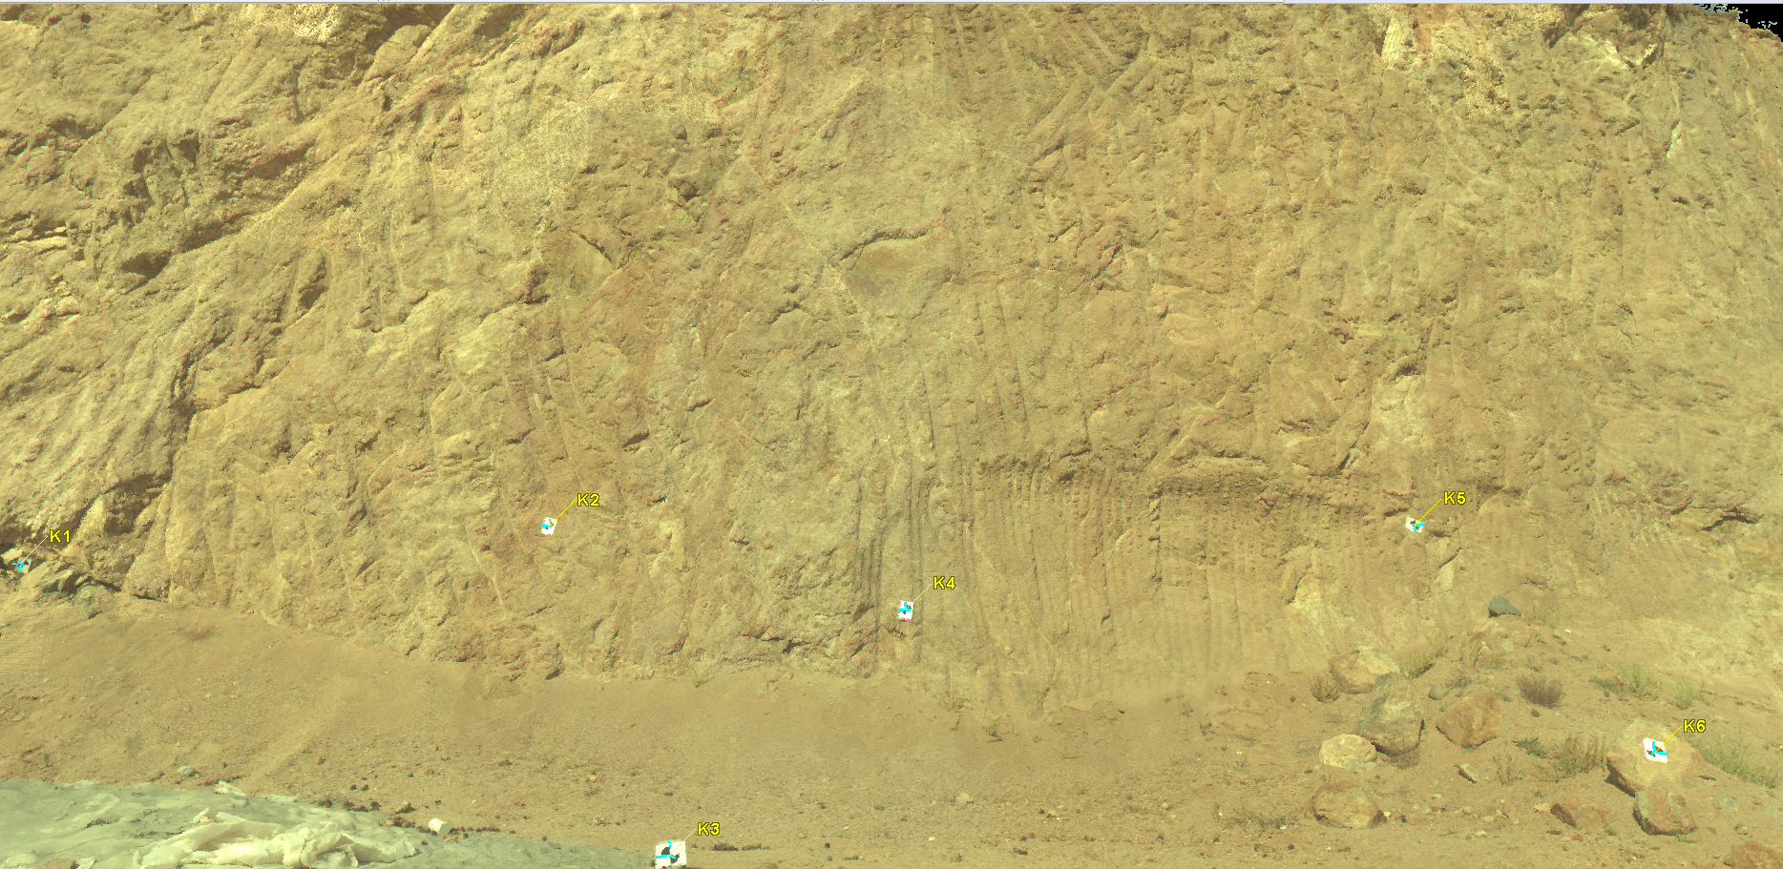
1. Introduction
2.5. Plani. and Vol. Comparison
3. Conclusions
TP and TLS performance evaluated on an irregular shaped rock surface.
 | Terrestrial Laser Scanner | Terrestrial Photogrammetry
Number of Points | 34000000 | 5000000
Decimated Number of Points | 600000 | 300000
Model Surface Area (m²) | 128.34 | 129.44
Model Volume (m³) | 199.40 | 200.38
European Geosciences Union General Assembly 2016

Slide 17
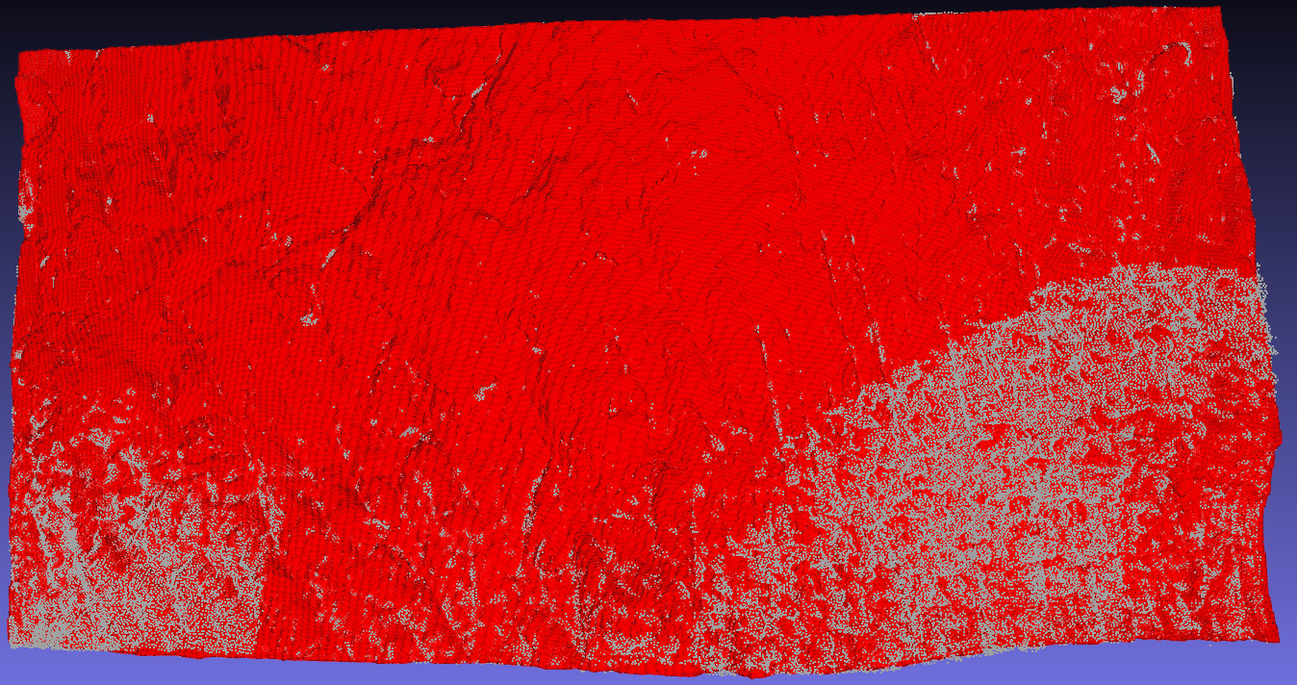
1. Introduction
2.5. Plani. and Vol. Comparison
3. Conclusions
Front view of rock surface point cloud
Red Laser Scanner point cloud
White Photogrammetric point cloud
European Geosciences Union General Assembly 2016

Slide 18
1. Introduction
2.5. Plani. and Vol. Comparison
3. Conclusions
Photogrammetric 3D surface model
Laser Scanner 3D surface model
European Geosciences Union General Assembly 2016

Slide 19
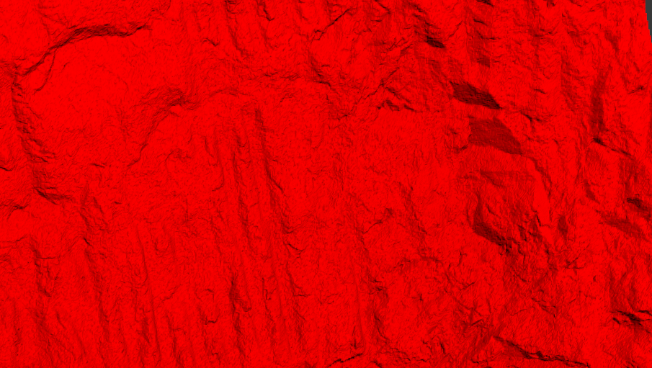

1. Introduction
2.5. Plani. and Vol. Comparison
3. Conclusions
European Geosciences Union General Assembly 2016

Slide 20
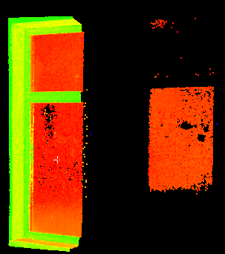
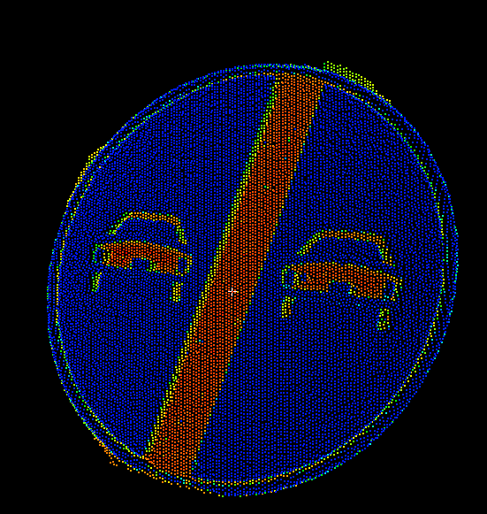
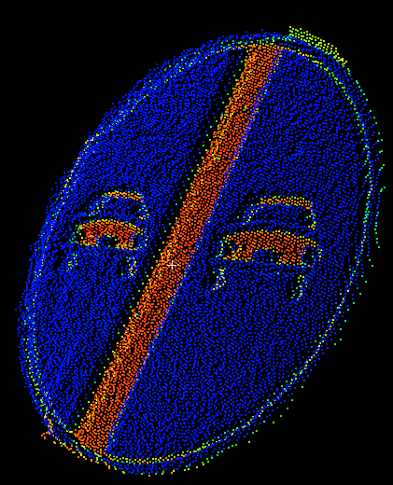
1. Introduction
2. Test Cases
3. Conclusions
Advantages of Terrestrial Laser Scanning
360 horizontal 270 vertical field of view to capture surrounding environment in one session
300 m range is enogh to modeling objects from distance
Fast scan speed; 360 degree full scan at low resolution takes approximately 2 minutes
Point spacing at 10 m is 0.2 cm, at 100 m it is 2 cm; allows creating very high resolution surface models
Disadvantages of Terrestrial Laser Scanning
Edge effects may occur on close proximity objects
Easily affected by surface reflectance
Point clouds are sometimes may become hard to interpret
Size and weight (apprx. 30 kg with carrying case) of the equipment makes it hard to carry around, especially on rough land.
European Geosciences Union General Assembly 2016

Slide 21
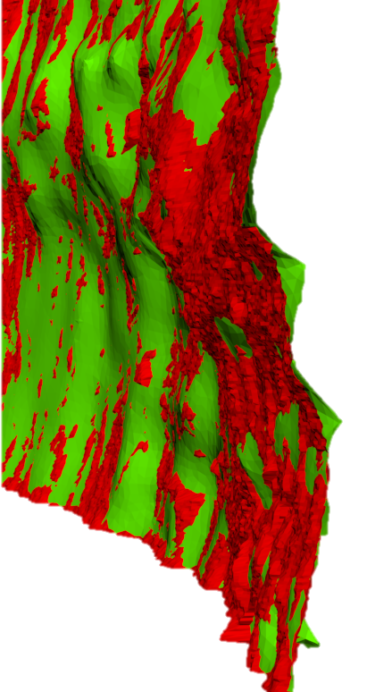
1. Introduction
2. Test Cases
3. Conclusions
Advantages of Terrestrial Photogrammetry
Fast image acquisition reduces time spend on field survey.
Centimeter level accuracy, suitable for most modeling applications
Camera end photogrammetric software costs far more lower than terrestrial laser scanners
Hanheld camera dimensions are allow user to carry it freely on the field and also make it easier to use cameras in cramped spaces.
Disadvantages of Terrestrial Photogrammetry
Processing time to create surface models may be long
Dense surface models prone to outliers,noise and tend to smooth sharp details
Dense surface models must be cleared from outliers and noise in order to get an accurate model
Varying accuracy
Accuracy depends on camera calibration and can be easily affected by coarse image acquisition geometry
European Geosciences Union General Assembly 2016

Slide 22
Thanks For Your Attention…
European Geosciences Union General Assembly 2016

