Slide 1






SOIL WATER REPELLENCY AS A VEGETATION-DRIVEN STRATEGY FOR SOIL MOISTURE SEQUESTRATION IN BANKSIA WOODLANDS
(WESTERN AUSTRALIA)
Miriam Muñoz-Rojas, Nicasio T. Jiménez-Morillo, José A. González-Pérez, Lorena M. Zavala, Jason Stevens, and Antonio Jordán

Slide 2


WHERE DO HYDROPHOBIC SUBSTANCES COME FROM?
ORGANIC COATINGS ON SOIL PARTICLES
WAXES ERODED FROM PLANT LEAVES
SOIL ORGANIC MATTER
FUNGI AND BACTERIAE
ROOT EXUDATES

Slide 3
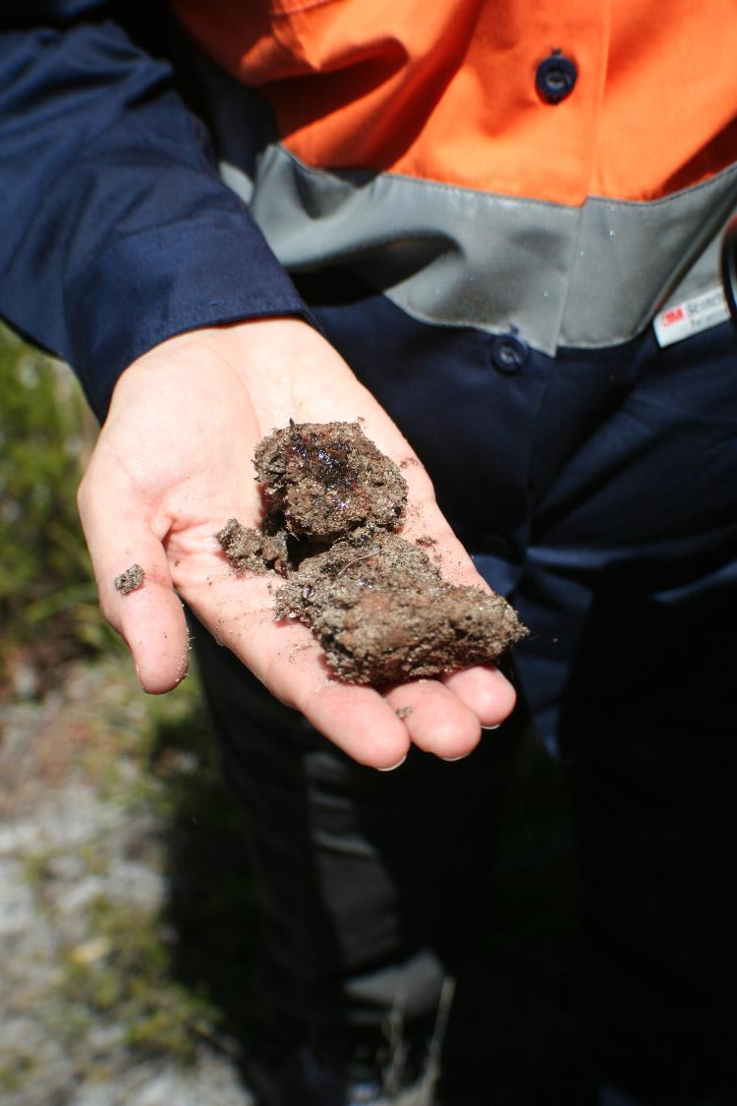
WHAT ARE THE IMPACTS OF SOIL WATER REPELLENCY?
Hydrological and geomophological impacts
  Delayed water infiltration
  Increased runoff rate
  Increased soil erosion risk
  Irregular wetting fronts and preferential flow paths
  Increased aggregate stability
Ecological impacts
  Dry soil pockets
  Increased carbon sequestration rate
  Accelerated leaching of nutrients
Water-repellent soil aggregates below Banksia attenuata (WA, Australia)

Slide 4
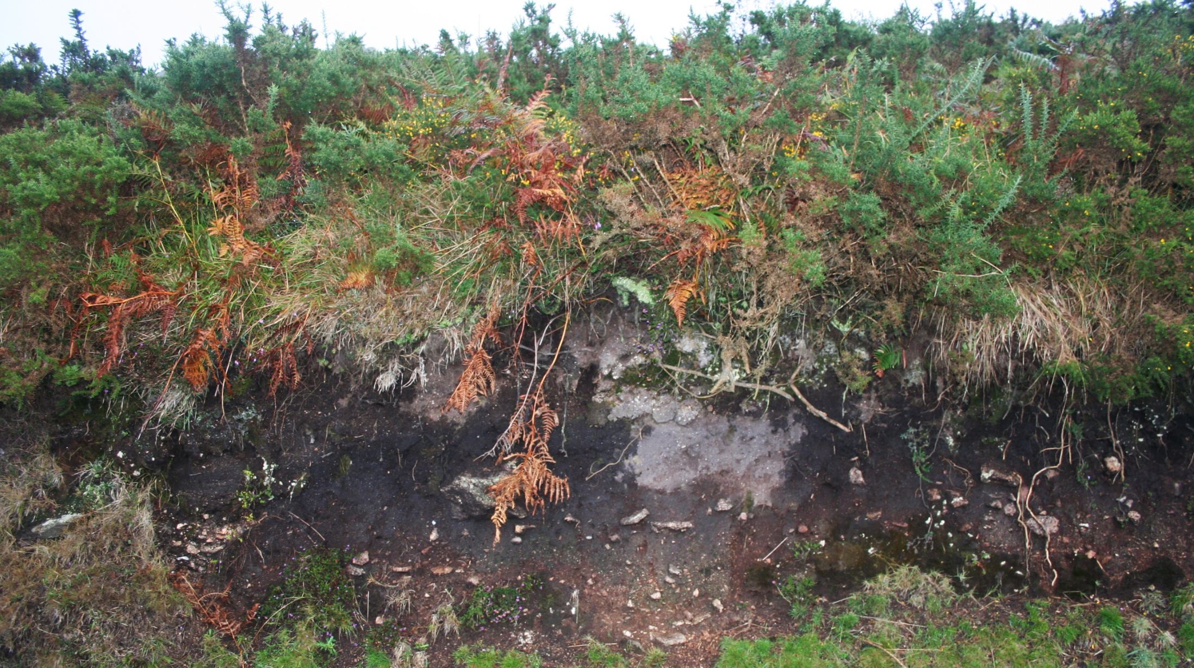

Irregular wetting front in a water-repellent soil in Galicia (NW Spain)
DRY SOIL POCKET
(ALTHOUGH IT RAINS ALL THE YEAR)

Slide 5
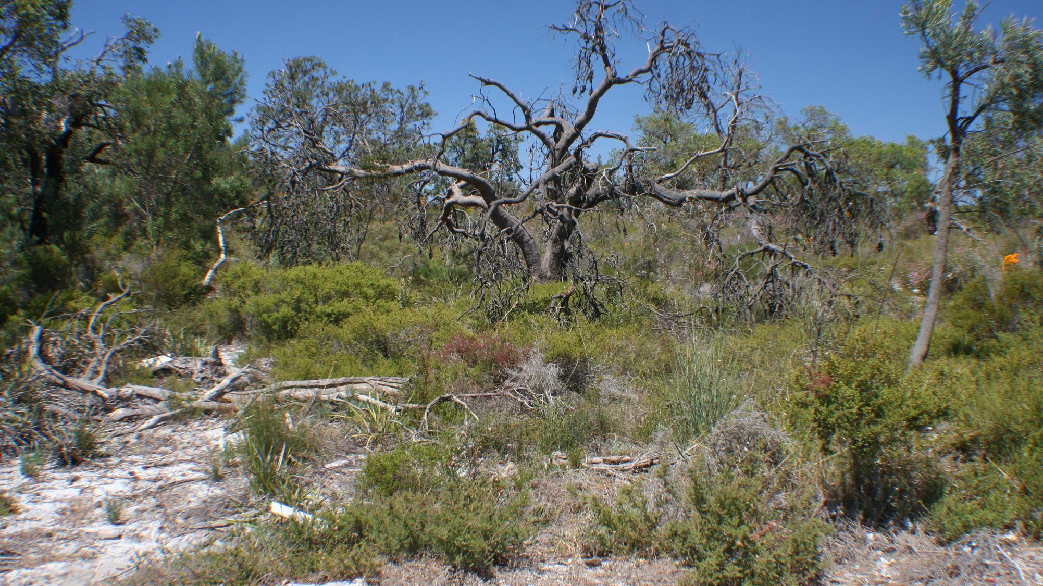
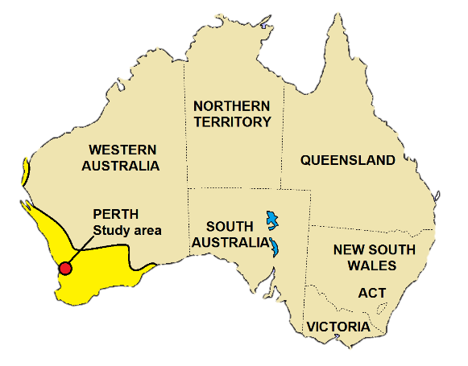
Banksia woodland near Perth (SW Australia)

Slide 6
HYPOTHESIS: DOES BANKSIA INDUCE SOIL WATER REPELLENCY AS AN ECOLOGICAL STRATEGY?
General behaviour
Banksia woodlands
Wettable soil surface
Wettable soil surface
Water-repellent subsurface layer
Water-repellent soil surface
Sequestered water
Wettable soil surface

Slide 7
VERTICAL DISTRIBUTION OF WATER REPELLENCY IN BANKSIA WOODLANDS
Extreme WR
Severe WR
Vertical distribution (0-0.5, 0.5-10, 20-30 and 40-50 cm) of water drop penetration times (WDPT, s; median ± range) below plants of Banksia attenuata, Melaleuca spp., Gompholobium spp. and Eucalyptus spp.

Slide 8
VERTICAL DISTRIBUTION OF MICROBIAL ACTIVITY IN BANKSIA WOODLANDS
Vertical distribution (0-0.5, 0.5-10, 20-30 and 40-50 cm) of microbial activity (ppm CO₂/h) below plants of Banksia attenuata, Melaleuca spp., Gompholobium spp. and Eucalyptus spp.

Slide 9
VERTICAL DISTRIBUTION OF MOISTURE CONTENT IN BANKSIA WOODLANDS
Vertical distribution (0-0.5, 0.5-10, 20-30 and 40-50 cm) of soil moisture content (%, mean ± SD) in banksia woodlands.

Slide 10
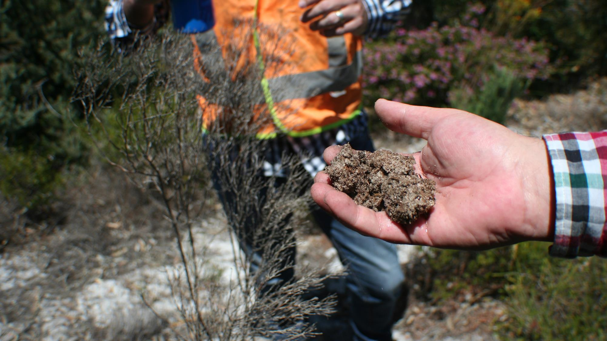
SOIL IS WATER REPELLENT AT THE
SURFACE

Slide 11
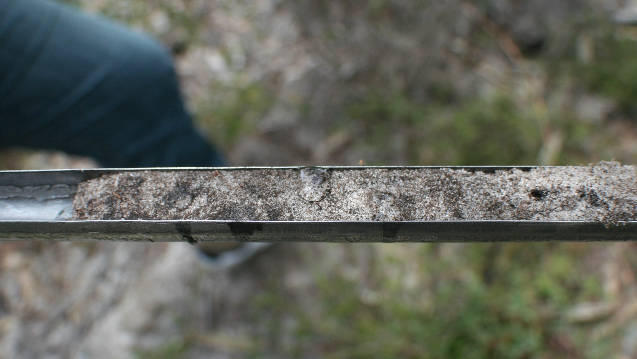
WATER DROPS DO NOT INFILTRATE IN DEPTH
NO ROOTS…
BUT HYDROPHOBIC EXUDATES ARE PRESENT HERE

Slide 12
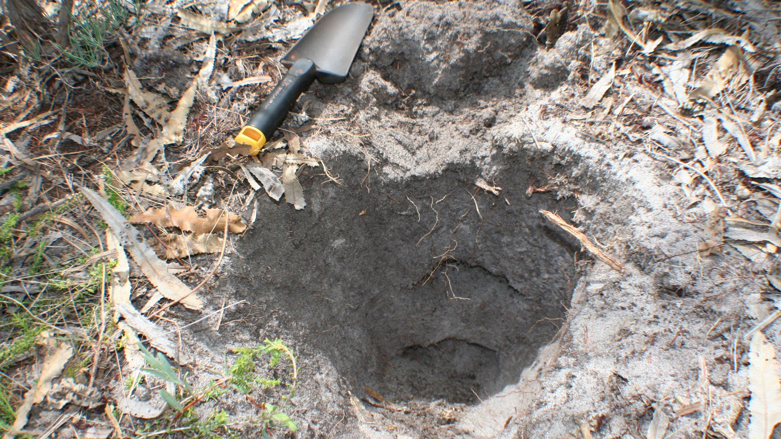

ROOT CLUSTERS CONCENTRATE HERE

Slide 13
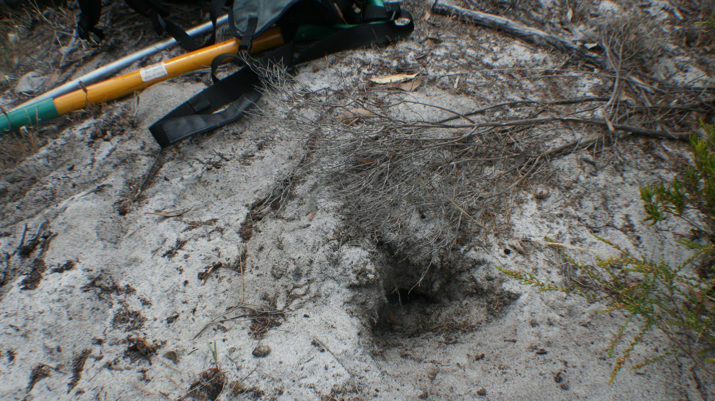
CRACKS AND MACROPORES ARE THE ORIGIN OF MANY PREFERENTIAL FLOW PATHS

Slide 14
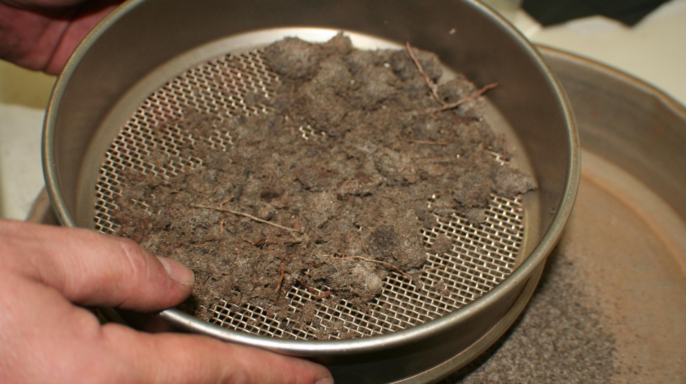
BANKSIA’S ROOT CLUSTERS (HERE SEPARATED FROM SOIL BY DRY SIEVING) FORM CONTINUOS LAYERS IN THE TOPSOIL

Slide 15
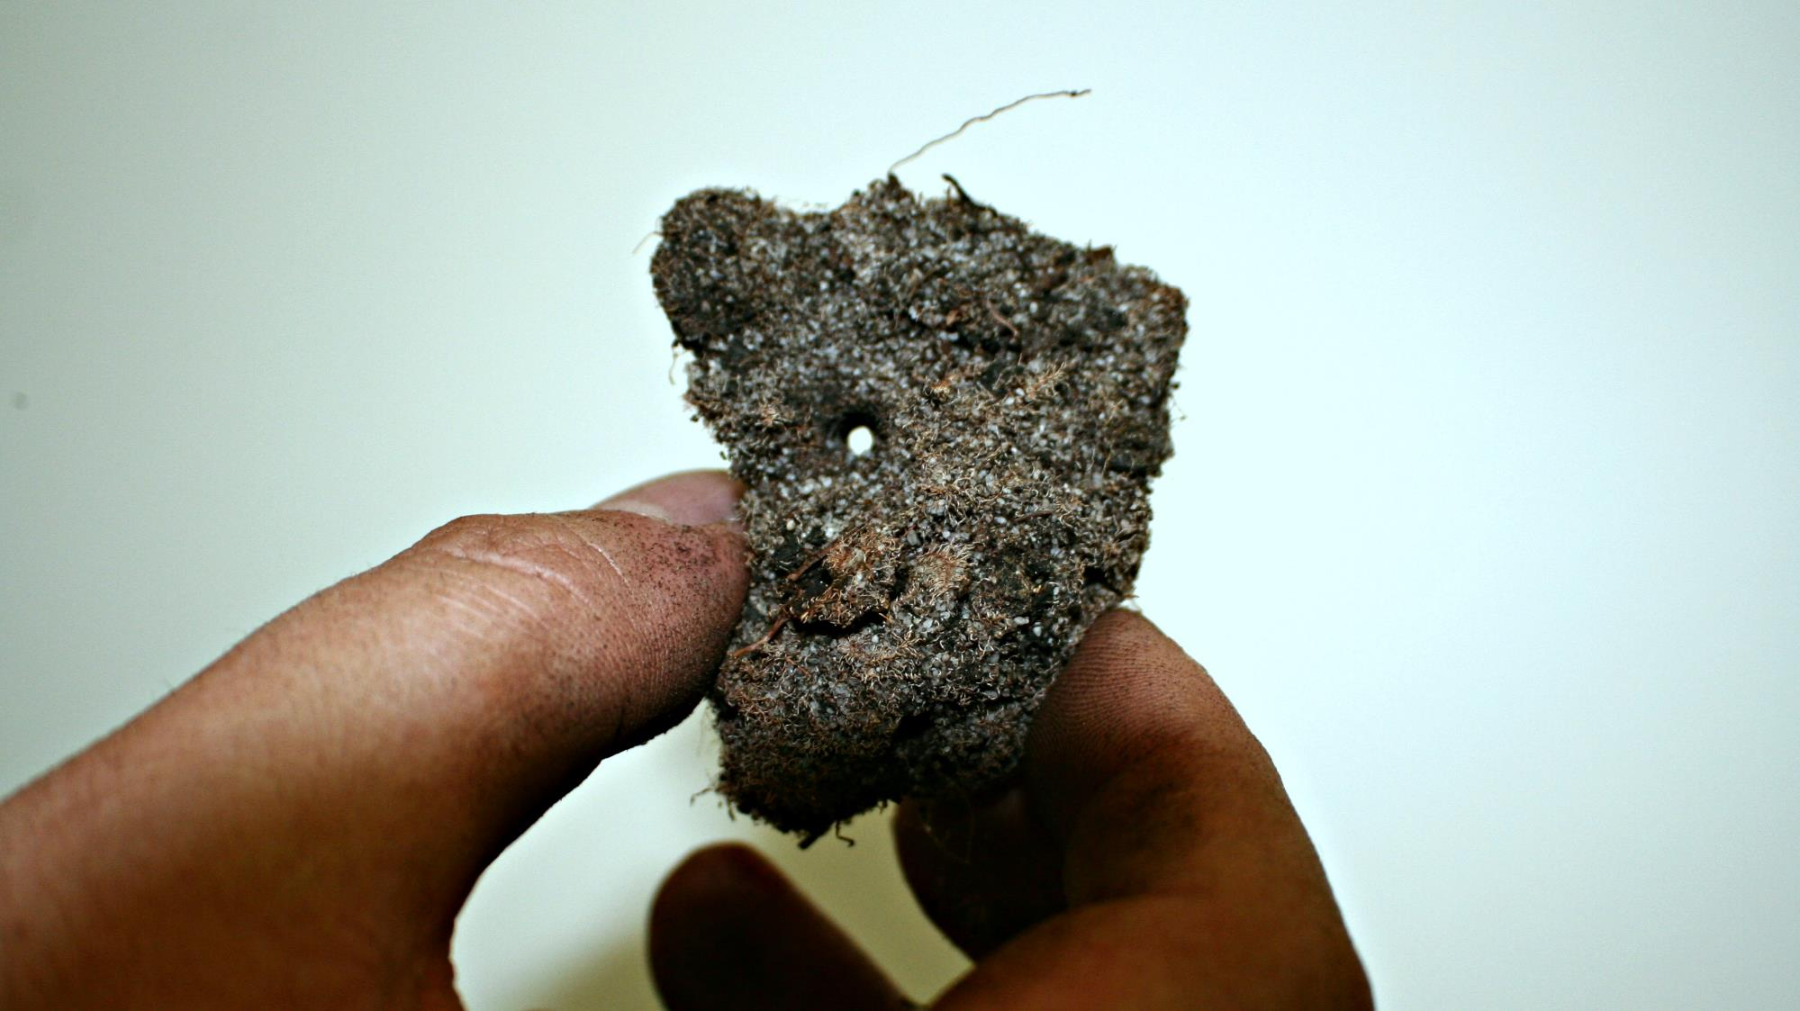
MACROPORE IN A SOIL AGGREGATE CEMENTED BY A ROOT CLUSTER

Slide 16
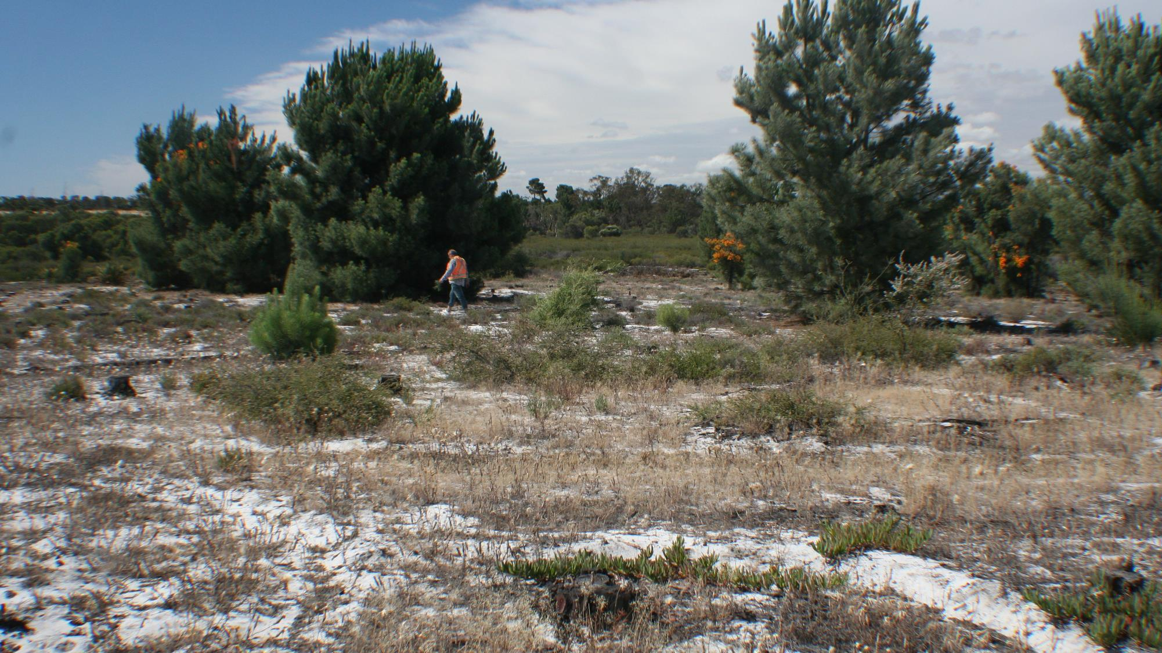
View of a degraded banksia woodland (Perth, SW Australia)

Slide 17
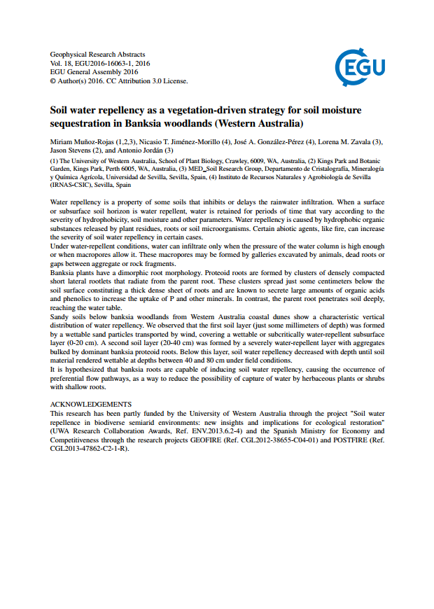



THANKS!
Acknowledgements
This research has been funded by the University of Western Australia (Research Collaboration Award 2015: ‘WiRE: Soil water repellence in biodiverse semi arid environments: new insights and implications for ecological restoration’) and the Spanish Ministry of Economy and Competitiveness (research projects GEOFIRE, CGL2012-38655-C04-01, and POSTFIRE, CGL 2013-47862-C2-1-R.

Slide 18
Affiliations
Miriam Muñoz-Rojas (1,2,3), Nicasio T. Jiménez-Morillo (4), José A. González-Pérez (4), Lorena M. Zavala (3), Jason Stevens (2), and Antonio Jordán (3)
  The University of Western Australia, School of Plant Biology, Crawley, 6009, WA, Australia
  Kings Park and Botanic Garden, Kings Park, Perth 6005, WA, Australia
  MED_Soil Research Group, Departamento de Cristalografía, Mineralogía y Química Agrícola, Universidad de Sevilla, Facultad de Química, C/Profesor García González, 1, 41012, Sevilla, Spain
  Instituto de Recursos Naturales y Agrobiología de Sevilla (IRNAS-CSIC), Avda. Reina Mercedes, 10, 41012, Sevilla, Spain

Slide 19
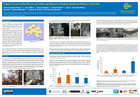
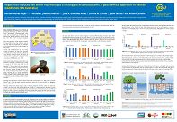
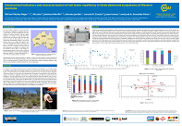
SEE ALSO:
Impact of a prescribed fire on soil water repellency in a Banksia woodland (Western Australia)
EGU2016-16926
Vegetation-induced soil water repellency as a strategy in arid ecosystems. A geochemical approach in Banksia woodlands (SW Australia)
EGU2016-1820
Geochemical indicators and characterization of soil water repellence in three dominant ecosystems of Western Australia
EGU2016-11368
Wed, 20 Apr, 17:30–19:00
Hall X1: X1.61
Thu, 21 Apr, 17:30–19:00
Hall X1: X1.51
Thu, 21 Apr, 16:02–16:04
PICO spot 4

