Slide 1
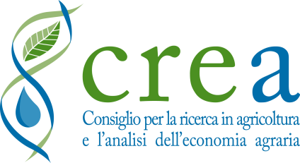
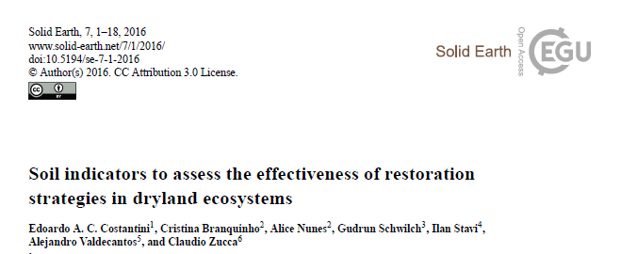
Soil indicators to assess the effectiveness of restoration strategiesin dryland ecosystems
Edoardo A.C. Costantini¹, Cristina Branquinho², Alice Nunes², Gudrun Schwilch³, Ilan Stavi⁴, Alejandro Valdecantos⁵, Claudio Zucca⁶
1 Consiglio per la ricerca in agricoltura e l’analisi dell’economia agraria, CREA-ABP Agrobiology and Pedology Research Centre, Firenze, Italy
2 Centre for ecology, evolution and environmental changes, Faculdade de Ciências da Universidade de Lisboa, Campo Grande, Lisboa, Portugal
3 University of Bern, Centre for Development and Environment (CDE), Switzerland
4 Dead Sea and Arava Science Center, Ketura 88840, Israel
5 Centro de Estudios Ambientales del Mediterráneo (CEAM), Valencia, Spain and Dep. Ecologia, Universidad de Alicante, Spain
6 Soil Conservation and Land Management International Center for Agricultural Research in the Dry Areas (ICARDA), Amman, Jordan and Dep. of Agriculture & Desertification Research Centre (NRD), Sassari, Italy. edoardo.costantini@crea.gov.it
COST Action ES1104: Setting Up a Drylands and Desert Restoration Hub

