Slide 1
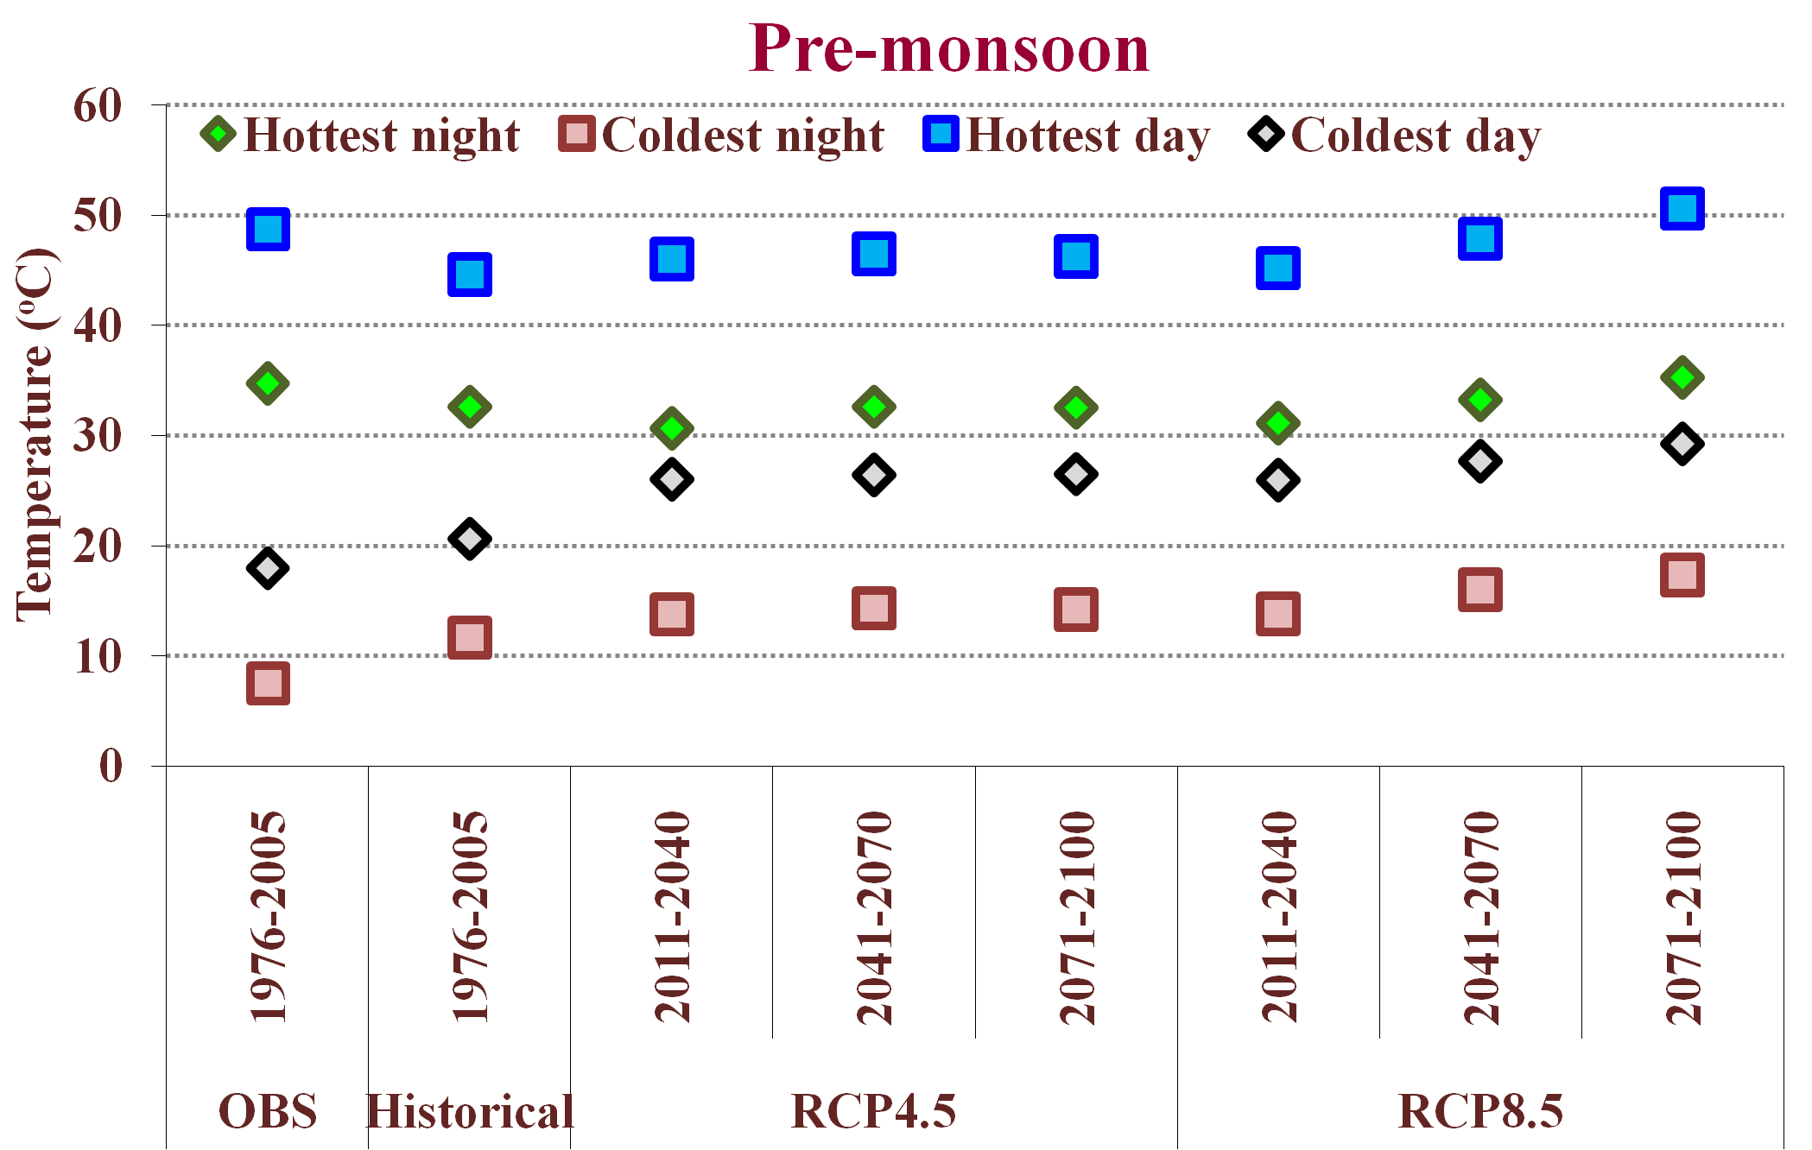
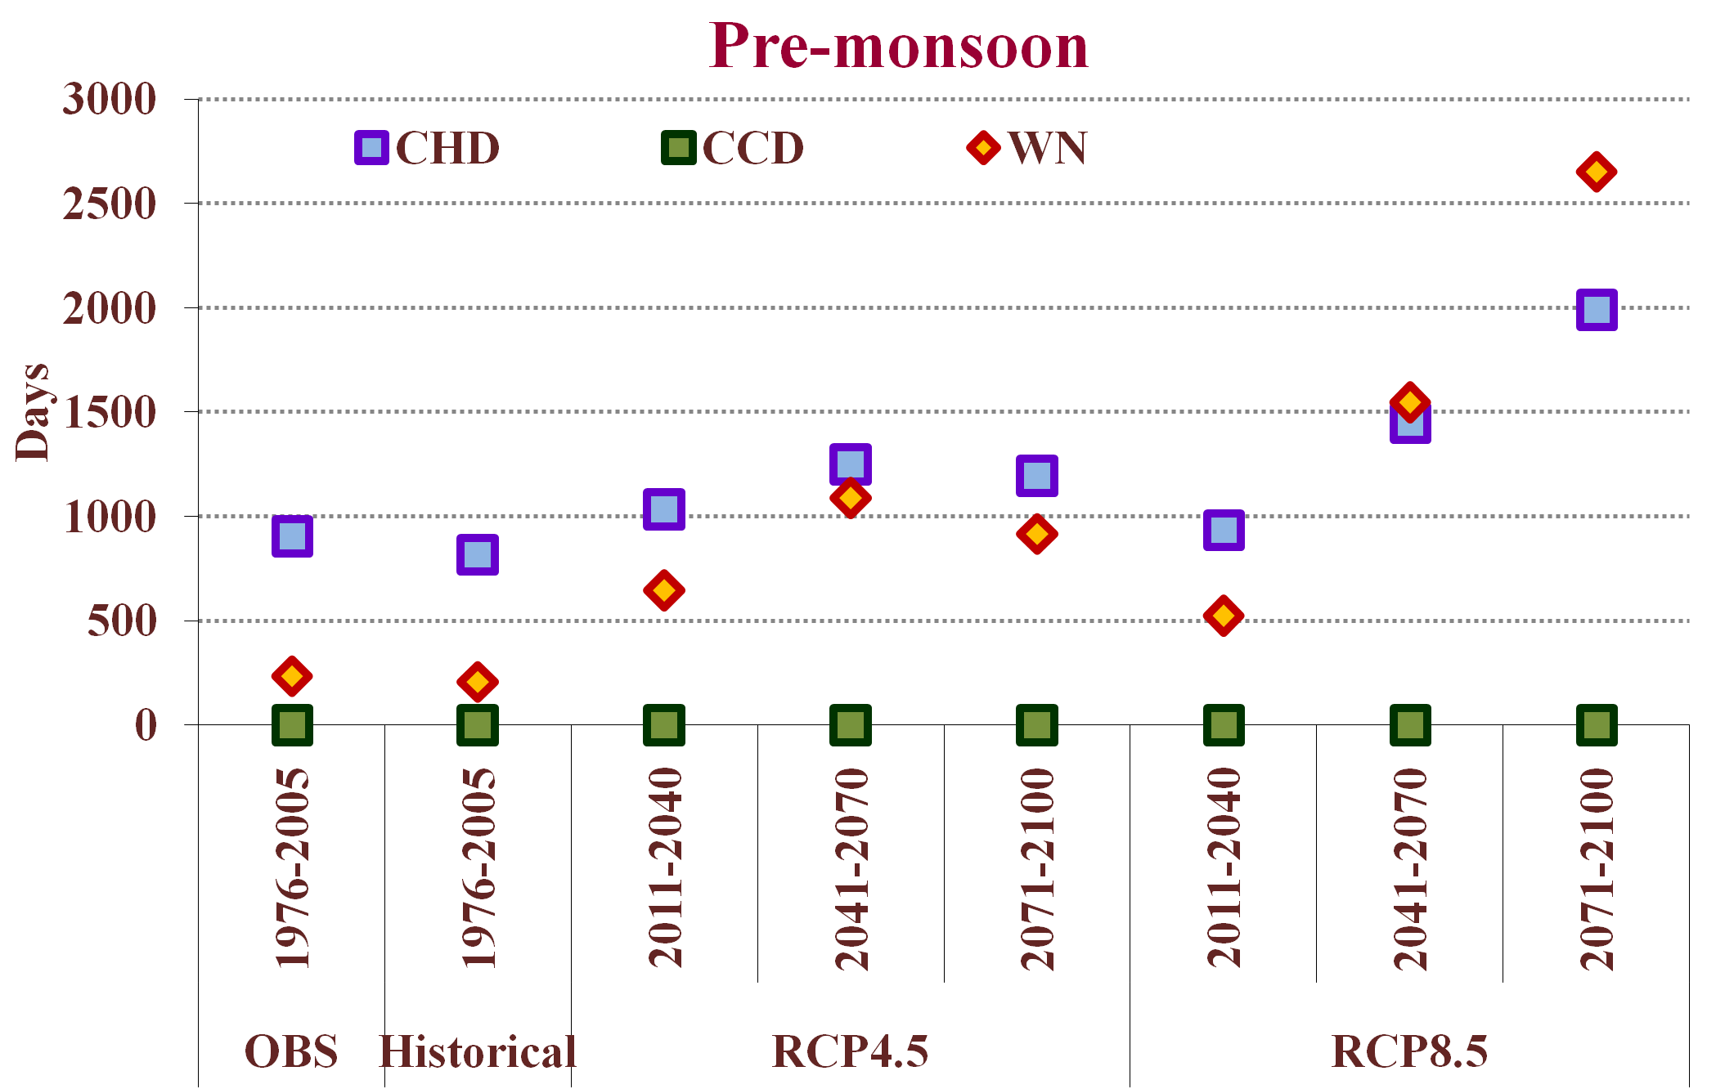
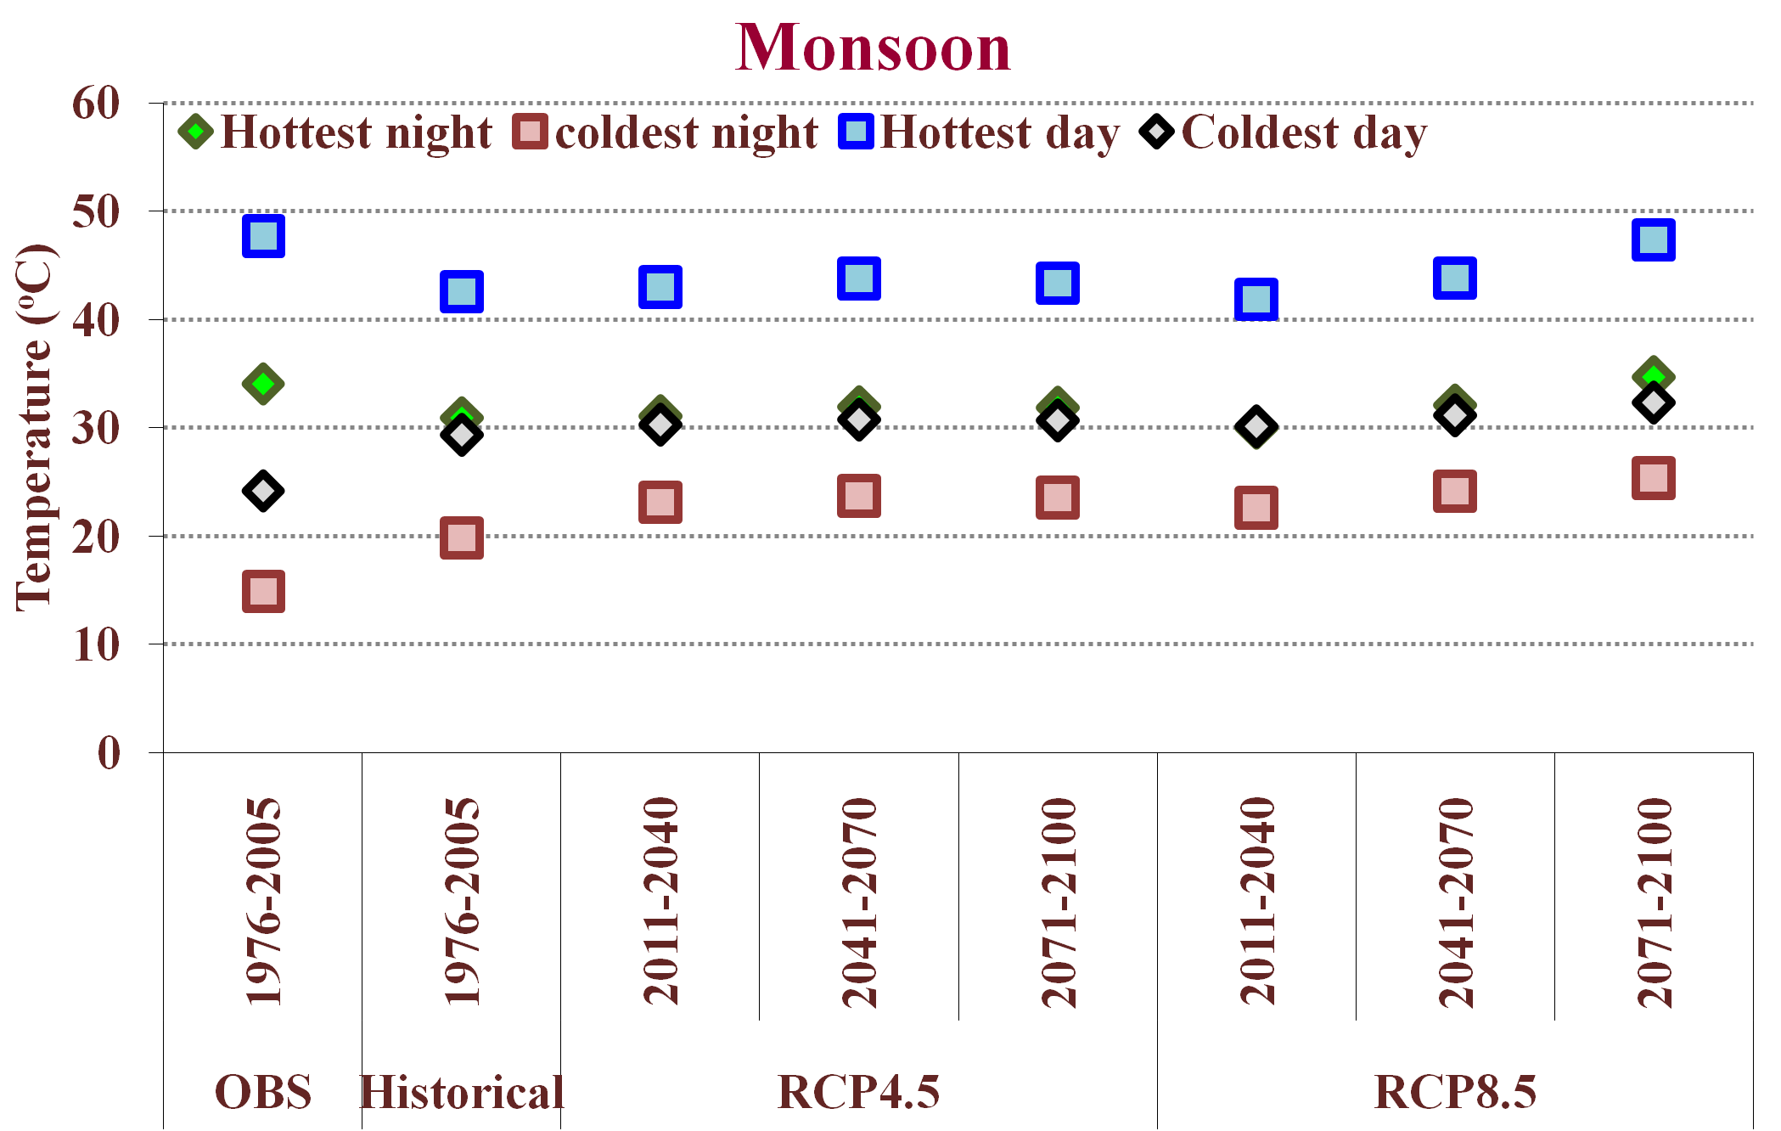
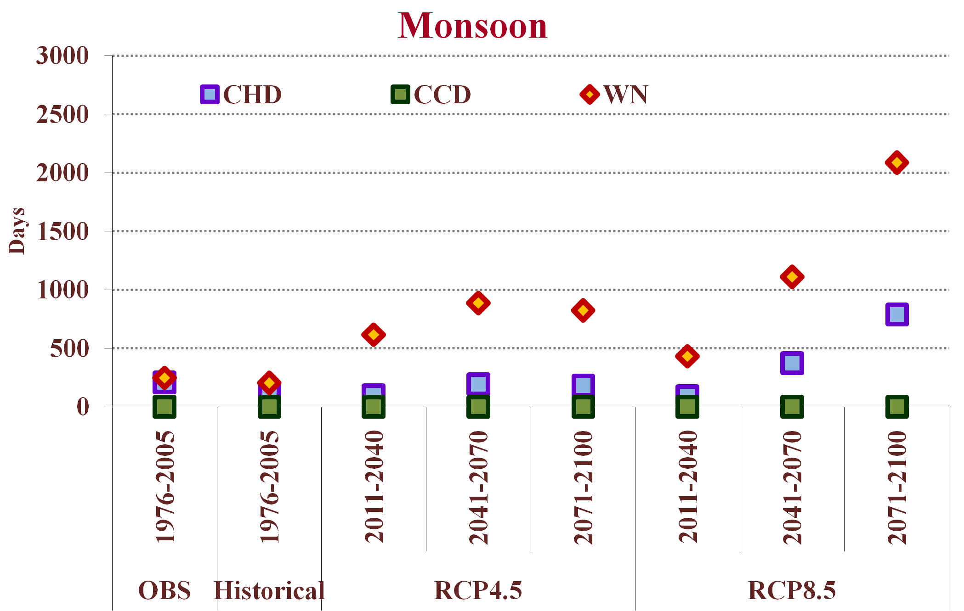
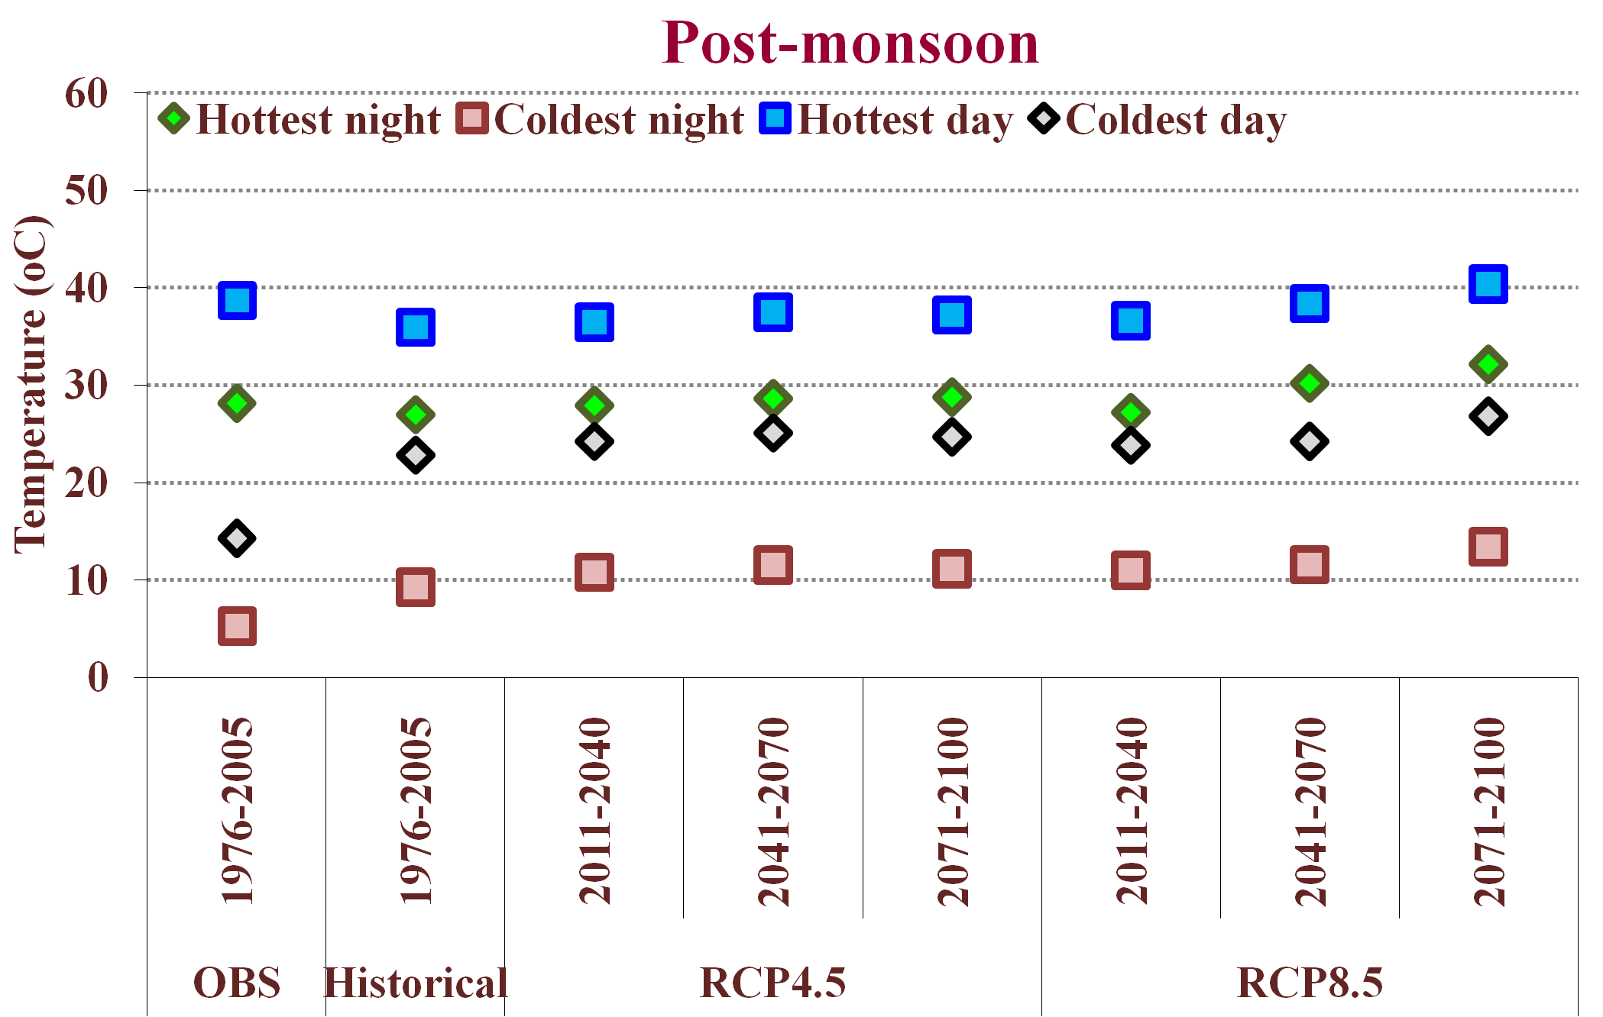
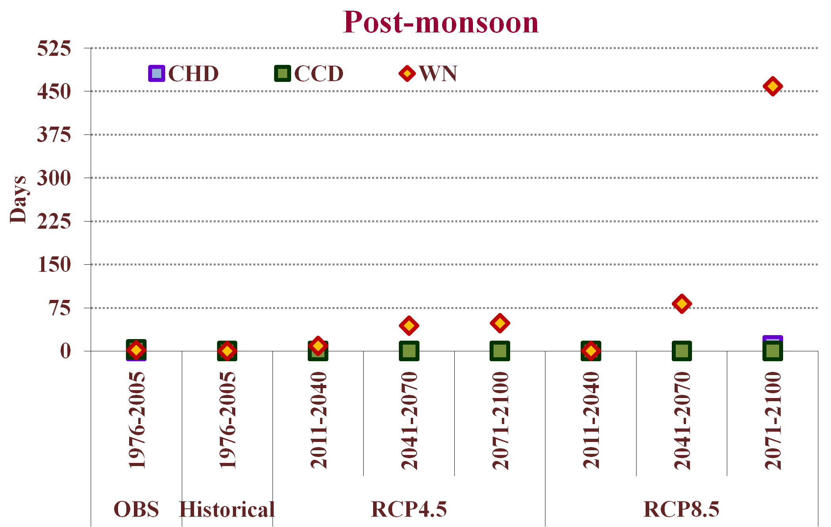
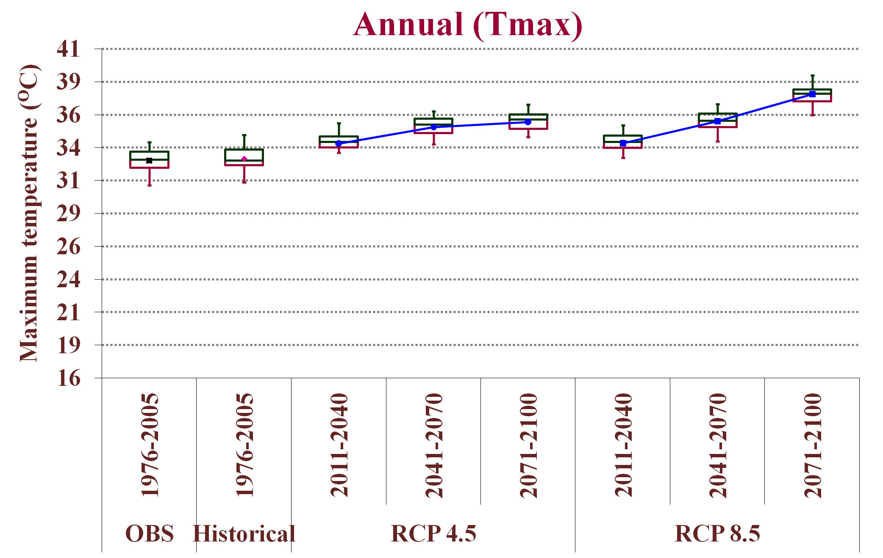
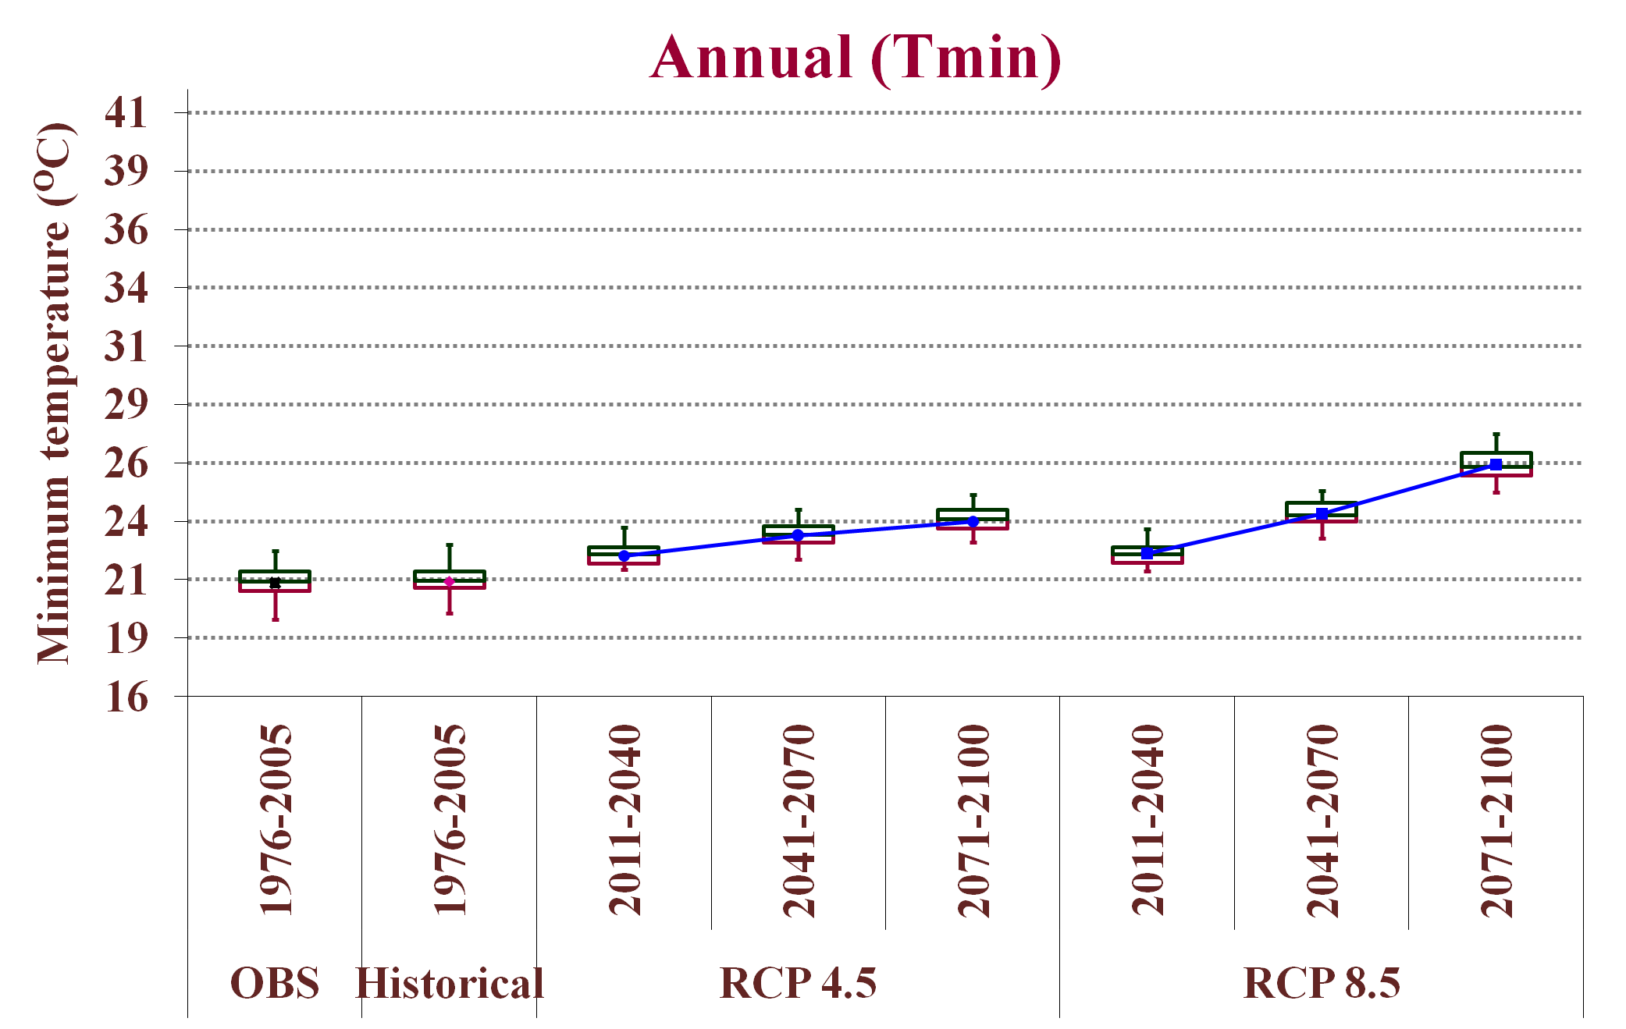
Regional Projection of Temperature for the 21st Century over the Eastern India
Pradnya Murlidhar Dhage*, Narendra Singh Raghuwanshi and Rajendra Singh Indian Institute of Technology, Kharagpur, India- 721302 West Bengal (India)
Email id-*prandhage@gmail.com
EGU General Assembly 2016
Abstract ID: EGU2016-3358
Introduction
Data
Results
Temperature
Increasing due to increased GHG emission and affecting hydrologic cycle
Future temperature information is required for climate change impact studies
Primary source: General Circulation Models (GCMs)
Challenges:
Reliability of GCM output
Coarse resolution and scale mismatch between GCM output and climate change impact need
Solutions:
Dynamical Downscaling
Statistical Downscaling
Observed data
Performance of Bias Correction and Spatial Downscaling (BCSD) technique
Temperature Intensity Indices
Temperature Frequency Indices
Sl. No | Station | Latitude | Longitude | Climatic Variable | Data Period | Data Source
1 | Purulia | 23.33 | 86.38 | Daily maximum and minimum temperature | 1971-2005 | IMD, Pune
2 | Bankura | 23.23 | 87.07
3 | Jhargram | 22.45 | 87.00
4 | Kharagpur | 22.33 | 87.32
Methodology
Objective
Four GCMs Predictors
Note: O=Observed data, A=CanESM2, B=CNRM-CM5, C=MPI-ESM-LR , D=IPSL-CM5A-LR and E=Multi-GCM Ensemble average predicted daily maximum and minimum temperature
To carry out downscaling of temperature using Bias Correction and Spatial Downscaling (BCSD) technique.
To project future regional temperature scenarios and to estimate seasonal temperature extreme indices.
Historical (1971-2005)
RCP4.5 and 8.5 Scenarios (2006-2100)
Fig. 2: Taylor diagram of observed and downscaled monsoon seasonal temperature of 4 CMIP5 GCMs for validation period (1991-2005)
Projection of Future Temperature Scenarios
Study Area
GCM Predictors Preprocessing
(Bilinear Interpolation)
Kangsabti reservoir catchment and command, India
Catchment : 3428 km²
Command : 5568 km²
Elevation varying from 61 to 228 m above MSL
Dominating crop: Paddy
Bias correction
(Dhage et al., 2016)
Multi-GCM Ensemble average
Fig. 5: Seasonal temperature extreme indices over historical (1976-2005) and future (2011-2040, 2041-2070 and 2071-2100) periods
Historical temperature scenario
Future (RCP4.5 and 8.5) temperature scenario
Fig. 3: Box plots of observed, historical and projected annual maximum and minimum temperatures for RCP4.5 and RCP8.5 scenarios
Conclusions
Mann Kendall Trend Test Results
BCSD method can be used for downscaling maximum and minimum temperatures.
In both RCP scenarios, the minimum temperature increases at higher rate than the maximum temperature with respect to the historical period (1976-2005).
For the future scenarios, frequencies of consecutive hot days and warming nights are increasing, while frequencies of consecutive cold days are decreasing.
Temperature will increase in intensity under both RCP scenarios with respect to the historical period (1976-2005).
The projected warming trends may change crop physiology and increase crop evapotranspiration in the study area.
Estimation of Temperature Intensity and Frequency Indices
Sl. No. | Indices | Unit | Definition
Intensity indices (Revadkar et al., 2009)
1 | Coldest day | ºC |  | Seasonal lowest Tmax
2 | Hottest day | ºC |  | Seasonal highest Tmax
3 | Coldest night | ºC |  | Seasonal lowest Tmin
4 | Hottest night | ºC |  | Seasonal highest Tmin
Frequency (India Meteorological Department)
1 | Consecutive Hot Days (CHD) | days |  | Consecutive days when Tmax > 40 ºC and Tmin departure from normal 5 ºC or more
2 | Consecutive Cold days (CCD) | days |  | Consecutive days Tmax ≤16 ºC
3 | Warming nights (WN) | days |  | Tmin >28 ºC
Fig. 1: Location of climatic stations in study area
Data
GCMs data
Sl. No | CMIP5 GCMs | Horizontal Resolution | Scenario (Period)
1 | CanESM2 | 2.8º ×2.8º | Historical (1971-2005) | RCP 4.5 and RCP8.5 (2006-2100)
2 | MPI-ESM-LR | 1.8º ×1.8º
3 | IPSL-CM5A-LR | 1.9º ×3.75º
4 | CNRM-CM5 | 1.4º ×1.4º
References
Dhage, P.M., Raghuwanshi, N.S., Singh, R., and Mishra, A. 2016. Development of temperature scenarios and their impact on paddy crop evapotranspiration in Kangsabati Command area. Theor. App. Clim. (DOI: 10.1007/s00704-016-1743-8).
Revadekar, J., Kothawale, D., and Rupa Kumar, K. 2009. Role of El Niño/La Niña in temperature extremes over India. Int. J. Climatol, 29(14): 2121-2129.
Fig. 4: Sen's slope (ºC/decade) of projected monsoon season maximum and minimum temperature at 4 climatic stations for period 2011-2100

