Slide 1
Incorporation of cooling-induced crystallisation into a 2-dimensional axisymmetric conduit heat flow model David Heptinstall^{1,2}, Caroline Bouvet De Maisonneuve², Jurgen Neuberg¹, Benoit Taisne², Amy Collinson¹ 1 Department of Earth and Environment, University of Leeds, Leeds, LS2 9JT, United Kingdom. 2 Earth Observatory of Singapore, Nanyang Technology University, Singapore 639798

Slide 2
Aims & Objectives
Our aim is to establish the thermal fluxes within a static magma column, during quiescence periods of 4 months and 2 years, which are representative of recorded gaps in activity between 1998 and 2010 at Soufriere Hills Volcano, Montserrat (SHV) (Wadge et al., 2014).
Our objectives of this study are
To quantify the influence of latent heat release on magma temperature evolution.
To establish the cooling timescales required for a magma column to cool to a crystal-rich plug (75 %), when magma is unlikely to be re-mobilised
To compare our estimates of latent heat of crystallisation and the extent of thermal rebound to previous studies

Slide 3
Methods
MELTS
COMSOL
Run 1: 34MPa – 18.5 MPa; 1002 ºC- 847 ºC; Liquidus 1000 ºC
Run 2: 34MPa – 9 MPa; 1002 ºC- 875 ºC; Liquidus 1000 ºC
Run 3: 25.4MPa – 10.9 MPa; 1014 ºC- 869 ºC; Liquidus 1014 ºC
Phase | aMon6a groundmass composition (Couch et al., 2003a) | Hydrous normalised melt used in study (at 34 MPa) | Hydrous normalised melt used in study (at 25.4 MPa)
SiO₂ | 71.41 | 69.99 | 70.18
TiO₂ | 0.28 | 0.27 | 0.27
Al₂O₃ | 13.58 | 13.31 | 13.34
Fe₂O₃ | 0 | 1.05 | 1.05
FeO | 2.78 | 1.77 | 1.78
FeO* | - | 2.55 | 2.55
MnO | 0 | 0.098 | 0.098
MgO | 1.64 | 1.61 | 1.61
CaO | 4.86 | 4.76 | 4.77
Na₂O | 3.73 | 3.66 | 3.66
K₂O | 1.6 | 1.57 | 1.57
H₂O | 0 | 1.9 | 1.62
Table 1: Normalised andesitic melt composition (Couch et al., 2003b). We used the MELTS software to calculate the latent heat generated by crystallizing melt phase, according to the bulk crystal and melt compositions.
Figure 1: The points record the temperature of the magma column within the conduit, conduit wall and host rock.

Slide 4

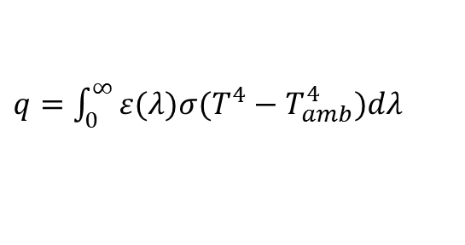
Methods – MELTS & COMSOL Parameters
Total enthalpy (𝛥𝐻 -KJ), specific heat (Cp - J/K), liquid melt (m-kg), crystal percentage as a ratio at model convergence (mc), the change in magma temperature between liquidus & model convergence (𝛥T -K). Thermal conduction & Radiative heat flux parameters
Melt-crystal convection 1.04 W/m³ (Collier & Neuberg., 2006)
Host rock conduction 2.25 W/m³ (Collier & Neuberg., 2006)
Convection from exsolved water 0.07 W/m³ (Di Genova et al., 2014) T_{amb} is 293.15 K
Surface emissivity (ε) is 0.95 (Hutchinson et al., 2013)
Maxwell-Boltzmann constant ($σ$) is 5.6×10⁻⁸ W m⁻² K⁻⁴
Other constant model parameters
Specific heat of water at constant pressure 0.738 J/kg*K (Di Genova et al., 2014)
Host rock density 2400 kg/m³ (Neuberg et al., 2006)
Crystal density 2700 kg/m³ (Costa et al., 2007)
Melt density 2400 kg/m³ (Costa et al., 2007)
Latent heat of crystallisation -$L_{∗}$ (J/kg*K)
$$\left.L_{∗} (\frac{J}{kg∗K})=(\frac{∆H−\left(Cp×∆T\right)}{\left(m1−m2\right)})/(mc∗∆T\right)$$
Specific heat – ${Cp}_{∗}$(J/kg*K)
$$\left.{Cp}_{∗}(\frac{J}{kg∗K})=(\frac{\left(Cp×∆T\right)}{\left(m1−m2\right)})/(mc∗∆T\right)$$
Surface to air radiation - $q$
$q=\int_{0}^{∞}{ε(λ)σ(T^{4}−T_{amb}^{4}})dλ$

Slide 5
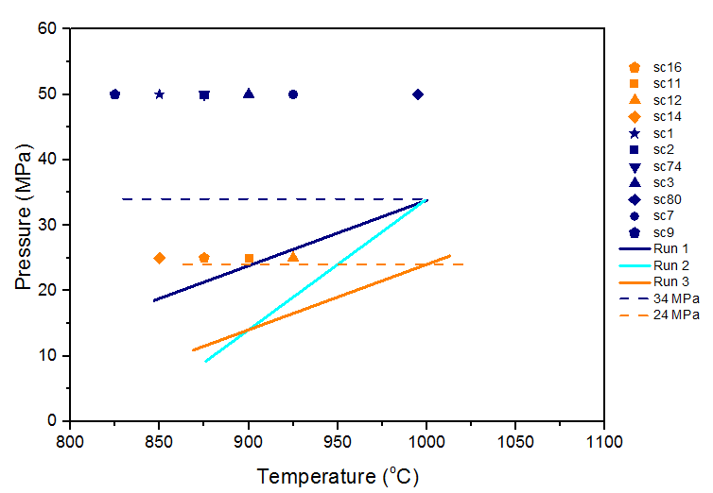
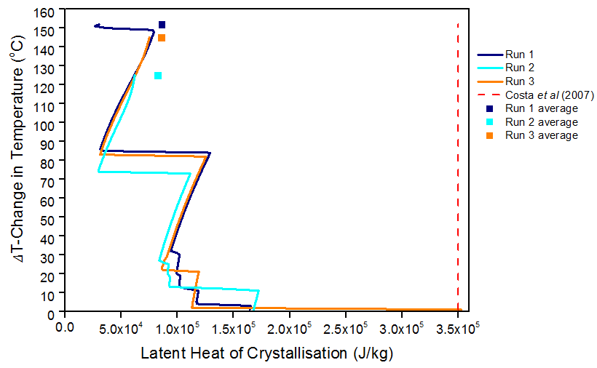
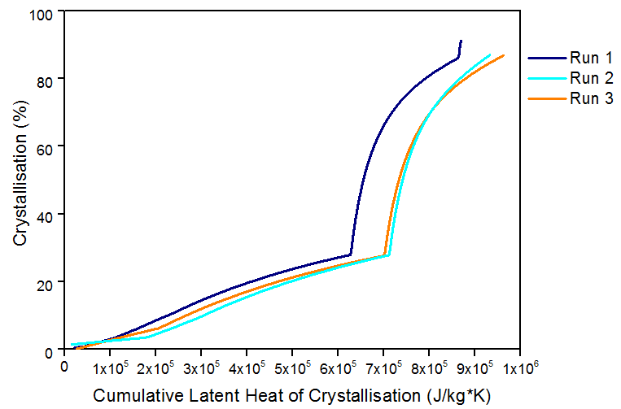
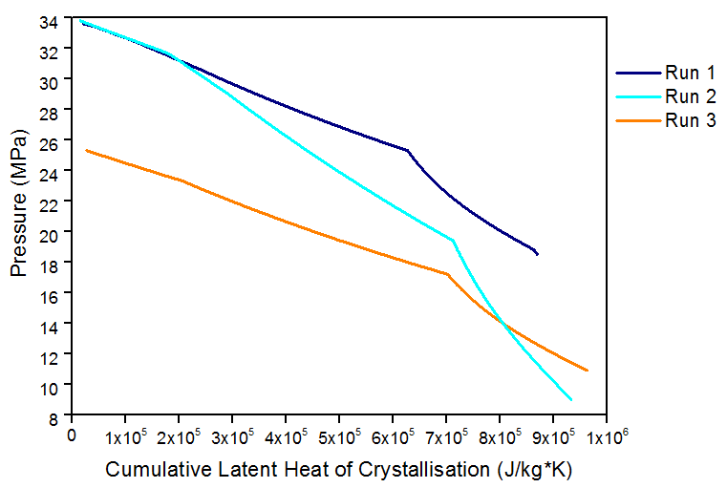
Results – Latent Heat of Crystallisation
Figure 2a (top left): Correlation between our MELTS runs and Couch et al (2003a) experimental glass, matrix and groundmass data. 25 MPa glass data sc11 and sc12 correlates with run 1.
Figure 2b (top right): Latent heat (J/kg) released in all MELTS model runs vary widely from Costa et al (2007), apart from near-liquidus latent heat release in run 3. Figure 2c (bottom left): Considerable release of latent heat during early crystallisation for all model runs, with over 70% of the cumulative latent heat released prior to 30 % crystallinity. Figure 2d (bottom right): Latent heat release with magma pressure, the kinks in the gradients are indicative of changes in crystallisation. Such as albite-rich Plagioclase Feldspar, Quartz & Diopside-rich Clinopyroxene crystallisation.

Slide 6
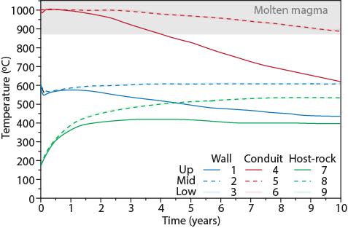
Results – Thermal timescales
Melt undercooling of 30ºC in run 1, 30ºC in run 2 & 44ºC in run 3.
Thermal rebound of 35ºC in run 1, 35ºC in run 2 & 36ºC in run 3 at 970ºC.
Cumulative latent heat release between liquidus and model convergence (87-90 wt% crystallinity). 8.69E5 J/kg*K in run 1, 9.32E5 J/kg*K in run 2, and 9.49E5 J/kg*K in run 3.
Latent heat released to 970ºC (Early crystallisation): 26.1% (2.27E+05 J/kg*K) in run 1, 35.4% (3.3E+05 J/kg*K) in run 2 and 39.2% (3.72E+05 J/kg*K) in run 3.
Latent heat released prior to Quartz crystallisation: 72.2% (6.27E+05 J/kg*K) in run 1, 76.4% (7.12E+05 J/kg*K) in run 2 and 73.9% (7.01E+05 J/kg*K) in run 3.
Figure 3: Thermal timescales over a 10 year period in run 1. Upper magma column cooling to 875ºC (75 wt% crystallinity) is after 4.1 years, whilst the middle-lower magma column requires 11 years, where the molten magma is considered to be too crystalline for remobilisation.

Slide 7
Conclusion
All COMSOL model runs show a thermal rebound due to latent heat release to be <40ºC for the Soufriere Hills andesite (Couch et al., 2003a;b)
Latent heat of crystallisation varies significantly with pressure and temperature, thus using an arbitrary value such as 3.5E+05 J/kg (Costa et al., 2007) will not be representative for a significant pressure range.
A magma crystallinity of 75 % is reached at 874ºC after 4.1 years in run 1, which is the most representative model of deeper level activity near the conduit wall based on Wadge et al (2014) observations.
Due to the open system nature of most quiescence periods observed by Wadge et al (2014), our model cooling timescales appear to be slower than the observed physical volcanology.
Due to the variability of latent heat release with melt composition & magma pressurisation accurate estimation of latent heat of crystallisation release within a magma column.
Computational modelling of latent heat with pressure and temperature is beneficial for 2D or 3D thermal-rheological simulation models

Slide 8
References
Bea, F., 2010. Crystallization dynamics of granite magma chambers in the absence of regional stress: Multi-physics modelling with natural examples, Journal of Petrology, 51, 7, 1541-1569.
Brandeis, G, Jaupart, C, Allegre, C.J., 1984. Nucleation, crystal growth and the thermal regime of cooling magmas, Journal of Geophysical Research, 89, B12, 10,161-10,177.
Cashman, K and Blundy, J., 2000. Degassing and crystallization of ascending andesite and dacite, Philosophical transactions: Mathematics, Physical and Engineering sciences, 358, 1770, Causes and consequences of eruptions of Andesite Volcanoes, 1487-1513.
Collier, L and Neuberg, J., 2006. Incorporating seismic observations into 2-D conduit flow modelling, Journal of Volcanology and Geothermal research, 152, 331-346.
Costa, A, Melnik, O, Sparks, R.S.J., 2007. Controls of conduit geometry and wallrock elasticity on lava dome eruptions, Earth and Planetary Science Letters, 260, 137-151.
Couch, S, Sparks, R.S.J, Carroll, M.R., 2003(a). The kinetics of degassing-induced crystallization at Soufriere Hills Volcano, Montserrat, Journal of petrology, vol 44, 8, pg 1477-1502.
Couch, S, Harford, C.L, Sparks, R.S.J, Carroll, M.R., 2003(b). Experimental constraints on the conditions of formation of highly calcic plagioclase microlites at the Soufriere Hills Volcano, Montserrat, Journal of petrology, 44, 8,1455-1475.
Di Genova, D, Romano, C, Giordano, D, Aletti, M., 2014. Heat capacity, configurational heat capacity and fragility of hydrous magmas, Geochimica et Cosmochimica Acta, 142, 314-333.
Genaraeu, K, Clarke, A.B, Hervig, R.L., 2009. New insight into explosive volcanic eruptions: connecting crystal-scale chemical changes with conduit scale dynamics, Geology, 37, 367-370.
Ghiorso, M.S and Sack, R.O., 1995. Chemical mass transfer in magmatic processes, A revised and internally consistent thermodynamic model for the interpolation and extrapolation of liquid-solid equilbria in magmatic systems at elevated temperatures and pressures, Contributions to mineralogy and petrology, 119, 197-212
Higgins, M.D and Roberge, J., 2003. Crystal size distribution of plagioclase and amphibole from Soufriere Hills Volcano, Montserrat: Evidence for dynamic crystallisation – textural coarsening cycles, Journal of petrology, 44, 8, 1401-1411.
Hort, M and Spohn, T., 1991. Crystallization calculations for a binary melt cooling at constant rates of heat removal: implications for the crystallization of magma bodies, Earth and Planetary Science Letters, 107, 463-474.
Hort, M., 1997. Cooling and crystallization in sheet-like magma bodies revisited, Journal of Volcanology and Geothermal Research, 76, 297-317.
Wadge, G, Voight, B, Sparks, R.S.J, Cole, P.D, Loughlin, S.C, Robertson, R.E.A., 2014. Chapter 1: An overwiew of the Soufriere Hills Volcano, Montserrat from 2000 to 2010, Geological Society, London, Memoirs, 39, 1-40.

