Slide 1
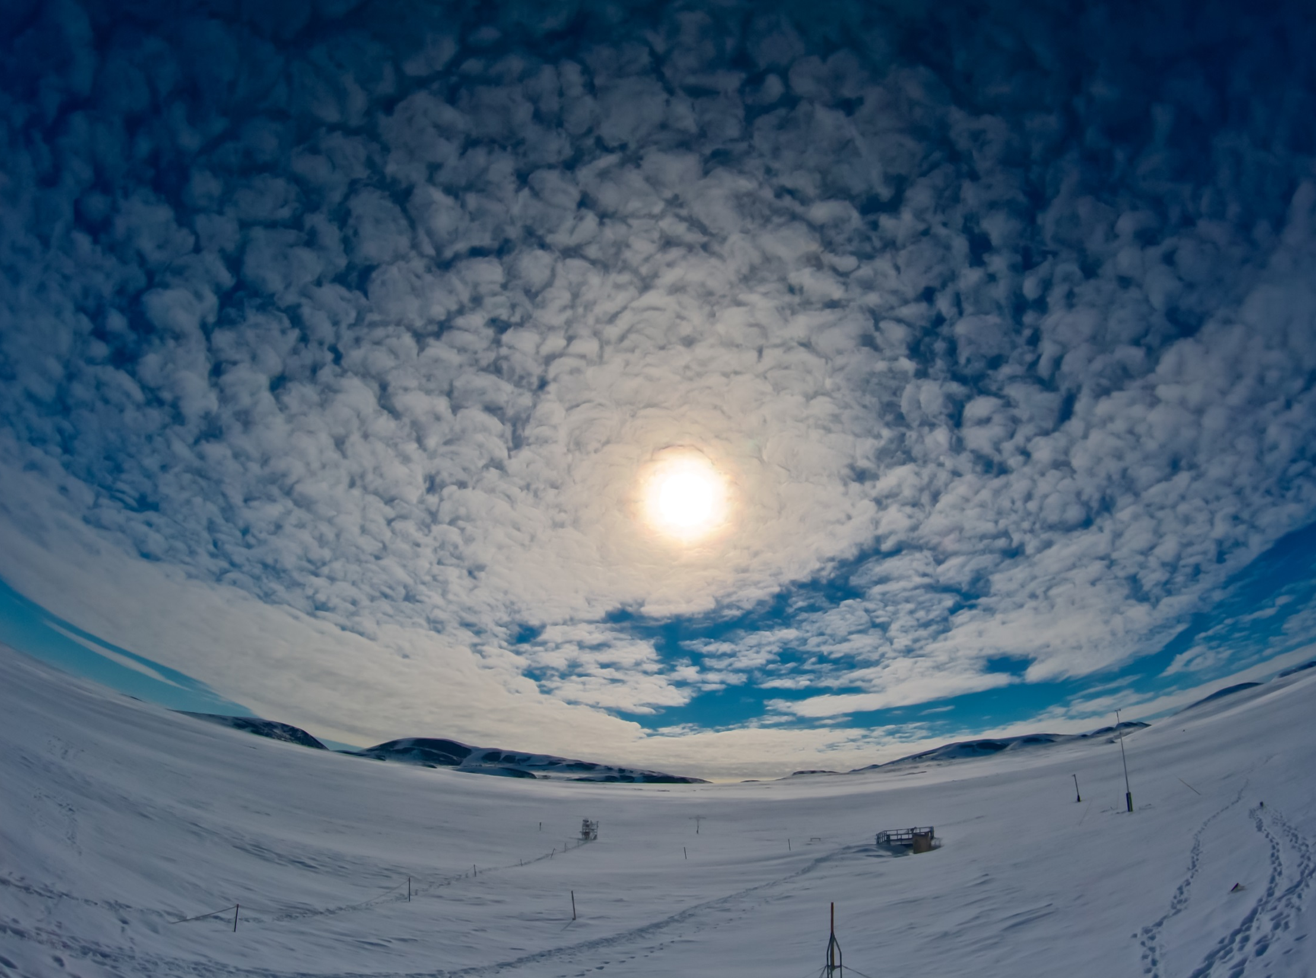
Probing the Arctic
Combining surface observations and model analyses
Thomas Haiden (ECMWF)
Thanks to: Christopher Cox (Univ. Colorado), Martin Janousek (ECMWF), Richard Forbes (ECMWF)
Photo IASOA

Slide 2
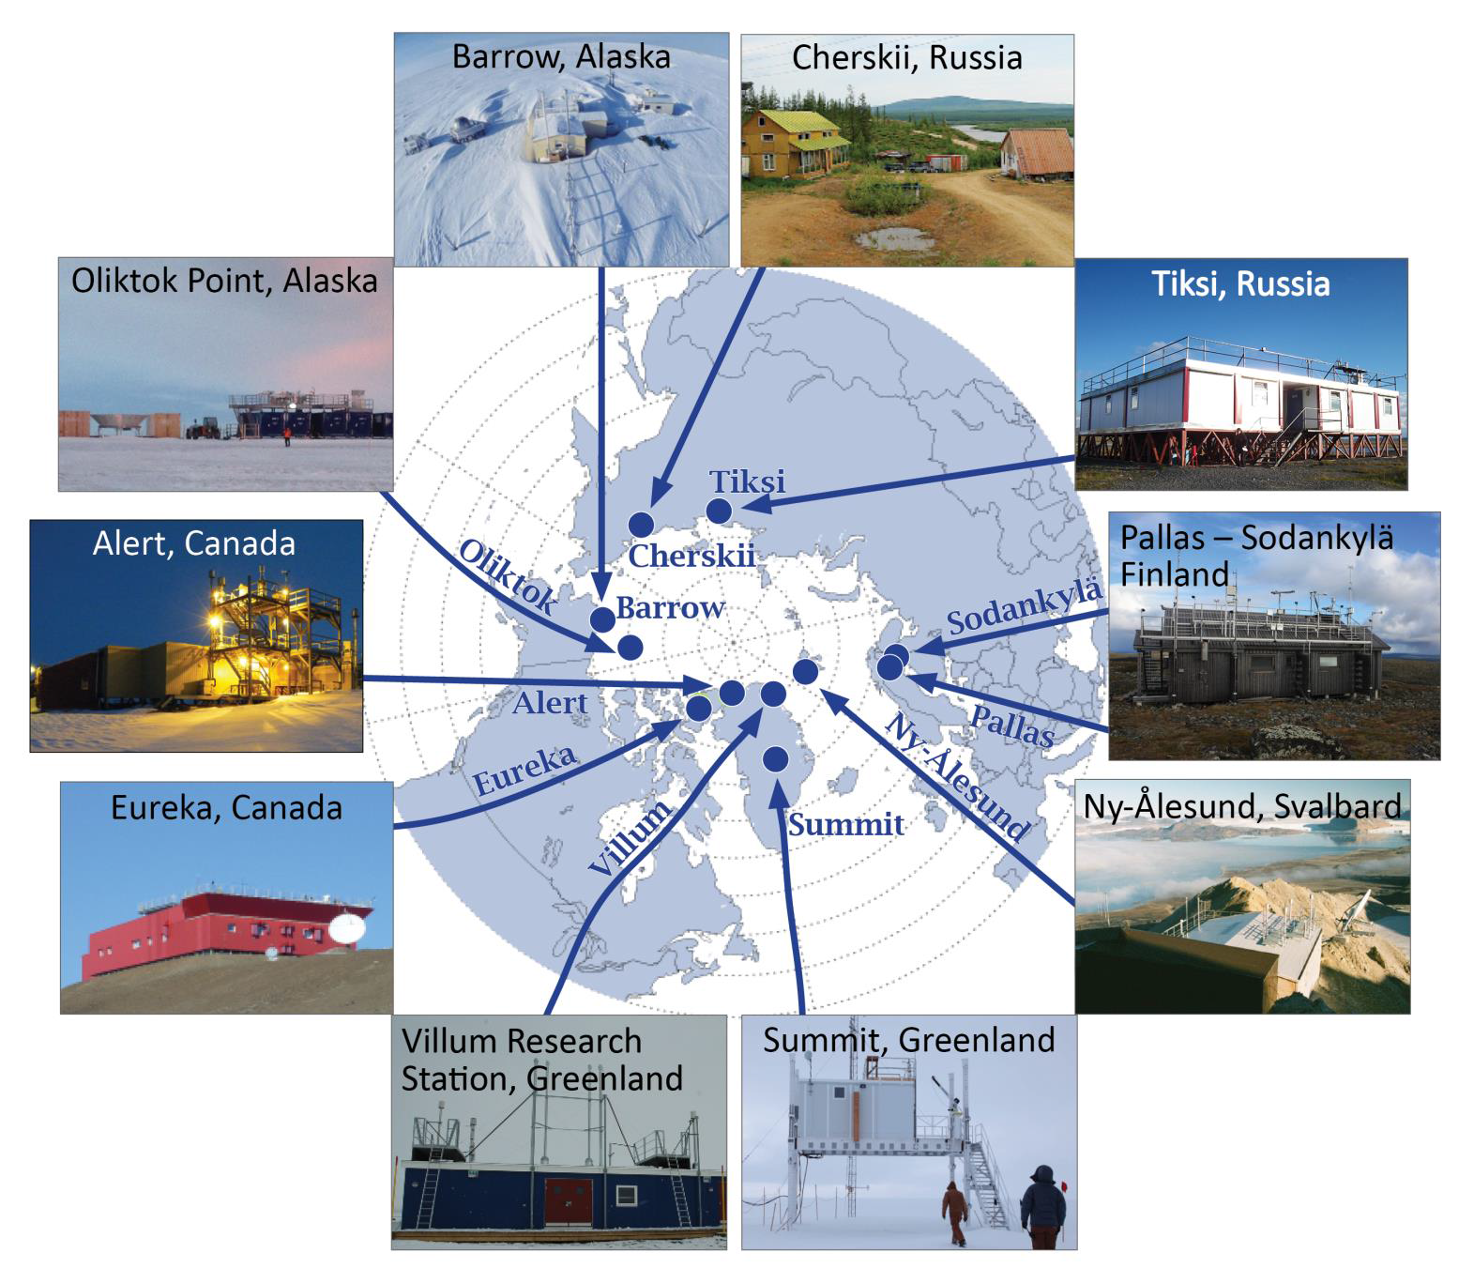
IASOA observatories

Slide 3
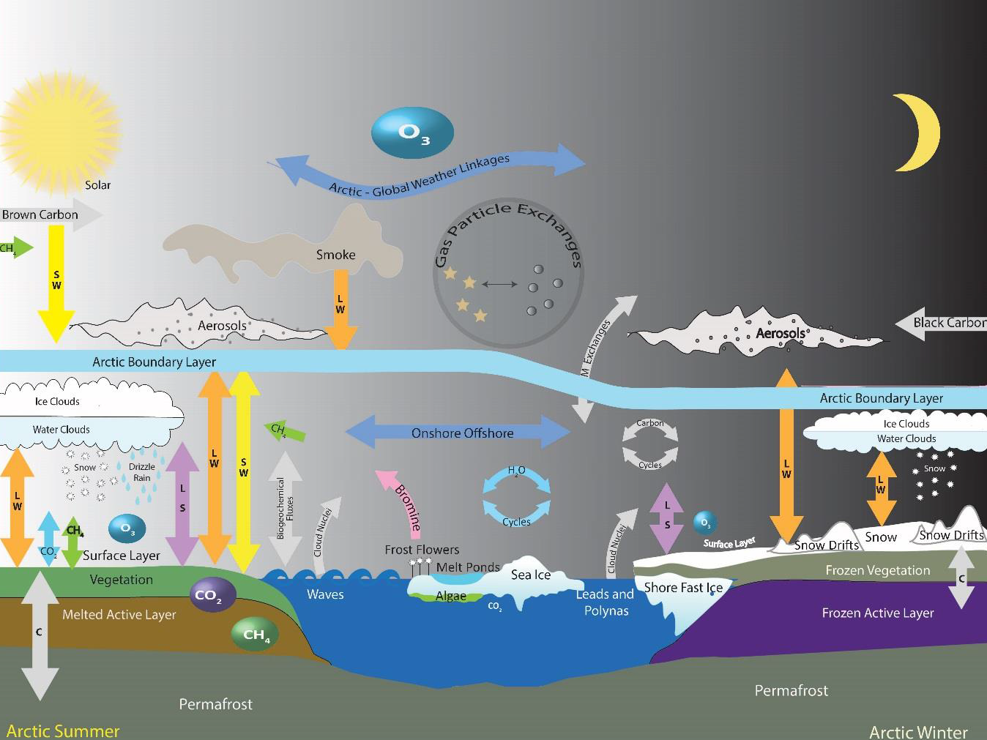
IASOA observations
Aerosol
Atmospheric State
Cloud Properties
Cryosphere
Greenhouse Gas
Ozone
POPs
Precipitation Chem
Radiometric
Reactive Gas
Surface Properties
Uttal et al. (2015)
‘Earth-system observation’ approach

Slide 4
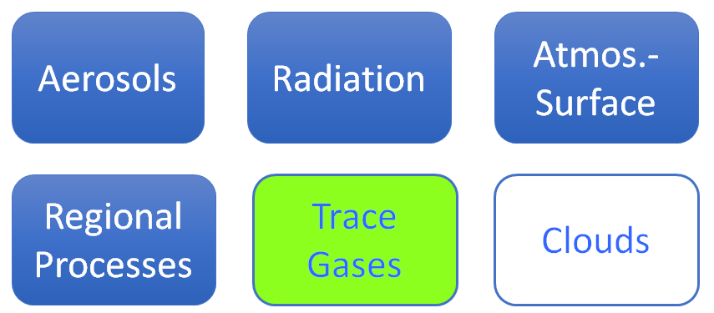
IASOA collaboration
6 Working Groups: sustained virtual research teams
S. Starkweather

Slide 5
How much information about the larger Arctic area do IASOA observations contain?
IASOA observation
Grid-scale value at IASOA location
Larger Arctic area
representativeness
synoptic-scale relationships
→ assess the spatial ‘footprint’ of IASOA observations using model analyses (ERA-Interim)
Notes:
ERA-Interim: daily climatology based on period 1989-2008 (20 years)

Slide 6
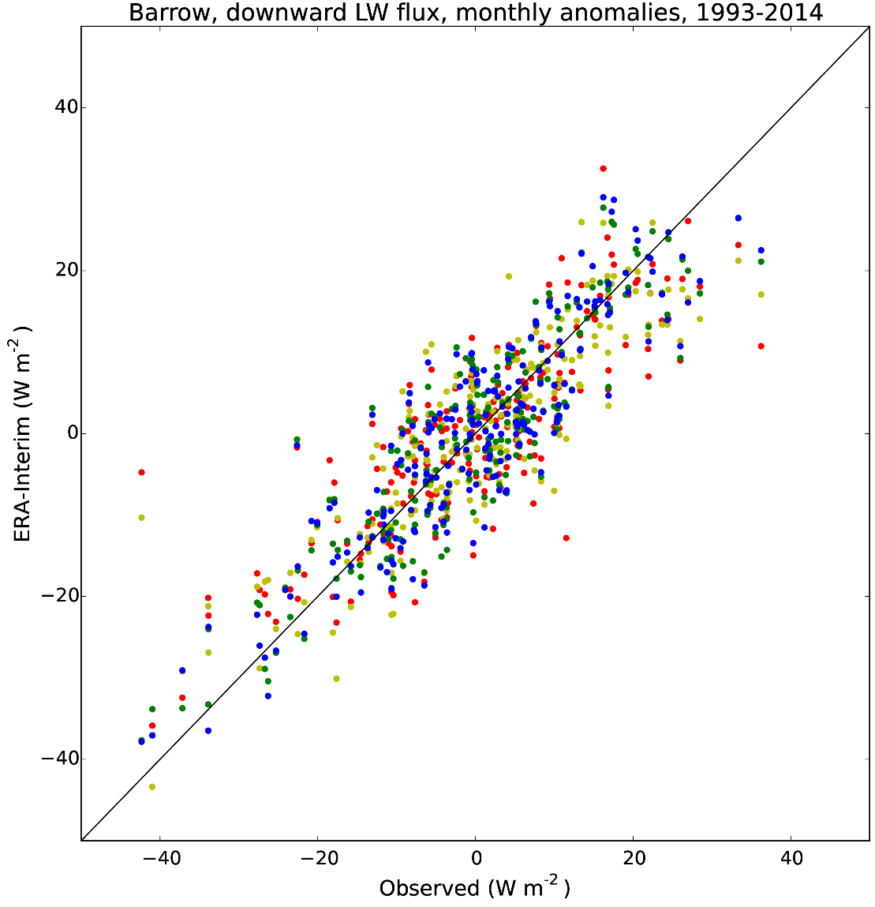
Downward longwave flux at Barrow
Grid point | Land fraction | r
0 | 0.33 | 0.823
1 | 0.07 | 0.852
2 | 0.00 | 0.886
3 | 0.00 | 0.885
68%-78% of observed variance represented
Notes:
About 1/3 to ½ of the difference in r between the ocean and land points is due to the Dec 1999 value where below -40 W/m2 was observed and the land points give around -10 W/m2.
More generally, the land points tend to slightly underestimate the stronger anomalies (of either sign).
Anomalies are relative to the period climatology (monthly means).

Slide 7
How much information about the larger Arctic area do IASOA observations contain?
IASOA observation
Grid-scale value at IASOA location
Larger Arctic area
representativeness
synoptic-scale relationships
→ assess the spatial ‘footprint’ of IASOA observations using model analyses (ERA-Interim)

Slide 8
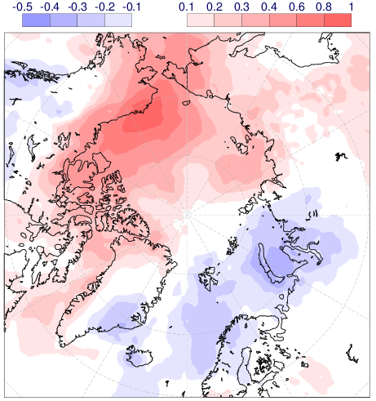
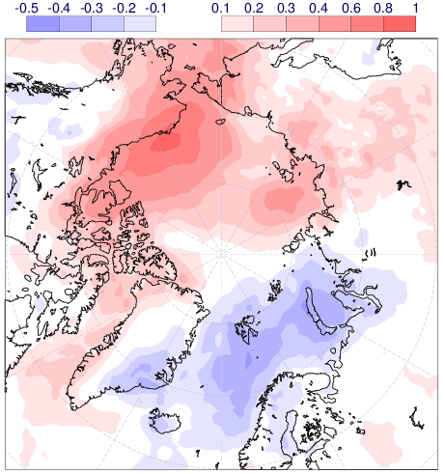
Spatial correlation of longwave flux at Barrow
Correlation within ERA-Interim
Correlation OBS v ERA-Interim

Slide 9
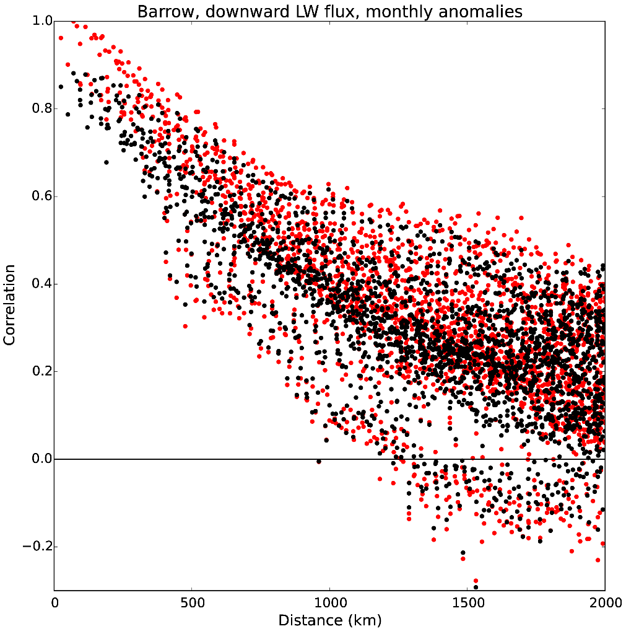
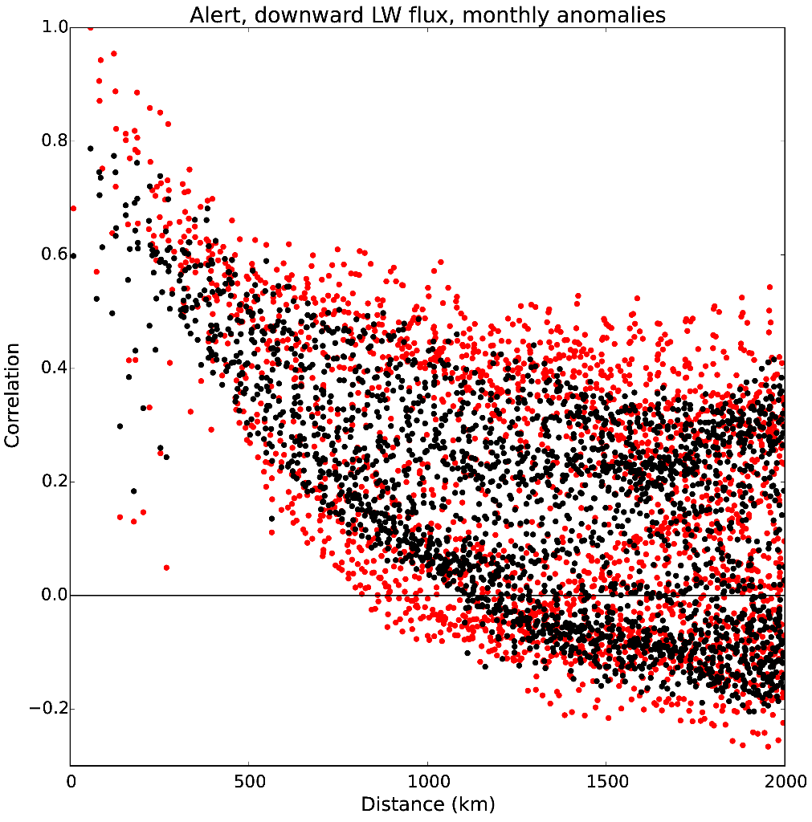
Correlation as a function of distance
ERA-Interim
Observation
Barrow
Alert
Notes:
Barrow: at close range, about 0.1 difference in r between obs and eraint; at 400-500 km however, difference rather small, which means that even without a station existing at a location, eraint can be used to estimate the footprint
Alert: larger difference at close range, some very low correlations at 200-300 km; at 400-500 km, however, obs and eraint relatively similar again; r is however ~0.1 smaller at that distance than it is for Barrow

Slide 10
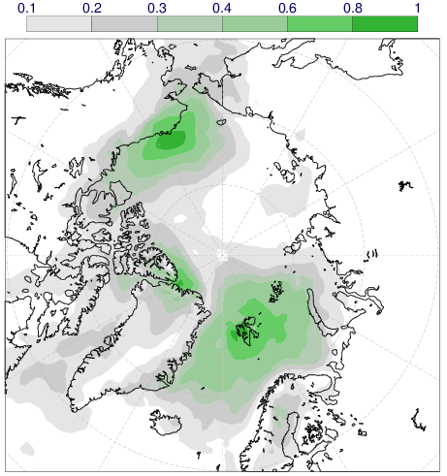
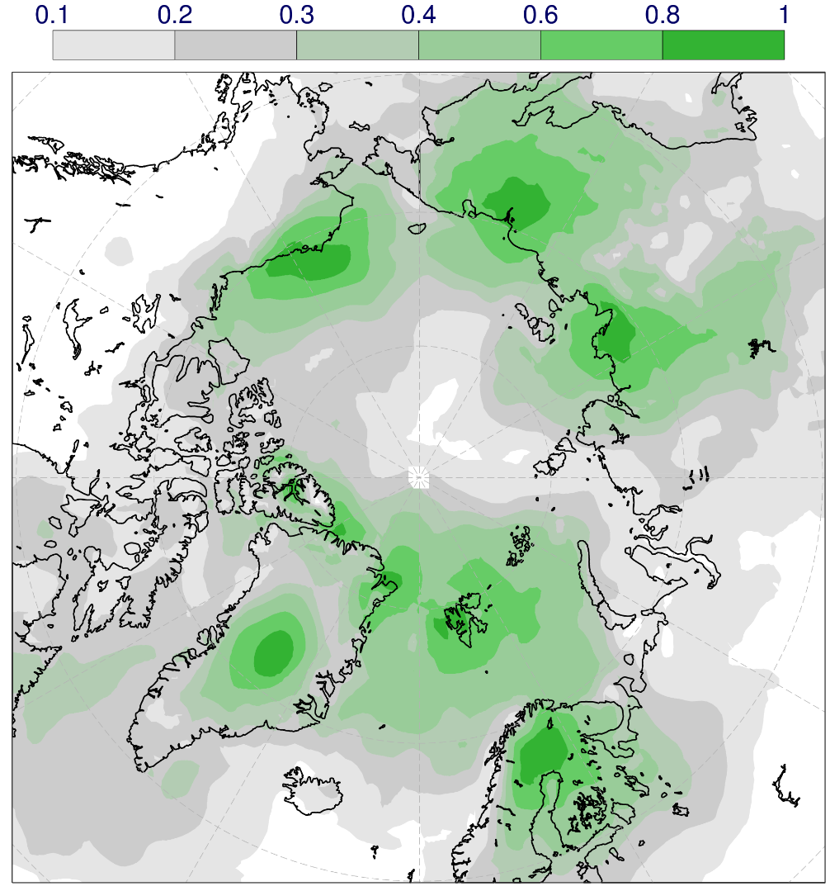
Variance explained by positive correlations
Barrow, Alert, Ny-Alesund
All IASOA stations

Slide 11
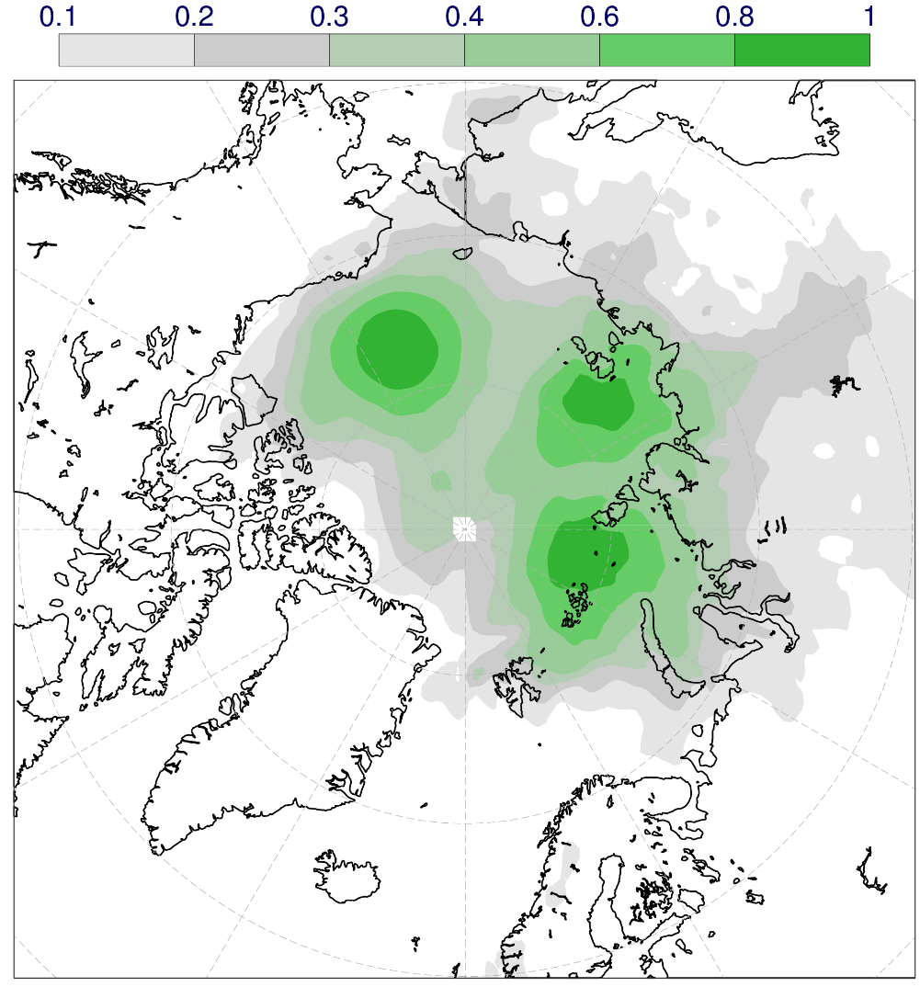
Correlations in areas of large sea-ice variability
Sea ice concentration anomalies for Sep (1979-2010)
LW downward (r²)
Kapsch et al (2013)

Slide 12
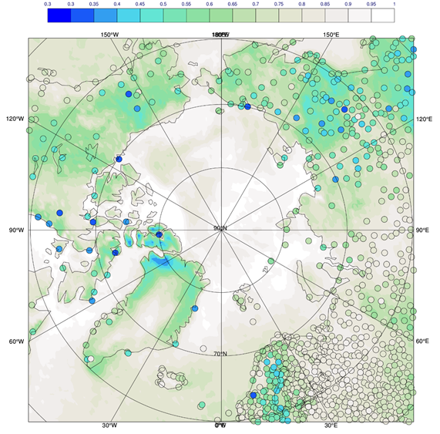
Winter-time cloud cover: analysis bias
Nov 2014 – Apr 2015

Slide 13
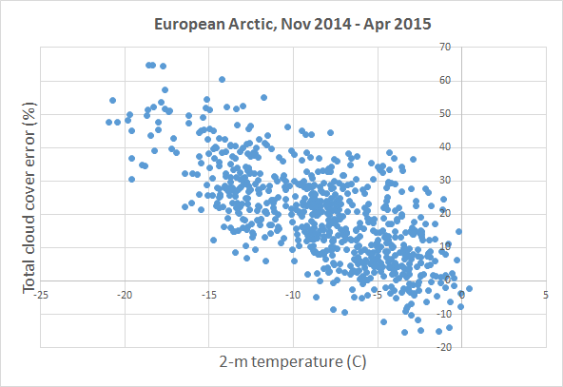
Winter-time cloud cover analysis error
r²=0.49

Slide 14
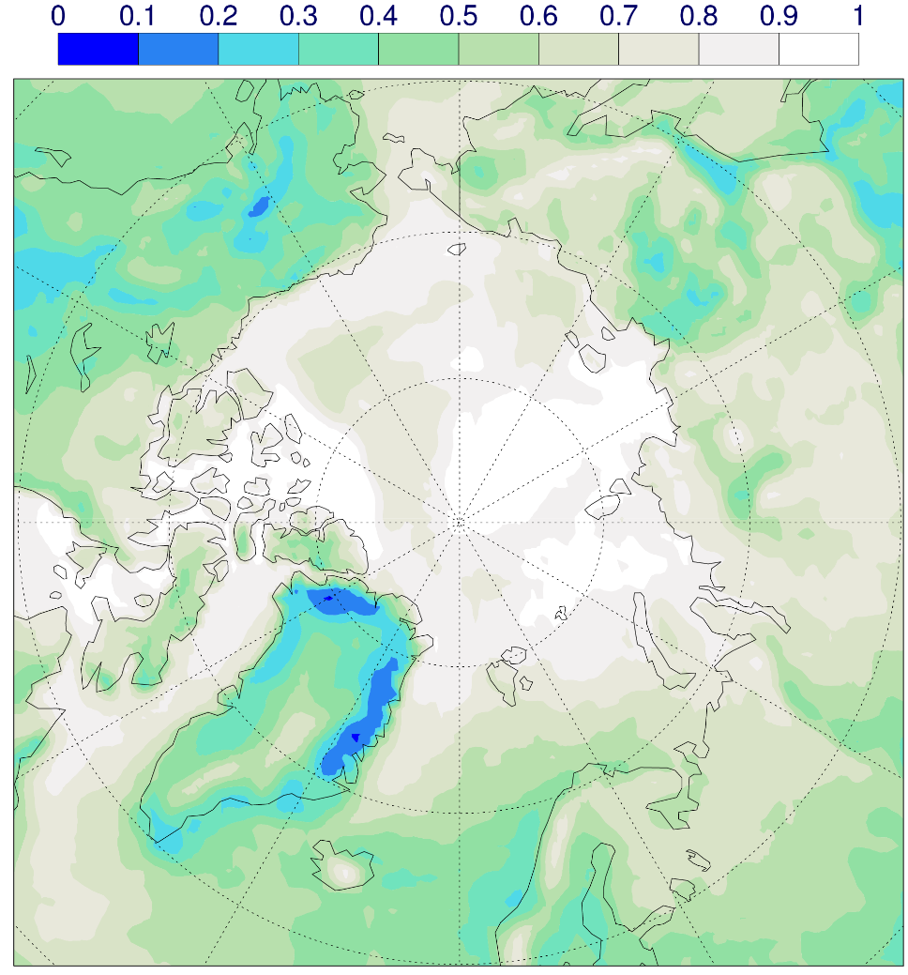
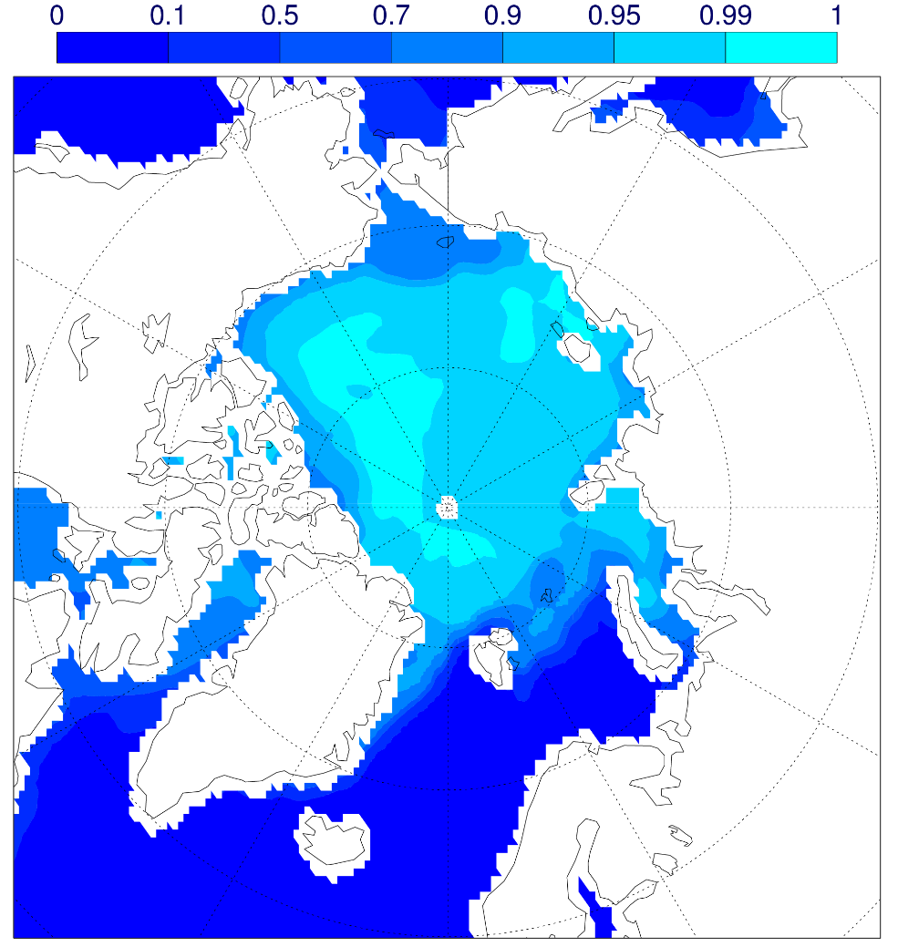
ERA-Interim low cloud and sea ice
Low cloud cover
Sea ice concentration
Averaging period: Nov 2014 – Apr 2015
Notes:
Nov 2014 – Apr 2015

Slide 15
Probing the Arctic
Combining surface observations and model analyses
Thomas Haiden (ECMWF)
Thanks to: Christopher Cox (Univ. Colorado), Martin Janousek (ECMWF), Richard Forbes (ECMWF)
Additional slides
Photo IASOA

Slide 16
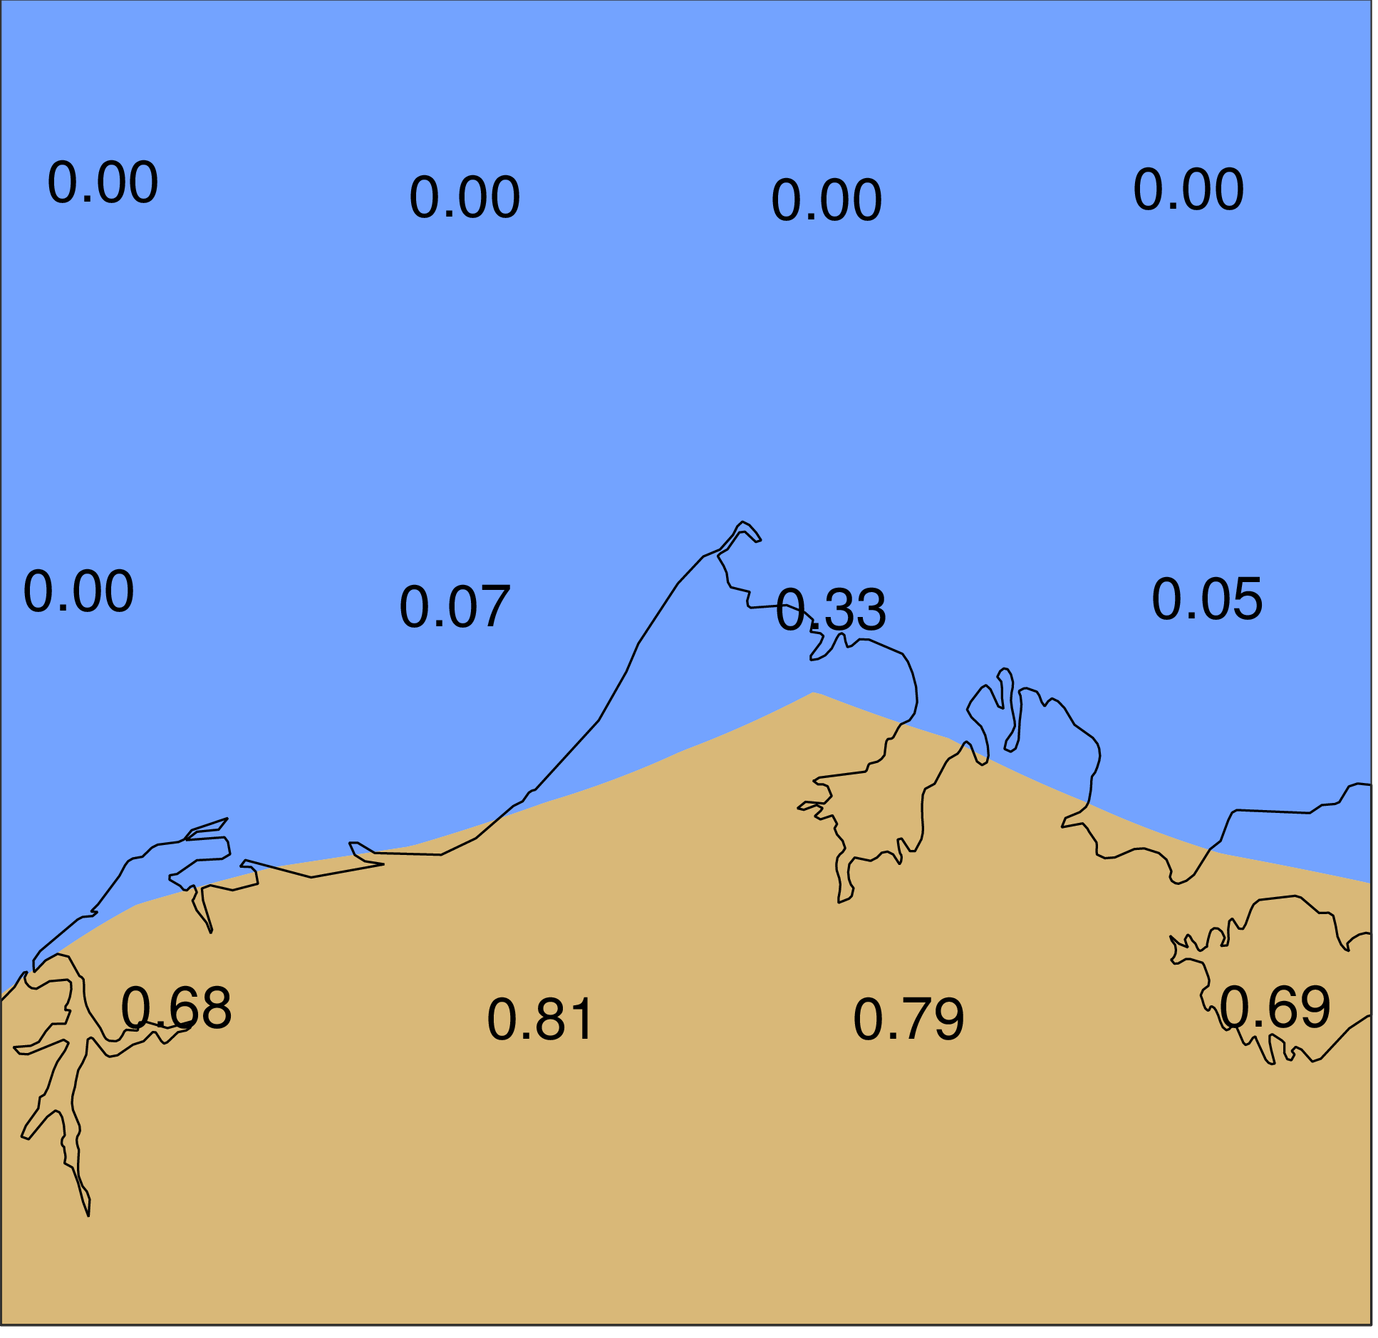
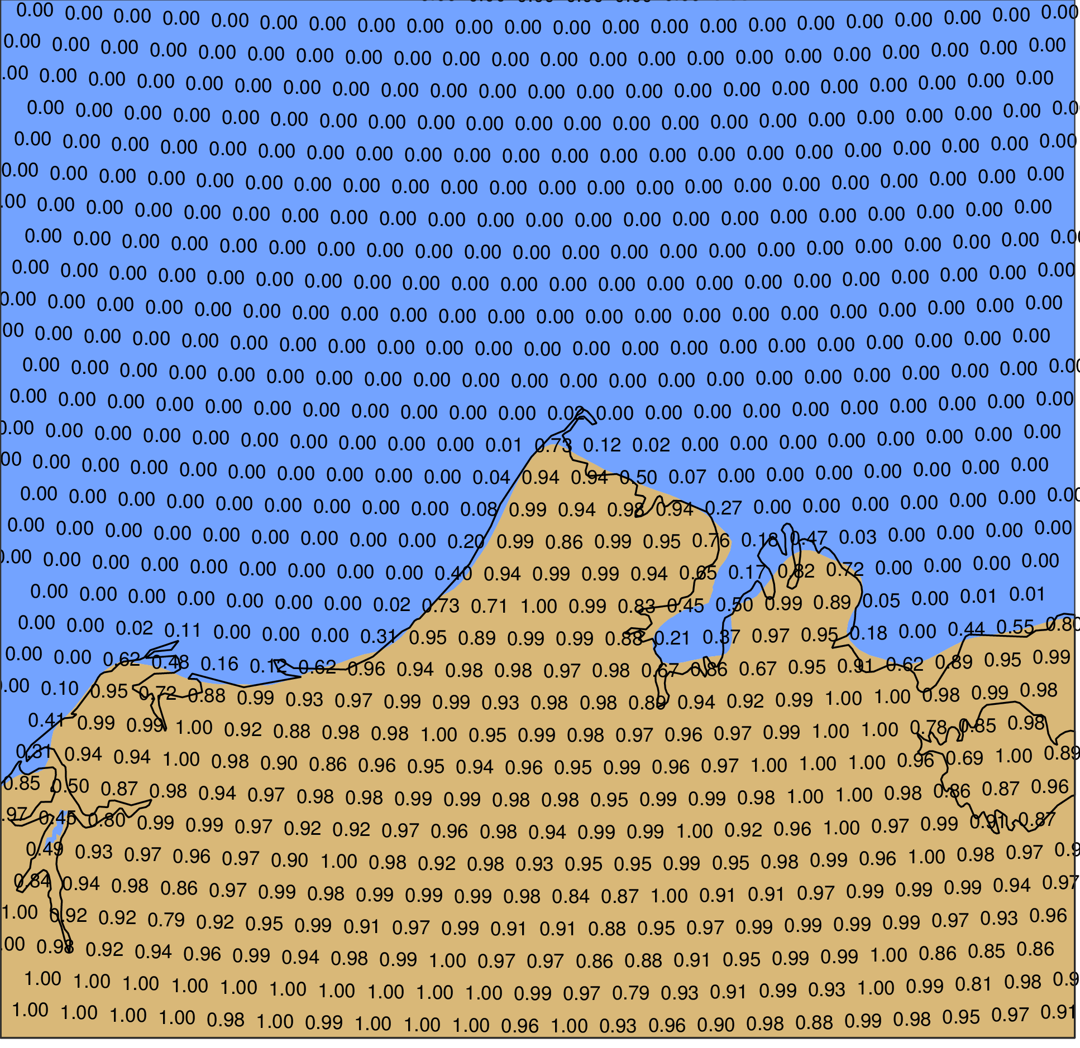
Example: Barrow, Alaska (71N,157W)
ERA-Interim (Δx=80 km)
HRES (Δx=10 km)
Which grid point is the ‘most representative’?
Look at systematic or non-systematic errors?
Look at daily or monthly values ?
Absolute values or anomalies?

Slide 17
Downward longwave flux at Barrow
Grid point | Land fraction | r
0 | 0.33 | 0.823
1 | 0.07 | 0.852
2 | 0.00 | 0.886
3 | 0.00 | 0.885
Ocean points in analysis match observations better than land points
68%-78% of observed variance represented
Notes:
About 1/3 to ½ of the difference in r between the ocean and land points is due to the Dec 1999 value where below -40 W/m2 was observed and the land points give around -10 W/m2.
More generally, the land points tend to slightly underestimate the stronger anomalies (of either sign).
Anomalies are relative to the period climatology (monthly means).

Slide 18
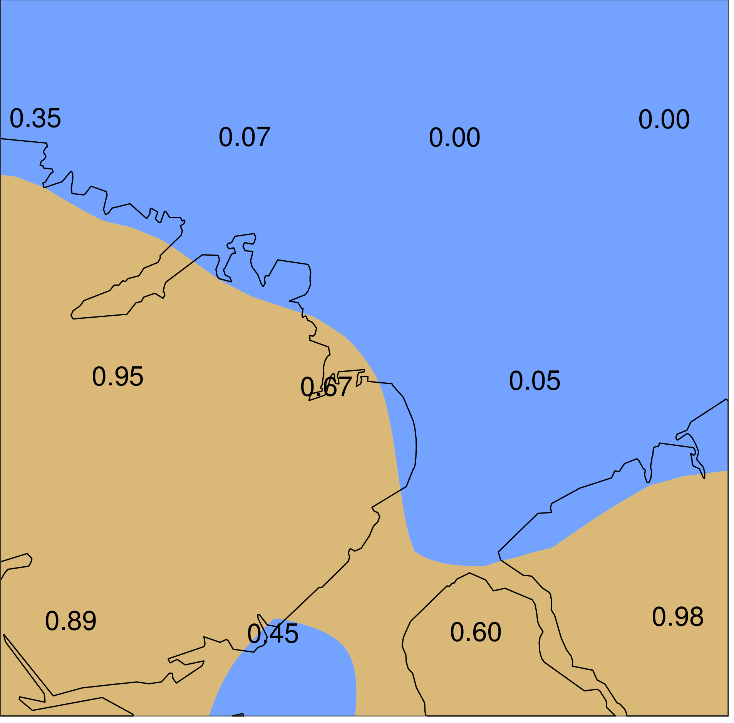
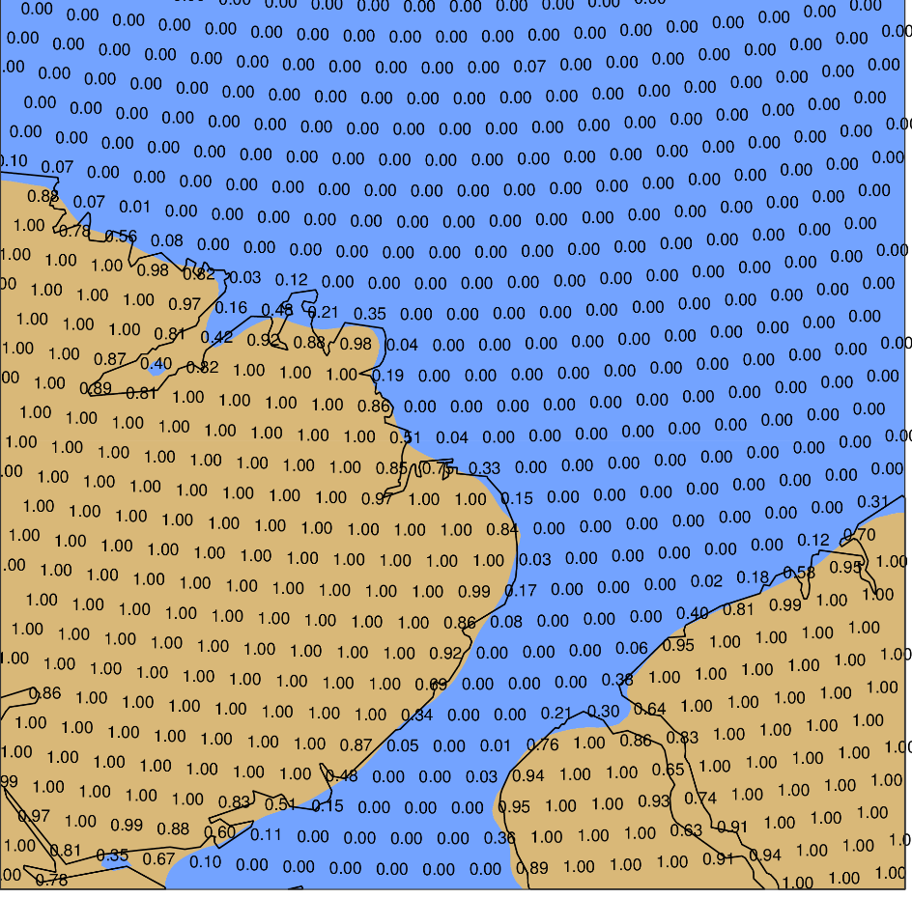
Example: Alert, Nunavut (82N,62W)
ERA-Interim (Δx=80 km)
HRES (Δx=10 km)

Slide 19
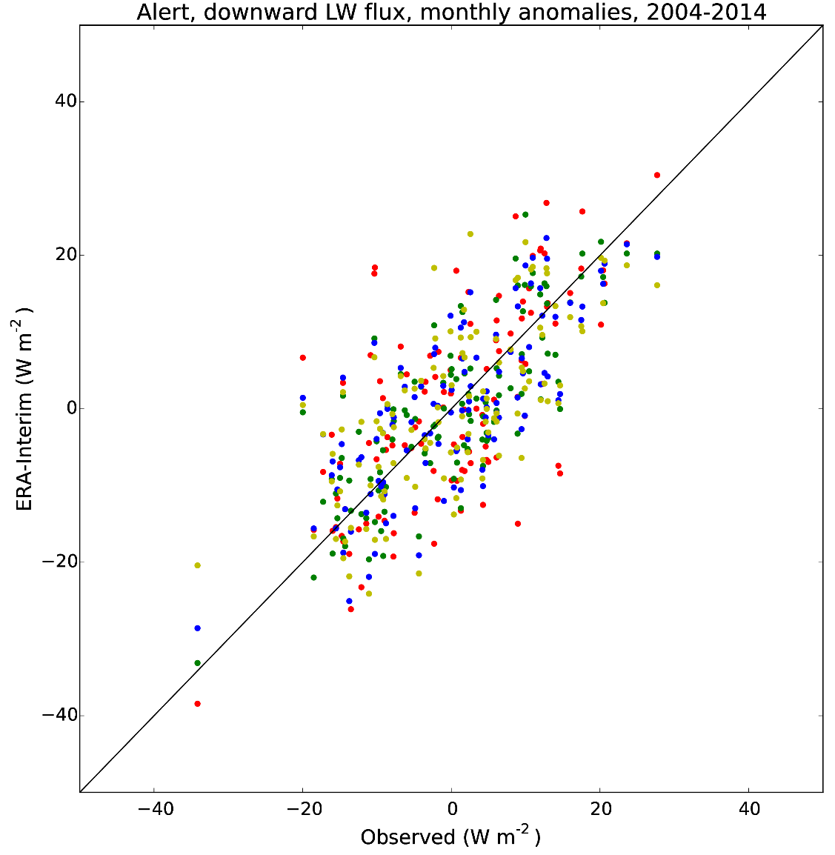
Downward longwave flux at Alert
Grid point | Land fraction | r
0 | 0.67 | 0.679
1 | 0.05 | 0.794
2 | 0.00 | 0.747
3 | 0.07 | 0.692
Local conditions not as well captured as in Barrow
46%-63% of observed variance represented

Slide 20
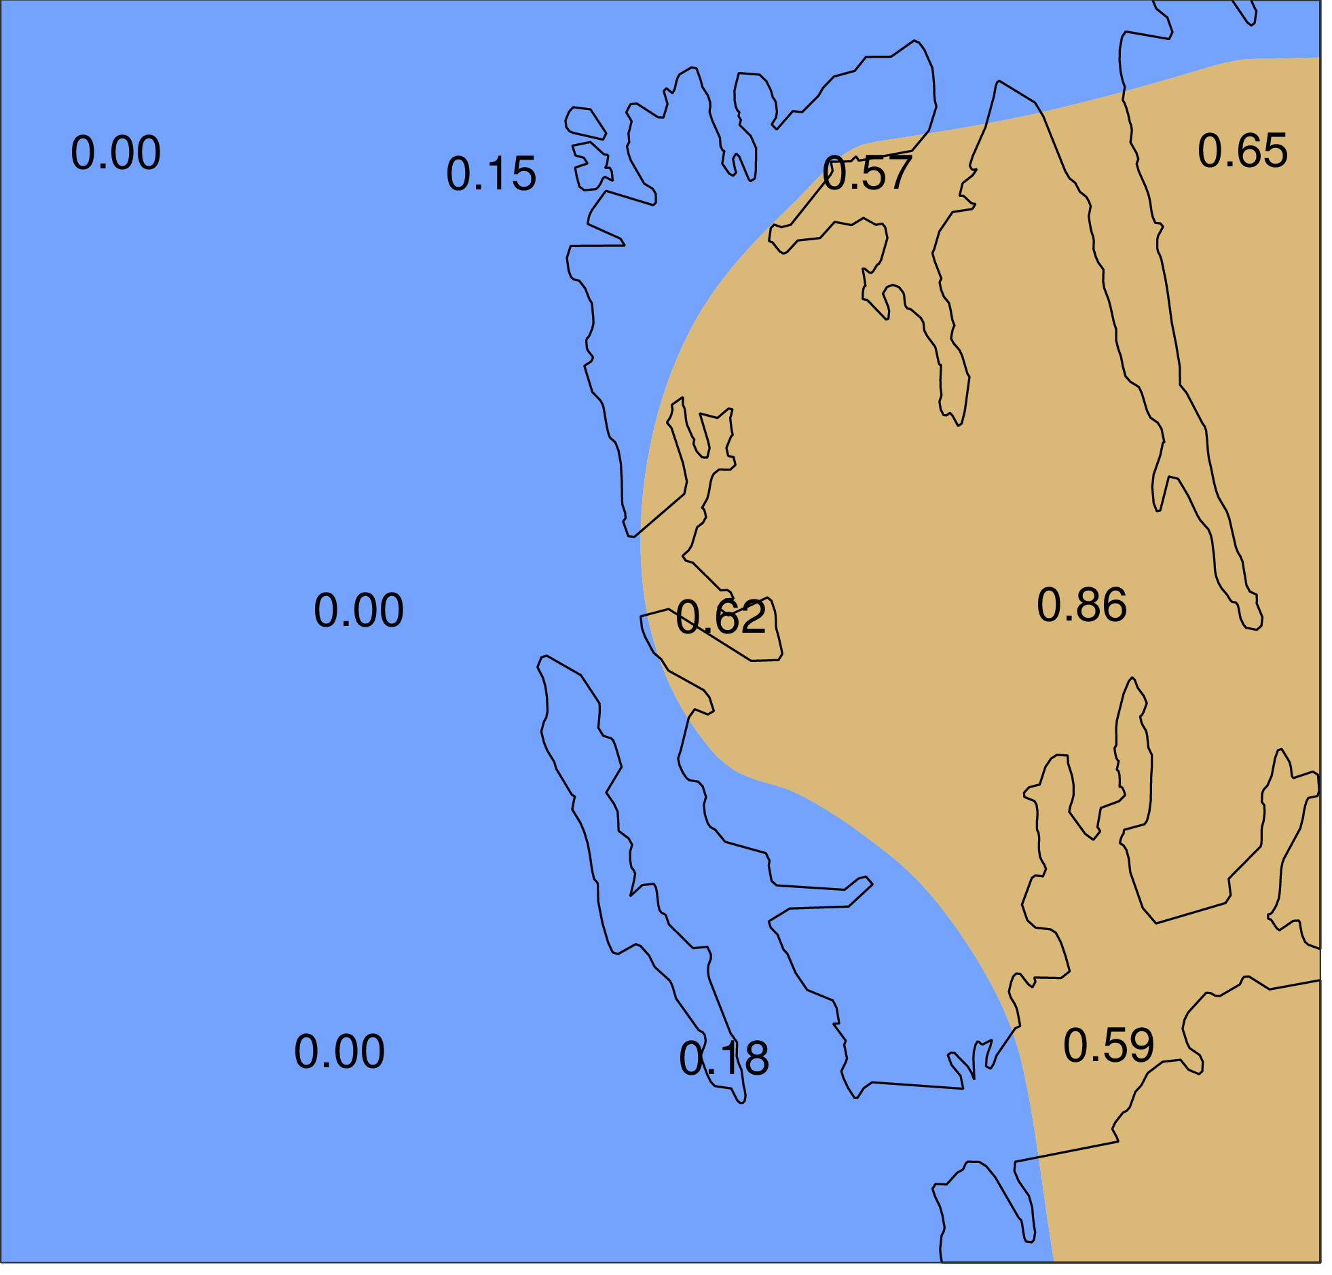
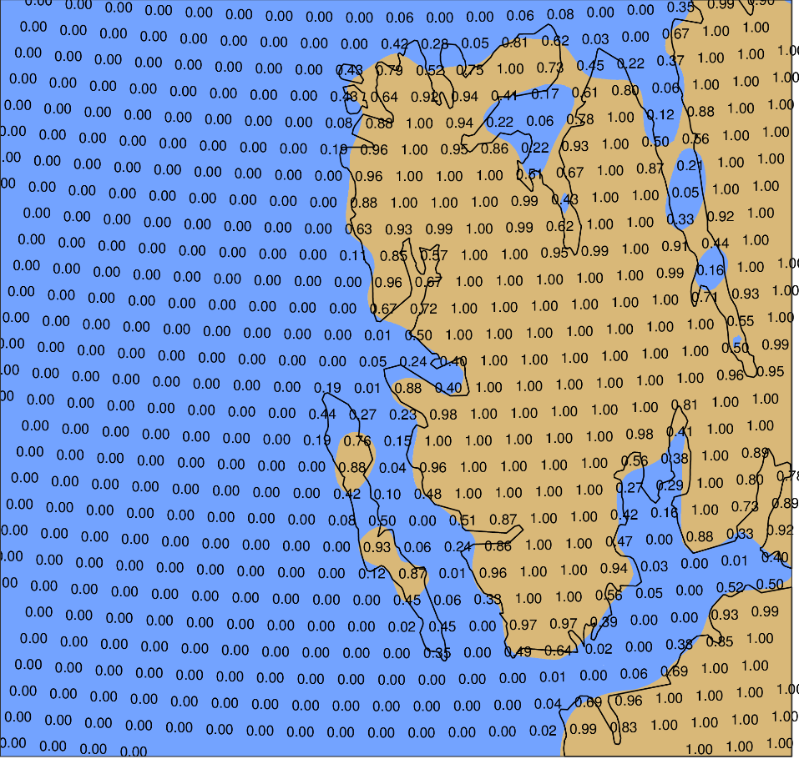
Example: Ny-Ålesund, Svalbard (79N,12E)
ERA-Interim (Δx=80 km)
HRES (Δx=10 km)

Slide 21
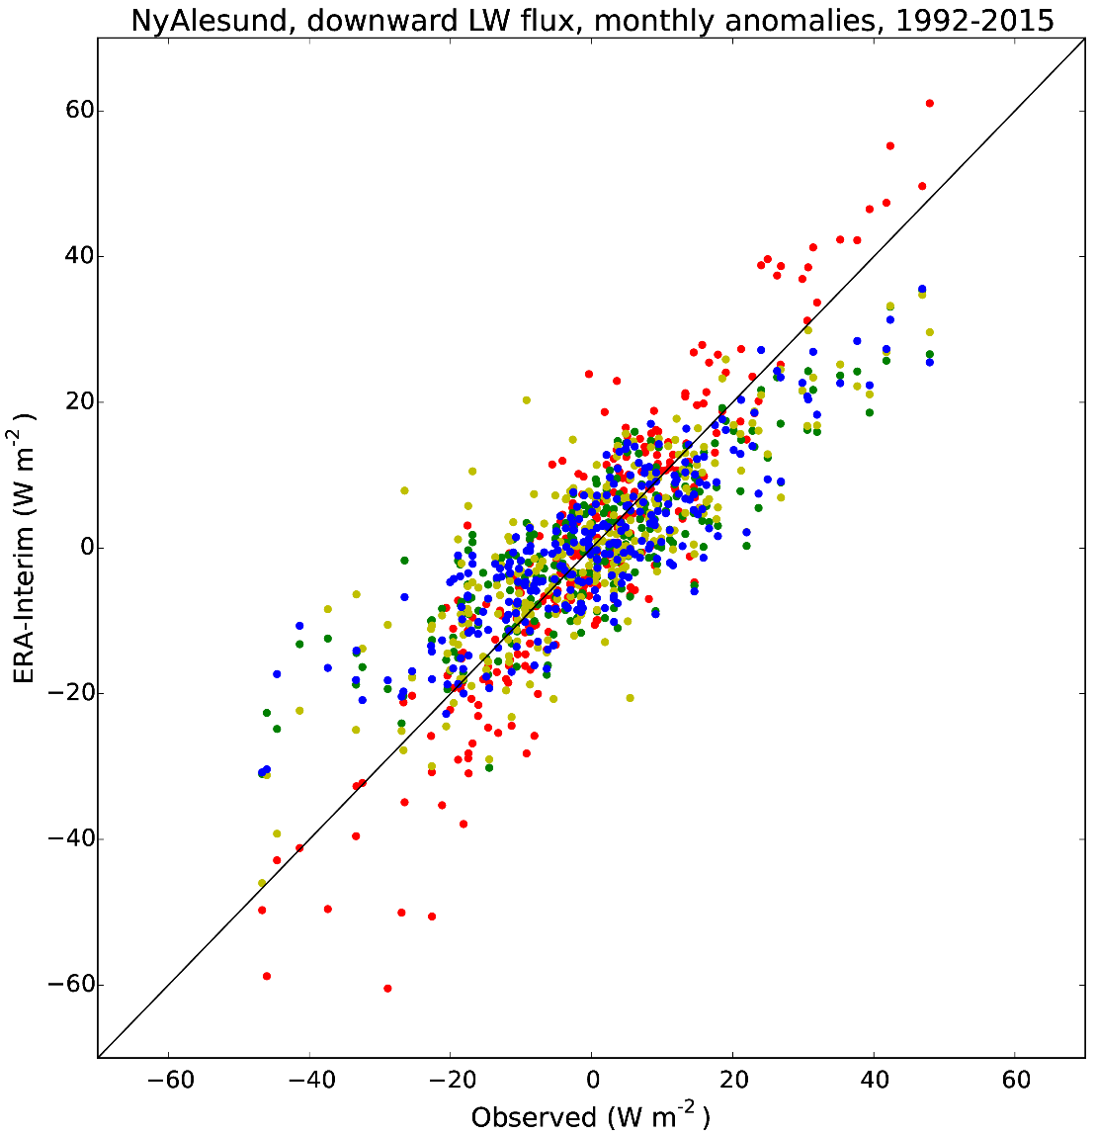
Downward longwave flux at Ny-Ålesund
Grid point | Land fraction | r
0 | 0.62 | 0.918
1 | 0.00 | 0.838
2 | 0.18 | 0.816
3 | 0.00 | 0.859
Largest anomalies
Highest correlation
Systematic differences between grid-points
67%-84% of observed variance represented

Slide 22
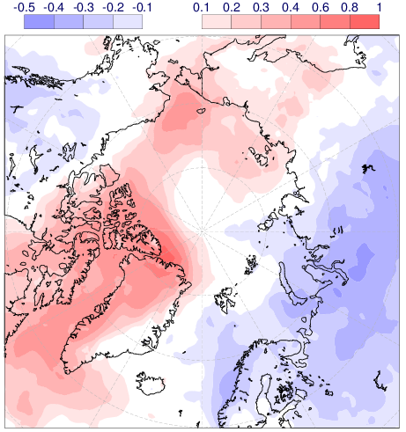
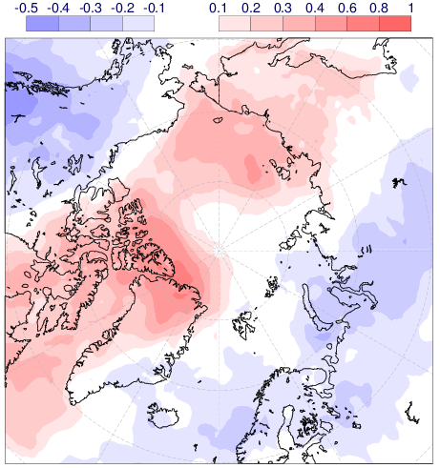
Spatial correlation of longwave flux at Alert
Correlation within ERA-Interim
Correlation OBS v ERA-Interim

Slide 23
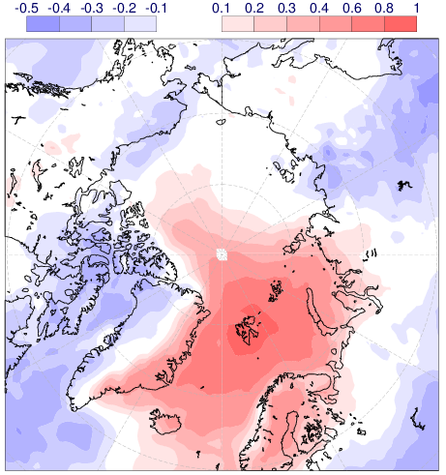
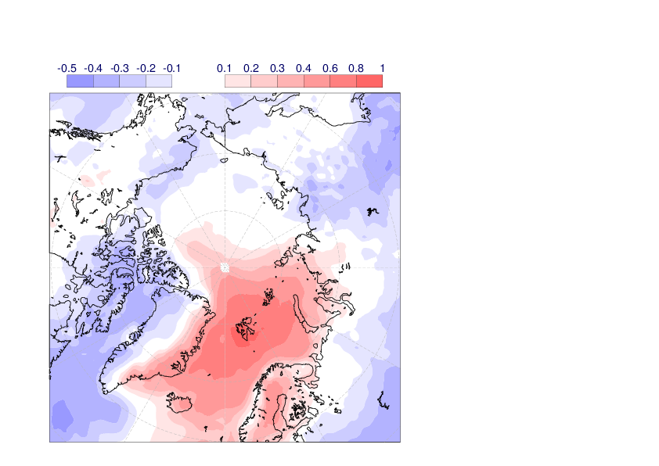
Spatial correlation of longwave flux at NyAlesund
Correlation within ERA-Interim
Correlation OBS v ERA-Interim
Notes:
Monthly anomalies over 2010-2014 period

Slide 24
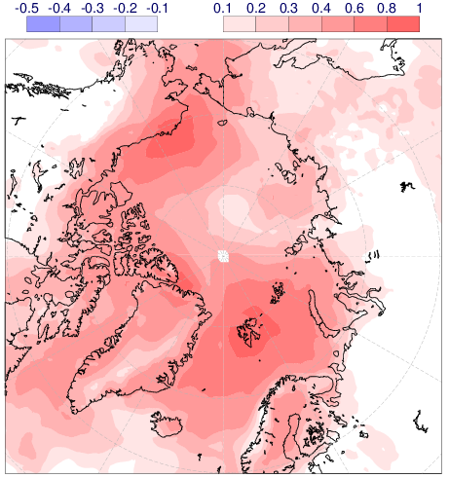
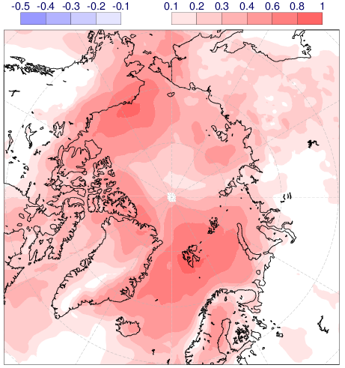
Superposition of positive correlations
Correlation within ERA-Interim
Correlation OBS v ERA-Interim

Slide 25
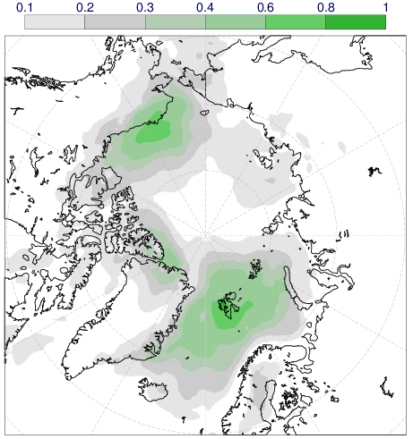
Variance explained by positive correlations
Correlation within ERA-Interim
Correlation OBS v ERA-Interim

Slide 26
Correlation as a function of distance
Barrow
Alert
Notes:
Barrow: at close range, about 0.1 difference in r between obs and eraint; at 400-500 km however, difference rather small, which means that even without a station existing at a location, eraint can be used to estimate the footprint
Alert: larger difference at close range, some very low correlations at 200-300 km; at 400-500 km, however, obs and eraint relatively similar again; r is however ~0.1 smaller at that distance than it is for Barrow

Slide 27
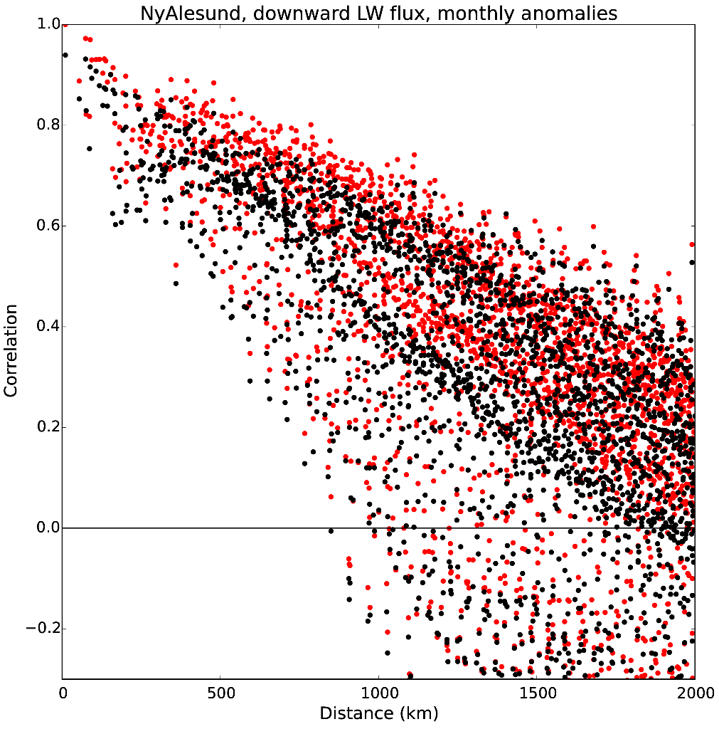
Correlation as a function of distance
Barrow
Ny-Ålesund
Notes:
NyAlesund has weaker drop of r with distance in the first 1000 km, difference between obs and eraint is smaller than for Barrow, Alert

Slide 28
Variance explained by positive correlations
Barrow, Alert, Ny-Alesund
All IASOA stations

Slide 29
Correlations in areas of large sea-ice variability
Sea ice concentration anomalies for Sep (1979-2010)
LW downward (r²)
Kapsch et al (2013)

Slide 30
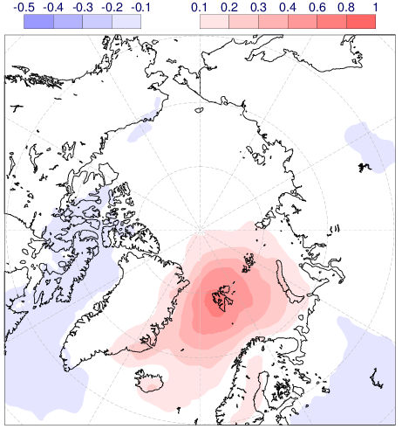
Longwave flux at NyAlesund OBS v ERA-I
Monthly
Daily
Notes:
Monthly anomalies over 2010-2014 period

Slide 31
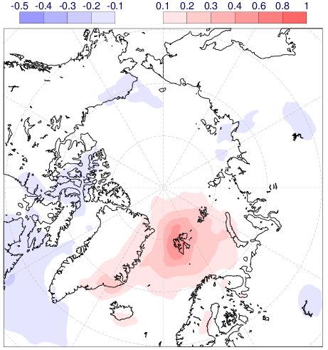
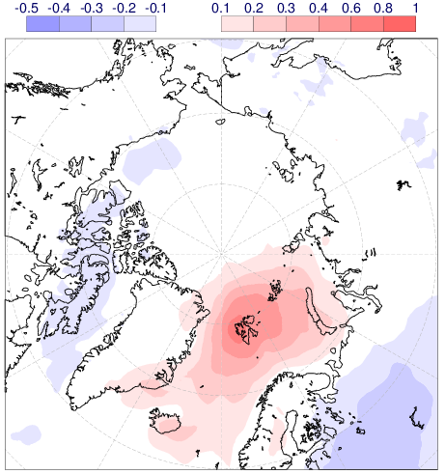
Longwave flux at NyAlesund OBS v ERA-I
Northerly flow
Southerly flow
Notes:
Daily values

Slide 32
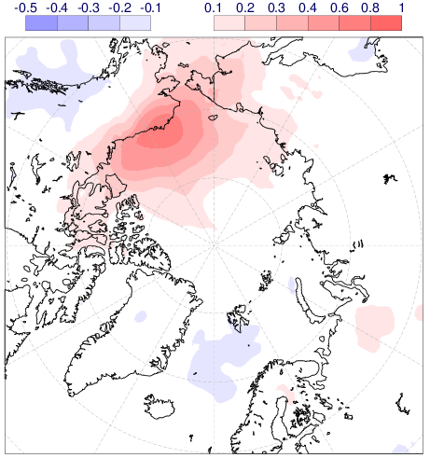
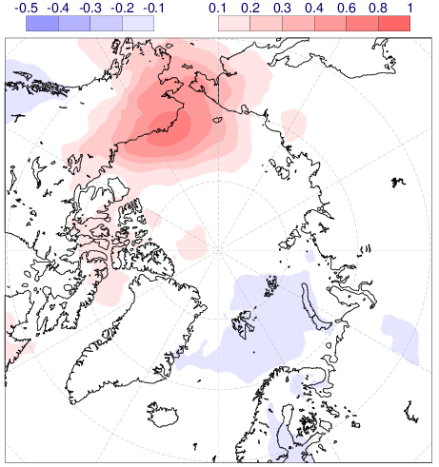
Longwave flux at Barrow OBS v ERA-I
Northerly flow
Southerly flow

Slide 33
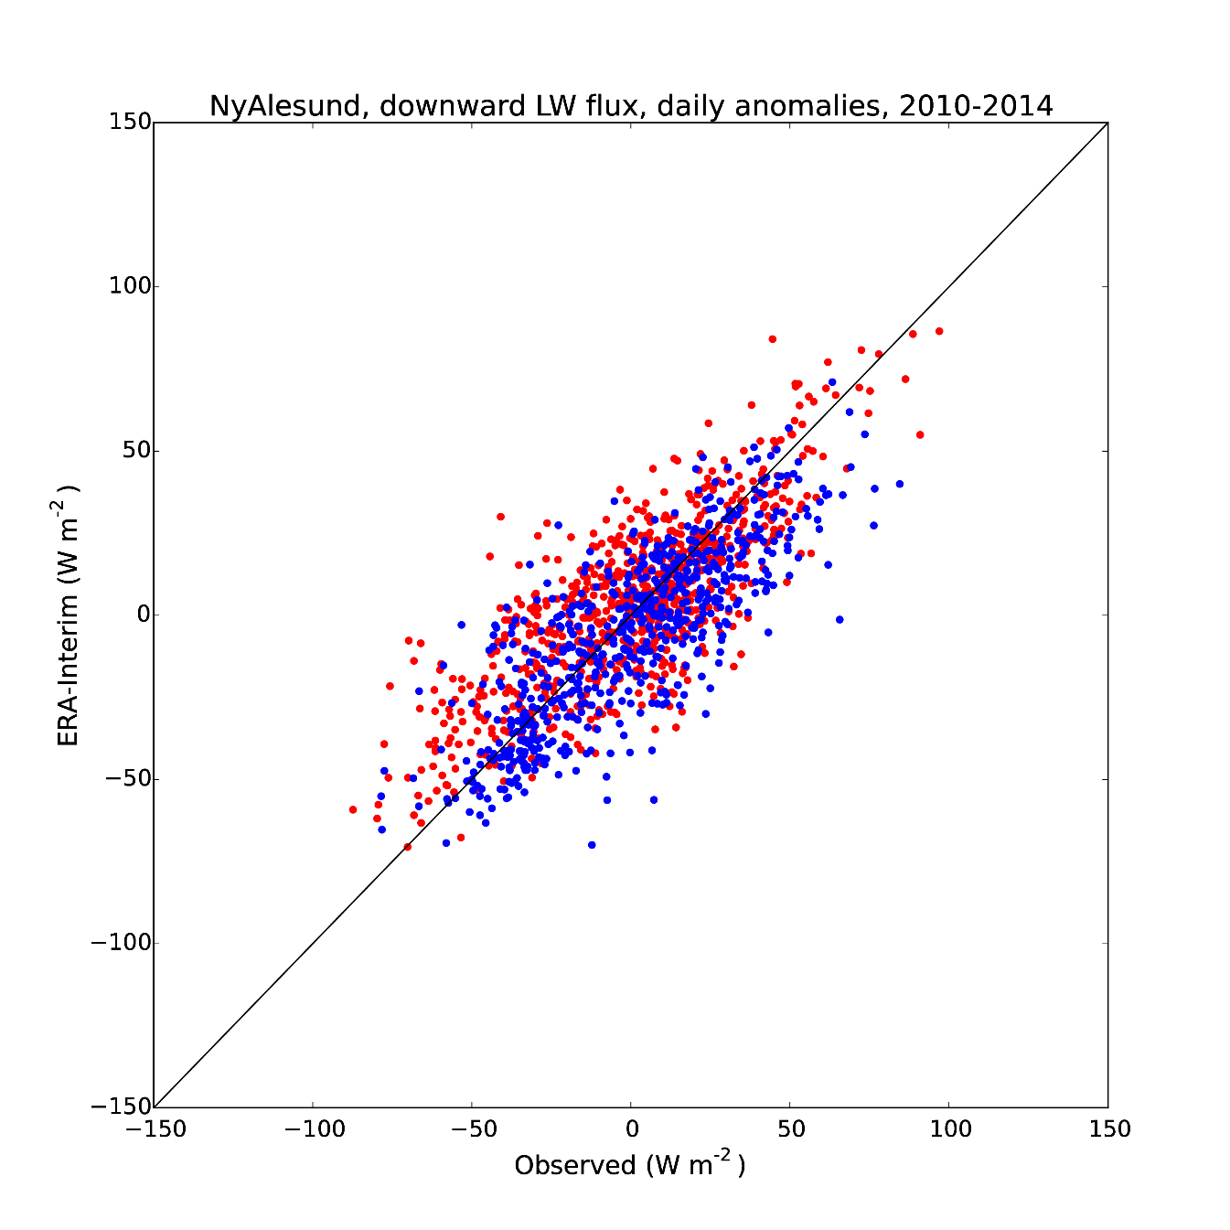
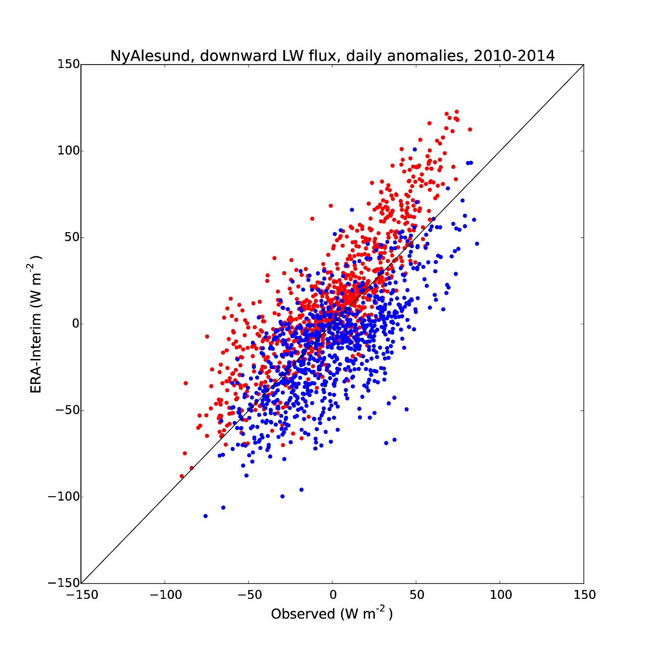
Longwave flux at Barrow OBS v ERA-I
Northerly flow
Southerly flow
Barrow
Ny-Ålesund
Notes:
Daily values, Barrow

Slide 34
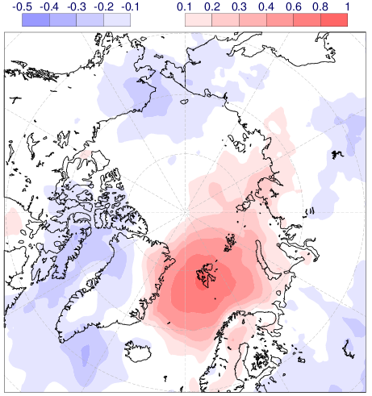
Longwave flux at NyAlesund OBS v ERA-I
All cases (1826 days)
700 hPa flow speed >10m/s (217 days)
Notes:
Daily values

Slide 35

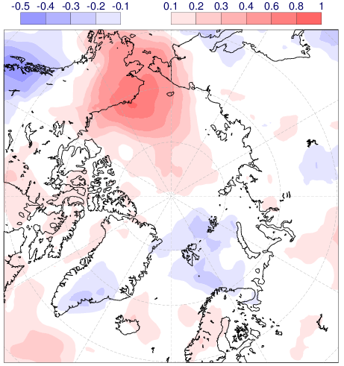
Longwave flux at Barrow OBS v ERA-I
All cases (1826 days)
700 hPa flow speed >10m/s (147 days)
Notes:
Daily values

Slide 36
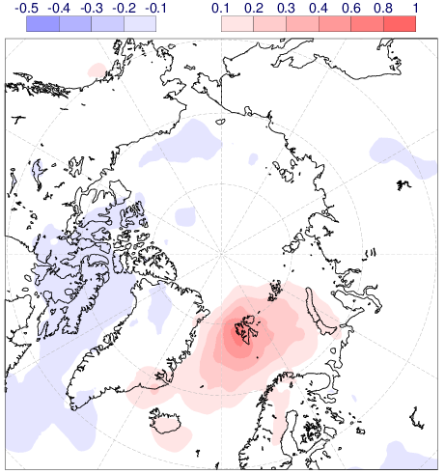
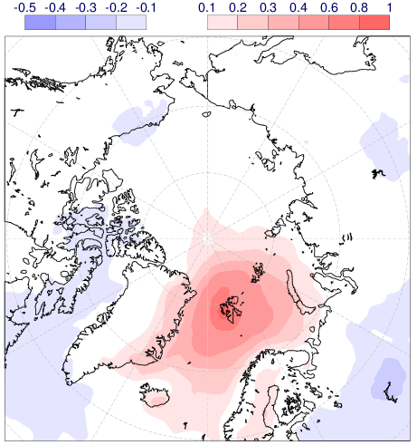
Longwave flux at NyAlesund OBS v ERA-I
Summer (May-Oct)
Winter (Nov-Apr)
Notes:
Daily values

Slide 37
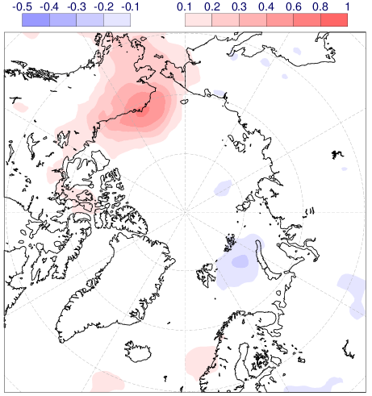
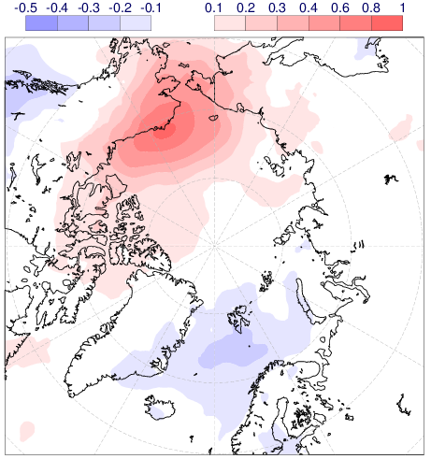
Longwave flux at Barrow OBS v ERA-I
Summer (May-Oct)
Winter (Nov-Apr)
Notes:
Daily values

Slide 38
Winter-time cloud cover: analysis bias
Nov 2014 – Apr 2015

Slide 39
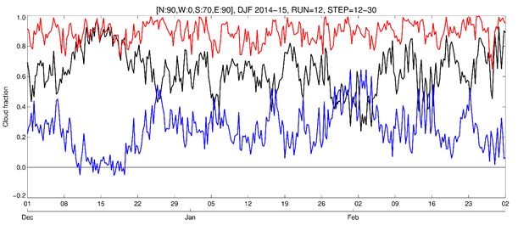
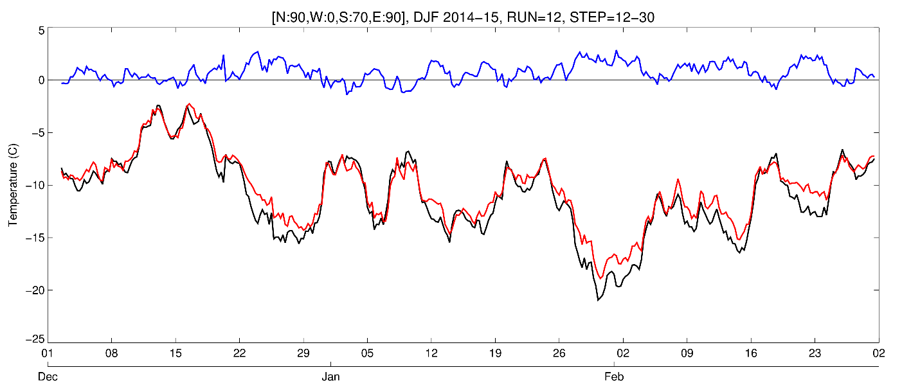
Winter-time cloud cover forecast error
FCST
Total cloud cover
OBS
ERR
2-m temperature

Slide 40
Winter-time cloud cover forecast error
r²=0.49

Slide 41
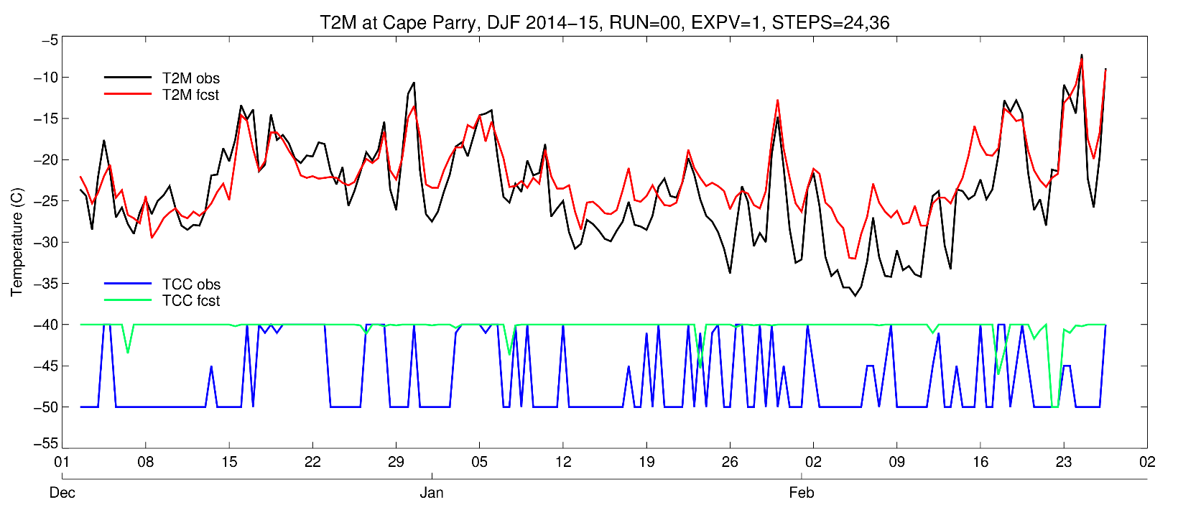
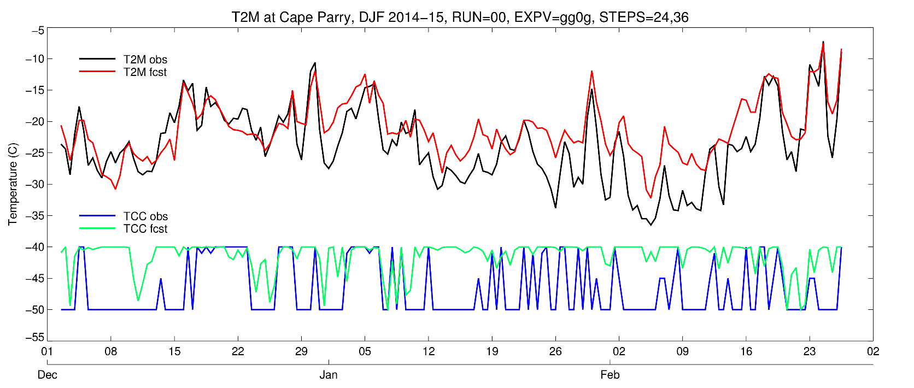
Cape Parry T2M and TCC obs and fcst
OPER
EXP

Slide 42
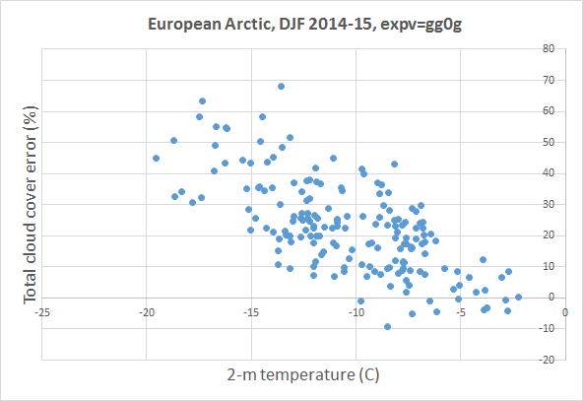
Winter-time cloud cover forecast error, EXP
r²=0.47

Slide 43

Cape Parry T2M and TCC obs and fcst
OPER
ERA-Interim

Slide 44


Cape Parry T2M and TCC summer (JJA)
OPER
ERA-Interim

Slide 45
ERA-Interim low cloud and sea ice
Low cloud cover
Sea ice concentration
Averaging period: Nov 2014 – Apr 2015
Notes:
Nov 2014 – Apr 2015

Slide 46


ERA-Interim low cloud and sea ice
Low cloud cover
Sea ice concentration
Averaging period: 5-15 Dec 2014
Notes:
5 – 15 Dec 2014

Slide 47


ERA-I Surface sensible and latent heat flux
Sensible heat flux
Latent heat flux
Averaging period: 5-15 Dec 2014
Notes:
5 – 15 Dec 2014

Slide 48


ERA-I Low cloud and surface latent heat flux
Sea ice concentration
Latent heat flux
Averaging period: 5-15 Dec 2014
Notes:
5 – 15 Dec 2014

Slide 49

ERA-I Low cloud and surface latent heat flux
Low cloud cover
Latent heat flux
Averaging period: 5-15 Dec 2014
Notes:
5 – 15 Dec 2014

Slide 50


ERA-Interim v CM SAF satellite observations
ERA-Interim
CM SAF
Averaging period: 1-31 Dec 2014
Notes:
00,12 UTC analyses used from ERA-Interim
CM SAF field from polar orbiting satellites

Slide 51
Discussion
Sotiropoulou et al. (2015): Summer Arctic stratus in the IFS
Problem representing stably stratified cloud regime
Problem representing low CCN regime in the Arctic
This study: Winter Arctic stratus in the IFS
Overestimation of cloudiness larger at colder temperatures
Surface fluxes at SIC<100% appear to be part of the problem
Beesley and Moritz (1999): Annual cycle of cloudiness in the Arctic
Ice particle growth by vapour deposition more efficient in winter

Slide 52
Conclusions & outlook
Representativeness of downward longwave flux at IASOA sites
- Correlation OBS v ERA-I is typically 0.65-0.9 (monthly, daily)
- NyAlesund and Barrow have larger ‘footprint’ than Alert
- Ocean points may correlate better with obs than land points
- Correlations within ERA-Interim can be used as proxy for actual observations at distances >200-300 km
Verification of Arctic low cloud in the IFS (HRES, ERA-Interim)
- Too frequent overcast at low temperatures
- Occurs especially in areas where sea-ice fraction <100%
- Need to disentangle surface, boundary-layer, and cloud physics contributions

Slide 53

Year of Polar Prediction 2017-2019
4.1.3 Extra observations
‘Stable boundary layers are still a perplexing problem for models that is particularly acute in
the Arctic, especially over land.’
4.3.2 Verification
‘.. the surface radiation budget is particularly important in
polar regions and should be observed and verified, especially as part of process studies.’

Slide 54


Year of Polar Prediction 2017-2019
Sparse surface observation network in the Arctic
- Model analyses more uncertain in polar regions
- Verification: each single station counts
- Complement satellite retrievals of cloud and surface properties

Slide 55

Downward longwave flux at Barrow
r=0.731
r=0.727
r=0.757
r=0.755
Sea points in analysis may match observations better than land points
Notes:
Correlation values based on daily anomalies

Slide 56

Downward longwave flux at Alert
r=0.603
r=0.736
r=0.722
r=0.711
Total cloud cover
1
0
Sea points match observations better than land point
Notes:
Correlation values based on daily anomalies

