Slide 1

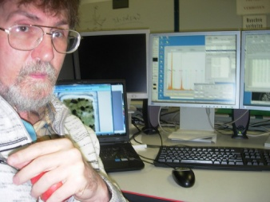
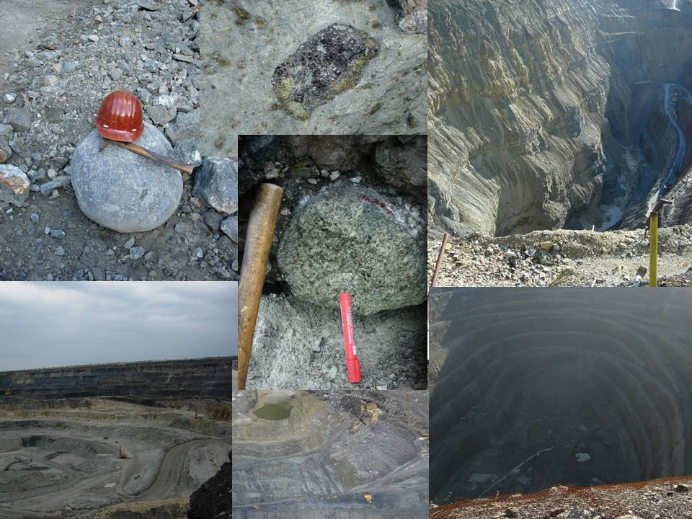
USAGE OF ECLOGITE THERMOBAROMETRY FOR MANTLE PETROLOGY
Ashchepkov Igor¹
N.V.Vladykin², Z.V. Spetsius³, C.A. Babushkina⁴, H. Downes ⁵, T. Ntaflos⁶.
1. V.S. Sobolev Institute of Geology and Mineralogy SB RAS, Novosibirsk, Russia;
2 Institute of Geochemistry SD RAS,
3 ALROSA Stock Company
4.Institute of Geology of Diamond and Noble Metals SD RAS, Yakutsk, Russia
5 Birkbeck College, University of London, UK
6. Vienna Universyty, Austria
Institute of Geology
and Mineralogy,
Novosibirsk Russia

Slide 2
Evoluation of method for Cpx
Evoluation of method for eclogitic Garnet
Orogenic eclogites PT
Correlations for natural eclogites
PT conditions checked using experimental data
Variations of eclogitic Cpx
PTX diagrams for the deep seated inclusions in KL4 (Drhawar craton)
and Sloan (Wyoming craton) kimberlites
PTX diagrams for the deep seated inclusions in Mir and Udachnaya kimberlites
PTX diagrams for the deep seated inclusions in Davik (Slave craton) and
Lace kimberlites (Lesotho)
Varieties of eclogites
PTX diagrams for diamond inclusionsof Ebelyakn placer andNyurbinskaya pipe
Abstract
Home

Slide 3

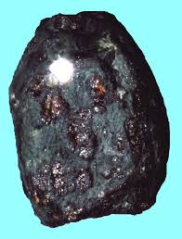
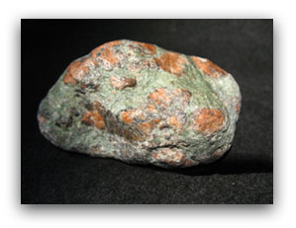
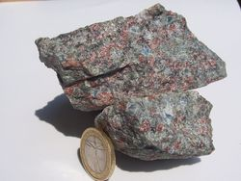
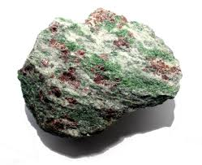
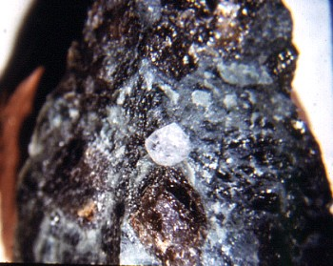
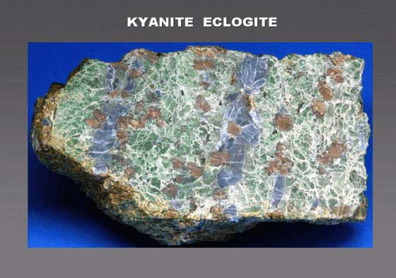
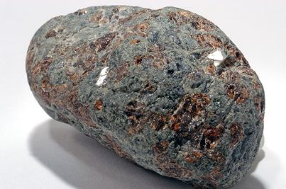
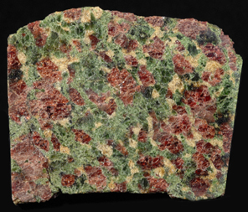
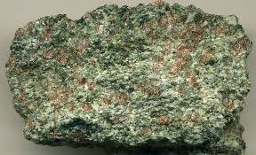
New thermobarometric methods give reliable PT
conditions checked using experimental data
Home
Eclogites xenoliths in kimberlites
are quite different
Ashchepkov et al., 2015
For eclogite Garnet
( monomin give PT
comarable to those
Ashchepkov et al., 2015
For CPX -Monomin
(universal ) could be
impplicated to all types
Beyer et al., 2015
Gar –Cpx
Hardly dependent
on Si in Cpx and T

Slide 4
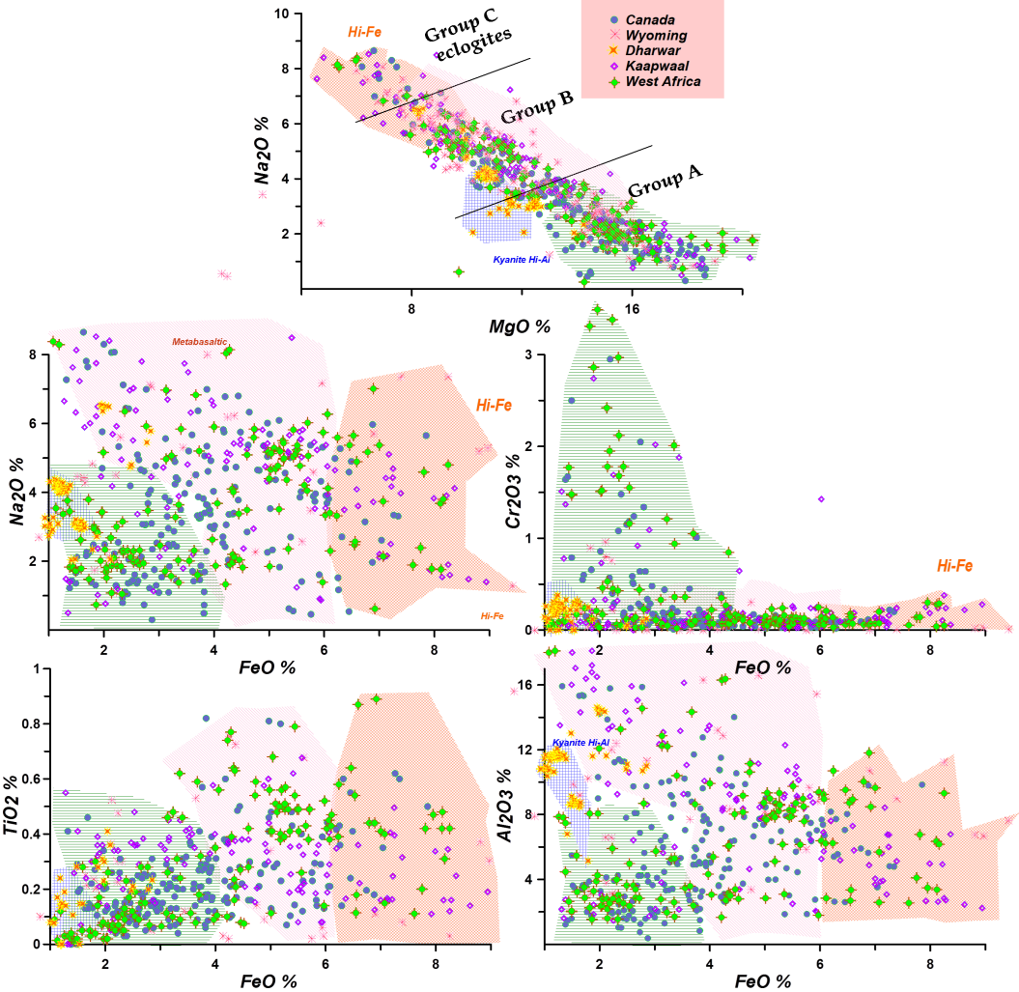
Variations of Clinopyroxenes in natural eclogite
Home
Enhanced monomineral thermobarometry for clinopyroxenes and garnet (Ashchepkov et al., 2015) allow reconstruction of thermal conditions for the mantle eclogitic xenoliths and xenocrysts of omphacites and pyrope almandine garnets of eclogitic and megacrystic types.
Three common groups according to Dawson,(1977) A. Mg - eclogites; B. common subduction-related basaltic eclogites and C. Na-Fe- rich eclogites. In addition group D compile Ca-Al rich varieties (Spetsius et al., 2008; Viljoen et al., 2010). We subdivided these groups and their positions in mantle lithosphere sections beneath the most studied pipes in Yakutia and most interesting localities Worldwide.
A Yakuia B Worldwide

Slide 5
Variation diagrams for the clinopyroxenes from
Experimental runs in eclogite and peridotite systems.
Home

Slide 6
Evoluation of method for Garnet from eclogites
Home
Garnet barometer (Ashchepkov, 2006) uses the oxides values to avoid the formula calculations. It was created as a sequence of the transformations of the calculated P (pressures). Equations of garnet barometer for peridotites use mainly Ca-Cr relations are used [Sobolev et al., 1973].
xcm=CaO+MgO; xd=(CaO+MnO+2.*FeO)^{0.4};
xd=(CaO+MnO+2.*FeO)^{0.4}; P=P+5.5*FeO+MgO/FeO;
P=P-(4- Cr₂O₃)*0.9-(TiO₂-0.1)*7-(FeO-7)*2;
P=5.25* Cr₂O₃/xd+0.02*(TºK-273)+22.5*FeO+MgO/20.+0.5*
CaO-TiO₂-12+FeO/7; P=P*2.05+0.0045*P;
P=-0.00007*P³+0.0057*P²+0.87*P;
P=P+5.5*FeO+MgO/FeO; P=P-(4- Cr₂O₃)
*0.9-(TiO2-0.1)*10-(FeO-7)*2
For peridotites:
P=0.855*P+0.485/CaO*TºK/1050+TiO₂*200;
P=(P-40)/(TºK-1000)/FeO*10+P;
P1=MgO*Cr2O3*(TºK-1050)*FeO/CaO*TiO2)/7000;
P2=MgO* Cr₂O₃*(TºK-1200)/120000;
Fe51=Fe/2*(Fe+Mg)+0.000045*(TºK-790)-0.0220;
P=P+P1*Fe51*5+P2*(1-Fe51); CrCa=Cr2O3/CaO;
P=P-6*CrCa**2-12.6*CrCa+25-5*TiO₂;
For eclogites the Na- admixture
[Sobolev, Lavrent’ev, 1971] and Ca/(Ca+Mg)
[Bobrov et al., 2009] are used:
P=0.815*P+0.45CaO*TºK/1150+TiO₂*200;
P=(P+Na₂O/TiO₂*8++CaO)/MgO*11)*1.20+5*Na₂O/CaO+7
* Na₂O/FeO+TiO₂/Na₂O*3
-100*MnO/Na₂O-80*Fe/(Fe+Mg); P=P-20/(85-P)*CaO/MgO

Slide 7
Evoluation of method for Cpx
Home
Internal exchange CaMgSi2O6 = NaAl Si2O6
in Cp x is used for the construction of barometer
KD =Na*Mg/(Al+Cr)/Ca
TºCpx - Texp
For the pyroxenes of group A:
AlCr=Al+Cr+(2*Ti-0.015)/(P-5)/P**2*40+0.55(Fe-0.2-0.21*Na)*0.18*P/62.5
The logarithmic dependence between P and KD was transformed to a lineal one. Final pressure equation for the eclogites is as follows:
P=0.325*(1-0.19*Na)/Al+0.01*Fe/Na +1.15*Cr)*KD* TºK **0.75/(1+5.5-2.5*Fe*P/60) *Fe) -log(1273/ TºK)*(Al+Ti+2.25*Na+1.5*Fe3+)*35 +(0.9-Ca)*10+Na/Al* TºK /300-1.5 -4*(Fe*33.2-4)+ (Ca*25.9-20)* TºK /2500
with further correction P=(0.00002*P**3-0.0036*P**2+0.875*P-9)*1.075 (Equation1 )
For the pyroxenes from "basaltic" eclogites of group B:
AlCr=Al+Cr+(4*Ti-0.0125)/(TºK-600)*500 +(Fe-0.205)*0.75
P=0.3525*(1-0.220*Na)/Al+0.015*Fe/Na) *KD* TºK **0.75/(1+8.5*Fe)
-log(1273/TºK)*(1.3*Al+Ti+0.5*Na+3.5*Fe3+)*35 +(0.9-Ca)*10
+Na/Al* TºK /100 (Equation 2 )
for the eclogites of group C high Fe and high Ca-Al eclogites the equation is slightly changing
P=0.335*(1-0.215*Na)/Al+0.012*Fe/Na) *KD* TºK **0.75/(1+5*Fe)
-log(1273/ TºK)*(Al+Ti+2.75*Na+2.5*Fe3+)*35 +(0.9-Ca)*10+Na/Al* TºK /300
+(Na-2.5)*Fe*( TºK -1500)/20+Ca/Mg*( TºK -1000)/75
(Equation 3)

Slide 8
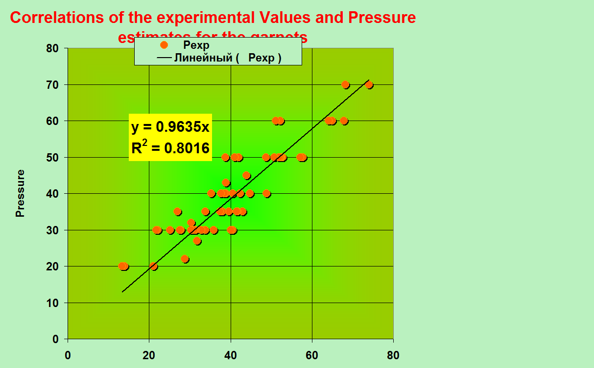
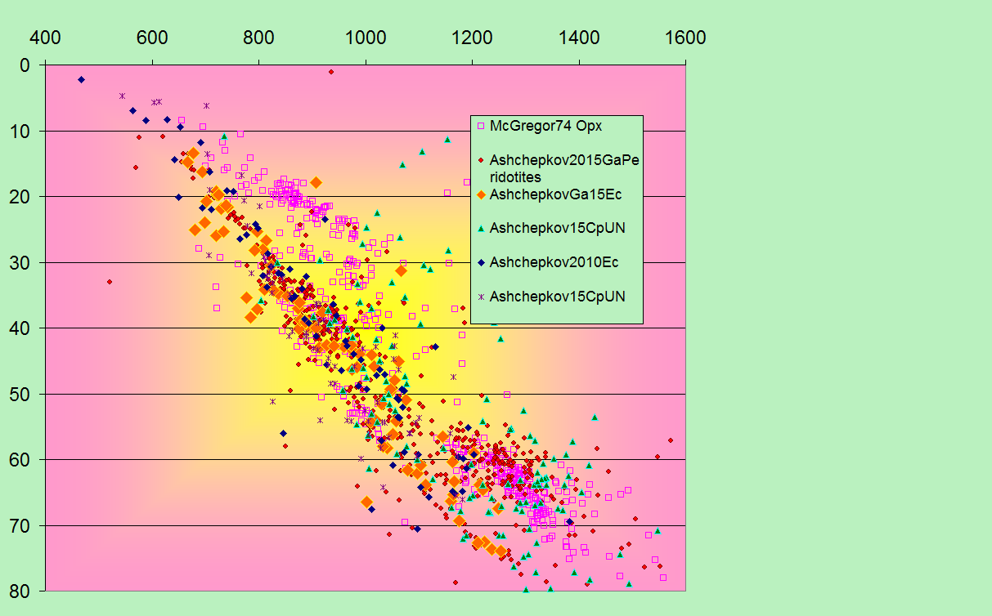
Correlations
Home

Slide 9
Correlations of the pressure estimates produced by the most reliable mantle barometers with the experimental P values in peridotite system
Home

Slide 10
Correlations of the pressures produced by universal Cpx barometer and pressures produced by the most reliable barometers
Home
B.

Slide 11
Correlation for natural eclogites
Home

Slide 12
Corrections to the Nimis Taylor, 2000 thermometer give the more agreements with the other thermometers for mantle rocks mantle
Home
A.
D.
E.
B.
G.
H.

Slide 13
. PT diagrams for mantle xenoliths of peridotite and eclogite type together from Udachnaya Mir Komsomolskaya and Nyurbinskaya kimberlite pipes.
The signs are shown on the legend.
Home

Slide 14
PTX diagrams for the deep seated inclusions in Mir and Udachnaya kimberlites
A)
B)
Restite
Cumulates
Partial melts
Basaltic
Cumaulates
Subd basalts
sedimants
Basaltic
Cumaulates
FeKD Solid/Melt = O.33 (Albarede, 1992)
Archean Ol 7- 8 – primitive magmas Fe 25-27
Home

Slide 15
PTX diagrams for the deep seated inclusions in Davik (Slave craton) and
Lace kimberlites (Lesotho)
Home
A.

Slide 16
PTX diagrams for the deep seated inclusions in KL4 (Drhawar craton)
and Sloan (Wyoming craton) kimberlites
Home

Slide 17
PTX diagrams for diamond inclusionsof Ebelyakn placer andNyurbinskaya pipe
Home
A.
B.

Slide 18
Home

Slide 19
Home

Slide 20
Orogenic eclogites PT
Home

Slide 21
Abstract
Partition coefficients of the trace elements between Gar and Cpx for most mantle eclogites relate to equilibration with the melts and REE patterns show different inclinations, while crustal eclogites which re-equilibrated in the solid state often show the same inclinations. Groups A1: a Cr-bearing group formed after crystallization of partial melts produced by volatile fluxes generated by ancient subduction (Heaman et al., 2006; Smart et al., 2009); A2 - low - Al cumulates and restites from komatiitic melts (Aulbach et al., 2011); A3 - low-Cr group which could be restites (Wyman and Kerrich, 2009 ) or deep cumulates from tonalite- trondhjemite or Mg-rich boninitic arc magmas (Horodytskyi et al., 2007; Barth et al., 2002); A4 a group derived by crystallization of differentiated protokimberlite melts (Haggerty et al., 1979; Kamenetsky et al., 2009).
For the group B Fe# of the omphacites are 0.11- 0.23 and they could be only cumulates from melted subducted MORB basalts or reactional products. The higher values of Fe –Na-Al rich group C (Fe# 0.25-0.4) could relate to the subducted basalts or Al - rich sediments (Spetsius et al., 2008) or Mg-rich
crustal rocks which were subducted without much melting. Group D Ca-rich eclogites are commonly low Fe but subduction related varieties (Dongre et al., 2015) could be higher in Fe and Na. Partition coefficients of the trace elements between Gar and Cpx for most mantle eclogites relate to equilibration with the melts and REE patterns show different inclinations, while crustal eclogites which re-equilibrated in the solid state often show the same inclinations.
Groups A1: a Cr-bearing group formed after crystallization of partial melts produced by volatile fluxes generated by ancient subduction (Heaman et al., 2006; Smart et al., 2009); A2 - low - Al cumulates and restites from komatiitic melts (Aulbach et al., 2011); A3 - low-Cr group which could be restites (Wyman and Kerrich, 2009 ) or deep cumulates from tonalite- trondhjemite or Mg-rich boninitic arc magmas (Horodytskyi et al., 2007; Barth et al., 2002); A4 a group derived by crystallization of differentiated protokimberlite melts (Haggerty et al., 1979; Kamenetsky et al., 2009). The largest group B with Fe# ( 0.15-0.25, moderate in Al and Na values, commonly reveal Eu anomalies. The GrB1 interpreted as subducted metagrabbro close to MORB (Jagoutz et al., 1974; Beard et al., 1996; Pearson, 1995; Snyder et al., 1997) reacted with oceanic water (Neal et al., 1990). Enriched Group B2 eclogites are thought to be products of fluid melting of ancient oceanic crust and interaction with peridotites during subduction (Aulbach et al., 2007). Group B3 eclogites (>3 GPa) may be basaltic cumulates derived from plume or ancient arc magmas in cratonic margins (Wyman and Kerrich, 2009); those near Moho may be eclogitized lower crustal cumulates (Shu et al., 2014). Group B4 eclogites are results of hybridization of subducted basalts with protokimberlite and other plume melts (Shatsky et al., 2008 -2015). High-Fe -Na Group C1 eclogites (Fe# > 0.27) may be subducted Fe- basalts; Ca-enriched varieties may be meta-tonalites or trondhjemites (Group C2) (Barth et al., 2002) and those which are very rich in Al could be
metasediments (Group C3) (Mazzone and Haggerty, 1989). High –Ca- Al GrD1 are rare high-Ca and low-Fe varieties, commonly Al-rich and kyanite-bearing (sometimes with coesite) (grosspydites) which may be originally carbonate metasomatites юEnhanced monomineral thermobarometry for clinopyroxenes and garnet (Ashchepkov et al., 2015) allow reconstruction of thermal conditions for the mantle eclogitic xenoliths and xenocrysts of omphacites and pyrope almandine garnets of eclogitic and megacrystic types. Three common groups according to Dawson,(1977) A. Mg - eclogites; B. common subduction-related basaltic eclogites and C. Na-Fe- rich eclogites. In addition group D compile Ca-Al rich varieties (Spetsius et al., 2008; Viljoen et al., 2010). We subdivided these groups and their positions in mantle lithosphere sections beneath the most studied pipes in Yakutia and most interesting localities Worldwide. Group A including Al-rich and low groups are restis or cumulates from the ancient komatiitic basalts or boninites. The Fe# for olivine in equilibrium is 0.05 -0.11 using melt -solid partition coefficient 0.33 for Fe (Albarede, 1992).
(Smyth, 1977) or metapelites (Liou et al., 2014); Group GrD3 eclogites are high-Ca and moderate-Fe and may be ancient Mg-granites (Barth et al., 2002; Jacob et al., 2003) . According to the thermobarometry GrA eclogites are distributed mostly in the lower (L) and- middle parts of SCLM and correspond to low - temperature thermal gradients. GrB2 eclogites form trends of increasing Fe# for garnets and omphacites with decreasing pressure. This could be due to the progressive melting of subducted basalts (Rosenthal et al., 2014) or an opposite due to crystallization of evolving partial melts from primary eclogites. In USCLM the GrB3 omphacites show reactional trends with decreasing Fe# upward or an opposite progressive rise due to magmatic differentiation. GrC dominate the middle part of the SCLM (3-4 GPa) and mostly correspond to the layer originated in the Early Archean time at 3.5-4.0 GPa possibly due to subduction of the tonalitic crust and related metasediments. CrD1 -rich grosspyditic varieties from India, Siberia and South Africa are relatively low-Fe and Al-rich and possibly are metasomatites or products of interaction of sediments and peridotites. The other Ca- rich varieties most likely are subducted anorthosites or rare granites
Supported by the RFBR grants: 05-05-64718, 03-05-64146, 11 -05-00060, 11-05-91060-PICS, 16-05-00841,
16-05-00860 and projects 77-2, 65-03, 02-05 UIGGM SB RAS and ALROSA Stock Company
Home

Slide 22
Varieties of eclogites
Home
1. The high-Mg eclogites (Fe=0.07-0.15) (Group A) consist of several Groups: 1a) a Cr-bearing group formed after crystallization of partial melts produced by volatile fluxes or heating (Heaman et al., 2006; Smart et al., 2009); 1b) a group formed by hybridization of plume melts and fluids with mantle peridotites (Aulbach et al., 2011); 1c) a low-Cr group which could be restites (Wyman & Kerrich, 2009 ) or deep cumulates from Mg-rich arc magmas (Horodytskyi et al., 2007; Barth et al., 2002). 1d) a group derived by crystallization of differentiated protokimberlite melts (Haggerty et al., 1979; Kamenetsky et al., 2009);

Slide 23
2. Cumulate or restites or reactional (Group B) Fe# (~ 0.15-0.30) Eclogites The largest group with moderate Al₂O₃ and Na₂O values, commonly reveal Eu anomalies. The most abundant rocks form Group 2a interpreted as subducted basalts and their modifications as well as eclogitized metagrabbro (with relics of ophitic structures), close to MORB basalts (Jagoutz et al., 1974; Beard et al., 1996; Pearson, 1995; Snyder et al., 1997) reacted with oceanic water (Neal et al., 1990). Enriched "gabbroic" type. Group 2b eclogites are thought to be products of fluid melting of ancient oceanic crust and interaction with peridotites during subduction (Aulbach et al., 2007). Group 2c eclogites are considered as shallow mantle basaltic cumulates derived from plume or ancient arc magmas in cratonic margins (Wyman & Kerrich, 2009); those near Moho may be eclogitized lower crustal cumulates (Shu et al., 2014). Group 2d eclogites are “metabasaltic of remelting or hybridization with protokimberlite and other plume melts (Shatsky et al., 2008).
Home

Slide 24
3. The high-Fe -Na Group 3 (Group C) eclogites (Fe# > 0.27) may be subducted Fe- basalts (Group 3a); Ca-enriched varieties may be meta-tonalites or trondhjemites (Barth et al., 2002) and those which are very rich in Al could be metasediments (Group 3c) (Mazzone & Haggerty, 1989). (Group 3b)
and remelted varieties at 3 -4 GPa (Gr3c)
Home

Slide 25
Home
4. High –Ca- Al Group eclogites : Group4a rocks are high-Ca and low-Fe varieties, commonly Al-rich and kyanite-bearing (sometimes with coesite) (grosspydites) which may be originally carbonate metasomatites (Smyth, 1977) or metapelites (Liou et al., 2014); Group 4b eclogites are high-Ca and moderate-Fe and may be ancient Mg-granites (Barth et al., 2002; Jacob et al., 2003) .

Slide 26
Home

Slide 27
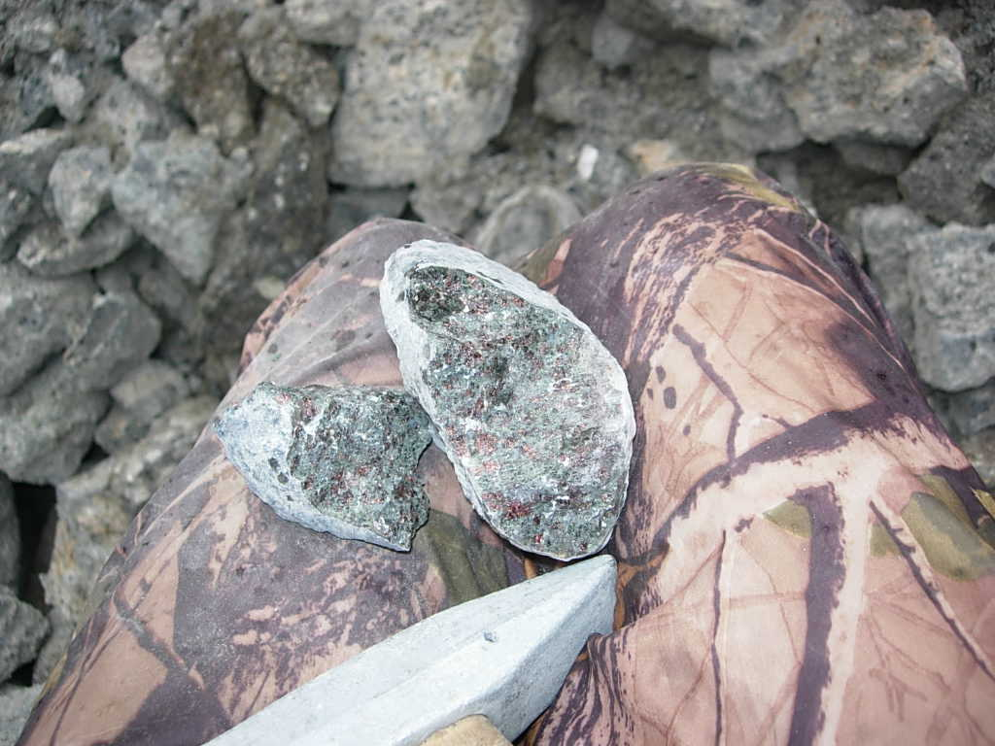
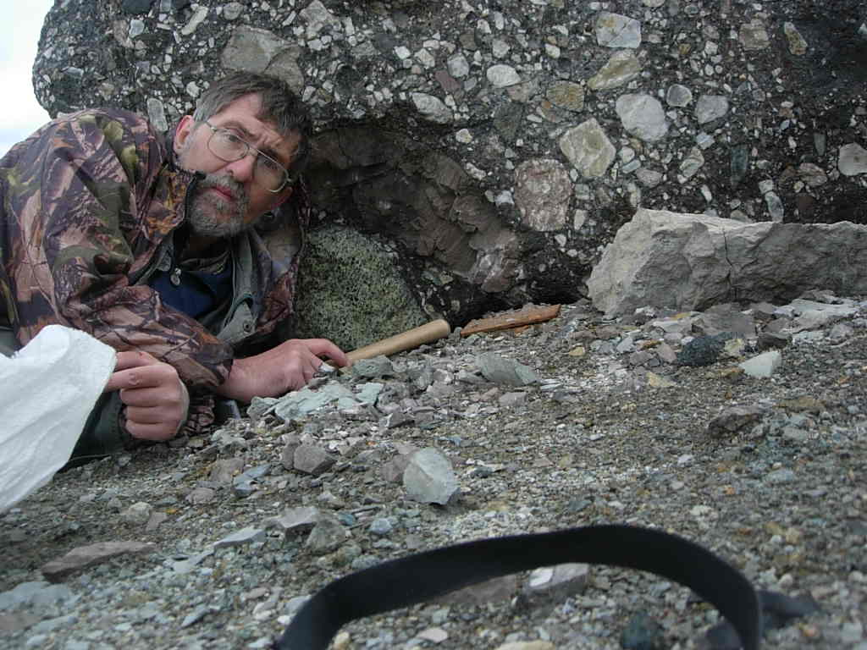
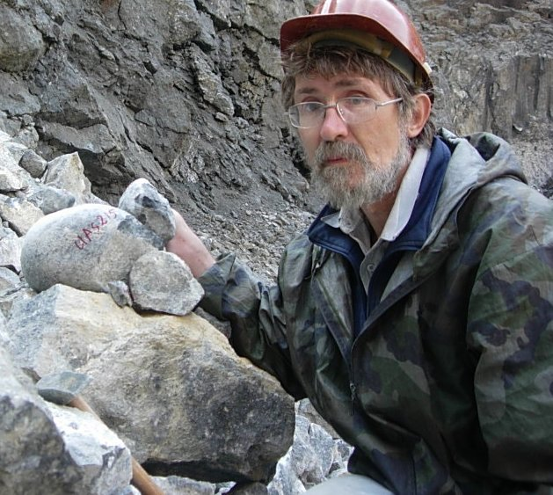
Acknowledgements
Home
Grants RBRF -05-17105, 99-05-65288, 05-05-64718, 11-05- 60, 16-05- 00860
77-2, 65-03, 02-05 projects UIGGM SD RAS and ALROSA Stock Company.
Special thanks to Sergey Kanakin and Nikolai Karmanov who helped in construction of PT program in initial stage
Thank you
for attention
Institute of Geology
and Mineralogy,
Novosibirsk Russia

