Slide 1
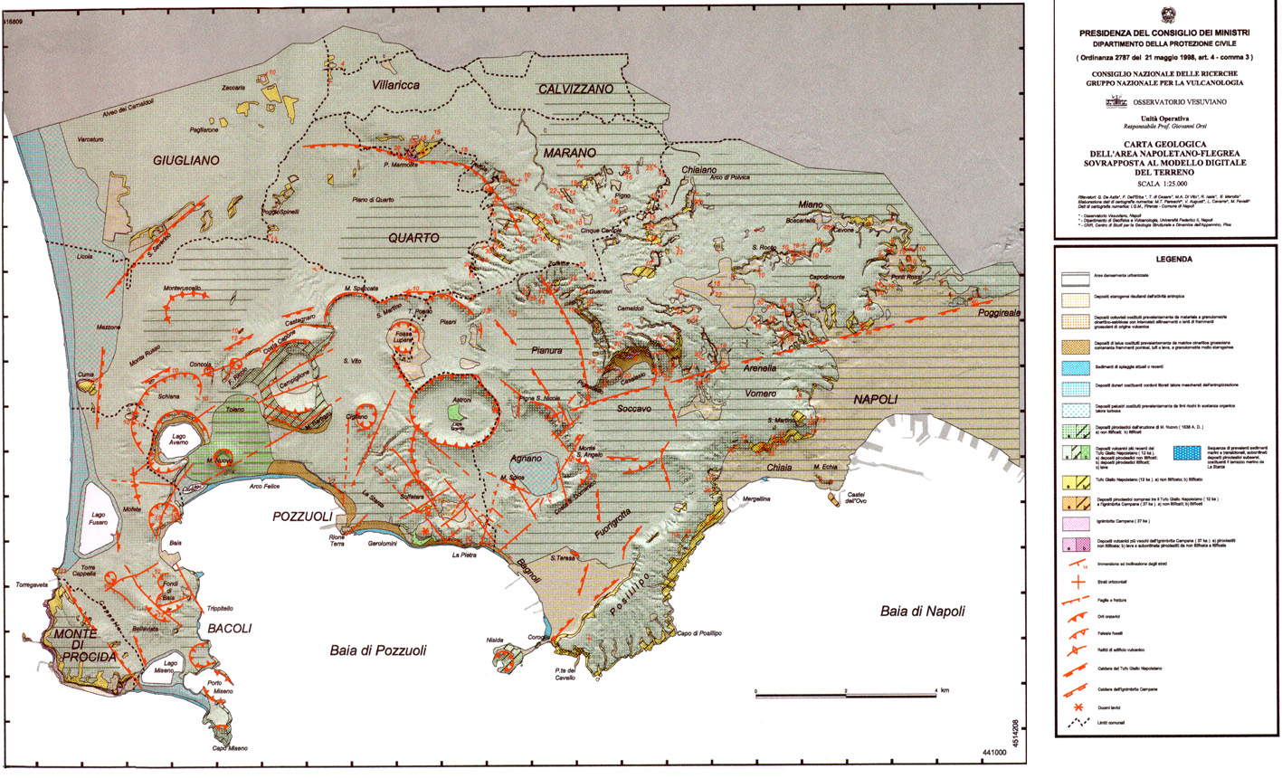
Residence times of alkali feldspar phenocrysts
from magma feeding the Agnano-Monte Spina Eruption (4.7 ka), Campi Flegrei caldera (Napoli, southern Italy)
based on Ba-zonation modelling
Raffaella Silvia Iovine ⁽¹⁾, Gerhard Wörner ⁽¹⁾, Fabio Carmine Mazzeo ⁽²⁾, Ilenia Arienzo ⁽³⁾, Lorenzo Fedele ⁽²⁾, Lucia Civetta ^{(4,2)}, Massimo D’Antonio ⁽²⁾, and Giovanni Orsi ⁽²⁾
Geowissenschaftliches Zentrum, Georg-August-Universität, Göttingen, Germany
Diparimento di Scienze della Terra, dell’Ambiente e delle Risorse – Università degli Studi di Napoli Federico II, Napoli, Italy
Istituto Nazionale di Geofisica e Vulcanologia – sezione di Napoli Osservatorio Vesuviano, Naples, Italy,
(4) Istituto Nazionale di Geofisica e Vulcanologia – sezione di Palermo, Italy
European Geosciences Union - General Assembly 2016, Vienna, Austria, April 17-22

Slide 2
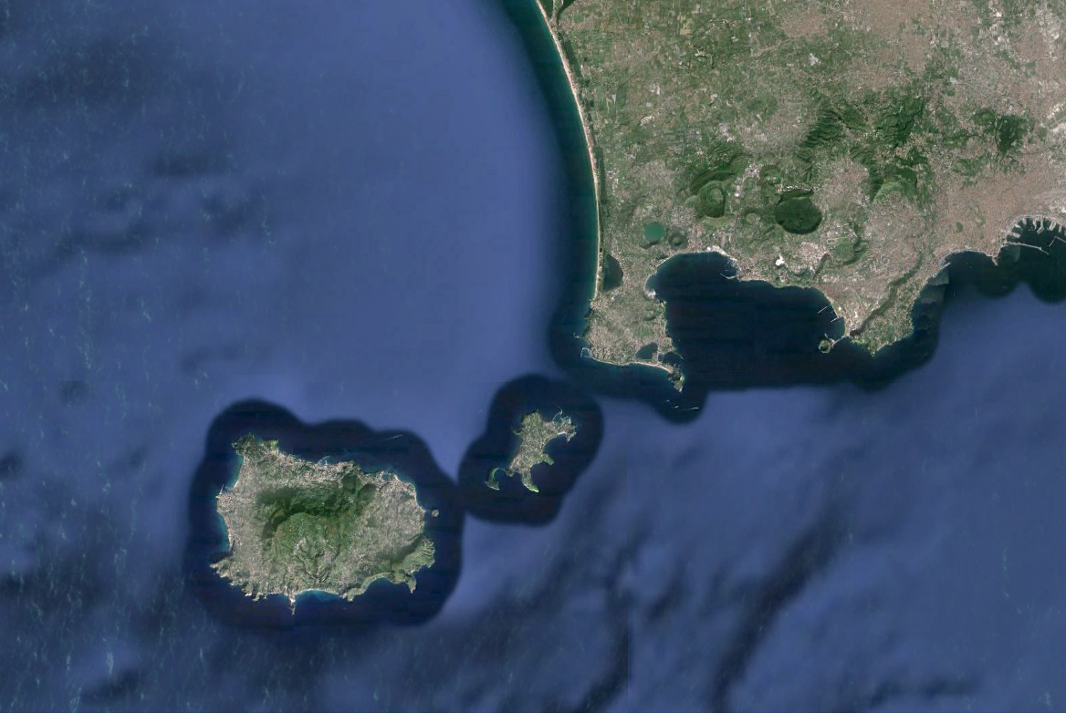
Phlegrean Volcanic District:
a large area with high volcanic risk
Campi Flegrei caldera
(or Phlegrean Fields)
Ischia Island
Procida Island
Campi Flegrei
Agnano
strong explosive activity in the past 60 ka,
last eruption 1538 AD
Procida
Ischia
Campi Flegrei caldera is inhabited by 500,000 people

Slide 3
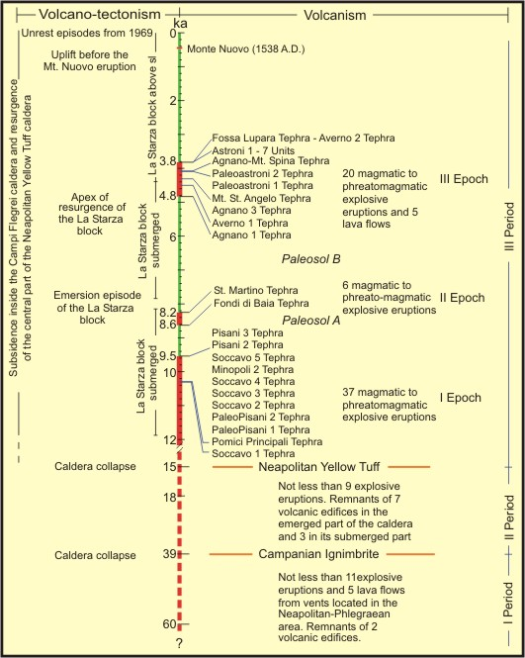
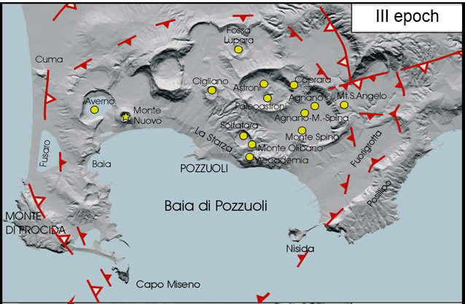
Campi Flegrei – Geology and Volcanology
At least 72 eruptions, mostly explosive, occurred during the III Period, some of them accompanied by caldera collapse
Two catastrophic explosive eruptions, accompanied by caldera collapse events, marked the Campi Flegrei history:
Campanian Ignimbrite (39 ka)
Neapolitan Yellow Tuff (15 ka)
During the third epoch (5.5 – 3.7 cal ka B.P.) 22 eruptions occurred, from vents located within the Neapolitan Yellow Tuff caldera, mostly in its North-Eastern portion
Notes:
The pyroclastic rocks emplaced during these two major events are stratigraphic markers, allowing subdivision of the Campi Flegrei history in three periods
The most abundant volcanic rocks are trachytes and phonolites; latites and shoshonites are much less abundant

Slide 4
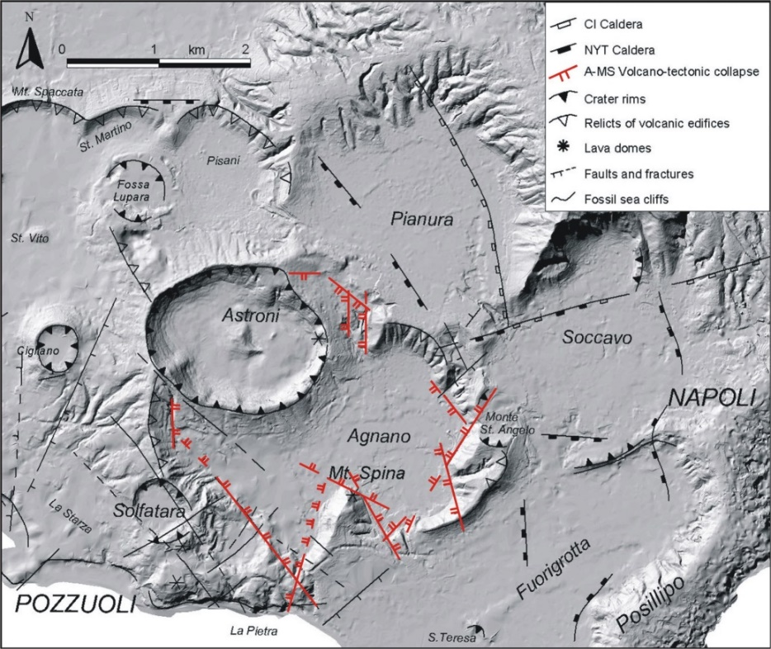
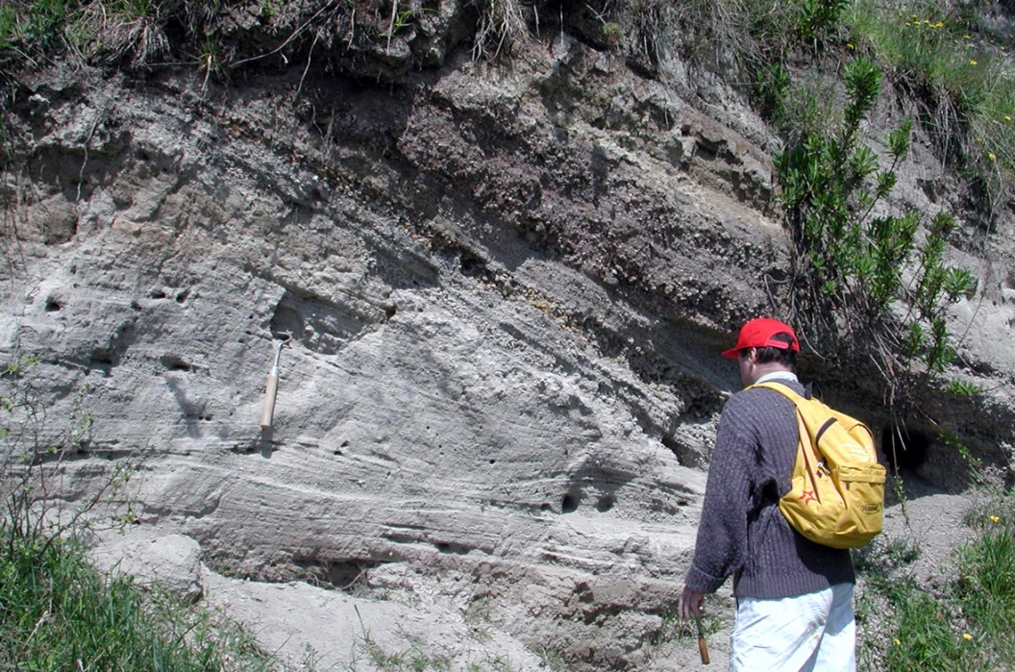
Agnano-Monte Spina eruption (4.7 Cal ka B.P.)
the highest magnitude event of the III epoch
area covered by tephra: ca. 1,000 km²
volume of ejected magma: ca. 0.85 km³ (D.R.E.)
collapsed area: ca. 6 km²
The A-MS eruption has been assumed as the maximum expected event in case of renewal of volcanism in short-mid terms at Campi Flegrei
(Orsi et al., Bull. Volcanol., 2004; Orsi et al., E.P.S.L., 2009)

Slide 5
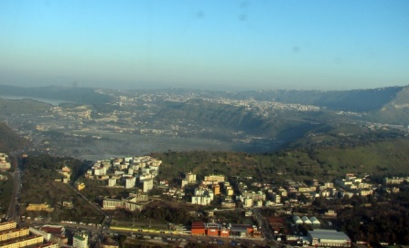
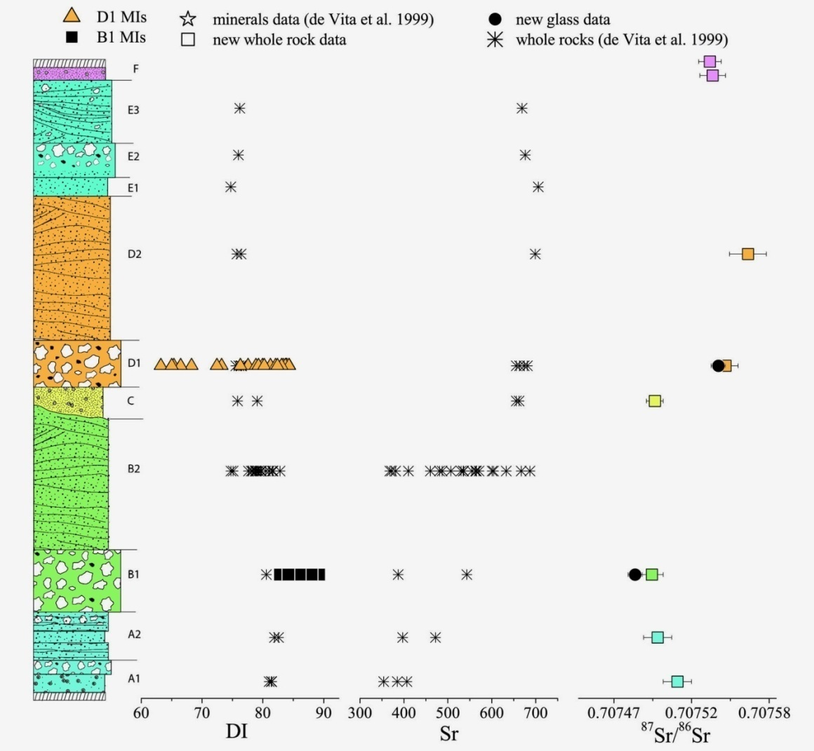
Agnano-Monte Spina eruption (4.7 Cal ka B.P.)
Stratigraphy : 6 members A through F
Agnano
The A-MS eruption has been fed by magmas varying from more to less evolved trachyte; variable ⁸⁷Sr/⁸⁶Sr and trace elements suggest magma mixing between two end-members
Arienzo et al., Chem. Geol., 2010

Slide 6
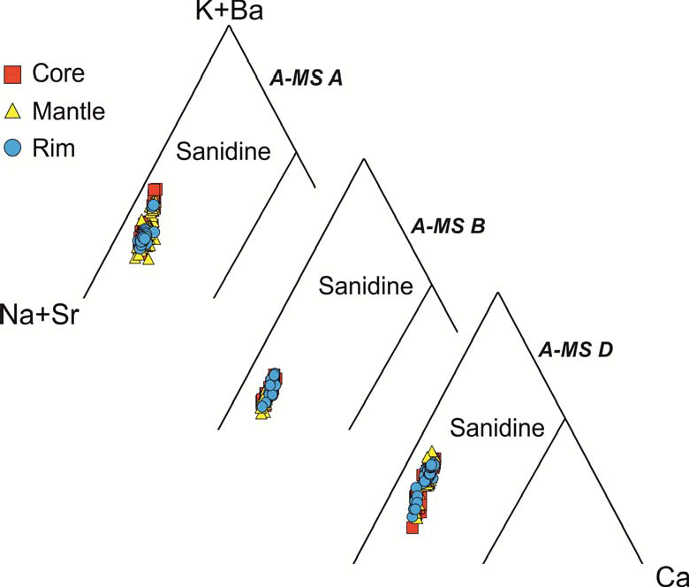
Agnano-Monte Spina eruption (4.7 Cal ka B.P.)
Focus on zoned feldspar phenocrysts to constrain pre-eruption magmatic processes and their timescales through diffusional geochonometry
Notes:
Reconstruct crystal residence times
in alkali feldspar phenocrysts
Accumulated back-scattered electron (BSE) images combined with compositional profiles obtained through WDS-EDS-EMPA can provide insights into diffusion of key elements

Slide 7
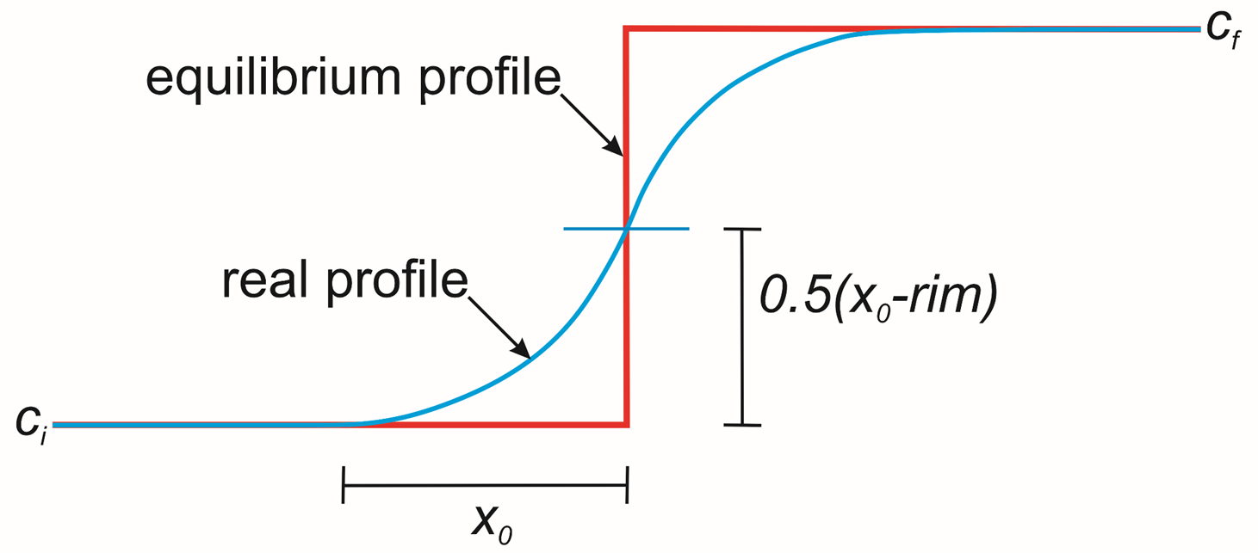
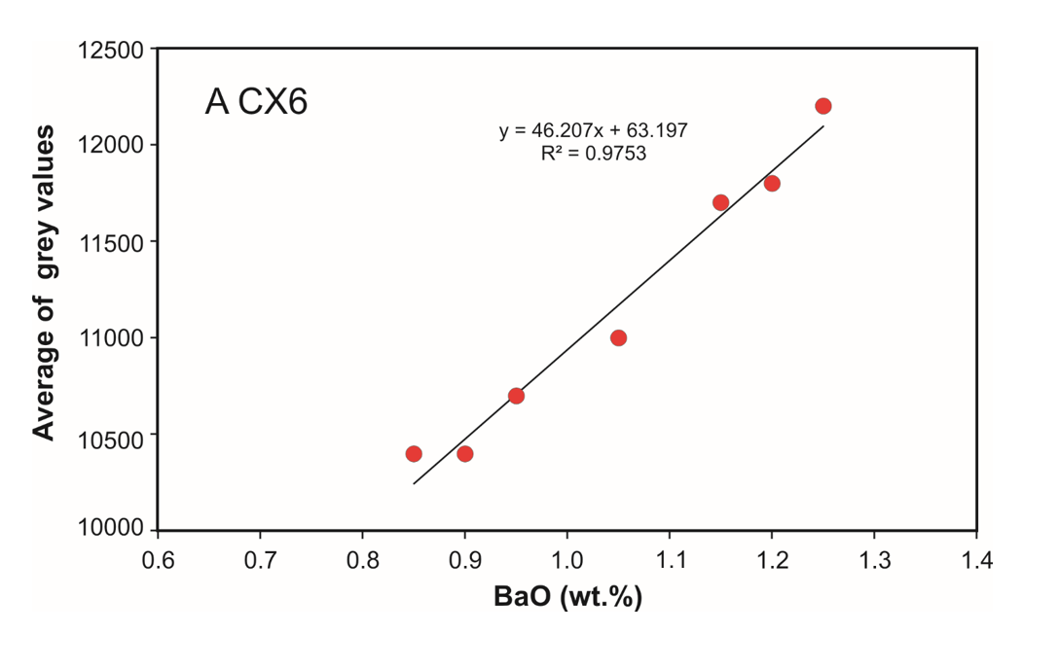
Agnano-Monte Spina eruption (4.7 Cal ka B.P.)
Diffusional geochronometry
D : diffusivity of Ba in sanidine
Cx₀ : concentration of the element at that point xo
cf and ci : maximum and minimum concentration of Ba along the diffusion interface, respectively
erfc : error function
xo - rim : mid-point of the profile
D : calculated diffusivity in µm²/yrs
t : diffusion time
D₀ = 0.29 m²/s,
diffusion constant of Ba in sanidine
E = 455000 J/mol,
activation energy needed for diffusion
R = 8.31 J/(mol · K),
the gas constant
T is the temperature of magma (K)

Slide 8
Agnano-Monte Spina eruption (4.7 Cal ka B.P.)
Temperature constraints
T = 900-950 °C
P = 50-100 MPa
(based on phase equilibria experiments at f(O₂) ~NNO +1.3 with excess 50:50 H₂O-CO₂ mixed fluid (Roach, 2005)
Temperatures used in residence times calculations:
900 °C
930 °C
950 °C

Slide 9
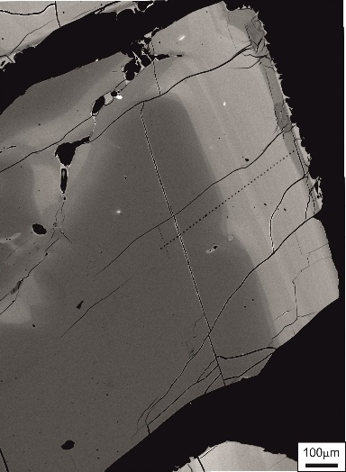
Agnano-Monte Spina eruption (4.7 Cal ka B.P.)
Profiles in A-MS feldspars
Profiles based on quantitative analyses
Based on grey scale swath profiles
core
rim
core
rim
t_{900°C} = 1599yrs
t_{930°C} = 500yrs
t_{950°C} = 235yrs
t_{900°C} = 18yrs
t_{930°C} = 6yrs
t_{950°C} = 3yrs
Notes:
Core-to-rim compositional profile in a sanidine phenocryst from A-MS

Slide 10
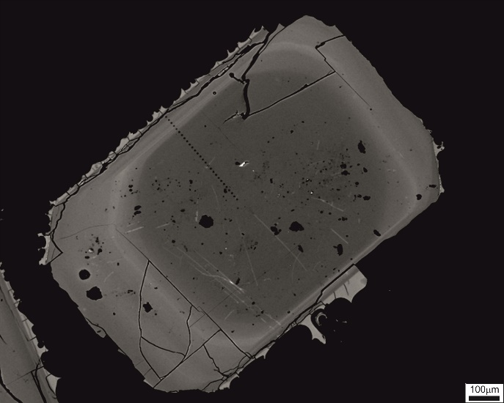
Agnano-Monte Spina eruption (4.7 Cal ka B.P.)
core
rim
core
rim
t_{930°C} = 192yrs
t_{930°C} = 5yrs

Slide 11
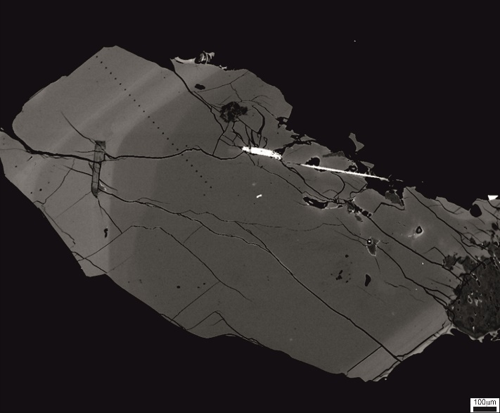
Agnano-Monte Spina eruption (4.7 Cal ka B.P.)
core
rim
core
rim
t_{930°C} = 267yrs
t_{930°C} = 33yrs

Slide 12
Agnano-Monte Spina eruption (4.7 Cal ka B.P.)
core
rim
core
rim
t=107 900°C
t=33 930°C
t=16 950°C

Slide 13
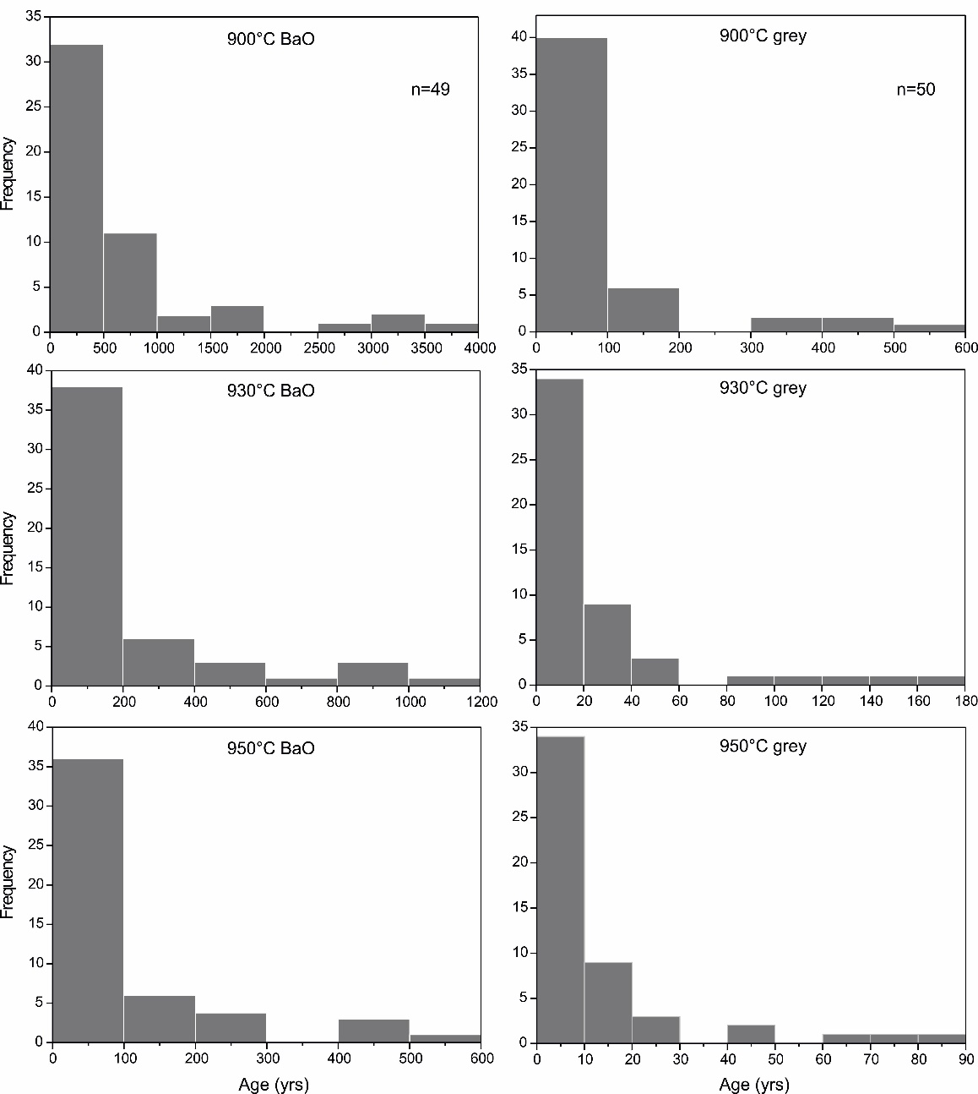
Agnano-Monte Spina eruption (4.7 Cal ka B.P.)
Results from A-MS feldspars
Quantitative analyses
Grey values
0- 500yrs: 32 cx
500-4000yrs: 17 cx
0-100yrs: 40 cx
100-600yrs: 10 cx
900°C
0- 200yrs: 38 cx
200-1200yrs: 11 cx
0- 20yrs: 34 cx
20-180yrs: 16 cx
930°C
0-100yrs: 37 cx
100-600yrs: 12 cx
0-90yrs: 34 cx
>90yrs: 16 cx
950°C

Slide 14
Agnano-Monte Spina eruption (4.7 Cal ka B.P.)
Conclusions
Residence times from BaO-quantitative profiles :
to 1200 years at 930°C
Most of the crystals <200yrs
Residence times from grey scale swath profiles :
2 to 180 years at 930°C
Most of the crystals <20yrs

Slide 15
Agnano-Monte Spina eruption (4.7 Cal ka B.P.)
Eruption
volume (km³ D.R.E)*
age (ka B.P.)#
time span
Agnano-Monte Spina
0.854
4.67±0.09
Paleoastroni 2
0.010
4.71±0.07
Paleoastroni 1
0.050
4.68±0.09
~100 yrs
Residence times correspond to eruption frequencies
Agnano 3
0.186
4.78±0.04
quiescence
~300 yrs
Monte Sant’Angelo
0.070
5.08±0.12
Agnano 2
0.014
n.a.
~500 yrs
Agnano 1
0.018
5.56±0.05
Paleosol B
* Orsi et al., E.P.S.L., 2009
# Orsi et al., Landesmuseum für Vorgeschichte, 2013
Notes:
If meaningful, centuries to decades timescales can be interpreted as
the time required for the magma to collect in the shallow reservoir (2-4 km) prior to the Agnano-Monte Spina eruption

Slide 16
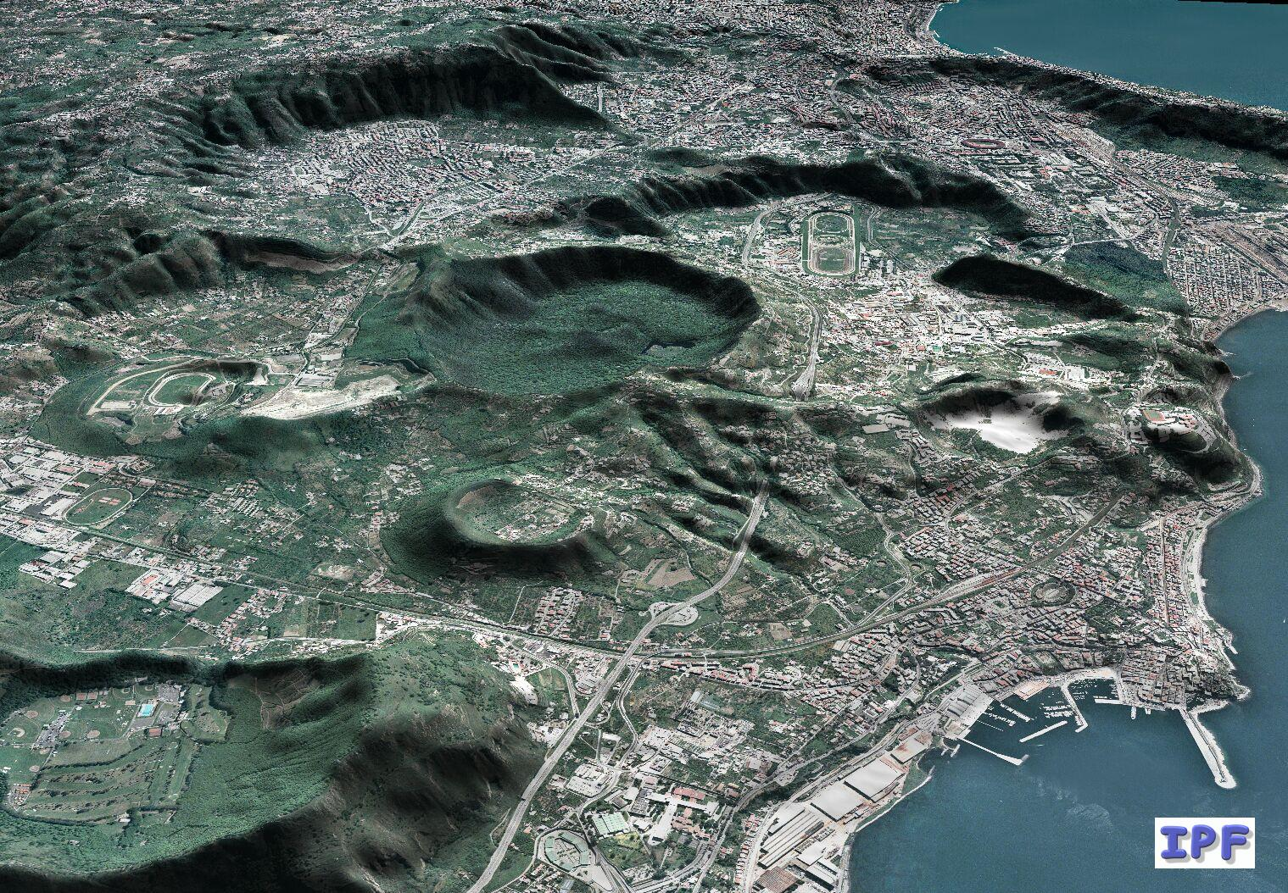
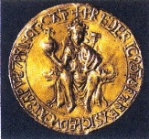
Residence times:
tens to hundreds of years
Eruption frequencies: hundreds of years
Thanks for
your attention
Magma assembly times: tens to hundreds of years

