Slide 1
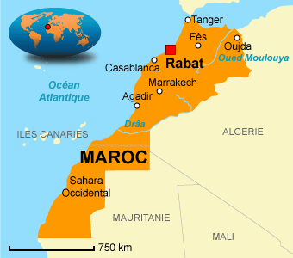
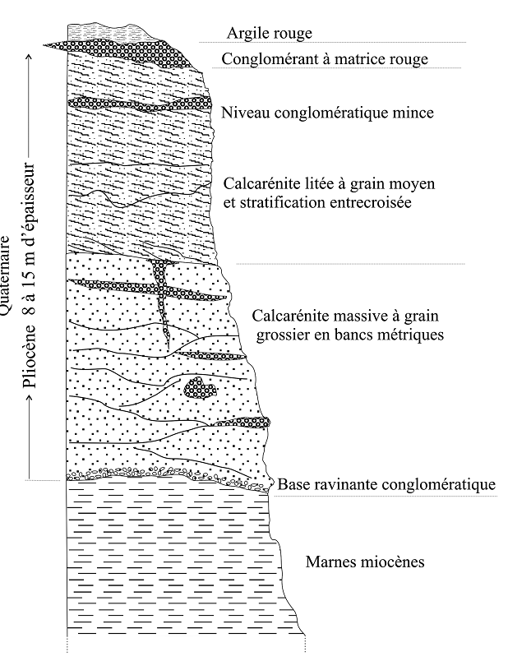
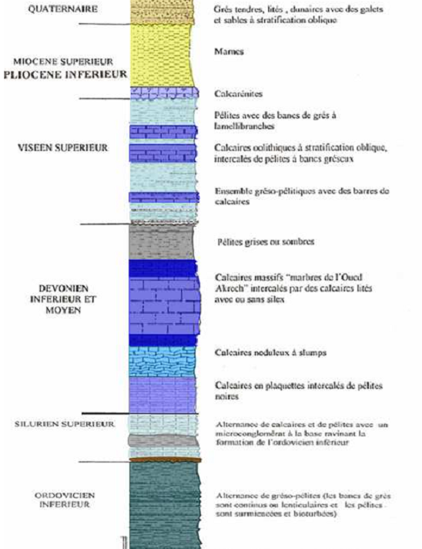
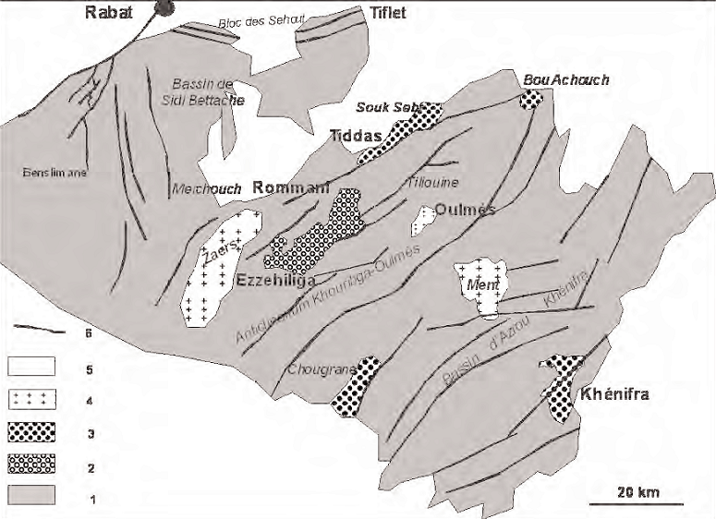
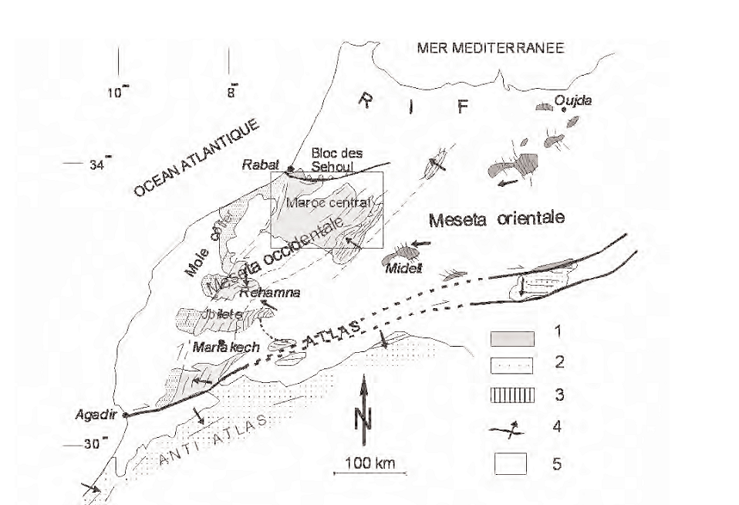
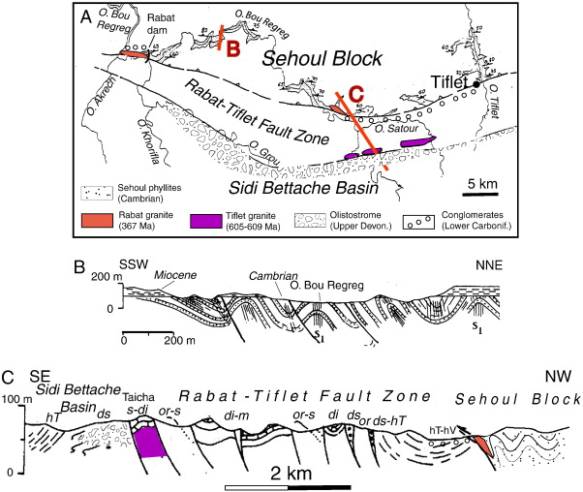
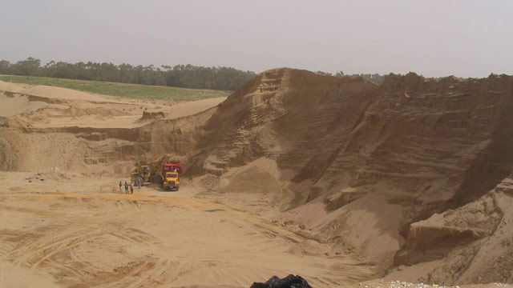
Geo-diversity and geo-materials in the region of Rabat-Salé-Zemmour-Zaer: Characterization and Rationalization of Utilization
BELHAJ.Sihamª, BAHI.Lahcen^{b} ,AKHSSAS.Ahmed^{c}
Laboratory: L3GIE, siham.ellayl.belhaj@gmail.com
I-Introduction:
III- Lithology :
V- Geo-materials:
Rabat imperial city and capital of Morocco was appointed in 2012 by UNESCO World Heritage thanks to the value, location and heritage significance of many historic sites it contains.
The wealth of this city by historicals monuments demonstrates the availability and richness in geo-materials.
This work aims to characterize the access, availability and location of Rbatis geo-materials.
Quaternary:
The Quaternary of the Rabat region is similar to that of the whole of the Moroccan Atlantic coast (Bouhaouli 1974 Texier et al 1994). It is represented by coastal marine deposits, mainly calcarénitiques, deposited during the Quaternary transgressions diferent at altitudes and distances from the coast increasingly important for older (90 to 100 m and 10 from the coast to the Messaoudien and 2 m and along the current coastline, for Mellahien).
The stratigraphic column of Fig.4 shows a section which outcrops on cliffs along the left bank of Bouregreg river near its mouth (Lambert coordinates: x: 368, 8; y: 381, 2).
All flap historic monuments are built from existing geo-matérials on a radius of 20 km radius around the city of Rabat.
These materials can be subdivided into two groups: the cohesive materials and geo-materials furniture.
Cohesive materials:
It's all solid materials whose exploitation requires first of the big block of extractions and operations routing to places crushing or flaking.
The solid limestone: PALEOZOIC base comprises many limestone layers of different thicknesses différentes.Ils ages are used for their ornamental values and their physico-mechanical properties.
Fig 1: Rabat location
II- Geographical aspect :
variety | Trade name | Reserve estimate
Grey | Pearl Grey | 18 Mt
Veined gray | Ykem river | 28Mt
Pink gray | Fisherman flower | 18Mt
Pink grainy | Red granite | 300Mt
Homogeneous Black | Black atlantis | 18Mt
Purplish black | Moorish purple | 18Mt
Veined black | Antique black | 21Mt
Parameter | Ykem river | Akrech river | Carrare marble
Density (g / cm3) | 2,74 | 2,73 | 2,75
Porosity(%) | 2,67 | 2,35 | 4,48
Water absorption(%) | 0,18 | 0,17 | 0,19
Resistance to com-pression in Admin (MPa) | 100 | 108 | 97
The supply of geomaterials has never been a problem for the city of Rabat.
In fact this is record to the geological diversity of the region of Rabat-Salé-Zemmour-zaer.
This diversity allows access to both consistent materials and other furniture while ensuring self-sufficiency in the field of construction.
The Rabat Salé Zemmours Zaers (RSZZ) is part of the north western end of the Moroccan Meseta (Michard, 1979 Piqué, 1979; Michard et al, 2008; Figure 1). Two structural units are distinct: the deRabat-Tiflet area north and central western Morocco south (Piqué, 1994; Tahiri, 1994).
The Rabat-Tilfet area consists of two units: (i) north of the block Sehoul or metamorphic unit (Piqué, 1979; El Hassani, 1990) to Cambrian to Ordovician material formed of metamorphic rocks (Fig. 1,2) and granites; (Ii) south axis or Bouregreg Rabat-Tiflet or sedimentary unit (Piqué, 1979; El Hassani, 1990) formed rock metamorphic little or no dating from the Ordovician to Late Visean.
The Rabat-Tiflet area forms the border (or ride north bordière) Basin Devonian Dinantian Sidi Bettache (BSB), north western end of West Central Morocco; axis Rabat-Tiflet part of the northern fringe of BSB (Piqué, 1979; El Hassani, 1990; Tahiri, 1991, 1994).
The central Morocco, especially its western part, is formed by the BSB and its bordering wrinkles: wrinkle west of Cherrat limiting east coastal pier, north block of Sehoul, east and SE wrinkle of Aguettouane and wrinkle-Zaers Oulmès (Piqué, 1979; El Hassani, 1990; Chakiri 1991; Tahiri, 1991). In these units, the series is complete Paleozoic Middle Cambrian (Acadian) to Permian (Autunian).
Fig5: Synthetic stratigraphic column of the flap region
Fig4: Log coastal Quaternary deposits of the Moroccan coastal plateau.
IV- Tectonic :
Tab1:Reserve estimate of solid limestone-Rabat(2010)
Tab1: average values of the physico-mechanical parameters of solid limestone-Rabat(2010)
-Calcarenite: It is about one of the most exploited rocks in Rabat under the name of "sandstone Rabat" or "salty stone", they easier to extract compared to the solid limestone with a very low resistance to weathering.
more rock this construction is used for the production of lime.
The Paleozoic basement very distorted by the Caledonian and Hercynian phase consists of a set Northern (block Sehoul) that overlaps a southern southward together. The first set, older, of Cambrian-Ordovician, is wrinkled and schistose by the Caledonian orogeny.
It consists of sandstones and shales; the second set, age from Ordovician to Carboniferous (Westphalian), distorted by folds (anticlines and synclines) during the Hercynian phases is essentially sedimentary.
Tectonically, two families of Hercynian faults affect these groups:
• Vertical faults N 120 ° E
• Faults strike slip later N 10 and N 70 ° E.
Fig2:structural scheme of the Variscan belt of northern Morocco. 1: Domain orogenic; 2: Margins in the chain; 3: Rabat-Tiflet area; 4: Main plicatives directions and divergences; 5: Post-Paleozoic cover.
 | SiO2 | Al2O 3 | Fe2O3 | MgO | CaO | Na2O3 | K2O | PF | CaCO3
Salé | 15,05 | 1,71 | 4,35 | 0,28 | 42,67 | 0,43 | 0,48 | 335,0 | 75,95
Sidi Bouknadel | 6,50 | 0,76 | 0,87 | 1,28 | 48,66 | 0,34 | 0,21 | 39,10 | 86,61
Fig 3: Schéma structurel simplifié du Maroc la situation de with central des principales a toponymes. 1: Principaux affleurements des terrains paléozoïques anté-Westphalien; 2: Les dépôts westphaliens; 3: Principaux Bassins permiens; 4: Granits varisques; 5: Couverture post-pa1léozoïque; 6: accidents Principaux varisques.
III- Lithology :
Tab3: Chemical analysis of Rabat’s Calcarenites(2010)
The Paleozoic Hercynian base comprises from bottom to top:
- Micaceous pelites, quartzites, pelites of alternations and micaceous sandstone (Ordovician p.p.);
- Conglomerates, pelites, alternations of pelites and dolomitic limestones (Silurian-Lower Devonian p.p. / Loch- kovien);
- Dolomitic limestones and shales (Devonian p.p.);
Fossil sandy schiste (Carboniferous p.p., Tournaisien) and conglomerates, pelites to gréso-pelites to goniatites and bivalves, greenish sandstone purposes (p.p. Carboniferous, Westphalian).
Neogene includes upwards:
Calcarenite (5 m) surmounted by yellow and blue marl (Miocene p.p.) that constitute the post-Paleozoic unconformably cover;
The Pliocene succession consists from bottom to top:
at. of sandstone lumachelles to conglomeratic beds in small discrepancy on the Miocene marls (Pliocene p.p., marine);
b. 10 m poorly consolidated sands and gravels, metrics benches calcarenite; intercalated thin conglomeratic levels (recent Pliocene fuvio submarine);
c. a dune system generally NE-SW direction (wind sandstone) parallel to the shoreline (Pliocene continental dune)
Furniture materials:
These are minerals to disjoint grains such as:
-Red clays: Played for which adobe construction, pottery, brickworks ...
-Blue and yellow marl Miocene
-Sands correspond to all the furniture rocks whose size is between 2 mm and 63 μm,they come essentially from beaches located between Rabat and Kenitra.
Fig6: schematic map of Shoul block and the area of Rabat Tifelt
(Contintnal Evolution: The geology of morocco André Michard, Saddiqi Omar Ahmed Chalouan Dominique Frizon de Lamotte 2008)
Fig7: Sands quarry
Conclusion
Rabat is well stocked for all geo-materials it needs for construction, Potrie the décord ... but surely the aprovisionnement and exéssives operation will cause in the future that deficite 'avoid

