Slide 1
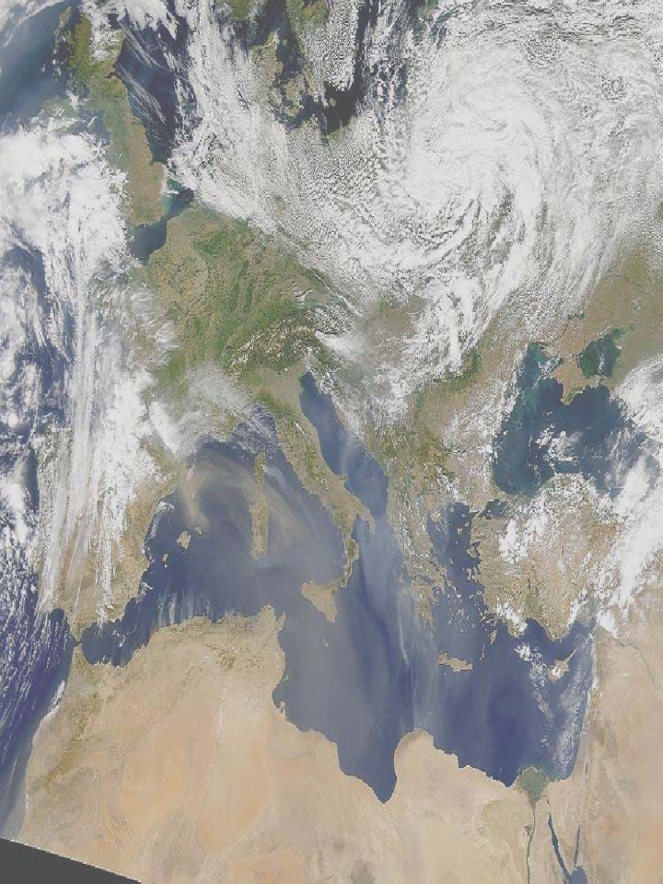
58
A modeling perspective of the ChArMEx intensive campaign: origin of
photo-oxidant and organic aerosol formation
Arineh Cholakian , Matthias Beekmann , Guillaume Siour , Augustin Colette , Isabelle Coll , Valerie Gros, Nicolas Marchand, Jean Sciare , Aurélie Colomb, François Gheusi, Stéphane Sauvage
EGU Vienna, 17-22 April 2016

Slide 2
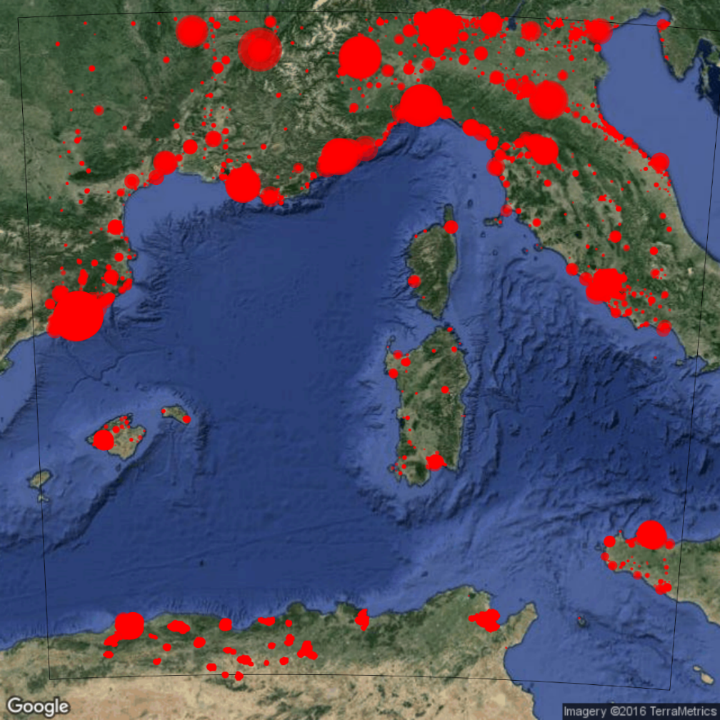
Why the Mediterranean?
In the Mediterranean :
Higher than normal concentrations of photo-oxydants and secondary organic aerosols
Multiple emission sources
High population density around the basin
Sensitive to climate change
Biogenic
Anthropogenic
Ships
Dust

Slide 3
General objectives of the ChArMEx campaign (Chemistry)
Better understanding of the role of atmospheric chemical processing on the photochemical oxidants budget, VOCs, and the secondary organic aerosol (SOA) formation downwind of continental plumes and in aged air masses.
Better understanding of the origins and sources of the high SOA (and particulate matter) and oxidant concentrations observed in the western Mediterranean in summer
Evaluate and improve existing chemistry-transport models and model algorithms of PM formation

Slide 4
Model setup
Chimere
Concentration of selected species
Observations
Domains
Emissions
Initial/boundary conditions
Meteorological data
Chemistry scheme
SOA scheme

Slide 5
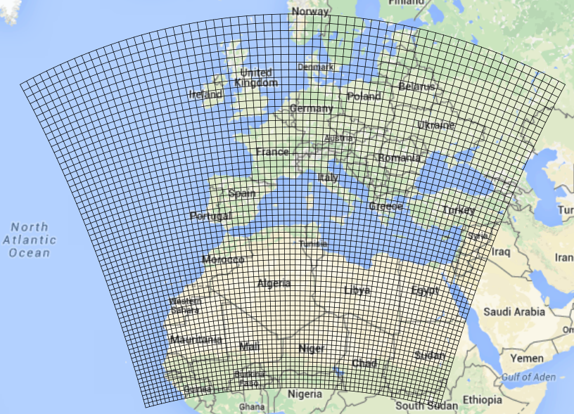
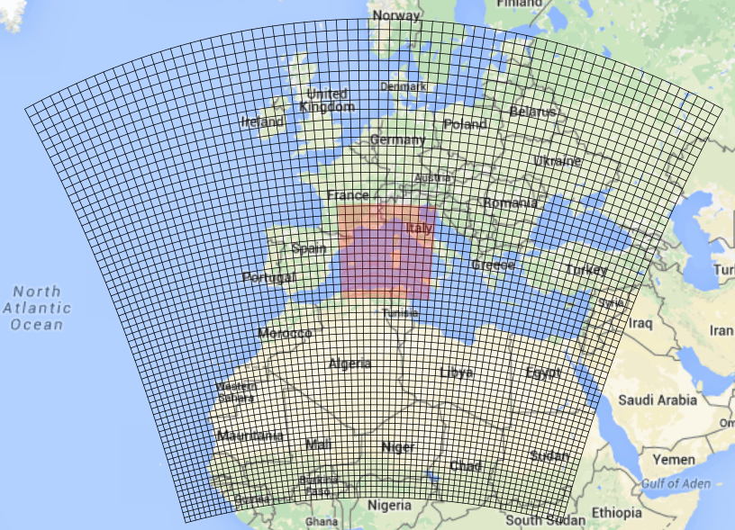
Model setup
Domains
Domain Resolution
1 30km
2 10km
3 3km
4 1km

Slide 6
Are the simulations representative of the domain?
Real topography 10km simulation 1km simulation
Cape Corsica obs. site
Altitude of observation site:
real :520m 10km : 80m 1km :320m

Slide 7
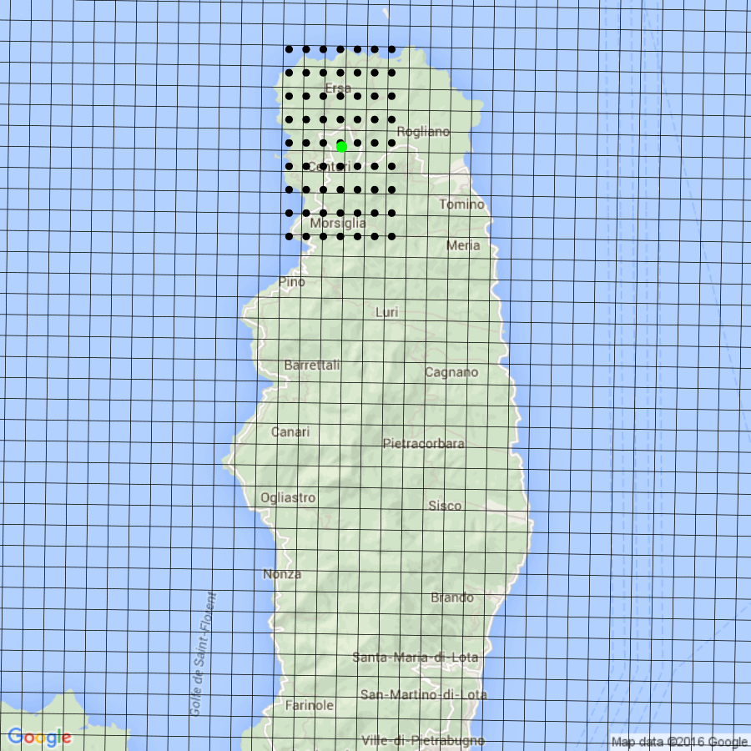
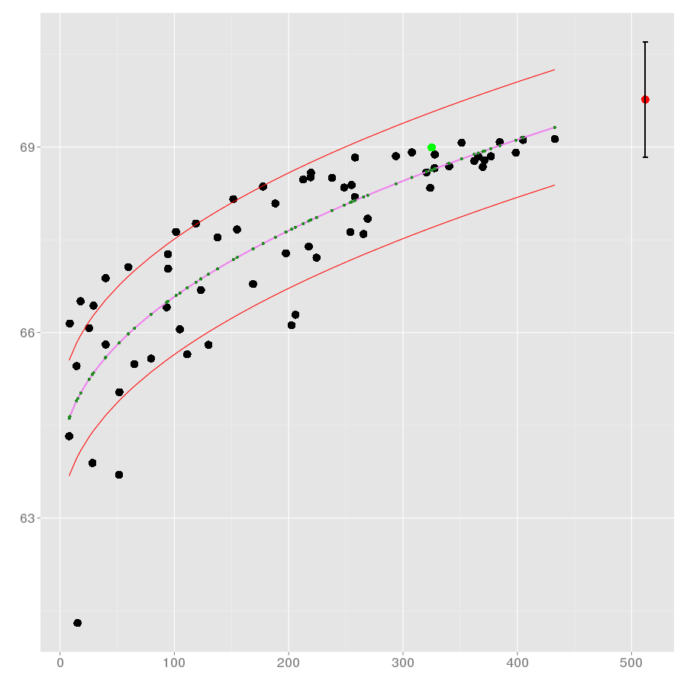
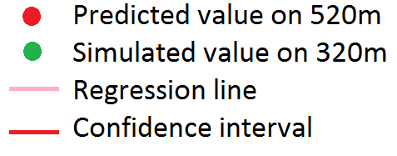
Are the simulations representative of the domain?
Non-linear regression for Ozone
Concentration (ppb)
Cell values
Look at neigbouring points
→ No cell with the right altitude
→ Extrapolate towards the right altitude
Altitude (m)

Slide 8
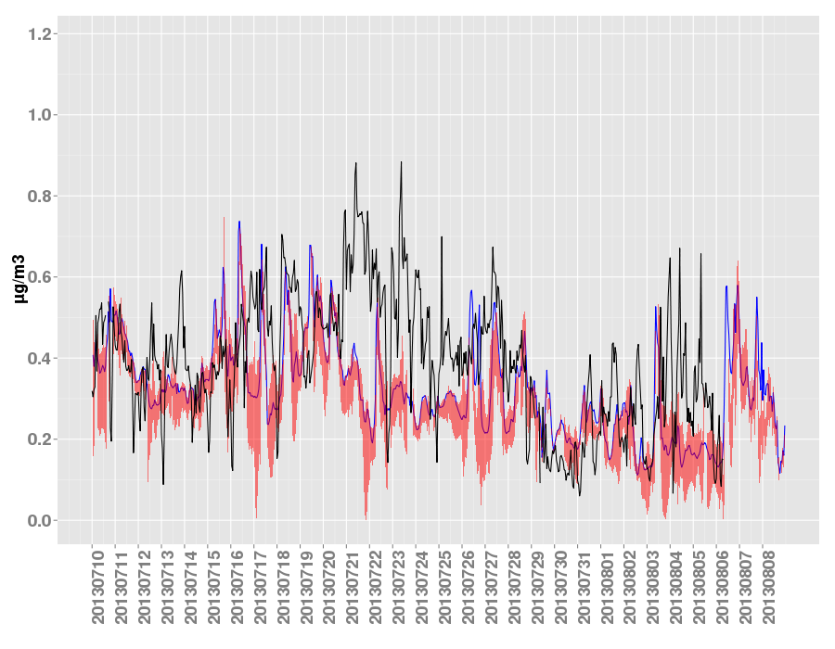
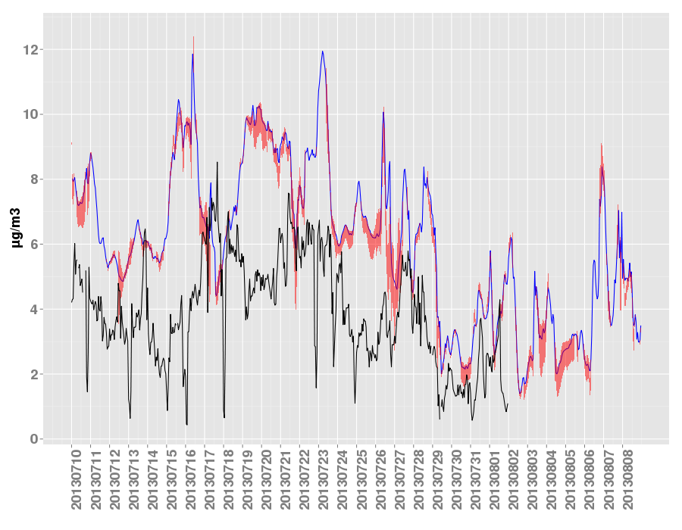
Are the simulations representative of the domain?
Organic aerosols
BC
Observations
Simulations
Uncertainty
BC concentrations : 37% uncertainty
NO_{x} concentrations : 108% uncertainty
SO₄²⁻ concentrations : 19% uncertainty
Ozone concentrations : 4% uncertainty
Organic aerosol concentrations : 10% uncertainty
BC | Simulations | Predictions
Mean | 0.31 | 0.29
R | 0.36 | 0.33
RMSE | 0.17 | 0.19
Bias | -0.07 | -0.09
OA | Simulations | Predictions
Mean | 6.18 | 6.05
R | 0.54 | 0.53
RMSE | 3.24 | 3.15
Bias | 2.54 | 2.41
Cape Corsica, july-august 2013

Slide 9
Model setup
Chimere
Concentration of selected species
Observations
Domains
Emissions
Initial/boundary conditions
Meteorological data
Chemistry scheme
SOA scheme

Slide 10
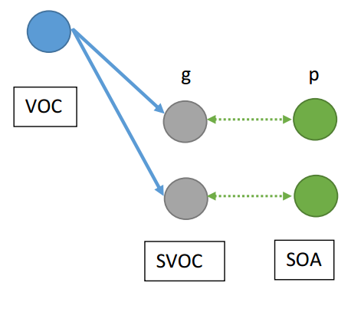
Explications on what schemes are added
Chimere standard scheme
VOC
VBS standard scheme
+biogenic ageing
+anthropogenic ageing
+fragmentation
+formation of non-volatile SOA
g
p
10³
10²
Emissions
Semi-volatile on gas phase
Particulates
Functionalization
Gas/particulate distribution
Fragmentation
Non-volatile SOA formation
10¹
10⁰
SVOC
SOA
Pun et seigneur 2006
Robinson et al 2009
Shrivastava et al 2015

Slide 11
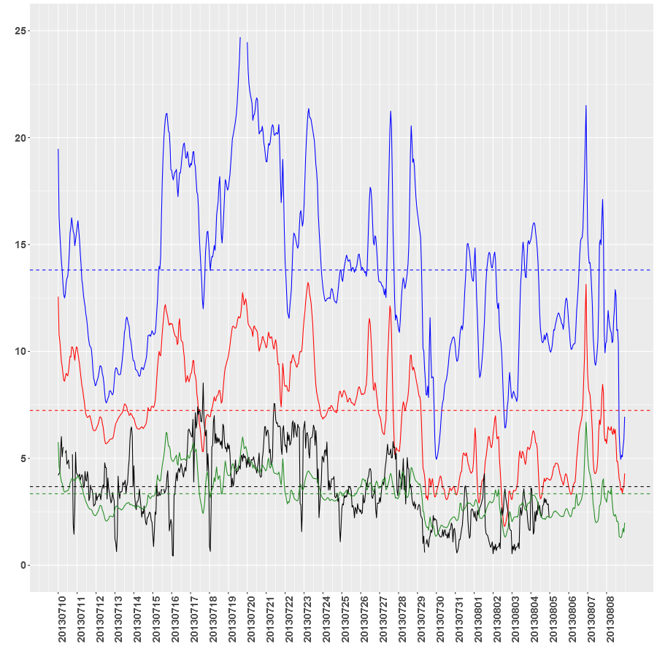
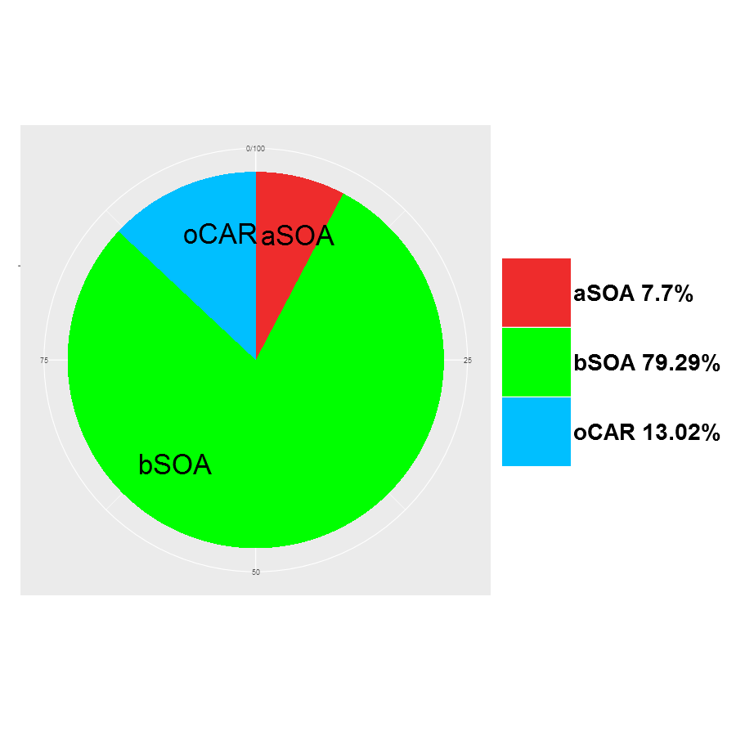
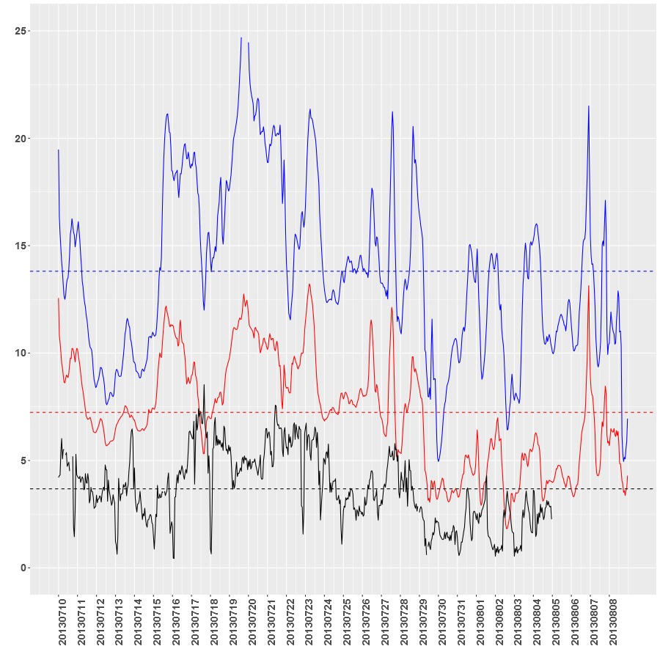
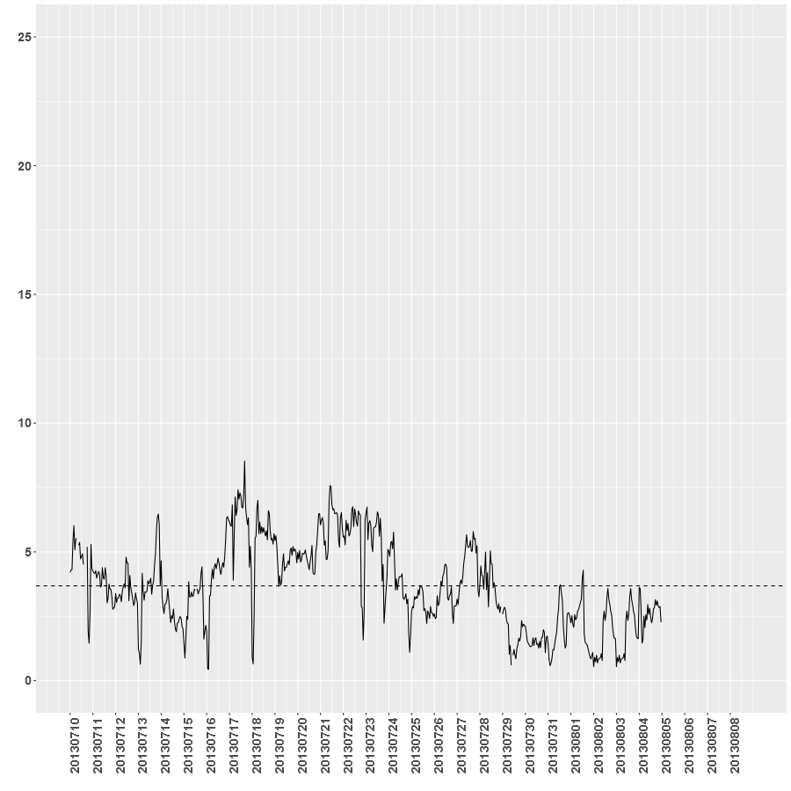
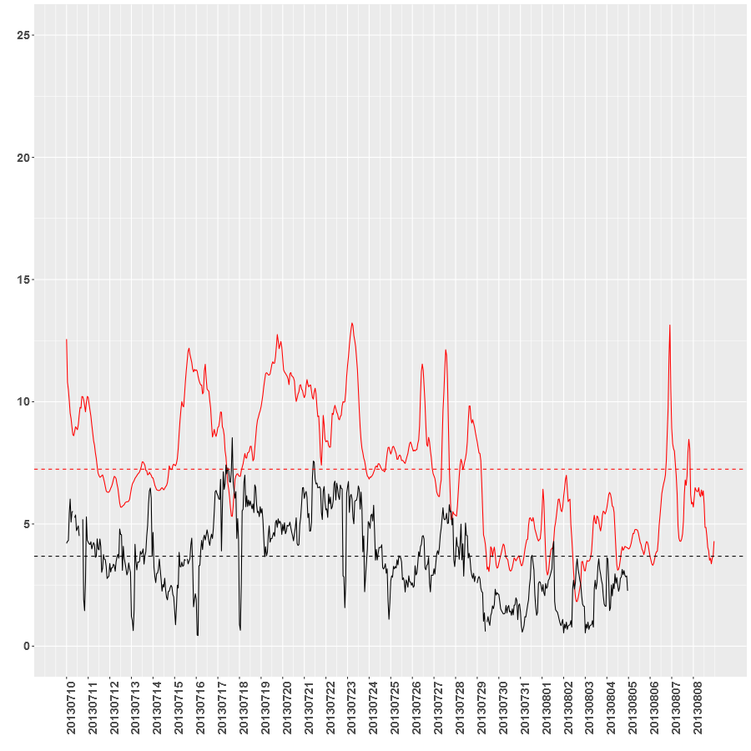
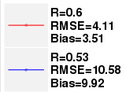
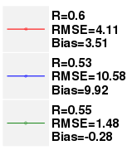
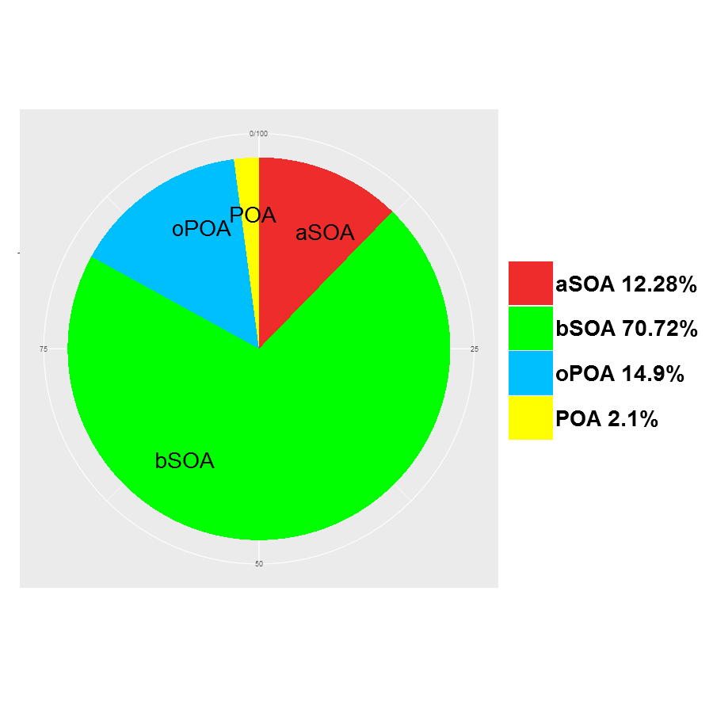
Comparison of different schemes
Chimere standard scheme
VBS modified scheme
VBS modified scheme
VBS scheme + biogenic ageing

Slide 12
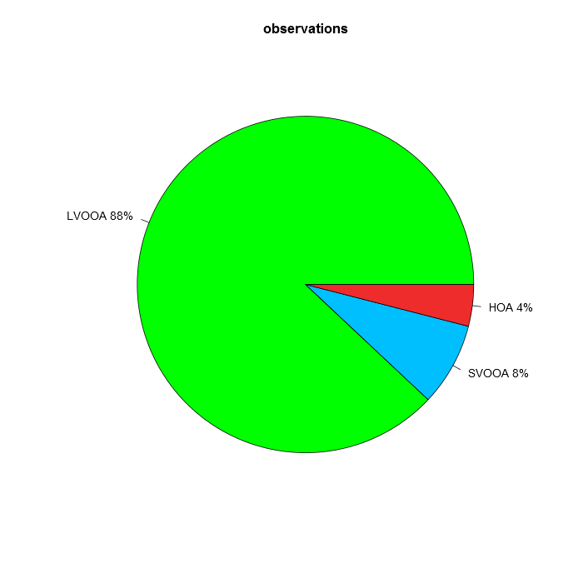
Simulation-observation comparison for modified VBS scheme
Simulations
Observations
LVOOA 88%
LVOOA 88.3%
HOA 1.9%
HOA 4%
SVOOA 9.8%
SVOOA 8%
VBS standard scheme
+biogenic ageing
+anthropogenic ageing
+fragmentation
+formation of non-volatile SOA
Observations for Cape Corsica, july-august 2013

Slide 13
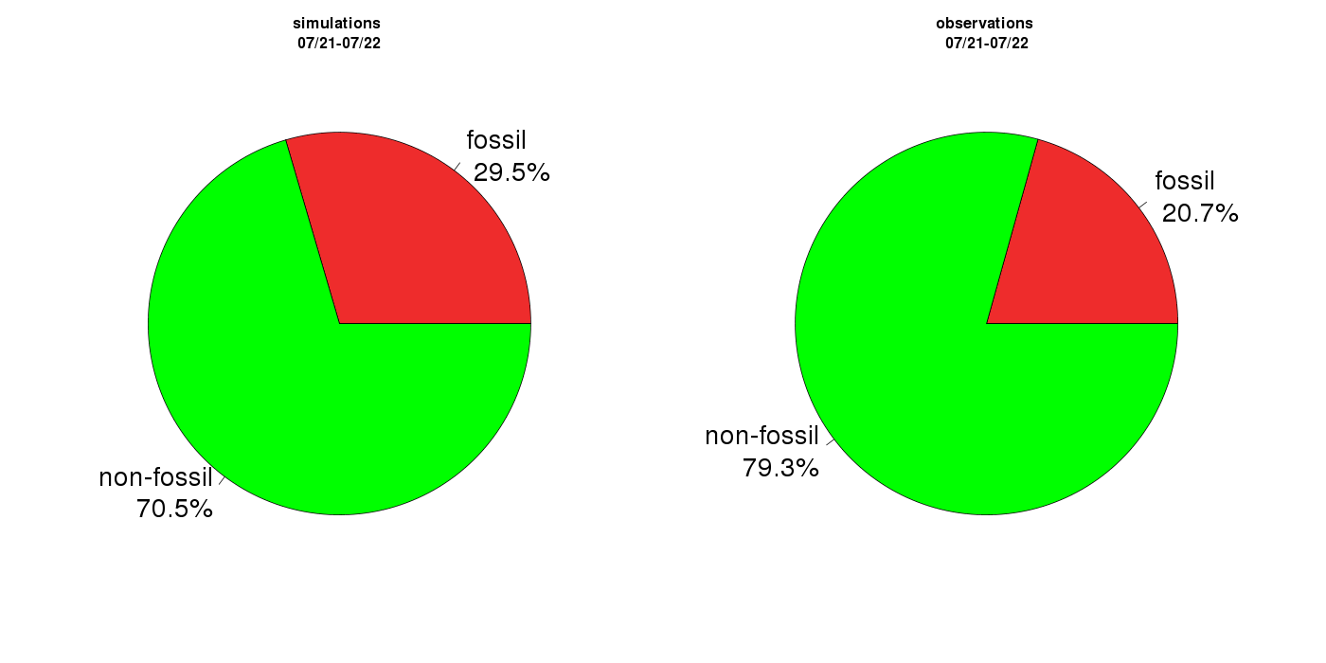
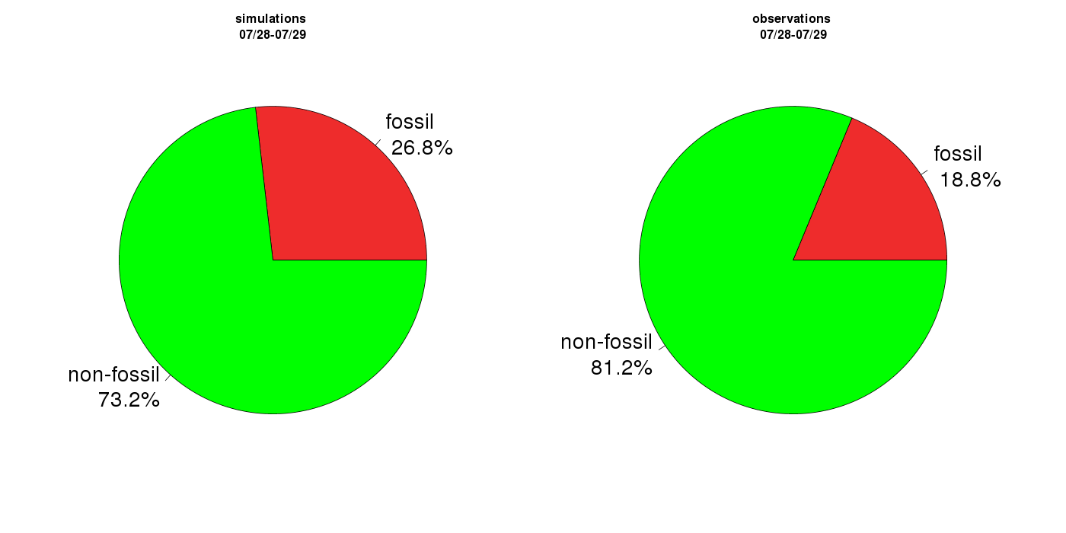
Simulation-observation comparison for modified VBS scheme
Simulations
21/07-22/07
Observations
21/07-22/07
Fossil 29.5%
Fossil 20.7%
Simulations
28/07-29/07
Observations
28/07-29/07
Non-fossil 79.3%
Fossil 26.8%
Fossil 18.8%
Non-fossil 70.5%
VBS standard scheme
+biogenic ageing
+anthropogenic ageing
+fragmentation
+formation of non-volatile SOA
Non-fossil 81.2%
Non-fossil 73.2%
Observations for Cape Corsica, july-august 2013
U Bern, S. Szidat

Slide 14
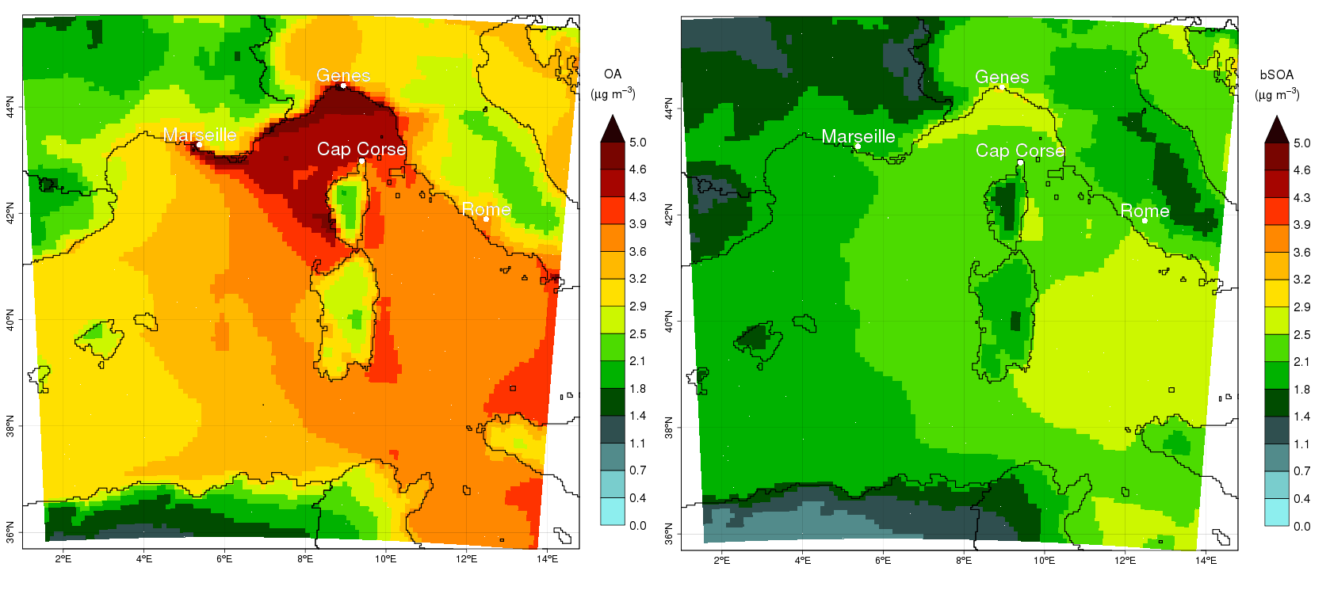
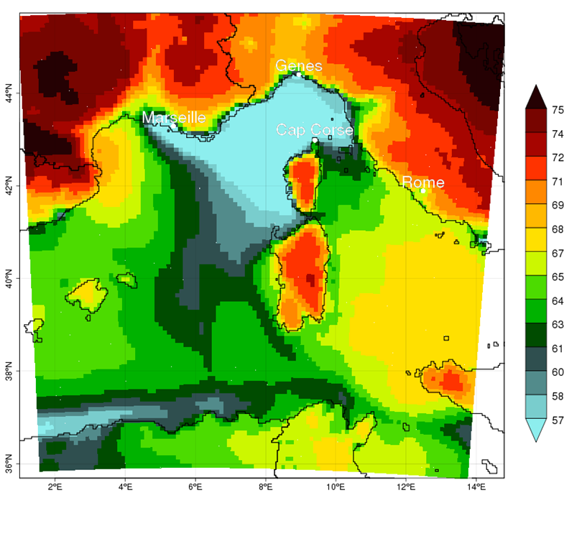
Structure of VBS modified scheme
µg/m3
%
OA
bSOA

Slide 15
Conclusion
The uncertainty in the 1km simulations with respect to orography is most for BC/NOx and least for ozone/organic aerosols
BC/NOx are very sensitive to altitude change, Ozone/organic aerosols are much less sensitive.
Fragmentation schemes and formation of non-volatile aerosols are important factors in the simulation of organic aerosols
The modified VBS scheme corresponds better with mass, 14C observations and PMF results
The continental biogenic secondary aerosols dominate in total organic aerosols except in the golf of Genoa where the anthropogenic part is near 50%

Slide 16
Thank you for your attention !
This work was performed using HPC resources from GENCI-[TGCC/CINES/IDRIS] (Grant 2016- t2015017232).
Thesis sponsered by:
EGU Vienna, 17-22 April 2016

